Slide 1
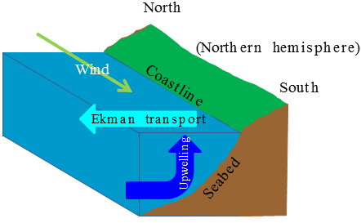
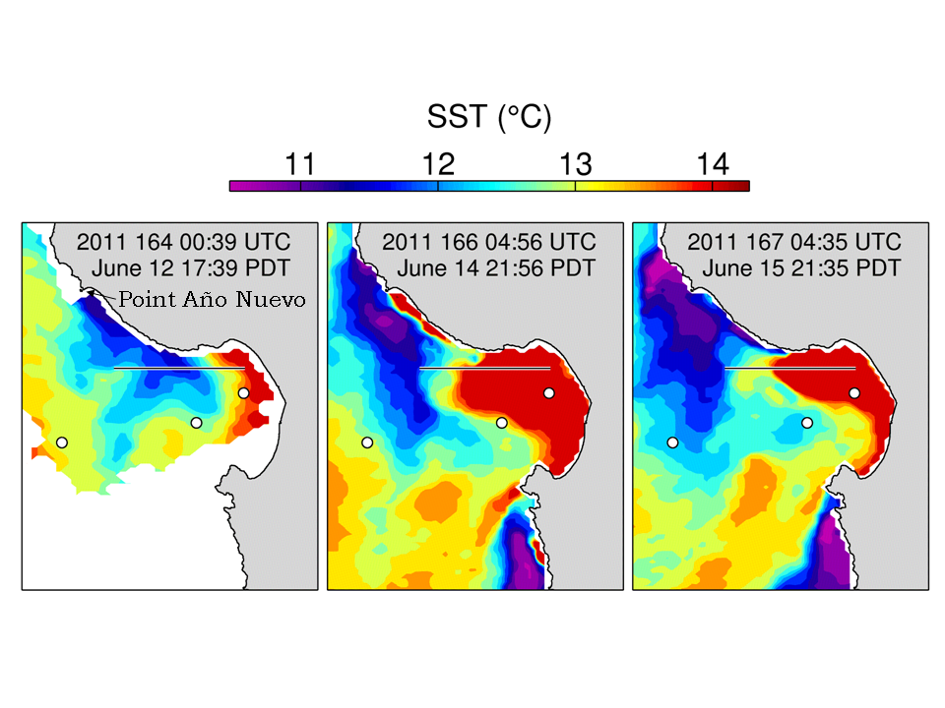
Coastal upwelling front
SST
Satellite AVHRR SST data Courtesy of Kudela Lab (UCSC) and NOAA CoastWatch

Slide 2
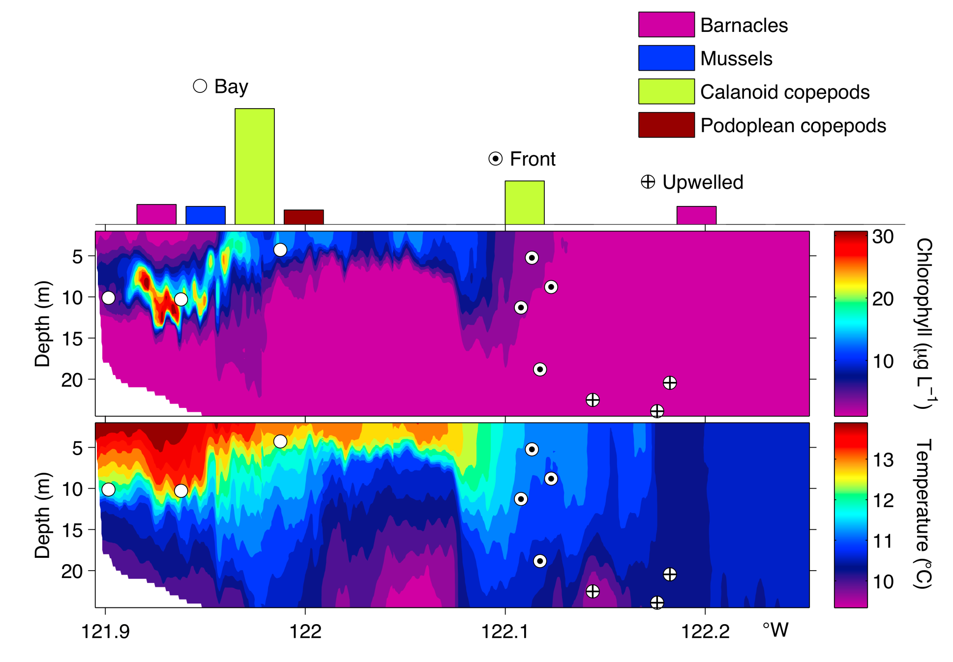
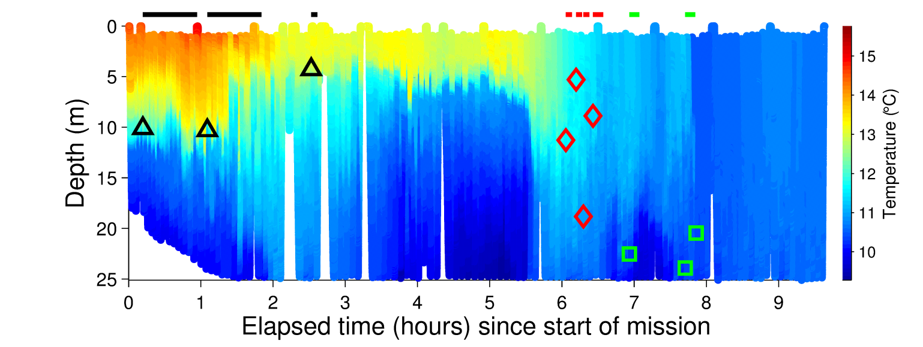
Autonomous detection and sampling of upwelling front
∆Temp_{vert}
(vertical temperature difference in water column)
AUV transect direction
Strong horizontal gradient
of ∆Temp_{vert} across the front
…
…
n-9
n-8
n-7
n-6
n-5
n-4
n-3
n-2
n-1
n
Index of
yo-yo profile
_{5 m}
₂₀ _{m}
Zhang, Ryan, Bellingham, Harvey, and McEwen, “Autonomous detection and sampling of water types and fronts
in a coastal upwelling system by an autonomous underwater vehicle,” Limnology and Oceanography: Methods, 2012

