Slide 2
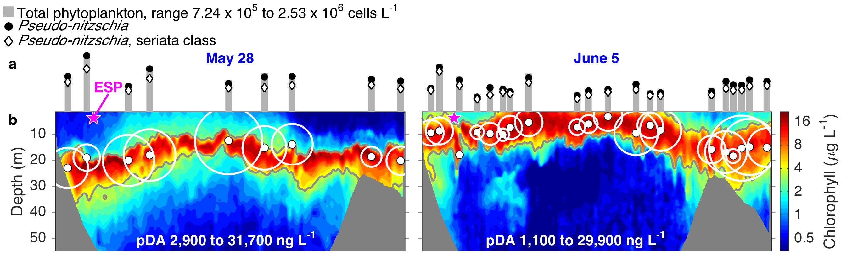
What can mobility provide?
May 28
June 5
Notes:
The Story:
AUV transects in southern Monterey Bay. Same transect, two weeks apart. June 5 experienced major upwelling event (Chl closer to surface)
ESP moored at purple star (in both). Even with the upwelling, we weren’t quite where the most action was on June 5. But AUV’s can stay with action all the time.
Circles are where we fired gulper. Circle size proportional to toxin concentration of samples brought back to lab.

