Slide 1
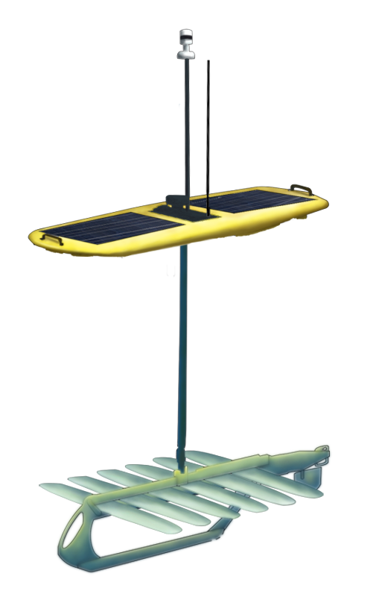
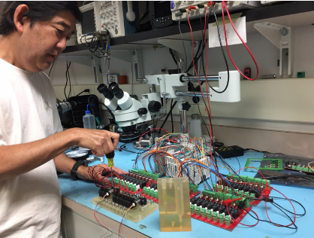
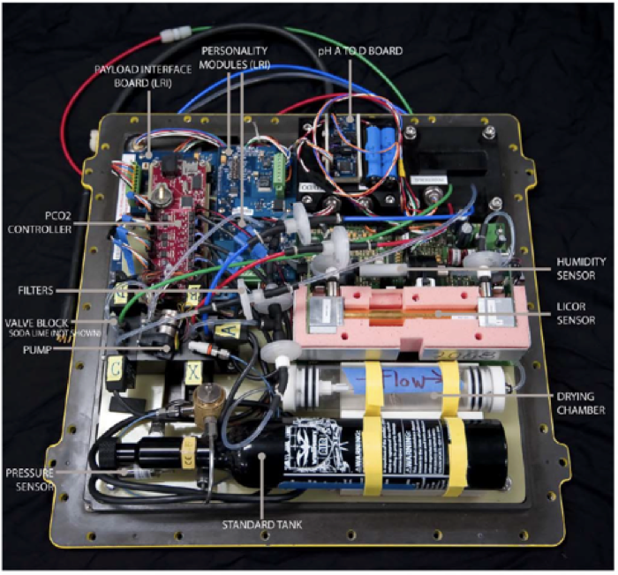
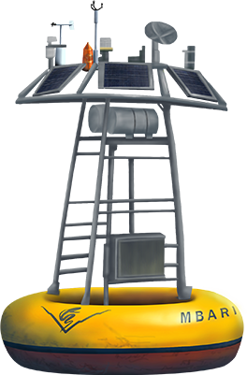


Sensor and Measurement Innovations
Notes:
Fundamental measurements that we still can’t measure. Biology is harder to measure.
Andrea and team are taking a laboratory based method for measuring Dissolved inorganic Carbon and pCO2
DIC sensor that can be widely deployed. Partnerships with PMEL, Jupiter foundation.

