Slide 1
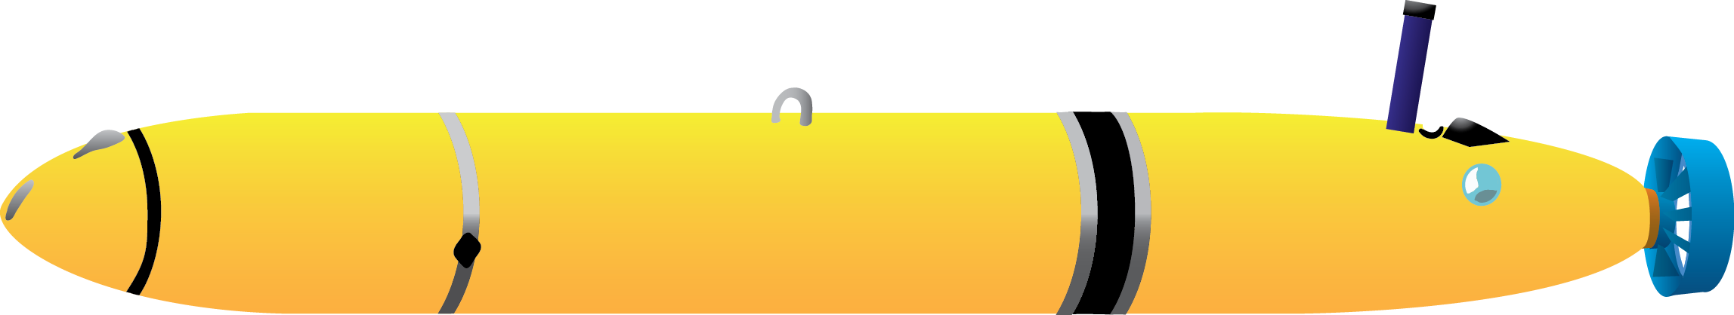
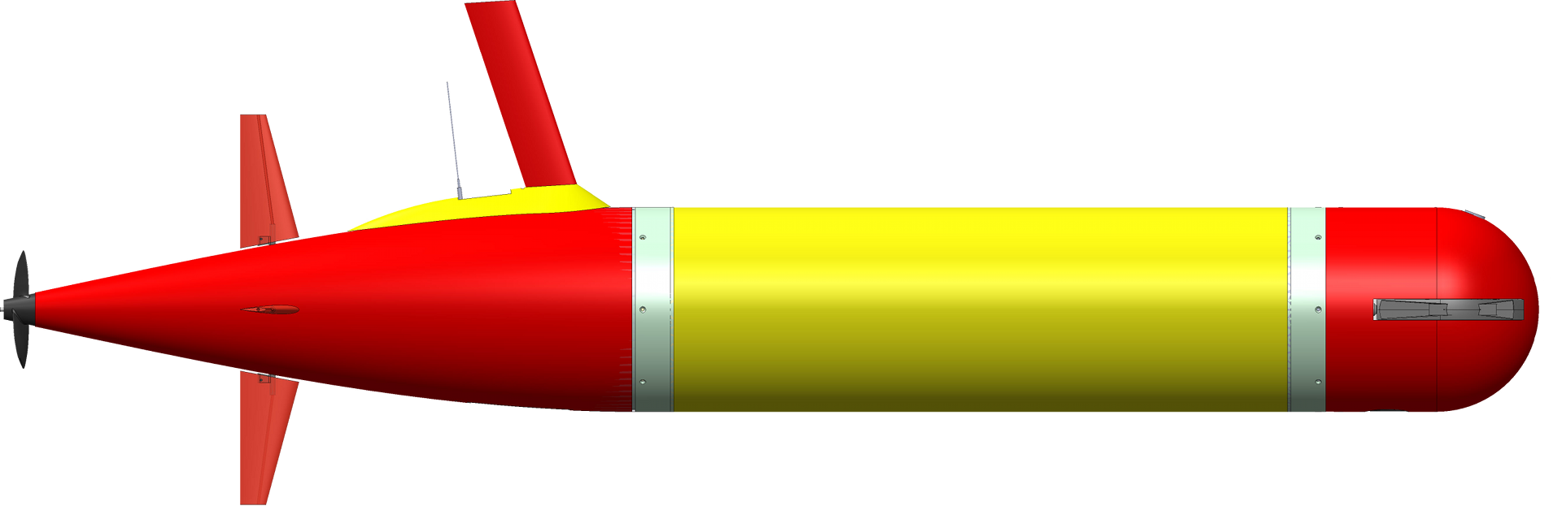
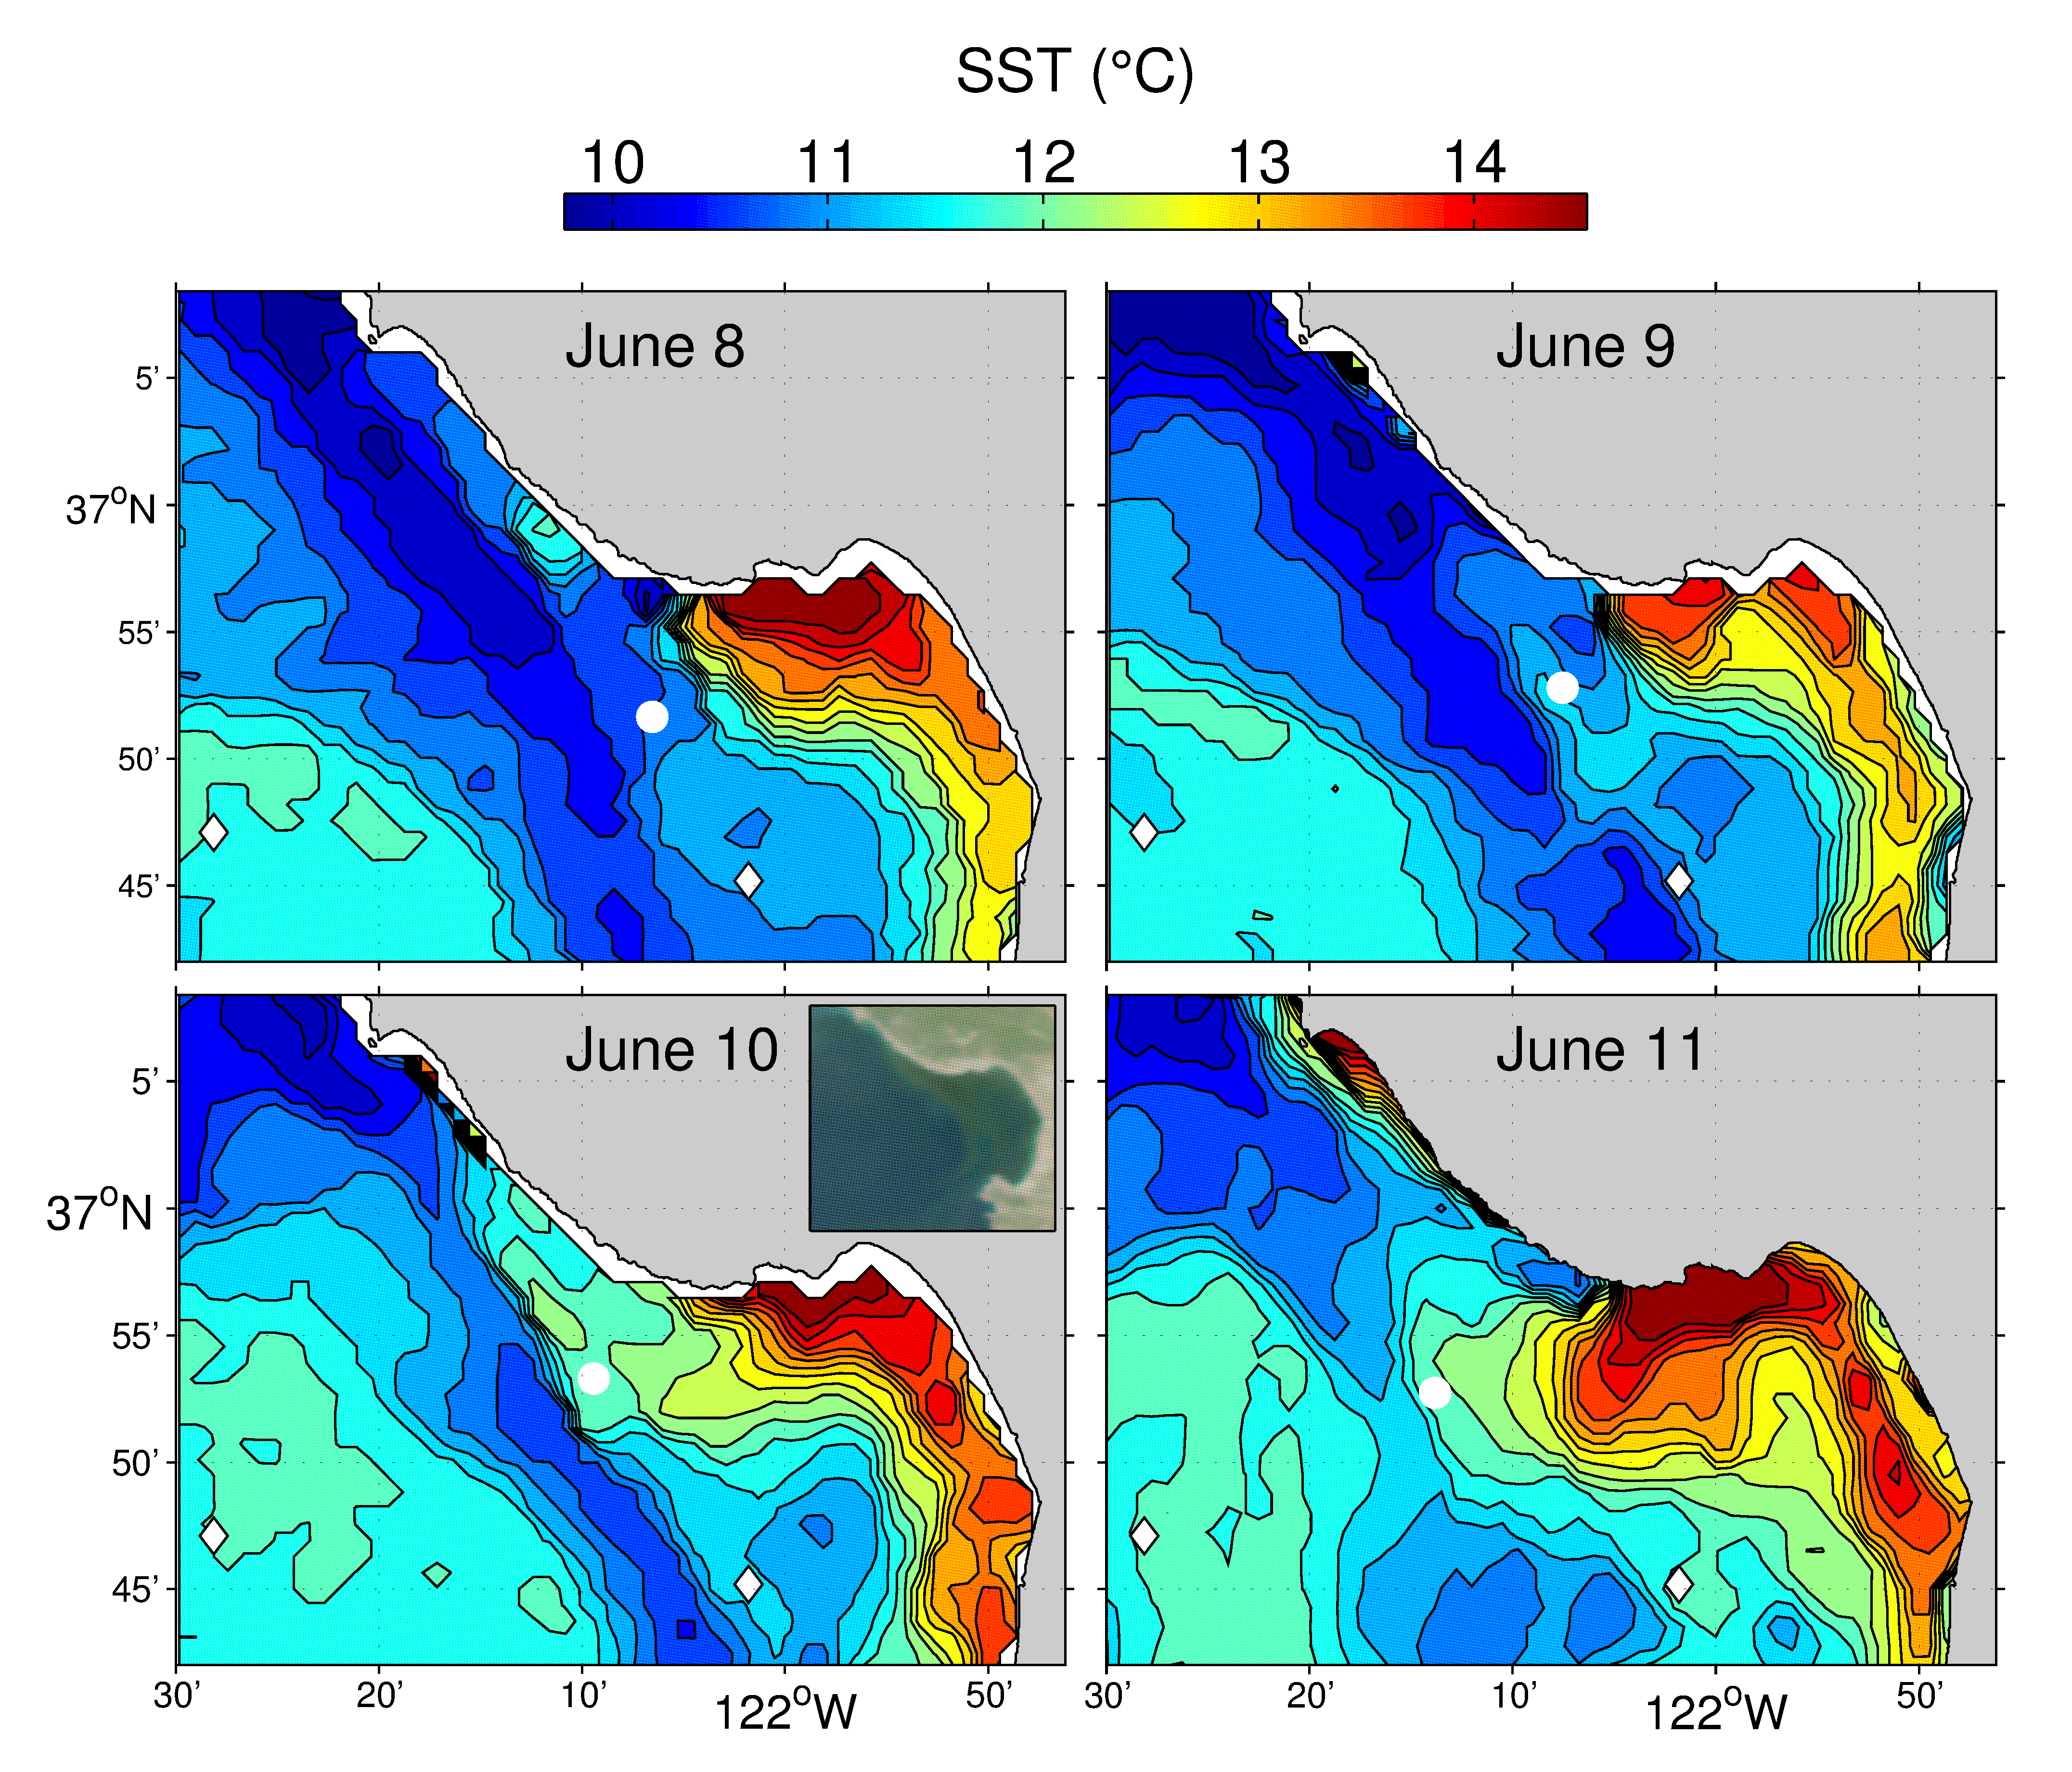
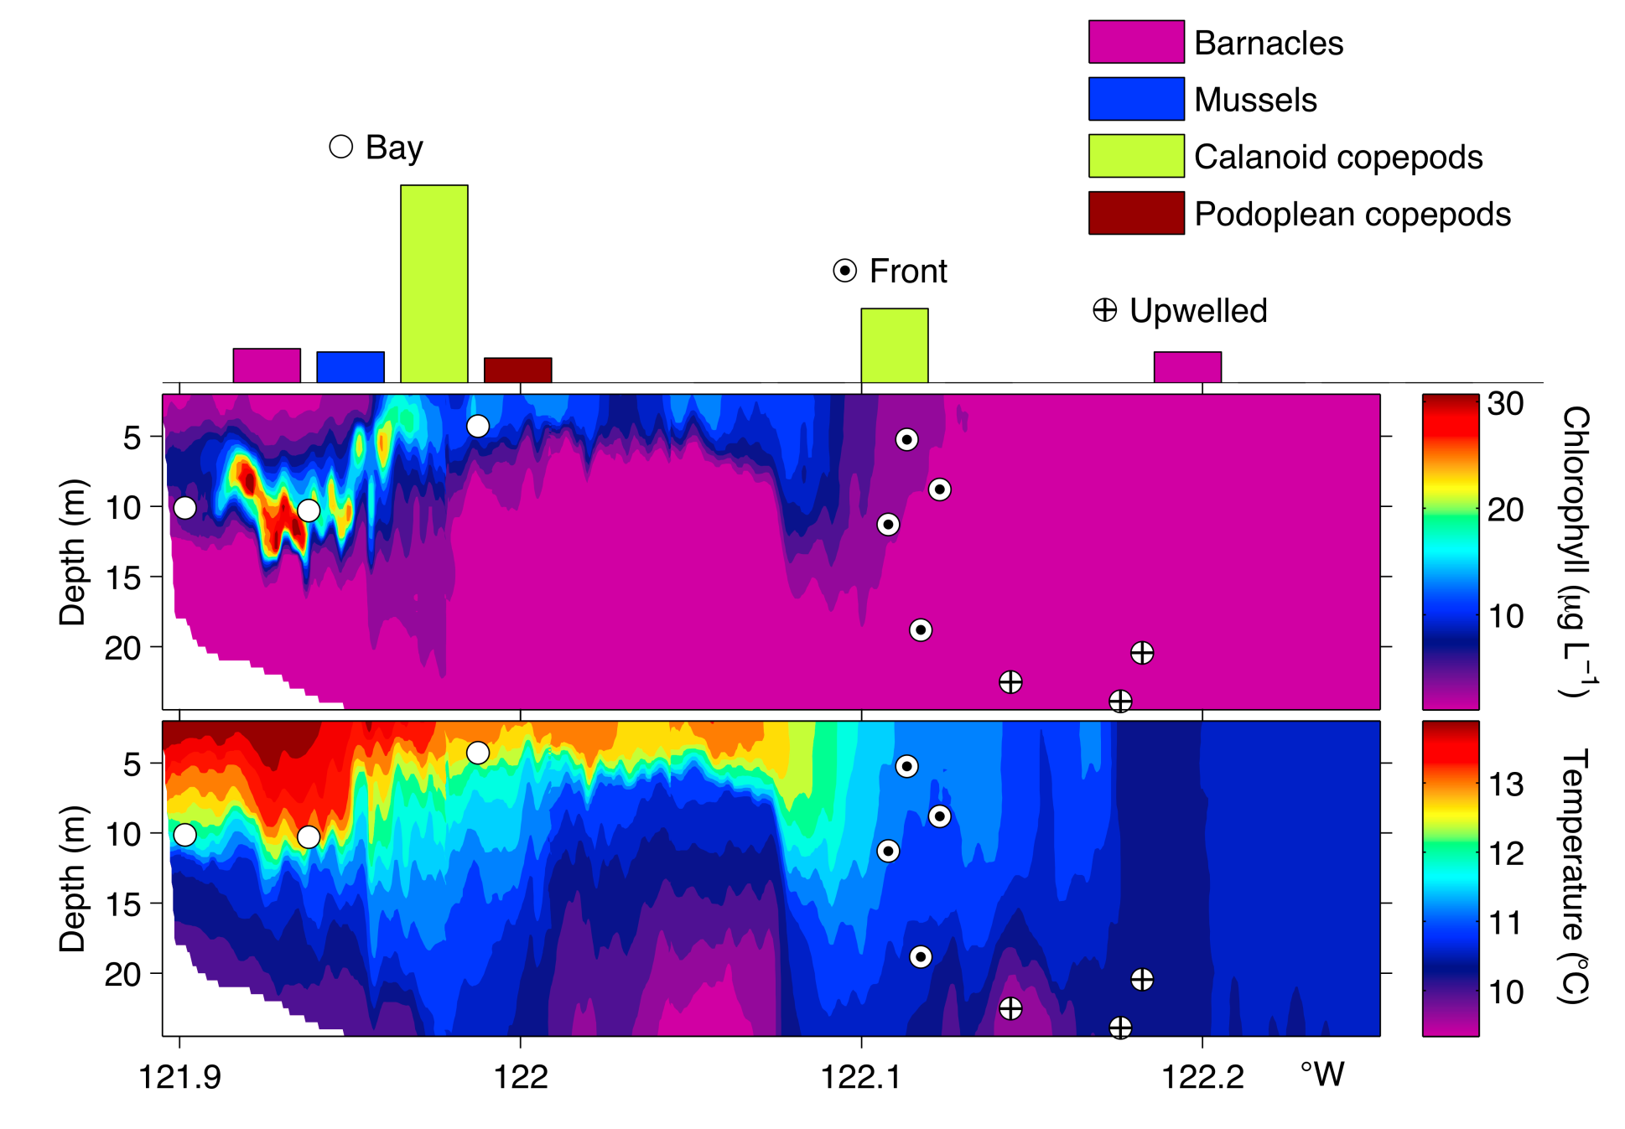
Targeted Sampling: Coastal Upwelling Front
autonomous classification
and sampling of 3 water types across the front
autonomous front tracking
, 2012
Y. Zhang et al., Limnology and Oceanography: Methods, 2012
Y. Zhang et al., Continental Shelf Research, 2015
Notes:
Targets and adaptive sampling. In targeted sampling there is a sought feature and we use onboard detection and classification.
Yanwu enabled the AUV to autonomously recognize an upwelling front and sample within and on both sides of the front (the 3 water types are: upwelling front (sharp transition zone- boundary), stratified water, upwelled water) to see how the communities varied. Dorado gulper samples. LRAUV tracking the front as it evolved.

Slide 2
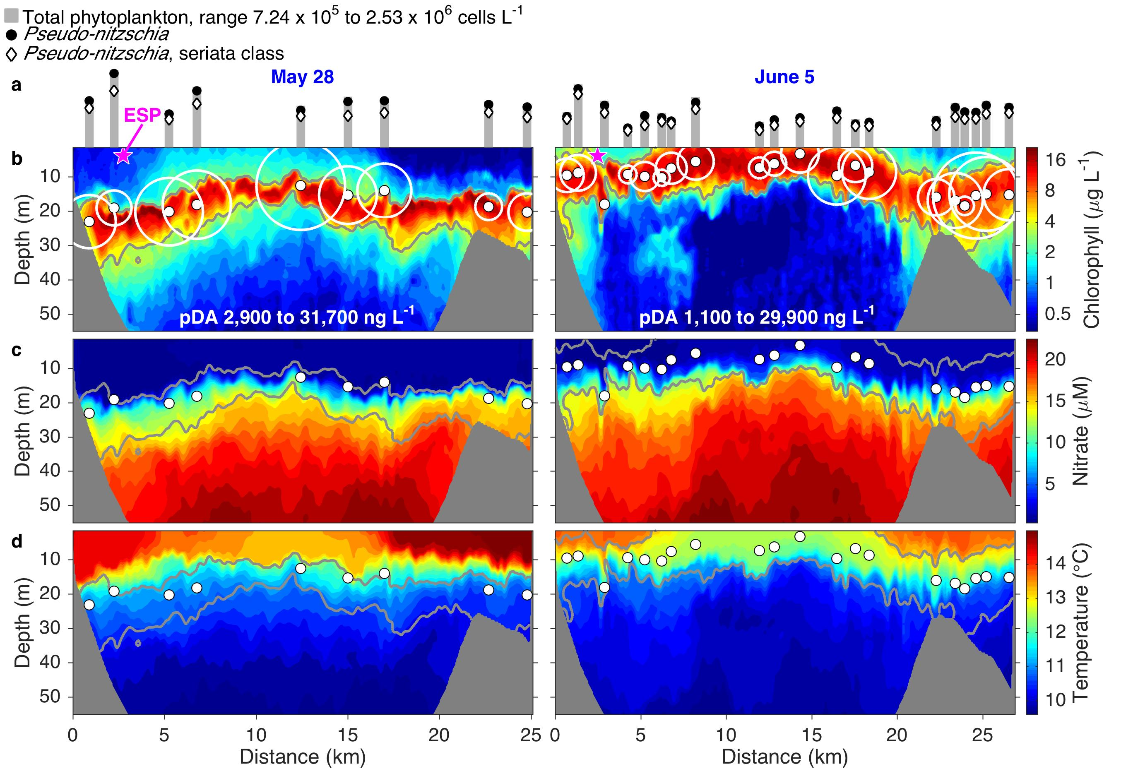
Adaptive Sampling: Peak Capture in Phytoplankton Patches
May 28
June 5
, 2015
Ryan et al., Geophysical Research Letters, 2017
Notes:
Adaptive samples is different. In this case you teach the AUV to determine where a maximum is- such as in these data a chlorophyll max as indicated in Red. Then when you are in the maximum you sample there. CANON ECOHAB. Yanwu. See the ESP.
Limited samples so to take it when it is most important.

