Slide 2
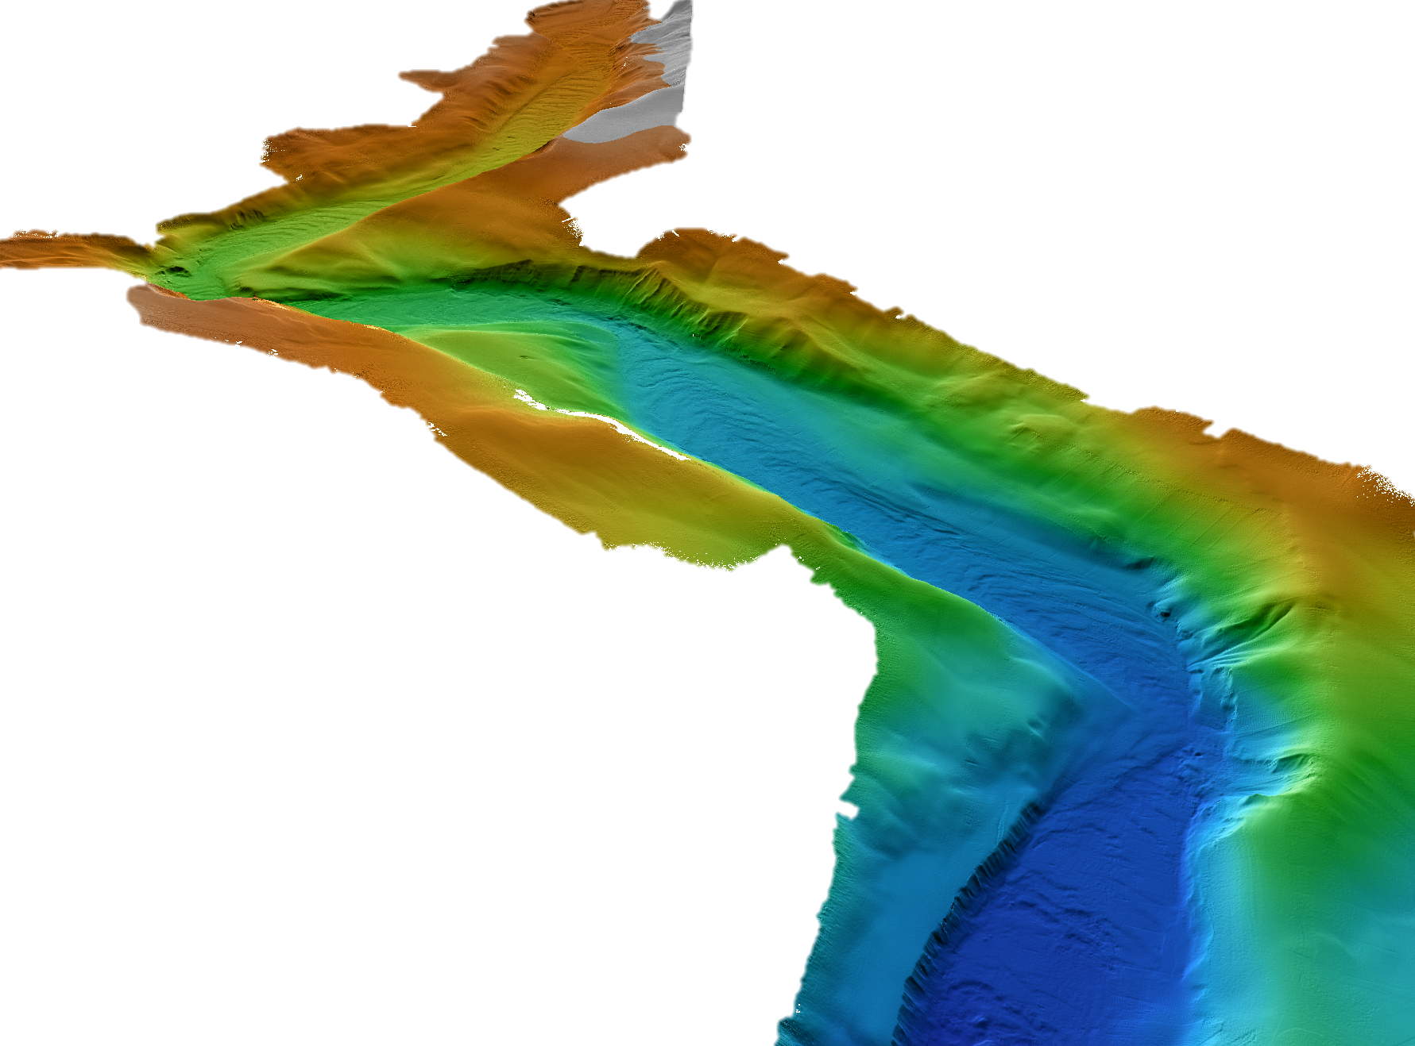
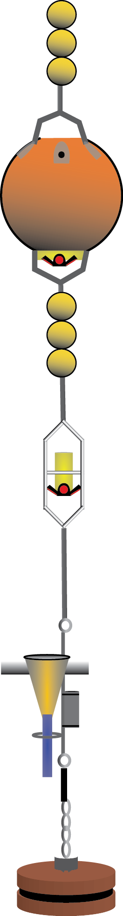
January 15, 2016
Sediment flows flush big heavy items down canyon
~ 200 m
450 200
Depth (m)
Notes:
BED05 moved from 420 m to 430 m on Jan 15

Slide 3
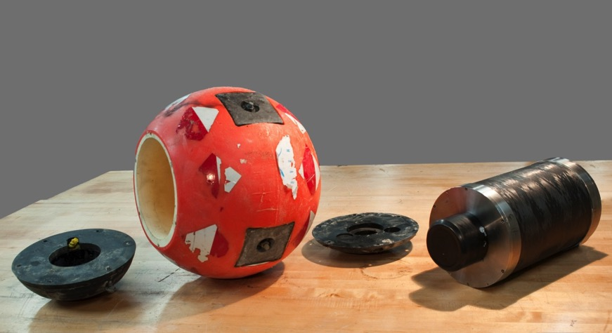
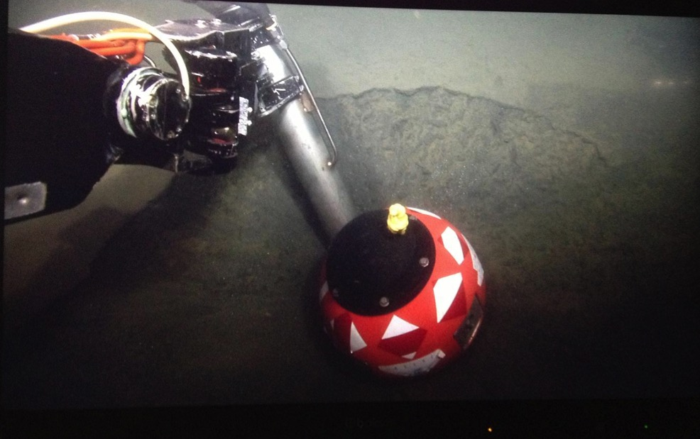
Foam Outer Shell
Electronic
Housing
BED
(Benthic Event Detector)
Measures:
Pressure (depth)
Time
Acceleration
Orientation
30 cm
Buried in
canyon floor

Slide 4
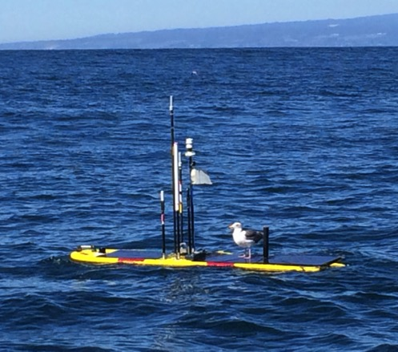
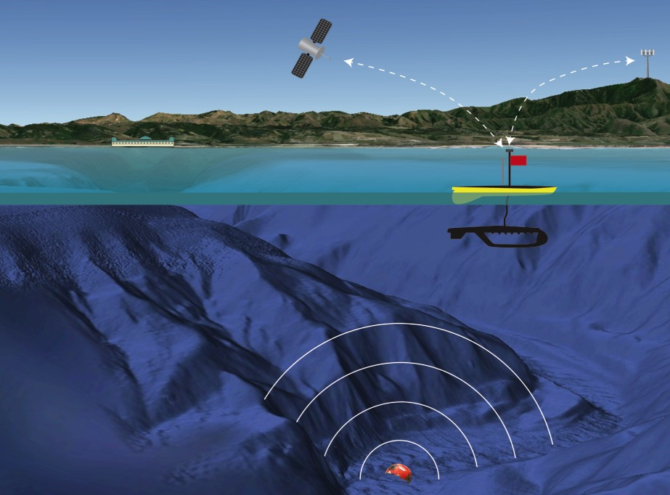
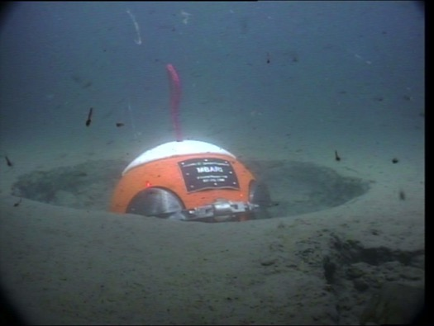
(1) Download data from instrument
Wave Glider serves as mobile hot spot to extract data
BEDs have modems that communicate
through > 1 m sediment

Slide 5

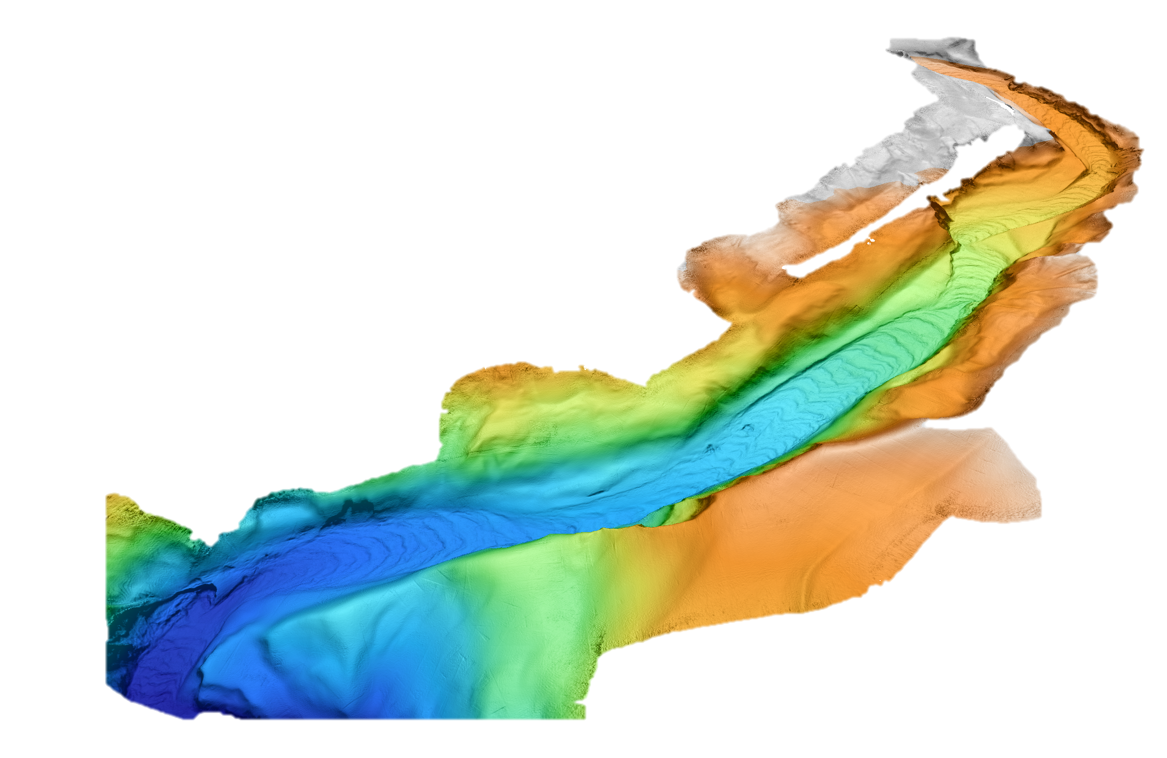
Depth changes:
BED09 moved 142m
BED08CU moved 29m
November 24th, 2016
BED03 moved 44m
MS1 moved 5m
BED09 moved 4306 m
AMT & BED11 moved 30m
BED08CU moved 847 m
BED10 moved 4m
BED03 moved 1209 m
BED04CU moved 1000 m
MS1 moved 151 m
AMT & BED11 moved 946 m
BED10 moved 175 m
~150 m
BED09 moved 204 -346m
BED08CU moved 204-233m
350 195
BED03 moved 282-326m
Depth (m)
MS1 moved 290-295m
AMT moved 299-328m
BED10 moved 321-325m
MS2 moved 526-529m
Notes:
BED08CU moved ~847m down canyon
BED10 moved ~175m down canyon
BED03 moved ~1209m down canyon
BED11 moved ~946m down canyon
BED09 moved ~4306m down canyon

