Slide 2
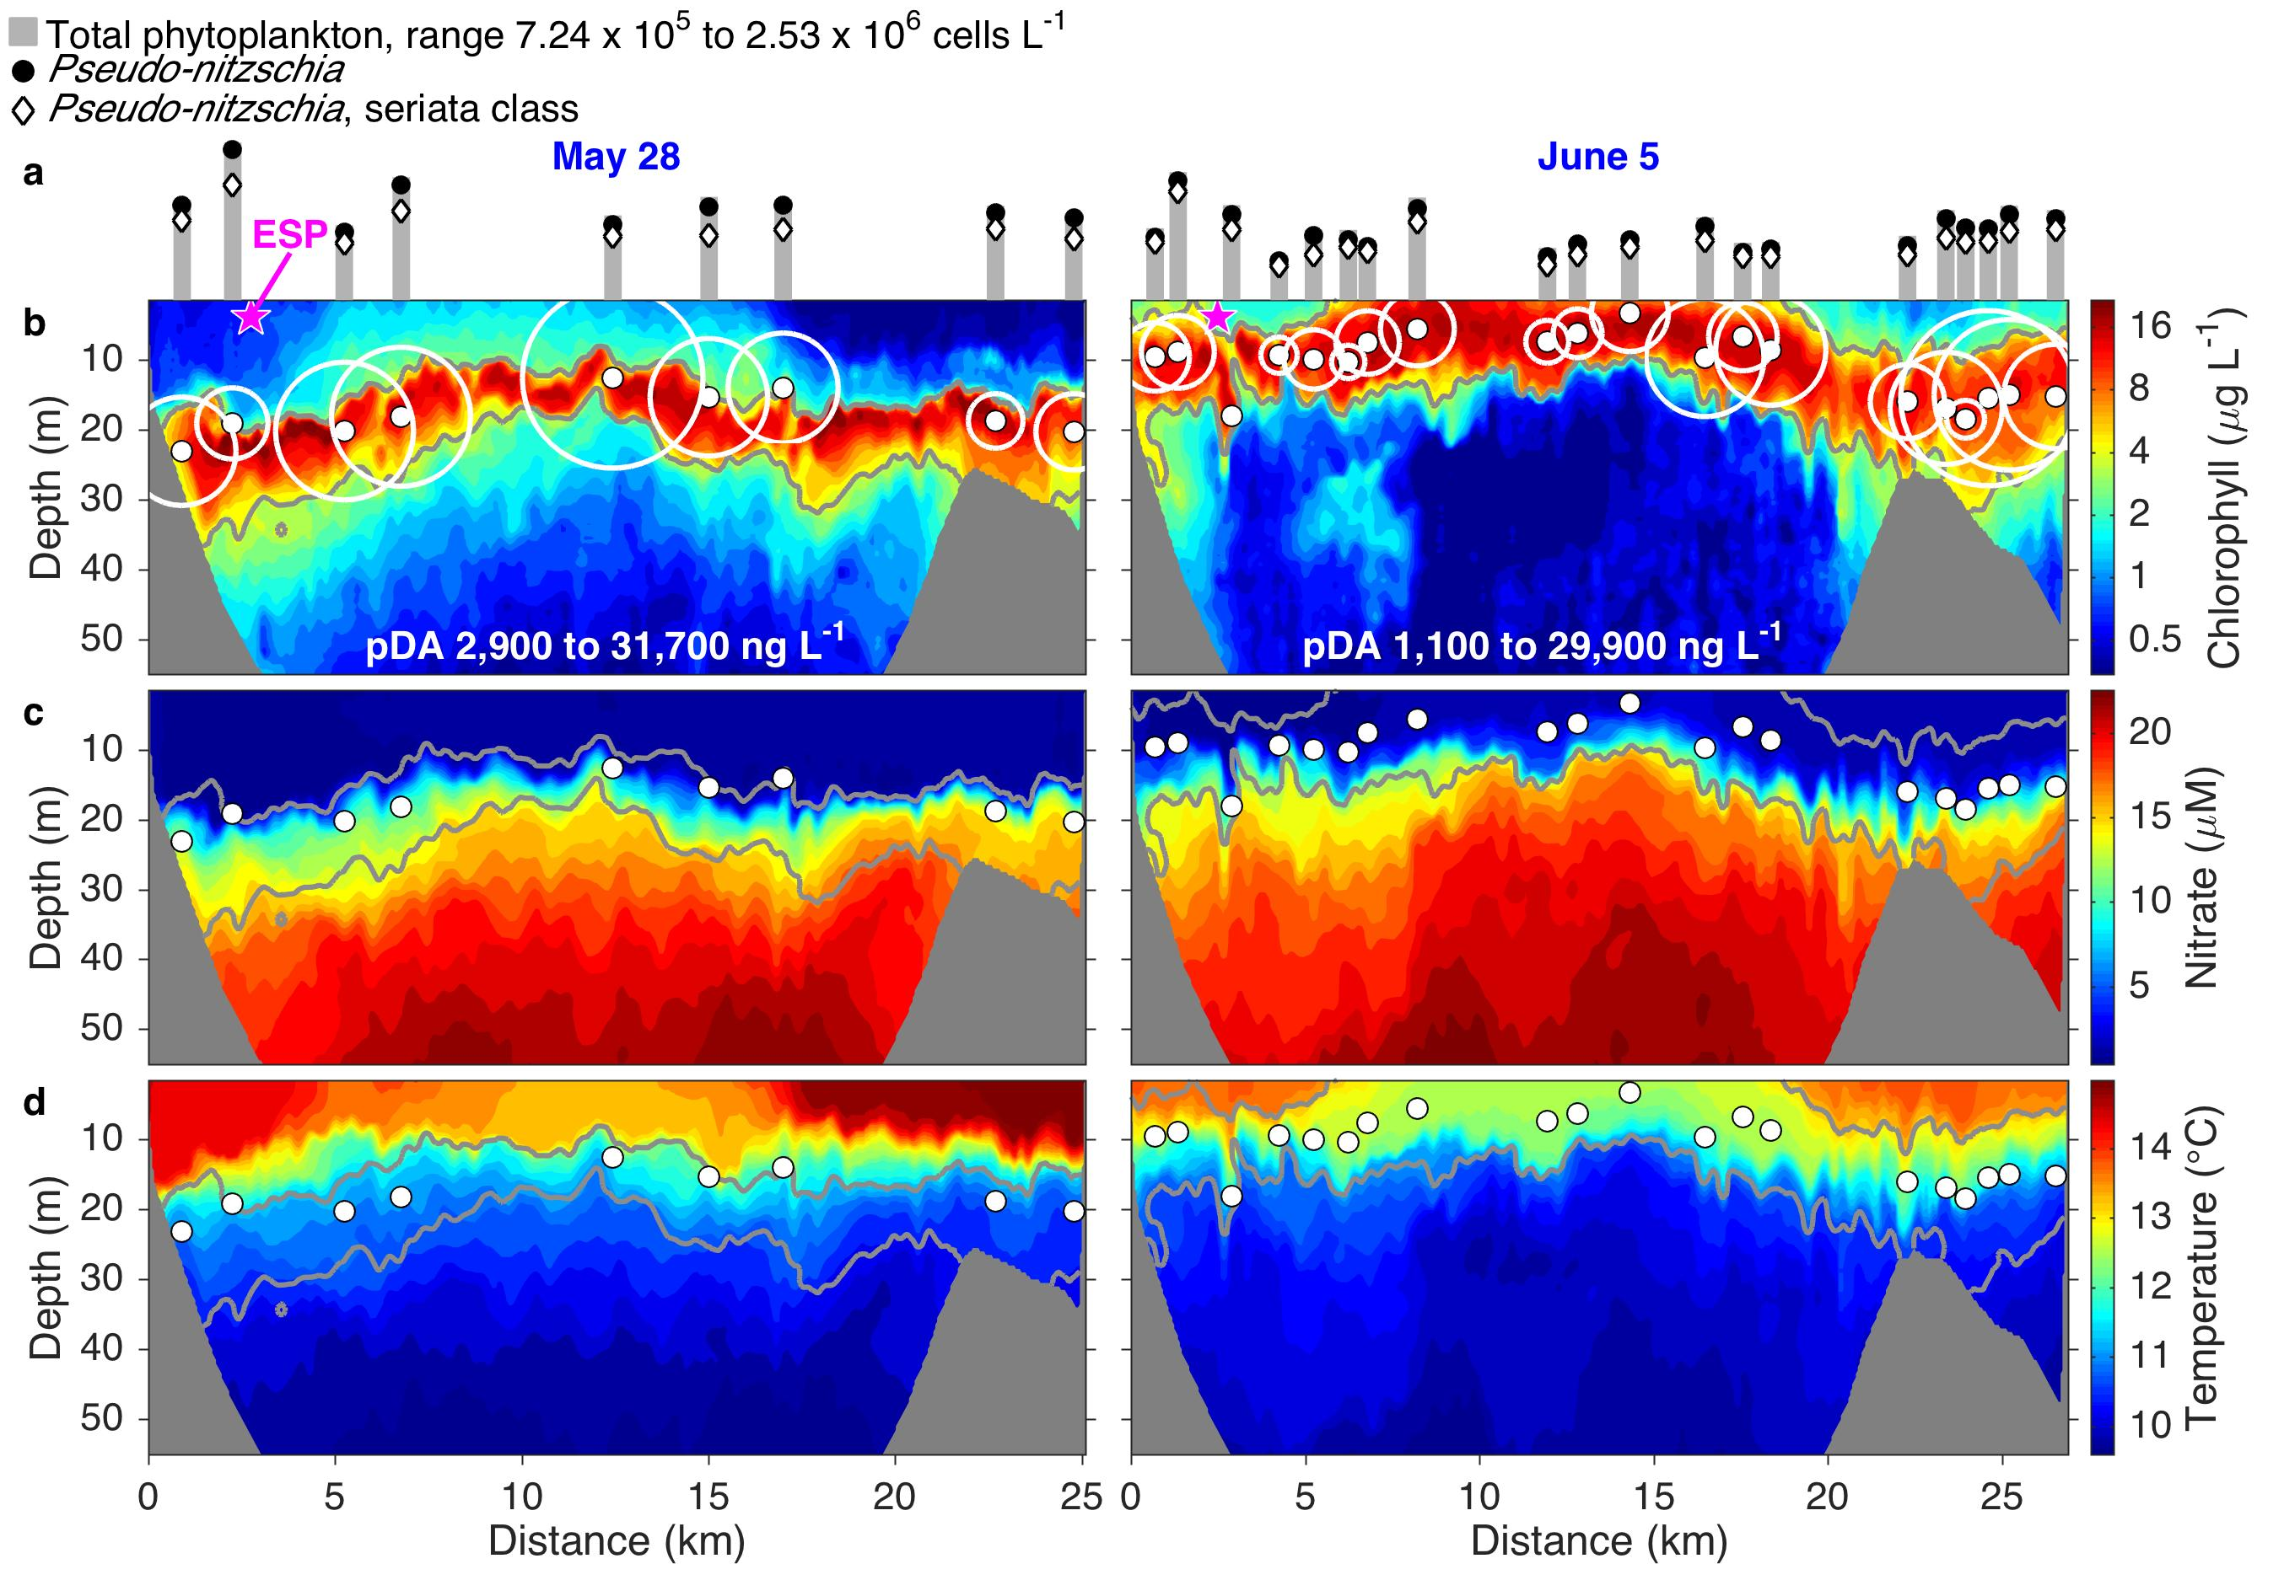
Why is mobility important?

Slide 3
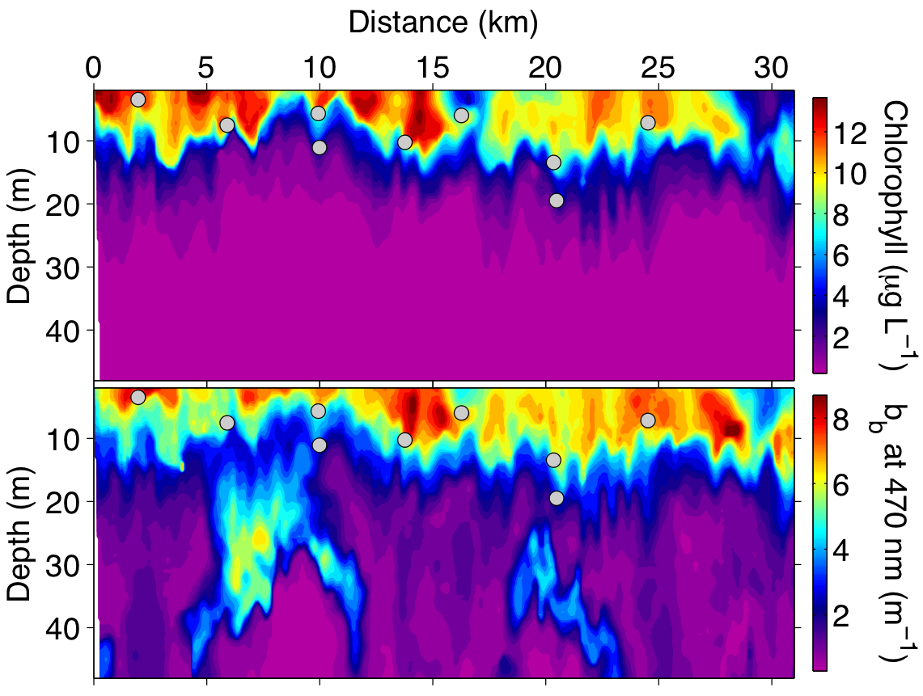
Autonomous signal peak/off-peak sampling
The AUV collected samples through the survey, identified local phytoplankton peak signal using chlorophyll fluorescence and optical backscattering, and acquired a “control” sample every fourth samples.
Notes:
Gulper sampling from the first half of the robot ballet.
Both Chlorophyll fluorescence and Optical Backscattering
Many particles are backscattering but not fluorescing beneath the surface phytoplankton populations.
Algorithm triggers to collect sample when both are peaking. Don’t want just backscatter; may not be phytoplankton. Don’t want just fluorescence
The illustration of Gulper sampling is from the first half of the robot ballet.
I showed both chlorophyll fluorescence and optical backscattering uses both. In this example we see particles that are backscattering but not fluorescing, below the surface phytoplankton populations. The algorithm requires peaks in both chlorophyll fluorescence and optical backscattering, to ensure that the peak in fluorescence is not simply due to quenching of fluorescence by high incident light levels (sun burnout) near the surface.

Slide 4
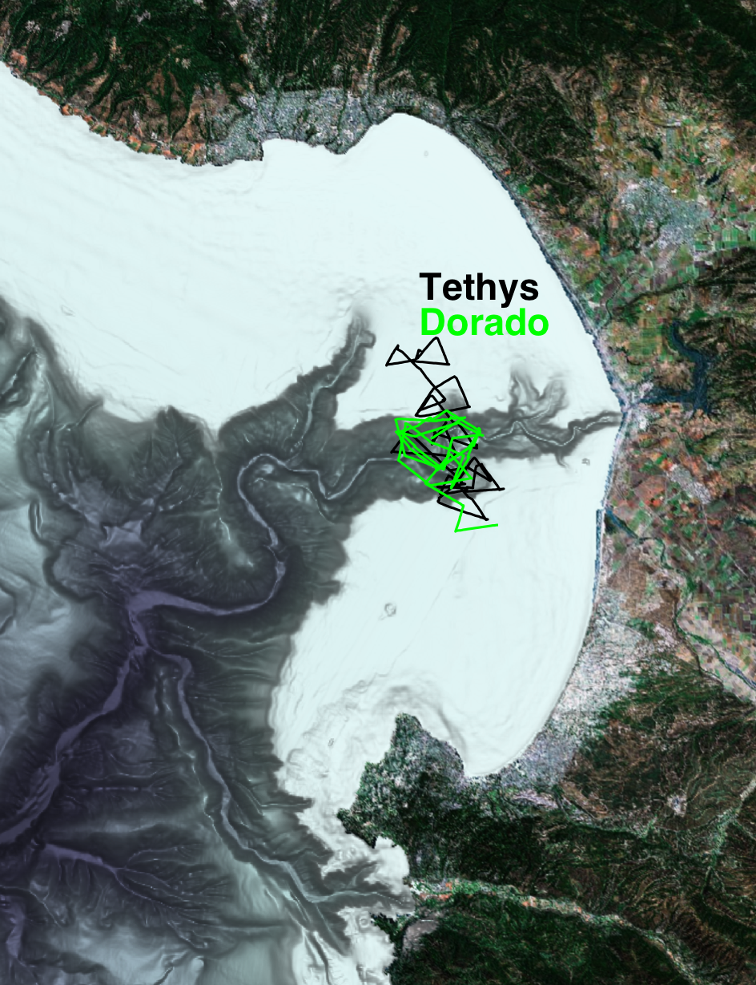
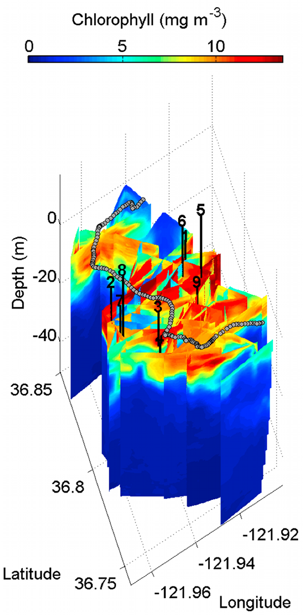
Tracking and sampling a bloom patch

