Slide 1
Maximized machining in one part
Other than main housing other parts are very simple
Did away with light baffling
Kept long lens to allow for camera movement
Lens can be pulled from the front without opening housing
Lens in recessed below holder – some scratch protection
Interior allows for camera to be in a rack then mounted to housing
Access into housing can be done without disconnecting or moving wires or disconnecting from vehicle if mounted with direct access to back plate
Mounting holes on all sides for brackets to accommodate future applications
Lens design has minimized water getting underneath
Did I miss a requirement or desire from the last meeting?

Slide 2
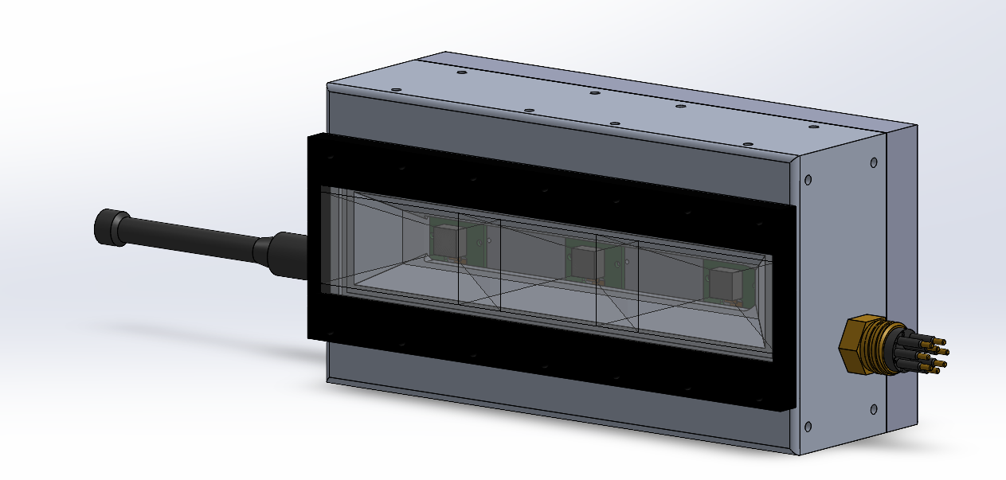

Slide 3
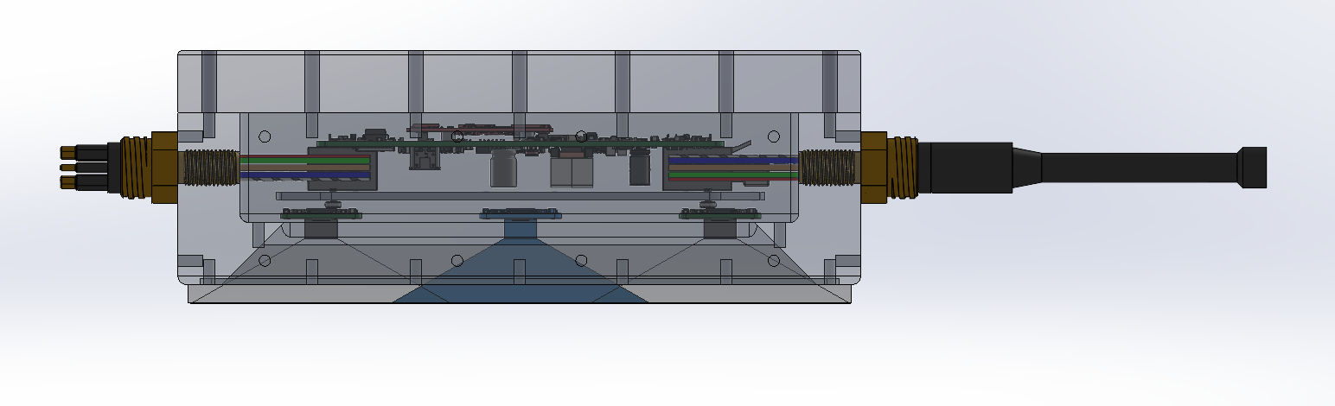

Slide 4
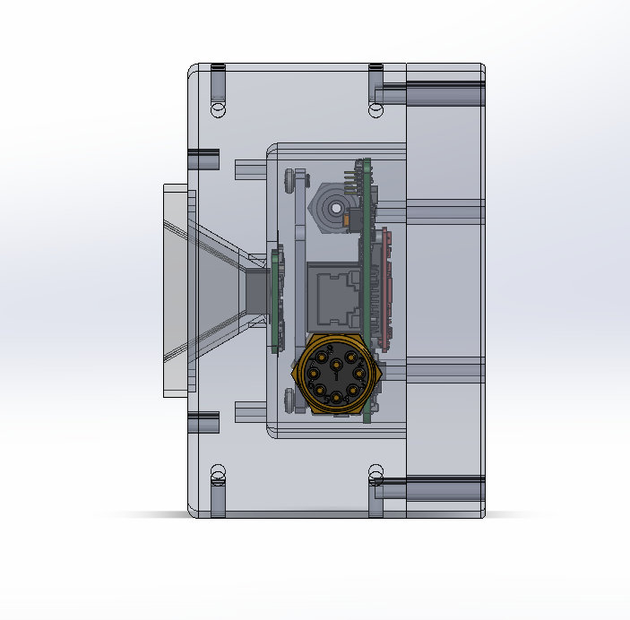

Slide 5
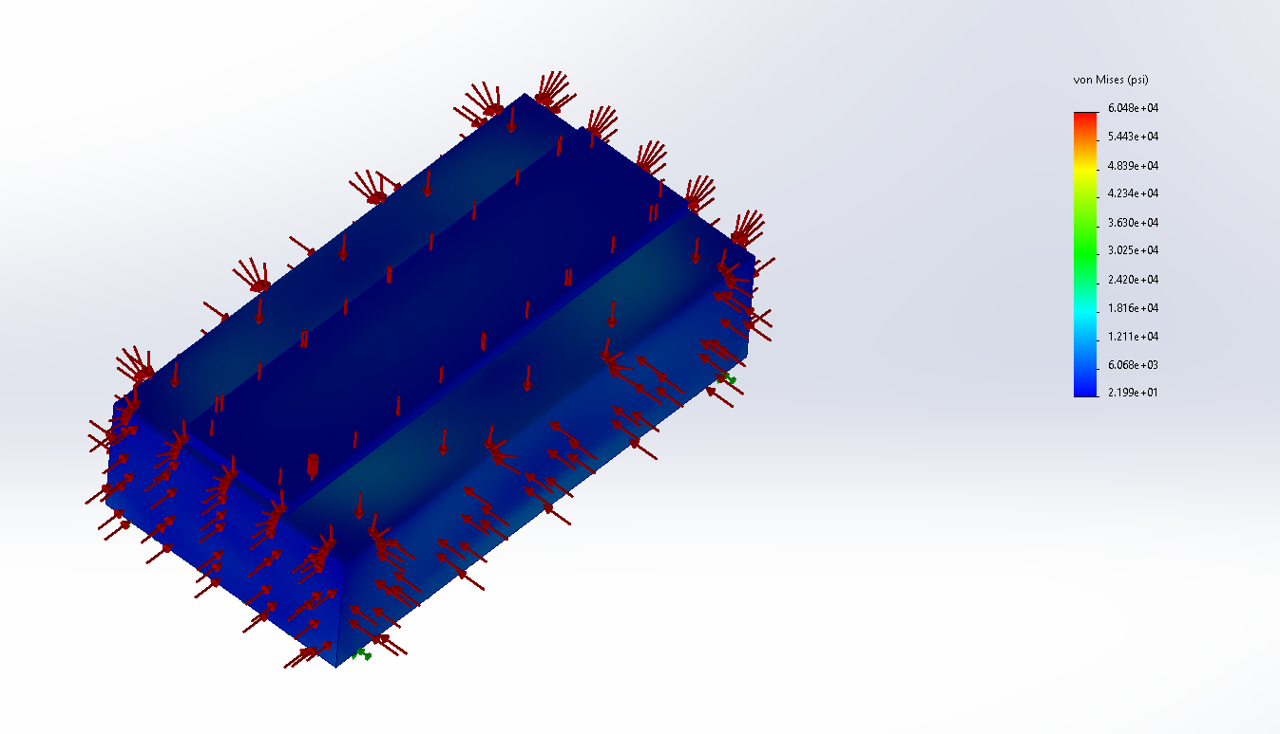

Slide 6
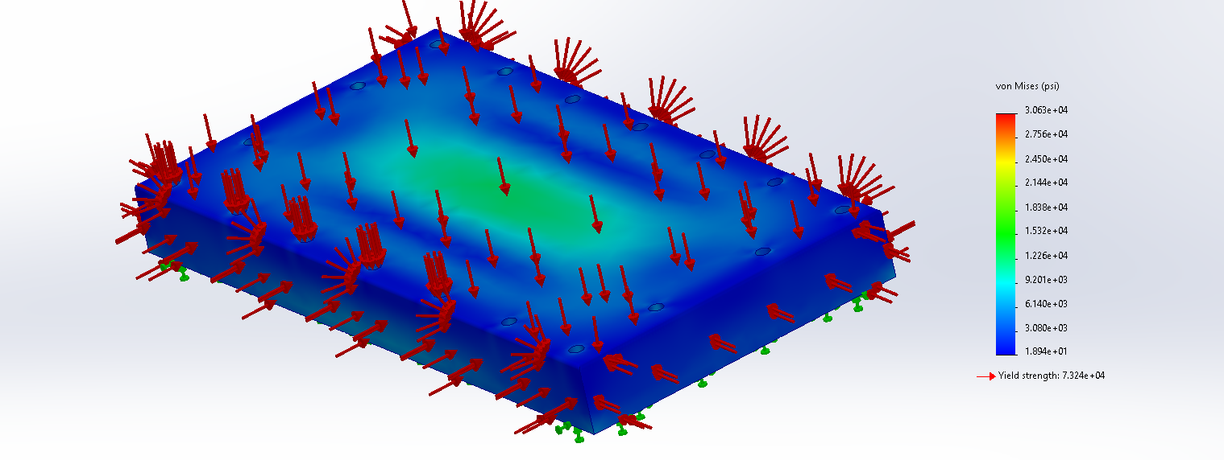

Slide 7
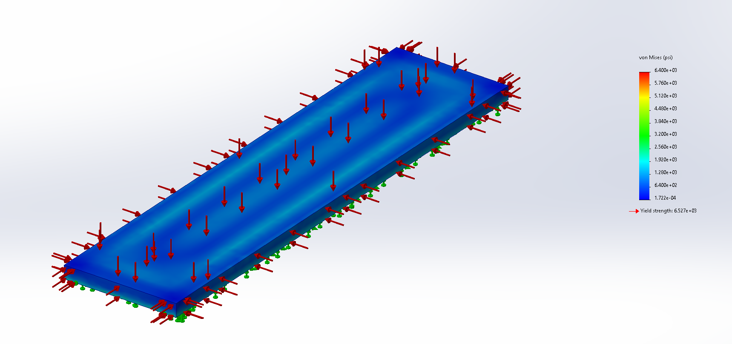

Slide 8
Things to do before going to the shop:
Counter sink screw heads to keep overall dimensions
Design the interior rack for the camera to mount onto 3D print
Double check Delrin will squeeze gasket enough or change material choice
Counter sink purge port for o-ring seat
Spot face the connectors for o-ring seat
Draw up the lens gasket
Detailed drawings for shop
If we know where this will mount with certainty, design the brackets that attach to the mount holes and get those into the shop as well

Slide 9
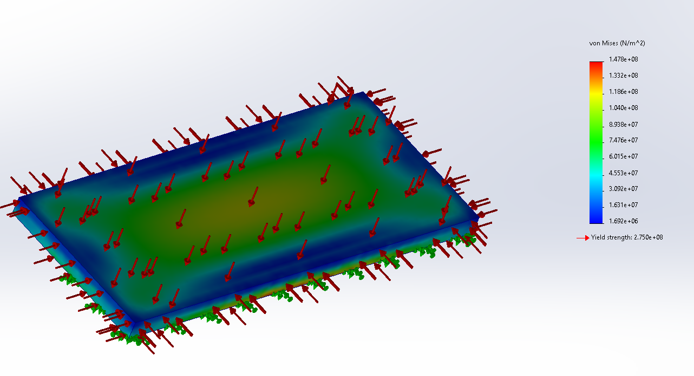
This is too heavy for MOLA… talking with Eric, he mentioned that we should probably make a lighter version for the shallower depth.
A quick look at 500 meters which is about 750 psi… just looking at the back plate as a reference…
1500 meter plate is wgt in air is 2.6 lbs
500 meter plate is
0.6 lbs in air
A rough guess is the 500 m housing would be about 25% of the total wgt of the 1500 m

