Slide 1
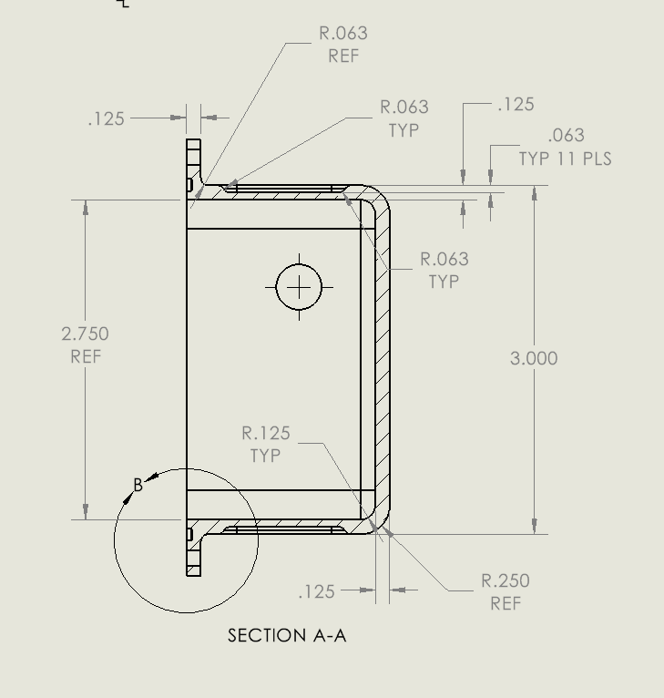
Strength Calc
Calc good for lid and base of housing
Shear strength of 6061-T6 = 30000 psi
Shear length = (2.75 x 2) + (6.25 x2) = 18.00 inches
Shear cross section = 18.00 x .125 = 2.25 sq in
Pressure @ 1500 m = 2250 psi
Area = 2.75 x 6.25 = 17.1875 sq in
2250 x 17.1875 = ~ 38,672 lbs
30000 x 2.25 = ~ 67,500 lbs
S.F. = 67,500/38,672 = 1.75

Slide 2
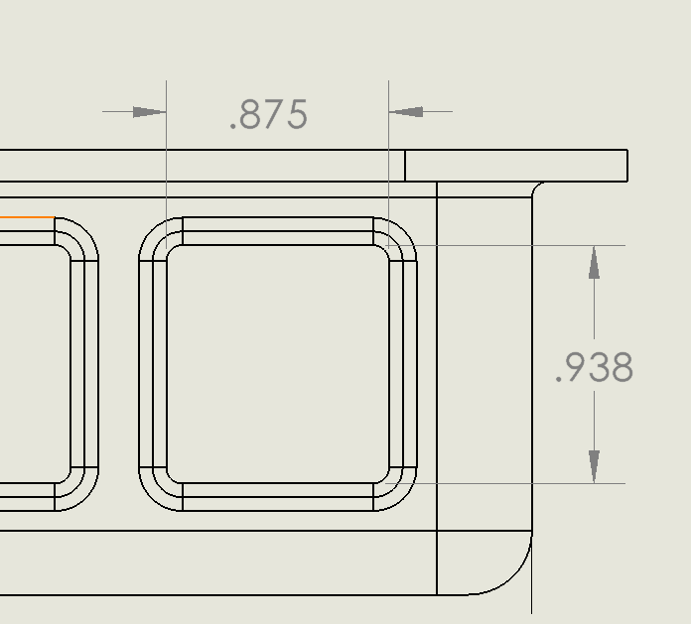
Strength Calc
Lightening Panels for housing
Shear strength of 6061-T6 = 30000 psi
Shear length = (.875 x 2) + (.938 x2) = 3.626 inches
Shear cross section = 3.626 x .063 = .228 sq in
Pressure @ 1500 m = 2250 psi
Area = .875 x .938 = .821 sq in
2250 x .821 = ~ 1,847lbs
30000 x .228 = ~ 6,840 lbs
S.F. = 6,840/1,847 = 3.70

Slide 3
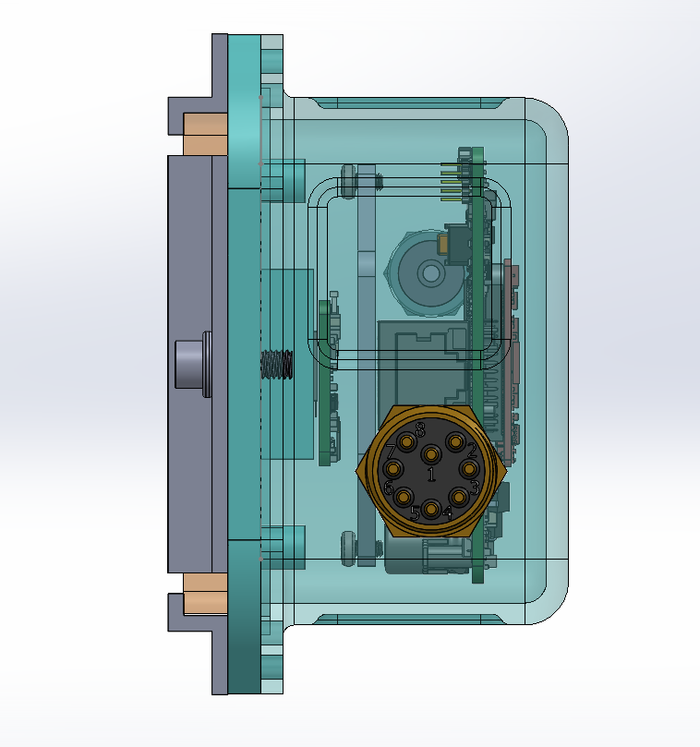
Thermal Estimate
Q
Ti
Te
R1
Rair
Rgel
R3
Ralum
R5
Ti – Te = Q*Rt
Simplifying – this is a linear system so Rt is the sum of Rs.
Ti ~= 75 C = 167 F Te ~= 55 F at the surface in Monterey Bay
This is the hot chip
T = 112 F
Resistor 1 – Chip
to Air interface
I was told 6 W for the chip but that isn’t the max - up it to 10 W
3.412 BTU= 1 Watt HR
Q = 10 * 3.412 = 34.12 BTU Hr
Resistor 3 – Air to
Aluminum
Rt(max) = 3.285 [BTU/Hr F] ^-1
Resistor 5 – Aluminum
to Sea
Ri = L / (k*A)
L = path length
k = Thermal Transfer Coefficient
A = Surface area

Slide 4
Thermal Estimate
Q
Ti
Te
Rt(max) = 3.285 [BTU/Hr F] ^-1
R1
Rair
Rgel
R3
Ralum
R5
Ri = L / (k*A)
k air = .016 BTU/Hr Ft F
k alum = 118.53 BTU/Hr Ft F
k plastic chip = 1.02 BTU/Hr Ft F
k seawater = .346 BTU/ Hr Ft F
k SarconGel = 3.00 BTU/ Hr Ft F
This is the hot chip
Resistor 1 – Chip
to Air interface
Approximations: Achip = 1 sq in = .00694 sq ft
Aair = 17.188 sq in = .1193 sq ft
Aalum = 19.500 sq in = .1353 sq ft
Resistor 3 – Air to
Aluminum
Resistor 5 – Aluminum
to Sea
R1 = .0001/(1.02*.00694) = .0141
Rair = .0104/(.016*.1193) = 5.4737
Rgel = .0104/(3.00*.0064) = .5417
R3 = .0001/(118.35*.1193)=.00001
Ralum = .0104/(118.35*.1353)=.0006
R5 = .0001/(.346*.1353)=.0021
Rt = .559 << 3.285 [BTU/Hr F] ^-1

Slide 5
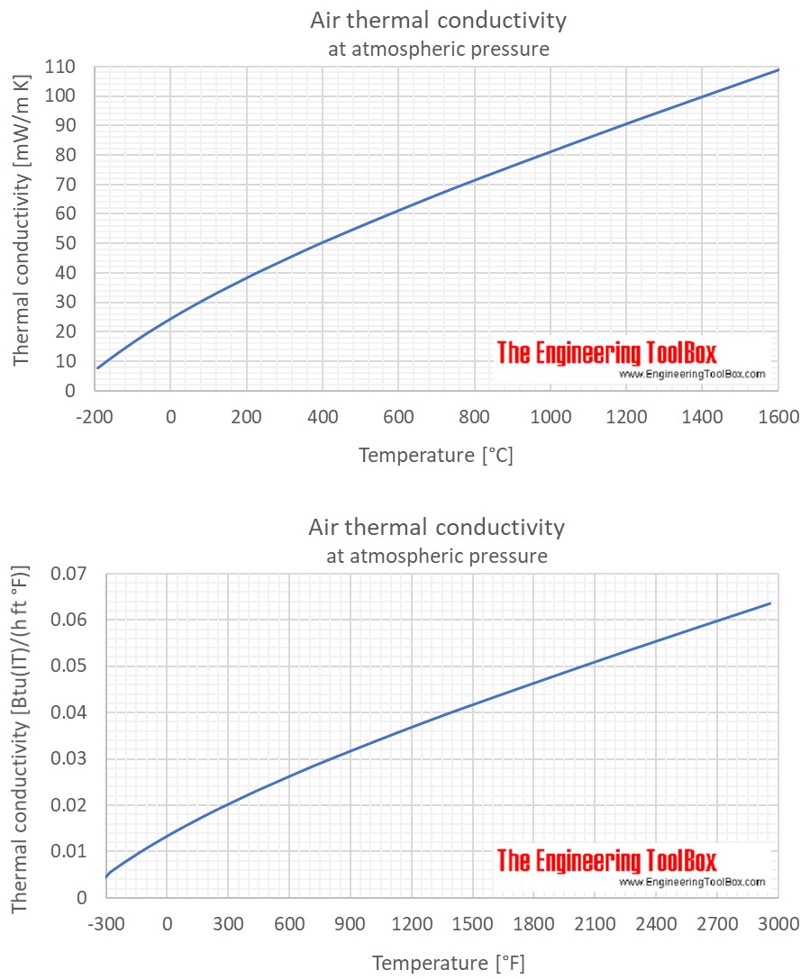

Slide 6
