Slide 1

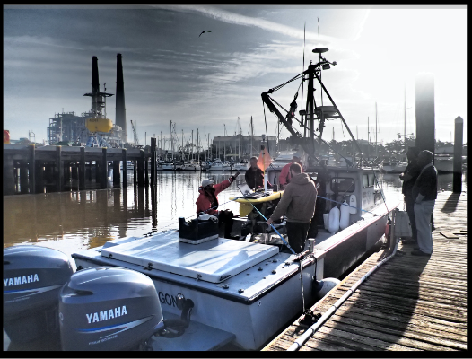
MBARI
Paragon ASV Concept Design

Slide 2
Project Vision
Phase 1 – Data Collection and Algorithm Development – Fielded August 2023?
Phase 2 – Operator Assistance/Aiding – 2024?
Phase 3 – Optional Autonomy - TBD

Slide 3
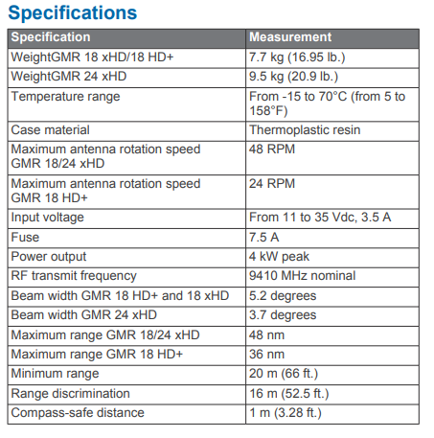
Existing System
https://www.mbari.org/wp-content/uploads/2020/02/Paragon-Manual-Revisions-2-05-20.pdf
Garmin 24 xHD Radar
Garmin Marine Heading Sensor
Garmin AIS 600 Class B
Sonar
  Garmin GT51M-THP
  Garmin B265LH
Display
  Garmin GPSMAP 7612xsv
  Garmin GPSMAP 7608xsv (unused)
  Garmin GPSMAP 8610xsv
860AH, 12V battery bank (+engine alternators produce >100A, full throttle)
Boat size and cruising speed affect standoff distances; larger boats need sensors with more range
  Jared commented that he typically gives obstacles >25ft (8m) clearances in the harbor (small lower risk objects might be closer) with much greater clearances used in the open bay
  To be useful, sensors must accurately detect targets >50ft (16m) in harbors with several hundred feet as a goal
All Garmin products use a proprietary Garmin network, NMEA2000 or both
  Garmin does not publish interface specifications
    The radar has been reverse engineered by an open source project and MBARI has used the code library
  NMEA2000 is a proprietary marine electronics association interface specification which is only available to members. MBARI is not a member. Membership is $7.5K plus specs and would preclude MBARI from publishing derivative work which might expose the interface.
Radar

Slide 4
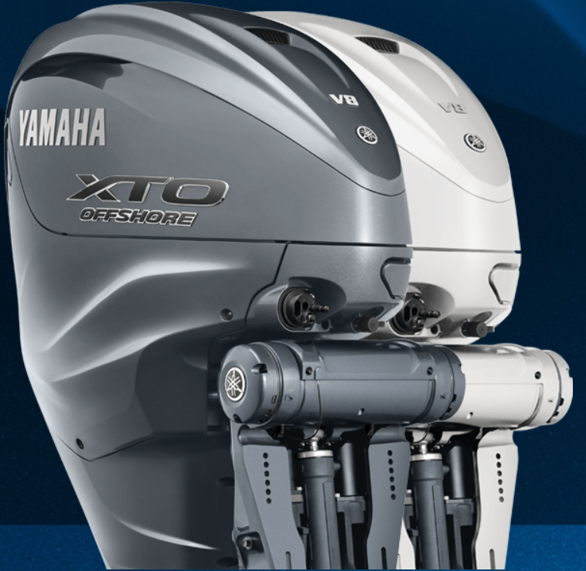
Paragon Upgrades
The Paragon’s engines will likely be upgraded in Q1 of 2024
  FROM twin engine Yamaha F300
  TO twin engine Yamaha F450XSB
  As part of the package, the steering/throttle/trim will be update to Helm Master Ex (required or the engines don’t work) a Yamaha proprietary CAN bus.
  Gauges will be updated to the Yamaha CL5 touchscreen and also routed to the existing Garmin system
Additional Paragon upgrades have been proposed
  Battery system update will add a 48V (400AH?) LiFePO4 system and dock charger
  Winch improvement
  RDF improvement

Slide 5
ASV project phase 1
Add sensors, data collection and processing to the Paragon
  LIDAR (Purchased)
  AHRS
  Cameras
  AIS
  Wind
  Datalink
  RDF (pending availability)
  Engine
  Storage/Networking
  Processor

Slide 6
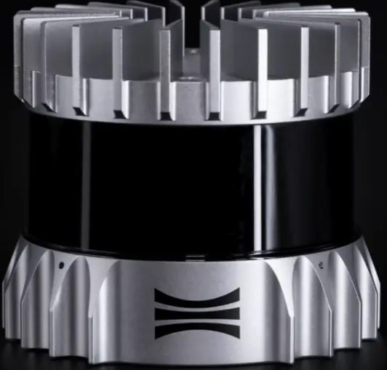
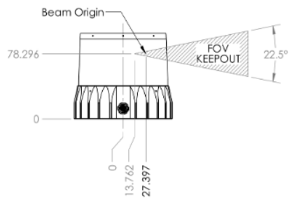
Lidar
Detector range estimates may overestimate performance in some scenarios
  Unlike real targets, probability of detection is measured with a flat surface parallel to the detector; as the reflection angle changes less light will be scattered back decreasing useful range
  As light level varies day to day and sun angle changes during the day, the detector’s noise floor changes affecting range
Purchased
Ouster OS0 Rev6
  For 10% Lambertian reflectance (~matte surface, average sun) 15m >90% detection, 20m >50%
  32 lines of resolution
  +/-45deg iFOV from centerline
  Useable range is may be too small to support many harbor scenarios and is unsuitable for most open bay scenarios
Ouster OS1 Rev6
  For 10% Lambertian reflectance (~matte surface, average sun) 45m >90% detection, 55m >50%
  128 lines of resolution
  +/-22.5deg iFOV from centerline
  Useable range probably supports many harbor scenarios but is a bit short for most open bay.
Not Purchased
Ouster OS1 Rev7 (newest generation)
  90m >90% detection, same iFOV
  Useable range would likely support all harbor scenarios and some open bay.
Ouster OS2 Rev7
  200m >90% detection
  iFOV +/-11.25deg from centerline
  iFOV makes mounting crucial but useable range is likely to support all harbor and most open bay scenarios.

Slide 7
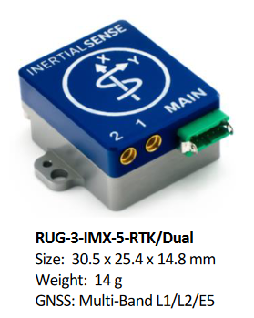
AHRS
Selection criteria:
  Dual GPS for compass soft iron rejection
    Two antennas are separated by 1 to 10m, accuracy increases with baseline
  Magnetometer for compass updates between GPS fixes
  Lower precision tactical grade IMU for speed and gravity reference between GPS fixes
  Linux ROS drivers
  Credible vendor
  No ITAR
All receivers require another ~$300 for high quality antennas/RF cabling
InertialSense RUG-3-IMX-5-RTK/Dual - $3299
  Better performance than VectorNav’s low precision IMU

Slide 8
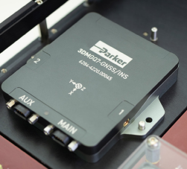
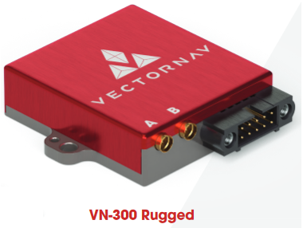
AHRS
VectorNav VN310 - $16500
  Best performing IMU, highest price
  IMU performance likely to far exceed application requirements
  Possibly a good solution if recycled into future projects
Parker 3DMGQ7-GNSS/INS - $3724
  Mid tier IMU, mid tier price
VectorNav VN300 - $4850
  Mid tier IMU, high price
  Already characterized/integrated IMU

Slide 9
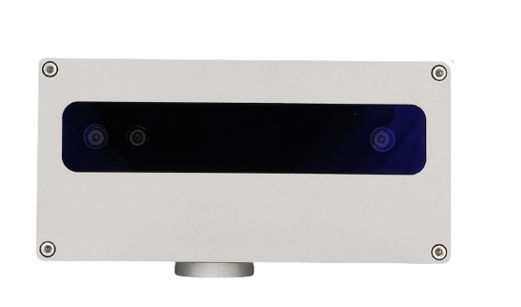
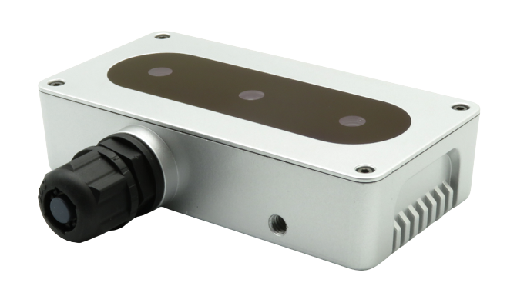
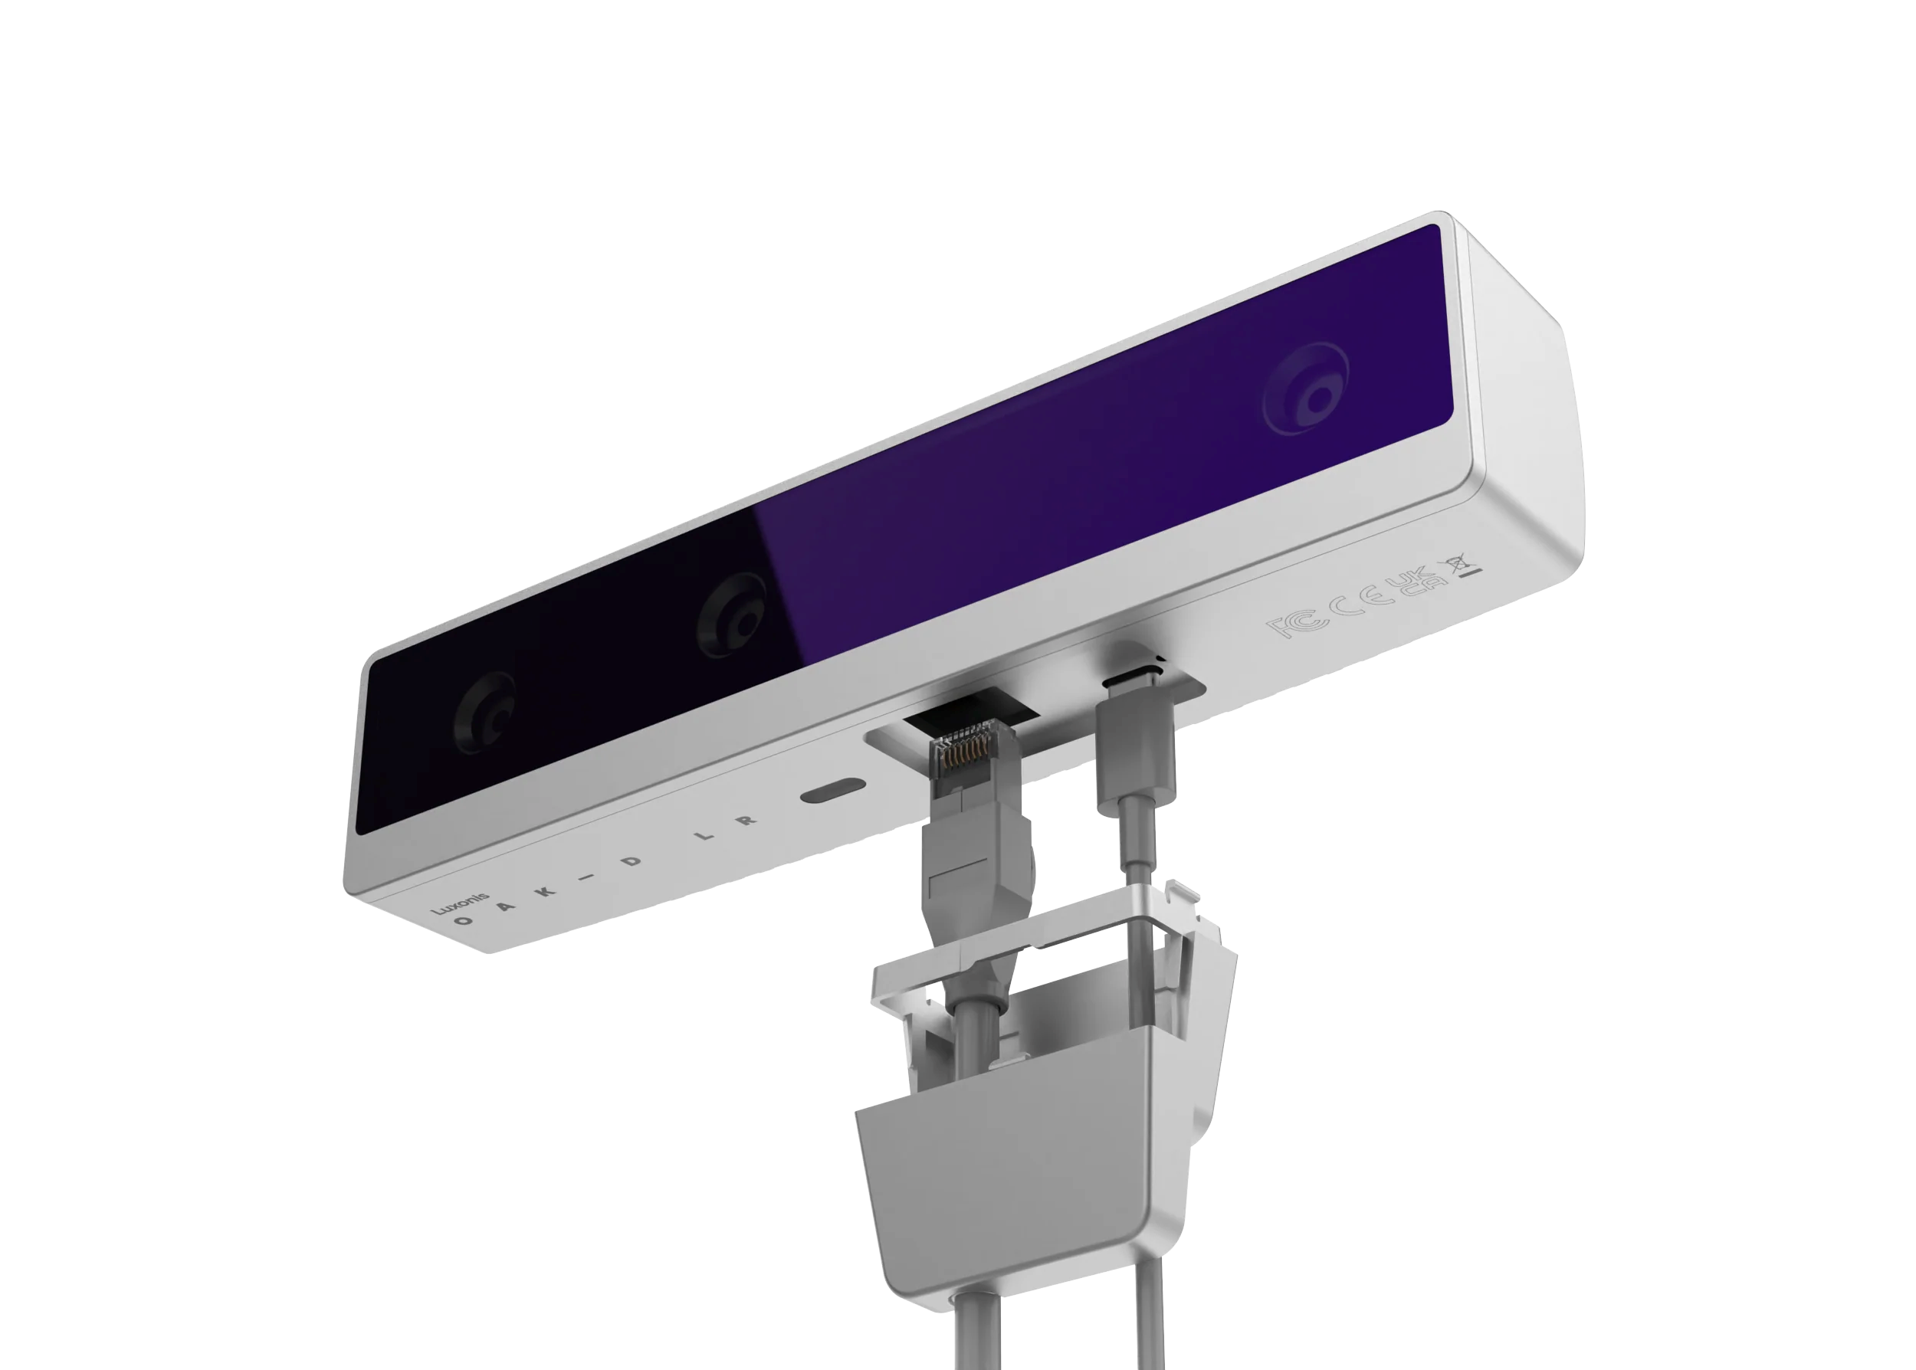
Cameras
Current Oak Camera’s depth perception with prebuilt models may be unsuitable for some harbor navigation scenarios and most open bay.
  OAK-D CM4 PoE is +/-10% at 17m ($599)
  OAK-D-PoE is +/-10% at 15m ($399)
OAK-D LR (preorder expected to start shipping in June)
  $799
  Wider baseline extends performance to +/-10% at 30m, 100deg DFOV
  Standard M12 lens facilitates trading FOV for accuracy up to 100m

Slide 10
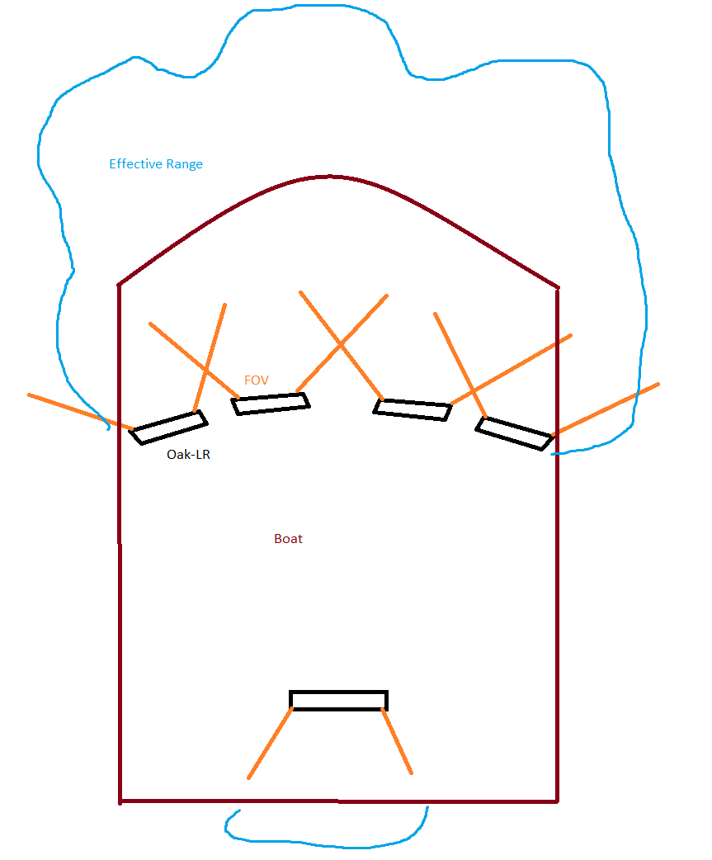
Camera mounting
Camera array made up of 5 Oak-LR with partially overlapping FOV camera modules with carefully set offsets would cover the front and back of the boat with a minimum of 30m accuracy
Camera feeds between arrays could be used to create increased range lobes at the front and a few degrees to either side for collision and cross traffic awareness
Although side pointing cameras are unlikely to be critical for navigation, they may still be helpful to locate the contrasting LEDs on LRAUVs during recovery

Slide 11
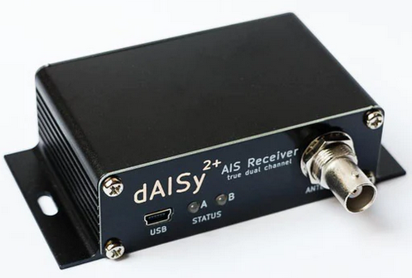
AIS
Provides heading and location of nearly all very large boats and many smaller boats in the area
The existing system uses a proprietary bus and is not trivially accessible
  Option 1: Converter+Open Source drivers ($300)
    A NMEA2000 gateway/serial converter converts the messages to an encoded serial stream
    Open source community reverse engineering (CANboat) may support enough of the encoded AIS messages to work
  Option 2: Duplicate equipment (~$300 - 1000)
    Use natively open source radio dAISy 2+ ($99)
    RF options
      Tap into existing VHF system (slight performance loss)
        Directional coupler ($100 - $400 ) such as ZFDC-20-1H+
          Some performance loss (<25%) expected due to VSWR and insertion loss
        Amp ($100 - $500)
        Cabling/balun $100
      Add VHF antenna
        Tricky mounting to avoid interfering with radar/existing system
        May not know if it is interfering with the existing system
        Will drop out during and for up to few hundred us after Paragon transmissions missing data
        Antenna ($100 – 500)
        Limiter ($50 - $500)
        Cabling ($100)
  Option 3: Via Starlink/online database (free – $500 +data)
    Online AIS databases offer access in exchange for sharing receiver feeds, MBARI could share data from a new or existing AIS system to access data on the Paragon
    Open source hardware targets consumer vs commercial so receiver costs (and performance) are lower; this would provide risk mitigation against insufficient range for open source hardware

Slide 12
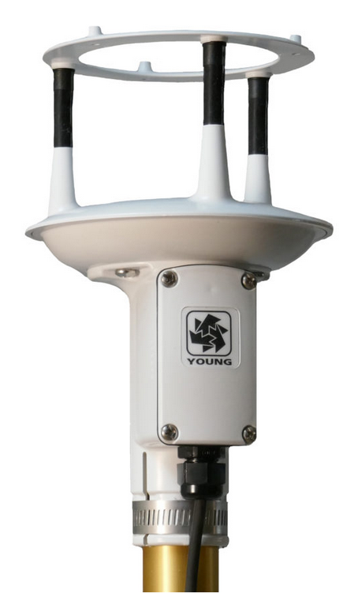
Wind
Wind is typically helpful in predicting wave size and direction which will change optimum navigation
Waves could be measured with other sensors but an anemometer may be an optimum method for triggering higher power options
Young ResponseONE 91000 ($1050)
  With internal compass $1300
    Potentially easier for Jared to permanently integrate
Range: | Wind speed: 0-70 m/s (168 mph) Wind direction: 0-360°
Accuracy: | Wind speed: ± 2% ± 0.3m/s (0-30 m/s), ± 3% (30-70 m/s) Wind direction: ± 2°
Resolution: | Wind speed: 0.01 m/s Wind direction: 0.1°
Threshold: | <0.01 m/s
Response Time: | <0.25 seconds
Serial Outputs: | RS-232, RS-485/422, SDI-12 Formats: ASCII, ASCII polled, SDI-12, RMYT, NMEA Baud: 1200, 4800, 9600, 19200, 38400 Units: m/s, mph, knots, km/hr Wind format: Speed & direction or U & V Status indicator: Standard with ASCII & NMEA
Power Requirement: | 10-30 VDC, 7 mA typical, 80 mA max

Slide 13
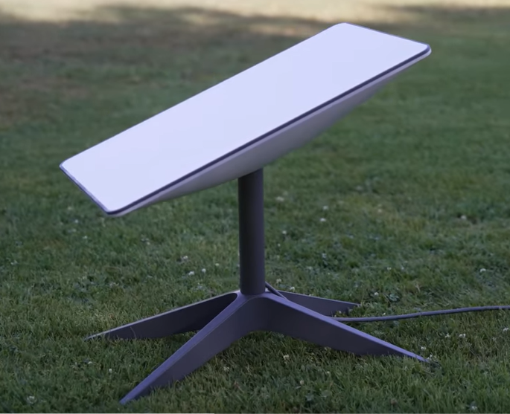
Datalink
Augments or provides AIS data
Current asset position
Permits remote troubleshooting and integration
Minimizes project impact on other Paragon missions by minimizing people on the boat
Starlink
  Starlink ($2500 equipment fee +$250@50GB - $2500@5TB/mth)
  Most helpful during initial integration
  220mbps data rate and data cap will not be sufficient to stream all sensors or download a day of data remotely
  Will be sufficient to stream data from a single sensor, download a few minutes of system data for troubleshooting/remote integration
Cellular
  $300 + $100month
  Helpful after the system is integrated and mostly running smoothly due to the data cap

Slide 14
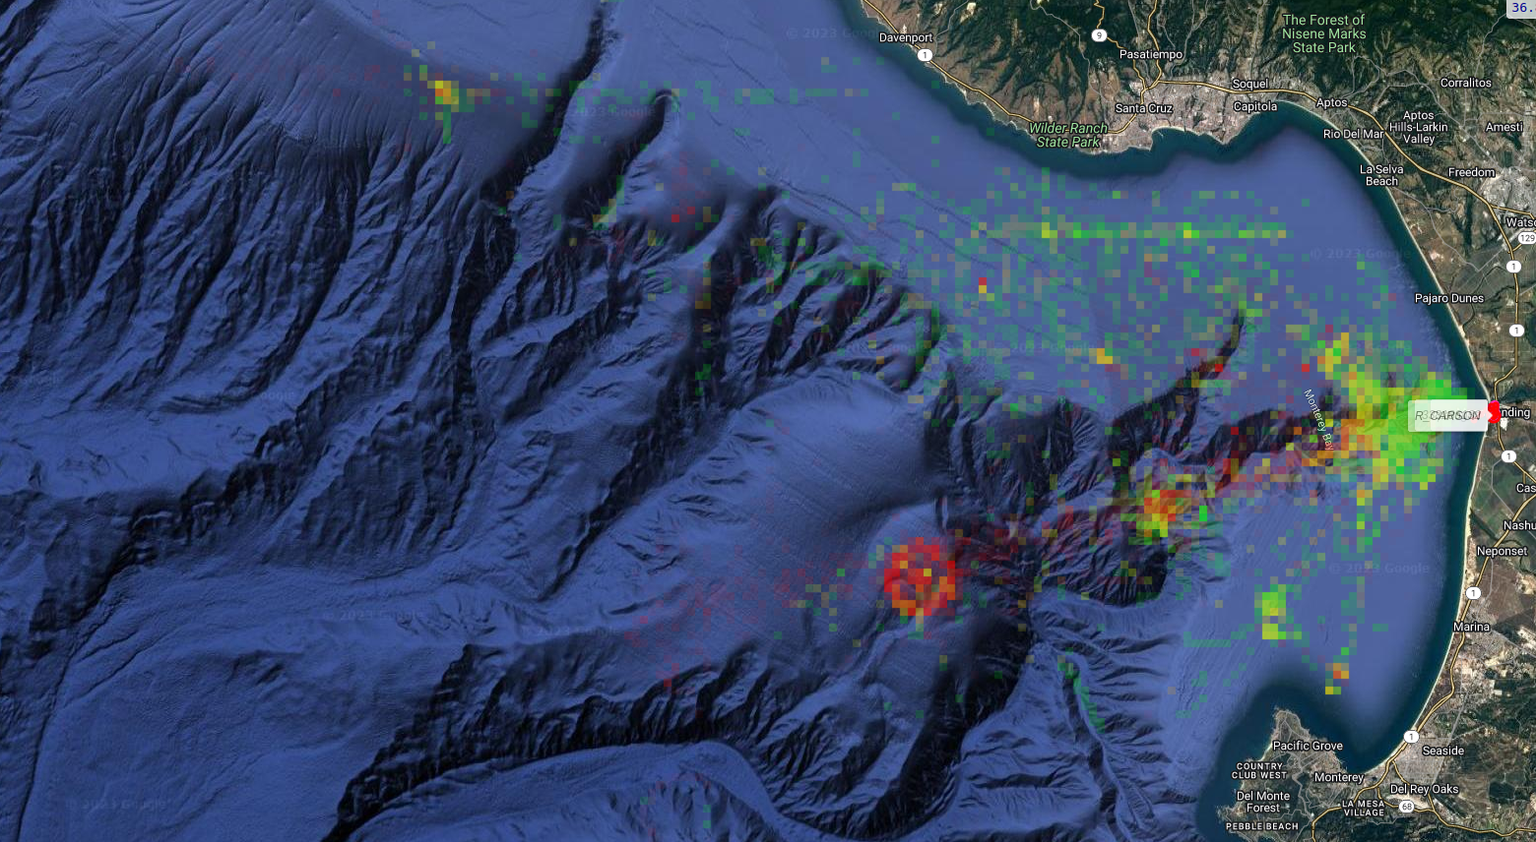
Cellular Coverage on the Bay is good
Opacity corresponds to number of samples
Color corresponds to number of times there was coverage (green = 100%, yellow 50%, red = 0%)
Includes 3G which has since been decommissioned and is a mix of multiple carriers
Data includes vehicles with smaller antennas close to the water; mast mounted recordings will likely show much better performance

Slide 15
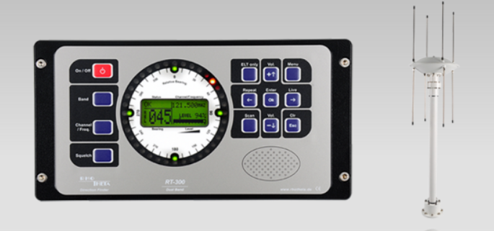
RDF
MBARI assets have an RDF beacon
  Indicates vehicle has surfaced
  Indicates direction
Currently use a handheld sweeper with headphones
Future upgrade planned
  Rho Theta RT-300 (~$7K) may be approved for purchase later this year or early next year
  Supports RS232 serial interface for compass inputs and target output
If external funding is approved, would need a RS232 to USB converter ($25) and custom SW module to interface to it.

Slide 16
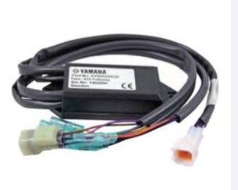
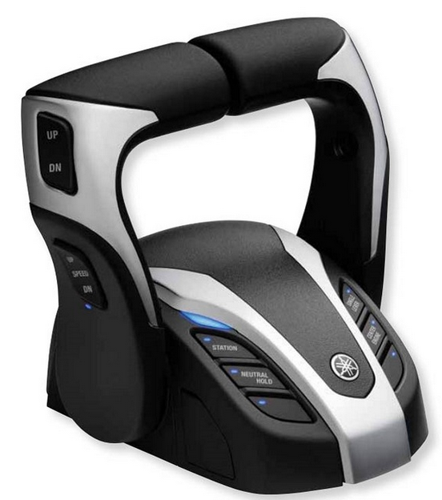
Engines
The current engine uses a proprietary Yamaha bus for throttle/trim but uses hydraulics for steering
  If the upgrade is approved, throttle/trim/steering will use a different proprietary Yamaha bus
  Yamaha technical support does not talk to customers, only dealers; yamaha only sells to dealers
  Our dealer indicated Yamaha was unwilling to provide any information regarding the bus
There is no easy way to gather/inject digital motor information; reverse engineering might be easier for the existing system but will become much harder after the upgrade.
Motor data and control may be possible using analog
  Caveat: Yamaha does not publish manuals or technical briefs, information has been scraped from forums and illegally reposted material on the web; official manuals would reduce project risk
  Option 1 – Gauge output - Yamaha Analog Gauge Interface is an add on module which interfaces Yamaha’s Command Link Plus bus to analog gauges (~$300). It may
    Be discontinued but is still stocked at various online dealers.
    Provide RPM and trim via an analog voltage
    Need 2 modules (one for each engine)
    Connect to a multiport hub on both the existing and new engines (additional hub ~$300)
  Option 2 – Binnacle input - the Yamaha helmmaster binnacle (~1k) contains a lever position sensor. It may
    Accept analog voltages
    Have plastic seams where a small 30+ gauge wire will fit
    Be easily dis/re assembled
    Connect to a multiport hub or the primary binnacle via one or two cable harnesses
  For either option, an ethernet/USB to analog converter will be required ($500 – $3K)

Slide 17
Storage/Networking – Data Budget
Preliminary Data Budget | Data | mbps
Device | Average | Peak
Radar | 120 | 688
Lidar | 200 | 400
Cam array 1 | 20 | 20
Cam array 2 | 20 | 20
Cam array 3 | 20 | 20
Cam array 4 | 20 | 20
Cam array 5 | 20 | 20
AHRS | 1 | 1
AIS | 1 | 1
Wind sensor | negligible | negligible
RDF | negligible | 0.01
Engine | 0.5 | 0.5
UI capture | negligible | negligible
Preliminary data budget predicts a peak data rate of 1 - 2Gbps
Lidar and radar will not typically both be operating at peak rates
  MBARI experience with the radar data indicates it can be significantly compressed
  Lidar data is also expected to contain large amounts of easily compressible data
  Lidar resolution can be dynamically configured to produce less data on demand; operation at sea will likely use this mode reducing data rates most of time to <100mbps
Camera rates assume some minimal compression of 2 camera streams in each array
  Cards inside each array are capable of realtime h.264 or h.265 encoding likely resulting in <5mbps/stream
  Calculated depth map/categorized data and confidence intervals may also be saved increasing streaming data by <1 mbps.
AHRS data assumes operation at the fastest rate possible
AIS data assumes only local traffic within ~10miles will be retained
RDF data assumes the feed will only be retained when the target is nearby
Engine data is likely to update at a few hz and be negligible, rate assumes significant over sampling which could be decimated before storage
Data rates make worst case assumptions and represent skylined values

Slide 18
Storage/Networking Architecture
Cam array 1
Cam array 2
Cam array 3
Cam array 4
Cam array 5
x5
Networking components will be chosen to accommodate peak rates (>2GbE)
  1GbE PoE switch (~$1K) will interface cameras to a higher bandwidth, managed switch ($1K)
  USB hub will interface slow sensors and keyboard/mouse to the computer
Storage will be sized to accommodate at least 1 day of peak rates and a few days of expected rates
Single board computers often natively support the m.2 m key form factor which supports up to 8TB of solid state storage
  Average price is ~$1k for 8TB
  Negligible power and size impact
  An 8 hour day at peak rates for the entire day would be ~ 4.3TB
Additional space via external storage possible but
  Should be connected via USB 3.x to support data rates
  Significantly increases either cost or power/space
    90TB – 100 TB spinning array is $3-6k and increases power consumption by 250 – 600W
    90 – 100 TB solid state array is $9-20K
Paragon has an under utilized ~7in (garmin) display which accepts an HDMI input and could be used for display
PoE Switch
radar
lidar
Managed Switch
WIFI/Modem
Existing radar
Garmin
Garmin display
SSD
HDMI
Analog IO
Computer
AHRS
USB Hub
UI
AIS
Wind

Slide 19
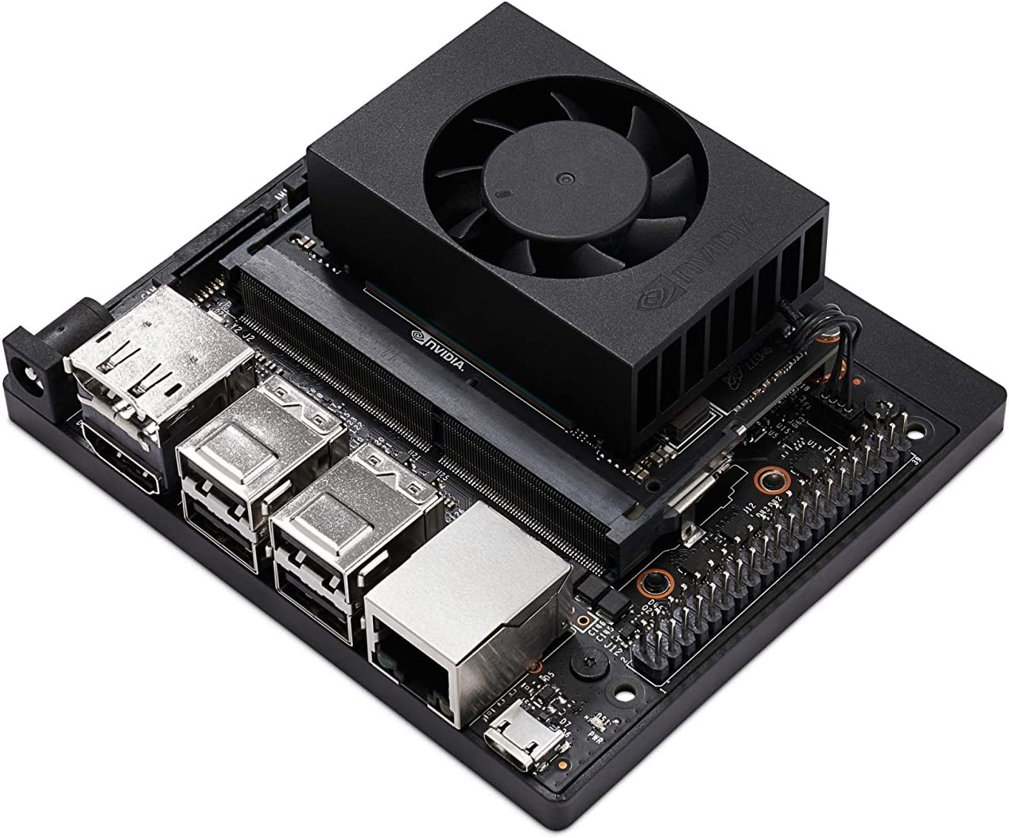
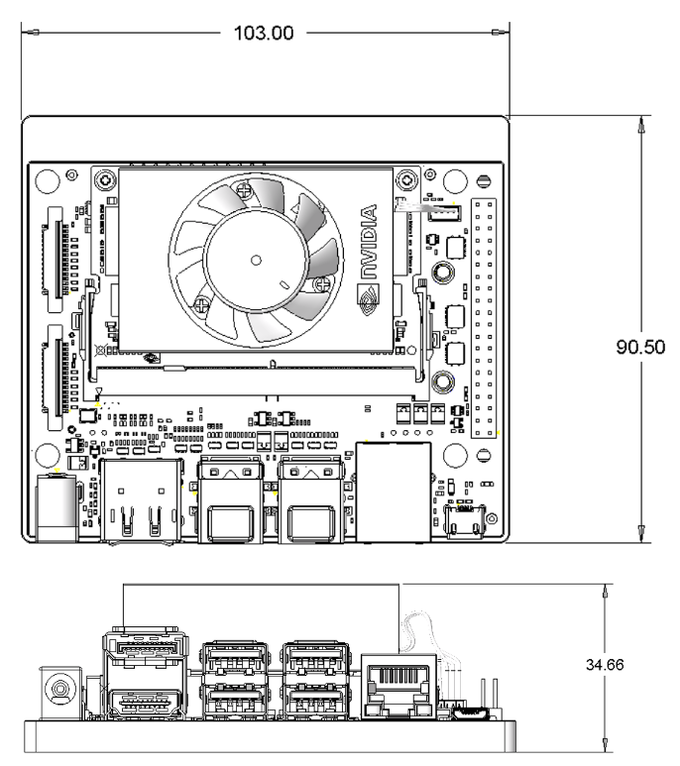
Processor
Selection criteria
  Support data rates
  Support linux
  Capable of at least lightly conditioning data for storage
    Zip files
    Data framing/time synchronization
  Synthesize/interpret data to control sensors
    Synthesize depth maps between camera arrays to create larger baselines
    Custom filters
    Enable lidar if targets are possibly in range
    Discard boring data
  Nice to have
    Run autopilot/navigation
    Display output
      Map/chart overlay
      Real time data visualization
COMPAS already owns an unused NVIDIA AGX Orin which should meet requirements
  AGX Orin is the most powerful NVIDIA computing module currently sold
  200 TOPS
  2.2GHz A78AE, 8 cores
  32GB of DDR5

Slide 20
Power
 | Power | W
Device | Average | Peak
Radar | * | *
Lidar | 20 | 30
Cam array 1 | 2 | 6
Cam array 2 | 2 | 6
Cam array 3 | 2 | 6
Cam array 4 | 2 | 6
Cam array 5 | 2 | 6
AHRS | 1.5 | 2.5
AIS | 1 | 1
Wind sensor | 1 | 2
RDF | * | *
Engine | 2 | 2
UI capture | 1 | 2
modem (starlink) | 70 | 140
SBC | 20 | 60
display (Garmin GPSMAP 7608xsv) | * | *
PoE Switch | 20 | 30
Managed switch | 15 | 20
*part of baseline
Sensor and computing power consumption will be <150W + starlink
PoE efficiency is low so total system power <350W
New motors will produce >2.5kW at peak RPM so the existing batteries can be fully charged during each mission; dock charging/maintenance should not be needed
The existing system will be designed to directly run off the existing 12V bus; power conditioning and isolation will be used (such as vicor power modules, $1k) to condition the bus
Power requirements are small enough no additional rigging is likely required; existing cabin panels can be utilized
1-3 additional DC/DC converters will be required (~$25/each)

Slide 21
Space
Power, computing, networking and storage are projected to consume less than 4 cubic ft and should fit inside.
Most sensors may be mounted on the mast or roof
Additional cable ports will likely be required

Slide 22
Cost
Device | minimum | projected
Radar | 0 | 0
Lidar | 0 | RFQ pending
Cam array 1 | 400 | 800
Cam array 2 | 400 | 800
Cam array 3 | 400 | 800
Cam array 4 | 400 | 800
Cam array 5 | 400 | 800
AHRS | 3500 | 3500
AIS | 0 | 500
Wind sensor | 1100 | 1400
RDF | 25 | 25
Engine | 500 | 3000
UI capture | 100 | 100
datalink | 0 | 8000
Computer | 0 | 0
misc (hub, cables, enclosures…) | 500 | 3000
power conditioning | 500 | 1000
switches | 1500 | 2000
Projected total cost is ~$30k
Datalink costs assume an MBARI owned starlink system is rented by the lab for the first 2mths for integration and then the system is transferred to cheaper data plans for the remainder of the project
Engine data monitoring costs are not well understood; online prices for the same Yamaha equipment from US suppliers vary by 2-5x.

Slide 23
Backup
Partial Yamaha Command Link Plus service manual 6Y9-28197-1N-11
  https://www.calameo.com/read/005385266a0602c76810c

Slide 24
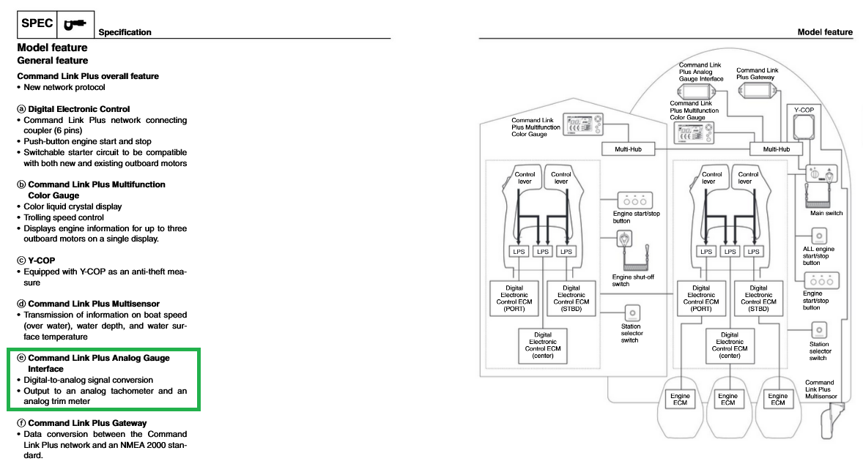
Back up

Slide 25
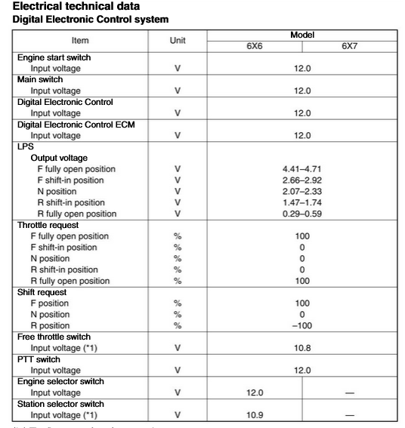
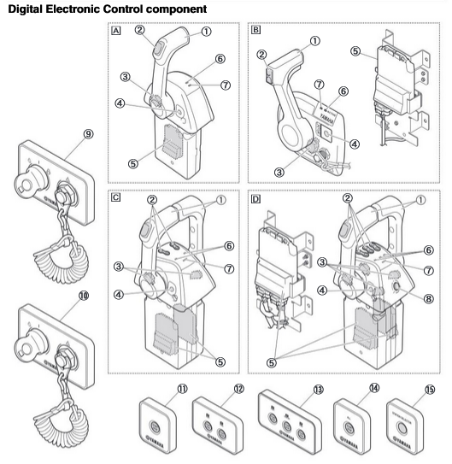
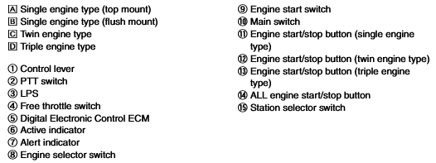
Back up
LPS may stand for Lever Position Sensor

Slide 26
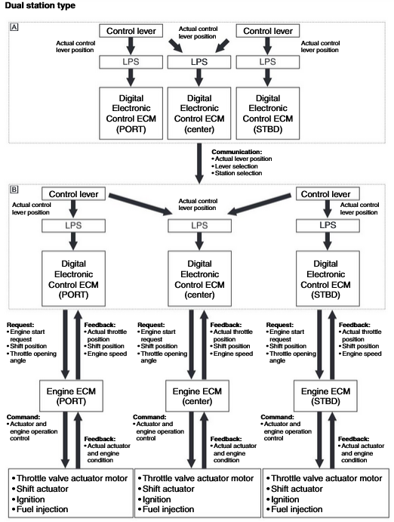

Back up
2nd station topology of Command Link Plus
Note depicts a 3 engine vs 2 setup

