Slide 1
R/V Paragon Status Report
Jared Figurski
09 Feb 2017

Slide 2
Overview
Usage Summary
Hydraulics Summary
CTD Winch Summary
CTD Hydraulic Winch
Transducer Pole
Paragon Plans
2017 Projects

Slide 3
2016 Usage
  LRAUV
  AUV
  M1
  Waveglider
  BEDS
  AMT
  ESP
  Glider
  swFOCE
  CPF
  PowerBuoy
171 Trips, 207 Activities

Slide 4
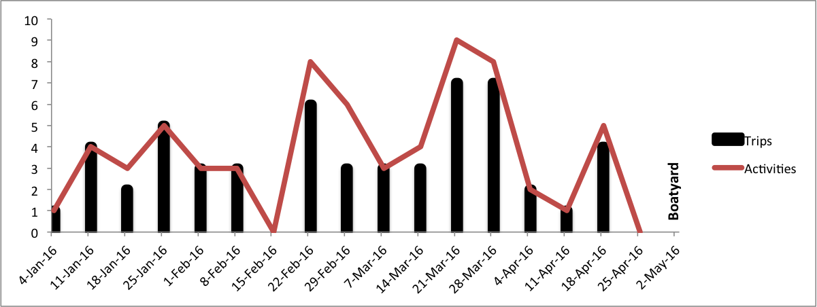
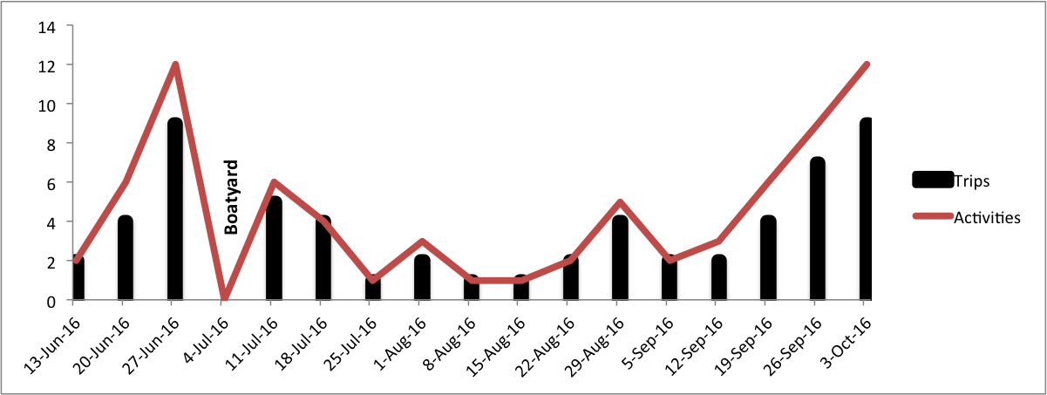
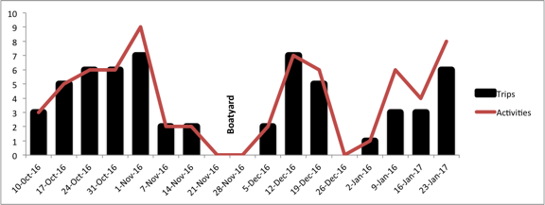
Paragon Activity 2016
171 Trips
207 Operations
Projects:
  LRAUV
  AUV
  M1
  Waveglider
  BEDS
  AMT
  ESP
  Glider
  swFOCE
  CPF
  PowerBuoy
3 Haul-outs
Timed to vacations and Engine Maintenance

Slide 5
Benchmarks
Operator training for 6 MBARI staff
  Jones, Plant, Chaffey, Conlin, Zicharelli, Marin
New operators: Jones, Marin
Operator In training: Conlin, Plant
UCSC support (SMURF, Kelp Forest Monitoring, Cage Experiment Removal)
DOEST
MOTC Instructor training course
Rescues: Dorado, Power buoy, AMT (?)

Slide 6
Improvements
Repaired and resurfaced all hatch covers
Repaired deck and resurfaced entire boat
Repainted bottom paint
Installed new transducer (keel- traditional)
Installed pair of side-vu transducers
Additional Garmin combo display
Replaced 2 bilge pumps
NMEA output cable
CO monitor
Install bulkhead pads for winch mount
Additional 3000W inverter
12V DC outlet
Fumigation

Slide 7
Annual Maintenance
Safety Gear Inspection/ Replacement
  Lights, PFDs, EPIRB, First Aid, AED, Flares, Survival Suits, Batteries, etc.
Engine Maintenance – Semiannual (200 hours)
Honda Engine Maintenance
Cleaning
Regular repairs

Slide 8
2017 Projects
All big projects are done
Directional VHF Finder / Mast Repairs
Towing setup
Gunwale roller setup
Storage shed
……

Slide 9
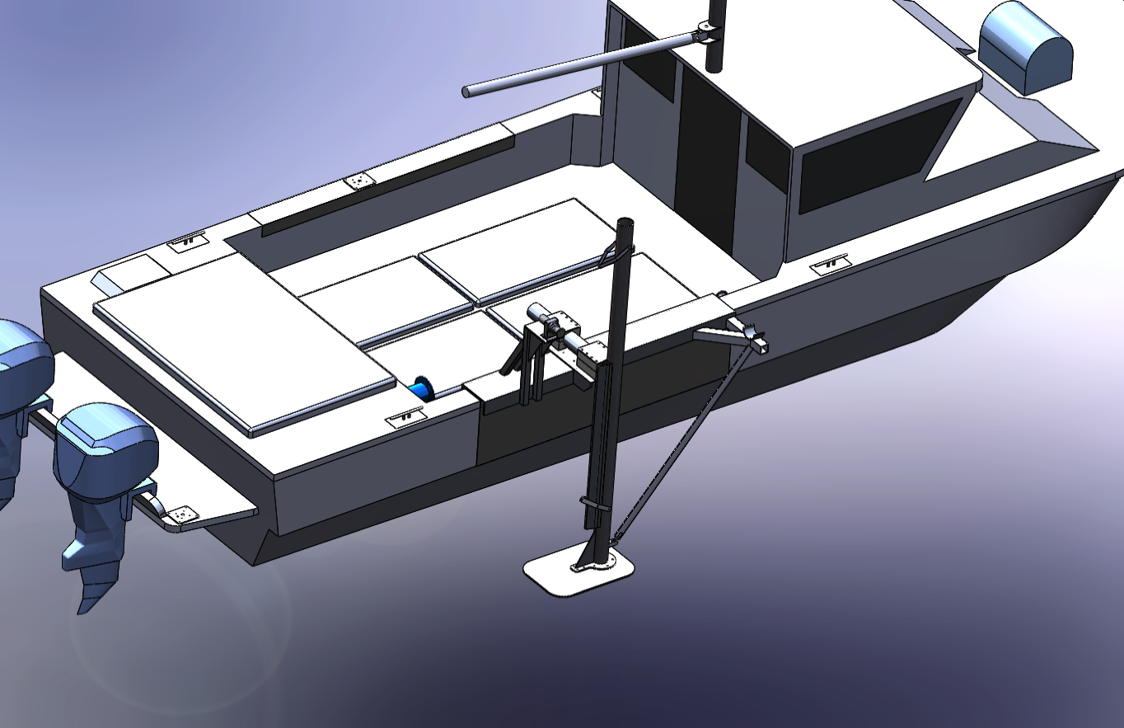
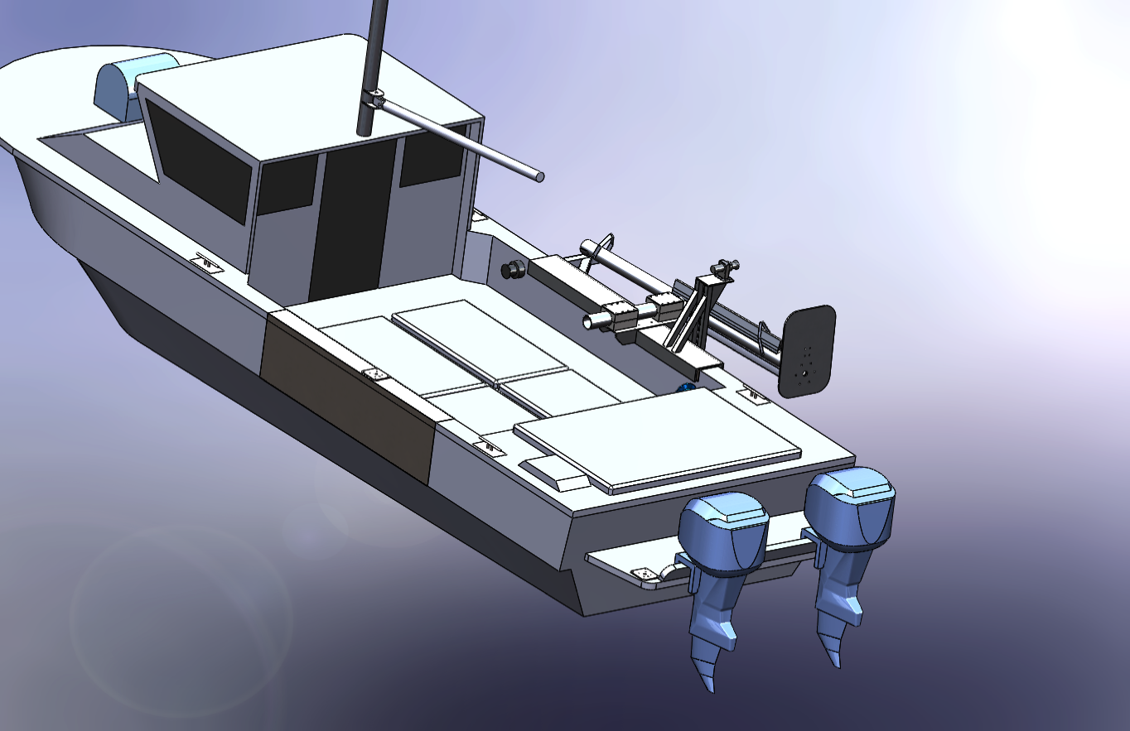
Transducer Pole for KBB

Slide 10
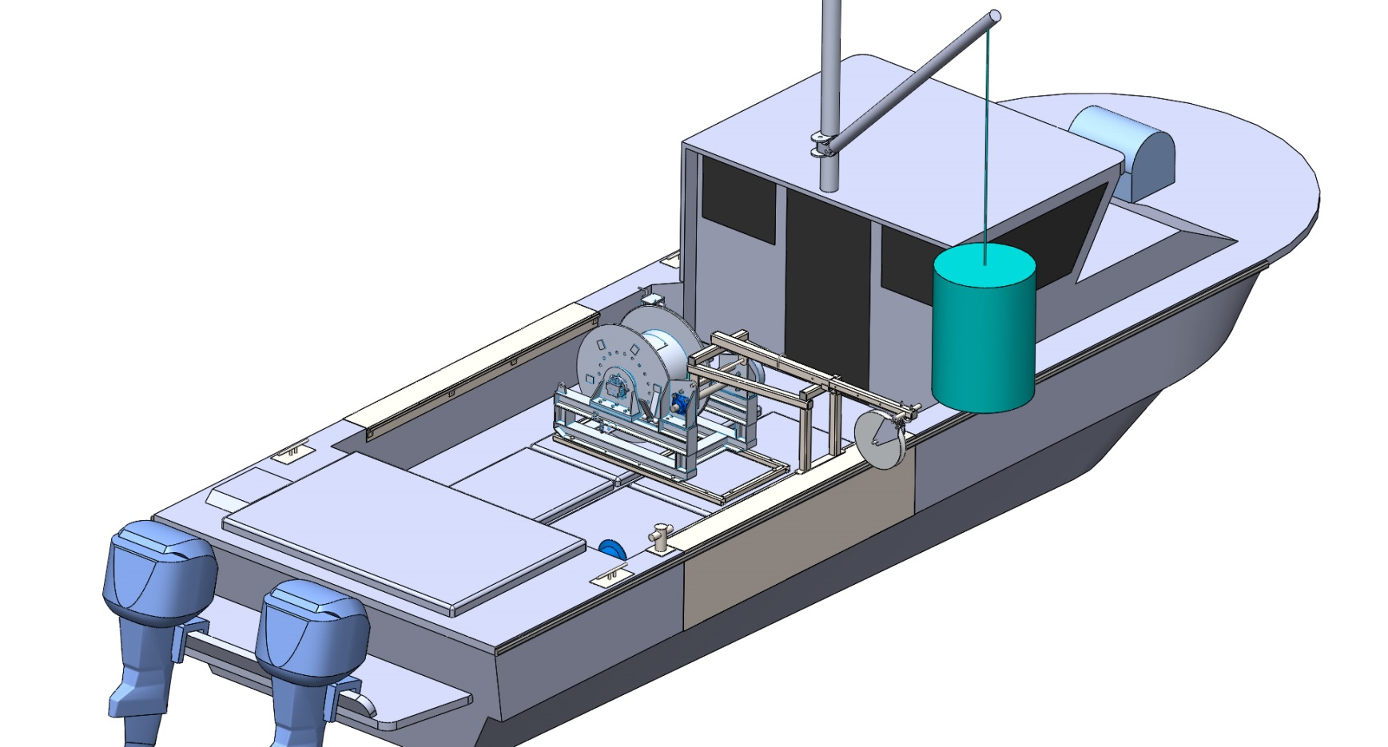
Hydraulic CTD overview
The CTD and Carousel will be stored on the deck, behind the boat driver seat
They will be deployed using the Paragon’s boom (500 lb load rating).
After being lowered in the water, the load will be transferred to the CTD boom and released with a quick release shackle

Slide 11
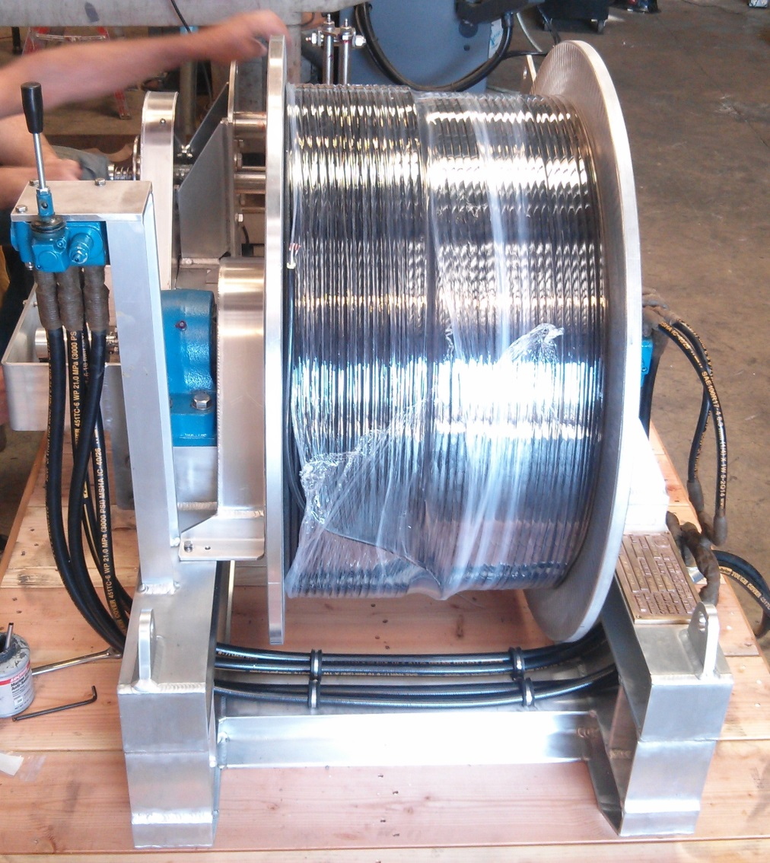
The winch
780 lb, including cable
Aluminum frame
Level winder
1000m long, 3/8” cable
Cable weight: 223lb in air, 42lb in water.
Break strength 2400 lb
Speed 45-70 m/min
Load cap.: 470 lb bare drum, 300 lb full drum
6 gpm @1500 PSI

Slide 13
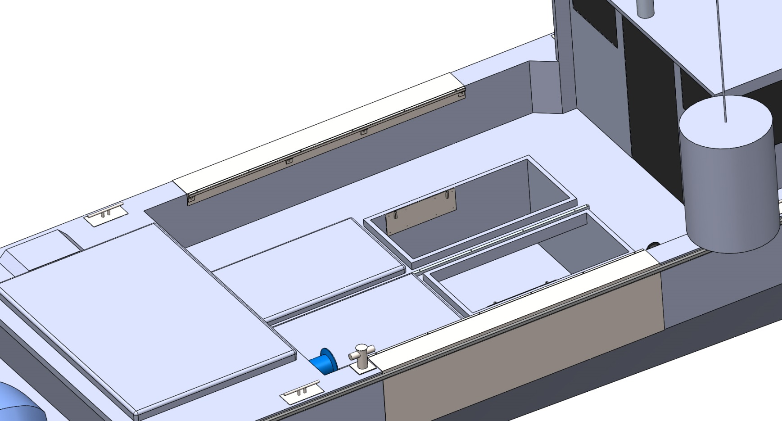
Suggested attachment design
-Two stainless steel plates are bolted to the bulkheads inside the hold
- 2” long coupling nuts are welded to the plates

Slide 14
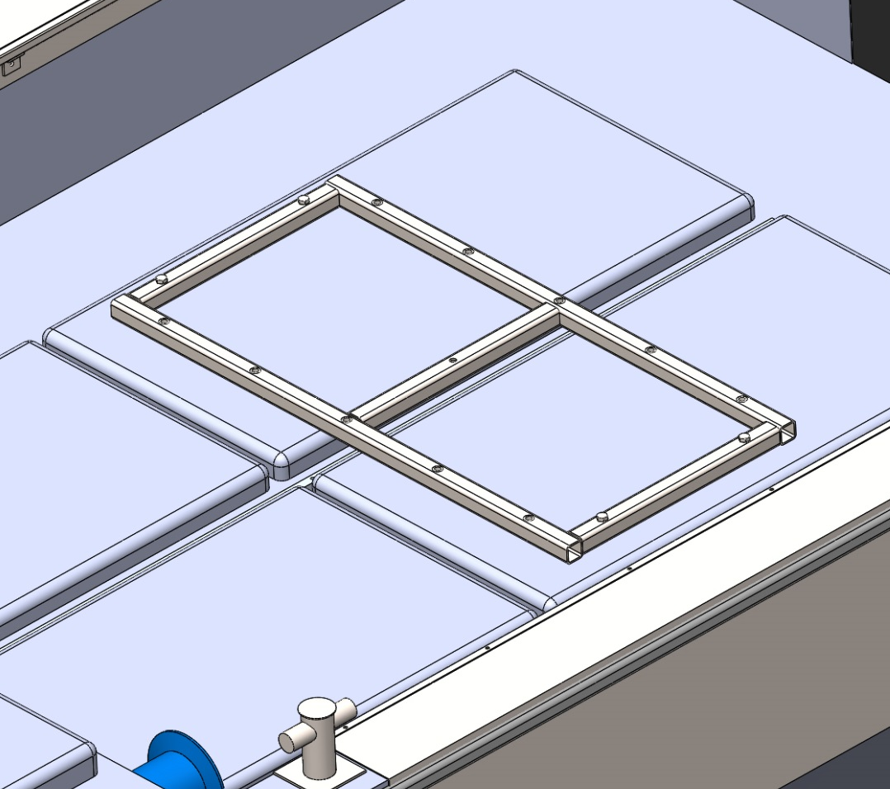
Suggested attachment design
Stainless steel frame is bolted on top of the hold covers.
4 holes in hold covers allows frame to be bolted. Can be bolted to LARS bar also.
Frame material: 2”x2”x3/16” SS
10 threaded holes welded to frame.
Weight: 74lb

Slide 15
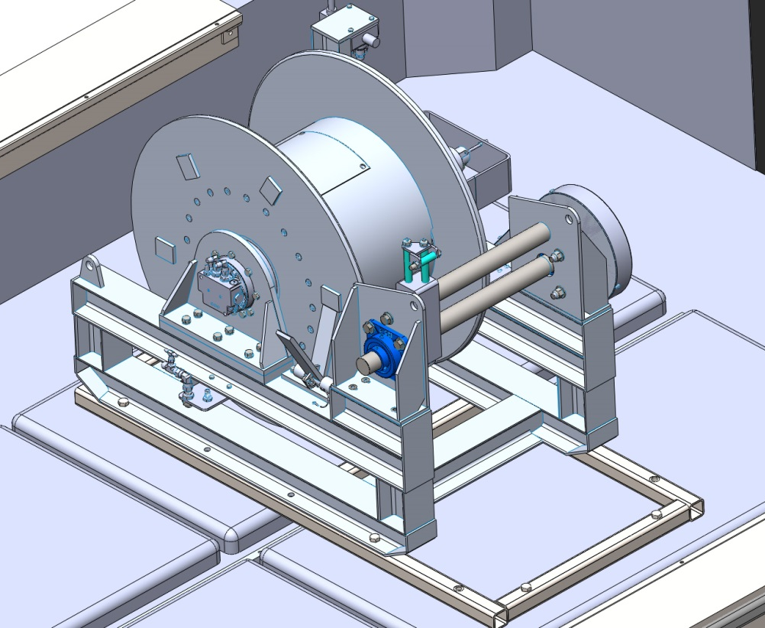
Suggested attachment design
Winch is lowered with dock davit and bolted to frame using 4 5/8” bolts.
Winch can be oriented to port or starboard, depending on operators need.

Slide 16
CTD Boom Specifications
Deploy CTD or SBE 32 Carousel
  300 lb in air when full
  28” diameter x 38” tall
300 lb working load rating
5 to 1 safety factor for vertical pull and up to 45º from vertical pull.

Slide 17
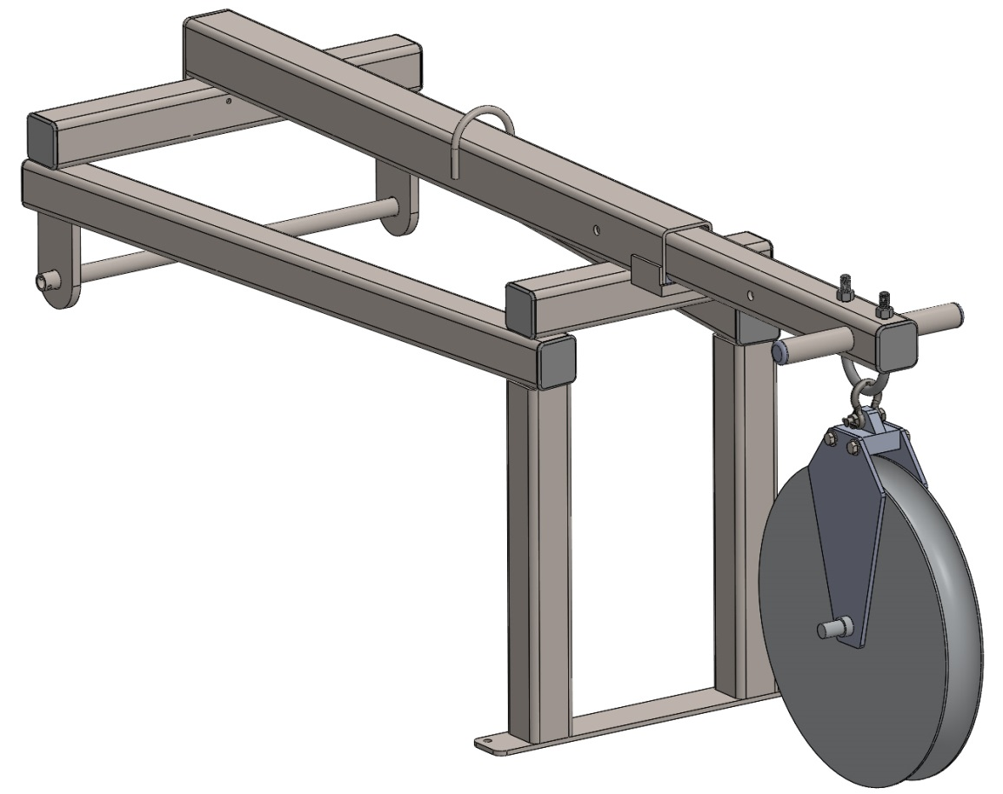
CTD boom features
316 Stainless steel tubing:
  2x2x3/16” for support frame
  2.5x2.5x1/4” inner boom
  3x3x3/16” for outer boom
UHMW bearings for telescoping boom
Handles for actuation
Recommended wire layout respected
4 locations for pin on the boom (0” to 24”)
Tie down for block to prevent motion during transit (TBD)

Slide 18
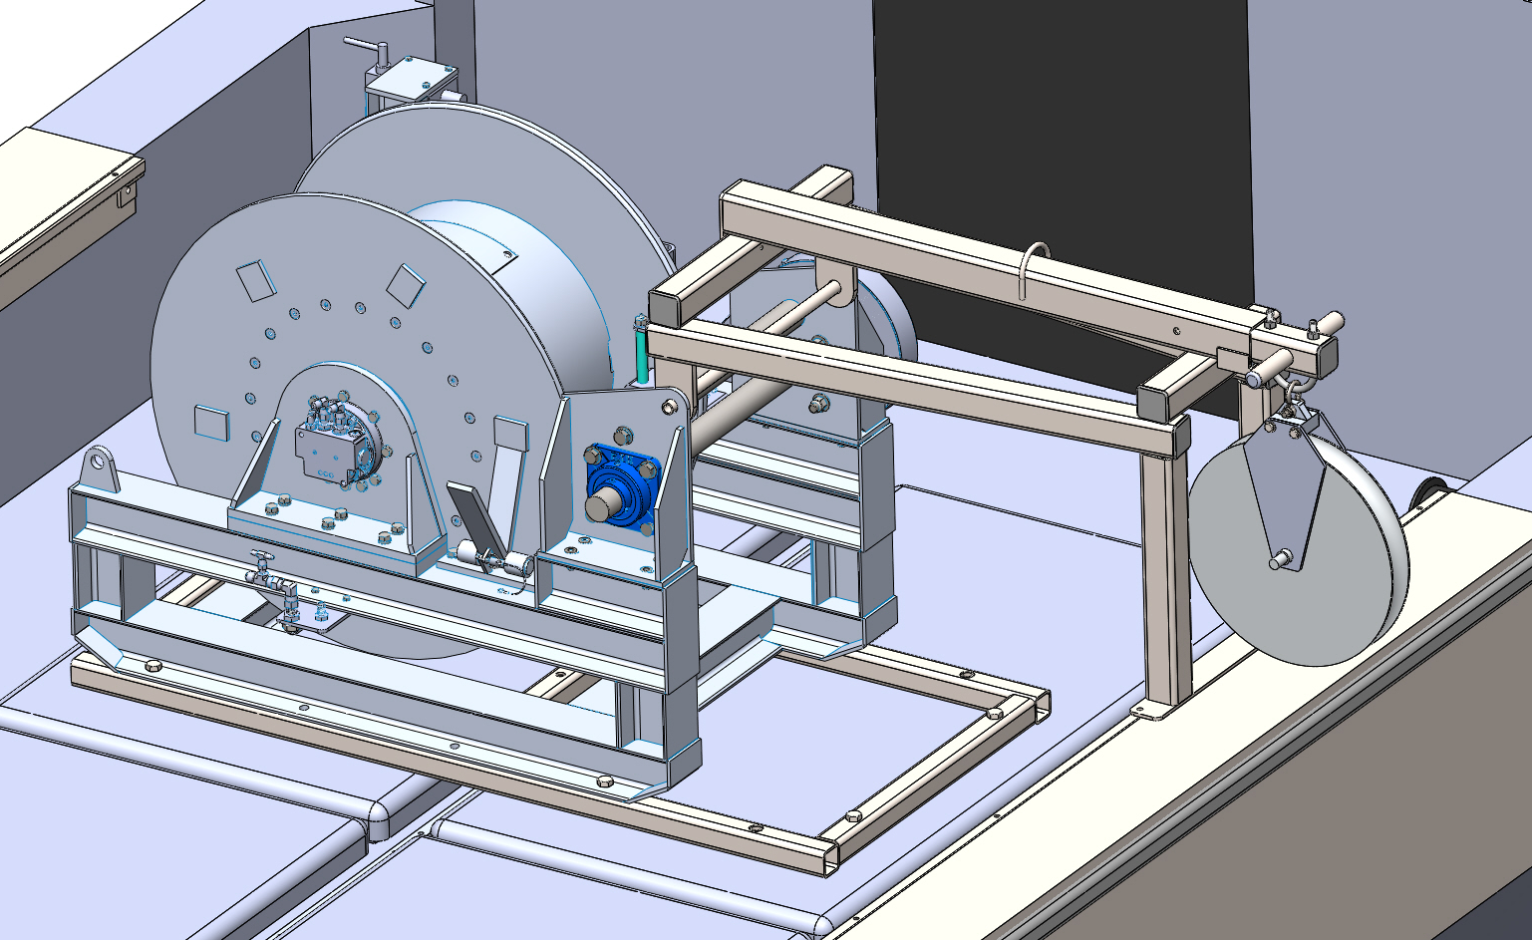
Winch/ Boom Combination
Hydraulic whips
Deck Box cable

Slide 19
Hydraulic System
Boom Capstan
Anchor Winch
CTD winch bulkhead
Aft Capstan

Slide 20
Schematic
Motor/Pump
Rear Capstan
Reservoir
CTD winch bulkhead
Boom Capstan
Anchor Winch
Scott Harlan, P.E. Mechanical Engineer Consultant

Slide 21
Hydraulics Specifications
  Motor (Honda GX390) w/ Electric Start
  11 hp Four Stroke
  Onboard Fuel and plumbing option
Pressure Compensated Pump
  8 GPM @ 1500 PSI (spec’ed for winch)
Reservoir – 20 Gal custom design
Plumbing – 3000 PSI (pressure ½”,return 5/8”)
    No drip QR fittings for CTD winch
    Hardlines inside cabin

Slide 22
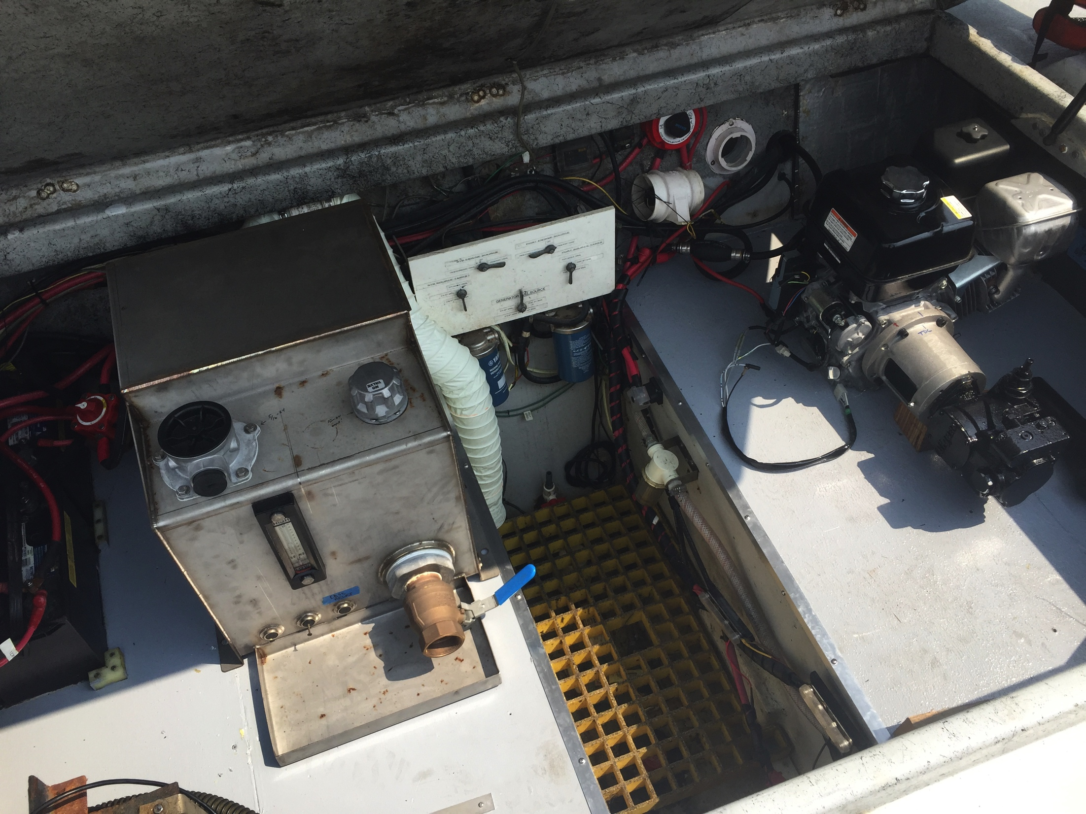
Hydraulics Status

Slide 23
Hydraulics Status
Valves and pump painted
Old System Removed
Aft compartment cleaned and resurfaced
Motor, Filter and Manifold mounted to base plate
Pump mount machined to change orientation
Reservoir is built
Plan for install
Iterative ordering of connectors and parts
Custom motor exhaust fitting

Slide 24
Hydraulics Plan
Installation- September 8 & 12-15 reserved
  Install
    Pump
    Reservoir
    Manifold
    Filter
    Valves
    Bulkhead Fittings
  Plumb
    Soft Lines
    Hard Lines

Slide 25
Towing Setup
Regular AUV tow outs
Mooring recoveries
Vessel towing
Easily Removable
Lightweight
Strong

Slide 26
Towing Setup
Larry has drawn a plan but doesn’t have time to follow up
Sanctuary Stainless booked through October
Francois on paternity leave

Slide 27
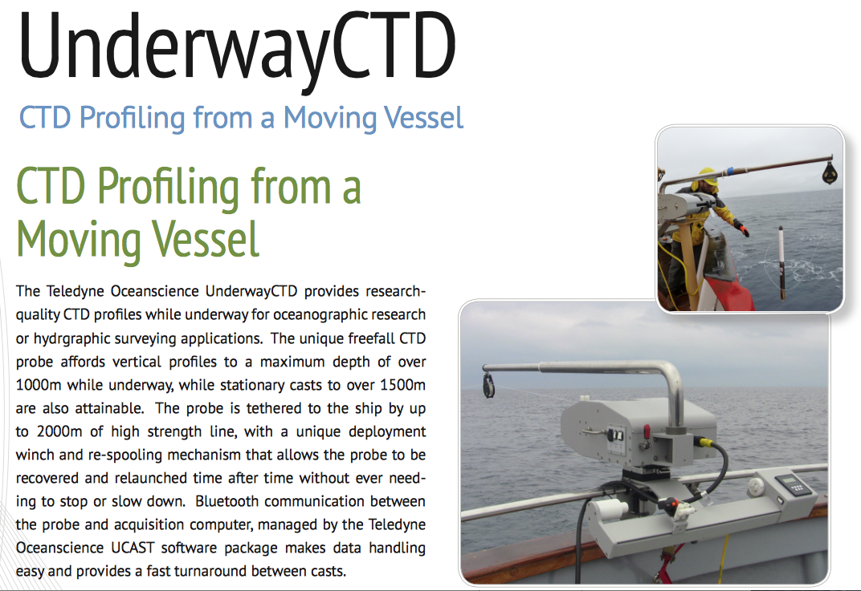

Slide 28
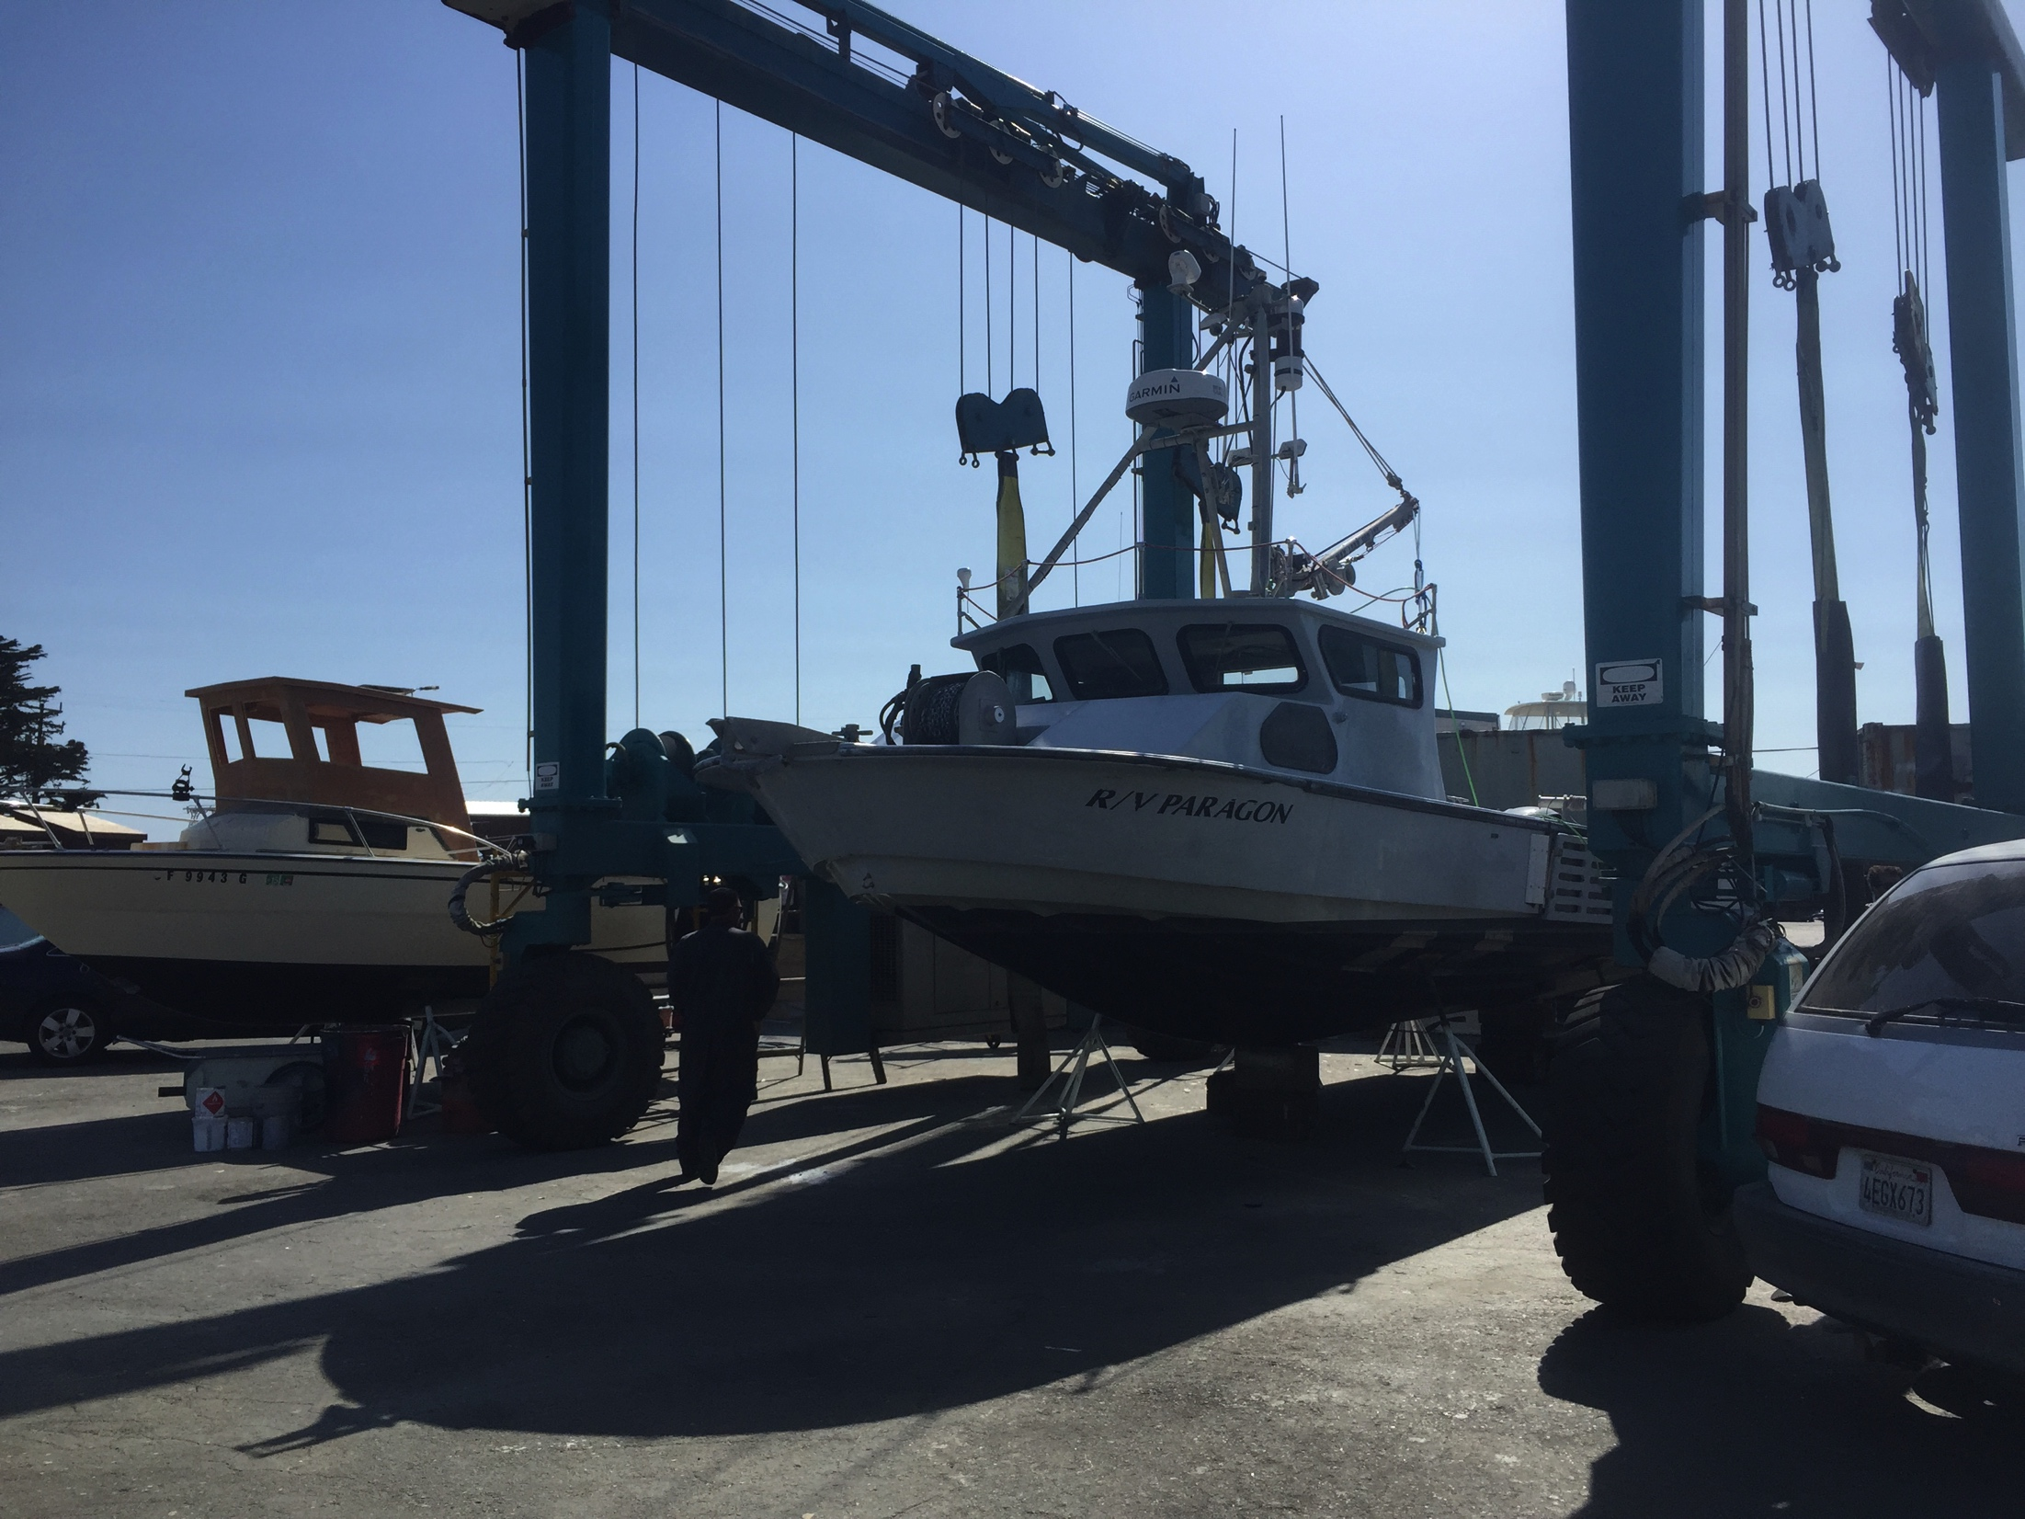
Plans
V-berth redesign and cushions
Roof storage
Replace wiper motors
Clothes hooks
Logo and striping
Wiring cleanup
Fuel tank inspections
Directional VHF – AUV group spec
Mast repairs and Antennae Installation
Transducer pole modifications
Aft Capstan Roller design
Repair Anchor winch bearings
Freshwater Pump/ heater
Paragon Container
Dock Box for Survival Suits
Open ROV

Slide 29
END

Slide 30
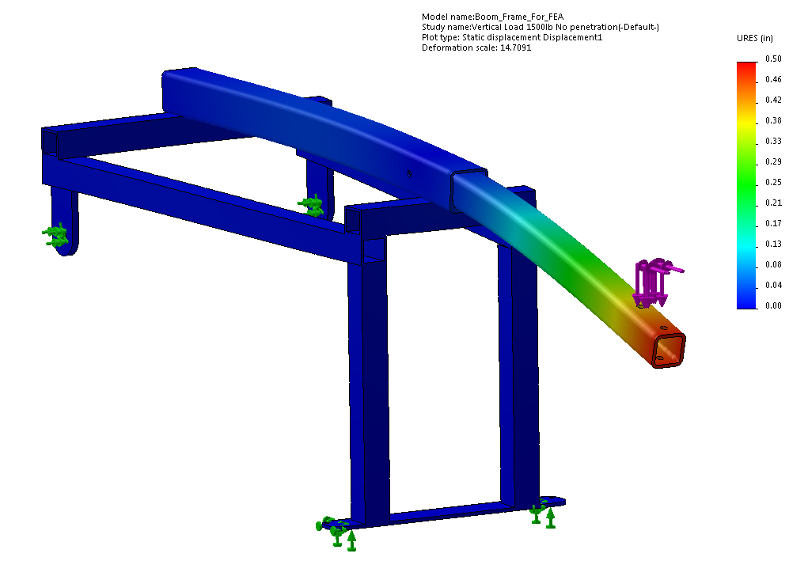
FEA : displacement
Max displacement = 0.5”

Slide 31
Structural analysis
FEA and calculations were performed for 1500lb (FEA results and calculations provided).
Vertical pull:
  Maximum stress in inner tube = 29400 PSI
  Maximum stress in outer tube 22600 PSI.
45º pull:
  Maximum stress in inner tube = 36800 PSI (too high?)
  Maximum stress in outer tube= 29600 PSI.
Wall thickness can be increase for inner tube. Max design load can be reduced for 45º pull. YS must be determined more accurately.
Stresses in the rest of the frame are below 20000 PSI. Bearings and attachment will be designed with same factor of safety.

Slide 32
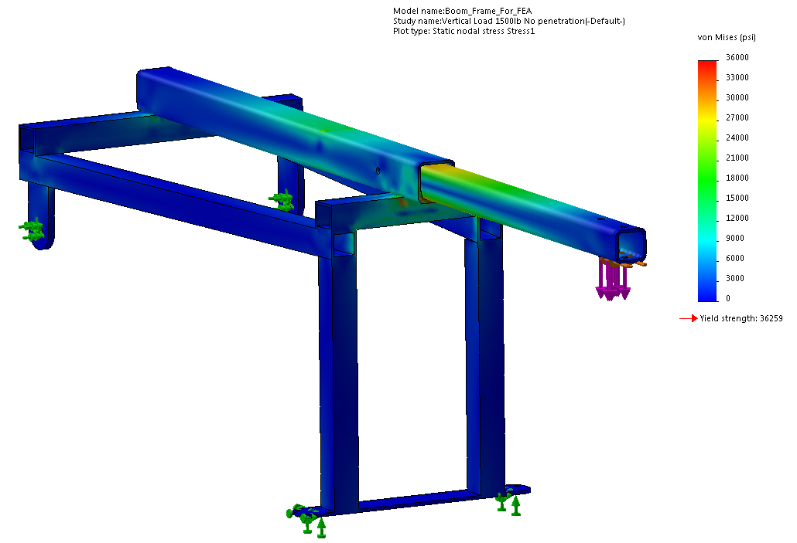
FEA : Stress
Max stress in inner boom = 29400PSI

Slide 33
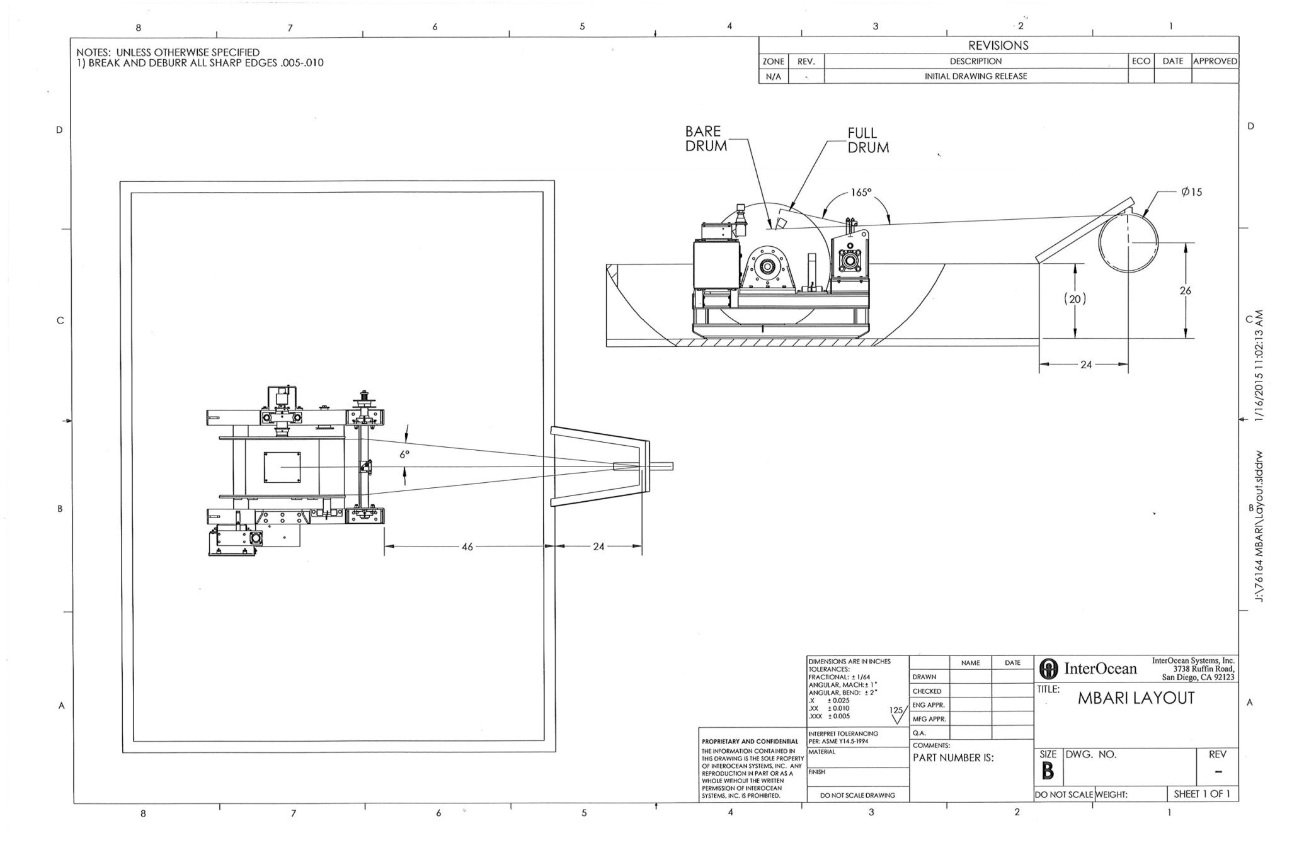

Slide 34
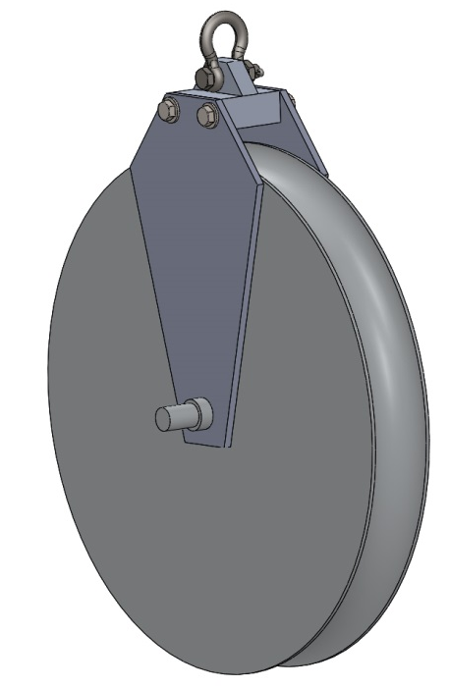
Block for CTD wire
Required minimum diameter: 15”
MBARI owns a sheave that we can used
Cheeks and attachment can be manufactured easily
3/8” shackle
Opening large enough for wire termination

Slide 35
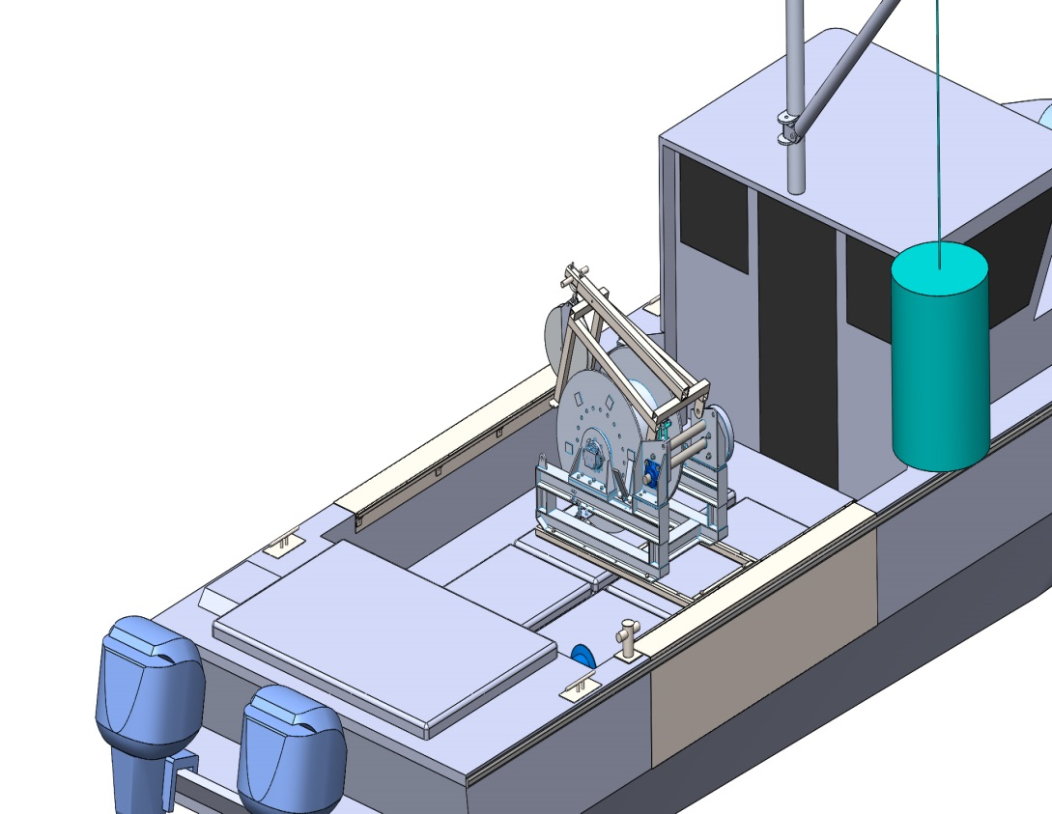
CTD boom features
If space is needed on the deck, the boom can be rotated and stored on top of the winch.

Slide 36
Motor w/out controls
Wrong valve style
Valve not detent
Wrong Connectors
Missing Connectors

