Slide 1
CTD winch on R/V Paragon
Design of attachments and boom
By Francois Cazenave
12/08/2015

Slide 2
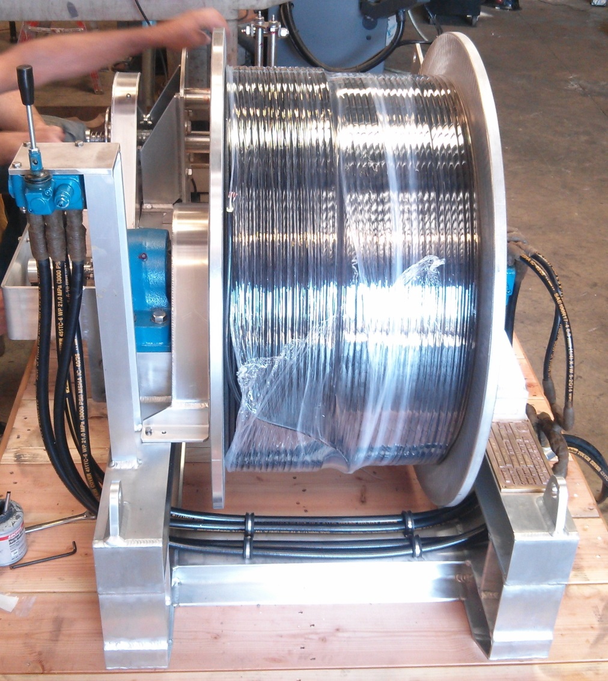
The winch
780 lb, including cable
Aluminum frame
Level winder
1000m long, 3/8” cable
Cable weight: 223lb in air, 42lb in water.
Break strength 2400 lb
Max speed 70m/min
Load cap.: 470 lb bare drum, 300 lb full drum

Slide 3
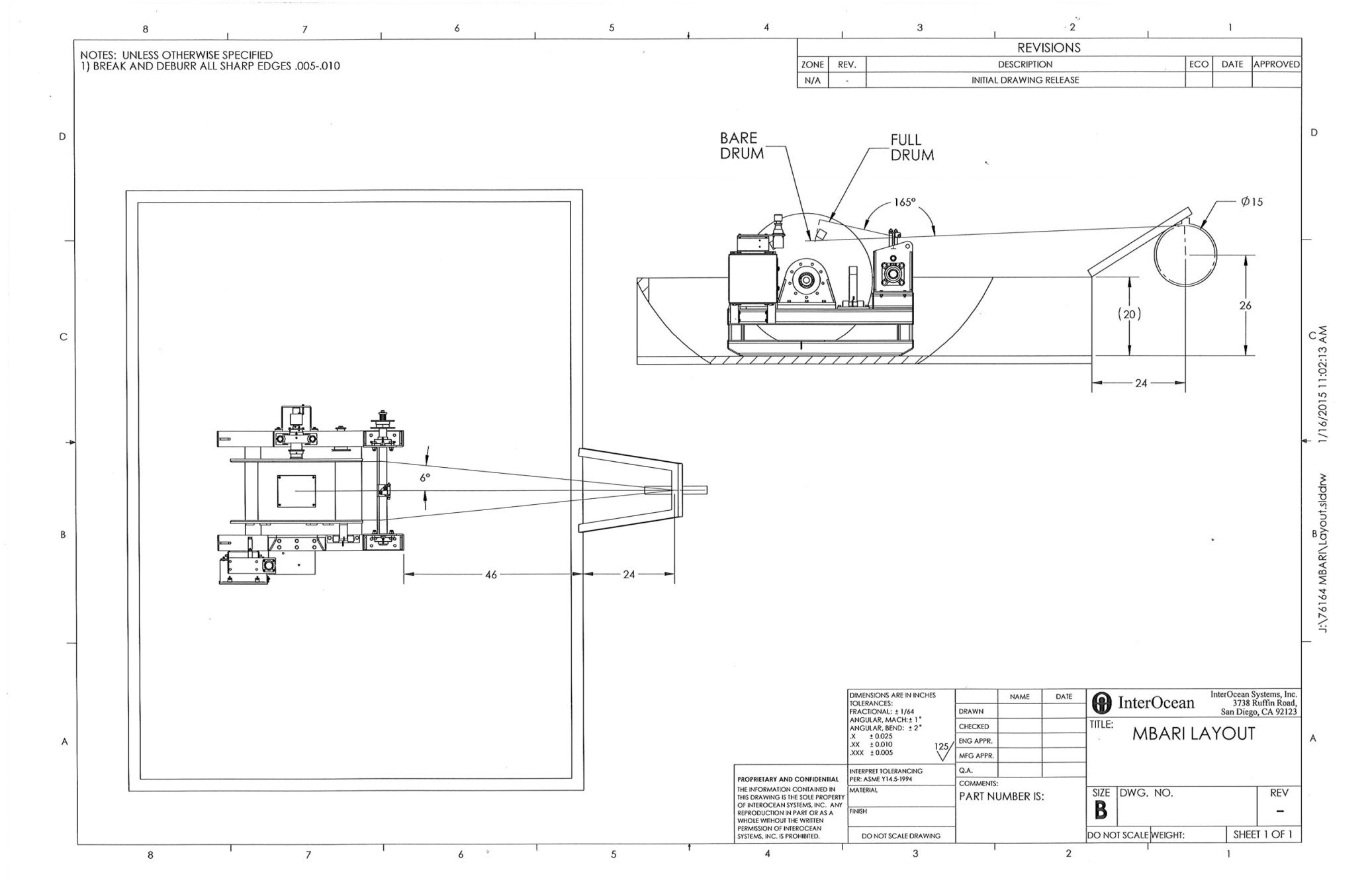

Slide 4
Requirements for winch attachment
The winch must be securely attached to the deck to handle all sea states the Paragon operates in.
The winch can be attached and detached easily by two operators, using 1000 lb rated MBARI dock davit, and basic tools.
Hardware and required tools must be kept to a minimum
Winch must be positioned so the aft hold covers are accessible and so operators can move around it easily

Slide 5
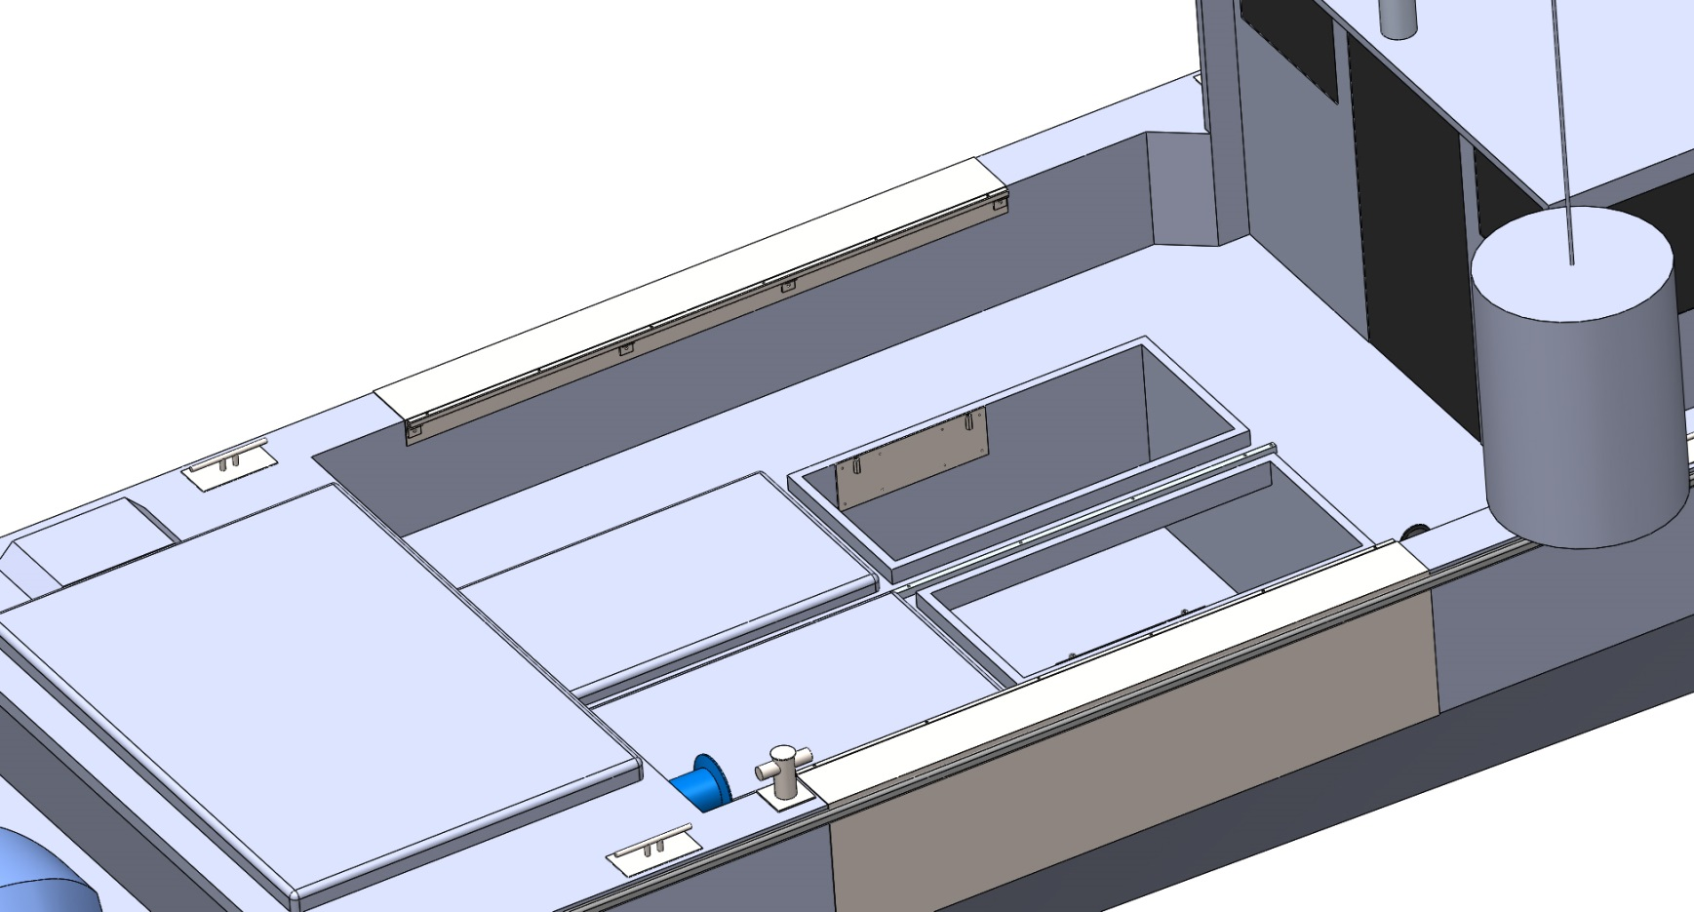
Suggested attachment design
-Two stainless steel plates are bolted to the bulkheads inside the hold
- 2” long coupling nuts are welded to the plates

Slide 6
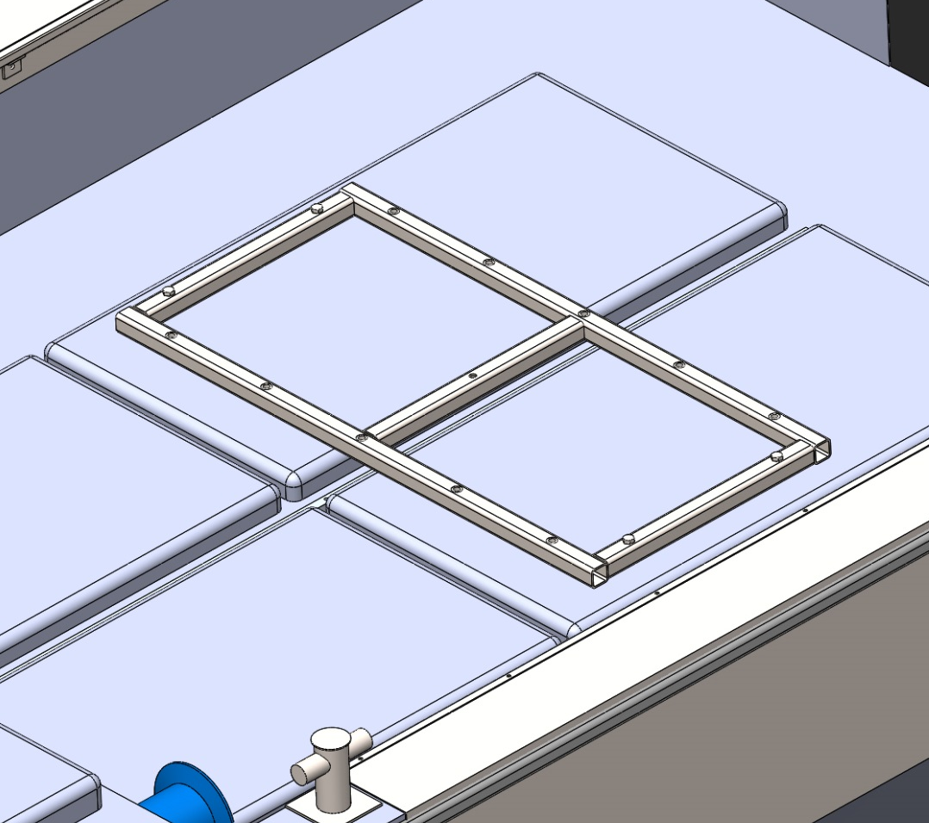
Suggested attachment design
Stainless steel frame is bolted on top of the hold covers.
4 holes in hold covers allows frame to be bolted. Can be bolted to LARS bar also.
Frame material: 2”x2”x3/16” SS
10 threaded holes welded to frame.
Weight: 74lb

Slide 7
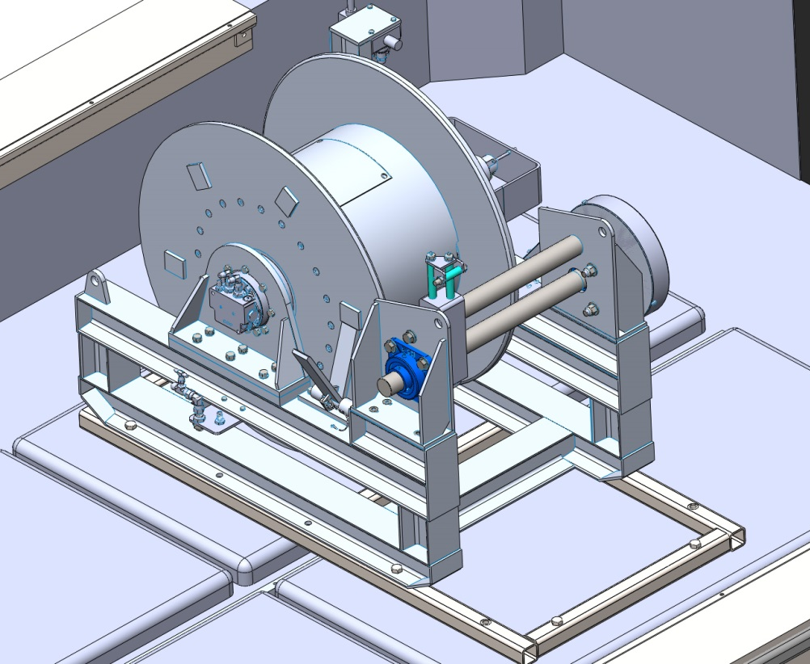
Suggested attachment design
Winch is lowered with dock davit and bolted to frame using 4 5/8” bolts.
Winch can be oriented to port or starboard, depending on operators need.

Slide 8
Requirements for CTD boom
Must enable safe deployment of CTD, or SBE 32 Carousel (300 lb when full of water, 28” diameter, 38” tall) by two operators
300 lb working load rating
5 to 1 safety factor for vertical pull and up to 45º from vertical pull.
Must respect wire layout specified by manufacturer
Must be retractable so it does not stick out past side of boat when not in use.
Must hold wire block at an appropriate distance away from side of boat when in use (20” on axis).

Slide 9
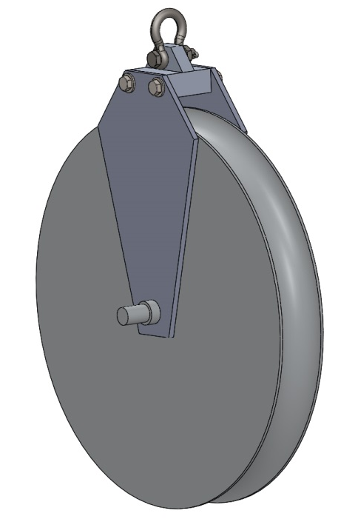
Block for CTD wire
Required minimum diameter: 15”
MBARI owns a sheave that we can used
Cheeks and attachment can be manufactured easily
3/8” shackle
Opening large enough for wire termination

Slide 10
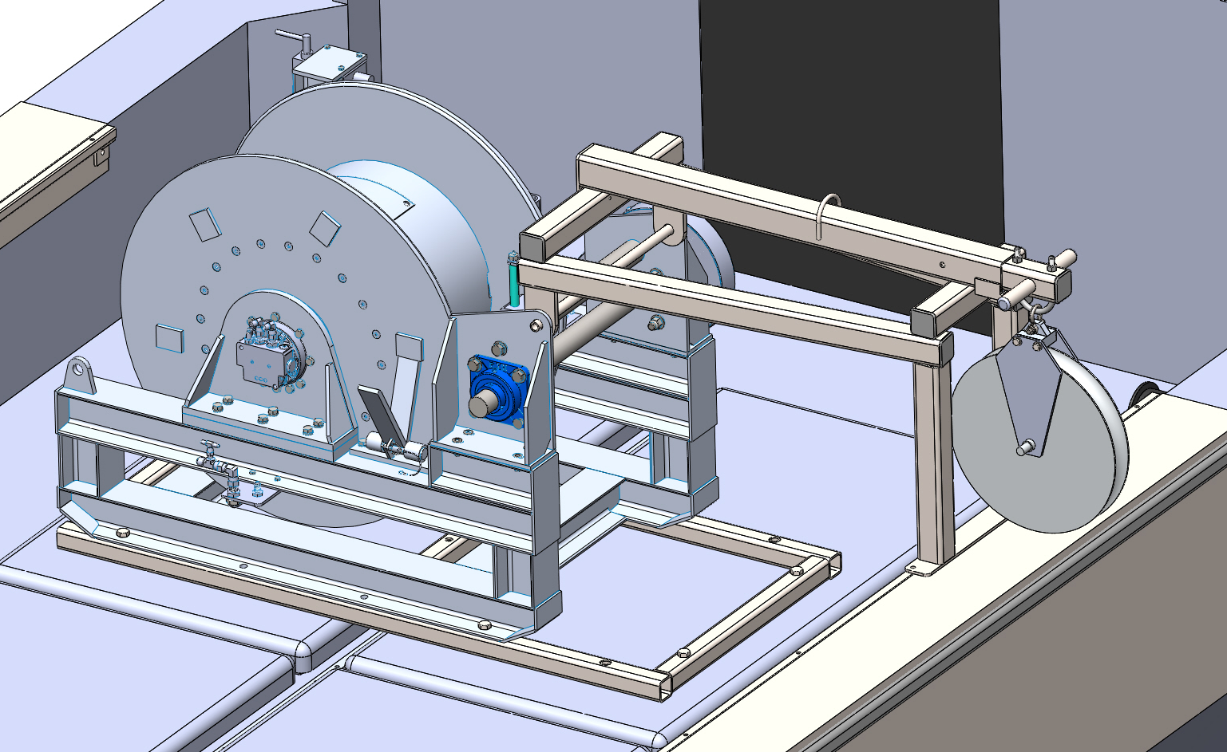
Suggested design for CTD boom
- Boom frame is attached to winch frame using pin
- Boom frame rests on gunwale and it bolted to it
- Shown in retracted position. Actuated by hand after removing pin. Extends 24”

Slide 11
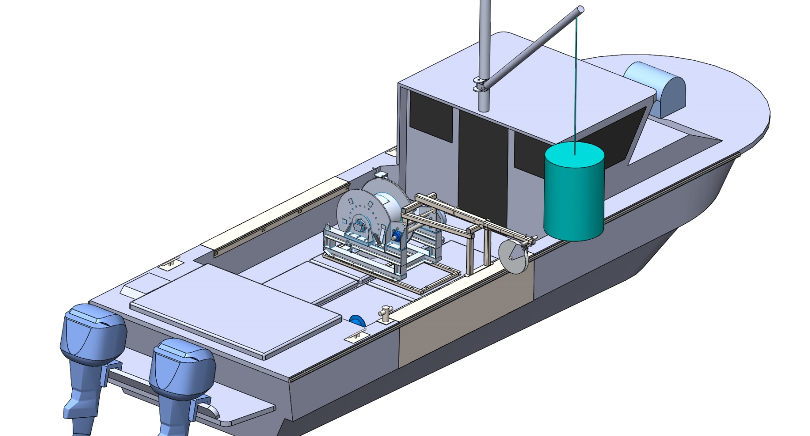
Suggested design for CTD boom
The CTD and Carousel will be stored on the deck, behind the boat driver seat
They will be deployed using the Paragon’s boom (500 lb load rating).
After being lowered in the water, the load will be transferred to the CTD boom and released with a quick release shackle

Slide 12
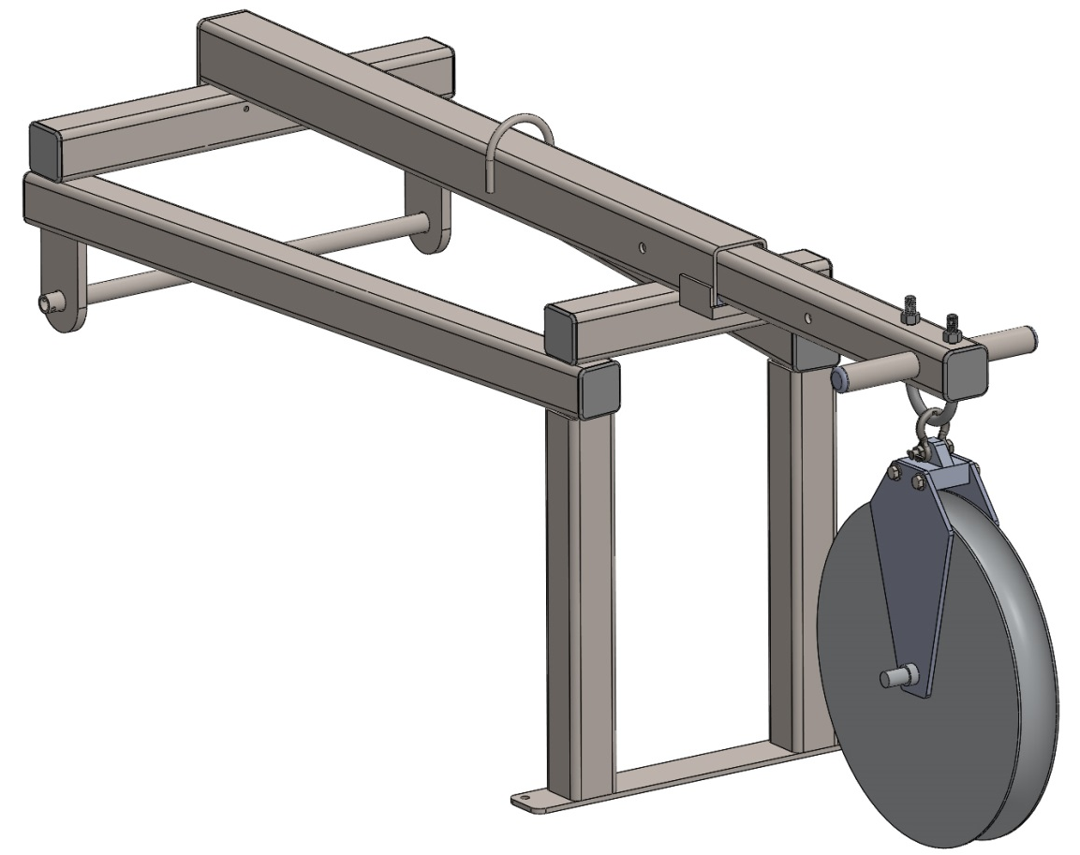
CTD boom features
316 Stainless steel tubing:
  2x2x3/16” for support frame
  2.5x2.5x1/4” inner boom
  3x3x3/16” for outer boom
UHMW bearings for telescoping boom
Handles for actuation
Recommended wire layout respected
4 locations for pin on the boom (0” to 24”)
Tie down for block to prevent motion during transit (TBD)

Slide 13
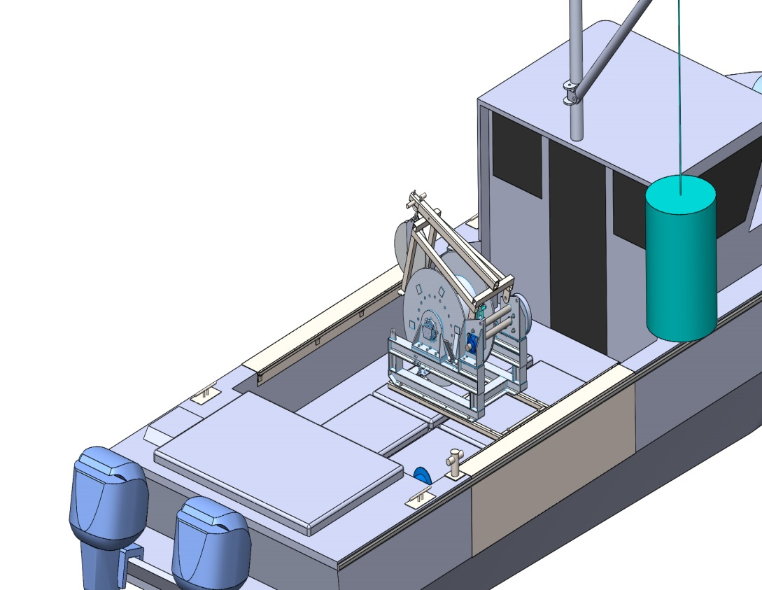
CTD boom features
If space is needed on the deck, the boom can be rotated and stored on top of the winch.

Slide 14
Structural analysis
FEA and calculations were performed for 1500lb (FEA results and calculations provided).
Vertical pull:
  Maximum stress in inner tube = 29400 PSI
  Maximum stress in outer tube 22600 PSI.
45º pull:
  Maximum stress in inner tube = 36800 PSI (too high?)
  Maximum stress in outer tube= 29600 PSI.
Wall thickness can be increase for inner tube. Max design load can be reduced for 45º pull. YS must be determined more accurately.
Stresses in the rest of the frame are below 20000 PSI. Bearings and attachment will be designed with same factor of safety.

Slide 15
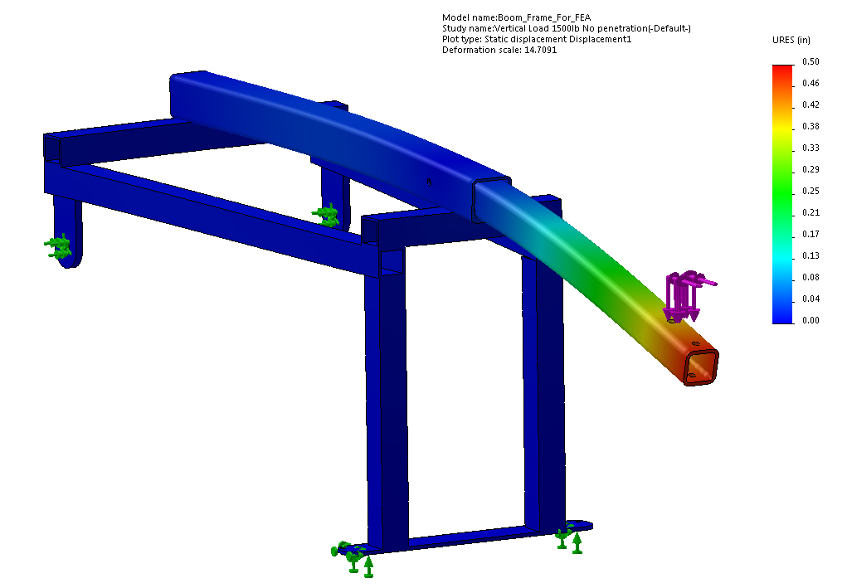
FEA : displacement
Max displacement = 0.5”

Slide 16
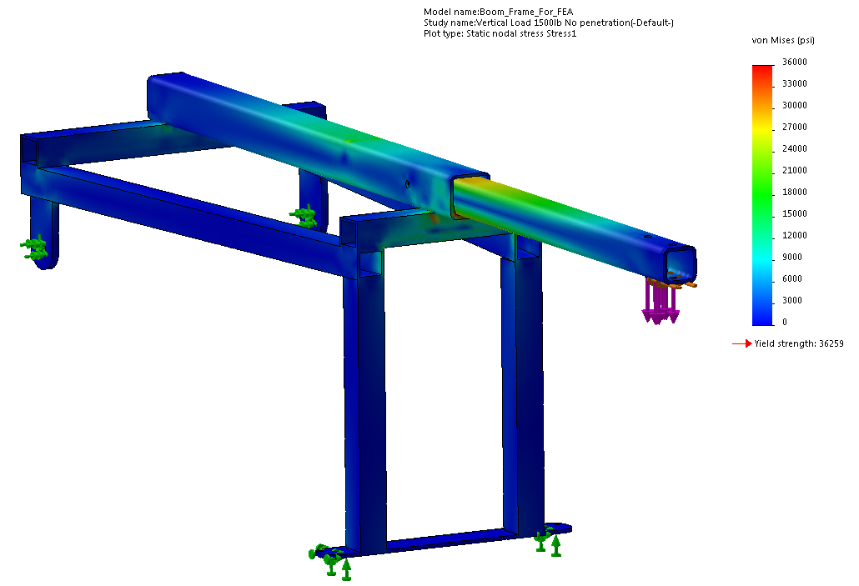
FEA : Stress
Max stress in inner boom = 29400PSI

