Slide 1
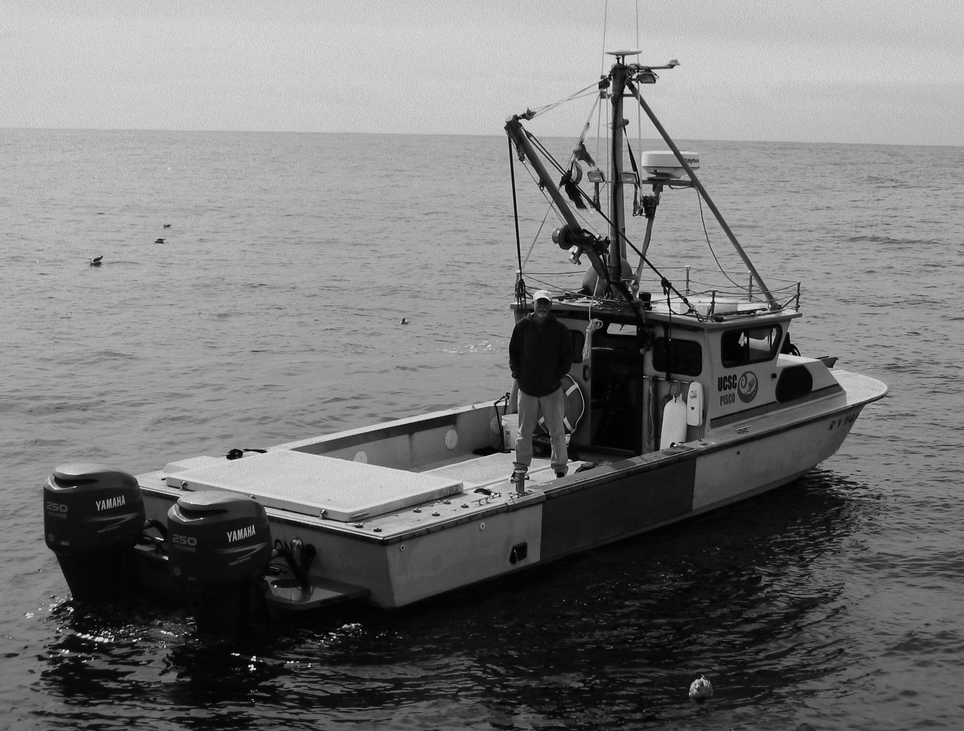
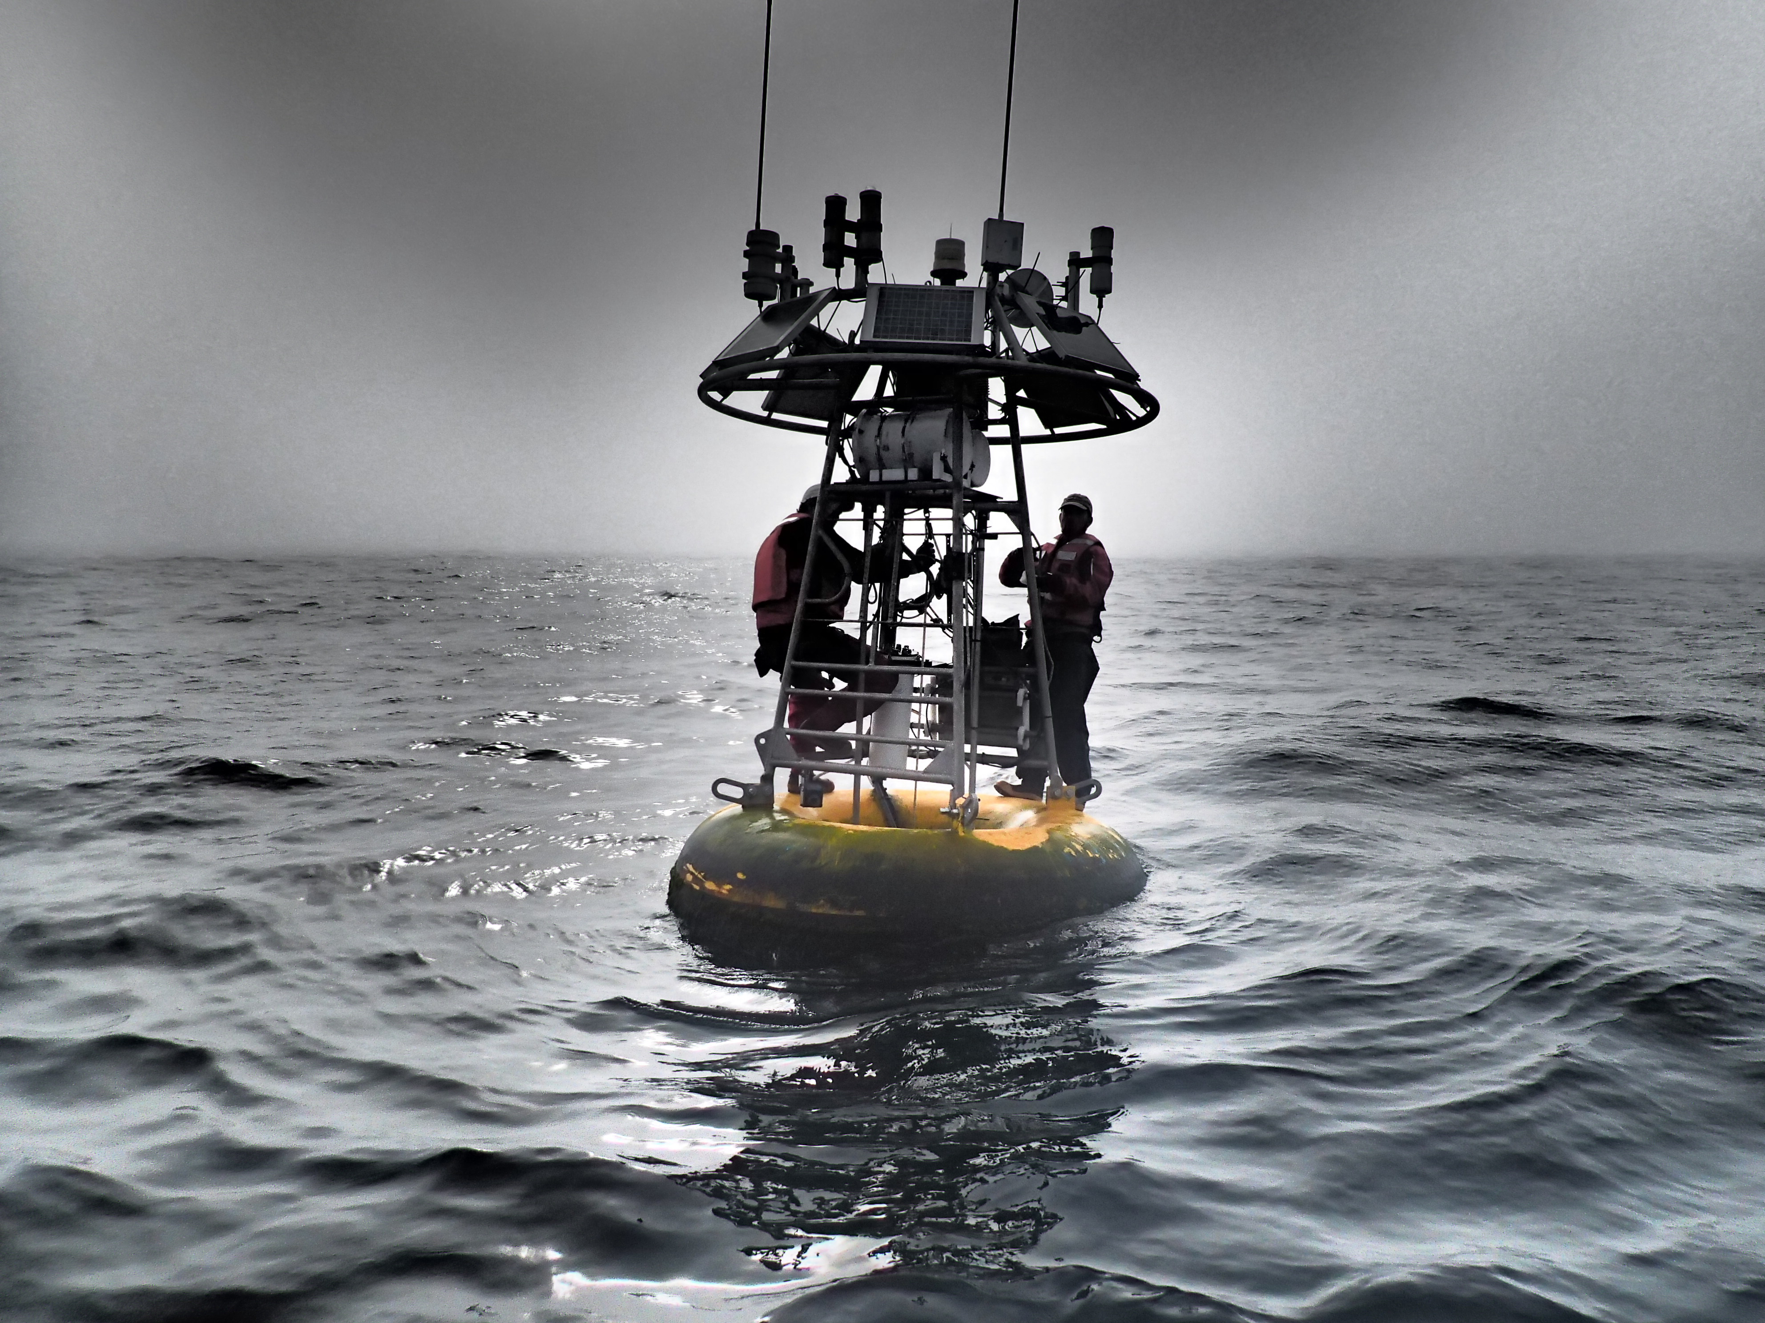
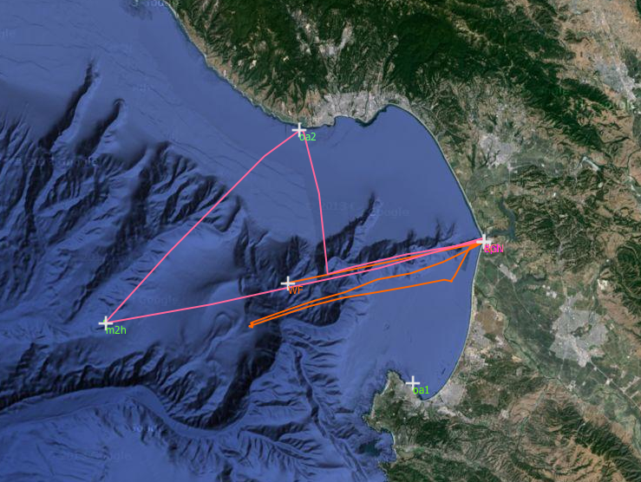
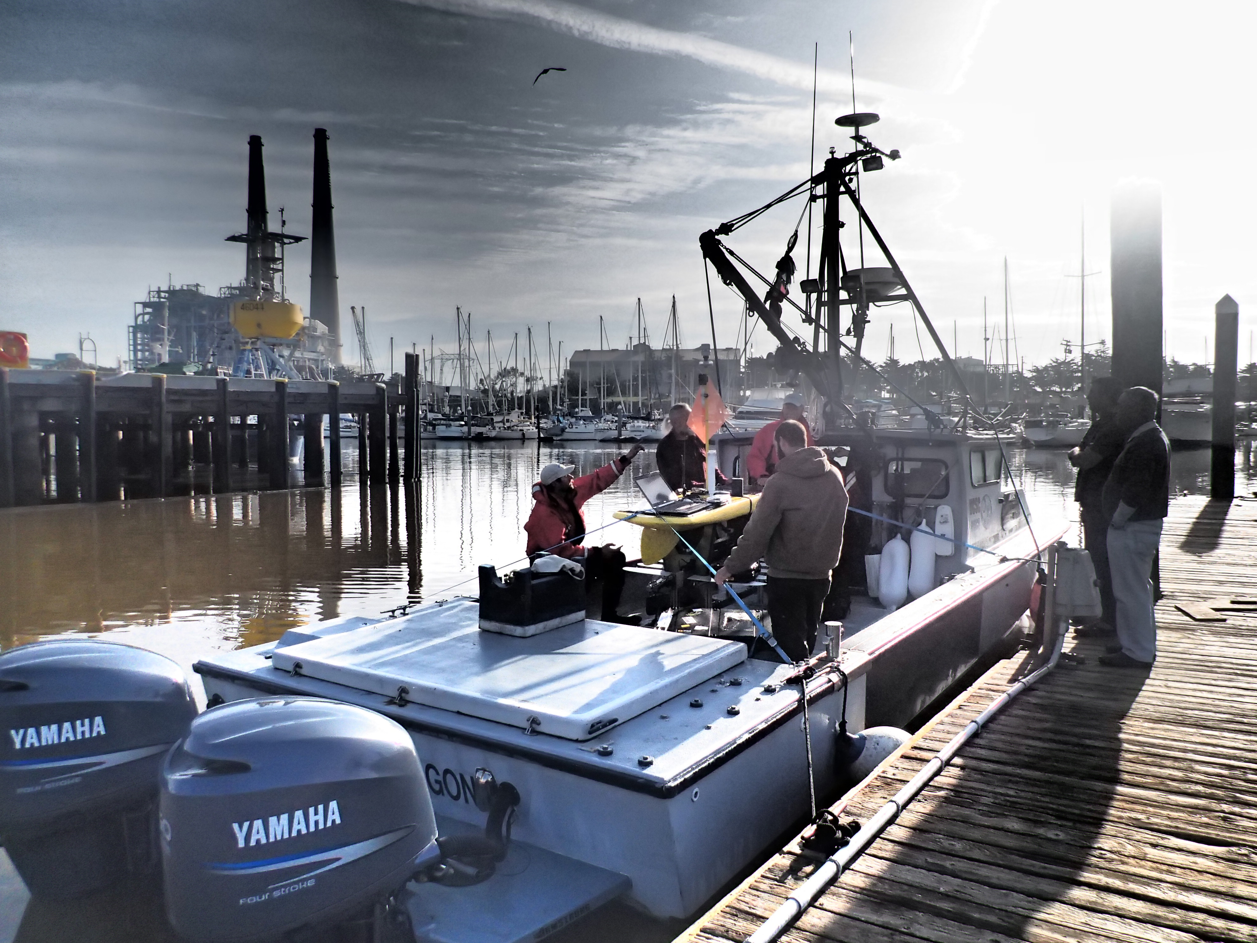
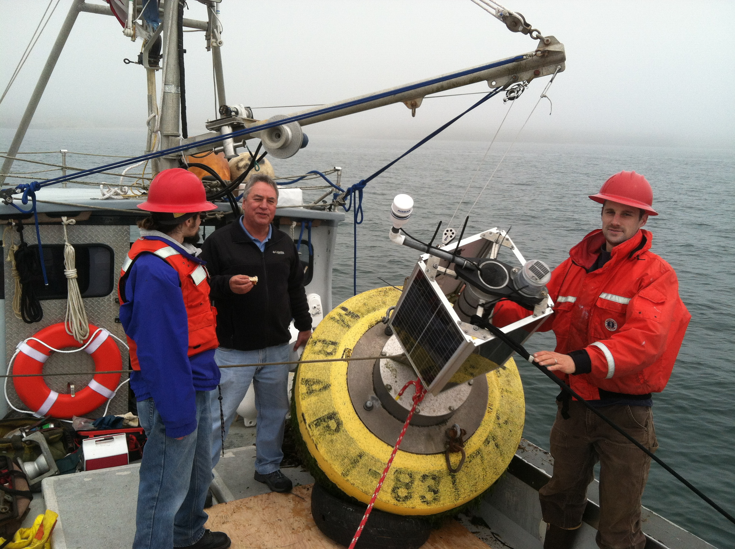
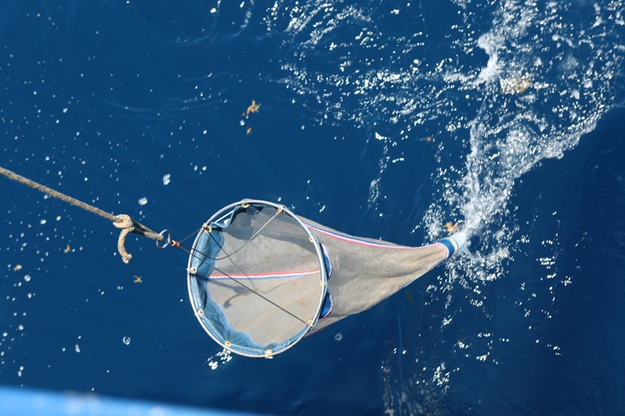
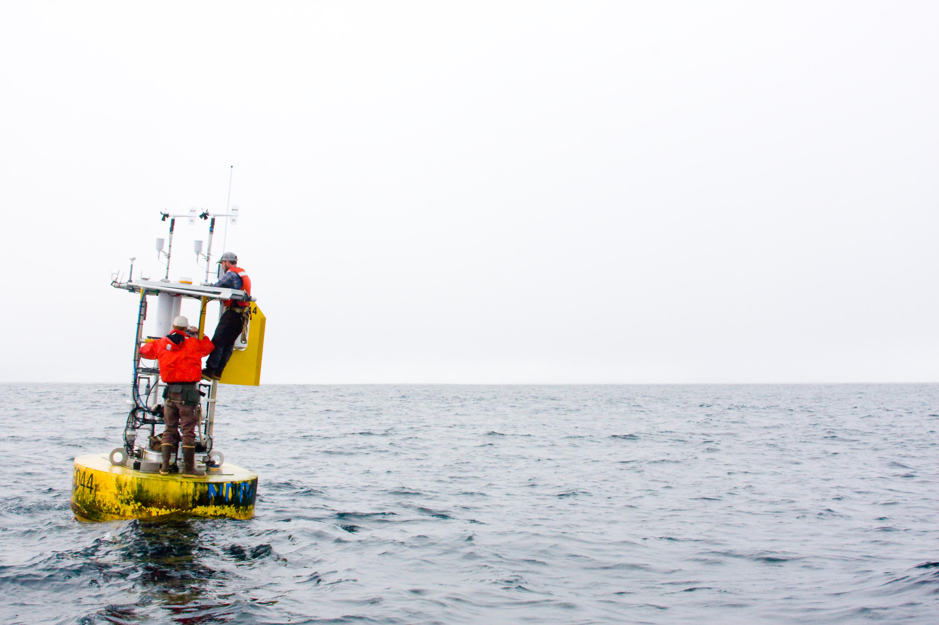
R/V Paragon
“around the bay in a day”
5) Maintenance on M1
7 hours & 3 personnel
1) Mobilize
~1 hour
4) OA Mooring Recovery
~1 hour
2) Plankton & water sampling
3) Maintenance on M2H
~0.5 hours
~1.5 hours

