Slide 1
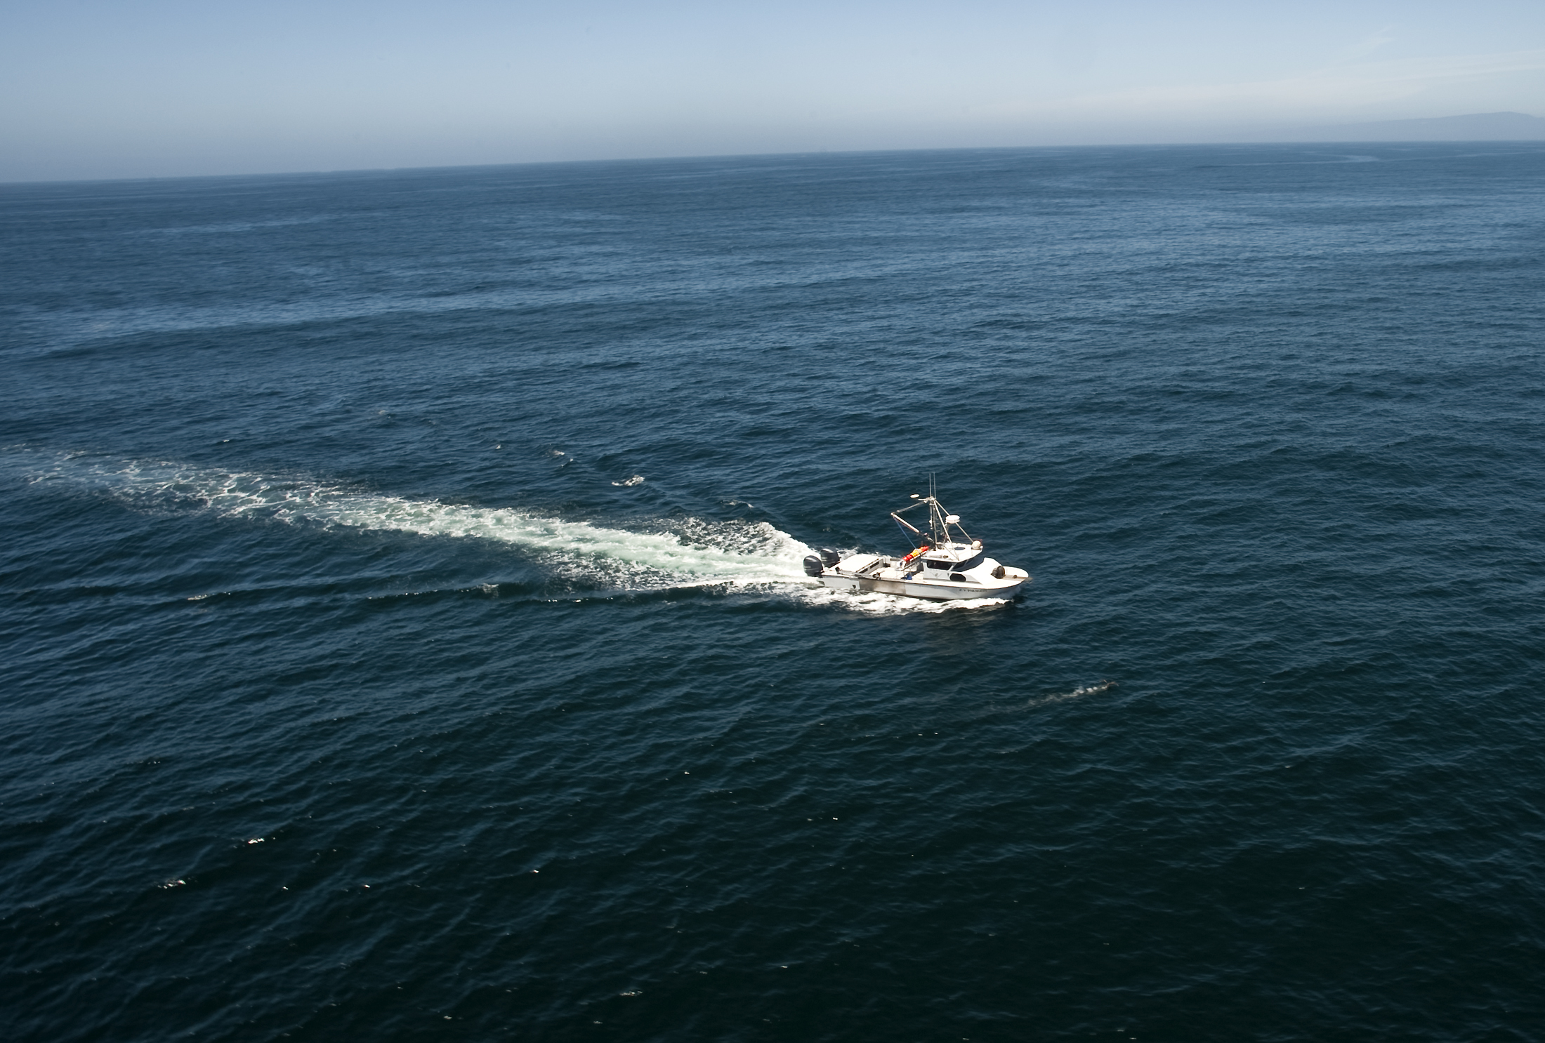
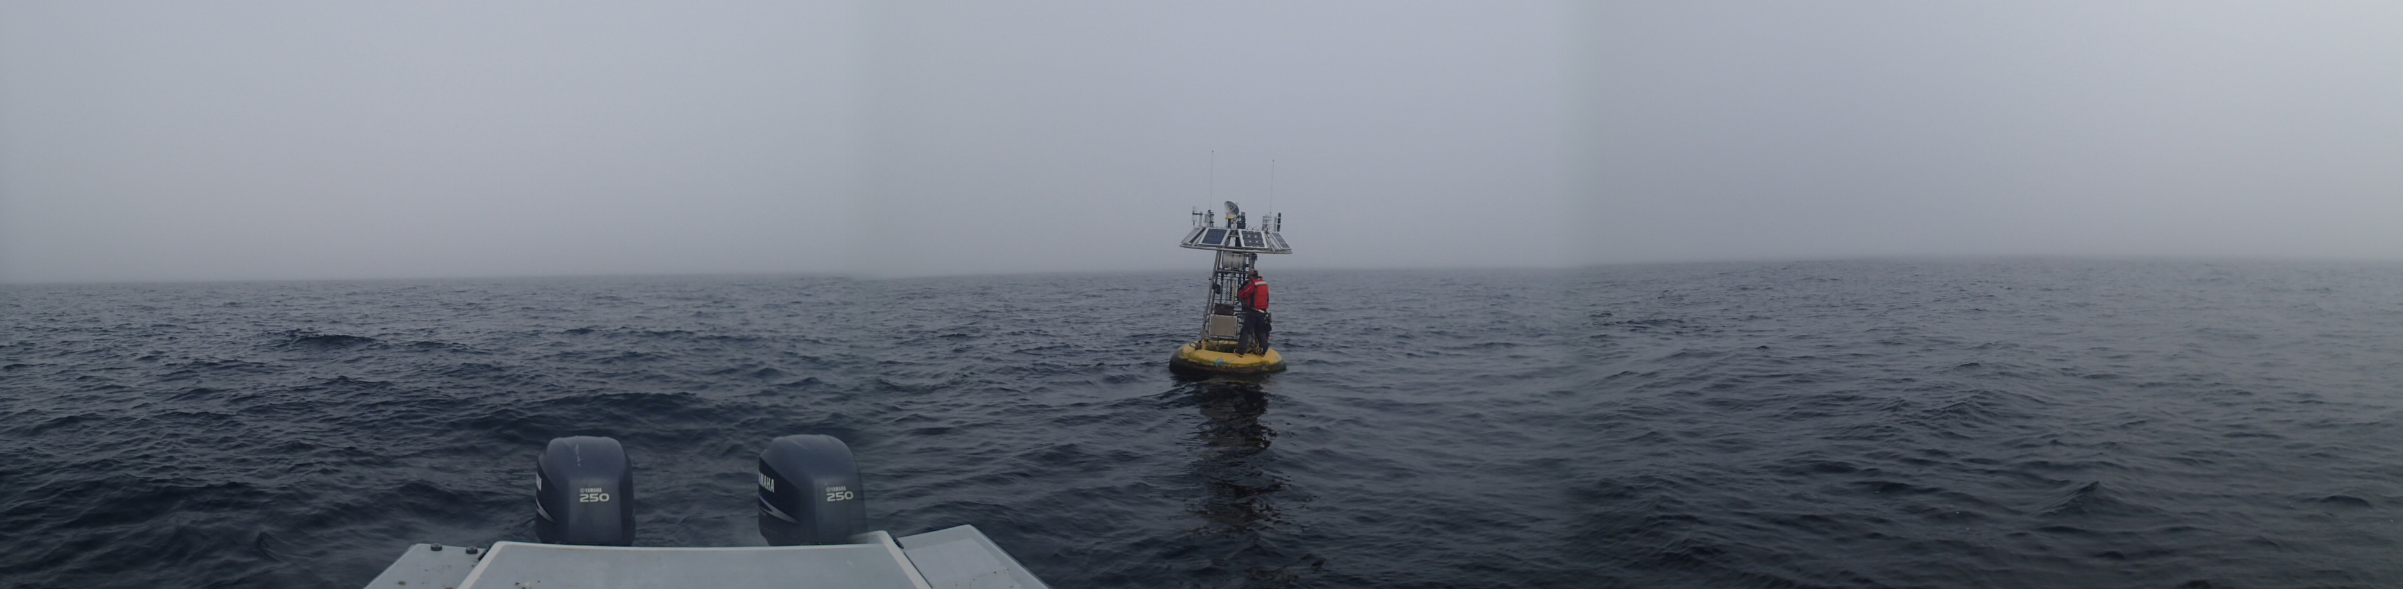
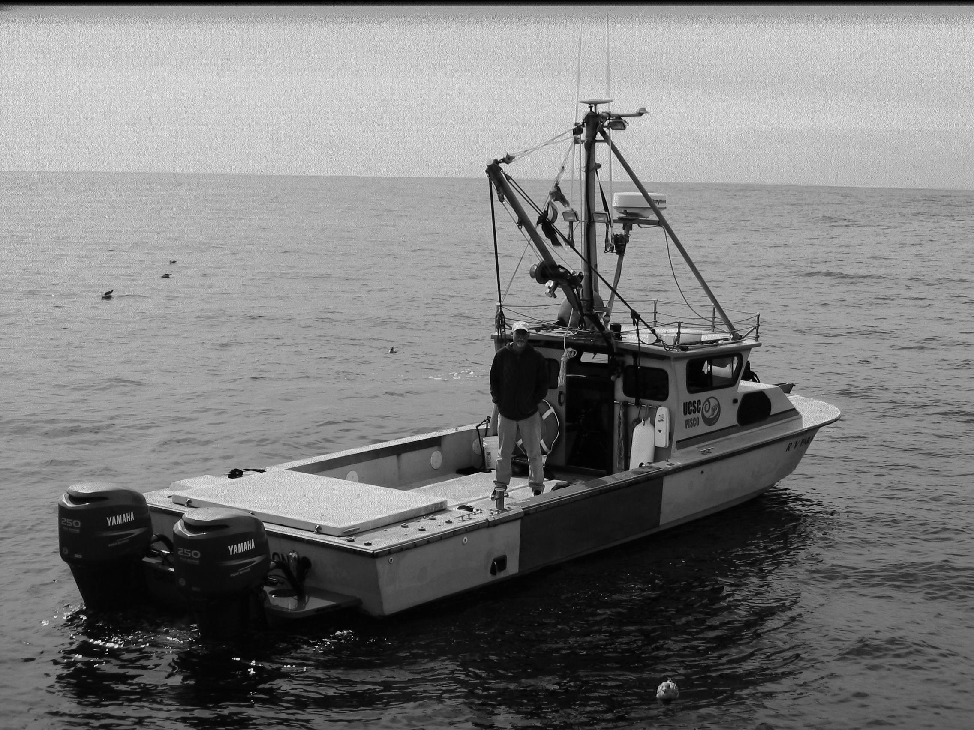
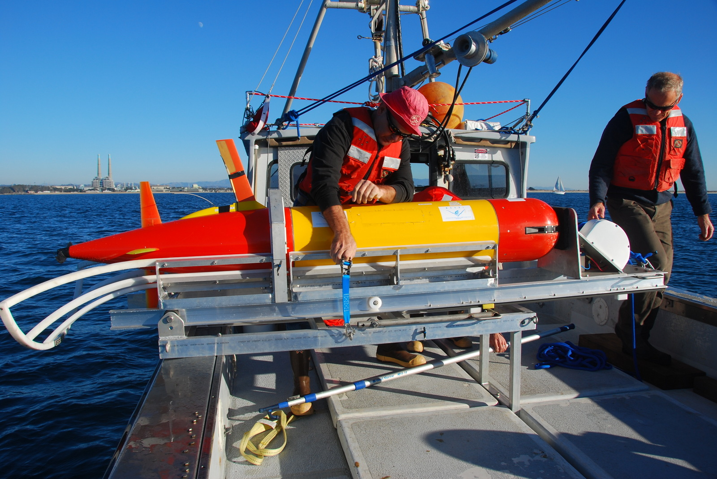
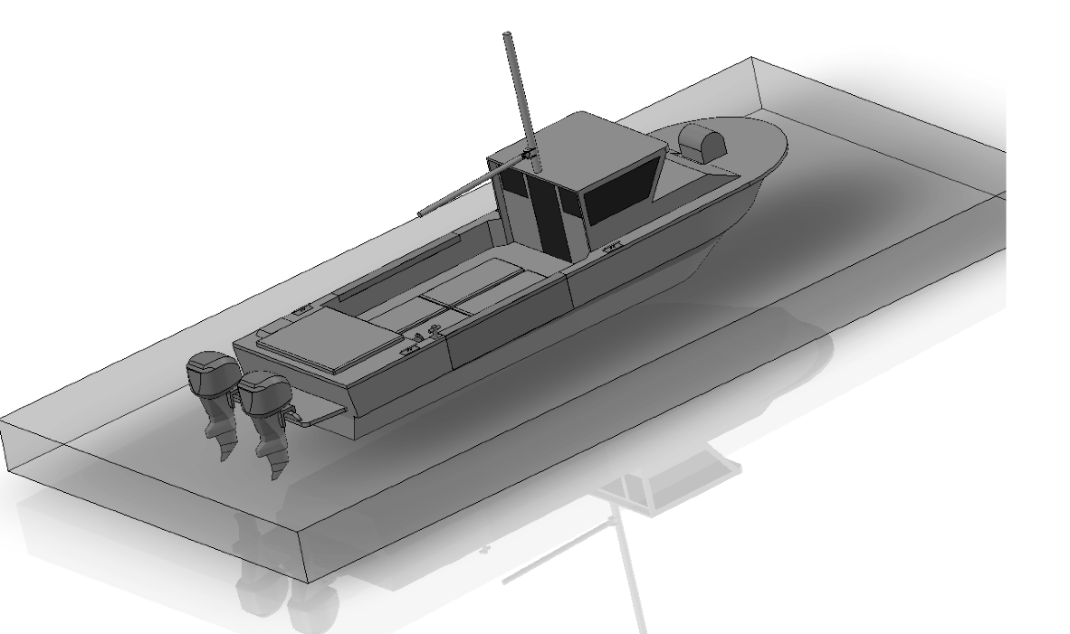
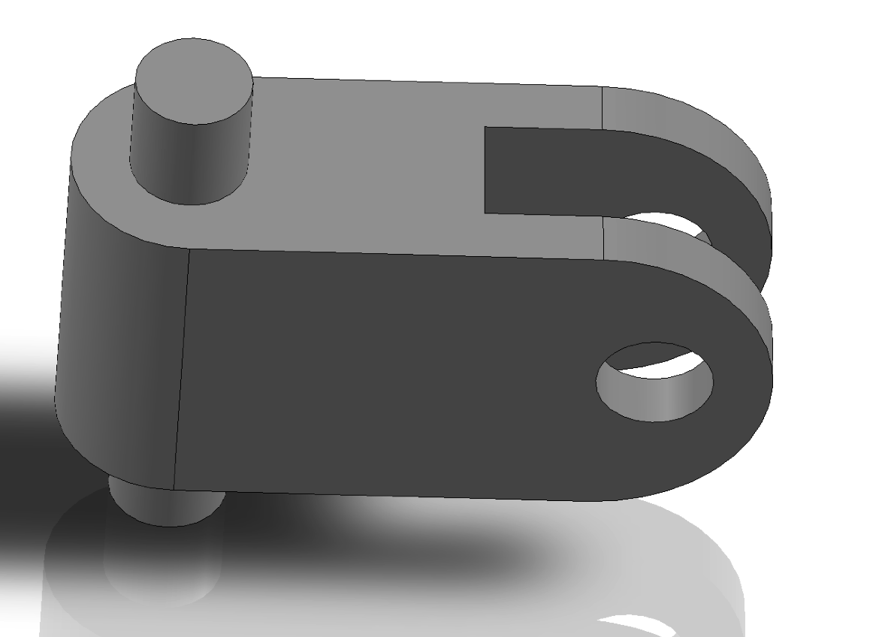
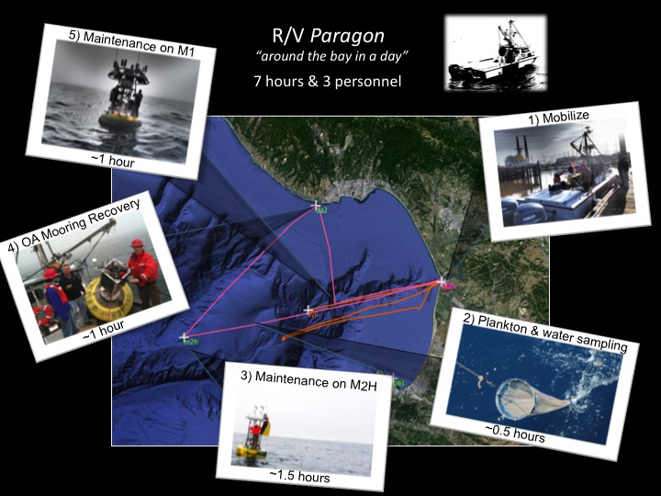
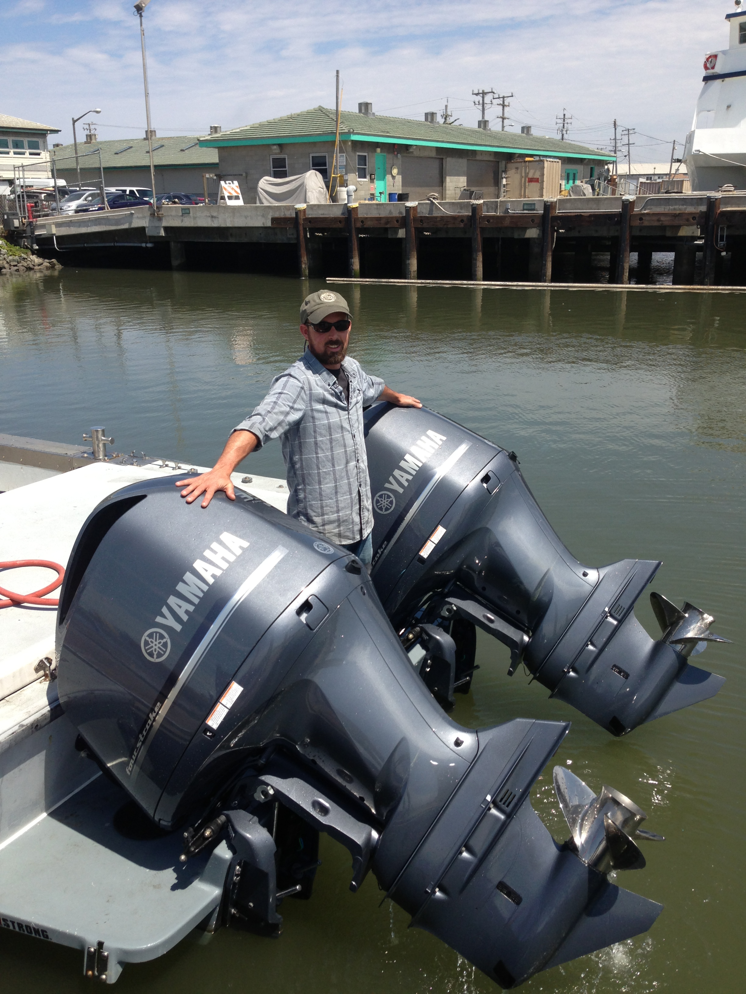
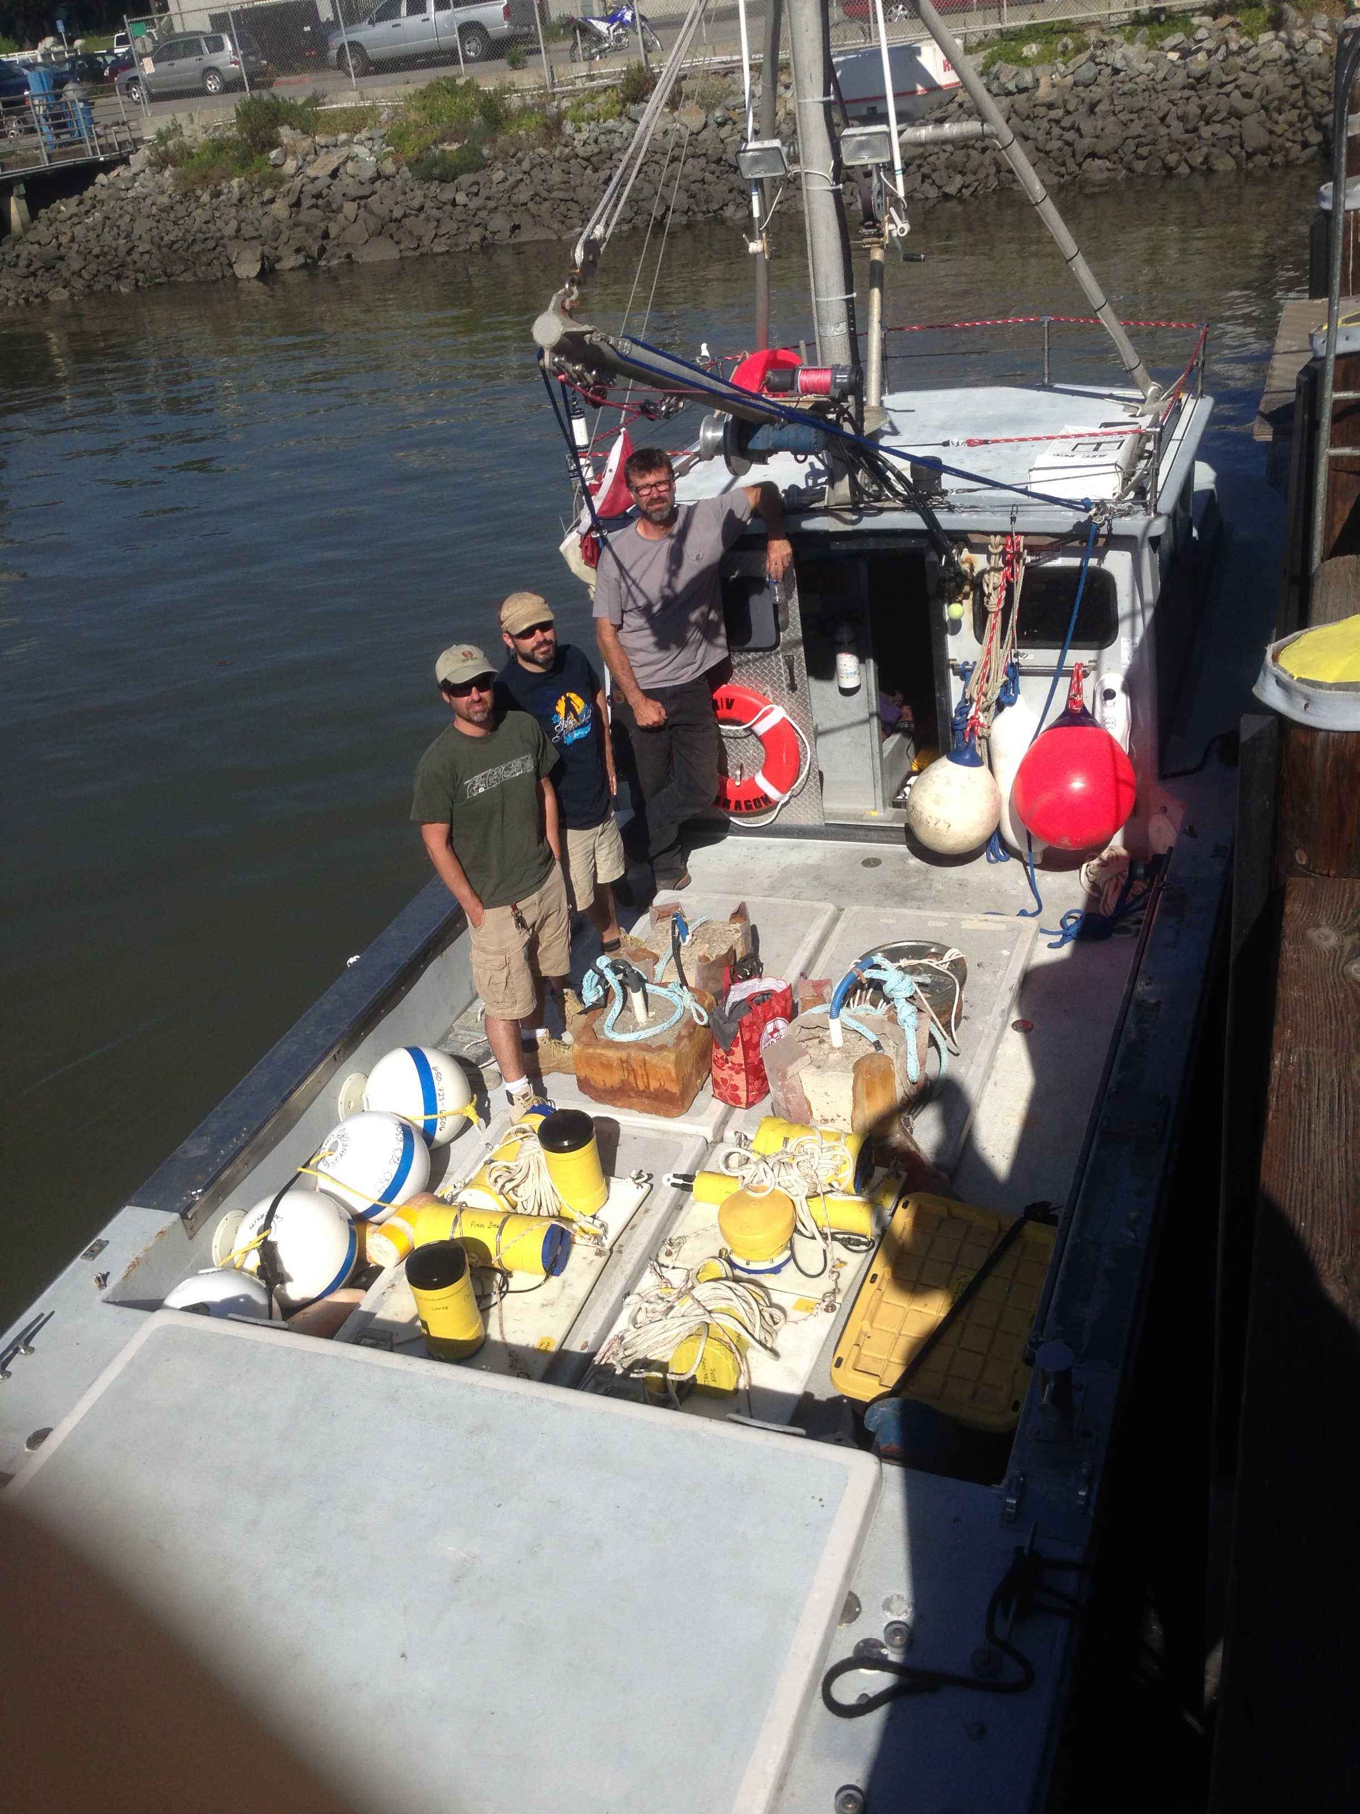
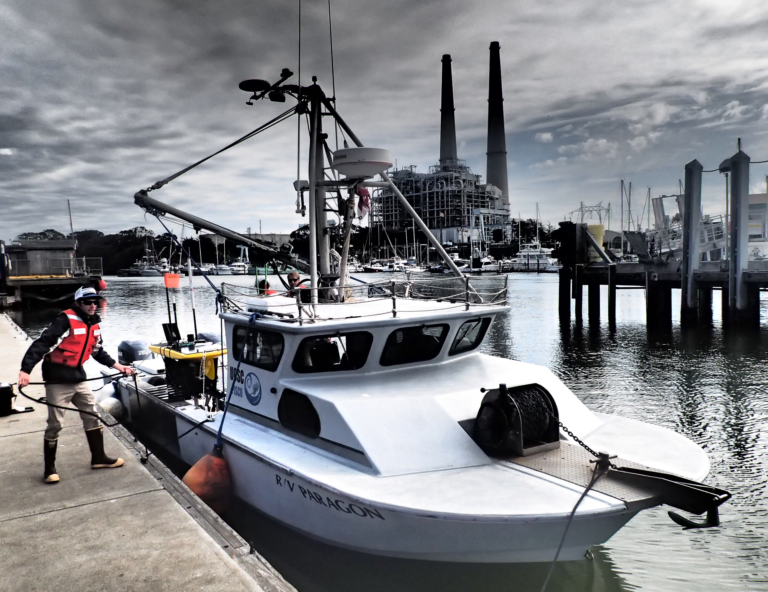
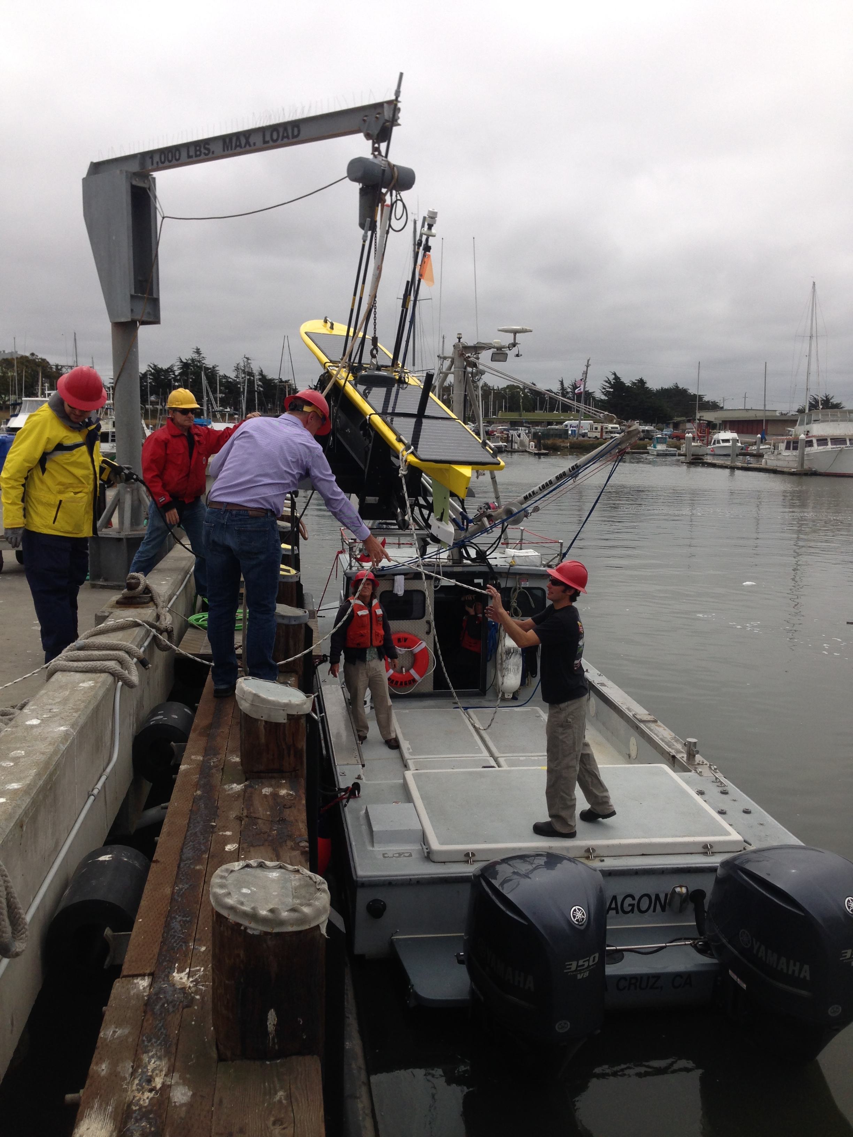
R/V Paragon
R/V Paragon supports Ocean Observatory technicians as they make repairs to the M1 weather buoy.
Engineers at MBARI customize the R/V Paragon to facilitate sampling and the deployment and recovery of instrumentation and vehicles.
History:
R/V Paragon was purchased from a commercial urchin diver in Oxnard, CA in 2001 by the Partnership for Interdisciplinary Studies of Coastal Oceans (PISCO) at the University of California, Santa Cruz (UCSC). PISCO repowered and customized the vessel for near shore scientific scuba diving and oceanographic research. For ten years it served as a research platform for kelp forest monitoring and process studies, oceanography, and education. In 2012, Dr. Mark Carr of PISCO-UCSC offered to loan R/V Paragon to MBARI for a minimum of one year. In 2013, the loan agreement was extended for an additional 5 years. UCSC retains ownership of the vessel during this period and MBARI is responsible for its operation and upkeep. R/V Paragon offers a unique opportunity for MBARI researchers to access
near coastal waters reliably, quickly, and inexpensively.
Engineers Hoover (left) and Hobson (Right) prepare to deploy the Long Range AUV on the Launch and Recovery System (LARS) designed at MBARI.
II. Vessel Description
Specifications:
Make: H & F Boats; Bandon, Oregon
Year Built: 1993
Material: Fiberglass/ Wood
Length: Hull (32 feet), Overall (36 feet)
Tonnage: 10 Gross ton, 8 Net ton
Working Deck Dimensions: 8.5 x 15 feet
Beam: 10 feet
Draft: 3 feet
Horsepower: 700 hp (F350 hp Yamaha Outboards)
Fuel Capacity: 550 gallons
Speed: 25-32 knots cruising (40 knots max)
Economy: 0.8 – 0.9 nm/gal
Endurance: ~400 nm
Deck Machinery:
Aluminum boom and mast
Max lifting capacity 500 lbs. (static)
12V WARN DC1000 electric hoist (1000 lb.)
5” hydraulic capstan
9” hydraulic line pinch (3/4”-1”)
7” Hydraulic Capstan (500 lb. lift capacity)
3” Windlass
Hydraulic Anchor Drum (20 pound Bruce anchor)
Collapsible mast for restricted overhead situations
MBARI goes BIG!
Twin 350hp four stroke engines
New engines increased the speed, reliabiliy, and economy of the
R/V Paragon
-Every day begins and ends at the dock-
R/V Paragon is versatile, fast and efficient Here you can see the track (pink) and missions accomplished in a single day
www.mbari.org

