Slide 1

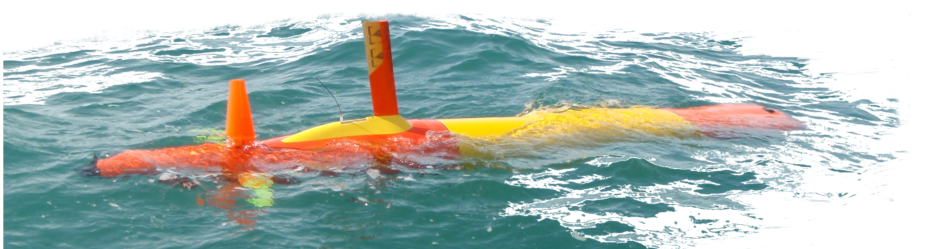


AUVs that fix themselves
Fault detection for LRAUV missions with minimal human intervention
Drew Gashler Memorial Summer Internship
Ben Yair Raanan
Dr. James G. Bellingham

Slide 2

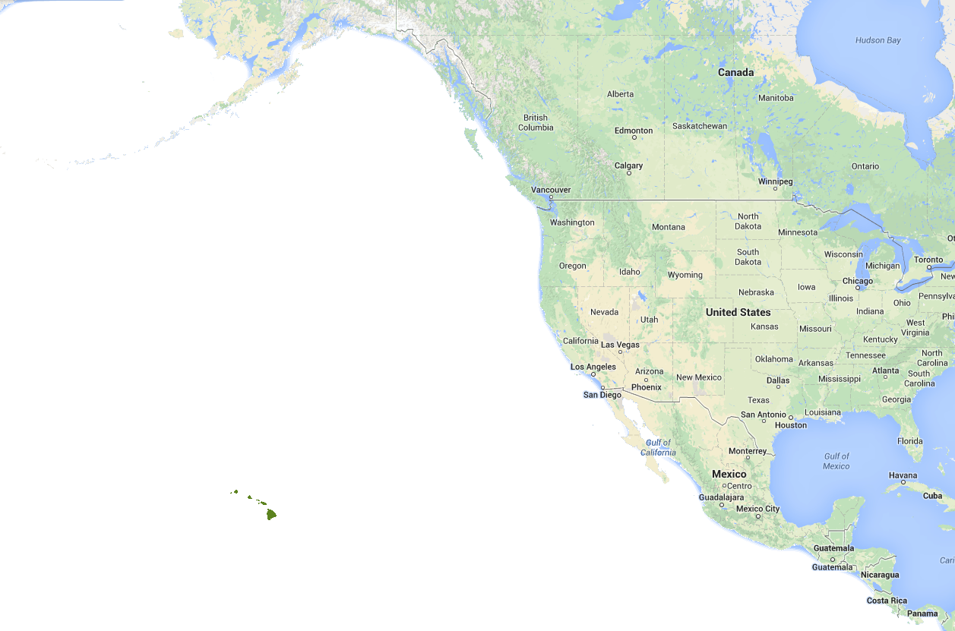
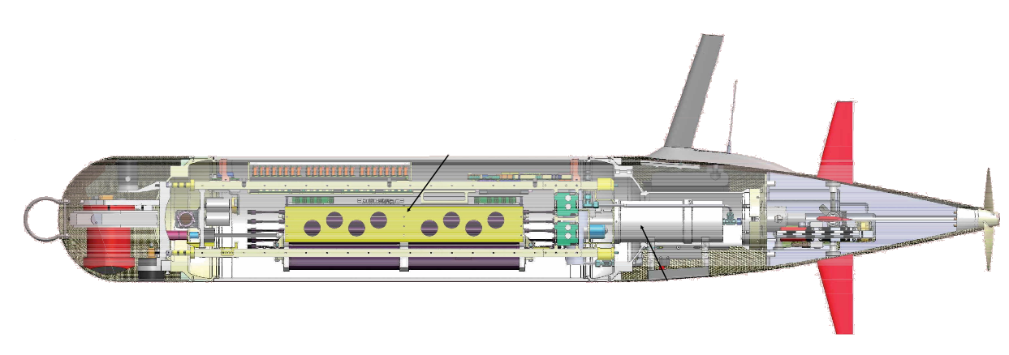

LRAUV
Tethys class long-range AUV
LRAUV is designed to be operated from shore via Iridium Satellite link
Faults necessitate human intervention
Maximum MTBOI* of 150 hours at best
Hawaii
Increase reliability by automation
Rechargeable | 1 week | 500 km
Expendable | 3 weeks | 1500 km
Goal | - | 3700 km
Detection
Diagnosis
Response
mbari.org/auv/LRAUV.htm
*Mean Time Between Unplanned Operator Intervention
Bellingham et al. [2010], Hobson et al. [2012], Kieft et al. [2011], Hoover [2013]
Notes:
The Tethys class long-range AUV was designed here at MBARI to satisfy the scientific need for studying biological process at the appropriate time and space scales using in situ sensors.
Every aspect of Tethys’ design is geared to maximize efficiency, for example Tethys can regulate vertical pitch angle by shifting its batteries forward and aft to reduce drag generated by high elevator fin angles.
And it’s the combination of these efficient sub-systems that provide a foundation for studying phytoplankton booms for bloom to bust (3 weeks).
Any vessel designed to stay at sea for long durations - Reliability becomes major theme
Currently Tethys has a “safety net” hardwired in to its system that captures most problems before the vehicle is at risk – however every time this happens the vehicle stops what ever it’s doing and comes to the surface to get operators input from Sat link

Slide 3
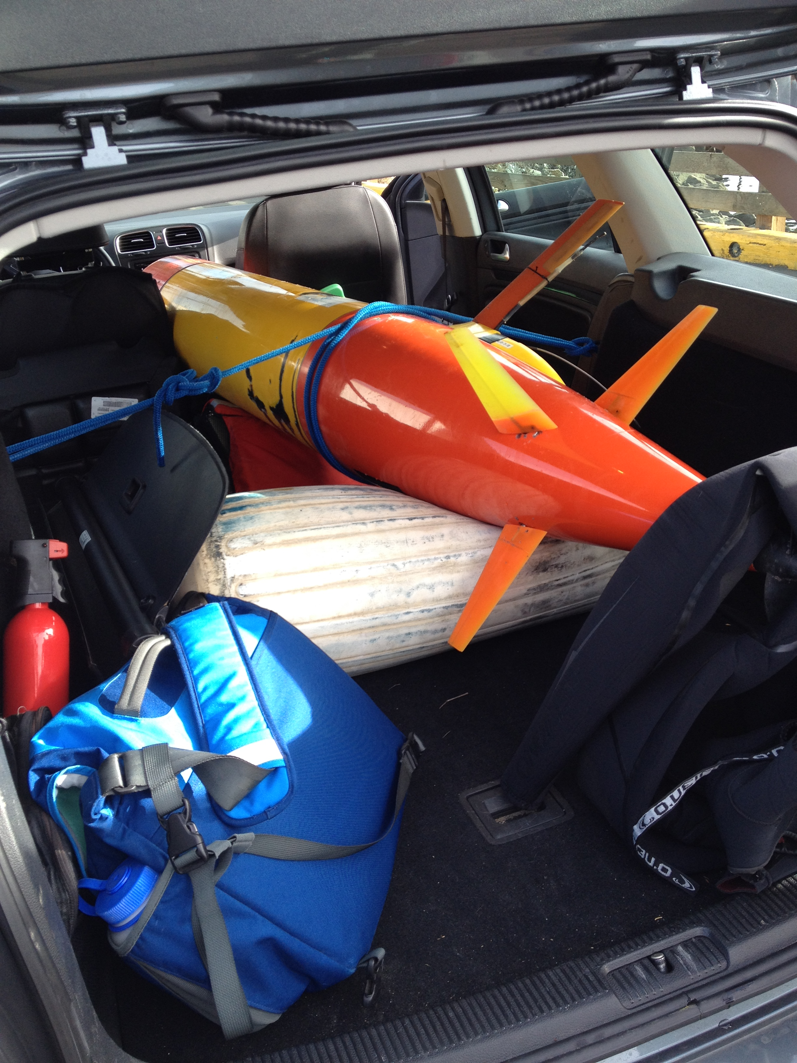
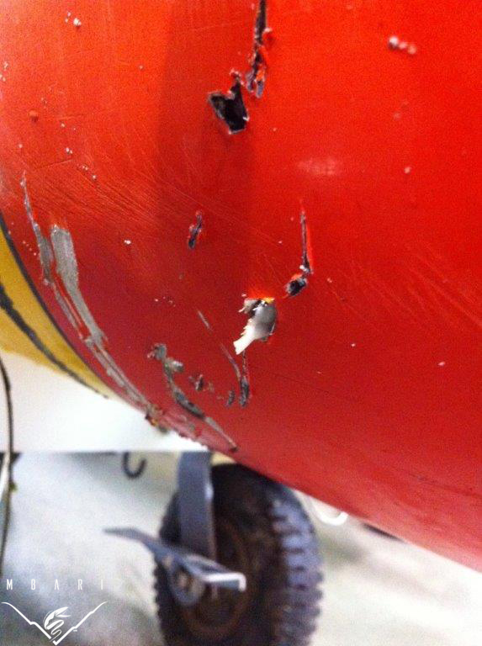
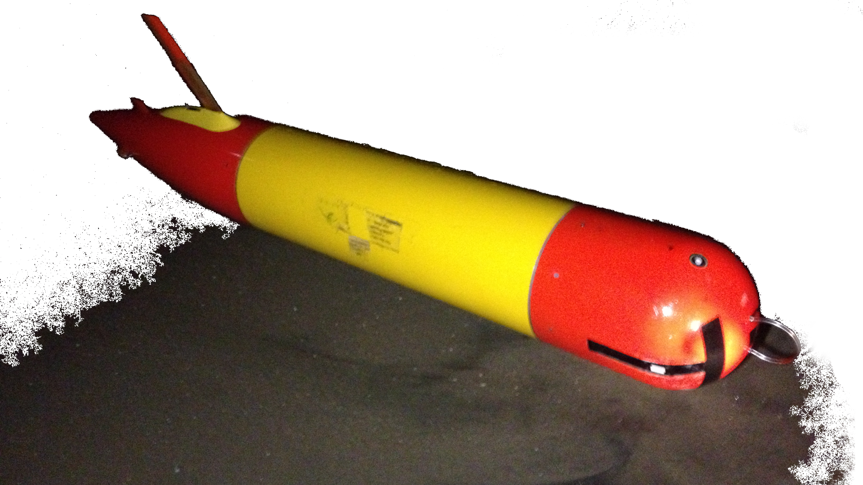
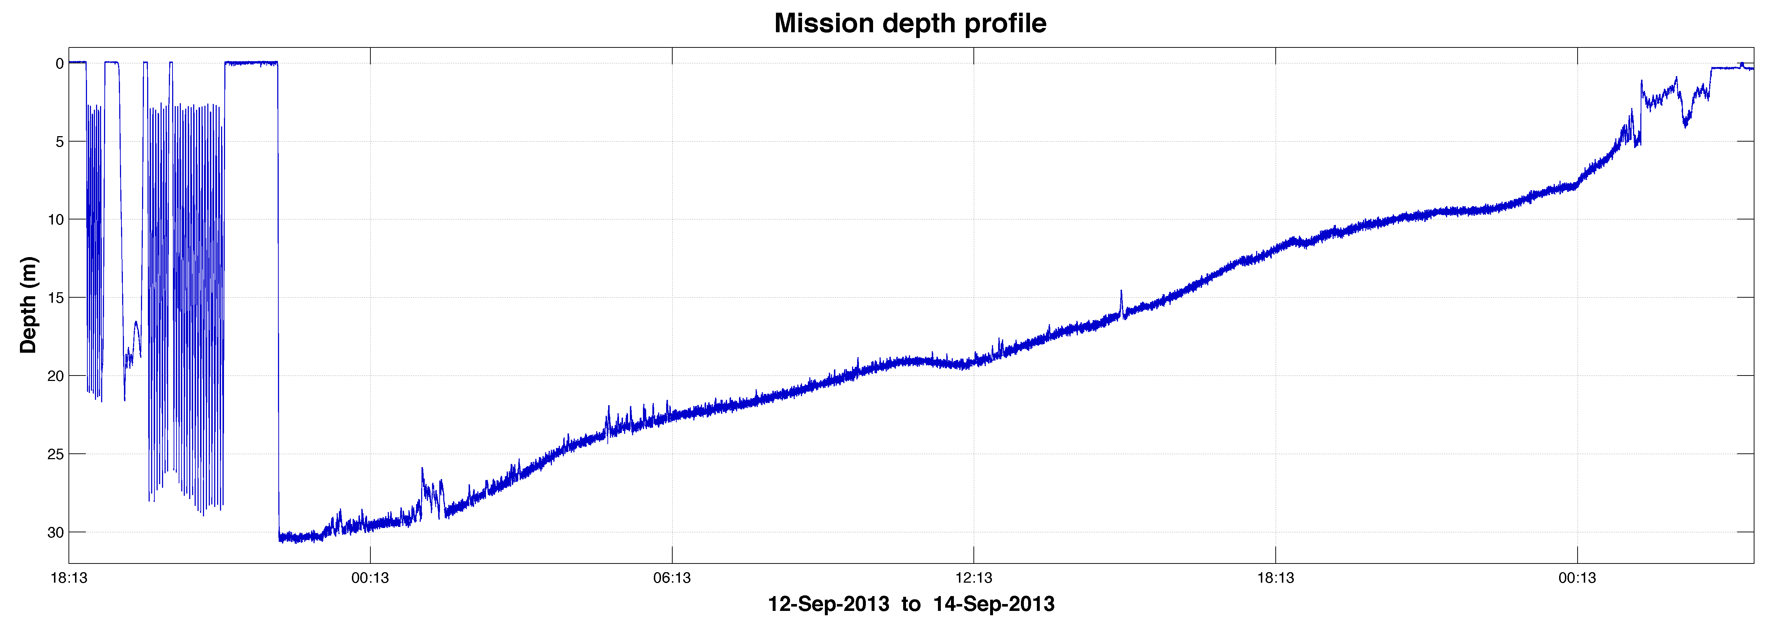
LRAUV reliability
Fault: Unplanned human operator intervention
Total num. of faults | Vertical control faults | Emergency recovery
539 | 329 (~60%) | <10
Tethys spends 2 days on the bottom
September 12th, 2013
Tethys attacked by a Great White
September 30th, 2013
Photos: LRAUV group, MBARI
Notes:
We’ll be using this mission as a study case
----- Meeting Notes (8/11/14 12:05) -----
between uplanned interventions

Slide 4
Project plan
Objective: Develop methods to detect anomalies in vertical plane flight performance of LRAUV
Vertical plane flight failure
Find indicators
Empirical behavior patterns
Simulated vehicle behavior
vs
Development of classifiers
Notes:
Find predictors – not necessarily cause and effect but rather a quantifiable metric/measurement we can use to determine if a malfunction is occurring or not
Empirical →essentially look at historical data and try to find patterns
Sim → compare simulated with observed
Use predictors to construct classifier and compare approaches → eventually will be integrated on to vehicle so it can detect failure, determine root cause and mitigate autonomously
----- Meeting Notes (8/11/14 11:54) -----
pridictors...

Slide 5
Empirical indicators
Empirical behavior patterns
Statistical time series analysis
Identify outliers corresponding to failures
(training datasets)
Notes:
Developing failure predictors
Characterize how certain vehicle properties behave under “Normal” conditions
Identify outliers which occur under “Failure” conditions
This is pretty straight forward, lets go ahead and do it! → Bottoming incident animation

Slide 6

Notes:
Blur your eyes test…

Slide 7
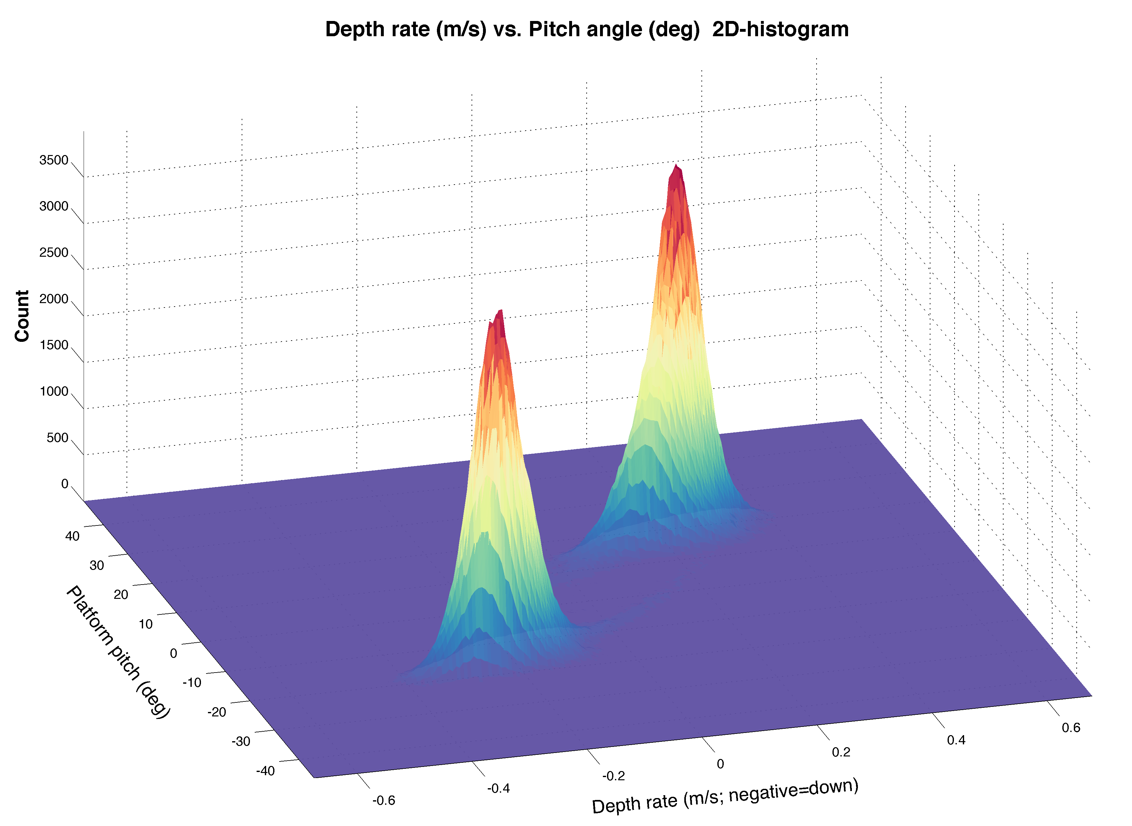
Empirical indicators
Empirical failure indicator:
Negative pitch angle
Simple(r) to derive
Great for “off the mountain”
Not great for “on the mountain”
The fault-zone!
Notes:
Developing failure predictors
2D hist:
Bimodal dist
Where is malfunction?
----- Meeting Notes (8/11/14 11:54) -----
add fail...
pros/cons?

Slide 8
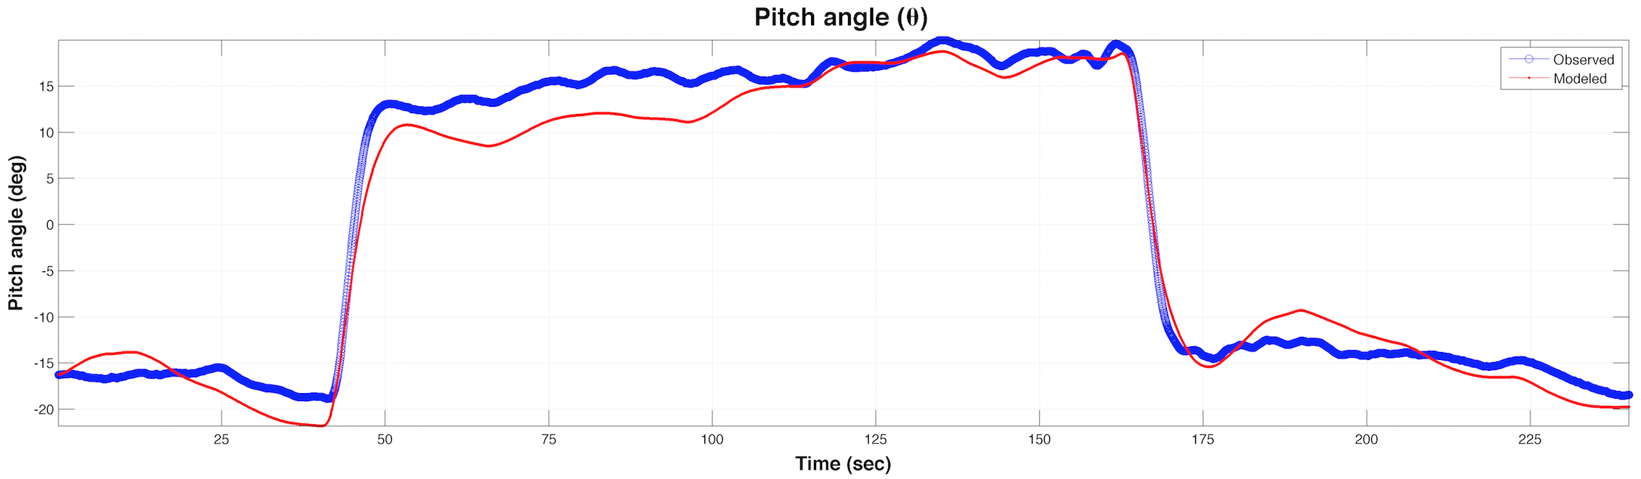
Simulated indicators
Simulation residuals
System control inputs
LRAUV simulator
Abkowitz [1969]
Numerical integration of the vehicle’s 6 DOF equations of motion
Requires 134 coefficients to run!
Modeled behavior
Observed behavior
Residuals
Hybrid of existing LRAUV simulator [Kieft et al., 2011] & REMUS model [Prestero, 2001]
Notes:
Start at diagram → Talk about the simulator (Rob McEwen) → compare output to observed using plot
Hybrid of existing LRAUV simulator and REMUS simulator written by Prestero at WHOI
6 DOF (nonlinear) simulation model - the model is an adaptation of a simulation created for REMUS by Timothy Prestero (MIT/ WHOI) . The model's combined nonlinear equations of motion account for kinematics, rigid-body dynamics and mechanics including terms for hydrostatics, hydrodynamic damping, added mass, body/fin lift and moments and propeller thrust and torque.
The model is fed historical mission data and returns simulated behavior of LRAUV to compare with observed.
Benchmarking: 1 min of data takes 55 sec to run
Model inputs include: Elevator angle, rudder angle, propeller thrust and mass-shift and buoyancy bladder. Model outputs are: Surge, sway, heave, roll rate, pitch rate, yaw rate, x position, y position, z position, roll angle, pitch angle and yaw angle (u v w p q r xpos ypos zpos phi theta psi).

Slide 9
Simulated indicators
Simulator failure indicator:
Deviation in pitch angle
Complex derivation
All terrain!
Notes:
Same figure seen in clip → Simulation residuals overlaid in color bar
Found a mid-water collision
Now we have 2 predictors! → But how do we utilize this data to build a predictive model for failure??

Slide 10
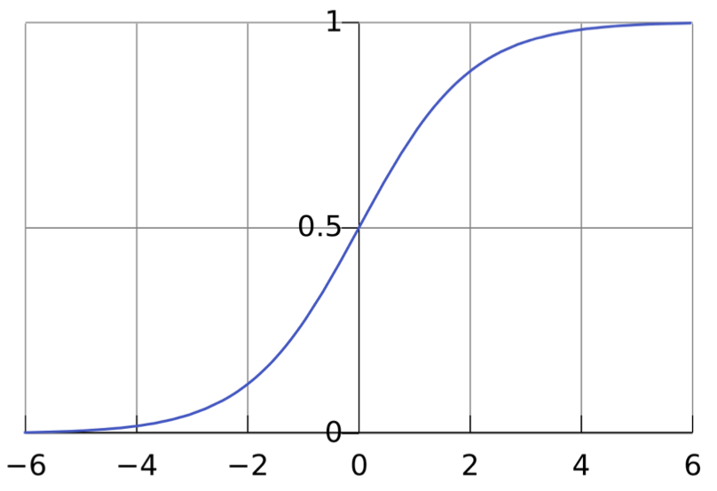
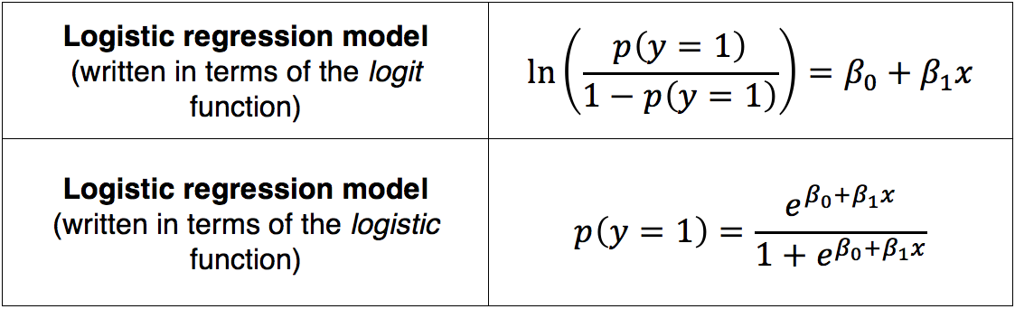
Binary classification
Logistic regression predictive framework
Gelman and Hill [2007]
^{The logistic sigmoid}
Where p = probability, x = measurement variable and β_{0,1} = regression coefficients
Figure: Wikimedia Commons
Notes:
Logistic regression is the standard way to find the best prediction of a binary Y variable (in our case 1=malfunction / 0=non-malfunction) for each value of the X variable (i.e. indicator).
Generalized linear modeling framework
Logistic regression is the standard way to model binary outcomes, that is, data Y that take on the values 0 or 1
What makes logistic regression different from linear regression is that the Y variable is not directly measured; it is instead the probability of obtaining a particular value of a nominal variable (i.e. 0 or 1; Figure 5).

Slide 11
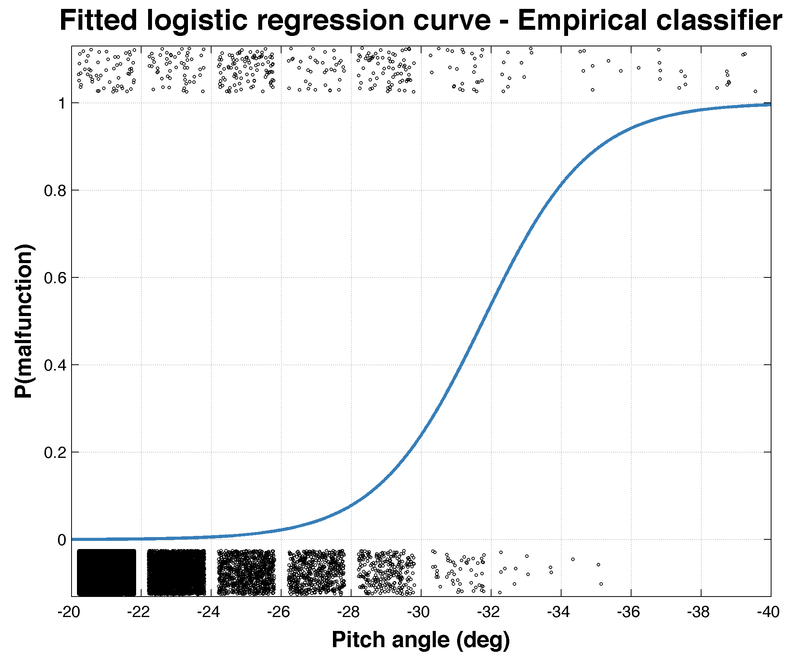
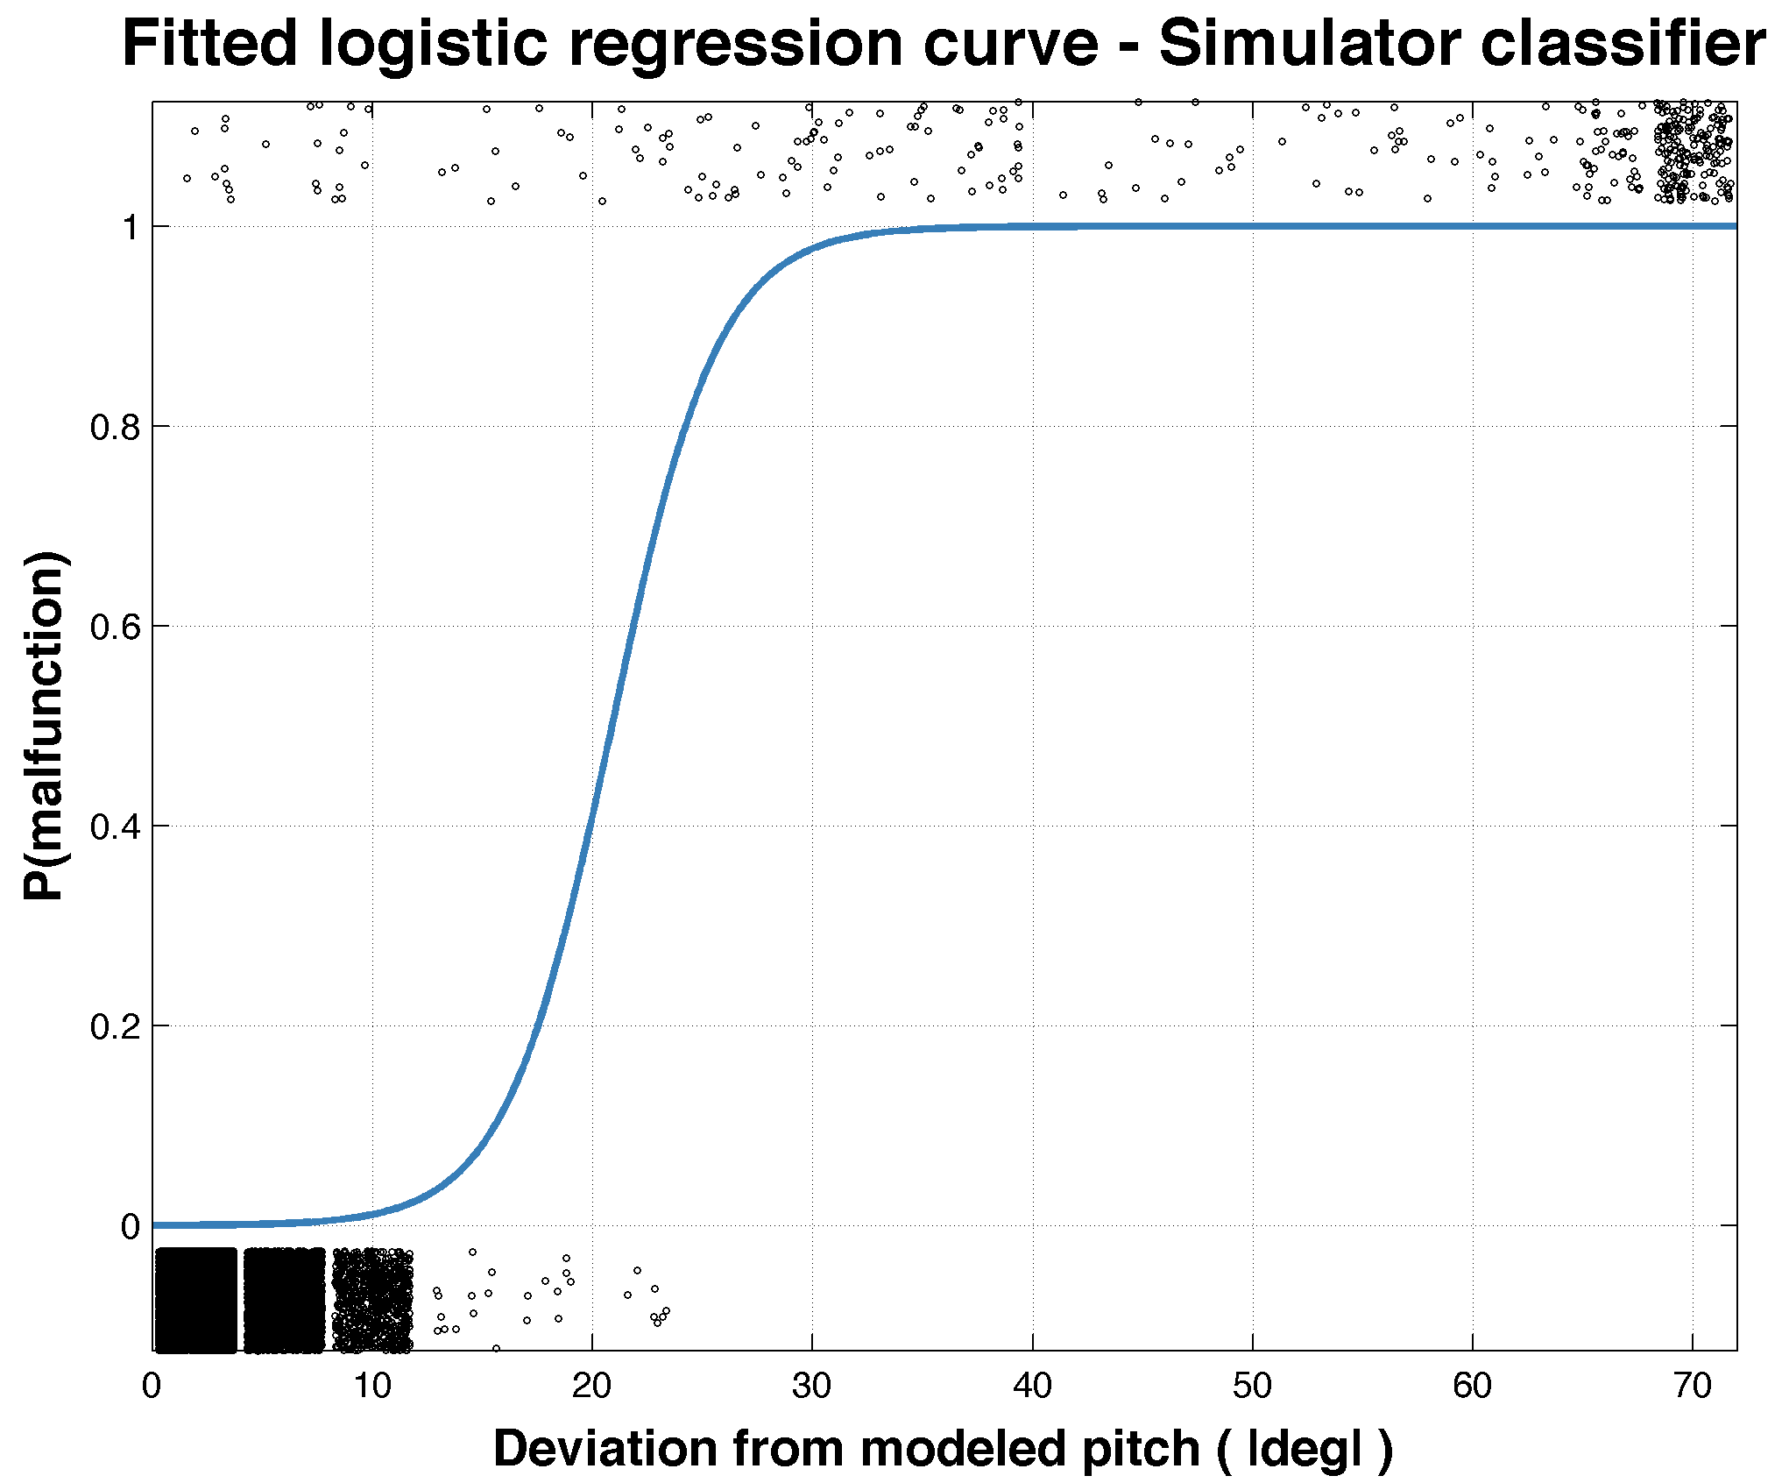
Binary classification
Malfunction
Normal
Notes:
X axis!
----- Meeting Notes (8/11/14 11:54) -----
loose formula

Slide 12
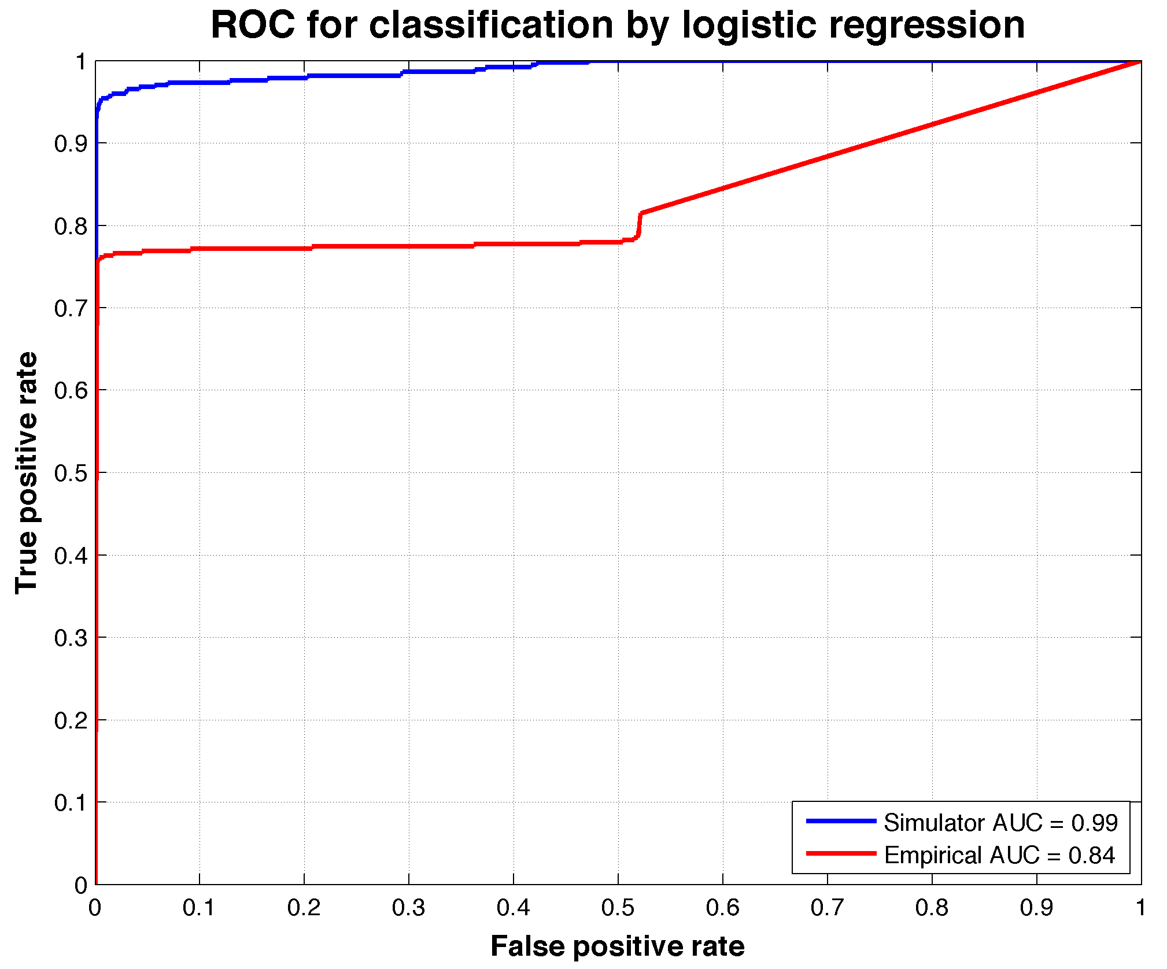
Classifier performance
Receiver operating characteristic (ROC)
  TPR =
  FPR =
true positives
total actual positives
false positives
total actual negatives
Optimal operating point:
TPR | FPR | Threshold
0.9 | 0 | 0.17
0.747 | 0.001 | 0.0013
Notes:
Receiver operating characteristic
Ani
In signal detection theory, a receiver operating characteristic (ROC), or simply ROC curve, is a graphical plot which illustrates the performance of a binary classifier system as its discrimination threshold is varied. It is created by plotting the fraction of true positives out of the total actual positives (TPR = true positive rate) vs. the fraction of false positives out of the total actual negatives (FPR = false positive rate)
----- Meeting Notes (8/11/14 11:54) -----
diagnol...
----- Meeting Notes (8/11/14 12:05) -----
false detect calling home all the time...
tpr we missed something and have to go get it...

Slide 14
Conclusion
Framework for detecting anomalous vertical plane flight performance of LRAUV has been established
Simulator approach outperformed the empirical approach and offers a single classification solution for a wide verity of scenarios
While simulator requires complex fitting routines, the empirical classifier is simple to derive and will probably be easier to implement onboard LRAUV
Framework can be applied as powerful mission debriefing system
Notes:
Ensure good science measurements
However, this approach will require numerous classifiers to encompass possible scenarios
----- Meeting Notes (8/11/14 11:54) -----
how much could we reduce vpf
----- Meeting Notes (8/11/14 12:05) -----
add end point
if we had this
what is a

Slide 15
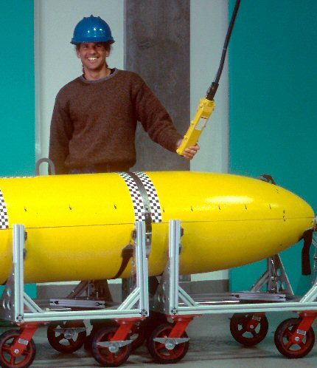

Acknowledgments
Drew Gashler Memorial
Internship
MBARI
James Bellingham
Thomas Hoover
Jordan Stanway
Brian Kieft
Rob McEwen
Yanwu Zhang
George Matsumoto
Linda Kuhnz
Todd Walsh
MLML
Erika McPhee-Shaw, WWU
Tomo Eguchi, NOAA
Brynn Kaufman, MLML
OSU
Mark Abbott
Will Dillon

Slide 16
Sources
Abkowitz, Martin A. Stability and motion control of ocean vehicles: organization, development, and initial notes of a course of instruction in the subject. MIT press, 1969.
Bellingham, J. G., et al. "A small, long-range AUV with flexible speed and payload." Ocean Sciences Meeting, Abstract MT15A. Vol. 14. 2010.
Fossen, Thor I. Guidance and control of ocean vehicles. Vol. 199. No. 4. New York: Wiley, 1994.
Hoover, T. (March, 2014) Operating Tethys, a Long Range Autonomous Underwater Vehicle. Friends of MLML. Lecture conducted from Moss Landing Marine Labs, Moss Landing, CA
Gelman, A., & Hill, J. (2007). Data analysis using regression and multilevel/hierarchical models. Cambridge University Press.
Glover, D. M., Jenkins, W. J., & Doney, S. C. (2011). Modeling methods for marine science. Cambridge University Press.
Hemminger, Daniel L. Vertical plane obstacle avoidance and control of the REMUS autonomous underwater vehicle using forward look sonar. Diss. Monterey California. Naval Postgraduate School, 2005.
Hobson, Brett W., et al. "Tethys-class long range AUVs-extending the endurance of propeller-driven cruising AUVs from days to weeks." Autonomous Underwater Vehicles (AUV), 2012 IEEE/OES. IEEE, 2012.
Hoerner, Sighard F. Fluid-dynamic drag: practical information on aerodynamic drag and hydrodynamic resistance. Midland Park, NJ: Hoerner Fluid Dynamics, 1965.
Kruschke, J. (2010). Doing Bayesian data analysis: a tutorial introduction with R. Academic Press.
Prestero, Timothy Timothy Jason. Verification of a six-degree of freedom simulation model for the REMUS autonomous underwater vehicle. Diss. Massachusetts institute of technology, 2001.

Slide 18
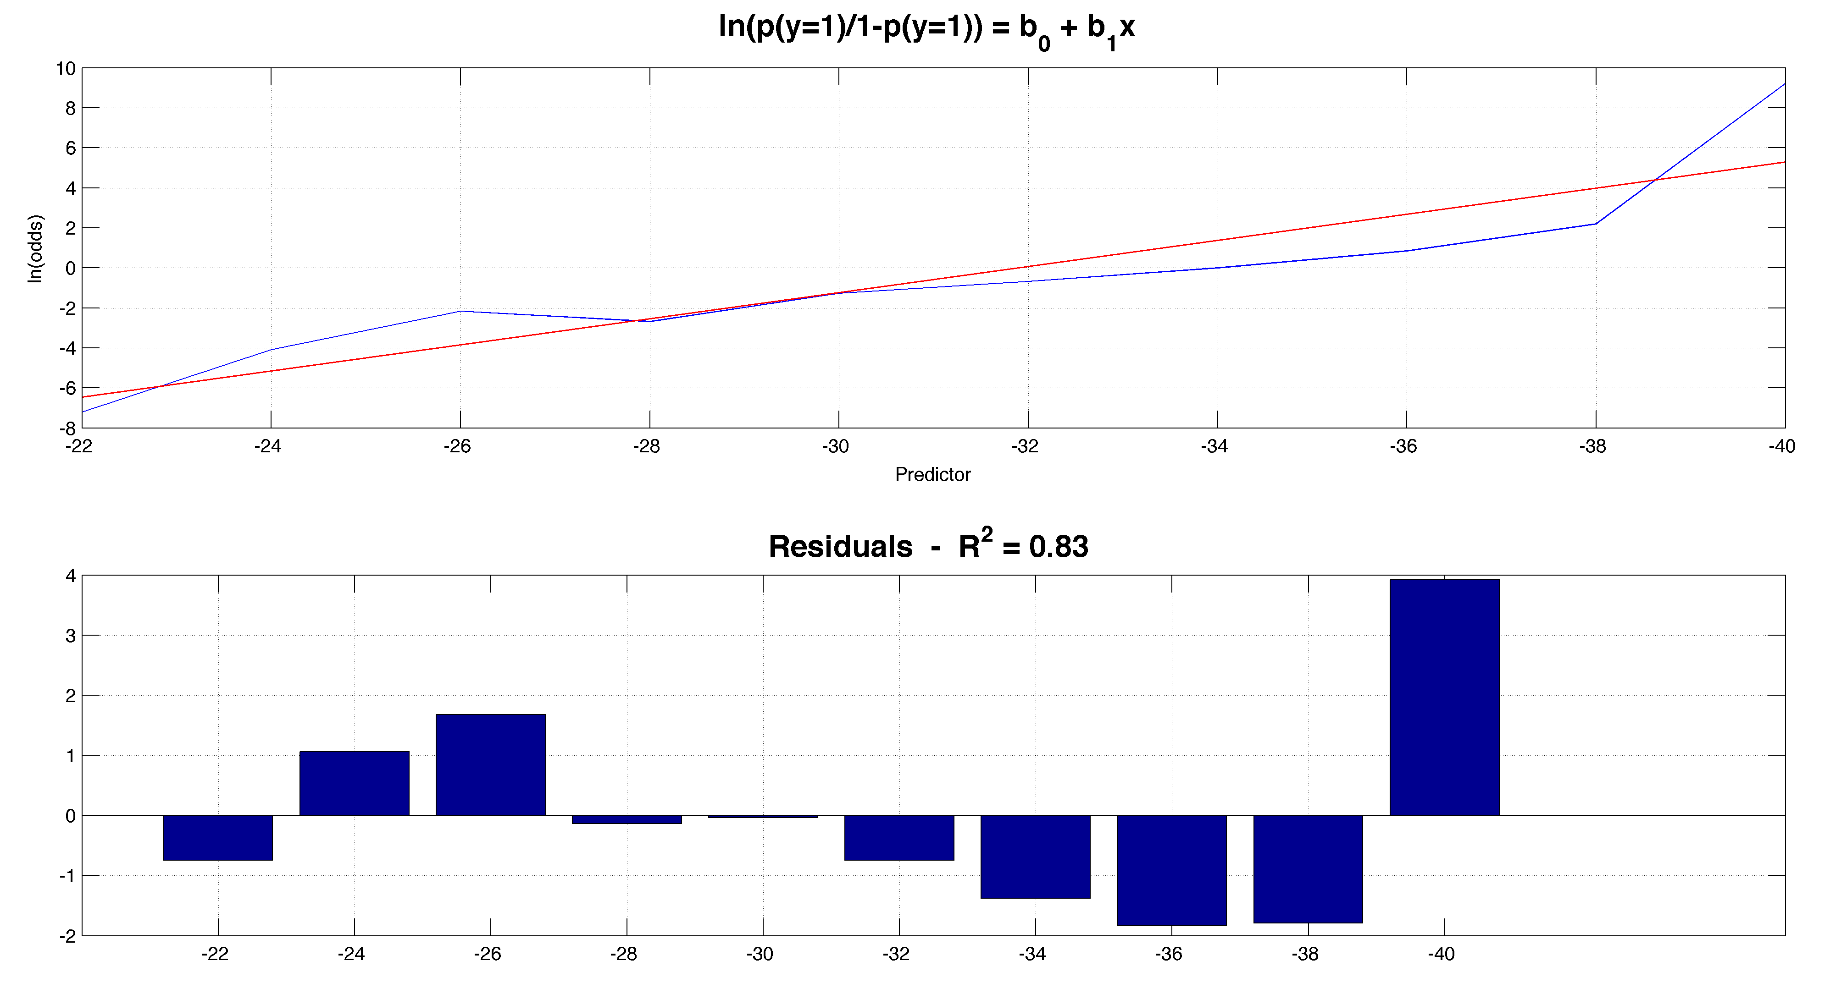
Binary classification
Empirical Logit:

Slide 19
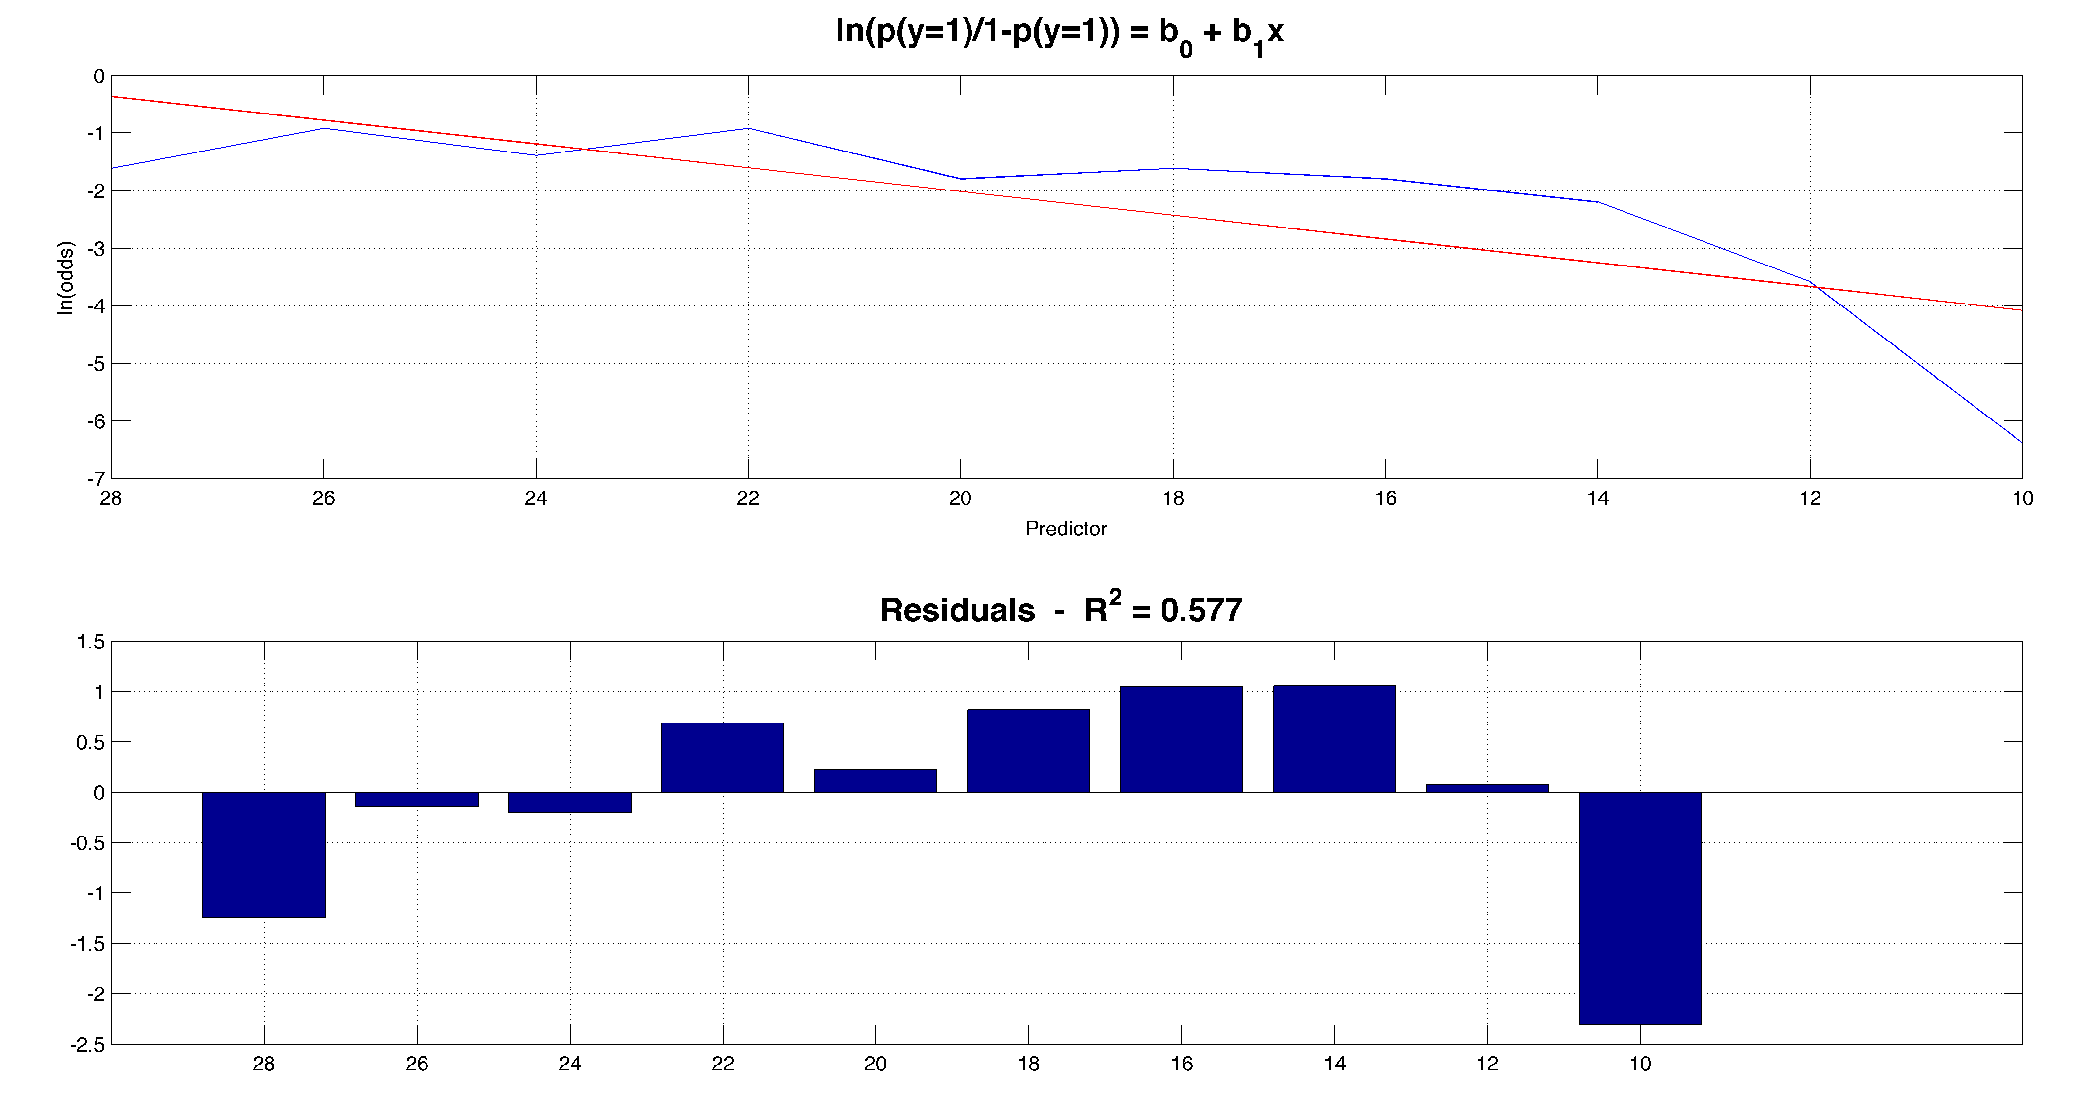
Binary classification
Simulation Logit:

Slide 20
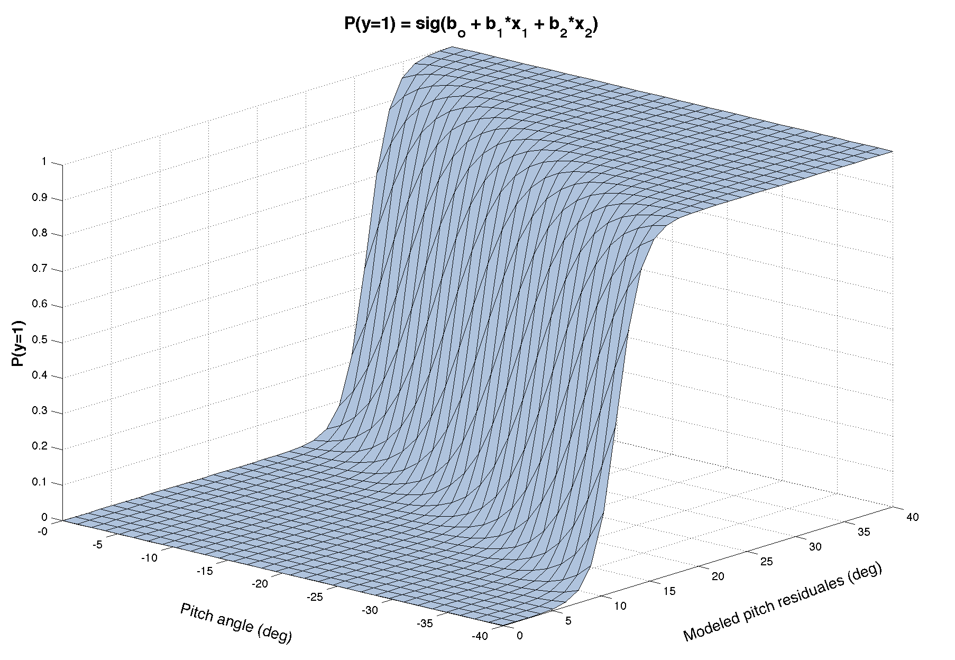
Binary classification
Logistic regression and predictive framework
*Kruschke [2010] and Gelman and Hill [2007]

Slide 21
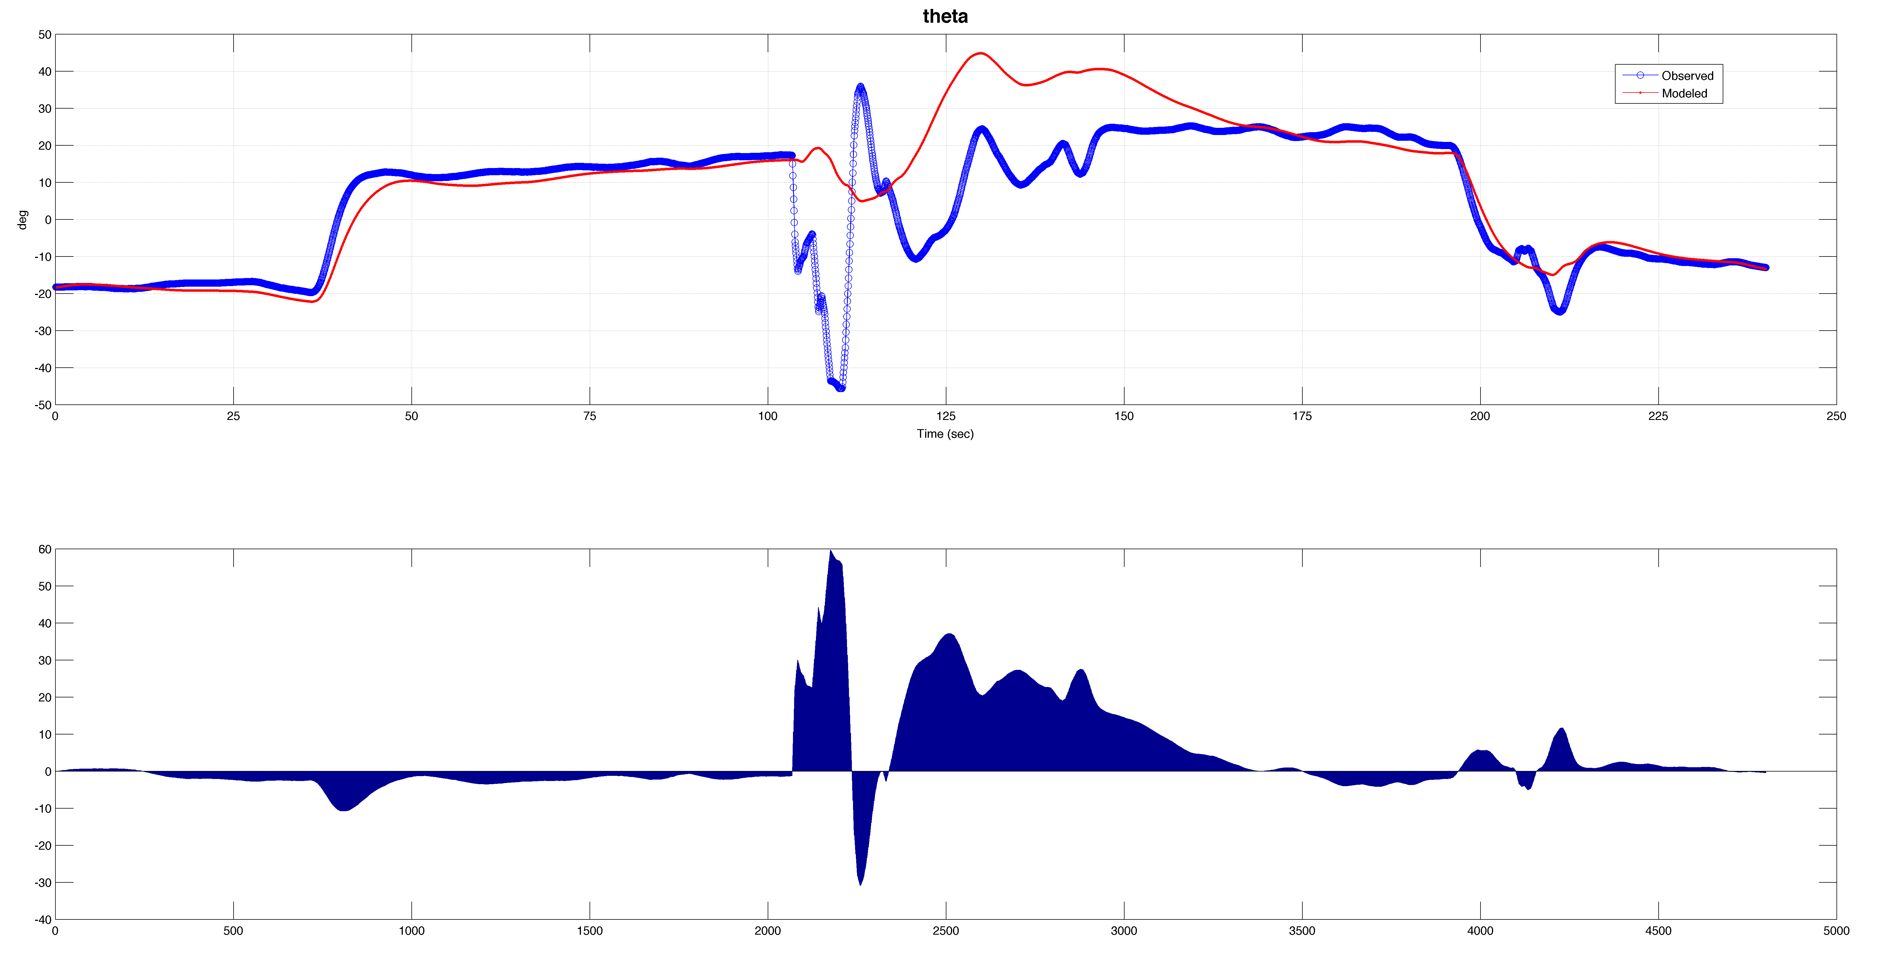
Simulated predictors
Shark attack incident:

Slide 22
Fault database
Identifying past critical failures
CRITICAL fault message - rough syntax:
“[CBIT] (CRITICAL): <text> in component: <component name>”
“[<component name>] (CRITICAL): <text>”
Components that relate to vertical control:
'MassServo','ElevatorServo','BouyancyServo','VerticalControl','ThrusterServo','DropWeight’. Others (indirect): 'Depth_Keller', 'DVL_micro’.
  Extract using Linux command set – find | grep | egrp
Eliminate redundancy and sort chronologically | by component (MATLAB)

Slide 23
LRAUV
LRAUV is designed to be operated from shore like a glider, via an Iridium Satellite link
Tethys is capable of trimming to neutral buoyancy and drifting in a low power mode
Tethys class long-range AUV
  Tethys provides capabilities falling between existing propeller driven vehicles and buoyancy-driven vehicles (gliders)
  Supports an 8 watt biological and chemical sensor payload for distances in excess of 1000 km at 1 m/s
Bellingham et al. 2010, Hobson et al. 2012
Photo: Thomas Hoover, MBARI
Notes:
The LRAUV was designed here at MBARI to satisfy the scientific need for studying biological process at the appropriate time and space scales using in situ sensors.
Tethys class LRAUV is a cross breed between propeller driven vehicles to gliders and supports an impressive 8-watt sensor payload to distances exceeding 1000km at 1m/s. (point to nose)
Tethys is designed to be operated from shore, via Iridium Satellite link.
Position is controlled by actuators which regulate:
Thrust, rudder and elevator angle, the position of the batteries which are mounted on a tray that moves frwd/back and finally, a buoyancy system that allows the vehicle to be adjusted to neutral buoyancy
Efficient operation of Tethys depends on running at neutral buoyancy and trimmed for zero angle of attack
Velocity profiles
----- Meeting Notes (8/11/14 11:54) -----
ballast to
website!

Slide 24
LRAUV
Studying phytoplankton blooms from boom to bust
Rechargeable batteries | 1 week | 315 miles
Expendable batteries | 3 weeks | 945 miles
Goal | - | 2300 miles
Hawaii
Slide credit: Thomas Hoover, MBARI
Notes:
Combining these capabilities provide a foundation for studying phytoplankton blooms from boom to bust,
by providing a mobile platform which can survey a bloom continuously through the two weeks to month-long lifetime of a bloom.
Any vessel designed to stay at sea for long durations → Reliability becomes major theme
For autonomous systems to be successful for long deployments, they must be reliable in the face of subsystem failures and environmental challenges. For example, should an AUV suffer the failure of one of its internal actuators, can that failure be detected and mitigated, or does the failure result in the loss of the remaining deployment or even the loss of the vehicle?
----- Meeting Notes (8/11/14 11:54) -----
km!

Slide 25
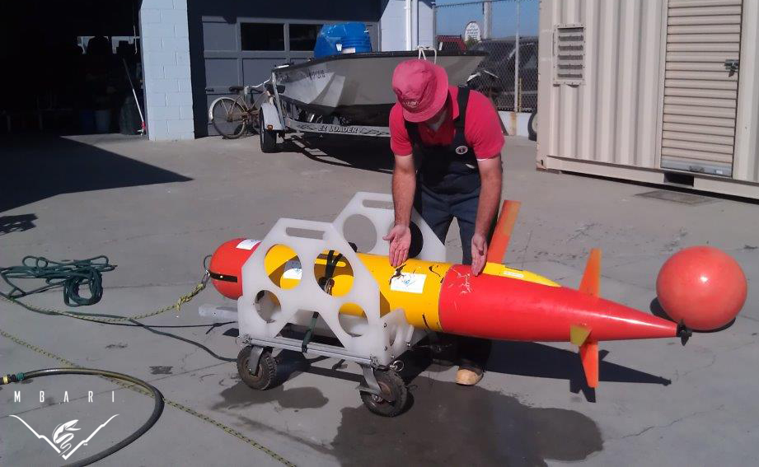
LRAUV failures
Maximum MTBCF* of 150 hours at best
Failures necessitate human intervention
*Mean Time Between Critical Failure
Tethys spends 2 days on the bottom
September 12th, 2013
Tethys attacked by a Great White
September 30th, 2013
Photos: LRAUV group, MBARI
Notes:
We’ll be using this mission as a study case
----- Meeting Notes (8/11/14 12:05) -----
between uplanned interventions

Slide 26
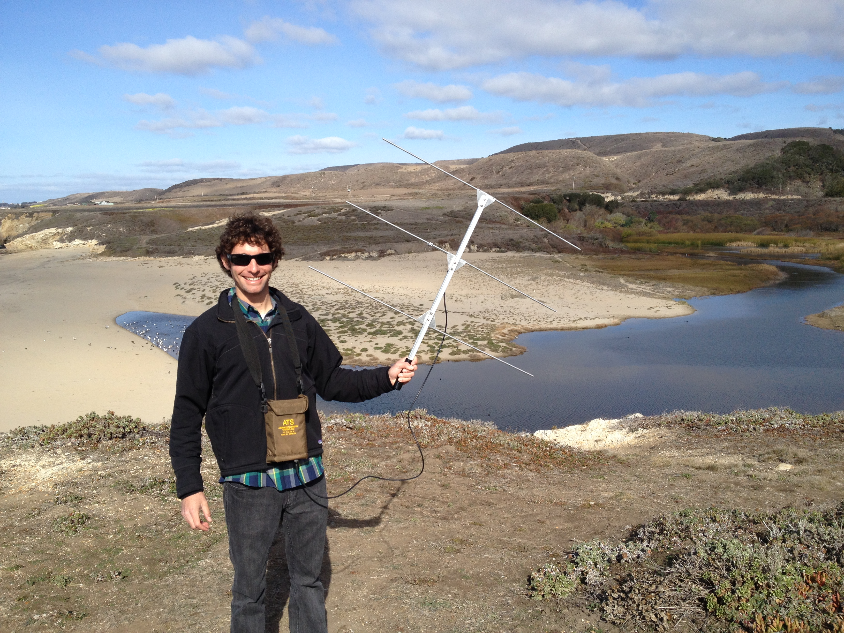
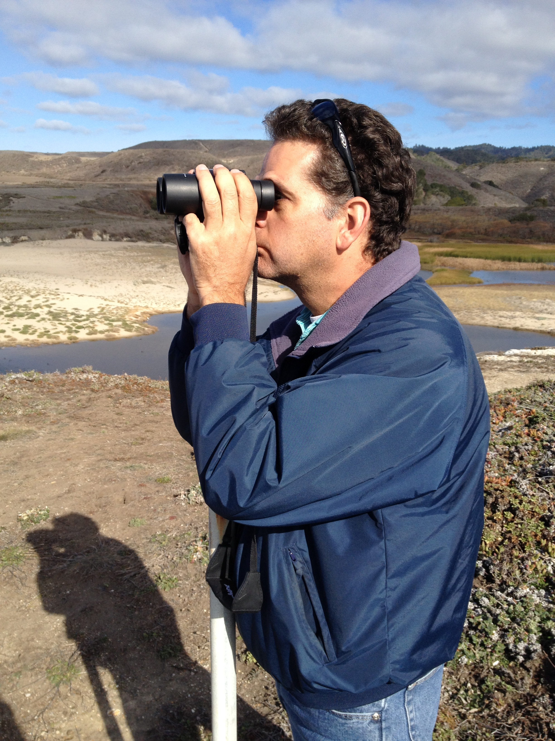
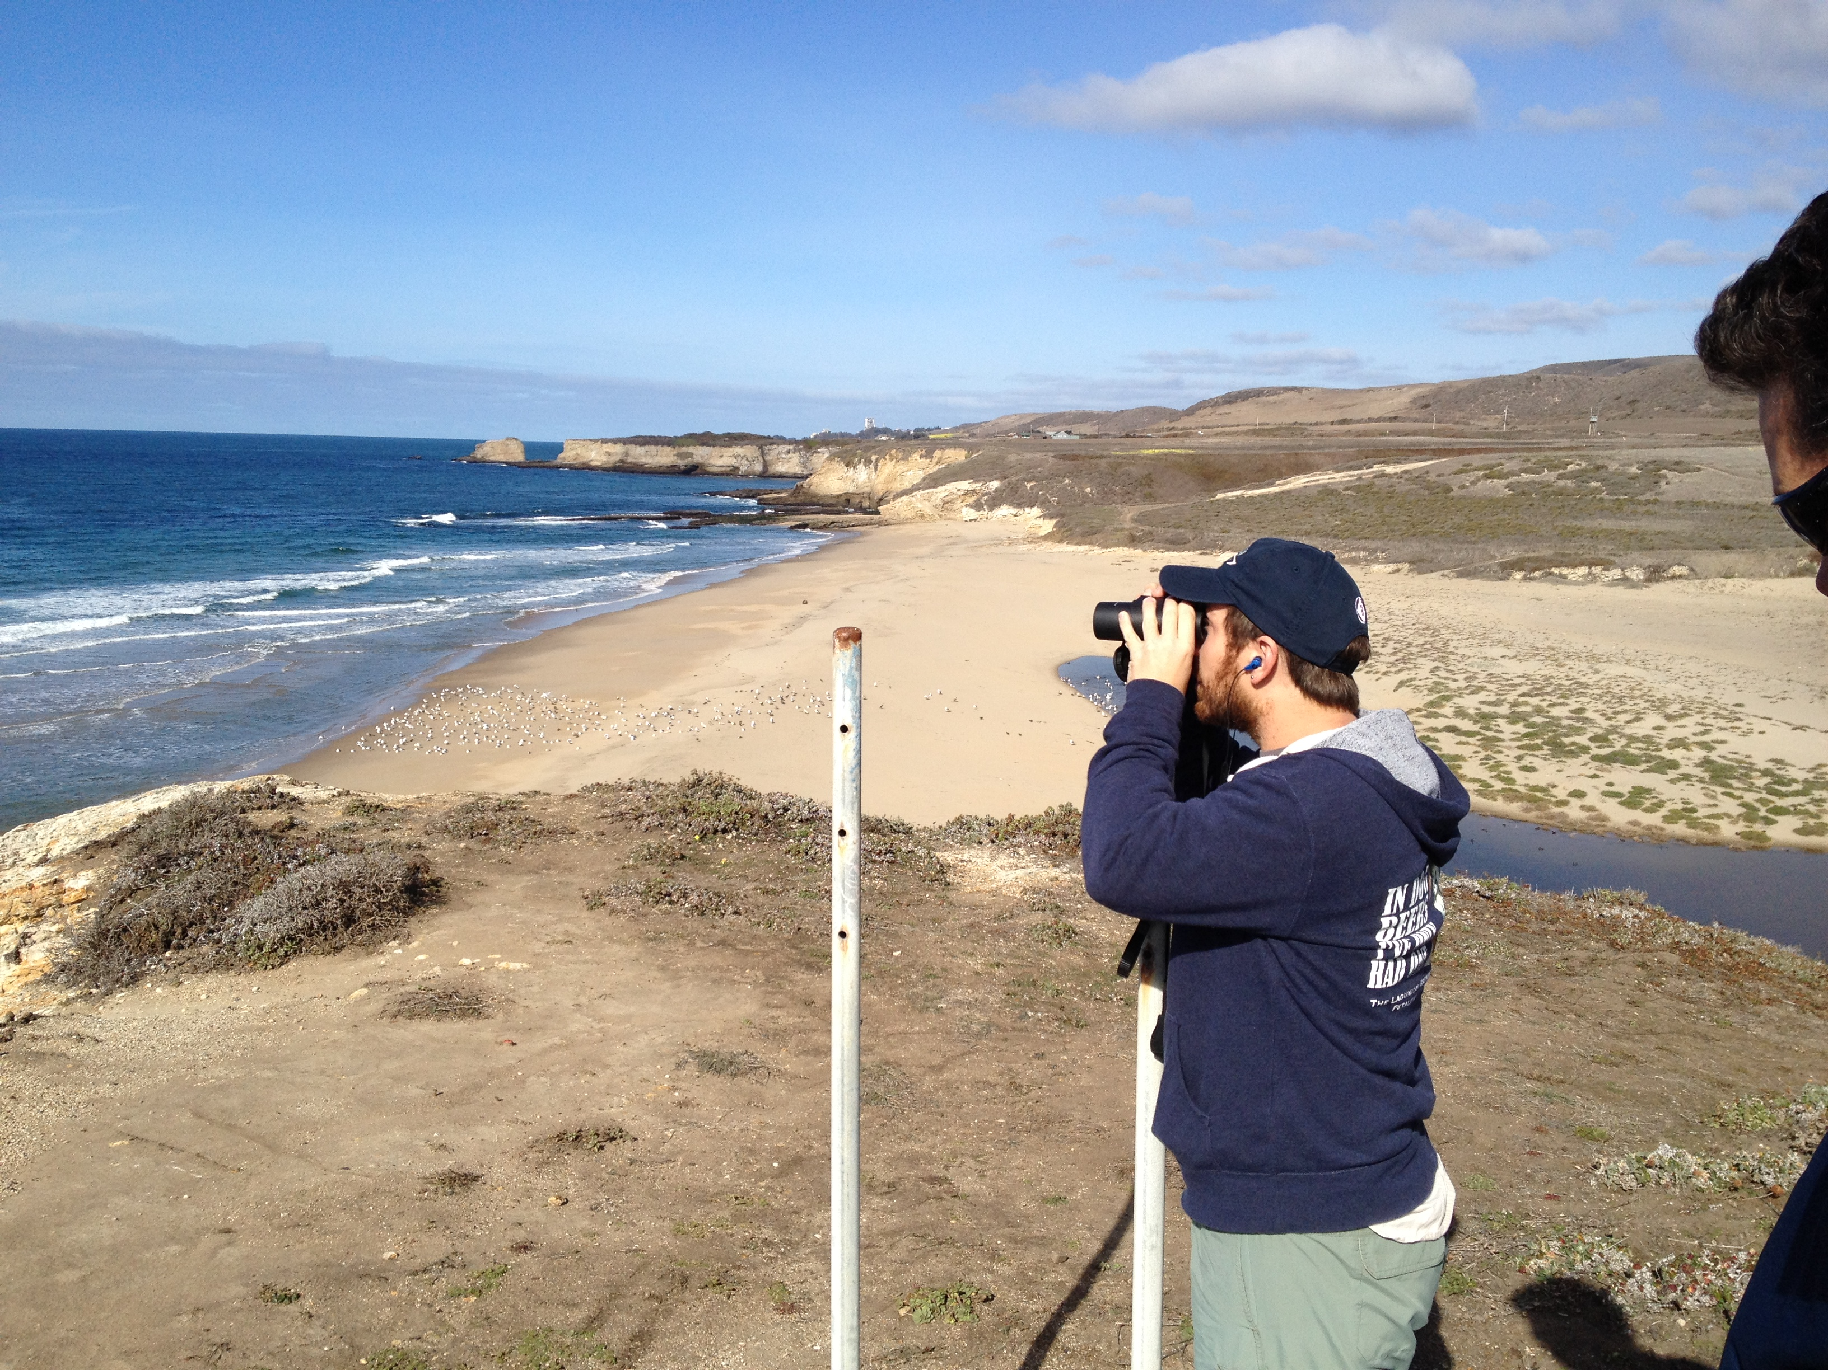
LRAUV failures
Photos: LRAUV group, MBARI
Notes:
These are not pictures of LRAUV fail… Due to their devotion we’ve managed to not loose a ¼ million$ AUV so far.

Slide 27
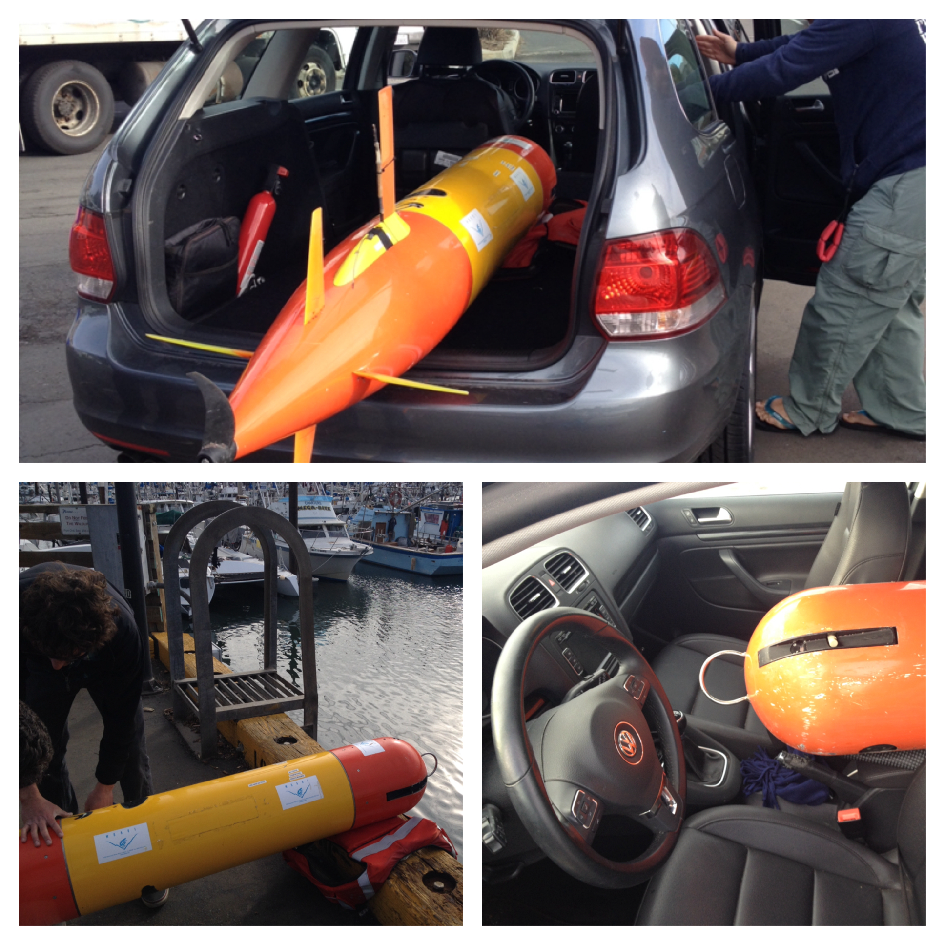
Photos: LRAUV group, MBARI
Notes:
Oh that and the lab’s intricate emergency recovery and transportation technic….

Slide 28
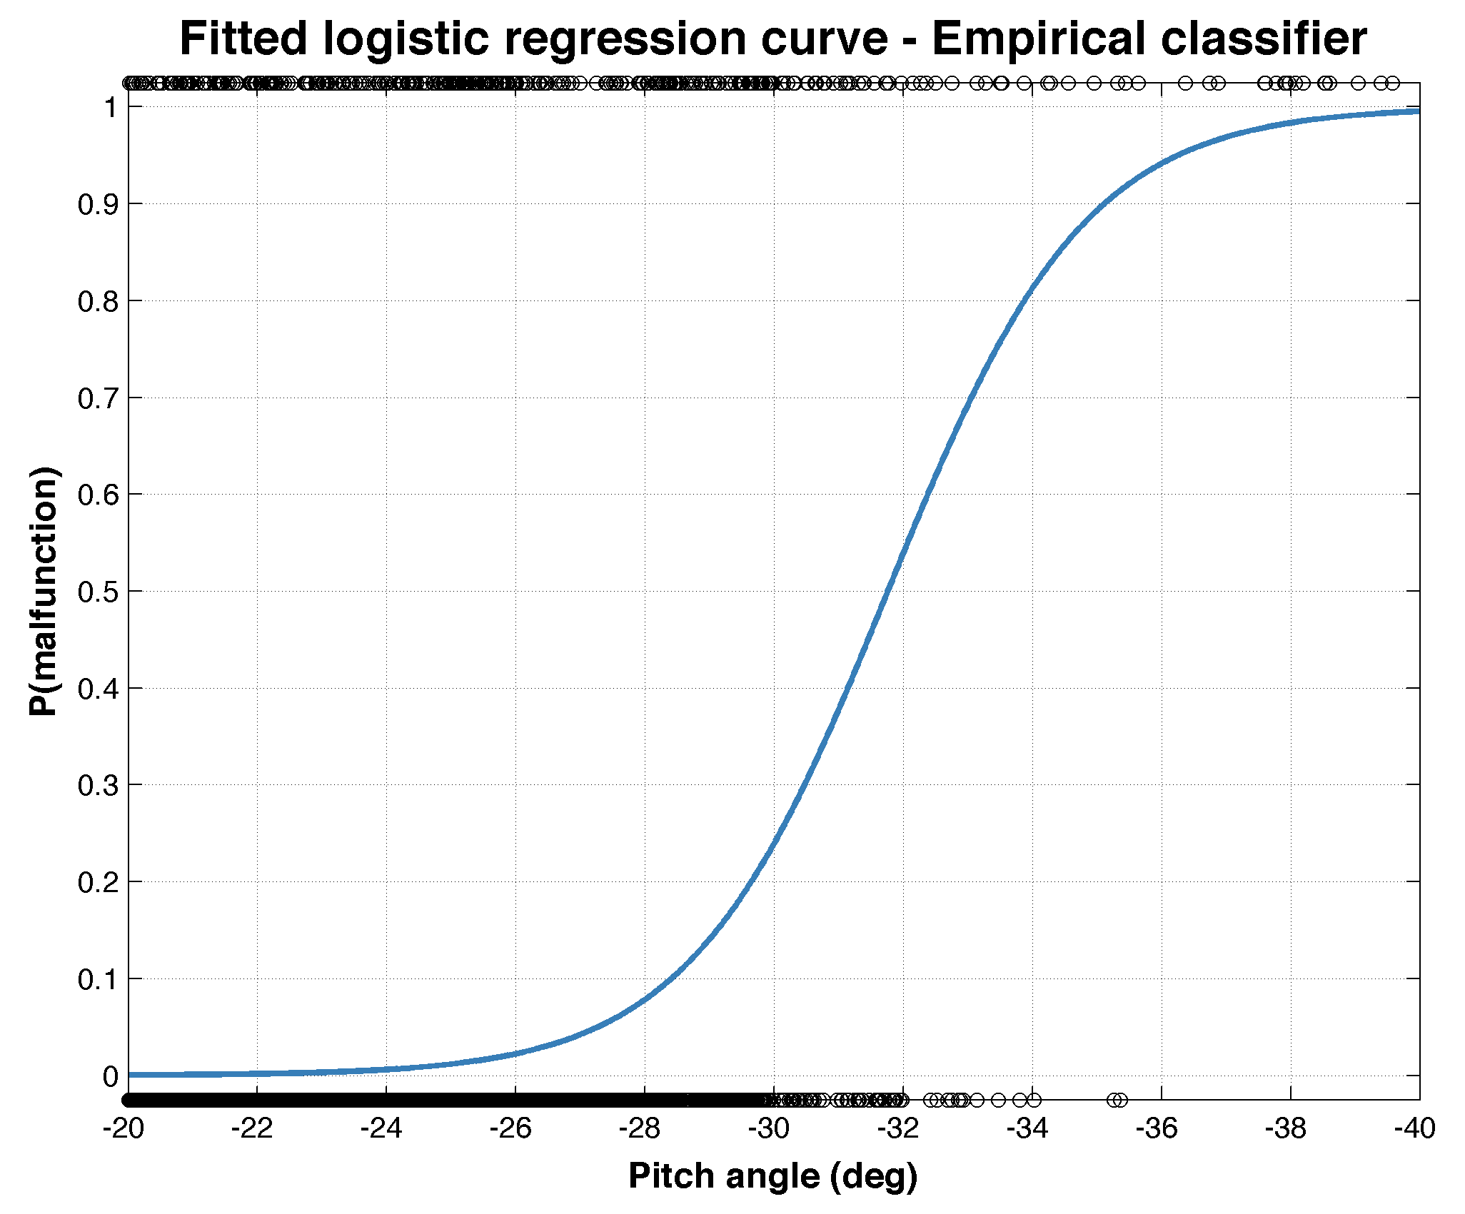
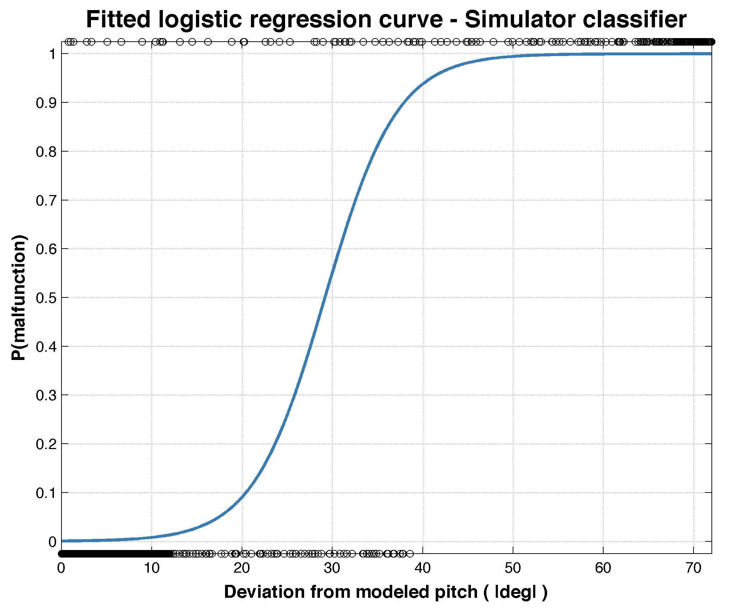
Binary classification
Malfunction
Normal
p(y=1) = | p(y=1) =
e^{-7.325 + 0.251*(Pitch)}
e^{-20.816 - 0.655*(Residual)}
1 + e^{-7.325 + 0.251*(Pitch)}
1 + e^{-20.816 - 0.655*(Residual)}
Notes:
X axis!
----- Meeting Notes (8/11/14 11:54) -----
loose formula

