Slide 1
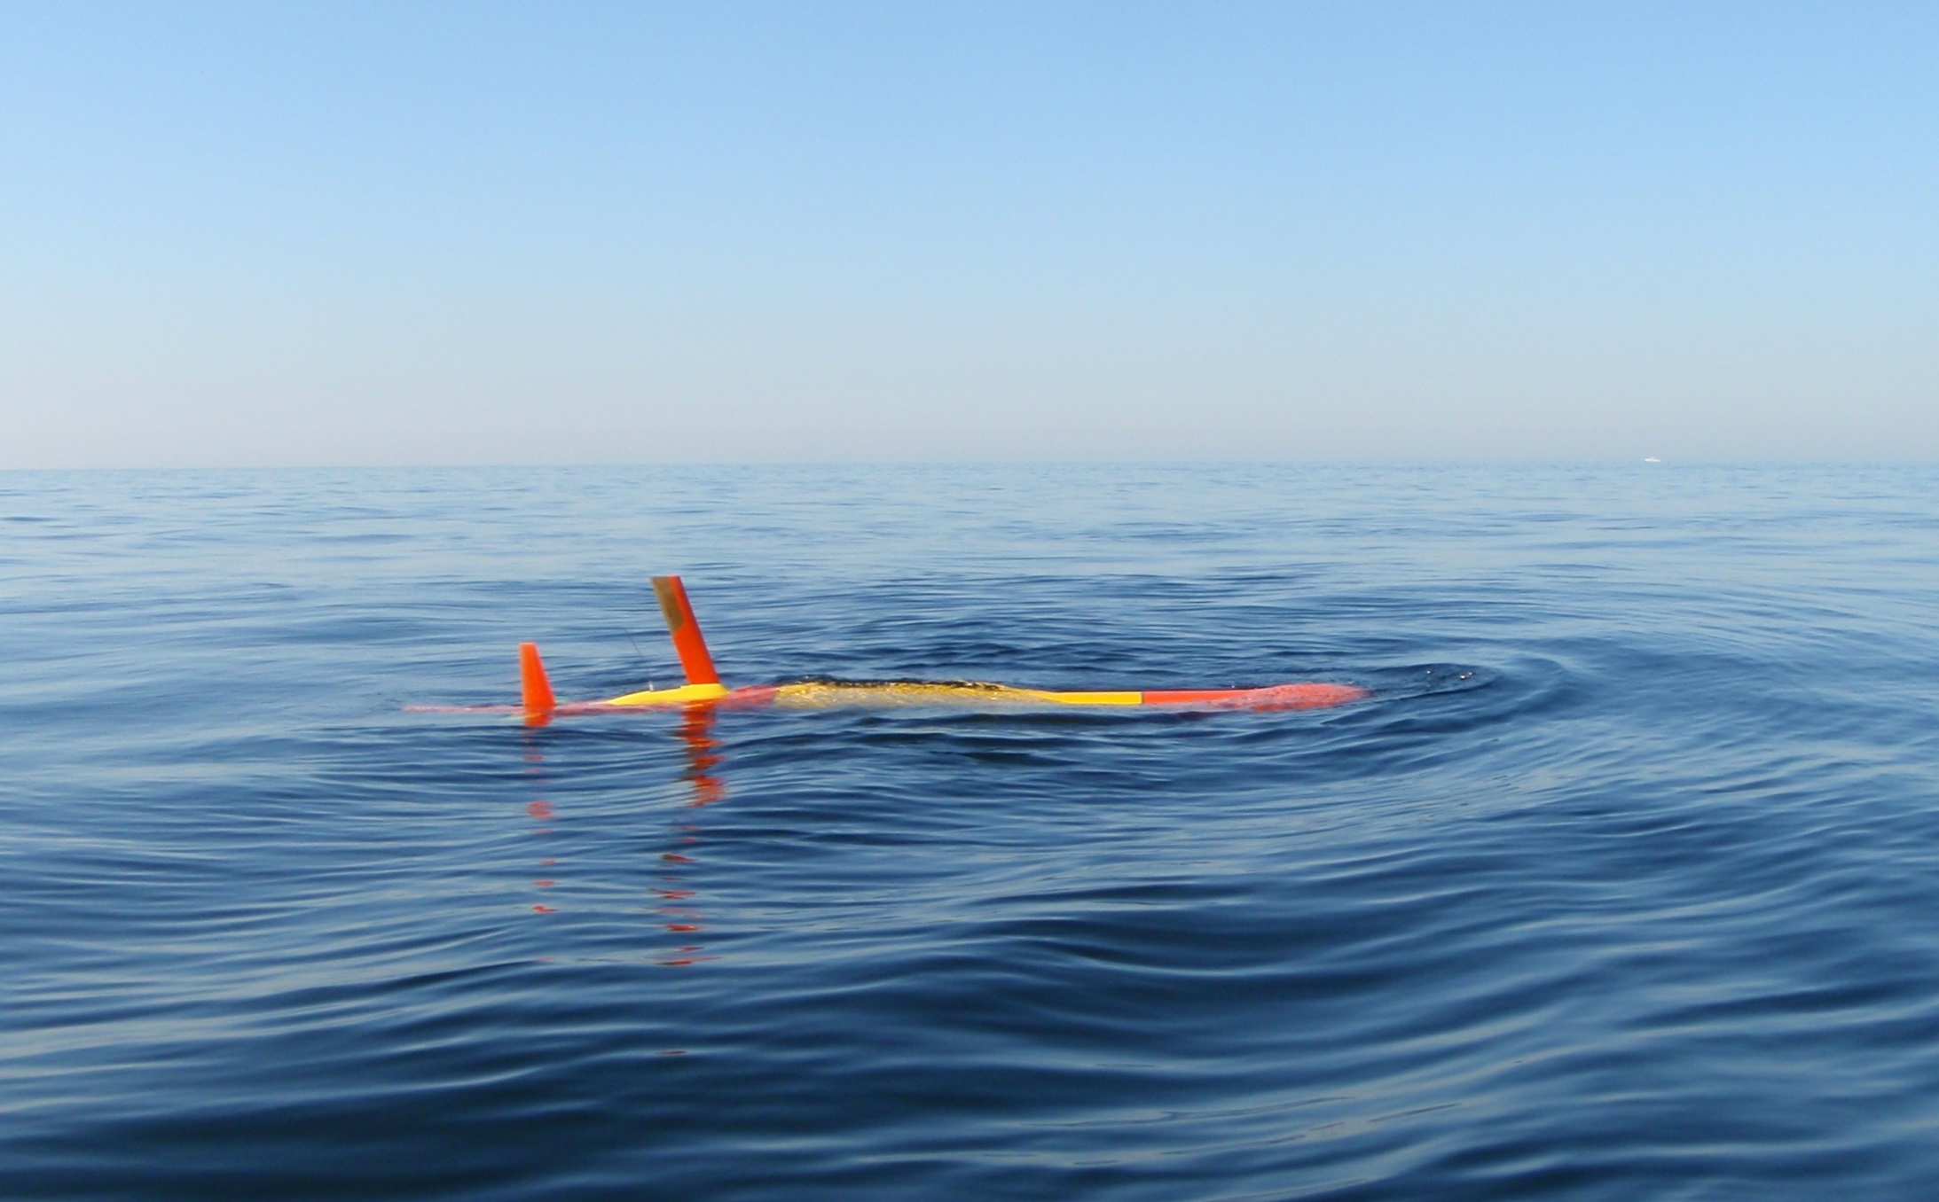
Operating Tethys, a Long Range Autonomous Underwater Vehicle
James Bellingham – Principal Investigator
Brett Hobson – Project Manager / Mechanical Engineer
Yanwu Zhang – Propulsion Design
Michael Godin – Software Architecture
Jordan Stanway – Navigation Software
Brian Kieft – Application Software
Rob McEwen – Controls Engineer
Jon Erickson – Mechanical Design
Farley Shane – Mechanical Engineer
Ed Mellinger – Electrical Design
Mark Chaffey – Electrical Design
Monterey Bay Aquarium Research Institute
Presenter: Thomas Hoover
Courtesy of David and Lucile Packard Foundation

Slide 2

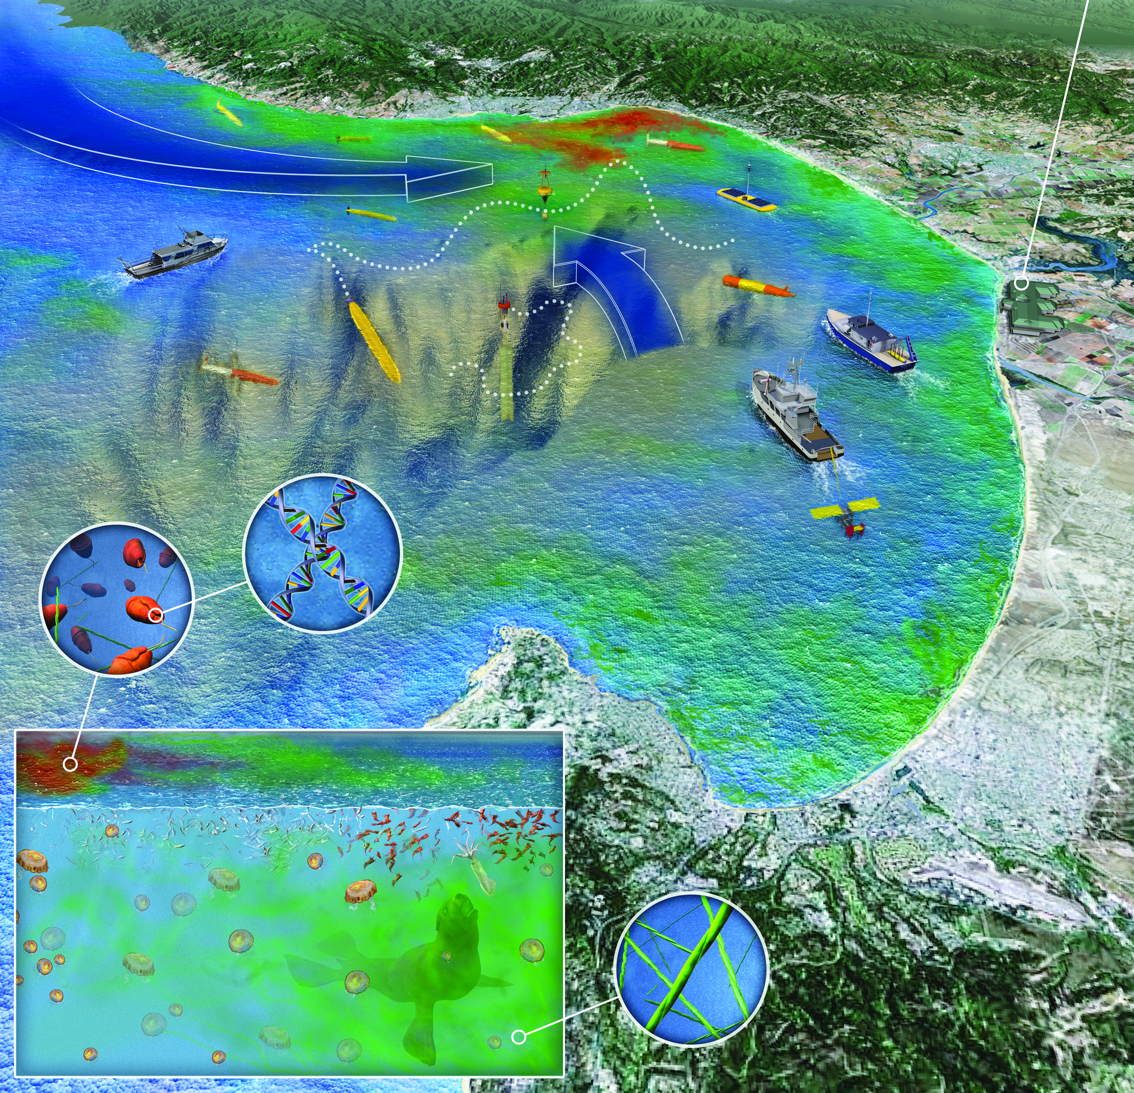
Why Tethys?
The Questions are changing -
From Physics to Biology
From:
Why is the salinity higher over there,
To:
Why are the diatoms toxic today and not yesterday
Notes:
Salinity, conductivity and density measurements might be compared to making maps of where the mountains, valleys, rivers and forests are.
Measuring phytoplankton, diatoms and the rest of the “squishy and growy things” might be compared to trying to understand the herd of antelope and the lions who feed on them.

Slide 3
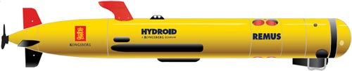
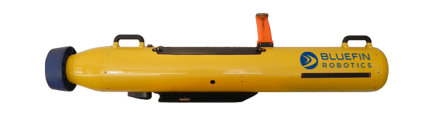
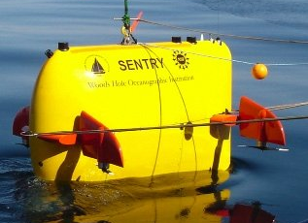
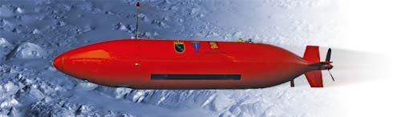
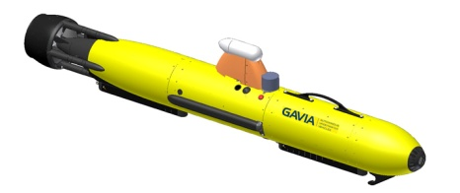
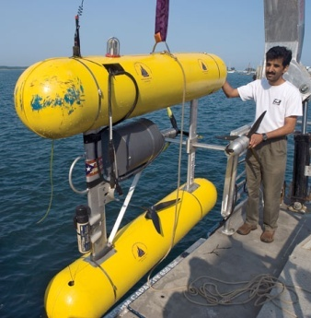
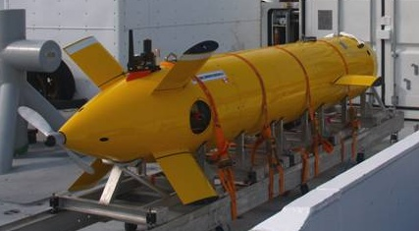
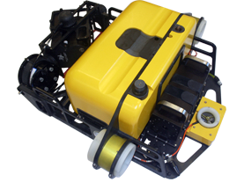
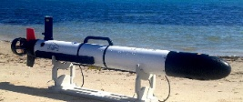
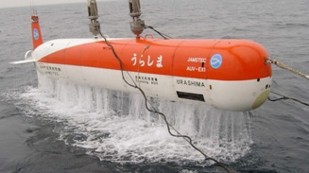
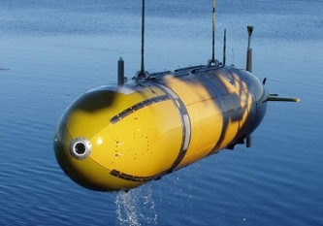
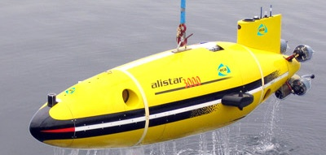
What About Existing AUVs?
Propeller-driven (cruising and hovering)
Hydroid Remus 100
Bluefin 9”
Kongsberg Hugin 100
WHOI Sentry
Teledyne Gavia
WHOI Seabed
Bluefin HAUV
ISE Explorer
Ocean Server IVER2
ECA Alistar
NOCS Autosub
JAMSTEC Urashima
Either too big, insufficient range or unable to “go Lagrangian”.

Slide 4
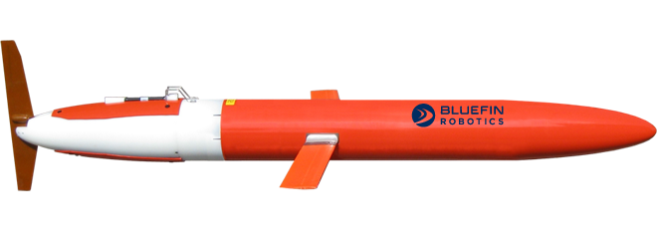

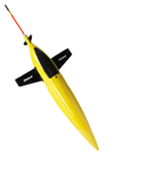
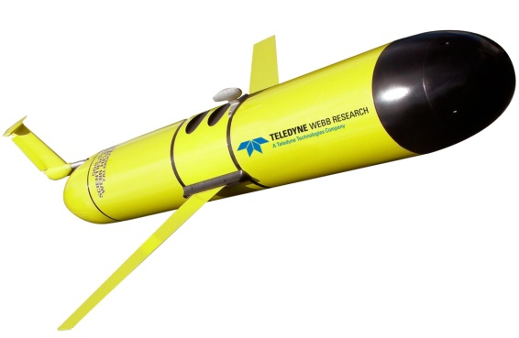
Why not buoyancy driven gliders?
Scripps Bluefin Spray
Teledyne Webb Electric Glider
UW – iRobot Seaglider
Teledyne Webb Argo Float
Too slow (<0.5m/s) and not enough payload power

Slide 5
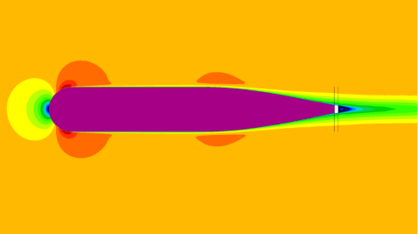
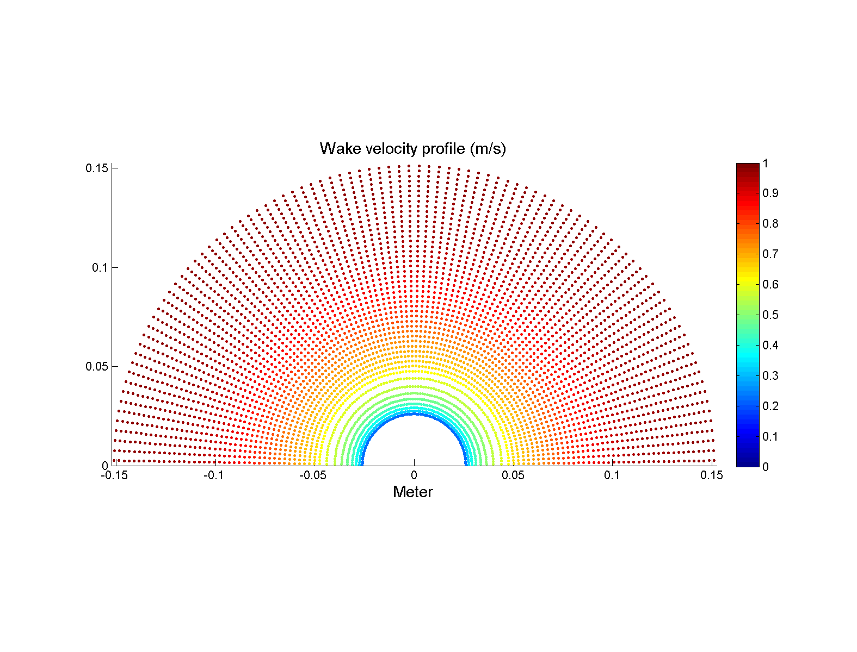
Technical Design
Elements that determine range and endurance.
shape
Potential Flow
separation
battery capacity
size
battery performance
C_{d}
CFD Calculation
propeller
efficiency
Range/ Endurance
Wake
C_{d}
PLL Propeller Design
RPM/Torque
hotel
motor
efficiency
appendage drag
Motor Selection
Notes:
Ability to carry sensors averaging 8 W over distances of greater than 1800 km (1000nm) at 1 m/s (2kt).
Ability to cover more than 4000 km (2200nm) with minimal sensors at 0.5 m/s (1 kt).
Ability to trim to neutral buoyancy and drift. (Lagrangian)
Small enough to be operated “out of a garage”
Low enough cost to be operated in significant numbers.

Slide 6
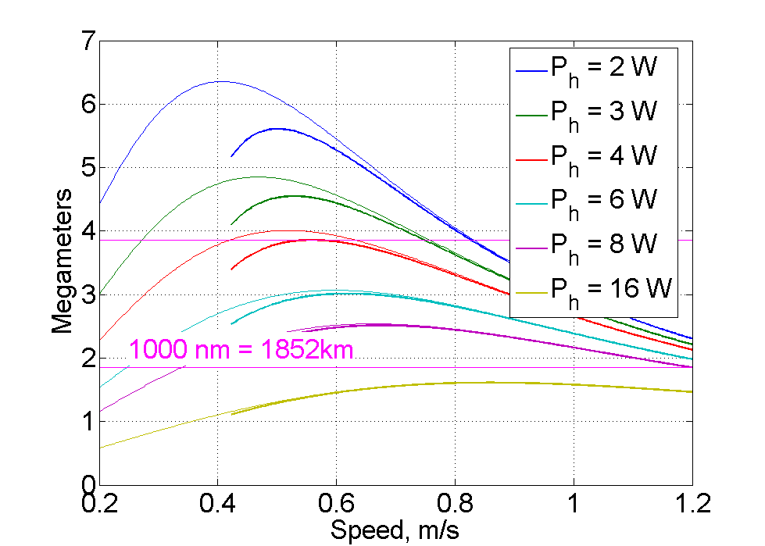
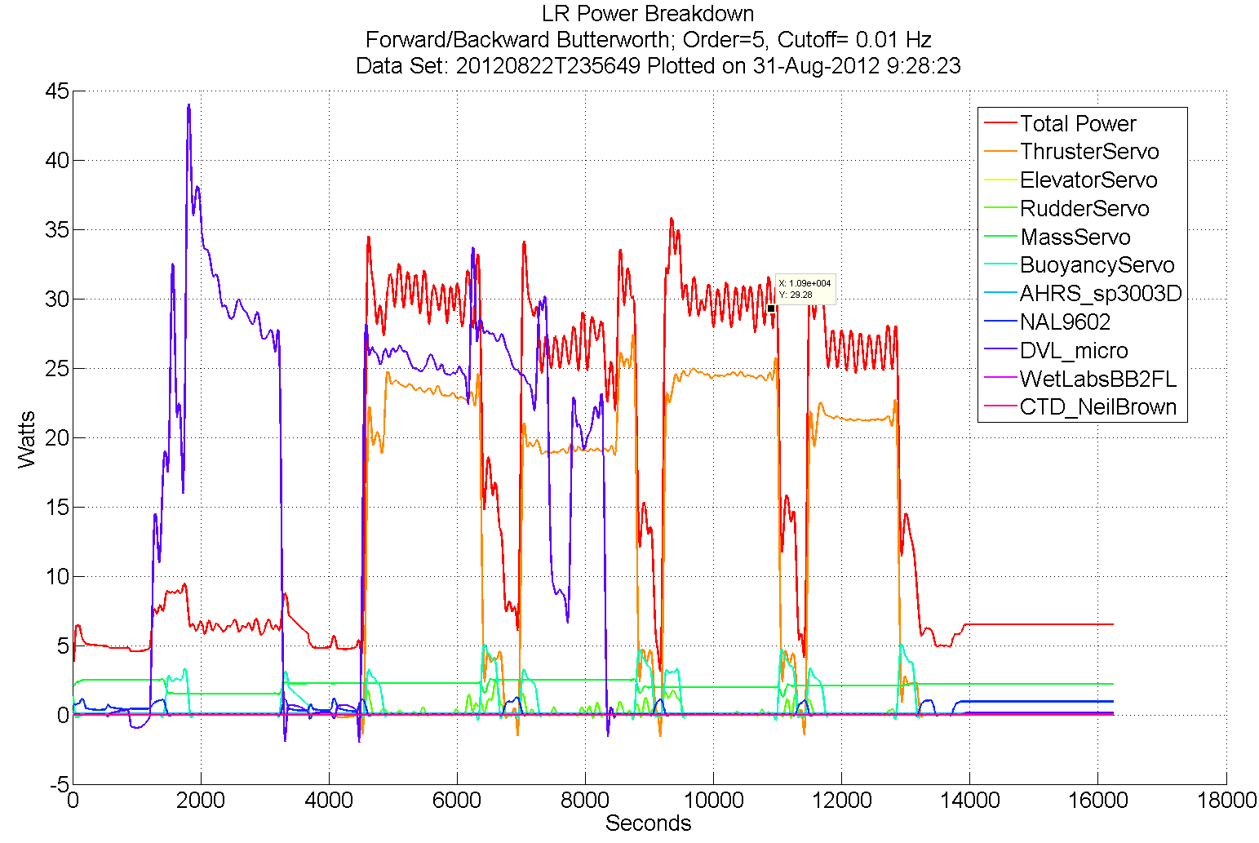
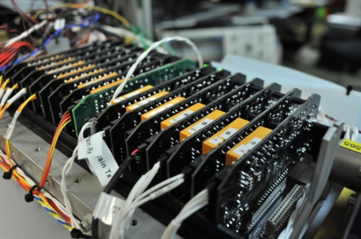
Technical Design, con’t.
16 Channels of independent, configurable, load control (expandable to 24)
Complete galvanic isolation of both power and communication ports for all channels
Allows isolation of ground faults
Easy to “reboot” auxiliary payloads
Measure and log current and voltage
Circuit breaker over current protection
Estimated range with various hotel loads
Tethys Load Control Boards

Slide 7
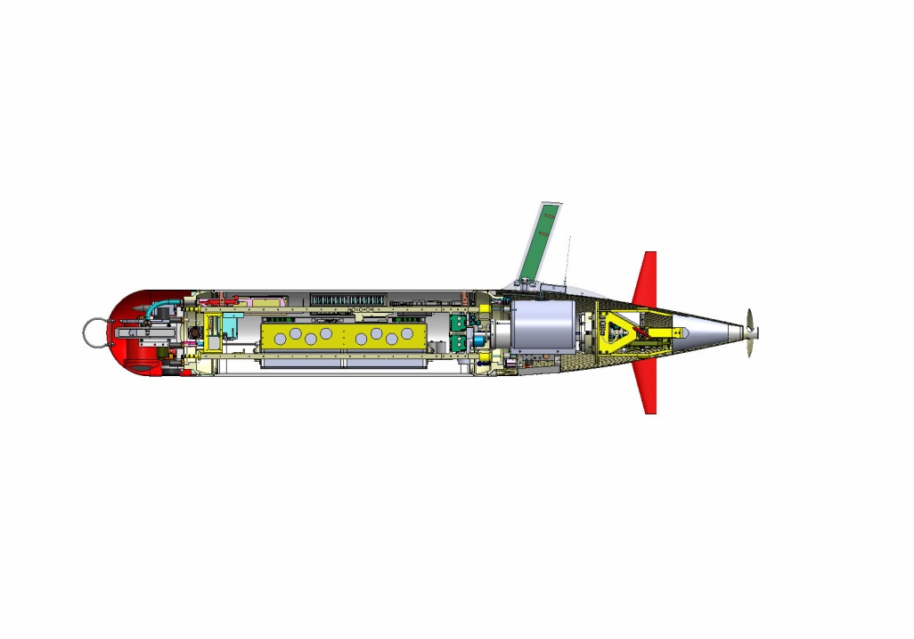
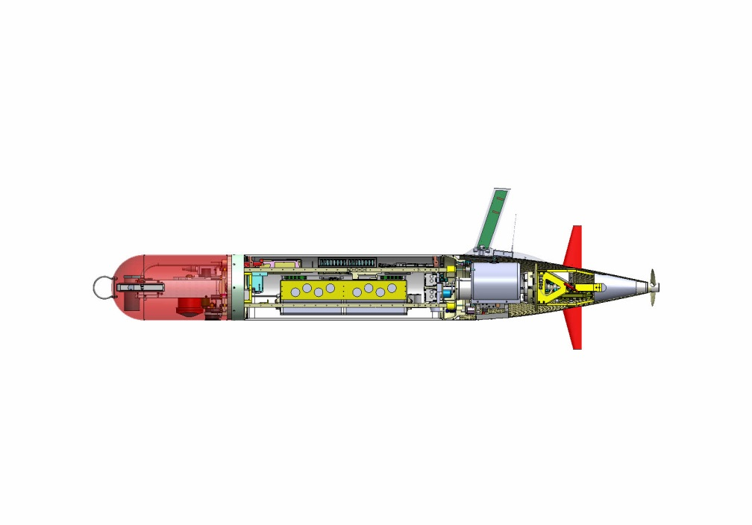
Design Implementation
ADCP, Fluorometer, CTD, O2, NO2 and PAR sensors
Iridium, GPS and RF in mast
Custom Design Propeller
Additional payload space for Turbulence sensor, ESP, Docking equipment, etc
Shifting Mass allows controlled angle of attack during flight
Buoyancy Engine allows neutral drift in water column
Rechargeable Li polymer
or Primary Batteries Li Sulfuryl Chloride
110 kg ( 240lb) dry weight
12” diameter, 78” to 102” length
Constant diameter 300m (1000 ft) pressure vessel,
Forward and Aft wet fairings

Slide 8
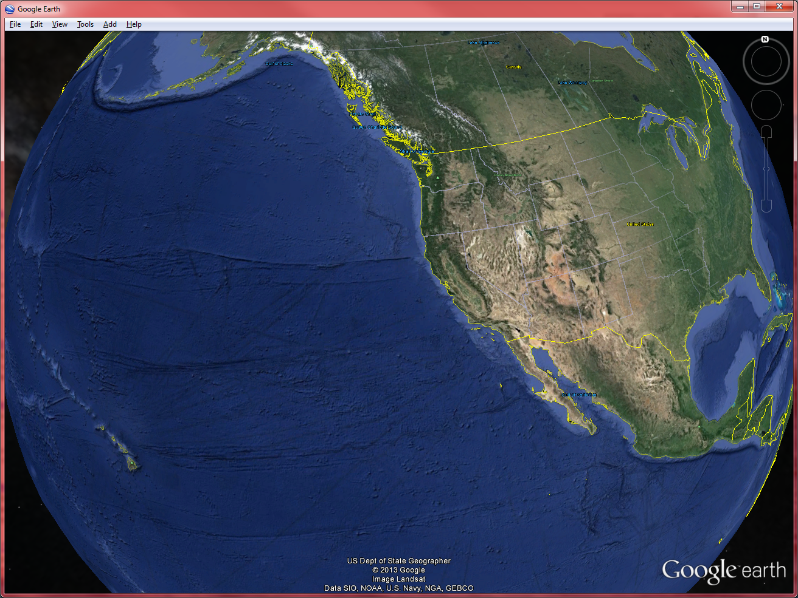
Operational Range…
Rechargeable Batteries
Expendable Batteries
Goal

Slide 9
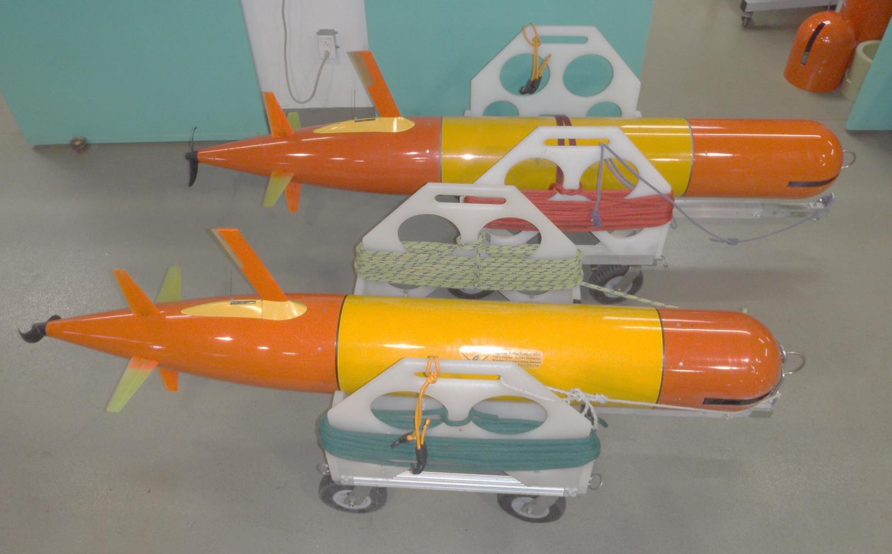
Operational hours to date…
Two vehicles with a combined total of 100+ deployments and 6,300+ hours of operation.
Maximum MTBCF* in excess of 150 hours has been achieved.

Slide 10
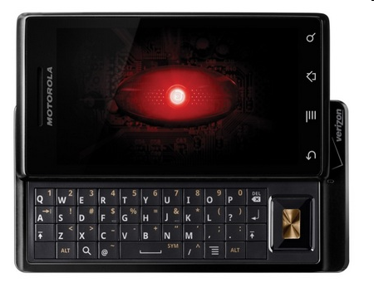
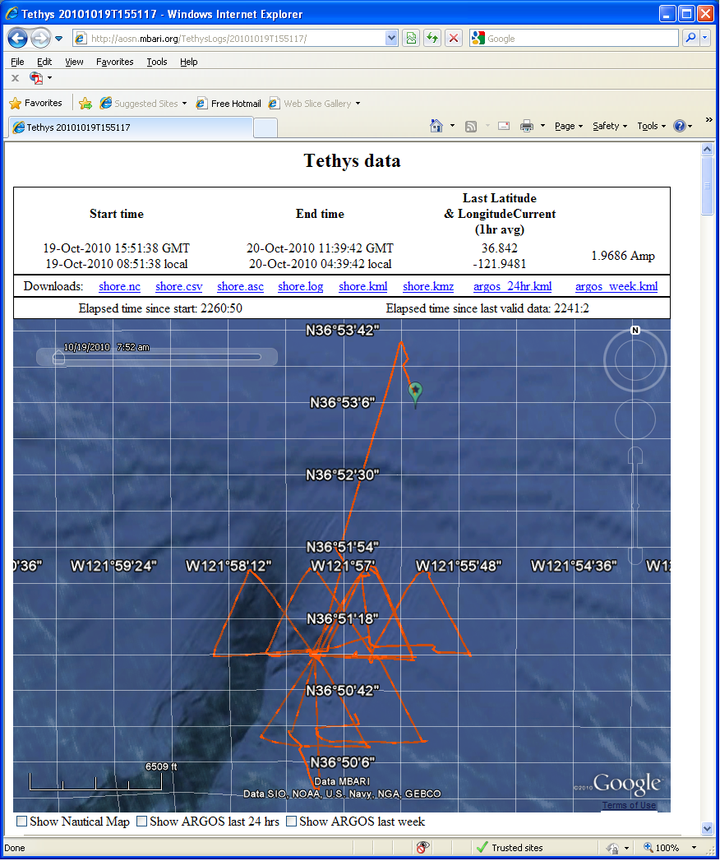
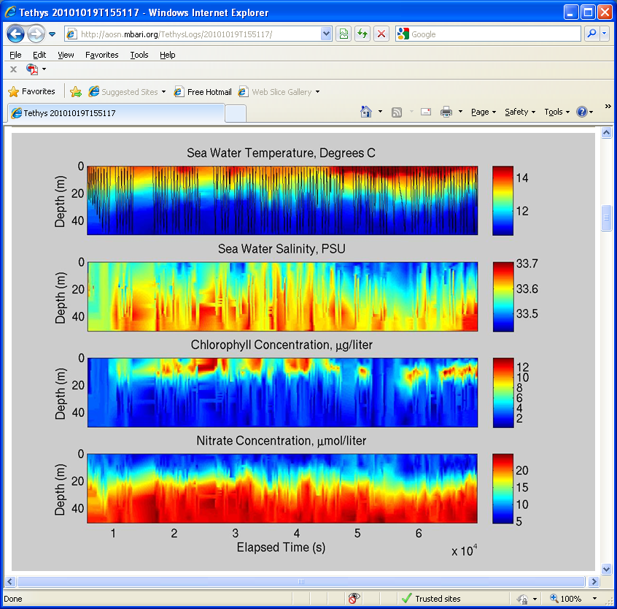
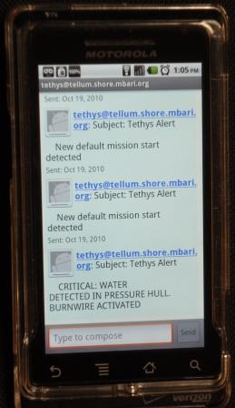
Operating Tethys
Smart phone web interface
Web interface for “real time” data review and operational control
Text message to alert operator of abnormal conditions.
Prioritized logging optimizes use of multiple communication channels

Slide 11
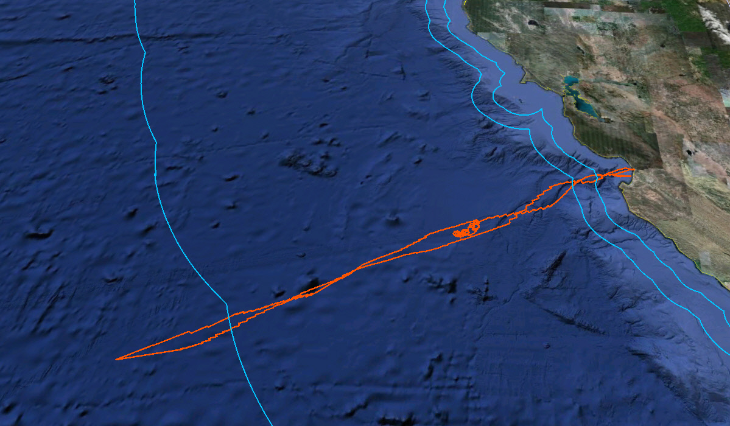
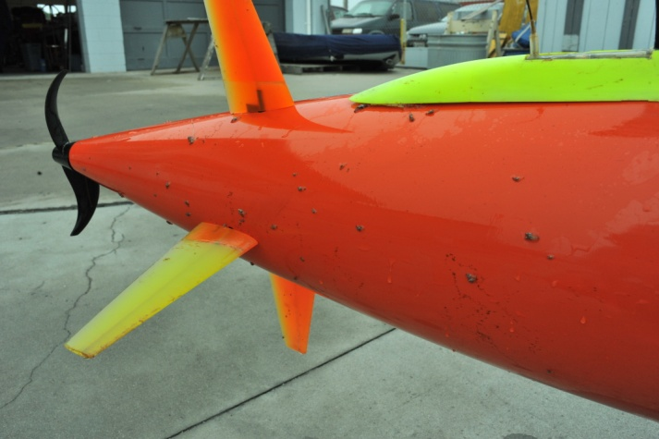
CANON 2010
  24 days, >1800 km, 500 km offshore, Three different missions
24 days, >1800 km, 500 km offshore, Three different missions
    Bottom Boundary Layer Experiment (NPS/MLML Collaboration)
200 MILE U.S. EEZ BOUNDARY
CANON Drifter Tracking
Play Video LRAUV_NOAA
500 km offshore on CalCOFI Line 69
Goose Barnacles

Slide 12
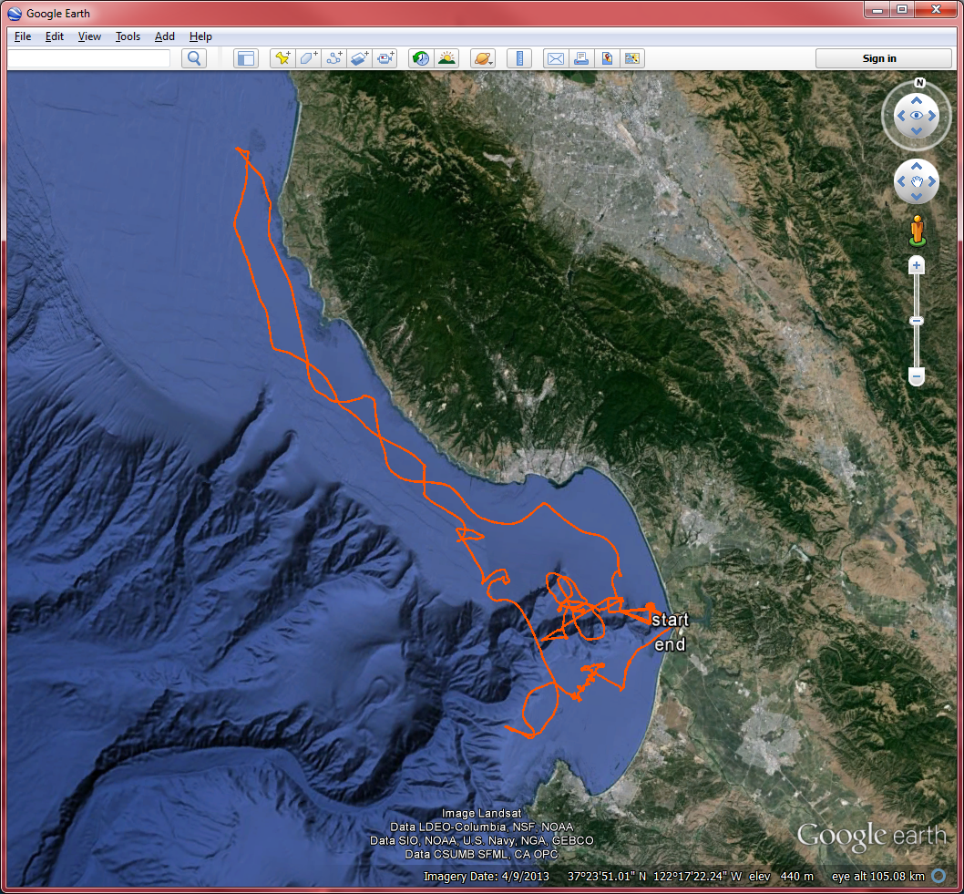
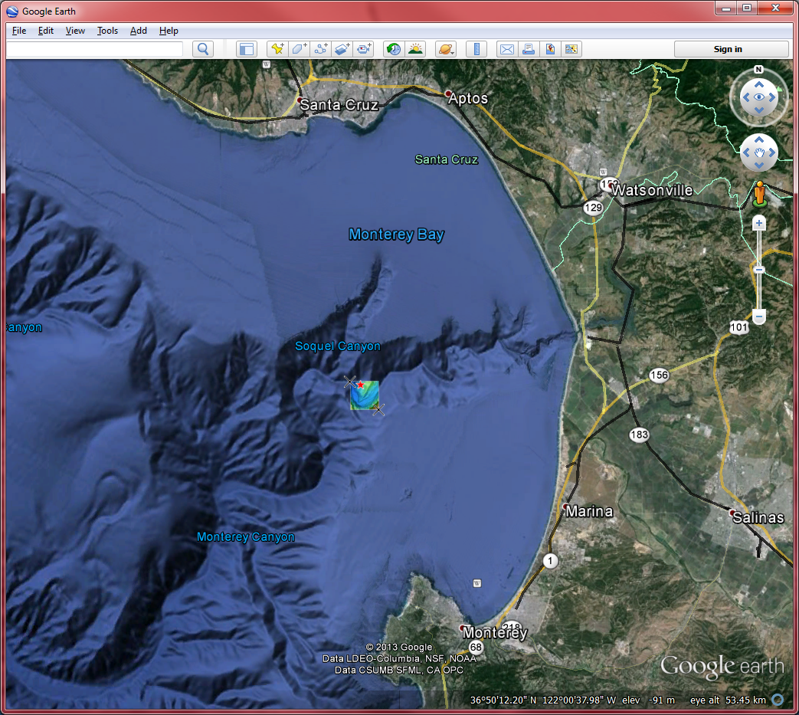
Tethys Down
Tethys 63 - 2012 Mar 8
Docking Testing with the Power Buoy during the day; station keeping at night. Rather than waste that time, Tethys was commanded over the canyon for a deep dive test to 280m.
She dove at 1130 that night and did not check back in….
Search with Airplane, small boat, vessel for hire.
Water depth > 900m. Crush depth is 450m.
No MBARI ships or ROVs available.
Survey with acoustic tracking beacon found target on bottom in vicinity of last report.
New MBARI ROV rushed to completion.
18 days later, at the Monday meeting planning the ROV dive, my phone rings…
Notes:
Search with Airplane, small boat, vessel for hire.
Water depth > 900m. Crush depth is 450m.
No MBARI ships or ROVs available.
Survey with acoustic tracking beacon found target on bottom in vicinity of last report.
New MBARI ROV rushed to completion.
18 days later, at the Monday meeting planning the ROV dive, the phone rings…
Tethys is on the ML Fuel dock. She was found by a fisherman off the Salinas River and brought to the fuel dock.

Slide 13
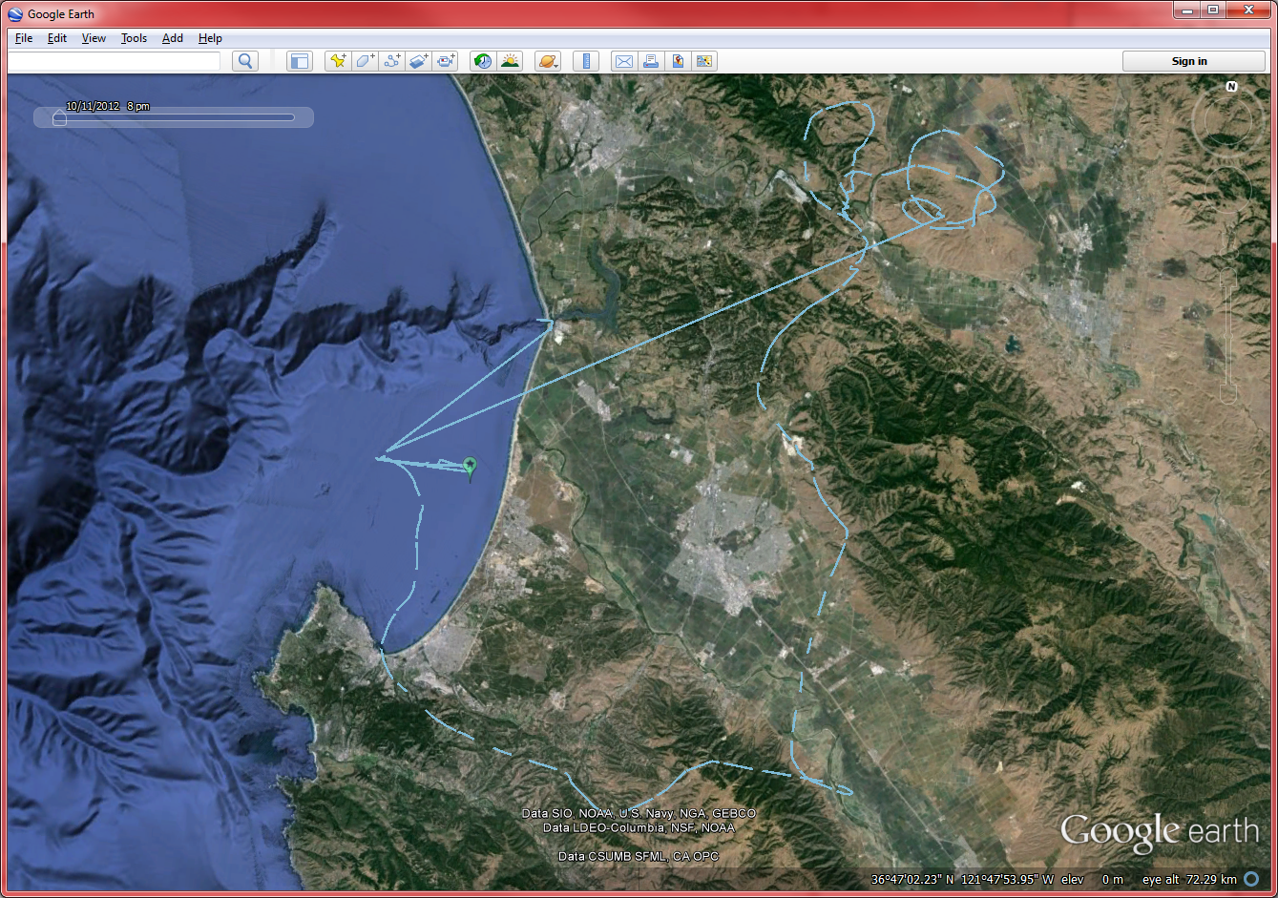
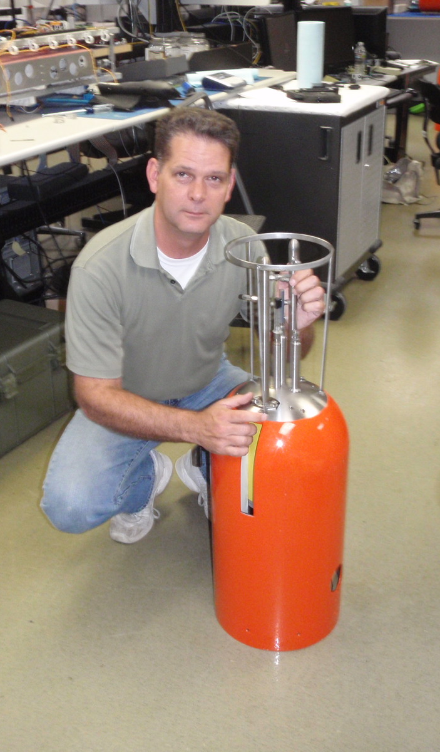
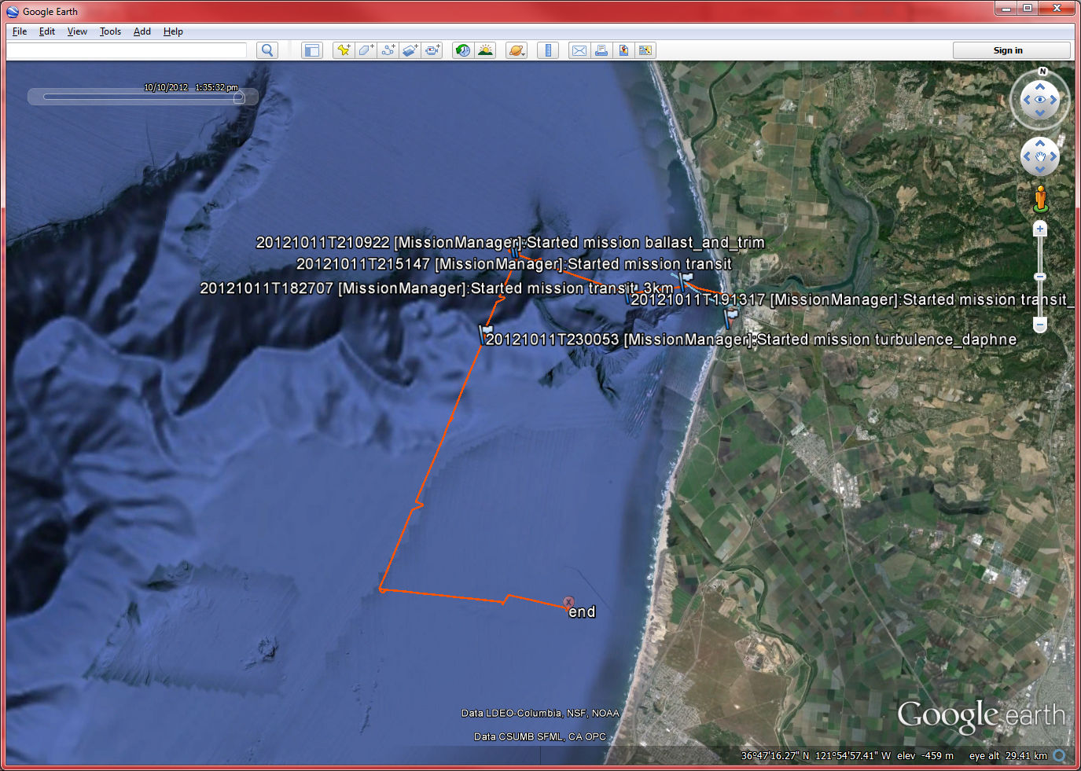
Daphne Down
Daphne 9 – 2012 Oct 11
Micro turbulence measurements requiring Daphne to run 2 to 3 meters off the bottom.
With a fancy sensor on her nose…
Play the video
LRAUV Daphne Recovered
Notes:
We were concerned about getting too close to shore.
Barely visible in this picture is the Marina Beach Water Treatment plant pipe. Buried under rip rap, up to 5 meters above the surrounding sea floor.
Plunging surf at the beach, hazardous for man, boat and Daphne.
Walked the beach and searched with acoustic transponder. Got a ping toward the seaward end of the line.
Play video

Slide 14
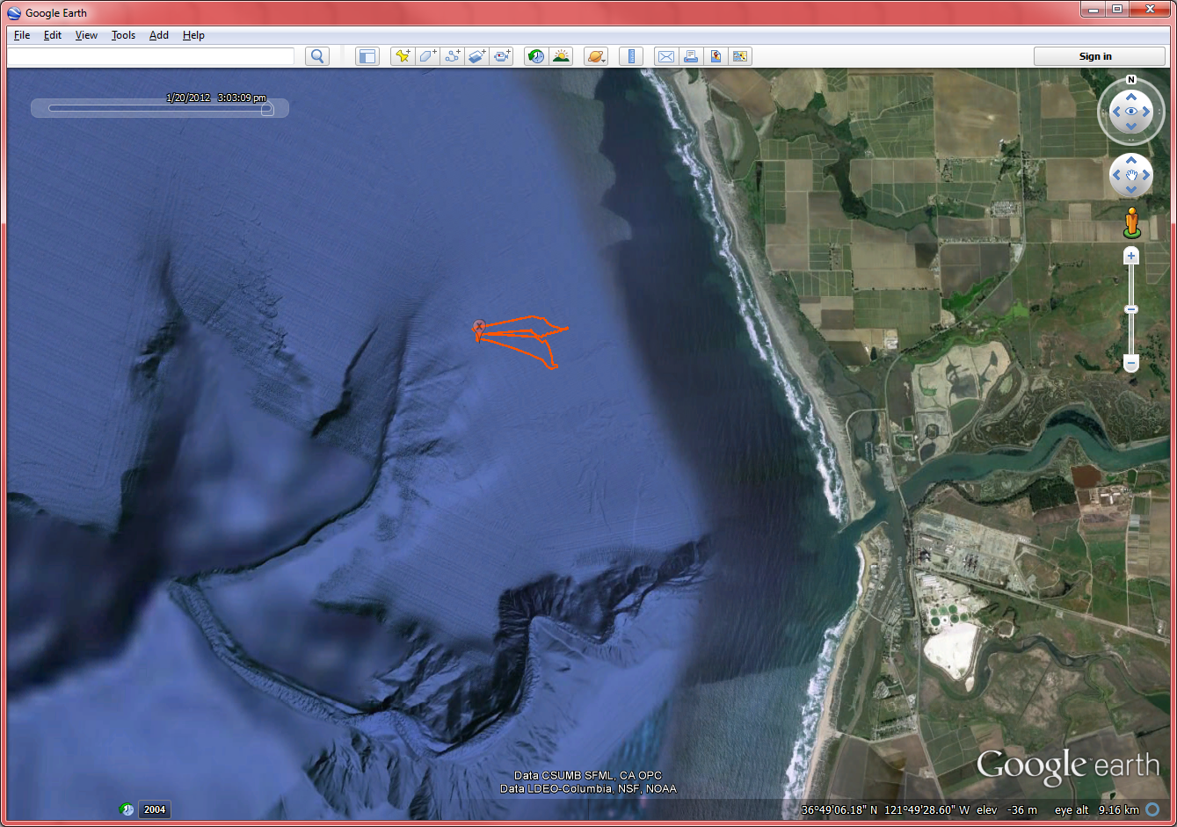
Hooking up with a fisherman
Tethys 56 – 2012 Jan 20
Making runs at an underwater dock with a camera recording video to see if we are successful.
Another run done, down loading data and suddenly, we lose comms with the vehicle…
Play the Video Tethys Captured
Notes:
We regain communications but she is making 12 knots for the harbor!!!
Looking out the window, we see a fishing vessel coming in and rush to meet it at the pier.
There are differing stories about what exactly happened but, we had a camera rolling…
Play video of “Daphne Captured”.

Slide 15
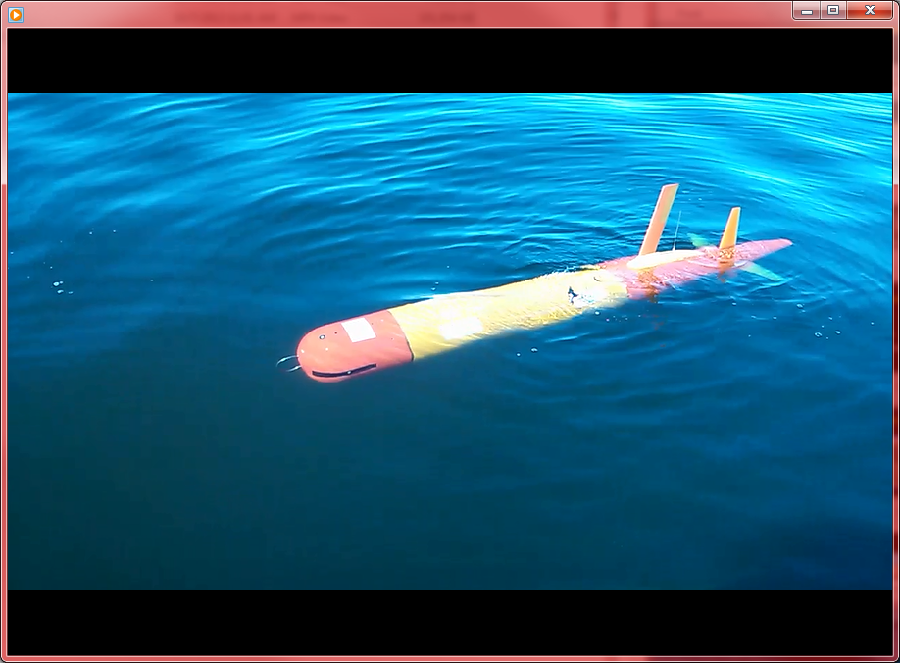
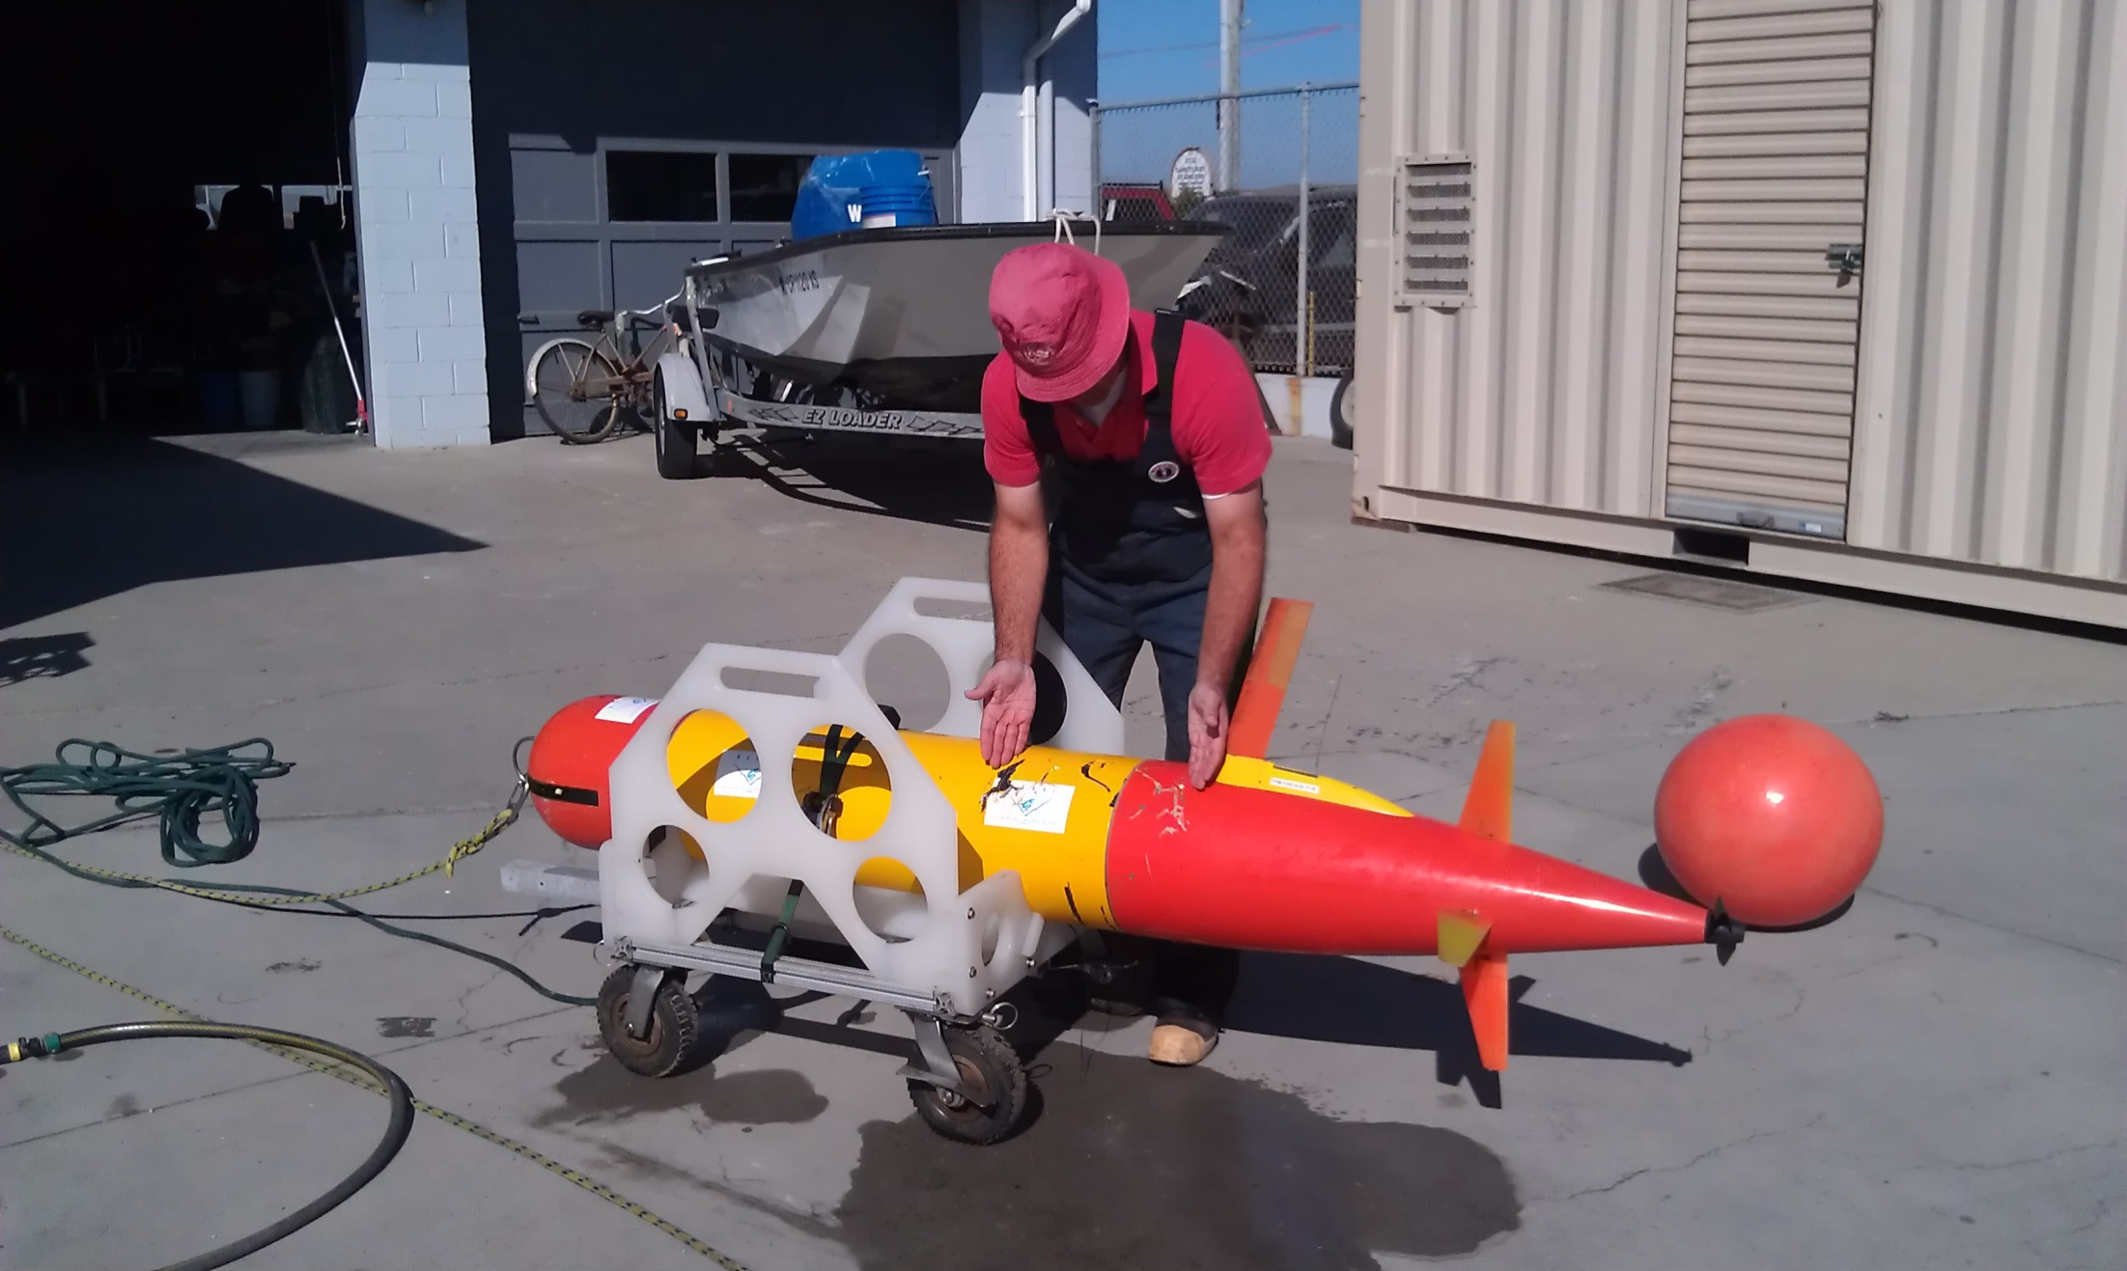
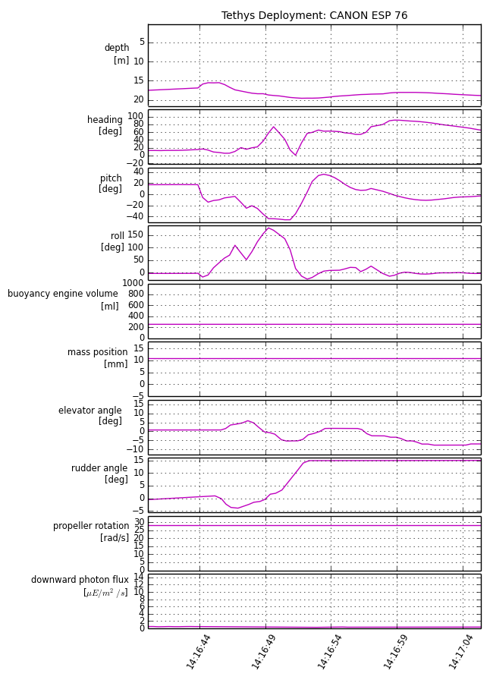
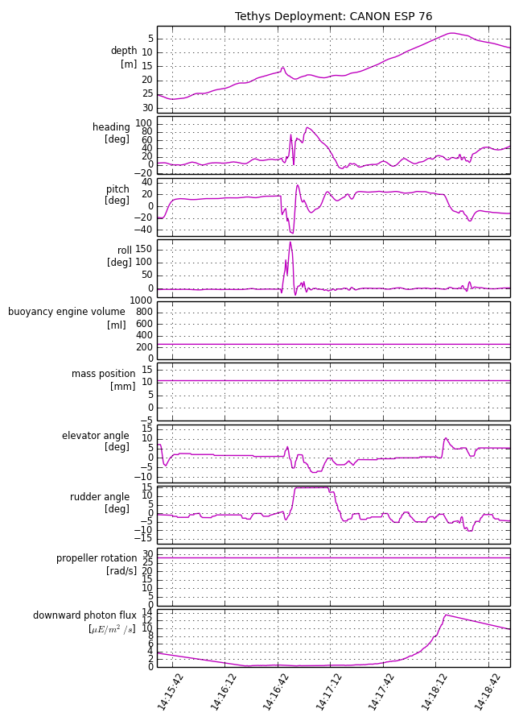
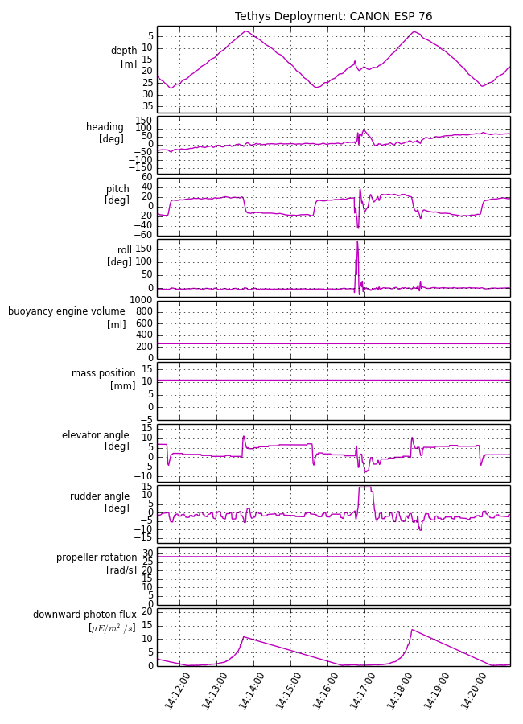
Great White Shark Interaction
Tethys 76
Sept 30, 2013 14:16:44 UTC (07:16:44 local)
While ascending from 27m dive, at 17 meters depth, struck from port side, and slightly below.
Strike lifted vehicle 2 meters, changed heading by 90 degrees, rolled vehicle 180 degrees and pitched vehicle negative by 60 degrees.
Play Videos “Located”, “Hooking up” and “SharkBite”

Slide 16
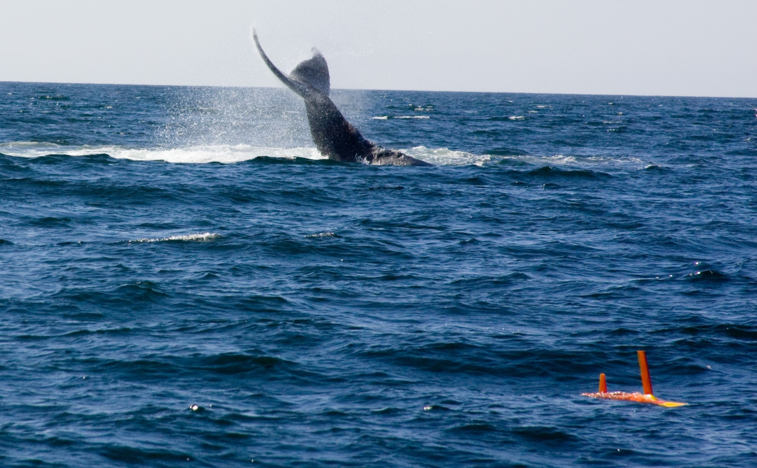
Questions?

