Slide 1
2022-09-6

Slide 2
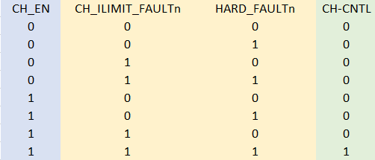
Channel Logic
Simple 3-AND gate
  CH Enabled
  No Faults
    Channel current limit
    Hard current limit
      (upstream overcurrent)

Slide 3
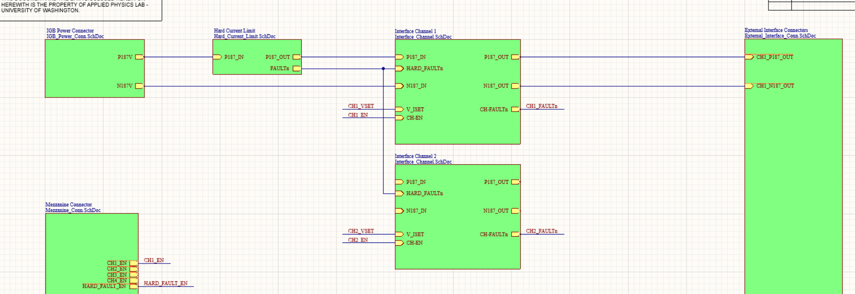
Generated internally to channel

Slide 4
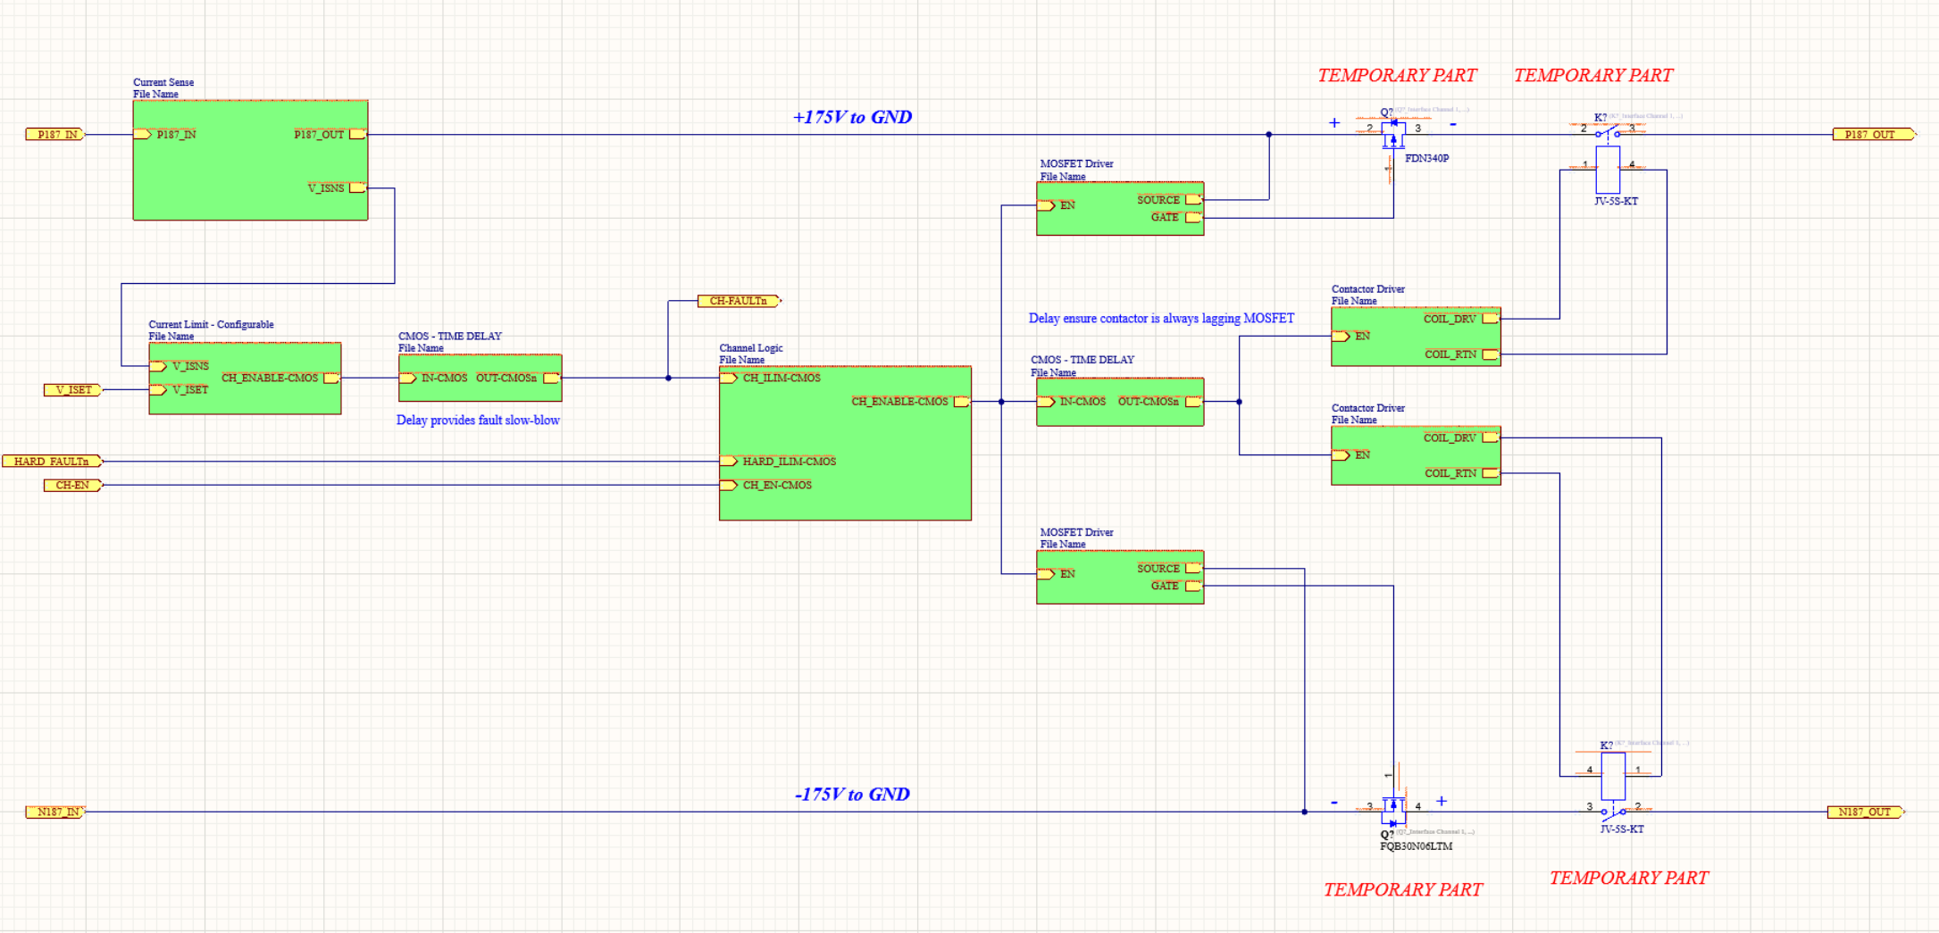
Current Sense
MOSFET / Contactor Control
Digital Logic
Current Sense Comparator

Slide 5
Logic Delays
ERROR: RELAY/CONTACTOR INDEPENDENT CONTROL IN CURRENT ICD
Delays CMOS FAULT to provide a “Slow Blow” current trip time
Delays CMOS CNTL to lag contactor ON/OFF from MOSFET state

Slide 6
ICD Review
Of the IPB PCBA Relevant Signals

Slide 7
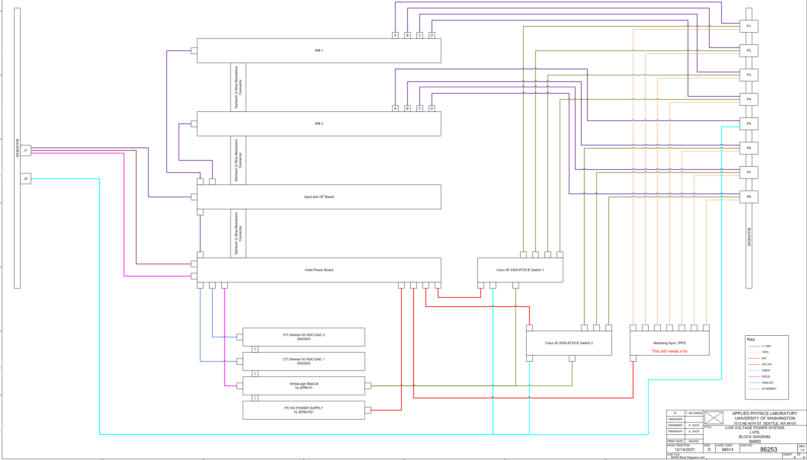

Slide 8
IPB_1
I/O | Type | DIR | ExpectedNeed | ICD HAVE | Use
IPBx_CHx_RLY_EN | GPIO | OUT | 4 | 4 | Turn ON contactor
IPBx_CHx_FET_EN | GPIO | OUT | 4 | 4 | Turn ON MOSFET
IPB1_RESET | GPIO | OUT | ? | 1 | IPB Board Fault Latch Reset?
IPBx_CHx_CURRENT_SET | GPIO | OUT | 4 | 4 | Voltage to set channel current trip limit
IPBx_CHx_I | Analog | IN | 4 | 4 | ADC for channel current sensing
IPBx_FETx_x_TEMP | Analog | IN | 8 | 8 | ADC for sensing temp at each MOSFET
IPB1_BOARD_TEMP | Analog | IN | 1 | 1 | ADC for sensing general PCB temp
FAULT_MUX_n | GPIO | OUT | 3 | 4 | N-BIT FAULT GPIO MUX
FAULT SENSE | GPIO | IN | 1 | 1 | GPIO input for fault monitor that is MUX’d

Slide 9
+/- 187V Powe Reference
Making sense of grounds

Slide 10
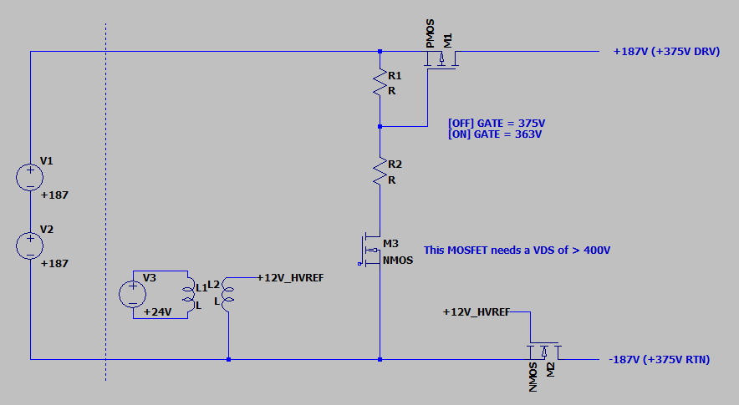
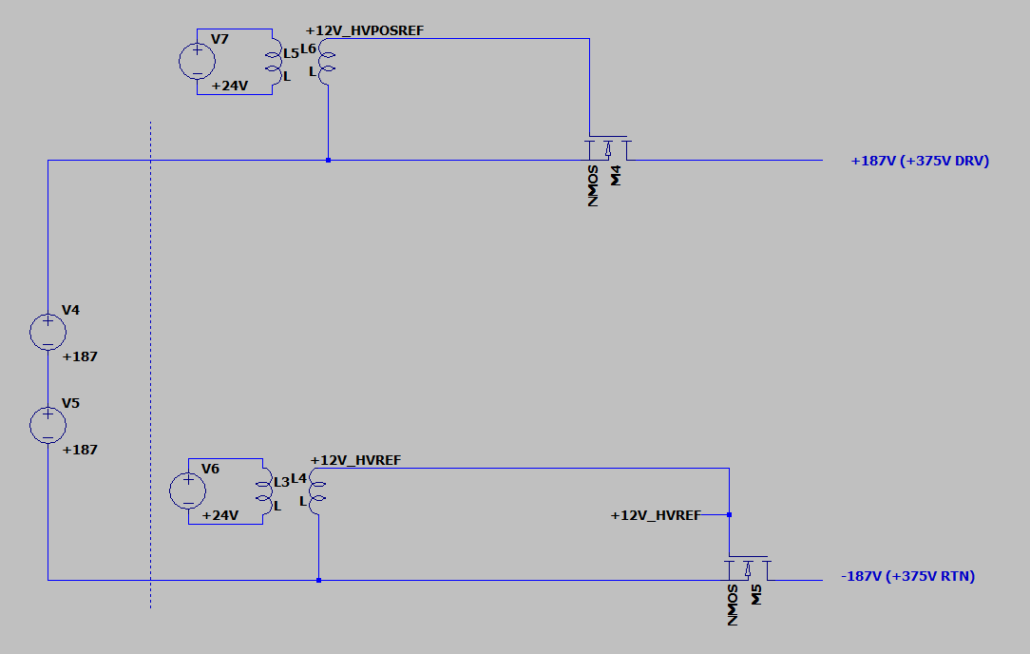
Dealing with no GND
-187V GND PMOS/NMOS
Isolated Dual NMOS Drivers

Slide 11
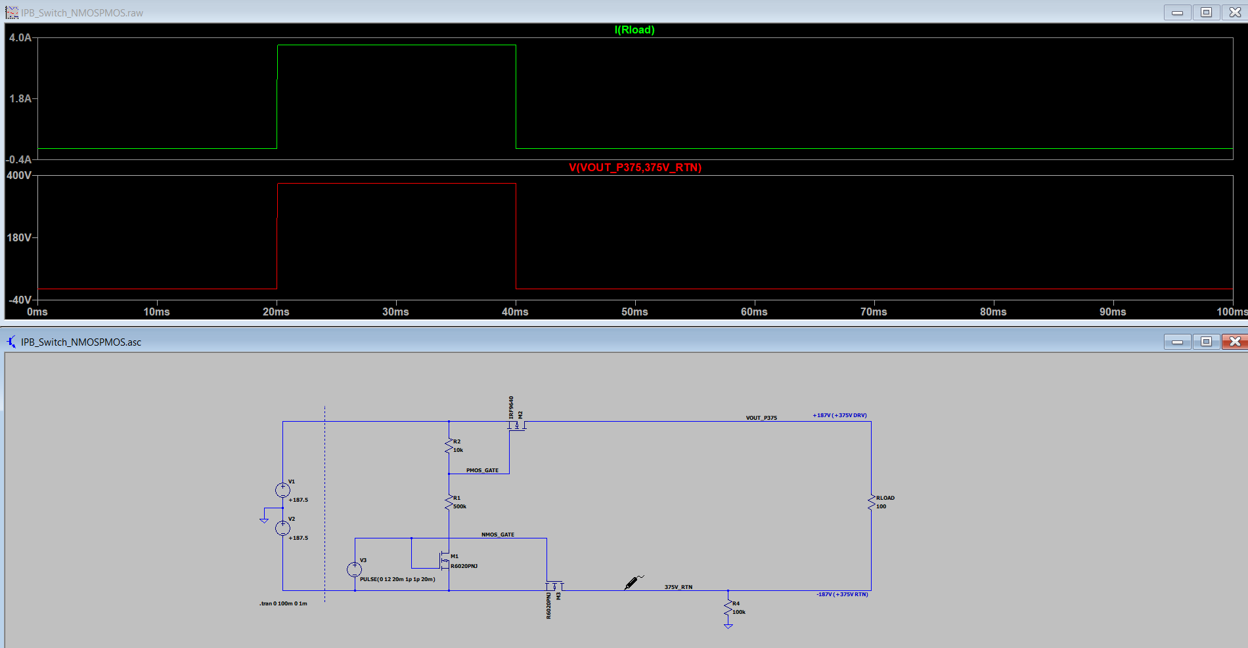
NMOS/PMOS Single Supply

Slide 12
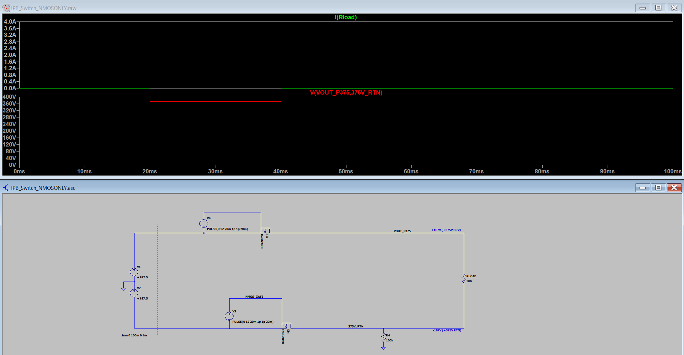
NMOS Dual Supply

Slide 13
Dealing with no GND
-187V GND PMOS/NMOS
Isolated Dual NMOS Drivers
8 DC/DC isolated converters needed
  Option: Discrete high-loss 375V to ~15V voltage regulator is made
2 MOSFET PN’s needed
  NMOS/PMOS
PMOS drive is complicated
  Directly driving from the 375V potential
Simple – allows 1 PN
  NMOS on HI/LOW side
  This is how RSN did it
16 DC/DC isolated converters needed
INVESTIGATING RSN AGREES THAT
THIS IS THE BEST DIRECTION

Slide 14
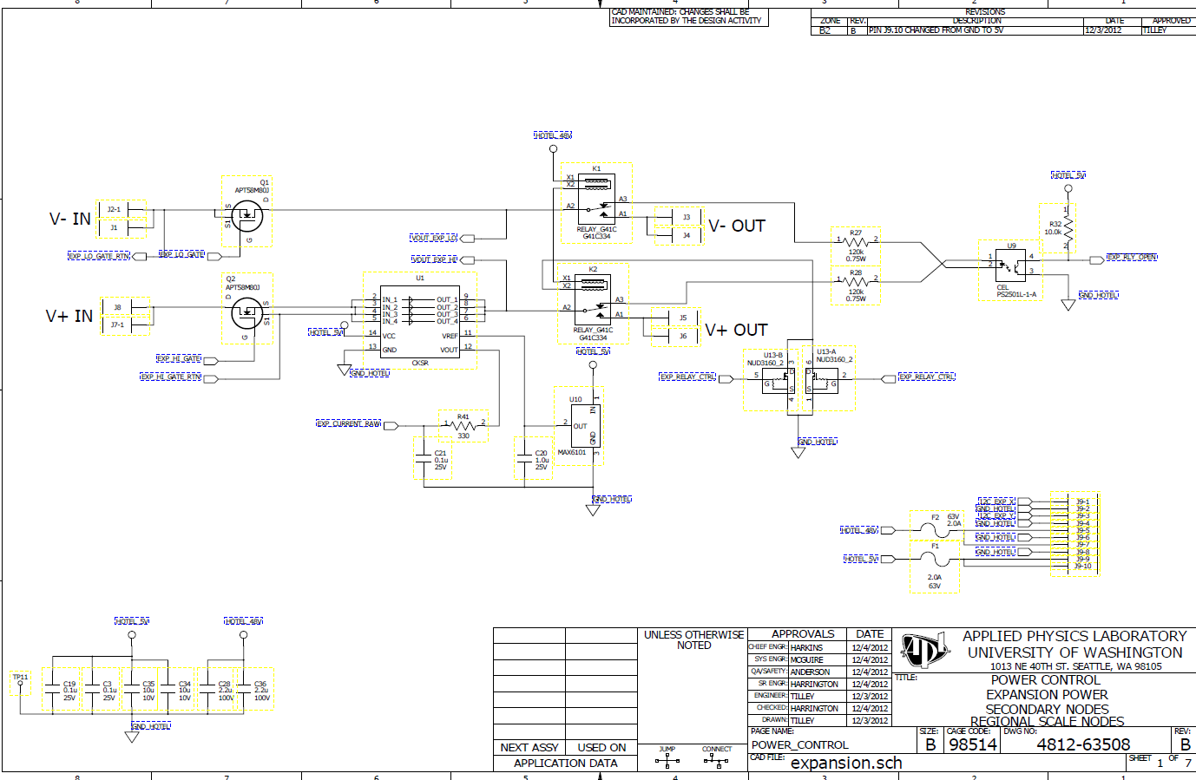
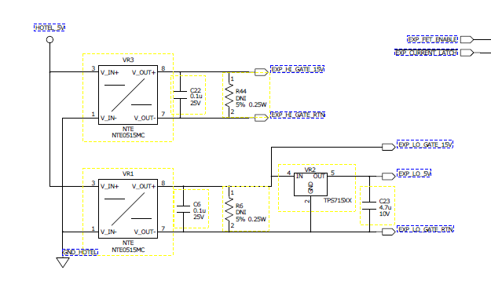
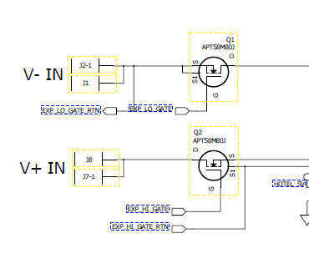
How did RSN do it?
Isolated supplies for each NMOS
Optocoupler switches GATES on/off

Slide 15
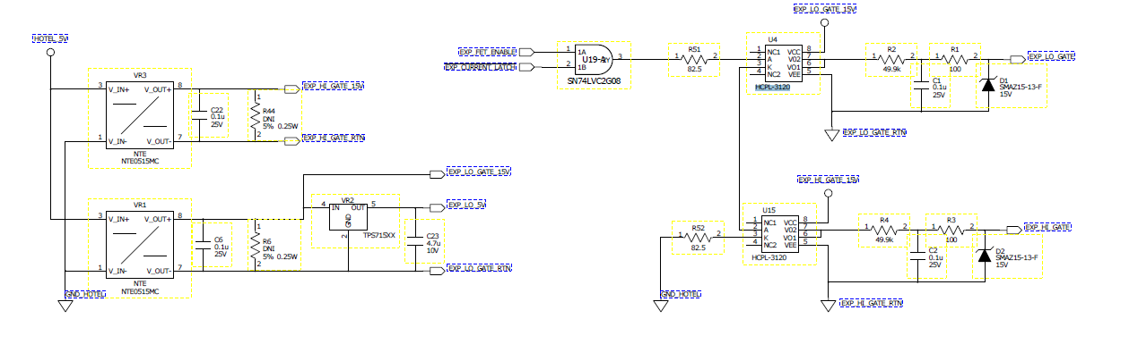
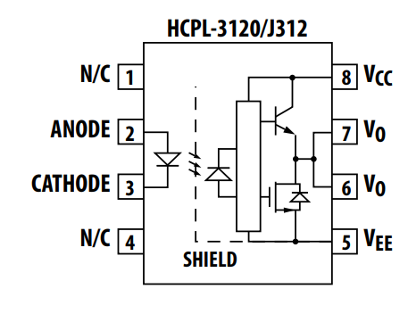
DC/DC Direct Gate Drive
Appears to be a push-pull gate driver
  This is actually pretty nice – simple
  R2/C1 form a soft-start circuit
Gut check is that this is low-stress electronics – no high voltage drop

Slide 16
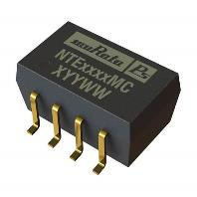
Isolated DC/DC RSN (NTE0515MC)
Isolated Module DC DC Converter 1 Output 15V 66mA 4.5V - 5.5V Input
  Likely not going to use due to low voltage input
Simple low power module
How many would I need?
  2/channel = 16 total dc/dc’s needed for gate drives
NOT 24V INPUT COMPLIANT

Slide 17
Isolated Power Supply Needs
~Few Watts output is all that is needed
Isolated to at least 1KV
18V to 32V Input
  Standard 24V bus input range (even though we’re 24V regulated)
SMT desired to maximize board layer mobility
~12V to 15V output for solid gate drive

Slide 18
Isolated DC/DC
PQME3-D24-S12-M
  12V 3W – 20mmx20mm (~100+ available Digikey)
PQP1-D24-S12-M
  12V 1W - ~130 available between Mouser/Digikey
  15mmx15mm
  MTBF 1,000,000 hours (114 years)

Slide 19
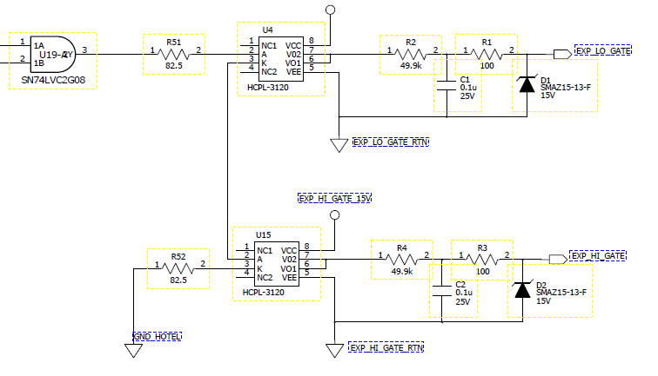
Isolated Gate Driver
No strong speed needs – ms is acceptable
  ON/OFF load switch – not a KHz driver
RSN used a basic optoisolator gate driver
  Push-Pull configuration
  Many of these available
Soft-Start Options
  Simple RC
    Non-linear turn on
  Current limited linear gate drive
    Linear ramp up easily tuned

Slide 20
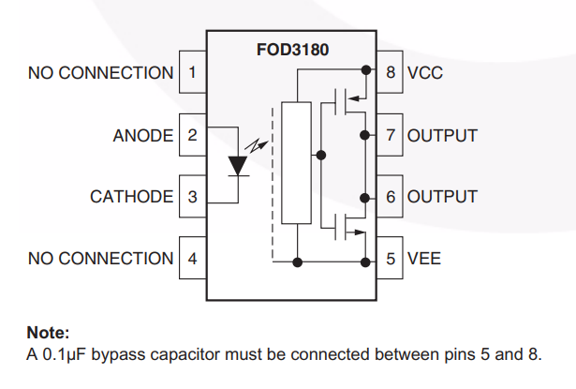
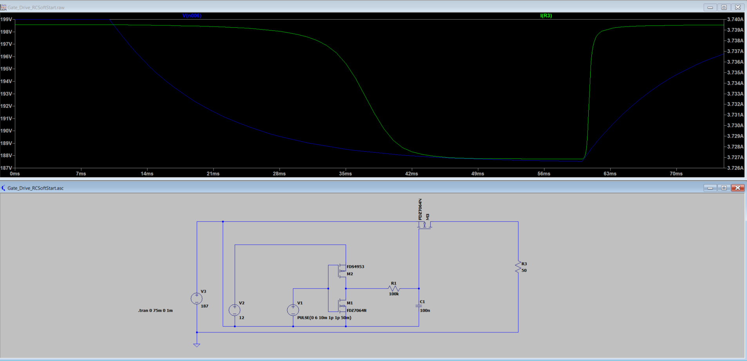
FOD3180 – Gate Driver
FOD3180 25V ABS MAX (~50% derated at 12V)

Slide 21
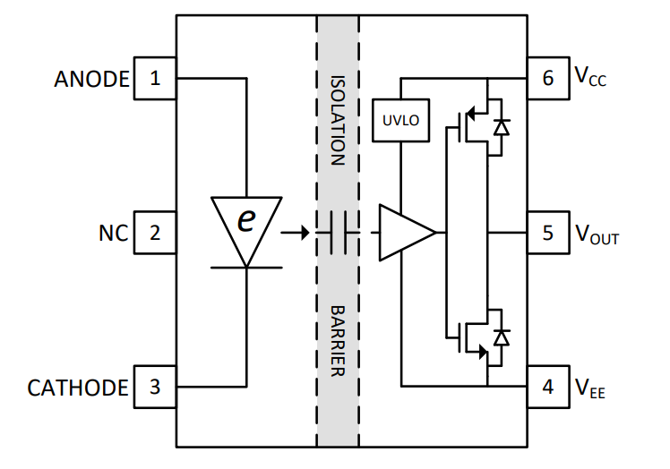
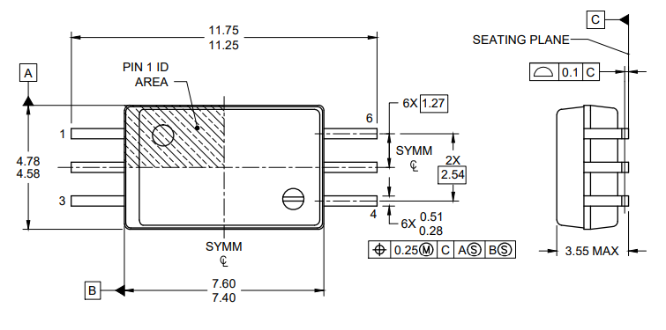
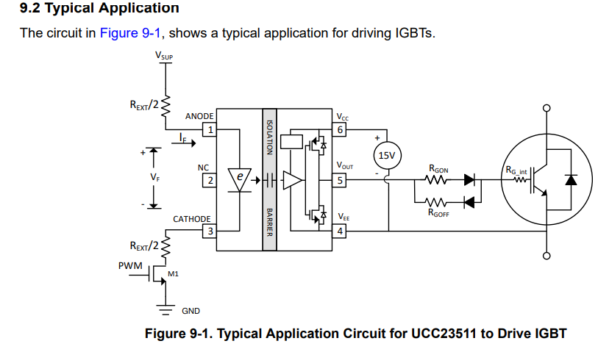
UCC23511 – TI eCoupler
Simulate Optocoupler (is actually a capacitive coupler)
  AEC-100 automotive part available
  No concern for LED degradation
  Many available
Needs 15V Drive!

