Slide 1
2024-12-18
MARS2, Brenton Salmi, DEC 2024

Slide 2
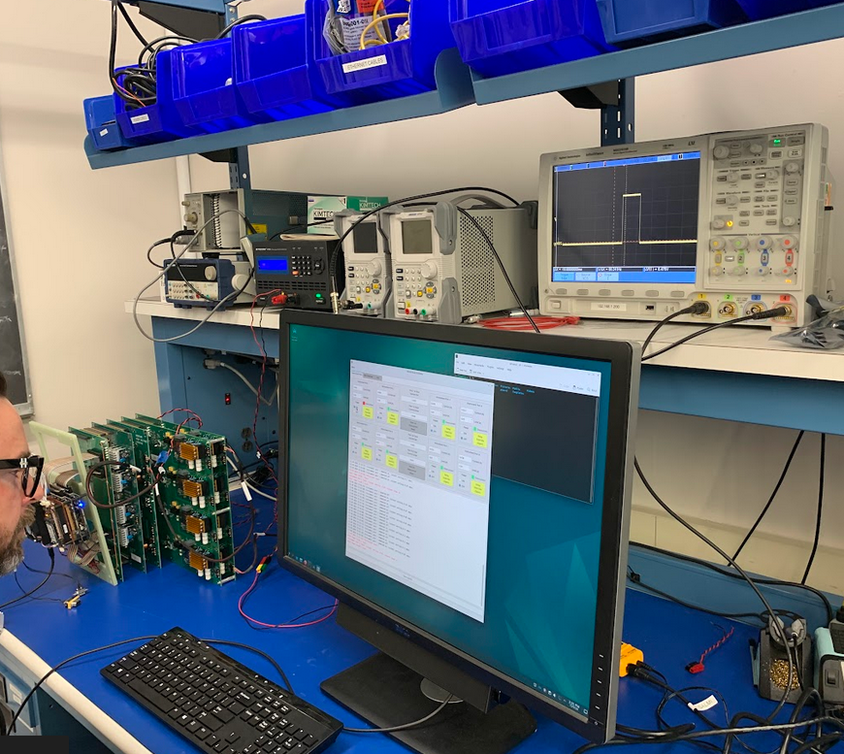
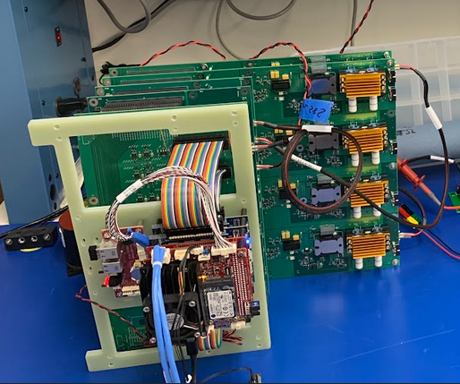
Status (Engineering Unit)
Engineering unit up an running!
Have let it run for many hours
  All relays ON
  ~230mA load on one channel
Resolved issue with ground fault self-test
  Known prior issue was self-test inop
Wired HPB temperature sensors
  Vicors, MOSFET, etc…
  Tested working
  Need to install “permenantly”

Slide 3
IGB Self-Test Fix

Slide 4
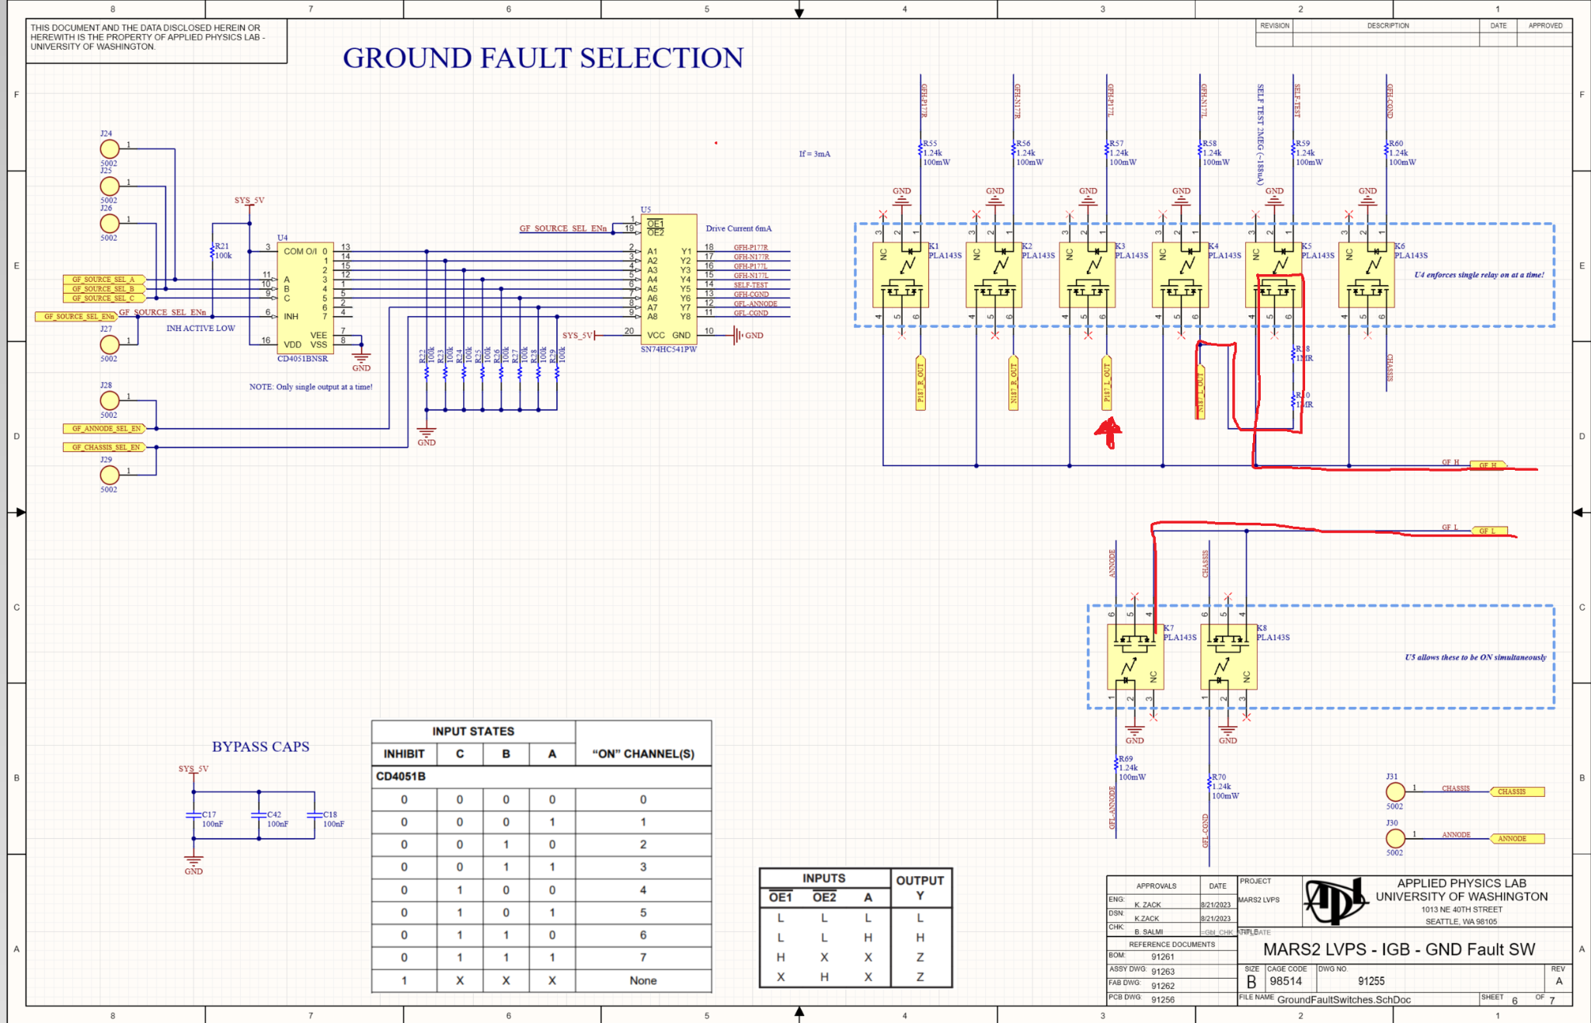
Circuit Issues (1)
There is no return path for the MVC_L RTN (N187) to get back to MVC_L +375V (P187)

Slide 5
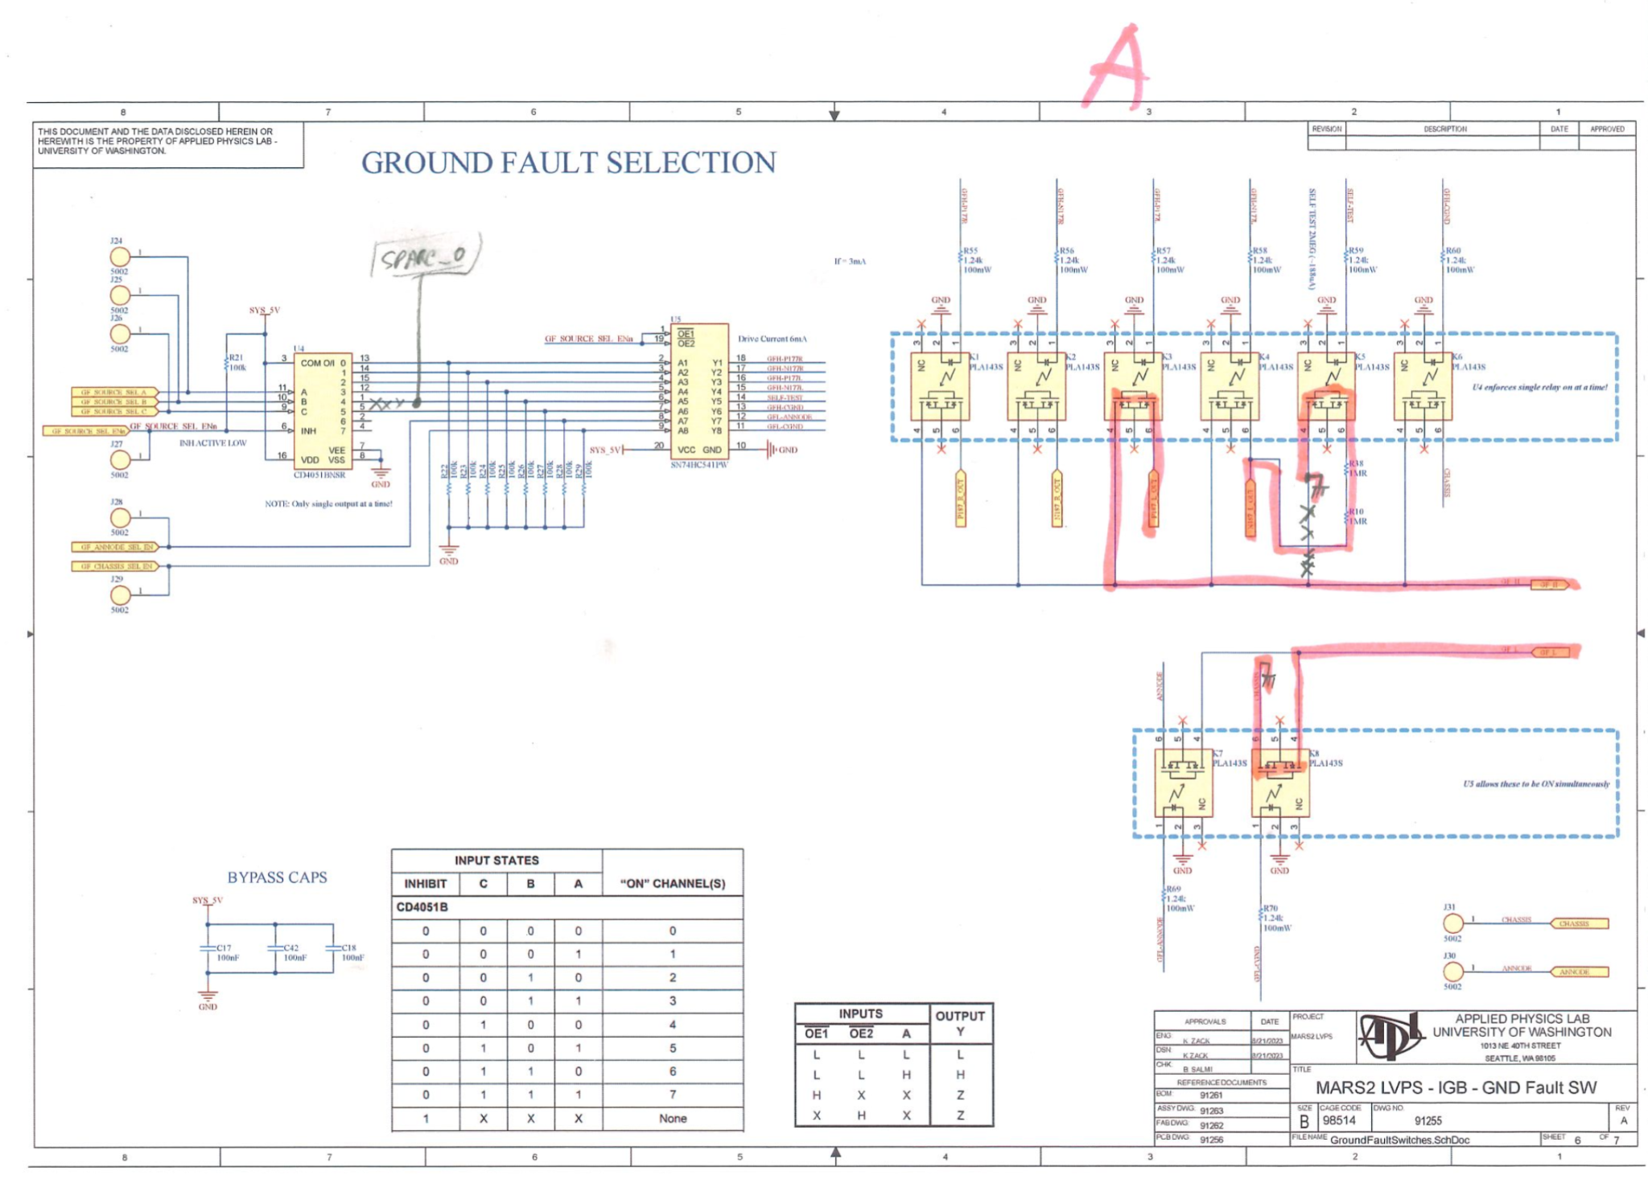
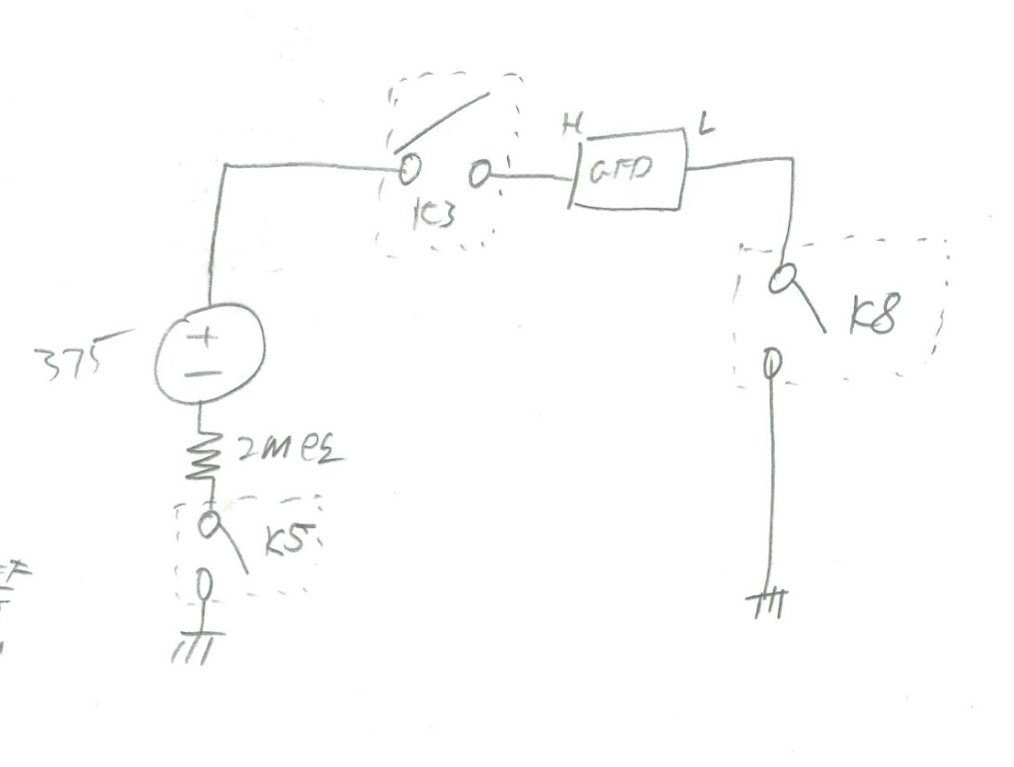
Update Topology
Real induced ground fault

Slide 6
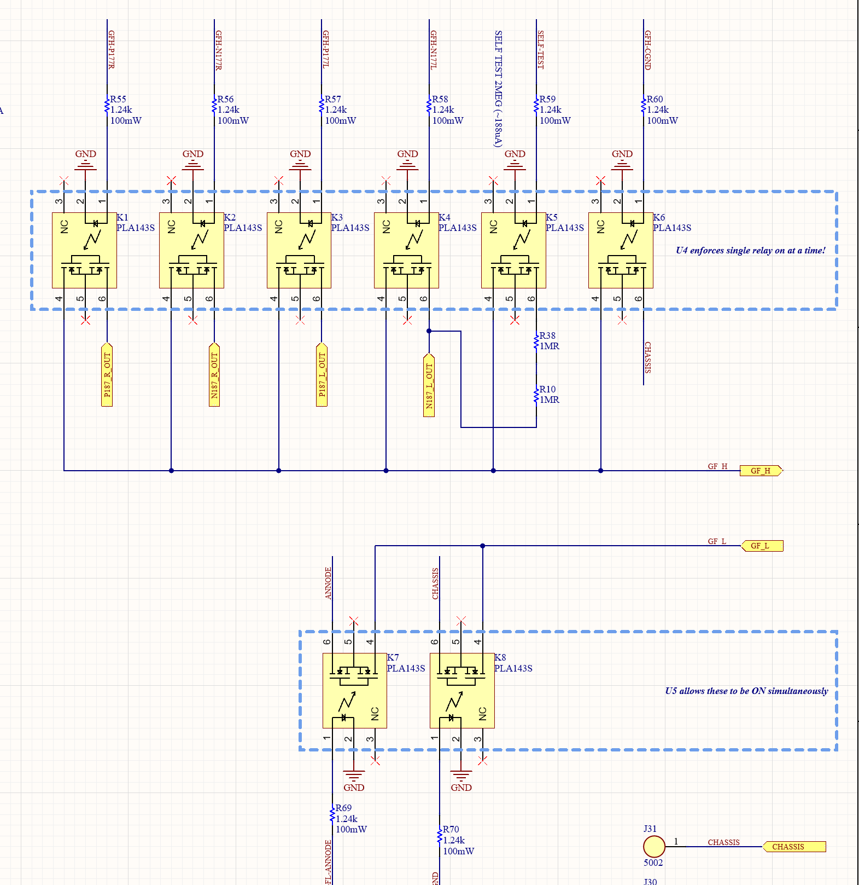
Fix Self-Test Relay Control
Self test requires 3 relays to be enabled at once but only 2 can be active at the same time in the current control method
  K3, K5, K7
No extra GPIO are available
The solution here is to DIODE OR the self-test control signal to turn on both needed HIGH/LOW relay with a single control signal

Slide 7
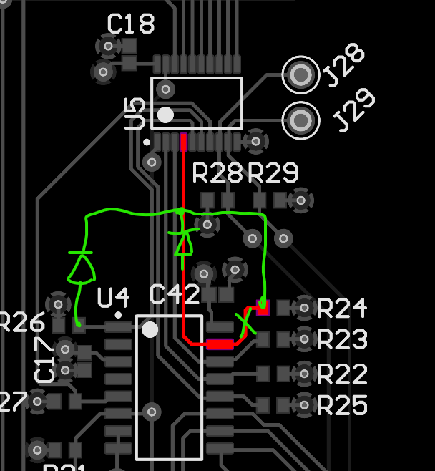
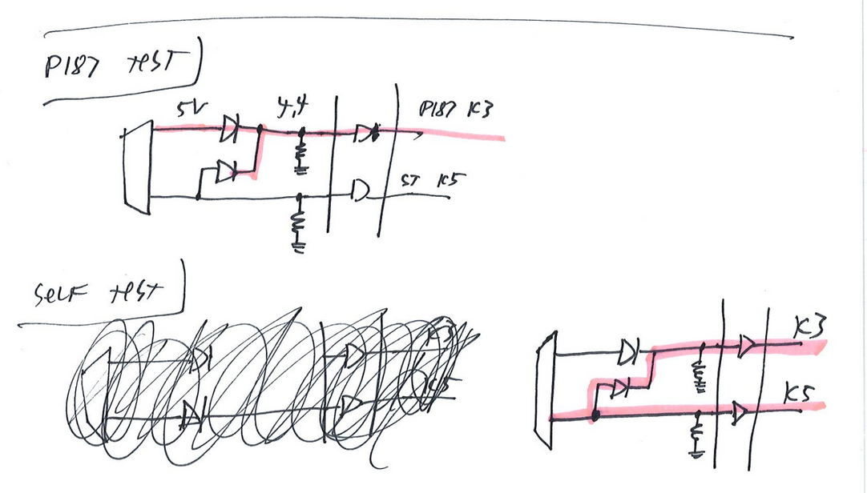
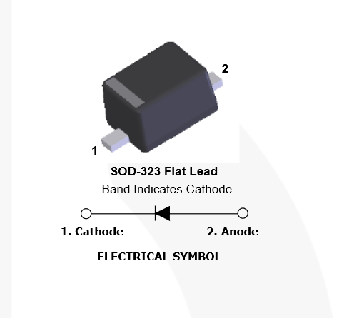
DIODE OR Self-Test P187
Step 1
  Cut trace in location shown in GREEN
  Install diode across cut trace as shown
Step 2
  Install second diode as shown from R26 to U5
Diode
  Use 1N4148WS

Slide 8
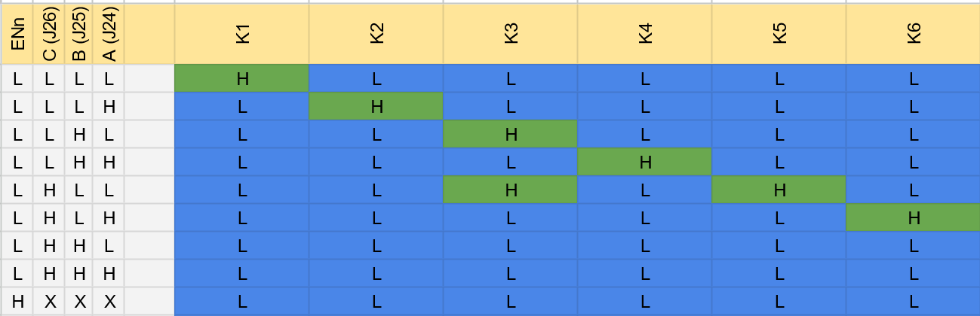
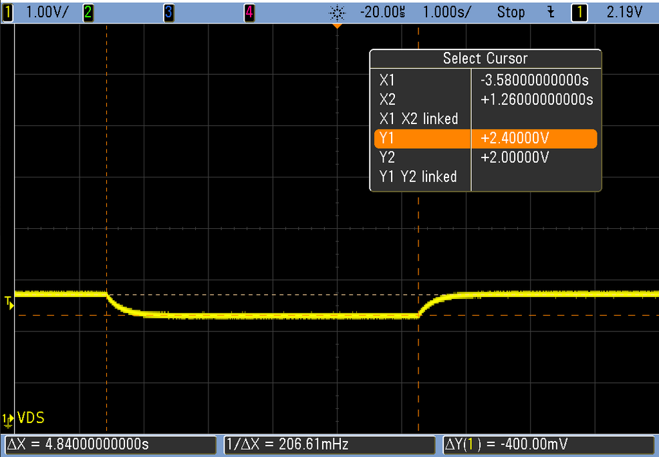
IGB Self-Test Testing
GFD relays work as expected with Self-Test functionality providing both K3 and K5 actuations.
IGB Ground Fault analog signal out during self-test

Slide 9
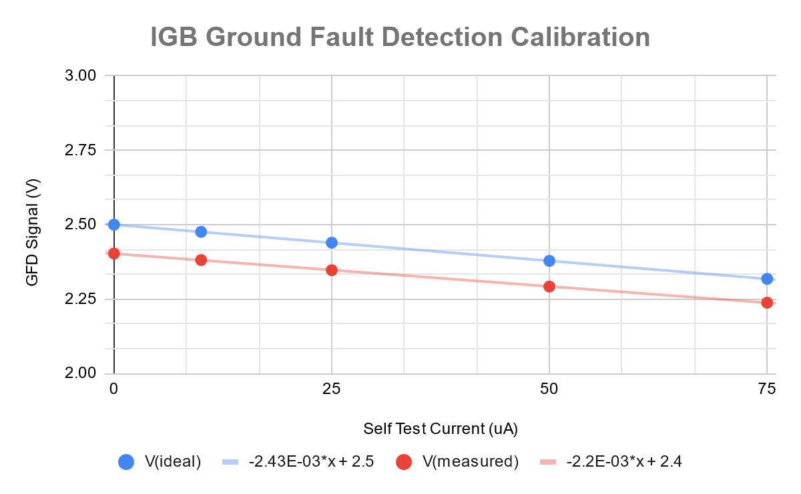
Ground Fault Signal Calibration
Using 2MEG self-test resistor on SN:1
V(mvc) was varied to produce specific current
Calibration required due to tolerances on analog signal chain
  Gain + offset

Slide 10
IGB Input Protection Removed

Slide 11
Risk Overview
RISK
  Input Protection MOSFETS (IXTN32P60P) get very hot at 3A+ input current (375V)
  Observed heating at 4A approached 100C
    Ambient 22C
    78C rise
  Absmax of part is 150C Junction0
Consequence
  Increased heating near ABSMAX significantly reduces lifetime reliability
Root Cause
  Incorrect design consideration for PMOS Rds(on) heating at max system current
  Keeping configuration would require heatsinks to be designed

Slide 12
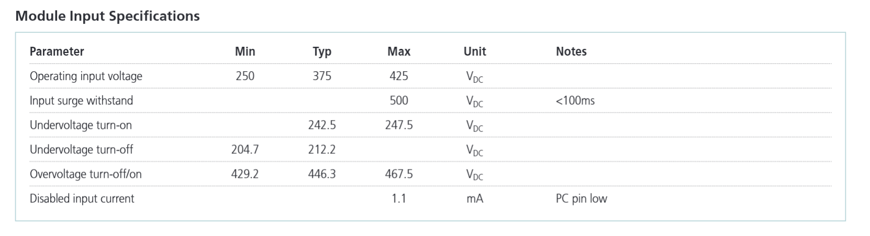
What Are We Protecting From?
MARS2 LVPS Reverse Polarity (375V)
Vicor Input Overvoltage
Hooking up 375V backwards will destroy the system
Field
  MVC -> LVPS
  Performed in lab during build
  Never modified after deployment
Engineering Lab
  Moderate risk of accidentally reverse polarity in lab using benchtop supply
Vicor V375C24C150BL
  Already OVP cutoff at 430V
  Surge withstand up to 500V
NOT NEEDED
Careful lab procedures
Possible to utilize external circuit to protect from this that is left connected continuously
System can be repaired / replaced in lab
NOT NEEDED
Overvoltage protection on IGB appears redundant to the Vicor’s existing OVP

Slide 13
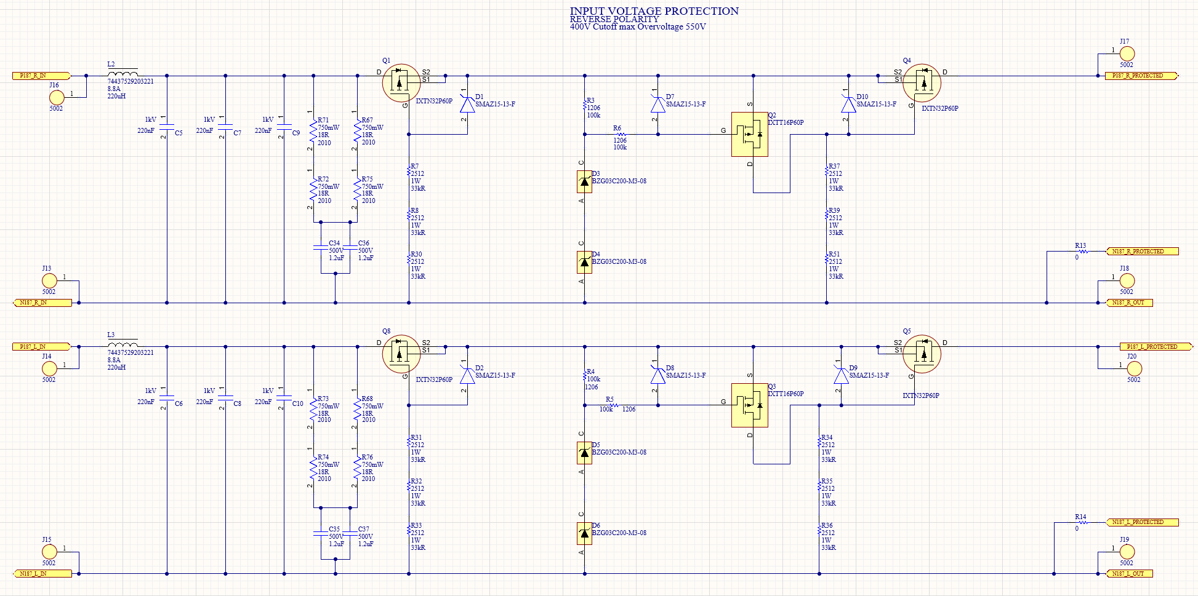
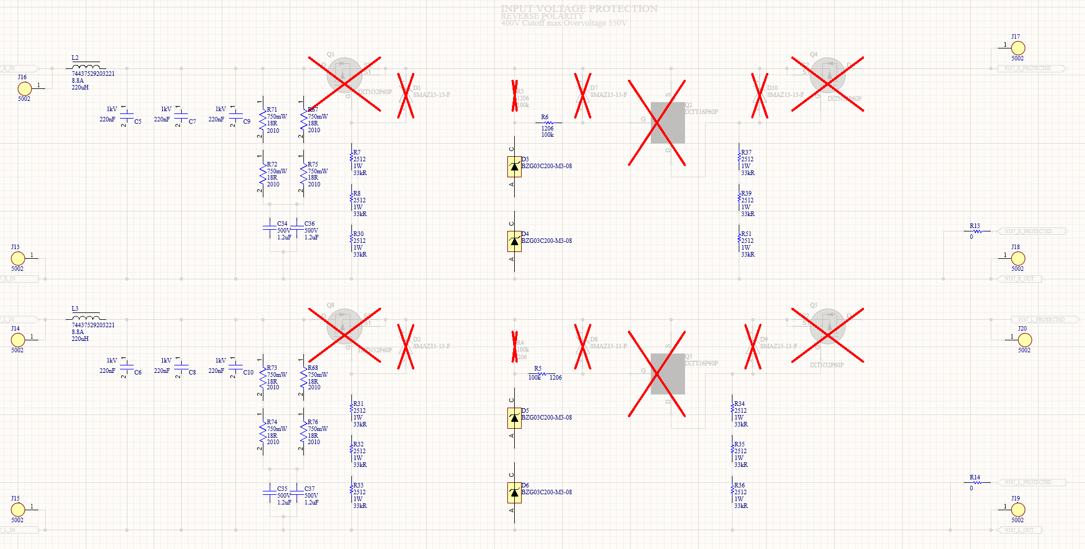
IGB Modifications
Original
Mitigated
(Performed 12/2024)
DNP
  Q1, Q2, Q4, D1, D7, D10, R3
  Q8, Q3, Q5, D2, D8, D9, R4
Jumper (solder) using SOT-227 pads shown
  16AWG

Slide 14
Looking Ahead

Slide 15
Install engineering temp sensors (HPB)
Move assembly to 320
  4A capable 375
Run Factory Acceptance Test (FAT) on ENG unit
  Not mechanically built
Build Engineering unit mechanically
Build Flight unit
Run FAT on flight unit
Burn in of flight unit
  Run for long duration

