Slide 1
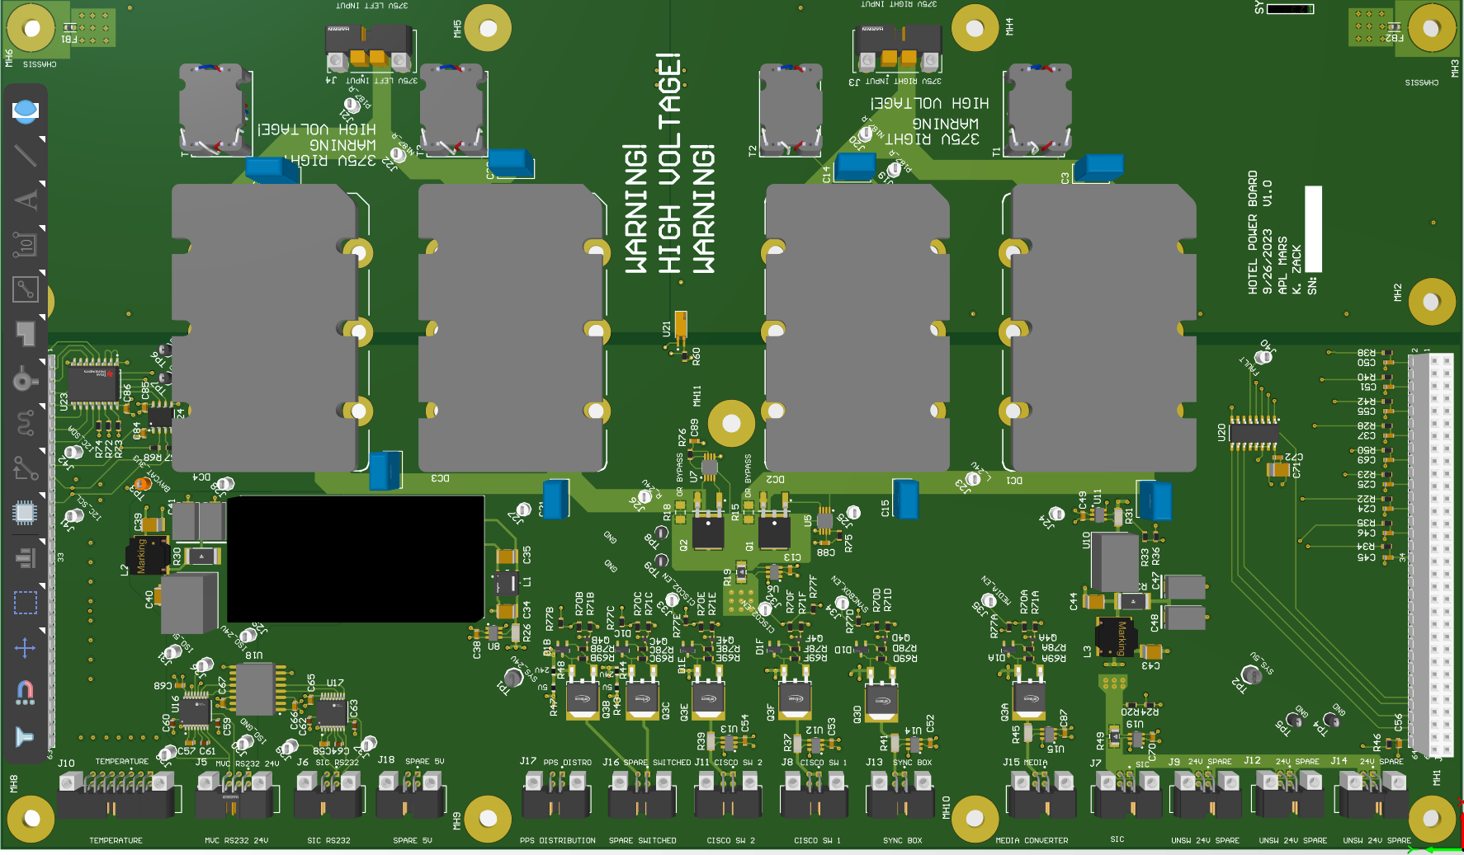
J5
J6
J18
J17
J16
J11
J8
J13
J15
J7
J9
J12
J14

Slide 2
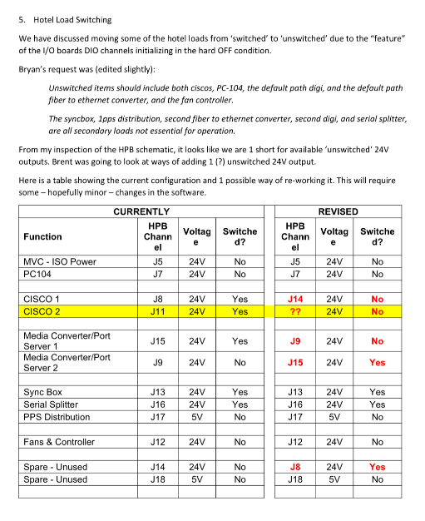
Tim’s Email (MBARI Needs)

Slide 3
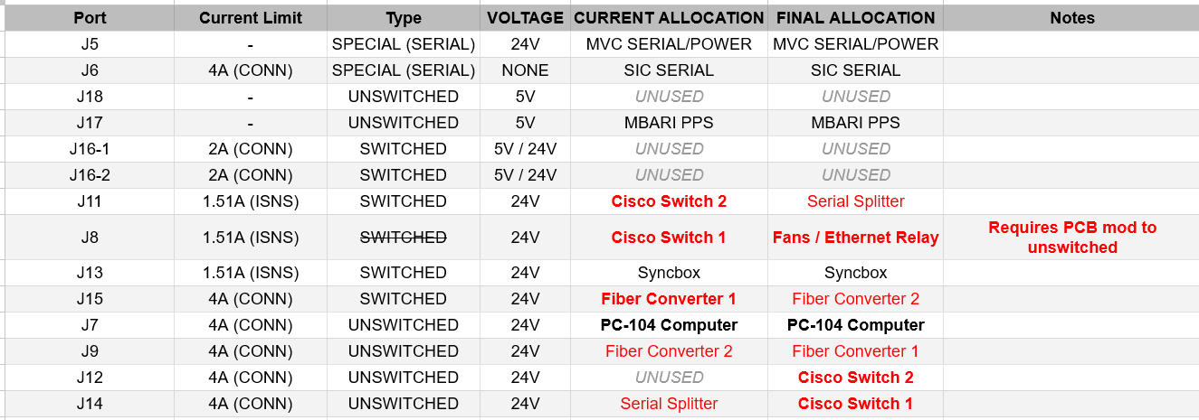
Port Changes

Slide 4
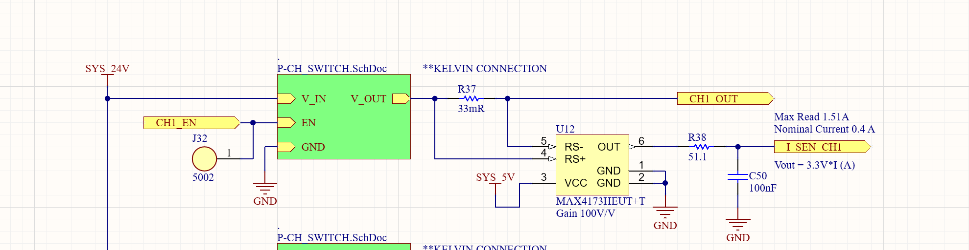
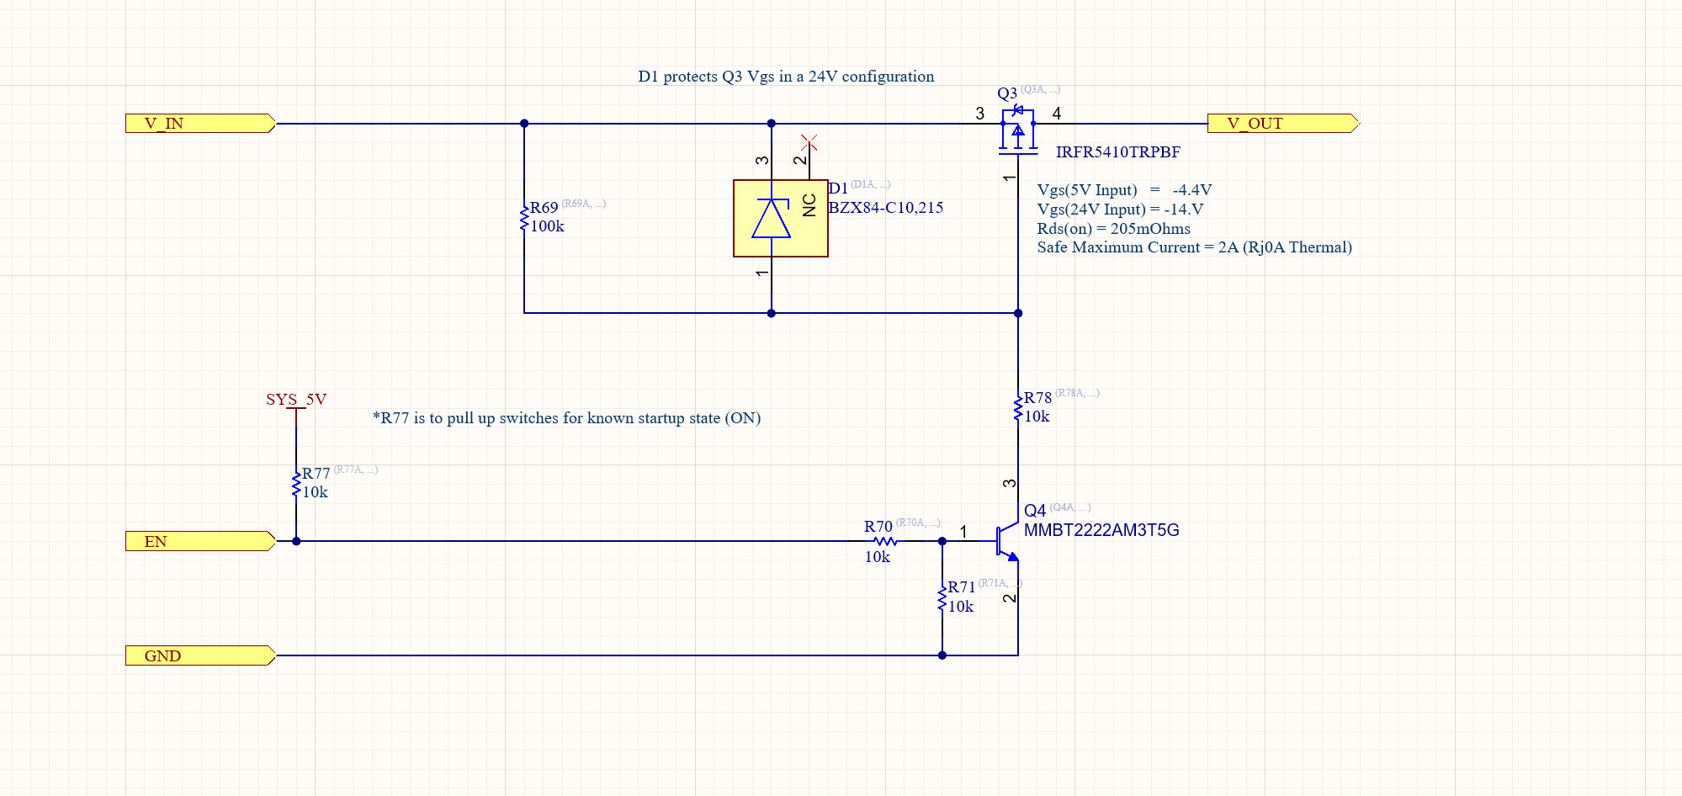
Fan Power Switched to Unswitched
FAN power configured to J8 (Formerly CISCO SW 1 -> CH1 SW)

Slide 5
PCB Mods Option 1
JUMPER
No cut traces

Slide 6
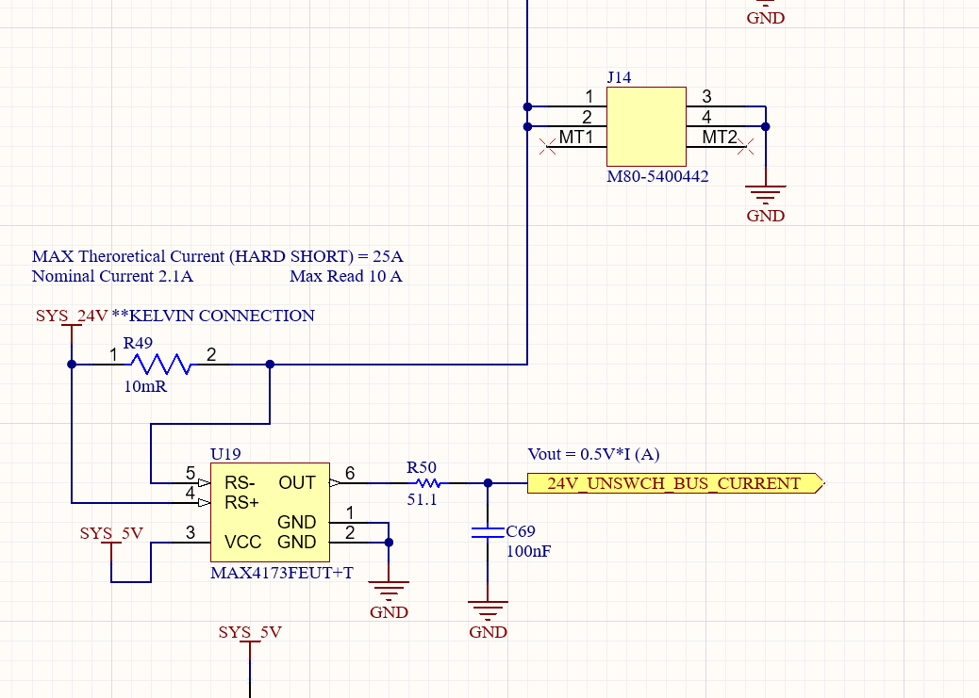
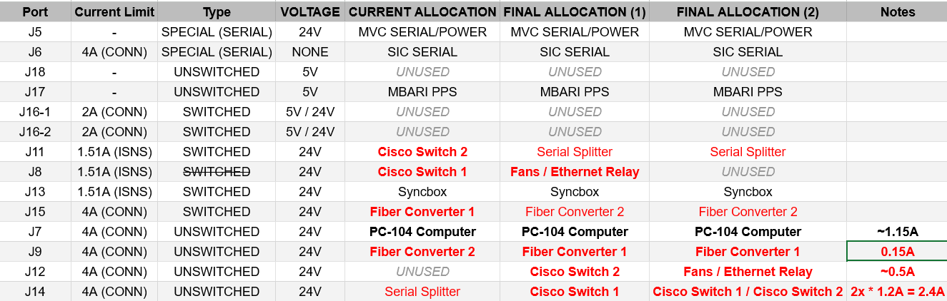
PCB Mods Option 2 (part 1)
Place both Cisco switches on J14 (Pins 1 and 2 respectively)
No PCB modifications needed
Harness modification needed

Slide 7
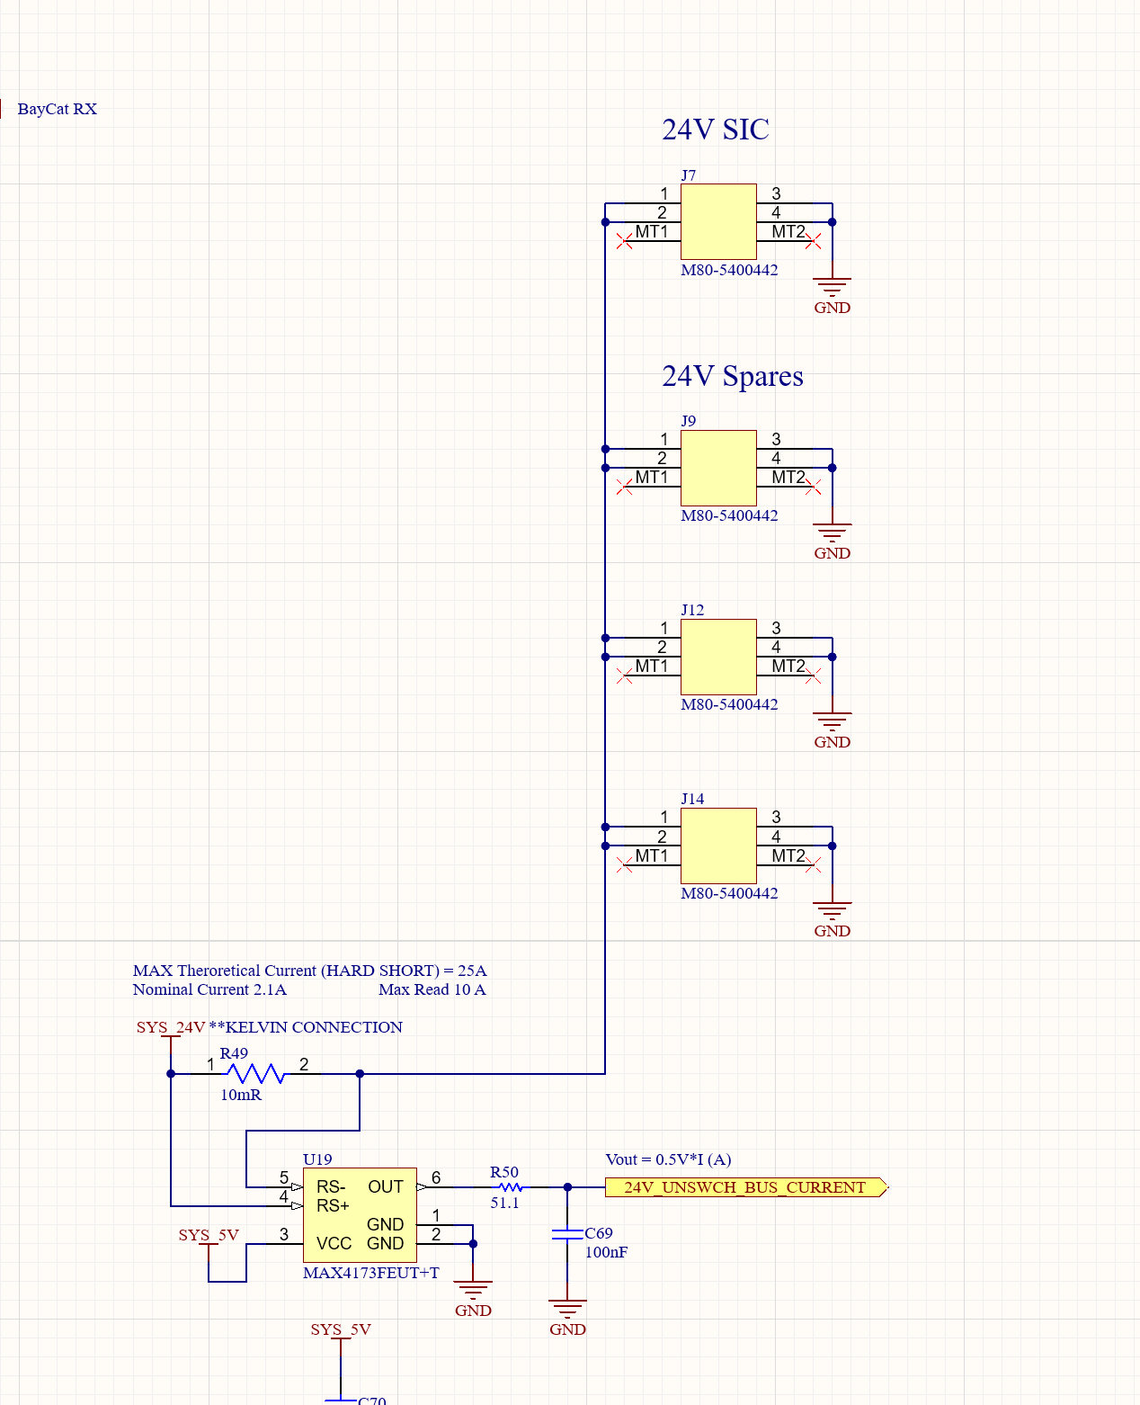
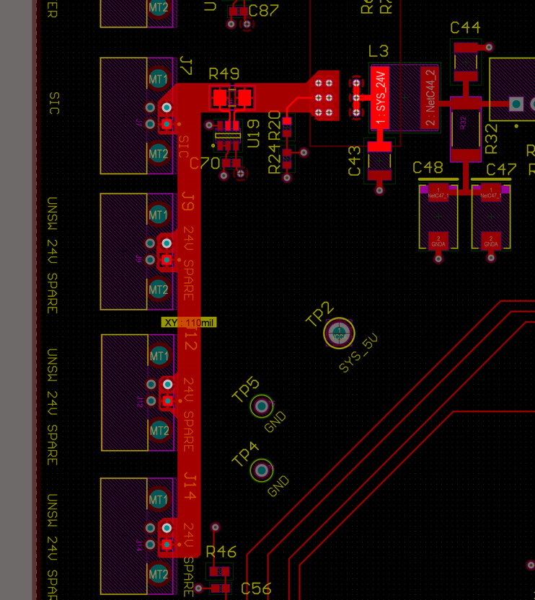
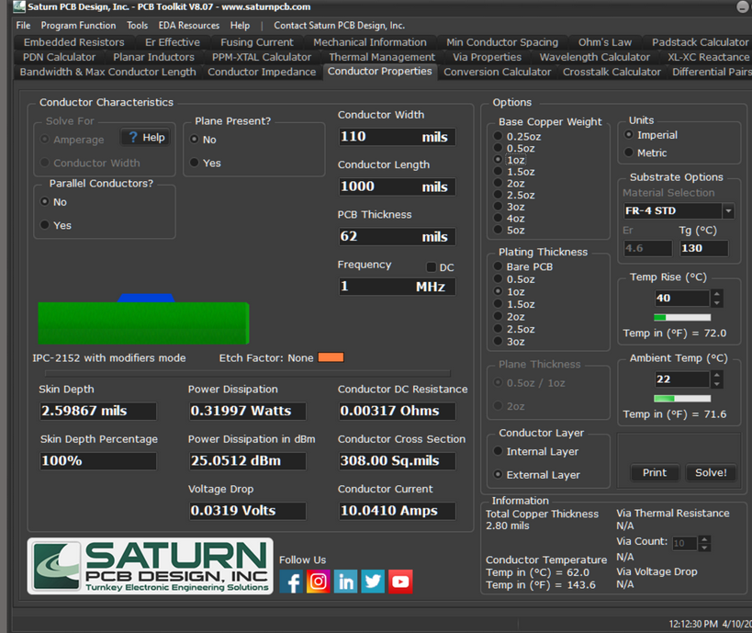
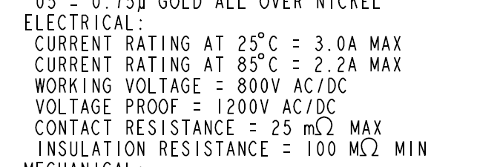
PCB Mods Option 2 (part 2)
PCB Traces are minimum ~110mil external (10A @ +40C)
R49 is 10mOhms 1206 rated 1W
  10A average power dissipation acceptable
Isense channel configured for 10A max reading
Worst case current estimated ~4.2A @ 24V
  J7+J9+J12+J14
Connectors rated 2.2A/pin @ 85C
No pin experiences more than ~1.2A

Slide 8
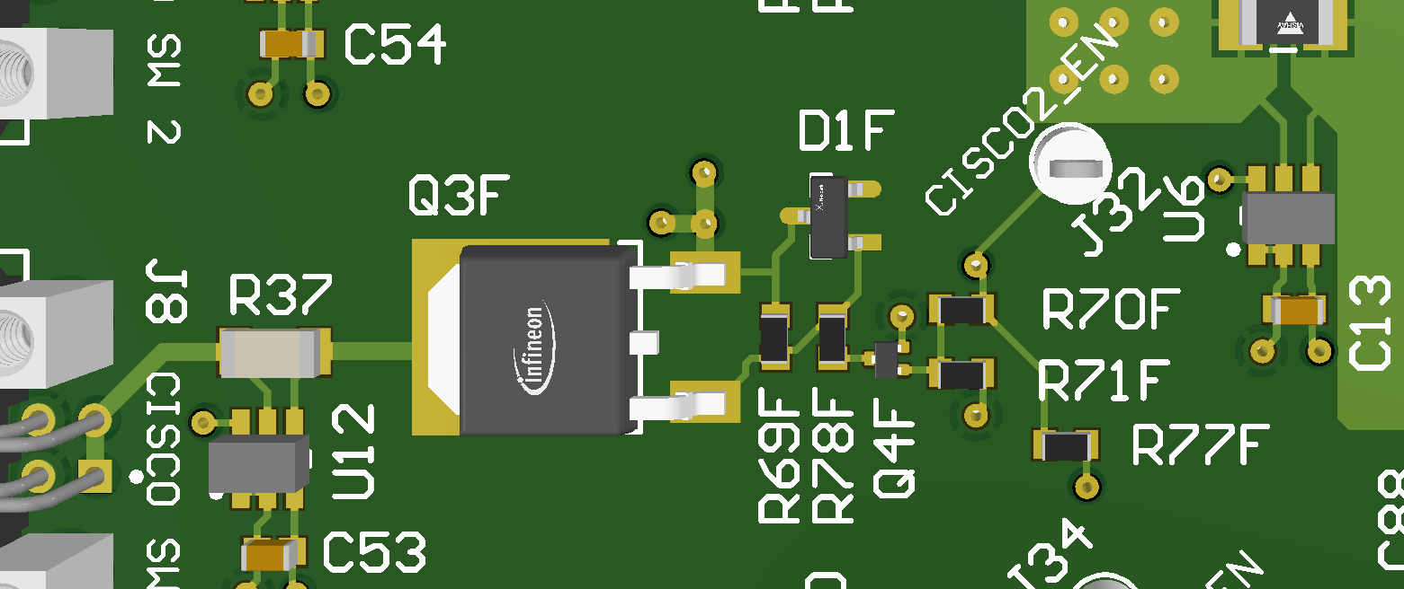
PCB Mods Option 3
Cut the trace at the RED line to allow pull up to bias always ON.

