Slide 1
MARS2 IPB Current Sense / Control
Brenton Salmi, Sep 2022

Slide 2
What does it need to do?
4A Maximum load
12 bit ADC measurement (Vref? Assumed 4.096V)
Goal 10’s ms acceptable rise time detection
  eFuse protection of wire/load simulating a thermal fuse

Slide 3
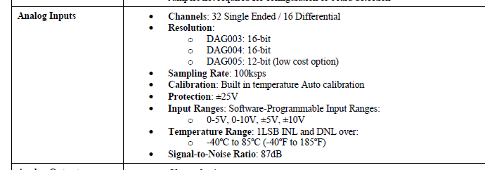
ADC Information
We have 16 bits but this is way way way more accurate than we should be needing
Each channel capable of 100KSPS?

Slide 4
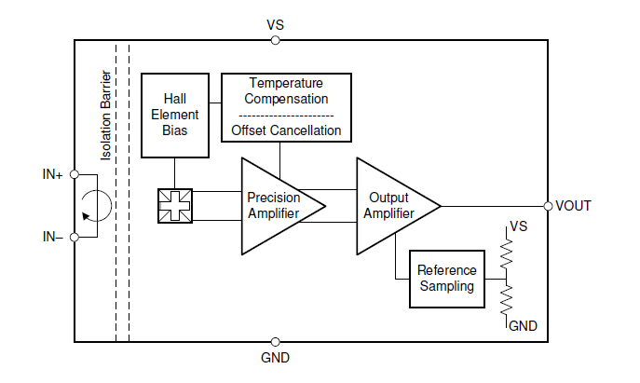
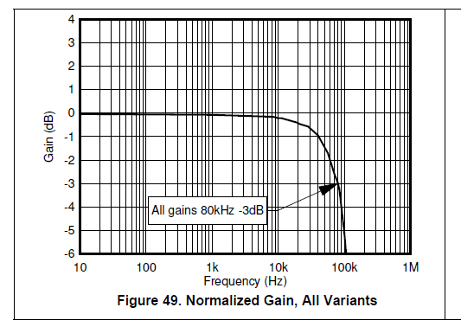
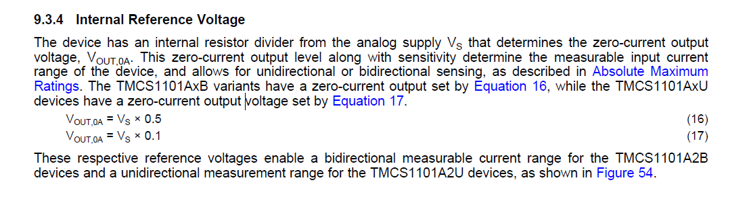
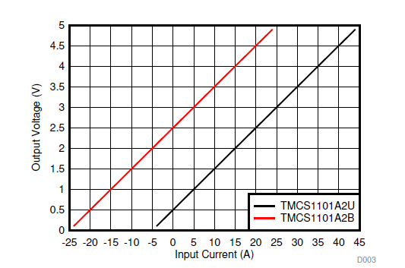
IGB PCB = TMCS1101A4BQDR
400mV/A
  4A = 1.6A
+/- 1.5% Maximum Error (Full-Scale+Drift)
Sampled Integrator Output
  The VOUT of the sensor is actually a discrete analog sampled integrator!
  This requires a reconstruction filter on the output to smooth
    Figure 51 shows a 100KHz LPF output in RED
Voltage Reference
  Vs*0.5 is the zero reference

Slide 5
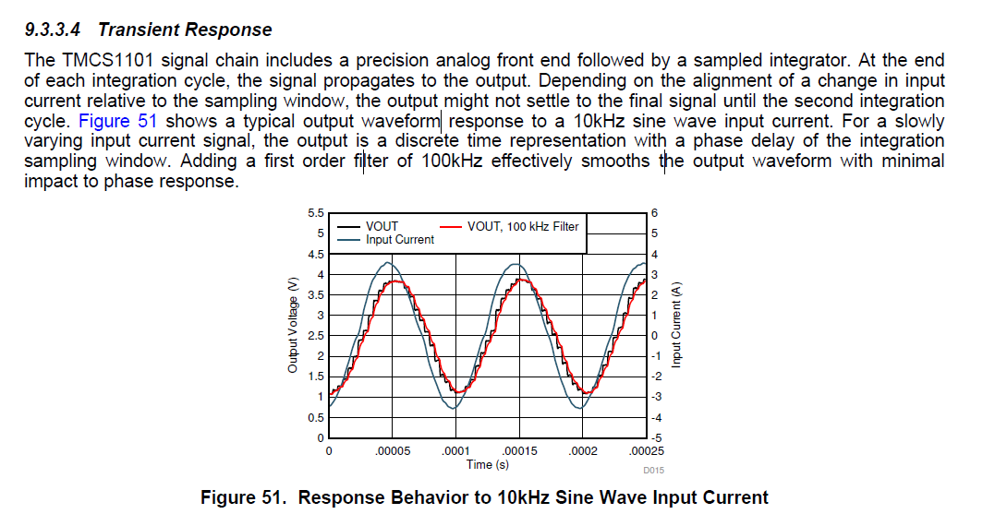
Voutput – Sampled Integrator

Slide 6
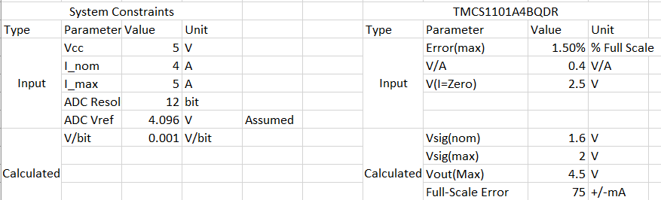
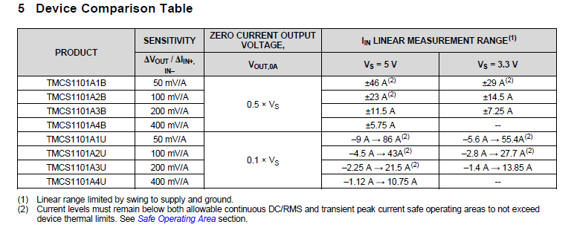
Current Sensor Output Error

Slide 7
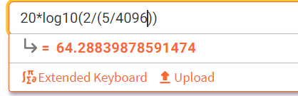
Required Bandwidth
Goal = Set Aliasing signals below 1 LSB
  10ms rise time observation ability assumed (arbitrary per IP6.2)
    BW = 0.35/Tr = 35Hz effective bandwidth needed
  Minimum Nyquist = 70Hz
  ADC LSB = (0-5V Range Setting) 5V/4096 = 1.22mV
  Per Kevin = We are sampling at 300SPS
    Nyquist Freq = 150Hz
  <1.22mV (LSB) aliased noise requires -64dB attenuation
    Assumes 2Vp-p noise (0 to 5A)
Place a 4th order Sallen-Key at 50Hz and call it good enough
  -30dB aliased signals which would be only ~60mV (150mA) error
    0-5A noise at the aliasing frequency (crazy noise)
  Placing at 50Hz allows some passband rolloff margin from 35 Hz signal
    35hz signal (10ms rise time) -0.5dB attenuation
    At the expense of allowing aliased noise to be sampled (at -30dB)

Slide 8
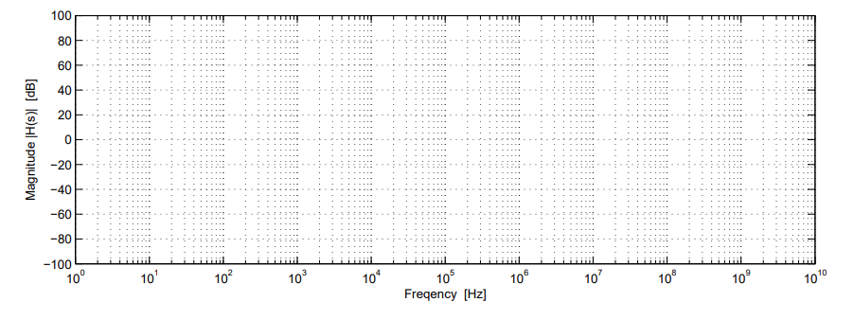
Current Sensor LPF Path
35Hz (10ms)
Signals in red shade will be observed in sampled data (~50LSB) worst case 5Ap-p noise @150Hz
150Hz
80KHz
300SPS
-20dB/Dec
-40dB/Dec
-60dB/Dec
SIGNAL
NYQUIST
Sensor BW
F(sample)
-80dB/Dec
ADC is used for telemetry only
  Non-critical – information only
  Ideal for situational awareness
Sampling Slower?
  To avoid aliasing in 1SPS data I recommend sampling at 300SPS and just averaging the data to 1SPS prior to sending upstream

Slide 9
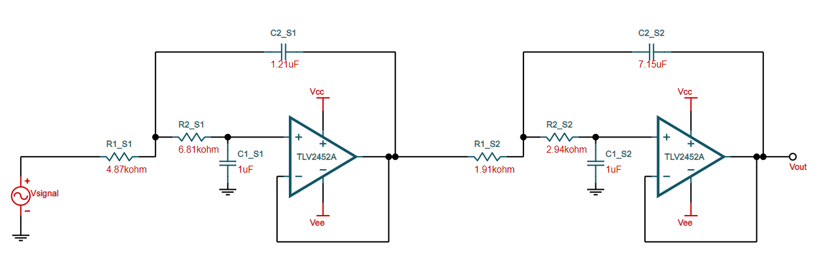
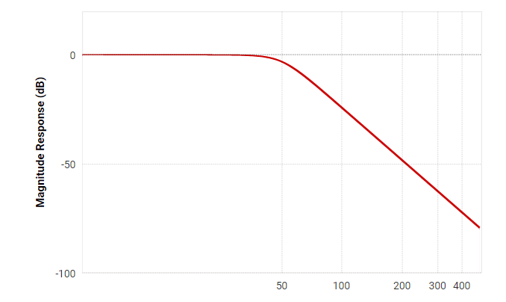
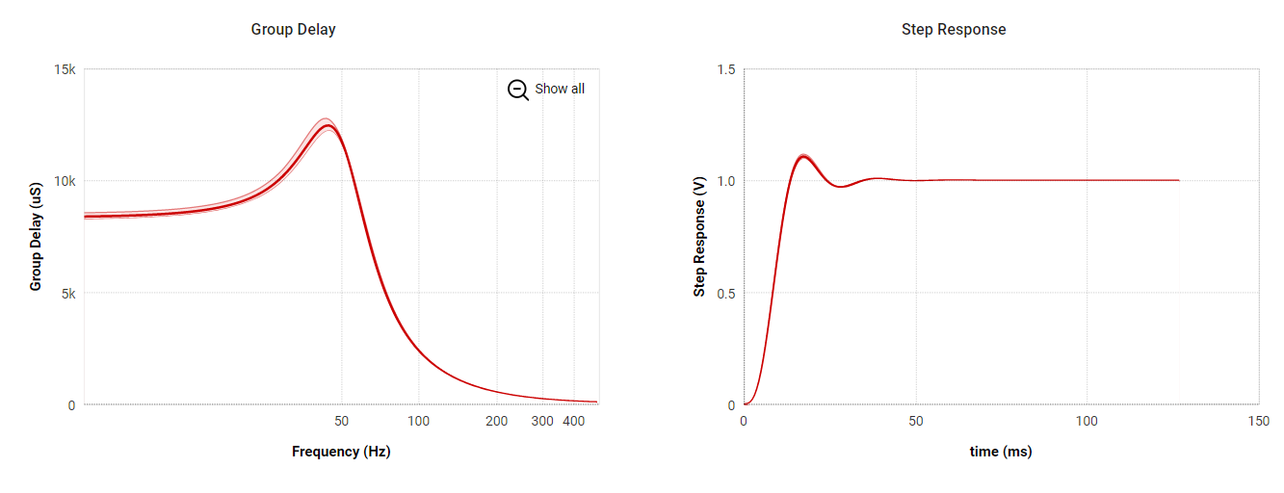
Ideal 4-th Order Butterworth
This is a rough ideal design – Update with real components
-0.5dB @ 35Hz

Slide 10
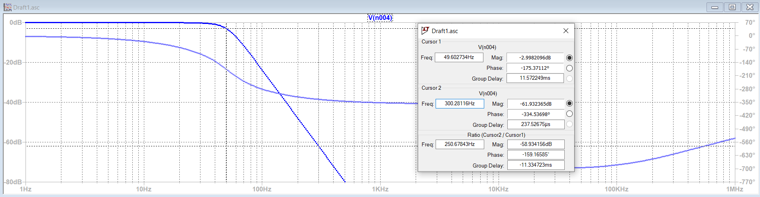
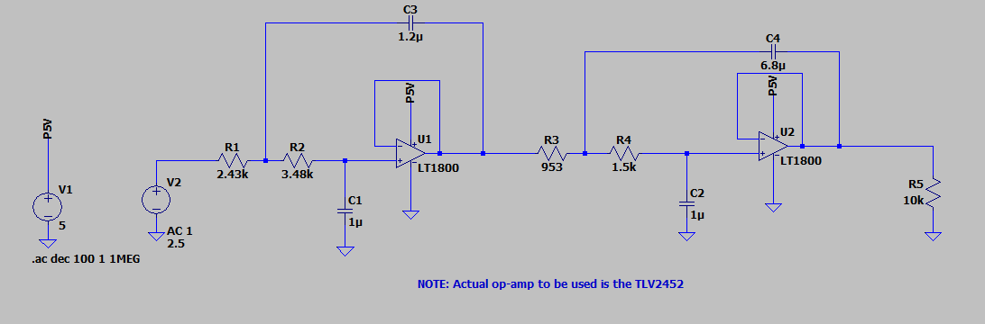
Anti Alias as built 9/27/22

Slide 11
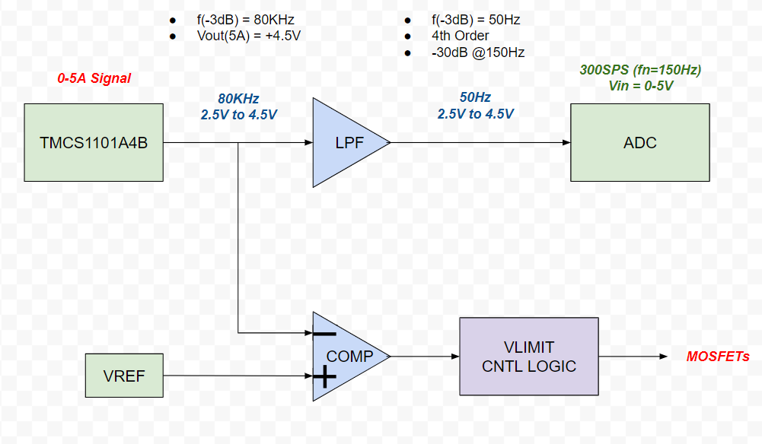
Vlimit Control (Analog)
Vref
  2.5V = 0A
  4.1V = 4A

Slide 12
Fault Debouncing Vs. Persistence
Fault Persistence
Simple Debounce
Meaning
  Trigger fault after x duration of fault occurrence
Inrush susceptible?
  No
Implementation
  Software = Easy
  Hardware = Hard
    Clock counter…
    Analog slew rate charge timer…
Meaning
  Trigger fault and latch for x duration
Inrush susceptible?
  Yes
Implementation
  Schmitt Trigger + LPF (input)

Slide 13
Fault Debouncing Vs. Persistence
Fault Persistence
Simple Debounce
FAULT PERSISTANCE DELAY

Slide 14
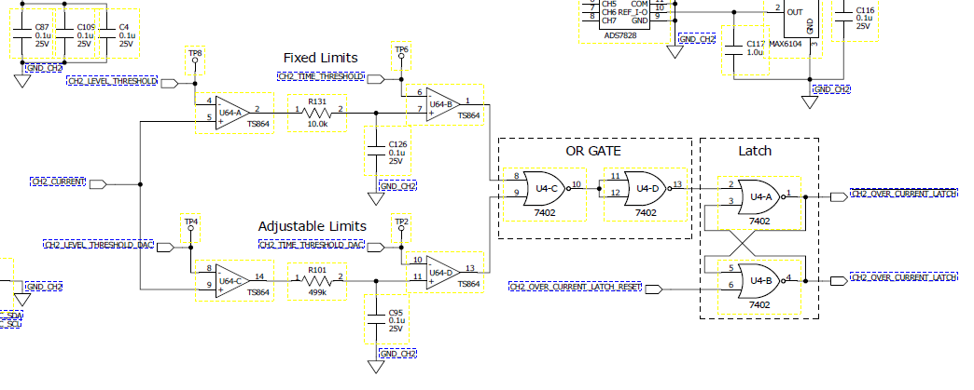
How does RSN do it
Simple RC filter to charge/discharge a capacitor
  Using time constant of the filter
  Adjustable voltage control of time duration
    Could be just a fixed duration for us

Slide 15
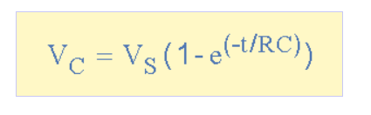
Trigger Timing Methods
RC Charge (RSN Method)
Controlled Slew Rate Charge
Extremely Simple
Non-Linear
Vcompare susceptible to op-amp input bias current
  4uA produces nearly a volt of error with RC magnitude needed
  Very low Ib op-amps needed
  Temperature effects
2 Op-amps + some R/C’s
Linear

Slide 16
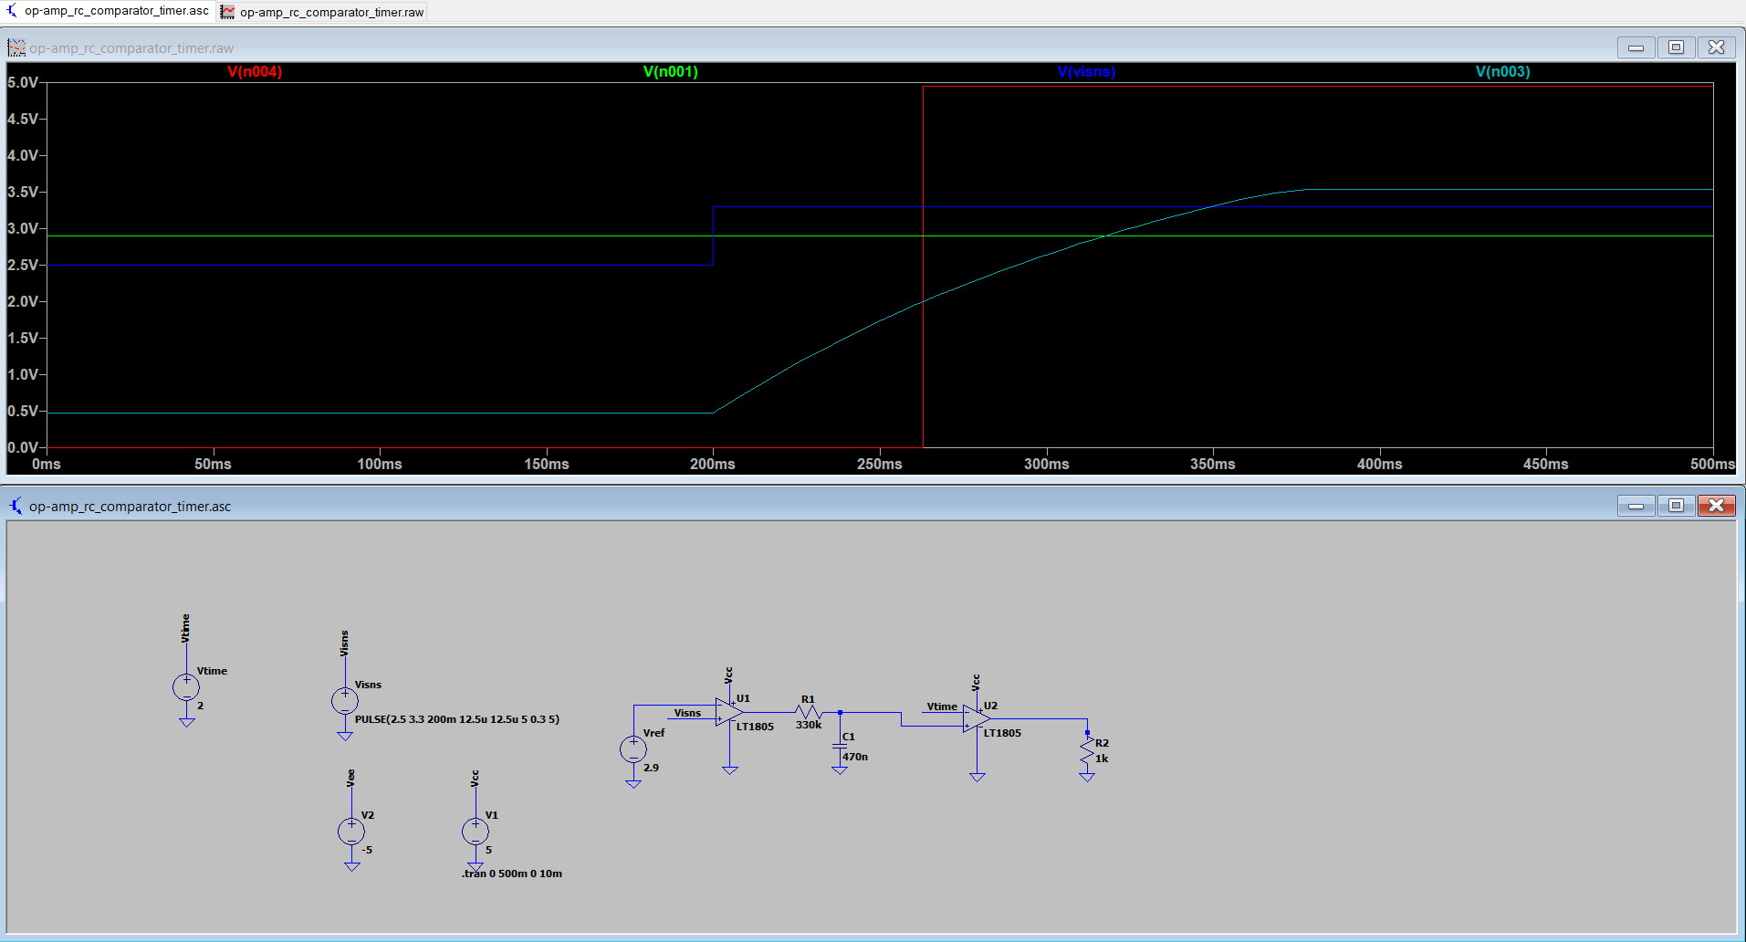
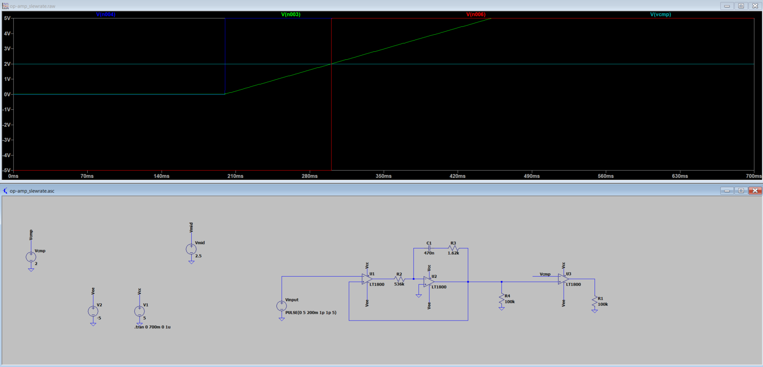
Simulation
RC Charge (RSN Method)
Controlled Slew Rate Charge
Expected = 80ms
Got = 62ms
Expected =100ms
Got = 100ms

Slide 17
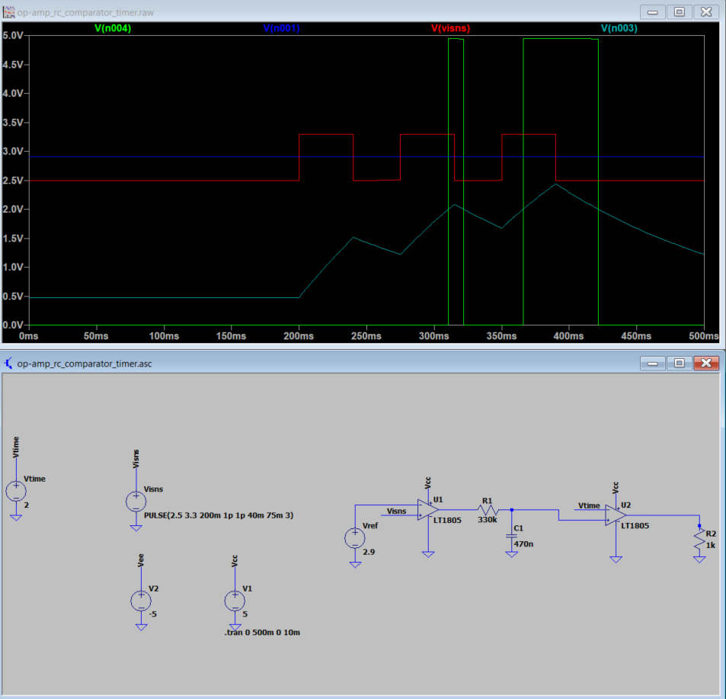
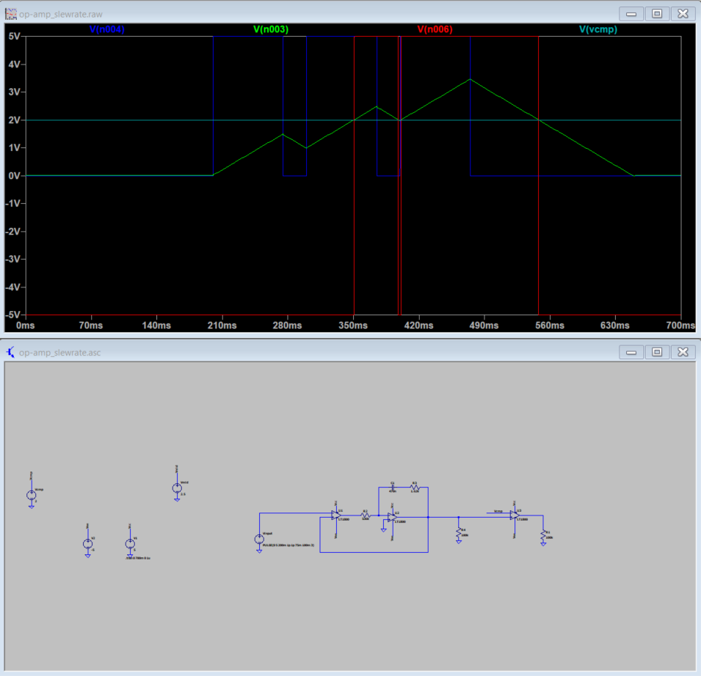
Both methods act as an “Accumulator”
RC Charge (RSN Method)
Controlled Slew Rate Charge

Slide 18
Method Challenges
RC Charge (RSN Method)
Controlled Slew Rate Charge
Making sure RC time constant is sufficiently accurate over temp/tolerance
Timing “chart” from bench data
  Inaccuracies (tol, input bias, etc…)
  20% capacitor driving – use precision?
Performing stability analysis per the datasheet to ensure rock solid
  Should be just “follow app-note”
Single supply operation shown in app-note
  Just need to redo

Slide 21
Vlimit Control Signal Debouncer
Desire to remove false trips
  Fast Inrush current
  Noise on a slowly rising signal
Circuit Type | Pro | Con
Schmidt Trigger | Simple | No inrush current protection triggering
RESET Supervisor Schmitt trigger + output timer delay |  | Same as Schmidt trigger since once trigger the timer is causing the output to hold for duration

Slide 22
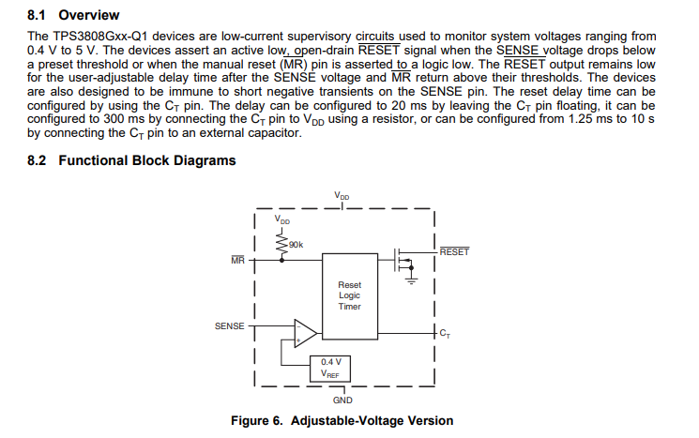
RESET Delay Timers
Contains internal hysteresis
Triggers for a MIN time set by CT pin
  Does not “accumulate” fault time
  Will not stop fast transients from triggering

Slide 23
Backup

Slide 24
Current Sensor LPF Path
35Hz (10ms)
Signals in red shade will be observed in sampled data (~50LSB) worst case 5Ap-p noise @150Hz
150Hz
80KHz
300SPS
-100dB/Dec
SIGNAL
NYQUIST
Sensor BW
F(sample)
ADC is used for telemetry only
  Non-critical – information only
  Ideal for situational awareness
Sampling Slower?
  To avoid aliasing in 1SPS data I recommend sampling at 300SPS and just averaging the data to 1SPS prior to sending upstream
  Move f(-3dB) appropriately and sample even slower.

