Slide 1
MARS 2 IPB Short Circuit Protection
Update, Brenton Salmi, July 2024
LAST UPDATE = 7/8/2024

Slide 2
Status
375V short circuit protection working!
System level updates were needed
  IGB Input capacitance to hold PSU rail up from drooping significantly
  IPB Input capacitance optionally added
  Inductance needed at IPB output
Why IPB output inductance?
  Required to limit di/dt during short @ 375V to allow protection circuitry time to react (~2us)
  ~40uH tested working

Slide 3
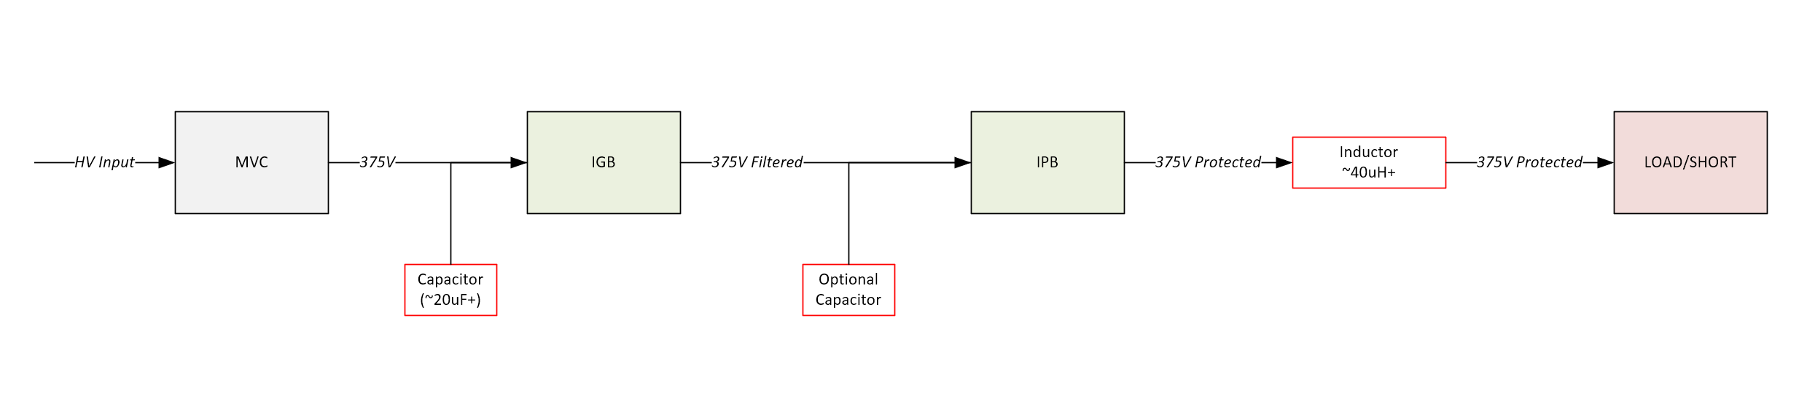
System Updates Needed
LC Filter
(saturates during short circuit)
Limits output current slew rate
Limits Vinput droop during high current outputs

Slide 4
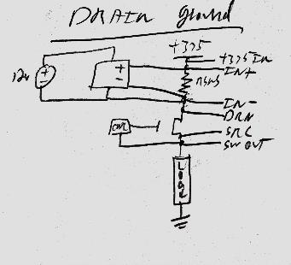
Short Circuit Configuration
Using independent isolated 12V supplies was the cleanest signals and more reliable implementation

Slide 5
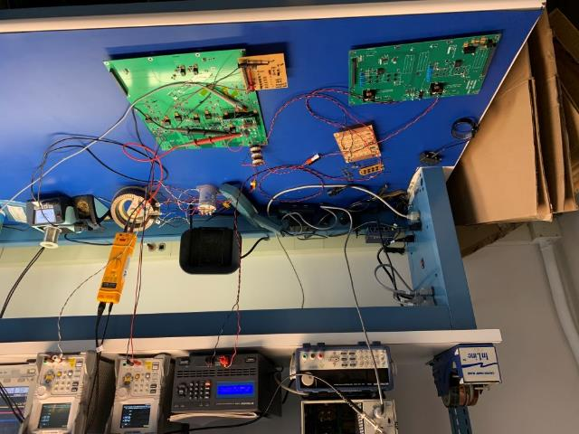
Setup
Setup simulates significant system input/output components
Dead Short
  ~1 Ohm here
20uF capacitance on PSU output
Inductance on IPB output limits short circuit di/dt
HV PSU
SIMULATED
SHORT CIRCUIT
DIODE PROTECTED Cin
20uF
IPB OUTPUT
INDUCTANCE
SHORT
PROTECTION
IGB
(LC FILTER)
IPB

Slide 6
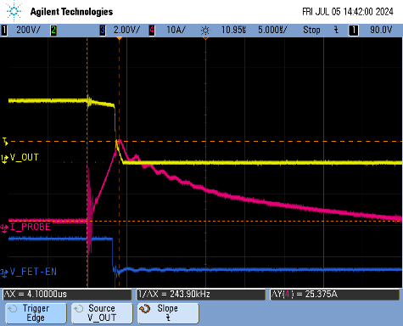
400V Shorting Test
Waveforms show shorting protection!
Output inductors limit slew
  ~40uH = 6.6A/us
  18A trip threashold
  ~1us response time
    Expected Imax = 24.6A
    Measured Imax = 25.4A

Slide 7
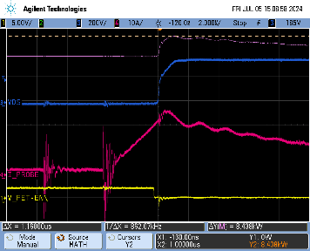
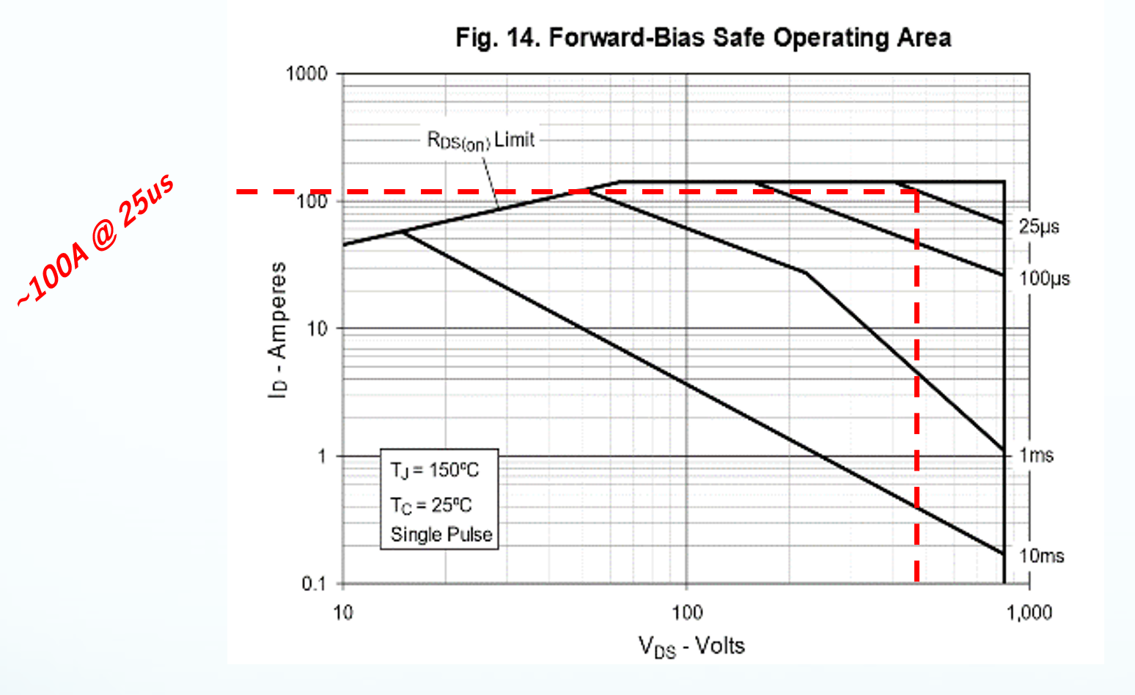
375V Vds / FET Power
Vds is clearly slightly overdamped
  Tuning can improve if desired
FET Power
  8.4kW peak
  ~25A for 1us (8.4kWpeak)
  Margin = 8.4kW @ 5us
    42mW!
  375V SOA ~100A for 25us
Note: IPROBE is measuring load current which includes output inductive flyback current not experienced by the MOSFET

Slide 8
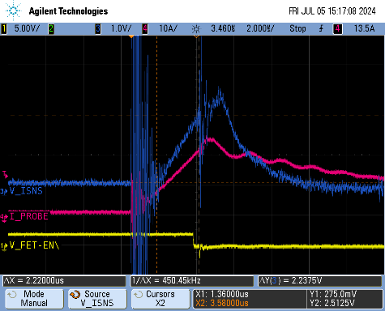
INA310 Current Sense
INA310 current sense
  Shows di/dt expected
  Shows Lout flyback
FET is turning off ~22A
  Vds snubber allows peaking of ~25A

Slide 9
Take-away’s / todo
Design Updates
Need to add capacitance to MVC output
Need to add large inductance to IPB output
Optional IPB input capacitance
  Stop Vdroop at IPB input
To-Do
Implement final logic integration to IPB
  Not fully implement on bench
    Report FAULT to computer
    Reset via channel enable toggling
Cleanup and tuning for final system/IPB updates of short protection circuits

Slide 10
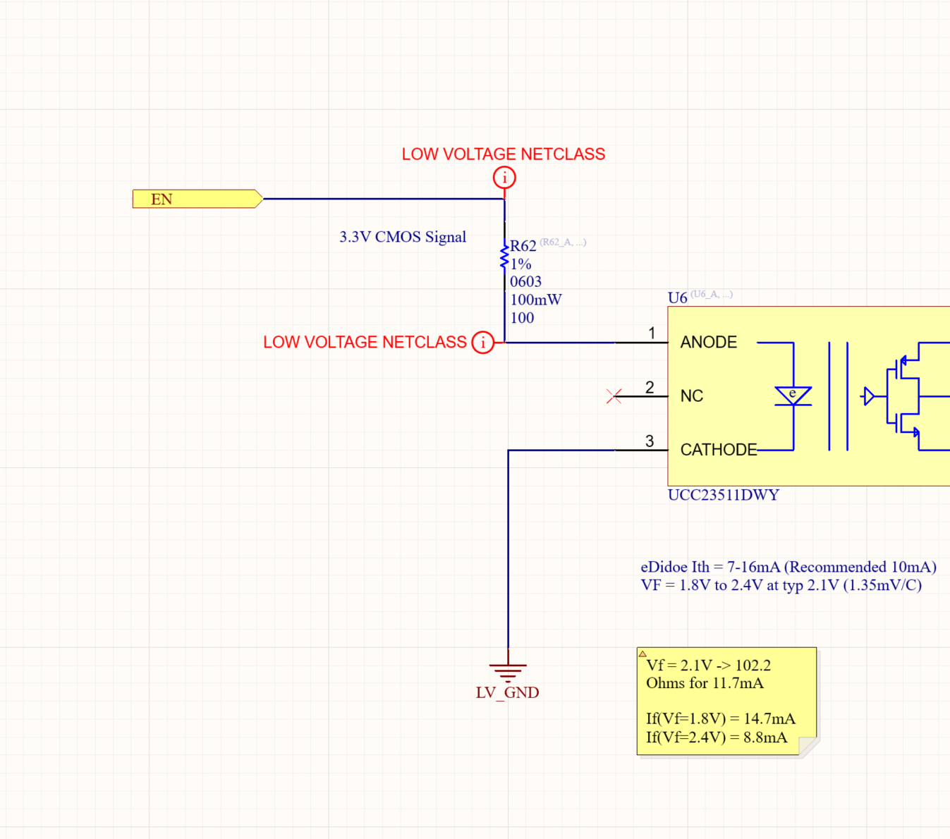
IPB Integration
(MOSFET CNTL – SP4)
Open collector shunts current to GND
Purpose
  Shut off MOSFET while SHORT fault is active

Slide 11
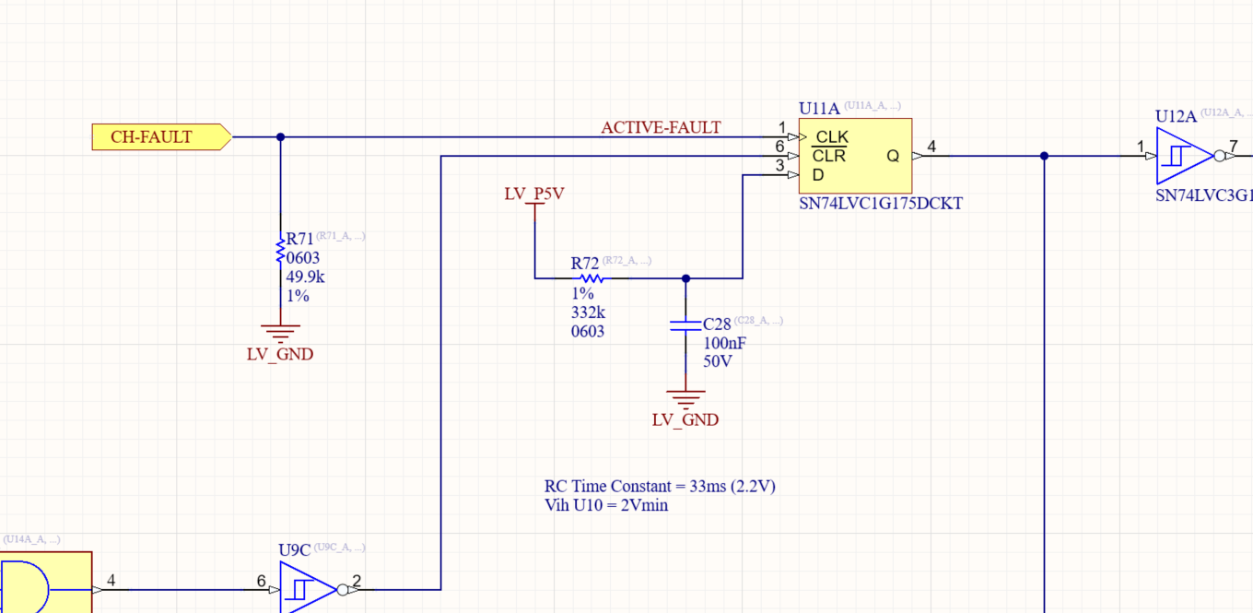
IPB Integration
(Channel Fault – SP3)
Open collector PNP shorts to P5V
Purpose
  Latch channel fault on main digital logic
NOTE
  Series resistor is needs from the CH-FAULT sheet entry
    4.99k
    Stops upstream driver from overcurrent

Slide 12
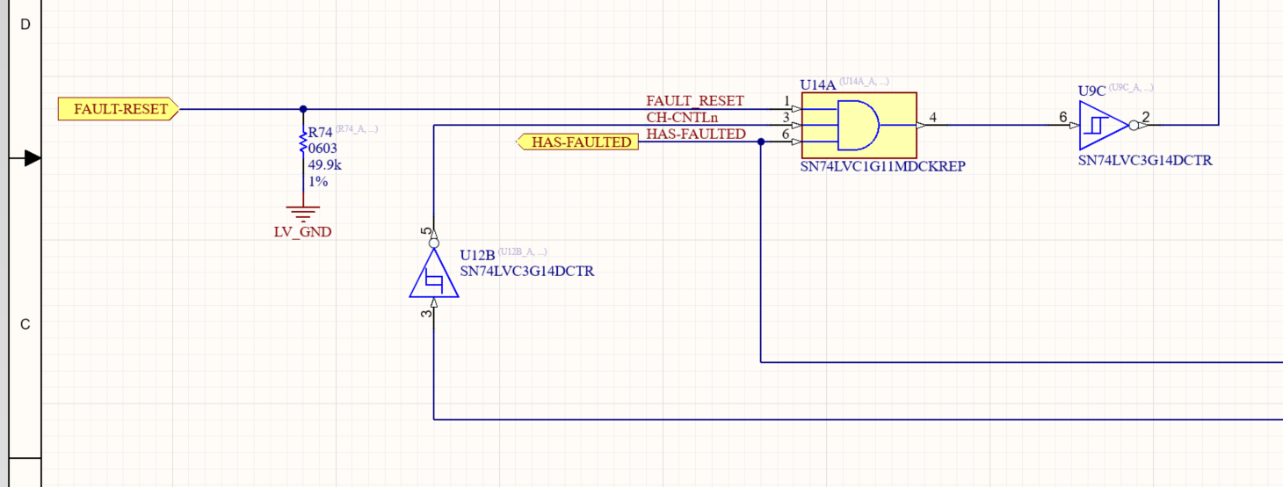
IPB Integration
(Channel Reset – SP5)
Bring FAULT-RESET to short circuit AND gate
Purpose
  Reset Short Fault (INA310) when channel is toggled

Slide 13
Updated Snubber Tuning
A great snubbing was found to work well at
  R = ~6.3 Ohms
  C = 100nF

Slide 14
Extra

