Slide 1
MARS 2 IPB Short Circuit Protection
Update, Brenton Salmi, May 2024
LAST UPDATE = 5/14/2024

Slide 2
Overview of Project Goal
Add Short Circuit Protection to IPB
Problem
IPB V1.0 testing and bring up analysis found that if a short circuit was applied to the IPB channel outputs the IPB/System would likely be damaged. Existing IPB Protection is overcurrent limit but not short circuit protection.
Short Circuit Uniqueness
Protecting from a short circuit requires significant differences than overcurrent protection – largely due to the speed of detection and extremely fast action needed to avoid damage. Short circuit protection is a self-preserving function of the IPB to maintain safe-operating-area semiconductor operation.
Why Is This a Problem?
MARS MVC system contains system capacitance (output of Schafer and bulk capacitance applied to MVC system externally) provides low impedance charge. A SHORT would allow this charge to develop EXTREME currents (>>50A) for short durations that exceed SOA of components.
A strategy is needed to ensure all components being stress due to high current are protected by either limiting current and/or removing the current fast.

Slide 3
Short Circuit Protection Needs
Need | Driving Need | Direction(s)
Detect short circuit event fast enough | Detection must be significantly faster than maximum SOA operation to allow detection AND action | Purpose built high speed high current detection Likely analog
Limit/Remove short circuit fast enough to maintain SOA | Maintain margin from limits of SOA current/duration | Update existing MOSFET driver for fast OFF time (<<10us) Add current limit functionality?
Safely handle resulting input / output harnessing inductive flyback | Avoid overvoltage of IPB MOSFET Vds limits. | Output Flyback diode Input MOSFET snubber design across drain/source
Overcurrent
  Minimal / Moderate current level exceedance that doesn’t risk safe-operating-area of components on short time scales
Short Circuit
  Excessive current level exceedance that risks damage to components on very short time scales (<10ms)

Slide 4
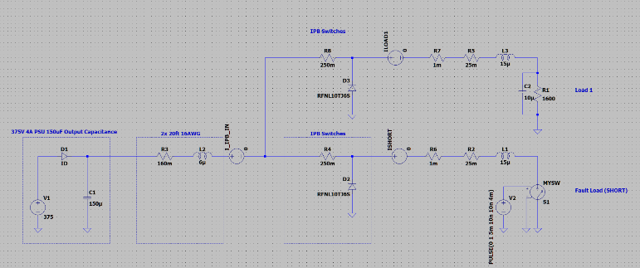
System Configuration
MVC TO IPB HARNESS INDUCTANCE
RELAY CONTACT RESISTANCE
PSU OUTPUT CAPACITANCE
OUTPUT HARNESS INDUCTANCE (TO SHORT)
MARS 1.0 PLACE 100uF HERE
MAY BE A GOOD IDEA TO MINIMIZE IPB INRUSH VDROOP
IPB MOSFET

Slide 5
Components At Risk
PCB | Component | Risk | Limit | Primary Protection Method
IPB | HV MOSFET | Exceed SOA current/time duration that damaged die | 25us = 105A 100us = 55A | Limit current Remove current prior to ABSMAX
IPB | HV Relay | Overcurrent of CLOSED contacts? | 30A ABSMAX | Limit current Remove current prior to ABSMAX
IPB | Current Sense | Overcurrent of the sensor ABSMAX (TMCS1101) | 275A pulse (1ms) | Limit current Remove current prior to ABSMAX
IPB | Flyback Diode | Short circuit flyback current when IPB MOSFET is OPENED fast | ~80A | Size diode for pulse operation if needed
IGB | Overvoltage/Reverse Polarity Semiconductors | Overcurrent through these configuration circuits |  | Limit current Remove current prior to ABSMAX
ALL | Harwin Connector Contacts | Generic current rating | 20A continuous – no pulse rating | I’m not really concerned with this

Slide 6
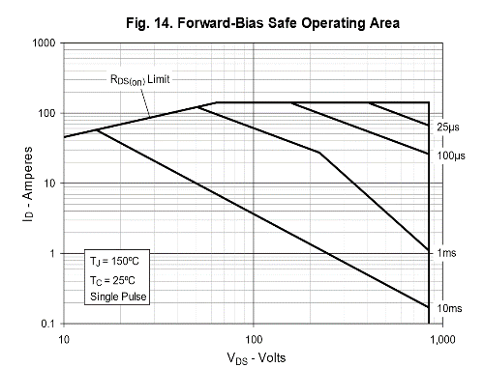
MOSFET
~100A @ 25us
In a SHORT condition the load resistance is ~0 ohms and therefore the entire 375V is across the MOSFET

Slide 7
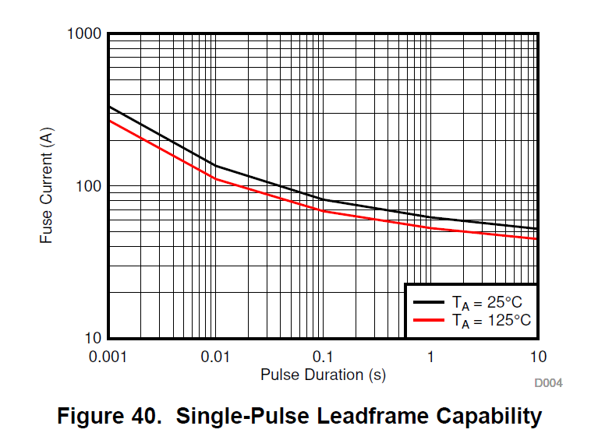
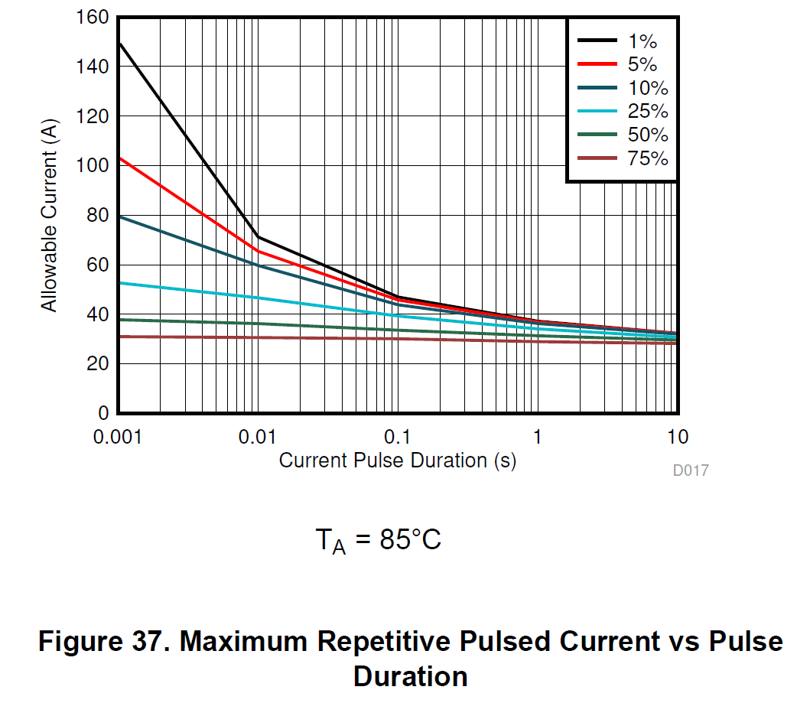
TMCS1101 Current Sense
Non-Repetitive
(Fusing Current!)
Repetitive
I don’t think that repetitive pulses are relevant (duty-cycled)
105A @ 10ms
275A @ 1ms
80A @ 100ms

Slide 8
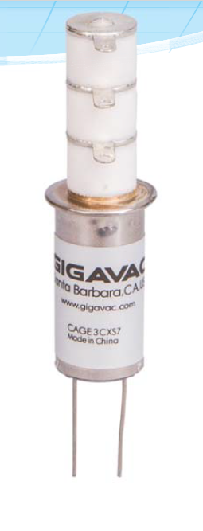
Relay
ABSMAX DC Current
30A for non-switching application
During high current pulse testing (40-90A observed) several relays are observed welded CLOSED

Slide 9
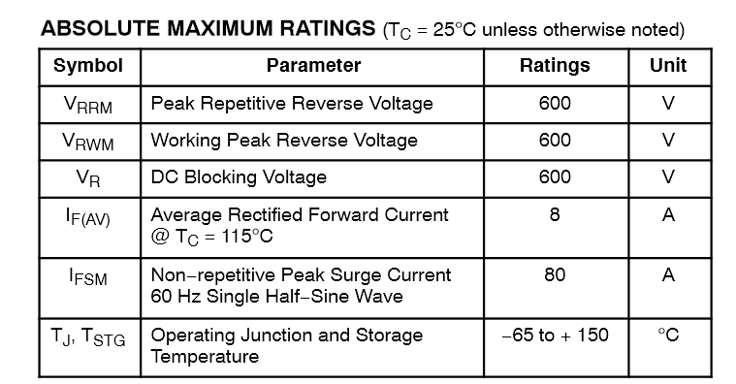
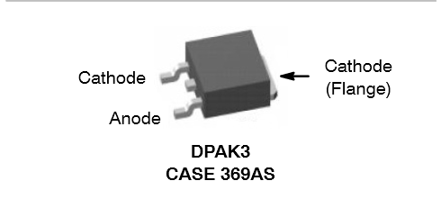
DIODE
FFD08S60S-F085
80A half sine wave 60 Hz
Use this as a rough guide – keep well below 80A

Slide 10
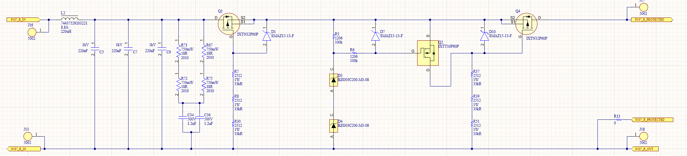
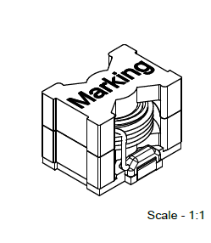
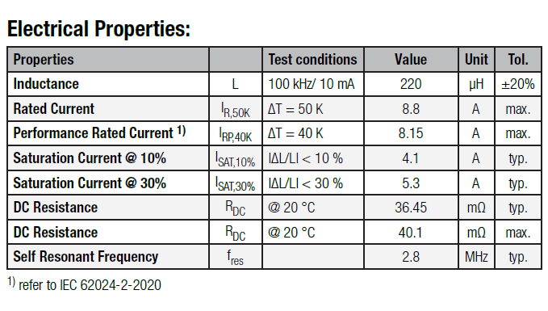
IGB OVP/Reverse Protection
MOSFETS same as IPB. During operation dropping <10V so same SOA applies as IPB
220uH inductor

Slide 11
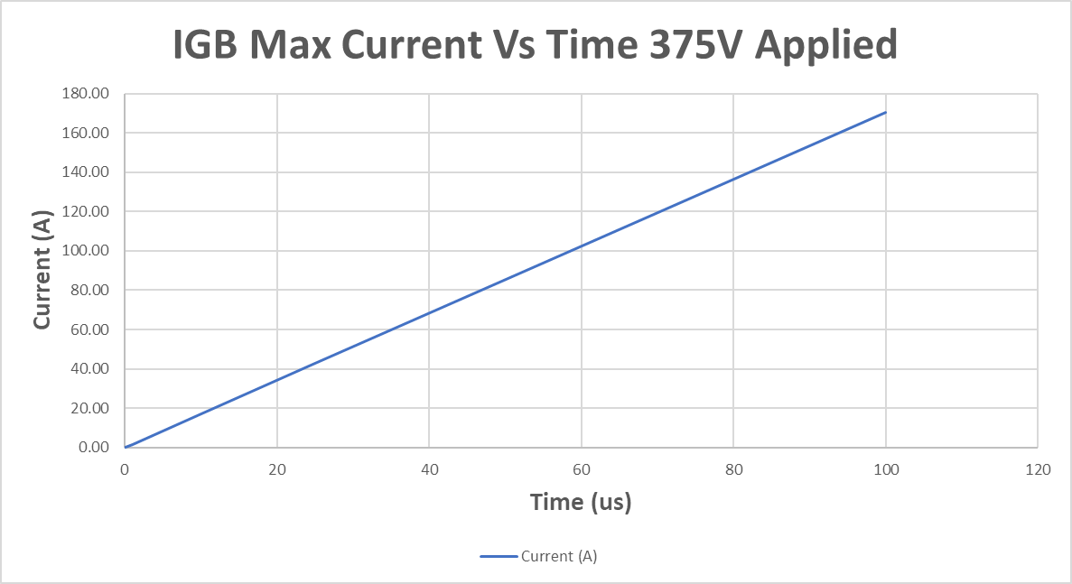
IGB Inductor
30A @ ~17us
MAX current is 8A
  Not a pulse rating – Giant wire so likely >>8A ABSMAX
Lowest system current rating is 30A pulsed (Relay)
  The determines the maximum time the short can persist safely in the system before limiting
  Sets the system response time needs
Limits A/sec rise a bit
  Will saturate quite low current (~5A)
  Less effective inductance above 5A so ensure a pretty wide margin!

Slide 12
Key Requirements
How are we going to do this?

Slide 13
Minimum System Requirements
Requirement | Value | Driver
Absolute Maximum Current I(max) | 30A | Relay welding current
Minimum time to reach I(max) | 17us | Limited by di/dt from IGB input protection inductor
Minimum time to reach 4A (from 0A) | 2.4us | Due to IGB inductors the minimum time needed to get above the system nominal current maximum (anomalous region).
30A
1.7MA/sec
17us
>100us @ 30A to stop curret if 30A regulated

Slide 14
Short Circuit Detection
Methods

Slide 15
Current Sense Methods
There are 3 ways to detect short circuit current:
High side resistive current sense
  Standard configuration
Low side resistive current sense
  Low common mode voltages
  Technically could short to another RTN path
High/Low side MOSFET V(Rds)
  Using MOSFET as the Rsense
  Less reliable over many channels without cal

Slide 16
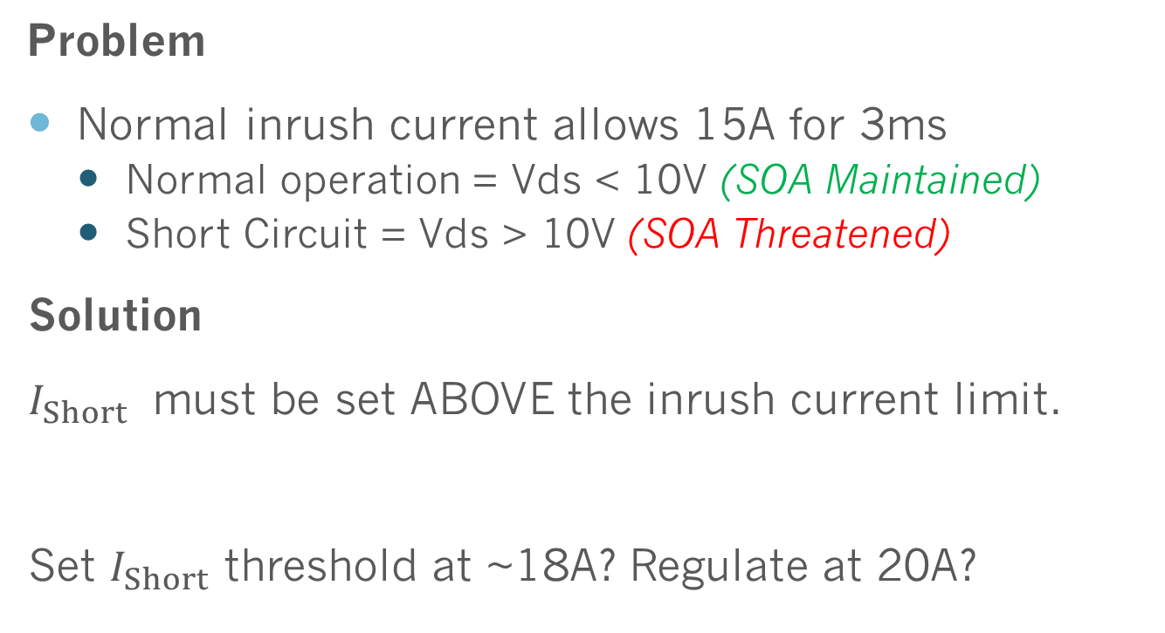
Dealing With Inrush Current
Problem
Normal inrush current allows 15A for 3ms
  Normal operation = Vds < 10V (SOA Maintained)
  Short Circuit = Vds > 10V (SOA Threatened)
Solution
$I_{Short}$ must be set ABOVE the inrush current limit.
Set $I_{Short}$ threshold at ~18A? Regulate at 20A?

Slide 17
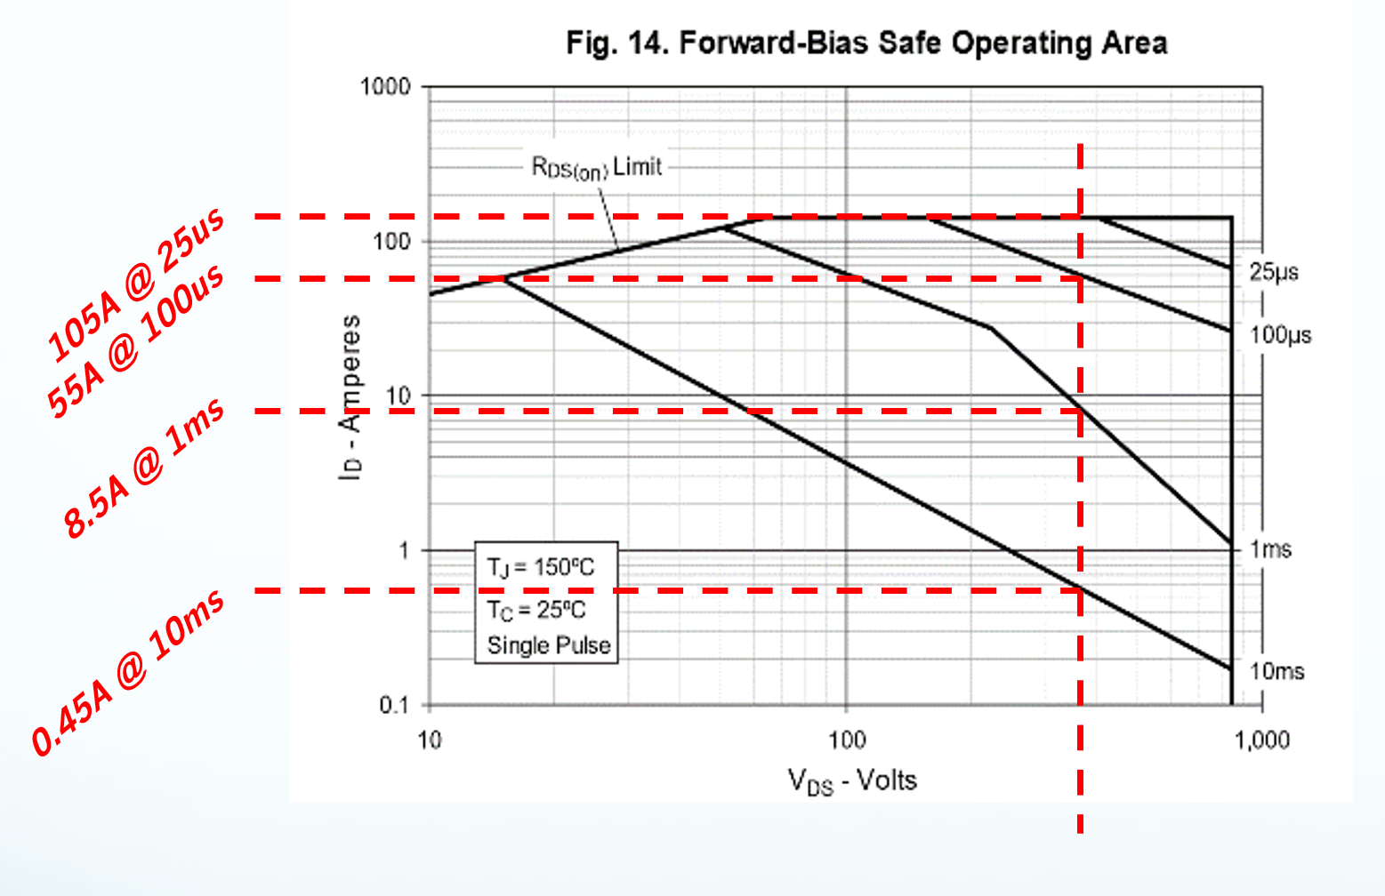



Regulating Short Circuit Current?
Regulating short circuit current would be useful to limit the energy buildup in the the system
  Limit inductive flyback energy
  Increase duration of fault survivability
  Giving time for system to react, shutdown
May allow “softer” turn off energies
Current di/dt limits maximum current
  1.7MA/s per IGB inductors (may be faster due to L saturation)
    ~5us shutoff time = +8.5A
    ~10us shutoff time = +17A
    ~20us shutoff time = +34A (exceeds relay Imax)
  MOSFET off must shutdown within ~10-15us regardless of current regulation to avoid relay damage
No Regulation Fast Shutoff (5us)
di/dt trajectory
~100us maximum allowed duration (SOA)
$I_{Max}=$30A
~28A Best Case!
$I_{Regulation}$= ~20A
=$I_{Short Circuit Detect}$ 18A
15A Inrush Current Allowed
Short Circuit Detected
Slow Short Circuit Shutdown
Current Regulation
Starts

Slide 18
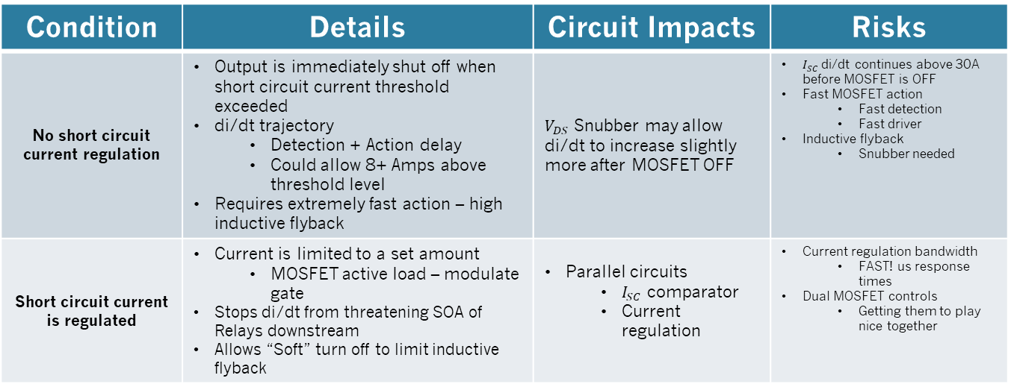
Current Regulation
TL;DR
Condition | Details | Circuit Impacts | Risks
No short circuit current regulation | Output is immediately shut off when short circuit current threshold exceeded di/dt trajectory Detection + Action delay Could allow 8+ Amps above threshold level Requires extremely fast action – high inductive flyback | $V_{DS}$ Snubber may allow di/dt to increase slightly more after MOSFET OFF | $I_{SC}$ di/dt continues above 30A before MOSFET is OFF Fast MOSFET action Fast detection Fast driver Inductive flyback Snubber needed
Short circuit current is regulated | Current is limited to a set amount MOSFET active load – modulate gate Stops di/dt from threatening SOA of Relays downstream Allows “Soft” turn off to limit inductive flyback | Parallel circuits $I_{SC}$ comparator Current regulation | Current regulation bandwidth FAST! us response times Dual MOSFET controls Getting them to play nice together
BASELINE PATH: No Current Regulation
This will be much faster and easier to implement and test – Backup is to add in a current regulation loop if too slow.

Slide 19
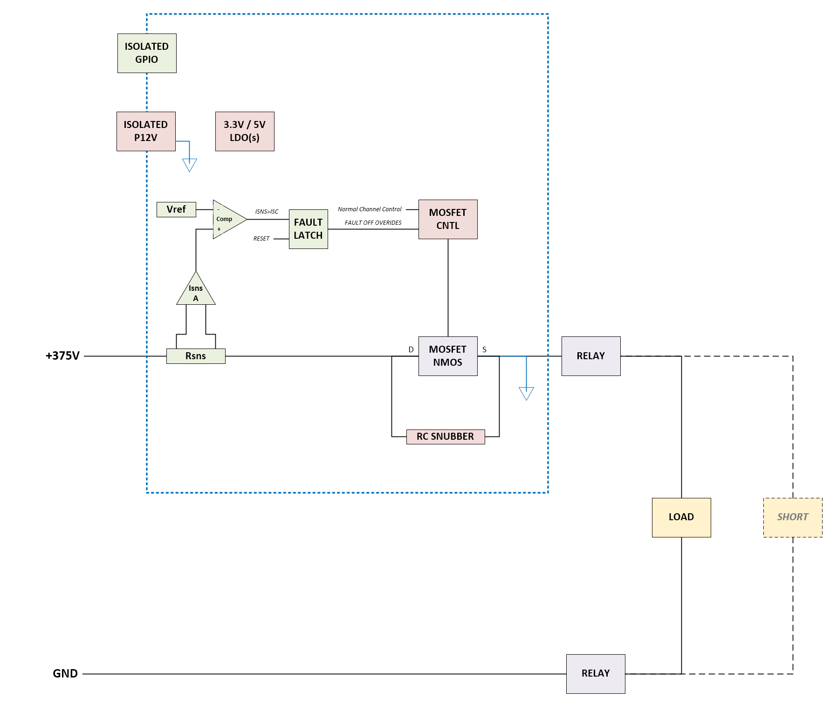
Short Circuit Protection
Minimum Viable (Test) Solution
Goals
Develop short circuit detection
  Accurate threshold
  Fast enough action (us speeds)
Modify Existing MOSFET driver
  Requirement: Turn-off less than ~5us
RC Snubber development
  Tuning for size and Vds
Short Simulation development
  Safely create 375V short circuit in the lab!
Notes
IPB Overcurrent Protection
  This remains in the system!
  Protects against minor overcurrent issues
  E.g. Power limited shorts/faults in load

Slide 20
Short Circuit Simulation
In The Lab! (Part 2)
Contactors
  (NO) TE LEV200 (from old project)
    >>1000 cycles at 100A make/break current
  (NC) TE LEVxxx variant also from old project
    Used to ensure capacitor is discharged
Resistors
  TE 2KW 10 Ohm resistors from old project
  Used to limit max current during initial testing
Capacitor
  ~4800uF each from old project 450V rating

Slide 21
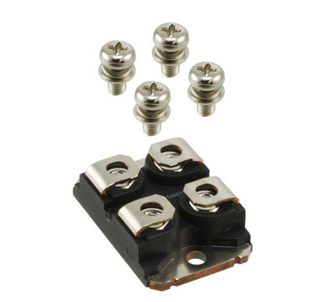
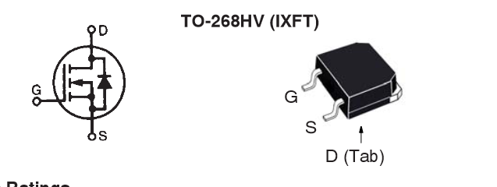
Existing IPB MOSFETS
Existing IPB MOSFETS
New MOSFET?
Same X-Class Family as IXFN66N85X
IXFN66N85X (Littlefuse) ($40/ea)
  SOT-227 Package
  Vds = 850V
  Rds(on) = 65mOhms
    1.04W @ 4A
  Gate Charge = 230nC
  Id(max cont) = 65A
IXFT50N85XHV (Littlefuse) ($18/ea)
  TO-268HV Package (SMT!)
  Vds = 850V
  Rds(on) = 105mOhms
    ~1.68W @ 4A
  Gate Charge = 152nC
  Id(max cont) = 50A
We should seriously consider a NEW MOSFET
  Labor $ to install SOT-227 is > New MOSFETS
  Large, screws = FOD
  Heating is not much of a concern at 4A cont. max…

Slide 22
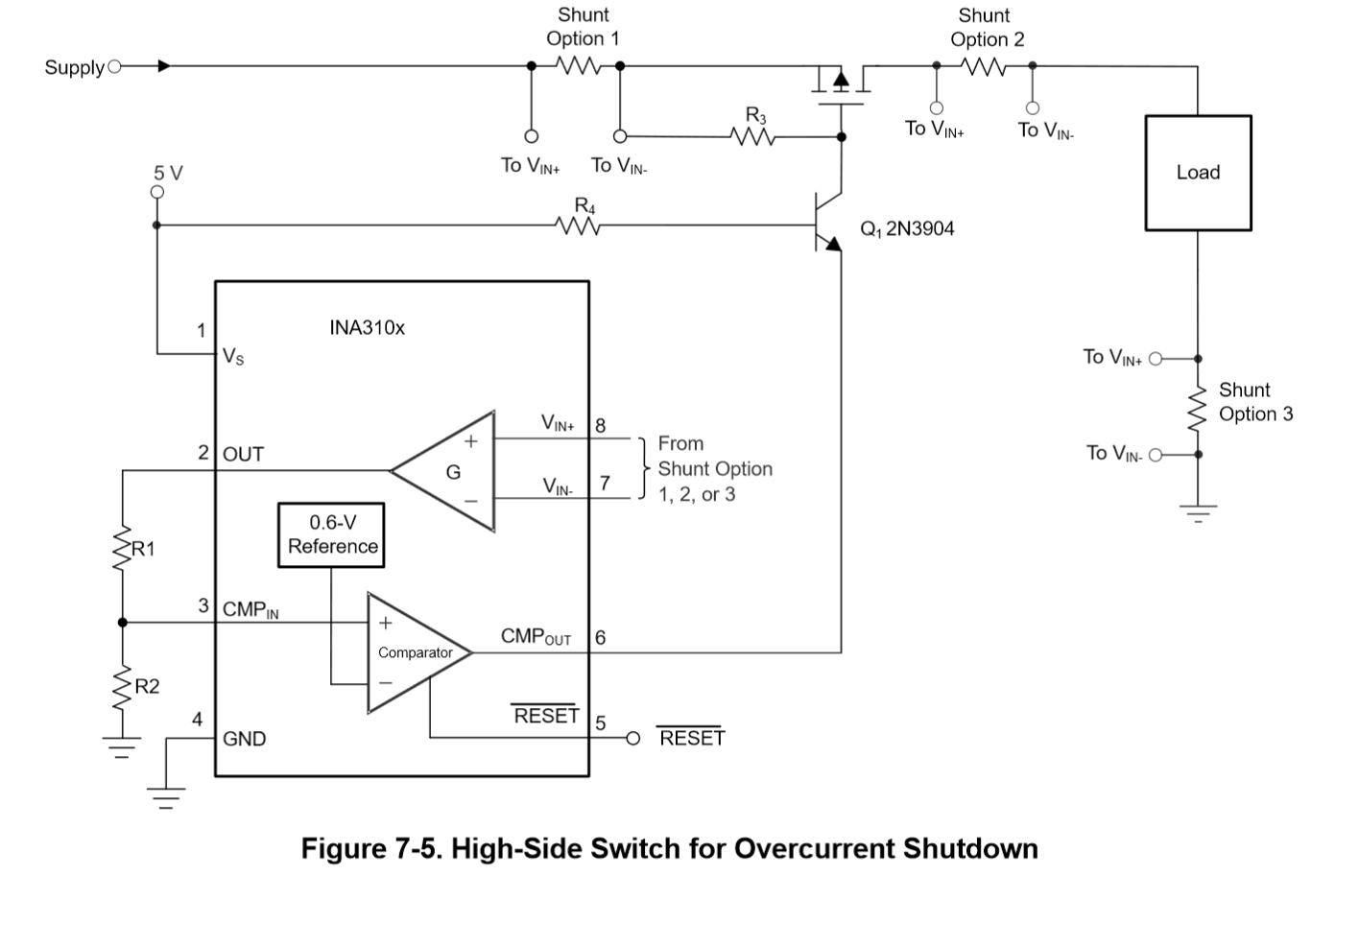
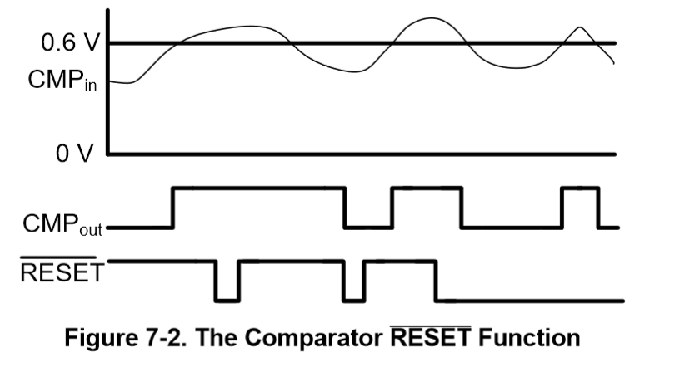
INA310x IC (Isns + Comp)
Integrated current sense & comparator
Low propagation delay (1us)
  Designed for overcurrent protection!
Many gain options and available

Slide 23
Estimated Gate Current
152nC gate charge & Ciss = 4.48nF
  Estimated gate current needed at 100ns turn off
    ~500mA per DS00786A application note
Existing UCC23511 more than needed (2A)

Slide 24
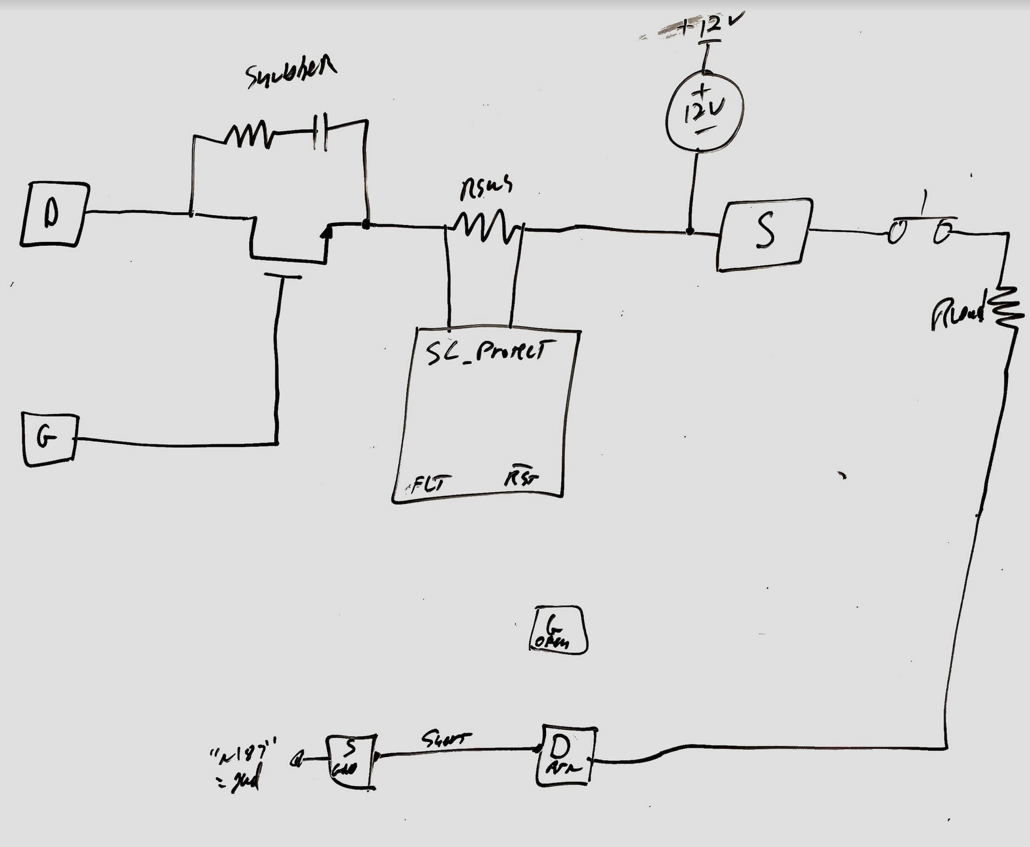
Integrating SC Protection
MOSFETS removed from existing IPB
  Only HIGH side MOSFET will be used
  MOSFET must be mounted on new adapter board
Relay is on normal IPB
FLT and RSTn need to come back into LV domain

Slide 25
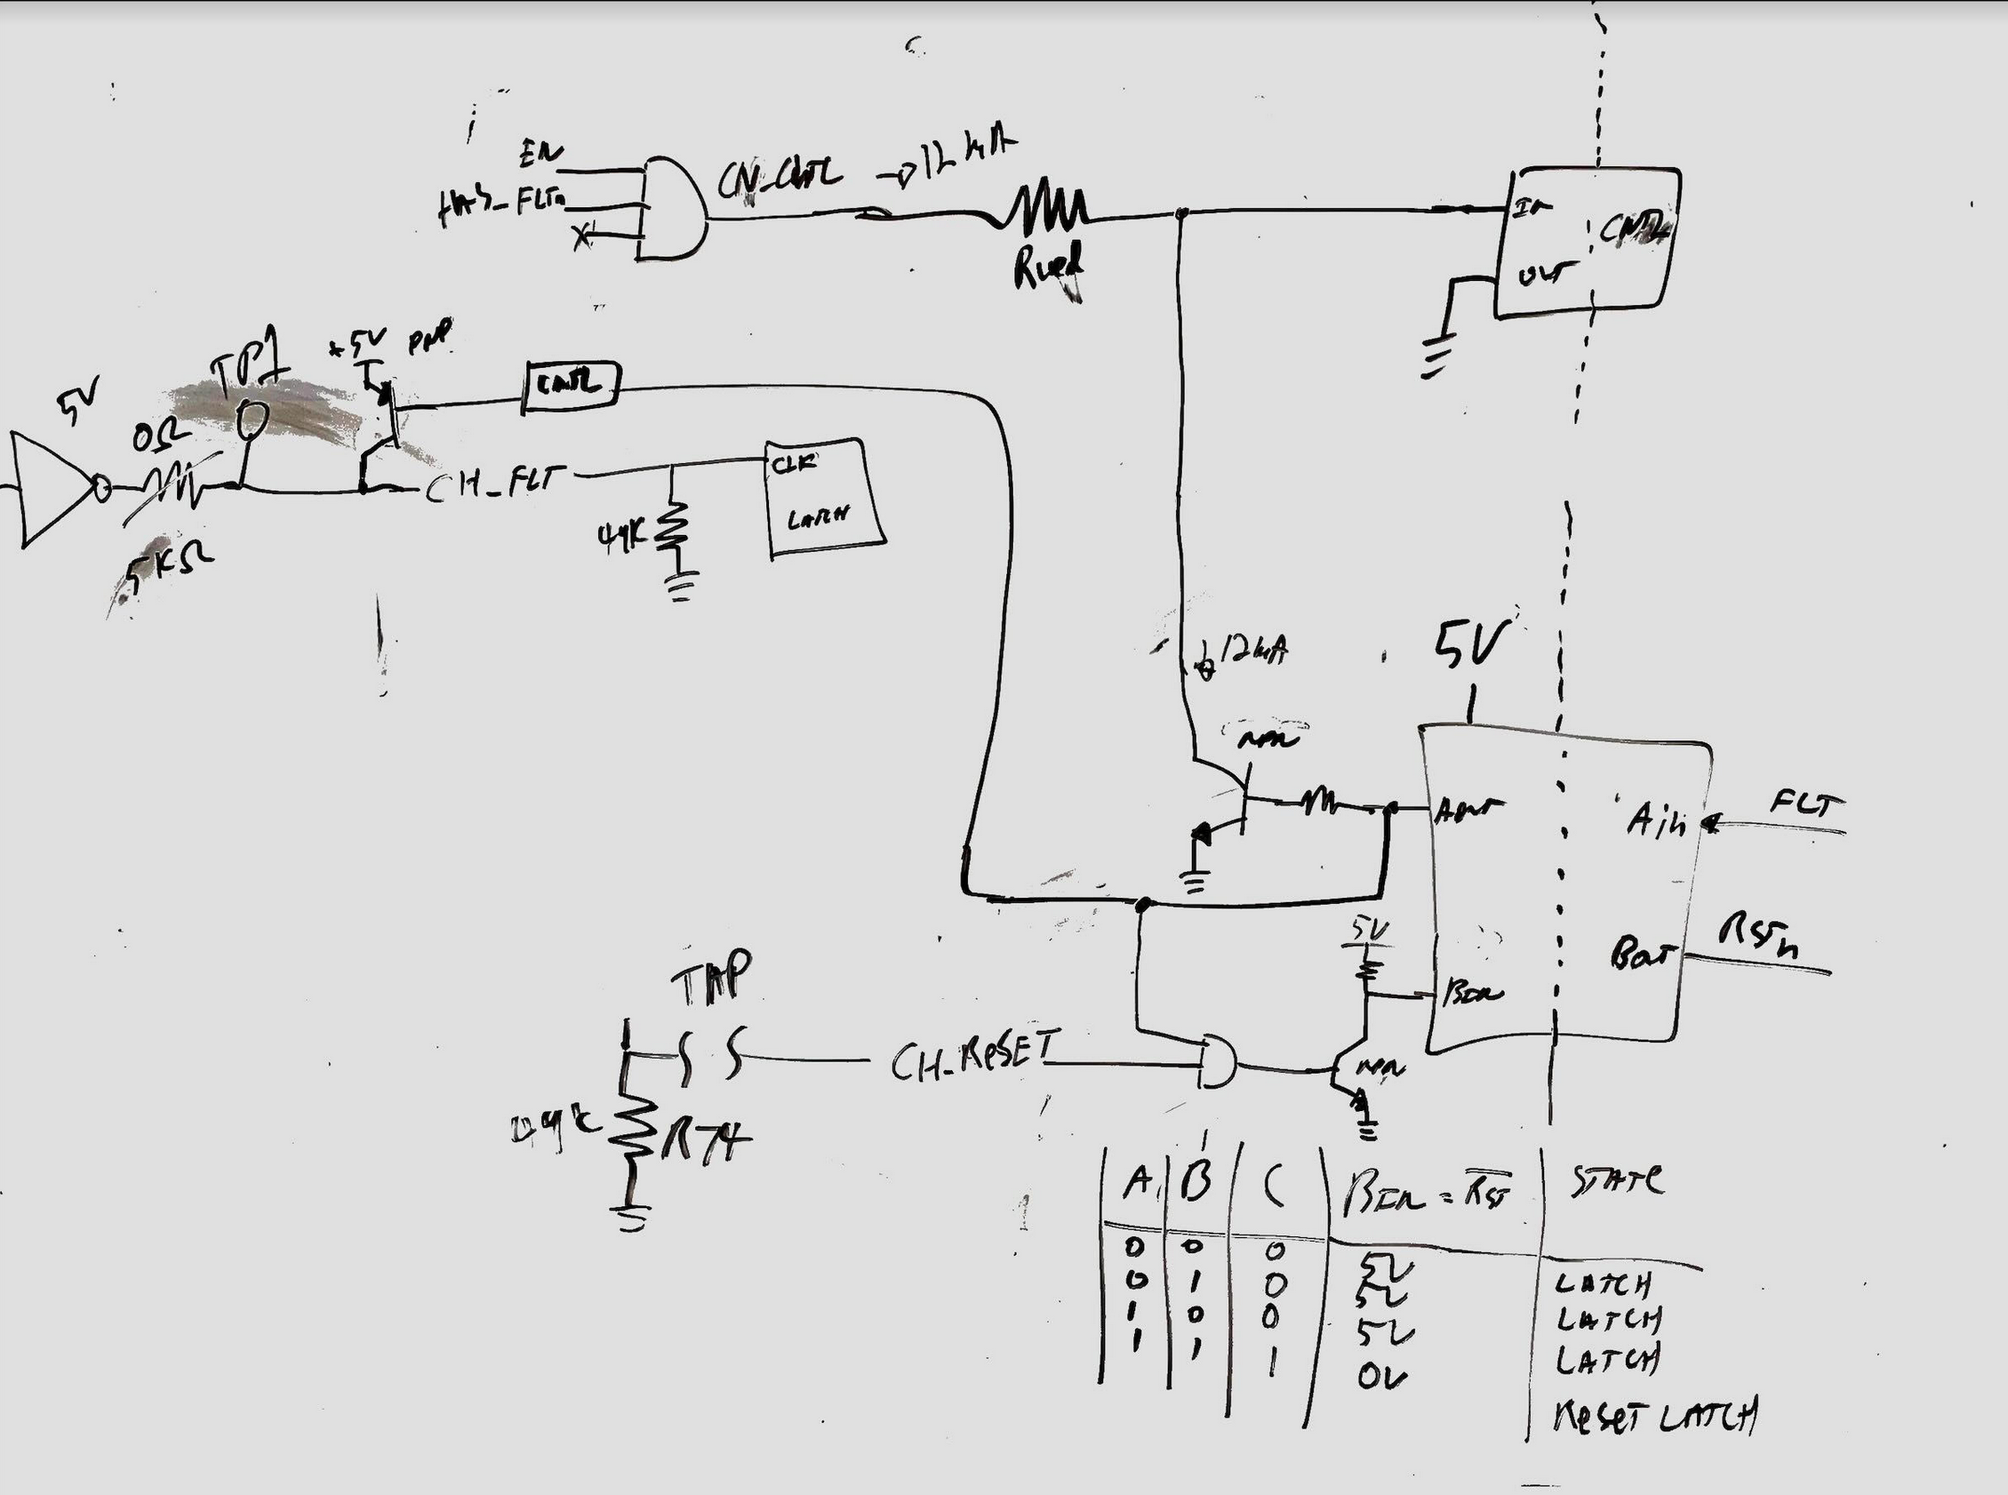
Integrating Fault and Reset
Fault
  MOSFET Control
    Open collector eliminates MOSFET driver current
    Fast!
  FAULT Channel Sig
    Open collector (PNP) pulls CLK input high to fault channel when SC fault occurs
    Replace 0 ohm with ~5K
Reset
  Use existing channel fault reset
  Use open collector to keep RSTn HIGH until fault occurs and RESET signal sent
    Maintains SC protection fault
    Use AND gate to make logic compatible

Slide 26
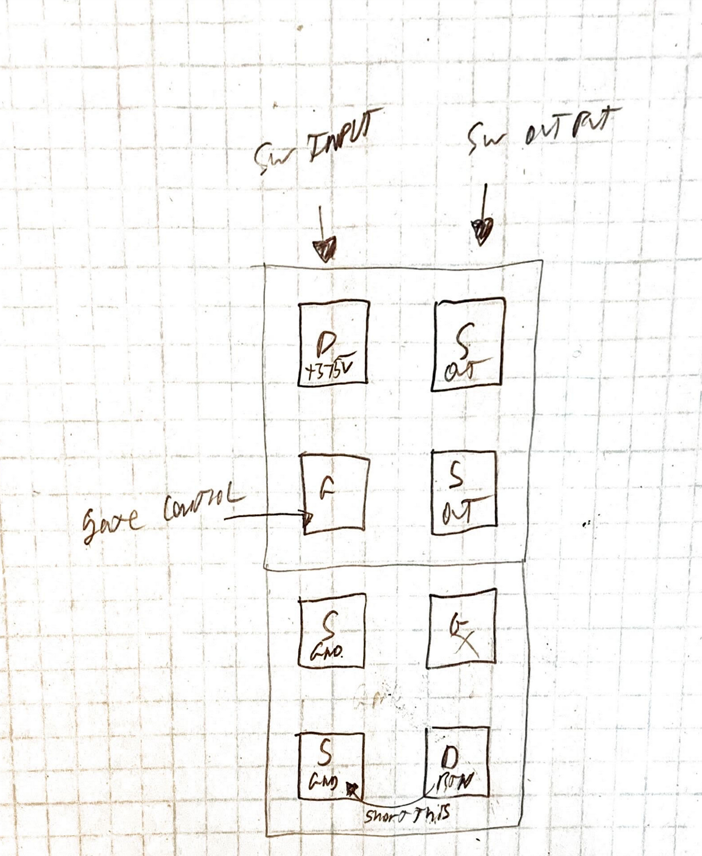
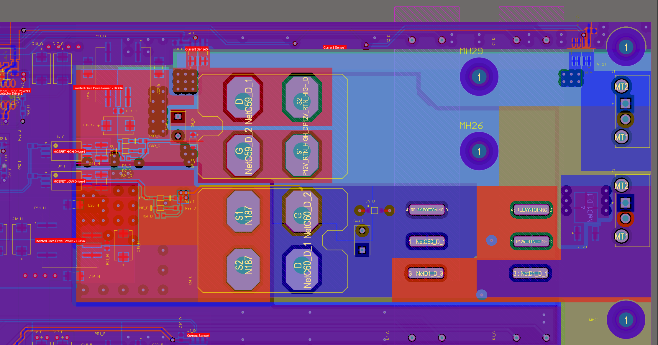
Adapter Board Mounting
VIEW FROM TOP SIDE PCB
ONLY the HIGH side MOSFET will remain in the system.

Slide 27
How to Drive Channel?
Existing external control provides SN74LVC1G11MDCKREP AND gate output to drive MOSFET Driver E-Diode input
Lets not worry to hard about this right now
  Lets get a short circuit protection implementation

Slide 28
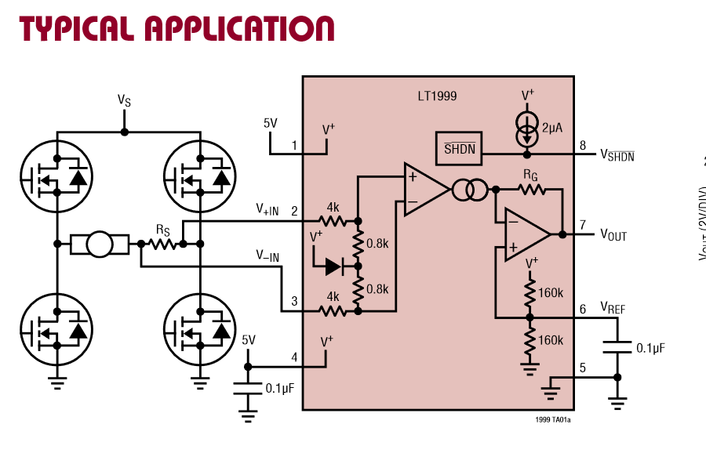
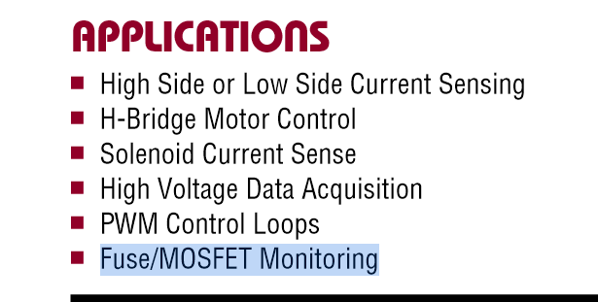
Current Sense Amplifier
LT1999-20
80V Input Vcm
  Floating on top 375V
BW = 2Mhz
Slew Rate = 3V/us
Gain = 20 V/V
  5mOhm Rsns
    20A = 2V (~700ns slew)
    25A = 2.5V (~850ns slew)
NOT TO BE IMPLEMENTED

Slide 29
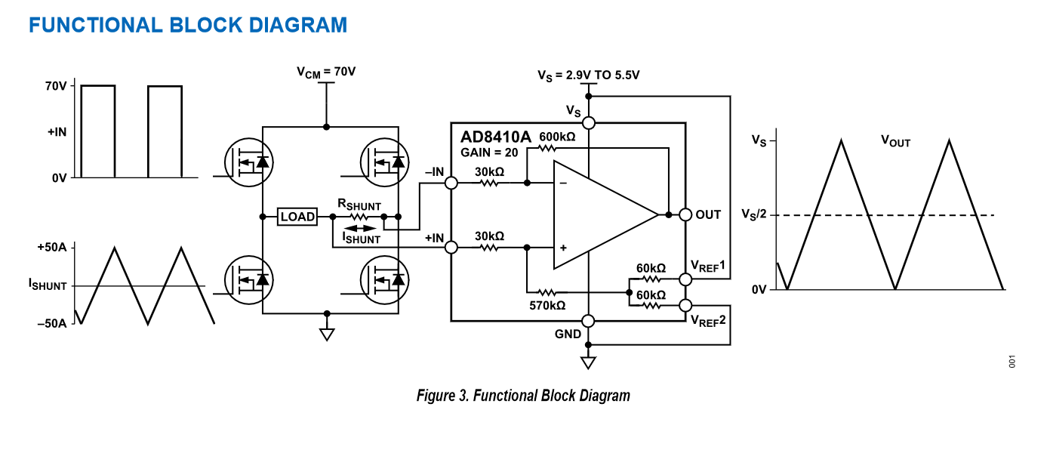
Current Sense Amplifier
AD8410A
70V Input Vcm
  Floating on top 375V
BW = 2.2Mhz
Slew Rate = 10V/us
Gain = 20 V/V
  5mOhm Rsns
    4A = 0.4V
    10A = 1V
    20A = 2V (100ns slew)
    25A = 2.5V
NOT IN LTSPICE

Slide 30
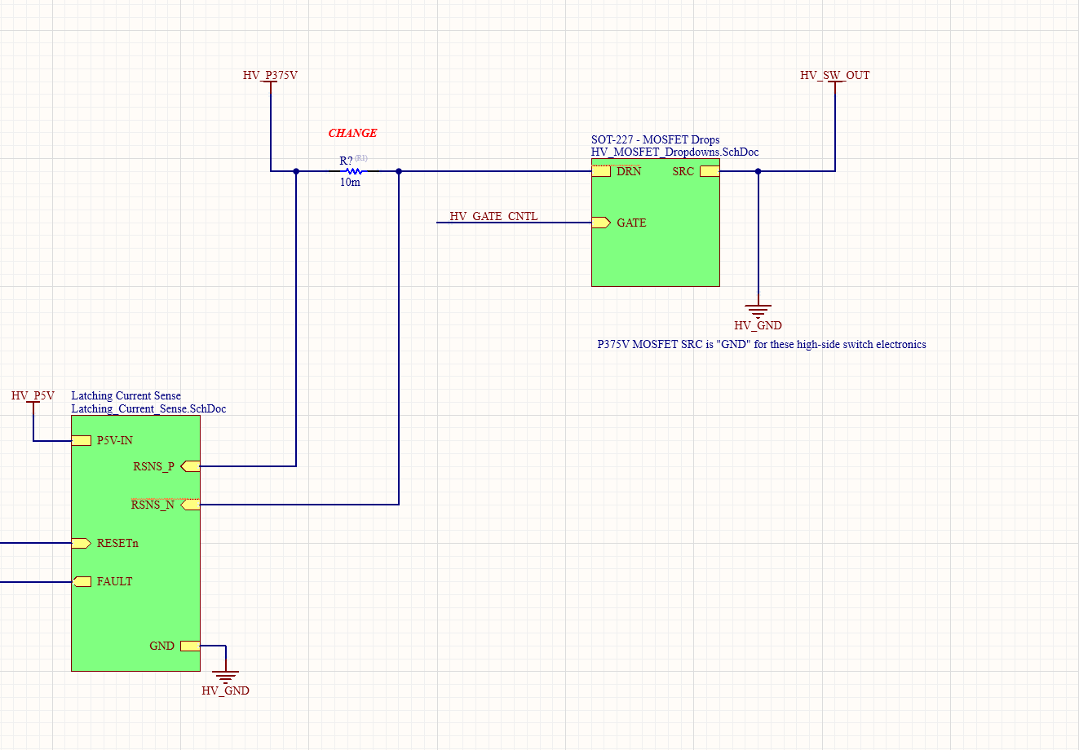
PROBLEM: High Side ISNS needs Dedicated Isolated PSU
Current implementation shown above would expose +375V common mode voltage to the current sense!
  Absolute crater!
Low side sense possible
  Possible to miss high current returns to other channel…
  Unlikely and simpler but High Side sense is the “Right” way to do this
High side sense
  Requires +5V with GND referenced to MOSFET Drain

Slide 31
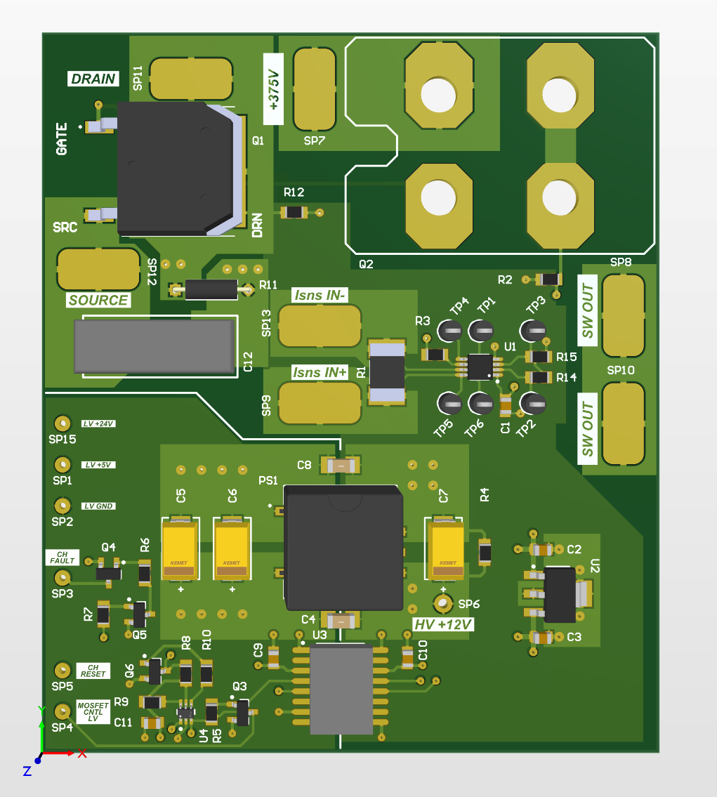
Adapter PCB
+375V
POST
GATE DRIVER
GND POST
ALT MOSFET
OR
SOLDER PADS TO EXISTING FET
Mounts using standoffs to the SOT-227 IPB PCB pads
  Brings out
    +375V
    MOSFET Gate Control
    MOSFET Driver GND
Solder pad configurability
  Supports 2 configurations desired
    Single +12V supply
      Adapter PCB +12V DC/DC DNP’d
    Dual +12V supply
GATE
DRIVER
POST
SW OUT
LOW VOLTAGE
SOLDER FLYWIRES
LATCHING
CURRENT SENSE
HIGH SPEED
DIGITAL IO
ISOLATOR
(FAULT/RESET)
LV LOGIC INTEGRATION
CIRCUITS

Slide 32
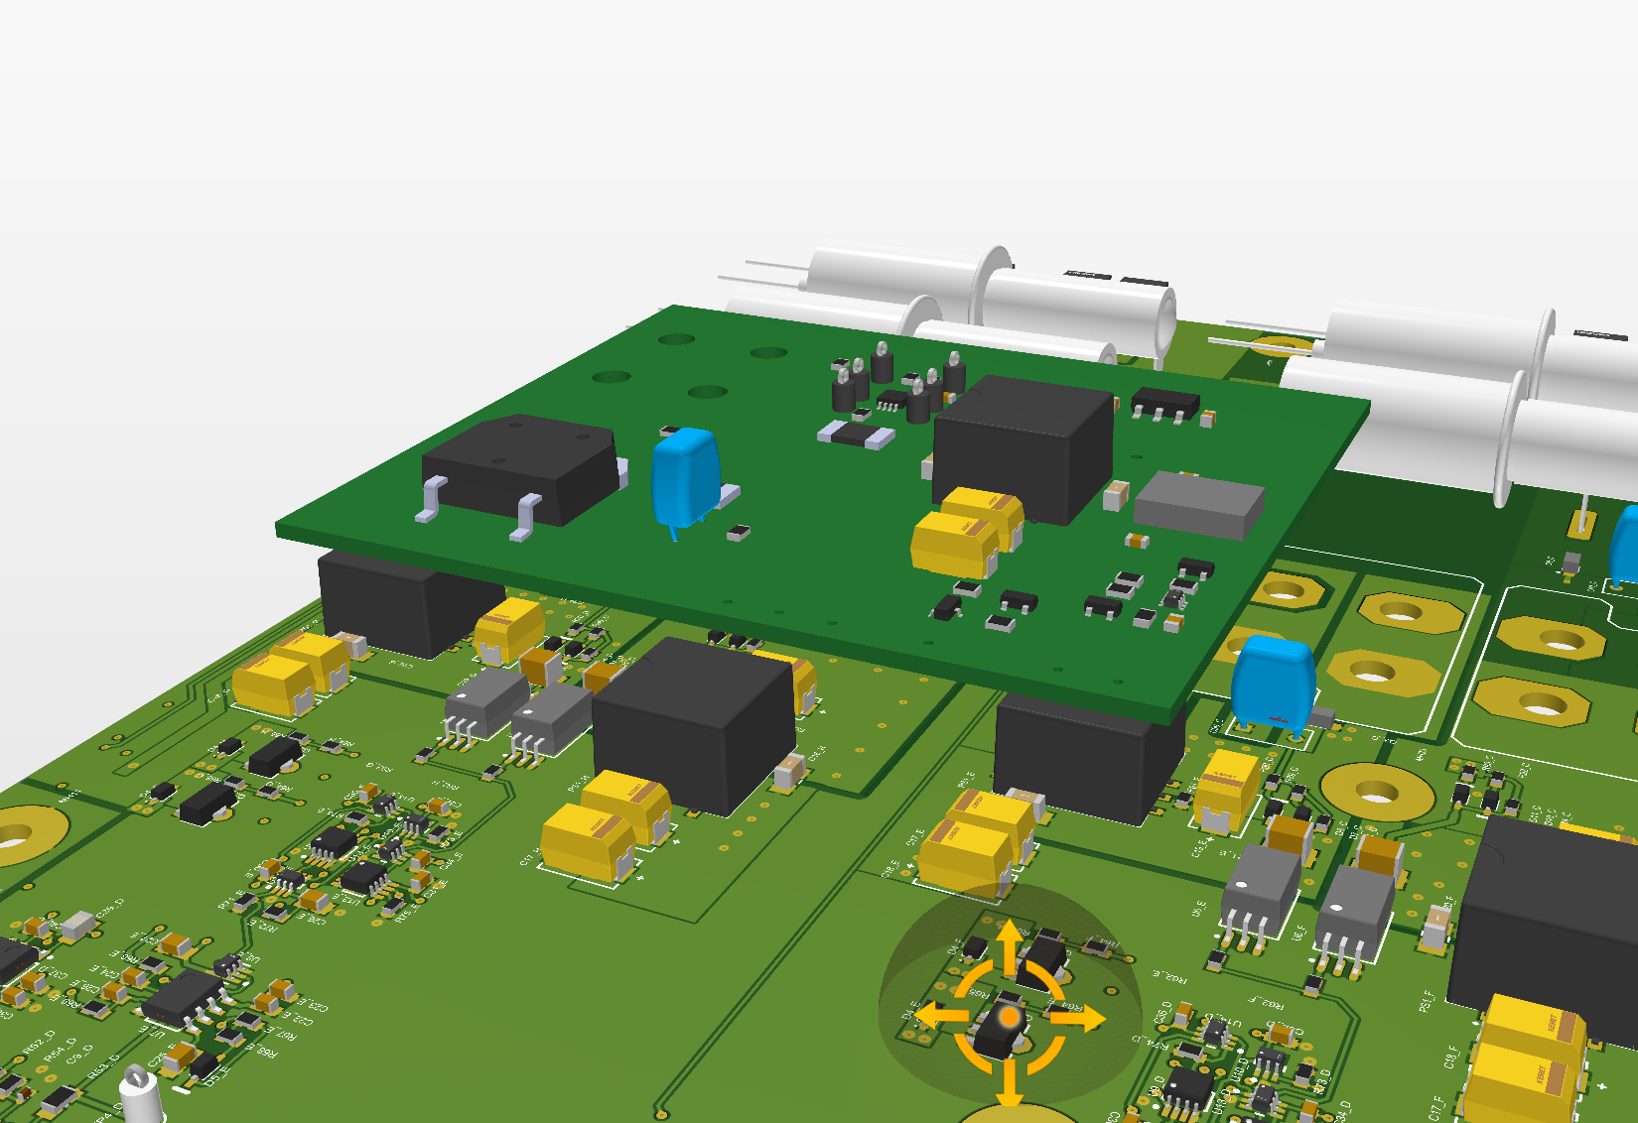
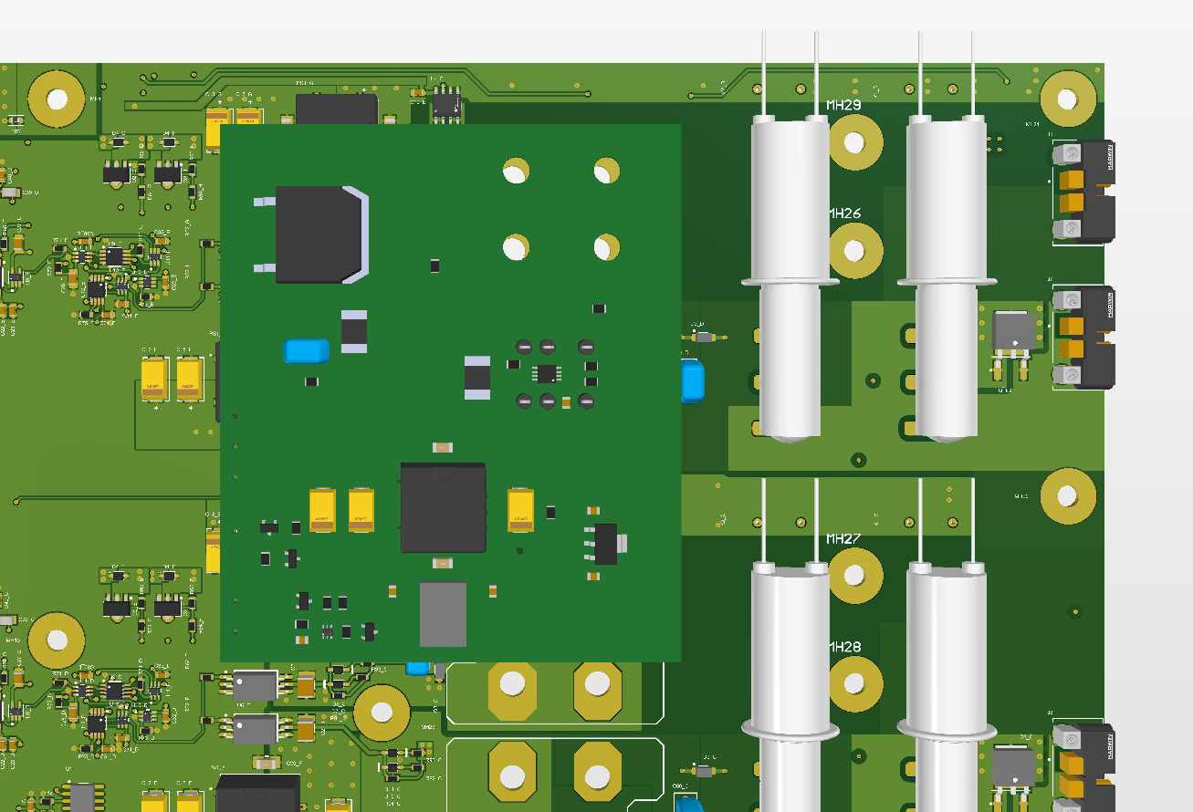
Adapater PCB FIT 3D
Fits over a single channel
Uses 0.5 to 0.75 inch standoffs
A handful of solder flywires to the IPB PCB

Slide 33
MVP PLAN
Minimum Viable Product Incremental Design Plan

Slide 34
Extra

