Slide 1
MARS 2 IPB Short Circuit Protection
Update, Brenton Salmi, August 2024
LAST UPDATE = 8/7/2024

Slide 2
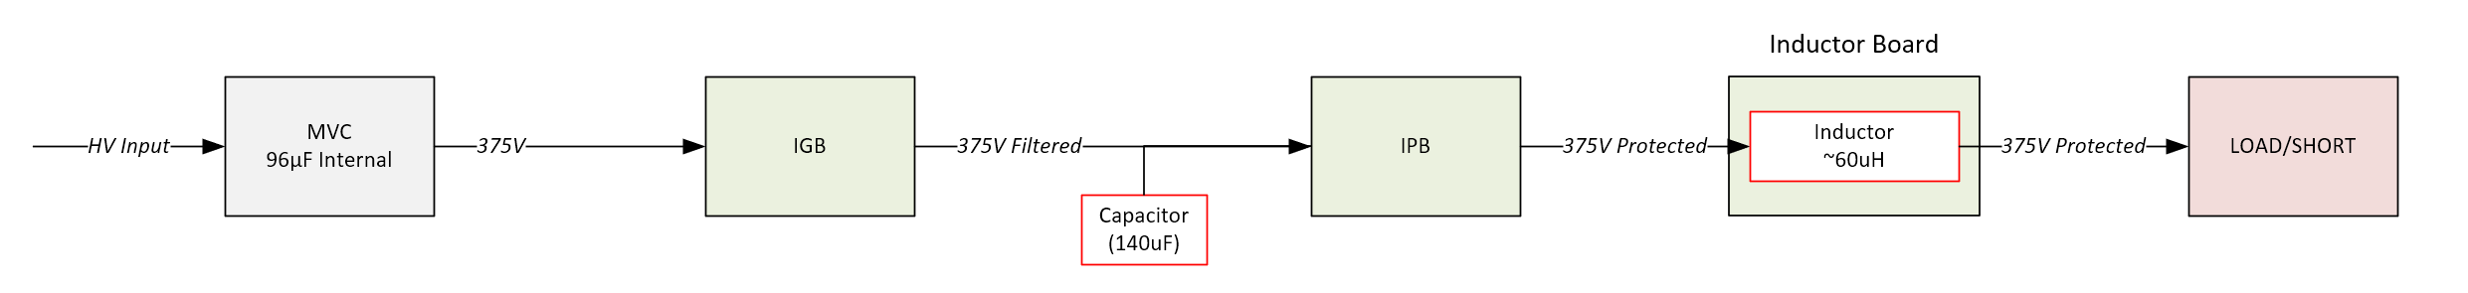
MVC output is 96uF per MFG (Per MBARI)
  No need for added capacitance
Sourced 140uF 800Vdc film capacitor for IPB Input
  MVC will current limit and charge on power up (no inrush)
  Mounted externally to IPB
  1x needed per IPB (2x total)
IPB Inductors (per channel)
  Sourced ED0006-AL toroidal inductors with >35A ISAT
  3x in series gives waveforms showing di/dt limiting desired
  Will be mounted on simple PCB and wired to IPB output

Slide 3
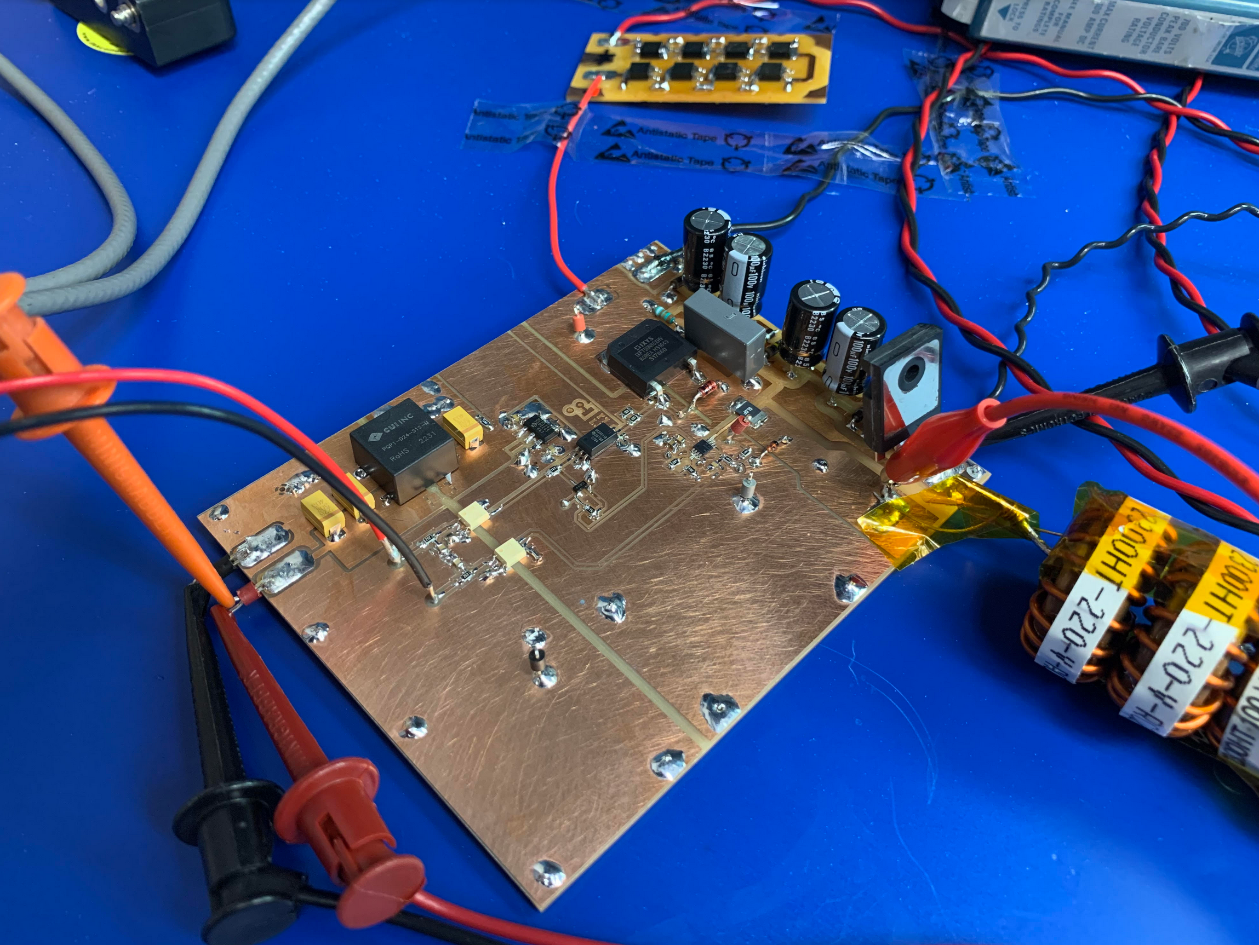
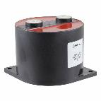
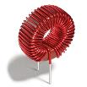
Short Circuit / Cin / Lout
IPB INPUT CAPACITANCE
Replacing with FFVE6B0147KJE
(140uF)
IPB OUTPUT INDUCTANCE
Replacing with ED0006-AL x3
(~60uF total)

Slide 4
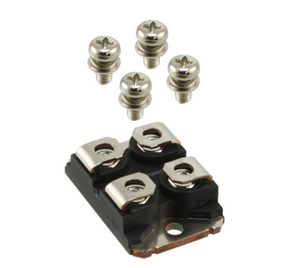
Tested Original IXFN66N85X
Existing IPB MOSFETS
IXFN66N85X (Littlefuse) ($40/ea)
  SOT-227 Package
  Vds = 850V
  Rds(on) = 65mOhms
    1.04W @ 4A
  Gate Charge = 230nC
  Id(max cont) = 65A
Bench testing identified IXFN66N85X much better 4A steady state temperature
Tested on MVP Short Circuit PCB Successfully

Slide 5
Updates Needed
Update | Description | Status
Fix Harwin Connector Footprint | Top/Bottom mounting hole clearance and shape | Done
PCB Board Edge Copper Pullback | Pullback copper from board edges ~20-30 mils | Implemented 30 mil clearance for all layers to board edge
Remove lowside MOSFET circuits |  | Done
Fix relay footprint | Pinout was incorrect and needed a flywire | Done
MOSFET driver PN update | Install correct 12V parts (UCC23511B) | Done
Update R62 (MOSFET Driver LED) | R62 needs to be 240 Ohms | Done
Update board fault delay timing | R50 = 10K = ERJ-3EKF1002V R48 = 3.32K = ERJ-3EKF3321V | Done
MOSFET GATE Driver Tuning | Update RISE/Fall (Tested MVP Values) | Done
IPB Mounting hole clearances | Mounting holes on HV side have insufficient clearances to HV potentials | Implemented keepout clearances
Implement short circuit protection | Implement short circuit protection design | In-Work
Finalize MOSFET Snubber | Crossing T’s & Dotting I’s (Final PN) ---- Long Life requires capacitor dv/dt limit current Long Life requires resistor maximum pulse current | In-Work

Slide 6
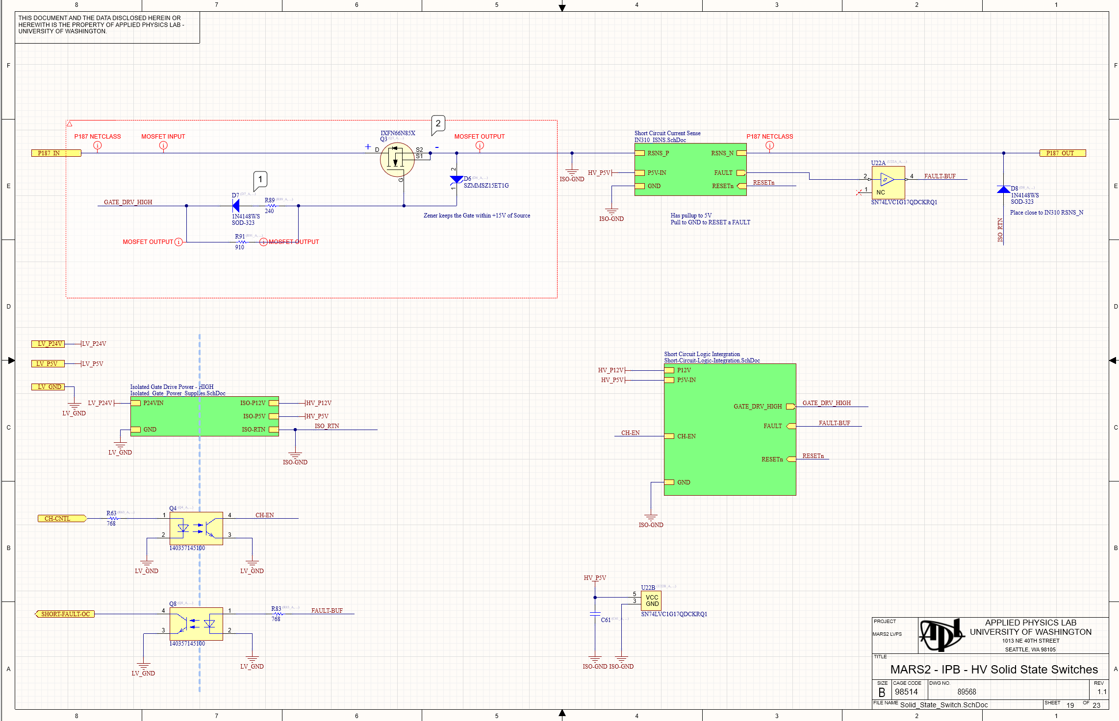
Short Circuit Protection Added To IPB 2.0

Slide 7
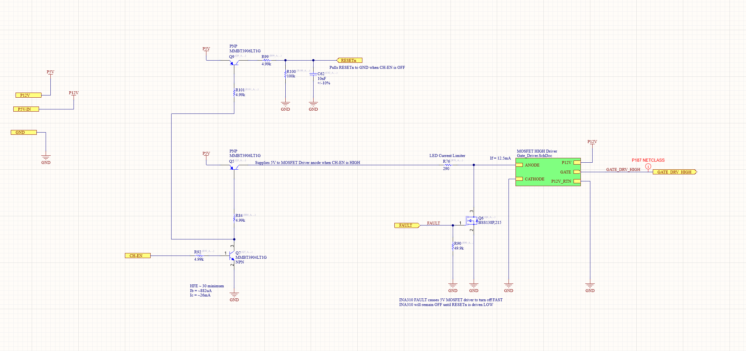
Short Circuit Integration
SHORT Fault action completely on HV side
  Extremely fast – tested on bench
INA310 RESET latch by disabling channel
  RC delay implemented to ensure reset into OFF

Slide 8
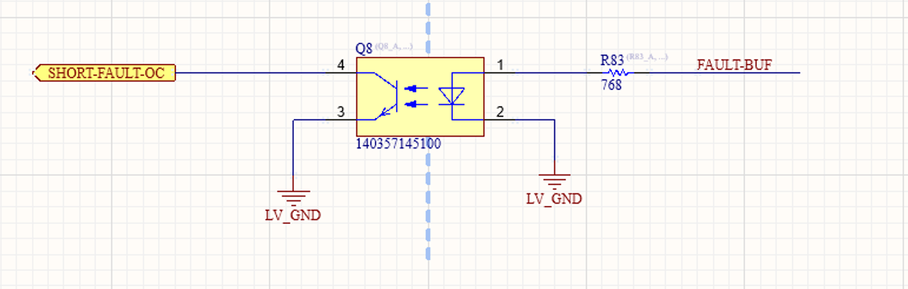
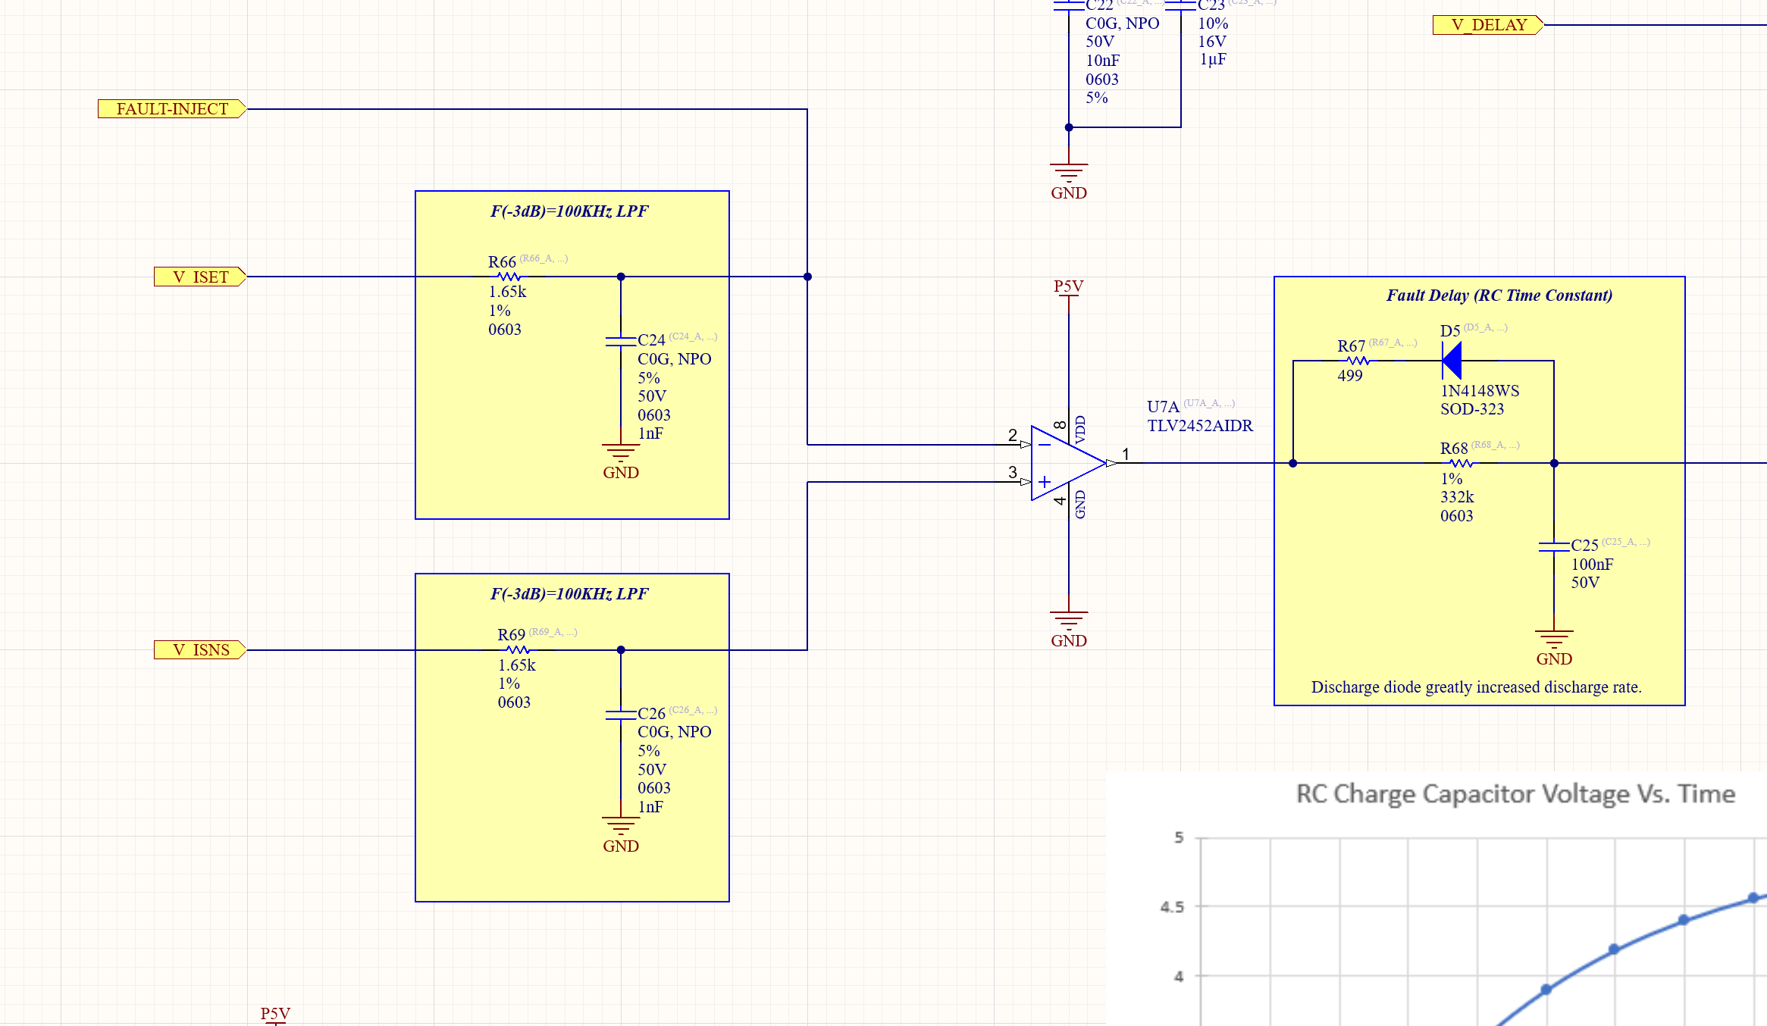
SHORT System Report
SHORT event will cause the opto-isolated open collector to pull V_ISET to ~0V which is a -4A current limit. (0A is 2.5V)
This will ensure the channel FAULTS and GUI responds as an overcurrent channel.

Slide 9
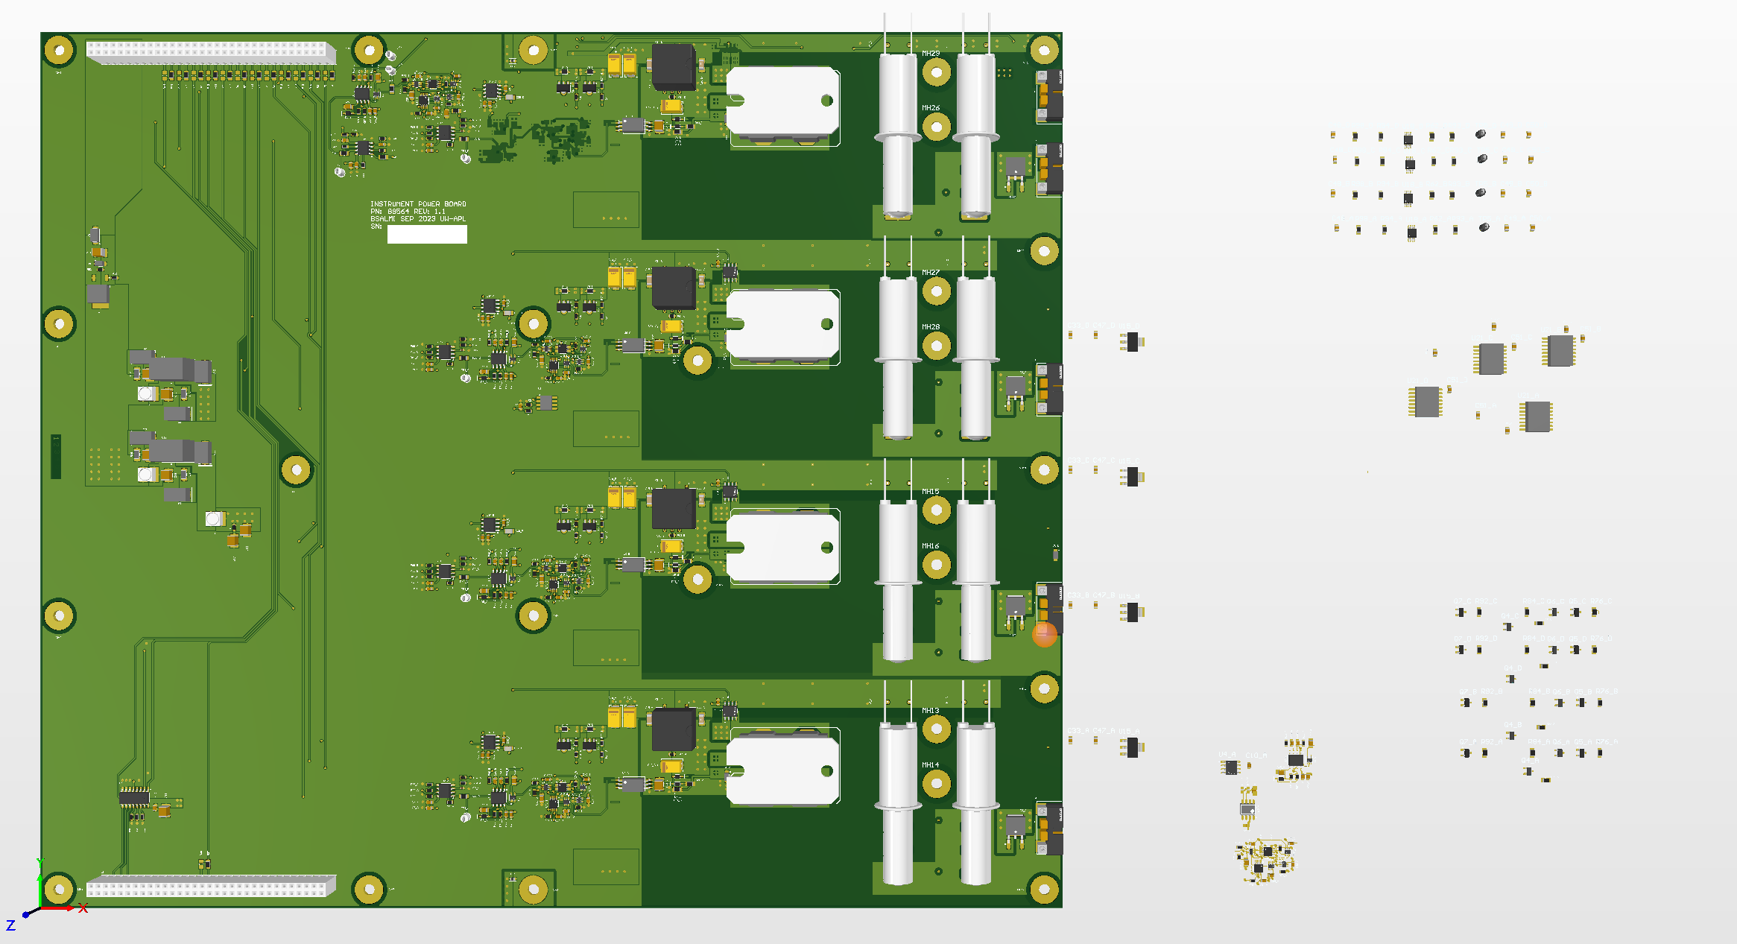
IPB PCB Updates
PCB has been significantly updated
Snubber R and C not shown
Short Circuit / Integration Components not placed yet
Will try to keep as much existing routing as possible

Slide 10
Extra

