Slide 1
MARS 2 IPB Short Circuit Protection
Update, Brenton Salmi, May 2024
LAST UPDATE = 7/12/2024

Slide 2
Test Setup
Testing below was performed with a 375V 500mA power supply
  This is sufficient due to the time scales involed and IGB / IPB input capacitance
  Power supply sees almost no fault current
    Fault timescale of <20us pulls all energy from capacitors
    Small PSU looks like a large PSU on these timescales

Slide 3
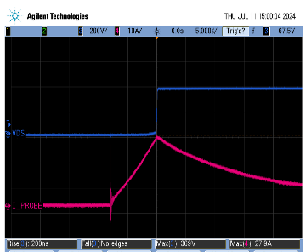
Short Circuit Protection!
SETUP
  225mA Load
  Shorting via contactor (800mOhm)
    ~450A if not protected
  ~18A Trip Current
RESULTS
  ~2us for circuit to react
    8A overshoot expected
  375V short successfully protected system
  Current <30A limit (~50uH)
MOSFET TURNING OFF (200ns)
SHORTING
CONTACTOR CHATTER
~3.8A/us di/dt
INDUCTIVE FLYBACK

Slide 4
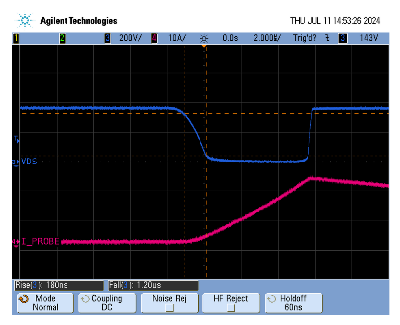
Enabling Channel Into SHORT
Enabling channel into a short is not a problem
Circuitry tuned for clean waveforms
  Less EMI
  Softer switching
  More Reliable
Vds snubber eliminated inductive flyback spikes
  Well below 850V Vds(max)

Slide 5
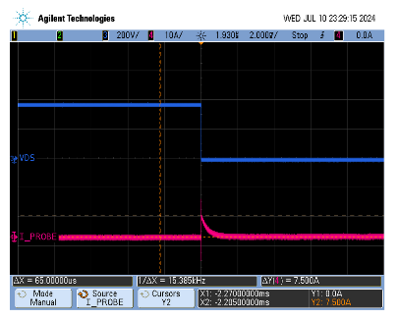
Capacitive Load (Inrush)
Configuration
  1500 Ohm Load (~225mA)
  20uF 375V load capacitor
    ~34 Ohms series resistance
    ~11A max Inrush charge possible
Results
  Expect RC charge
    7.5A measured
  Inrush was not a problem
Note: Current spike noise was tuned out after this waveform capture (gate resistor tuning)

Slide 6
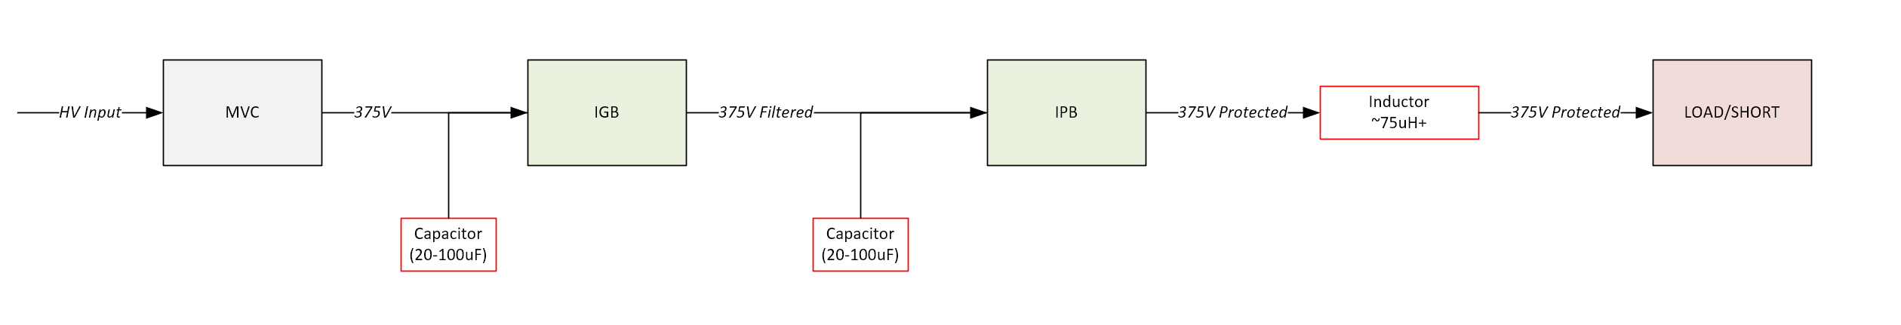
Final Design / Configuration
Significant lessons were learned at the system level during testing – Some system updates are needed.
LOAD SWITCH BULK CAPACITANCE
Keeps switch input voltage steady during inrush/faults
REQUIRED TO LIMIT di/dt OF SHORT CIRCUIT
(Implement on IPB PCB)
BUFFERS INRUSH/SHORT ENERGY FROM MVC OUTPUT DROOP
(NEEDS REAL MVC SYSTEM TESTING)
Bulk capacitance needed to maintain voltages during inrush or fault currents
  Voltage droops couple to other loads
  Voltage droops affect load switch operation
  PSU (MVC) may experience high speed feedback loop responses (“staircasing” observed)
Output channel inductor needed to limit rate of current increase during SHORT faults
  This gives the short circuit protection circuits time to react (~2us needed)
  IGB 220uH inductor is ineffective due to IPB input capacitance needed

Slide 7
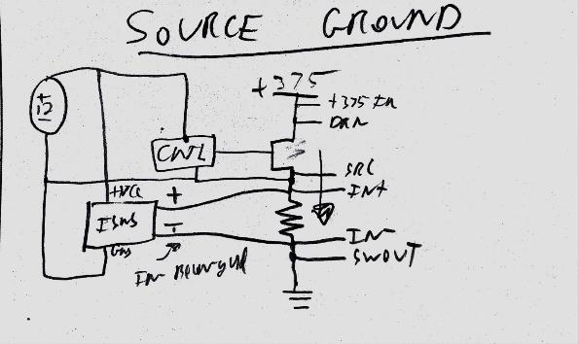
IPB Configuration
Single 12V power for IPB channel
Steering diode added to ISNS- input to protect from transients
  -20V limit Vcm – normal operation is <-1V

Slide 8
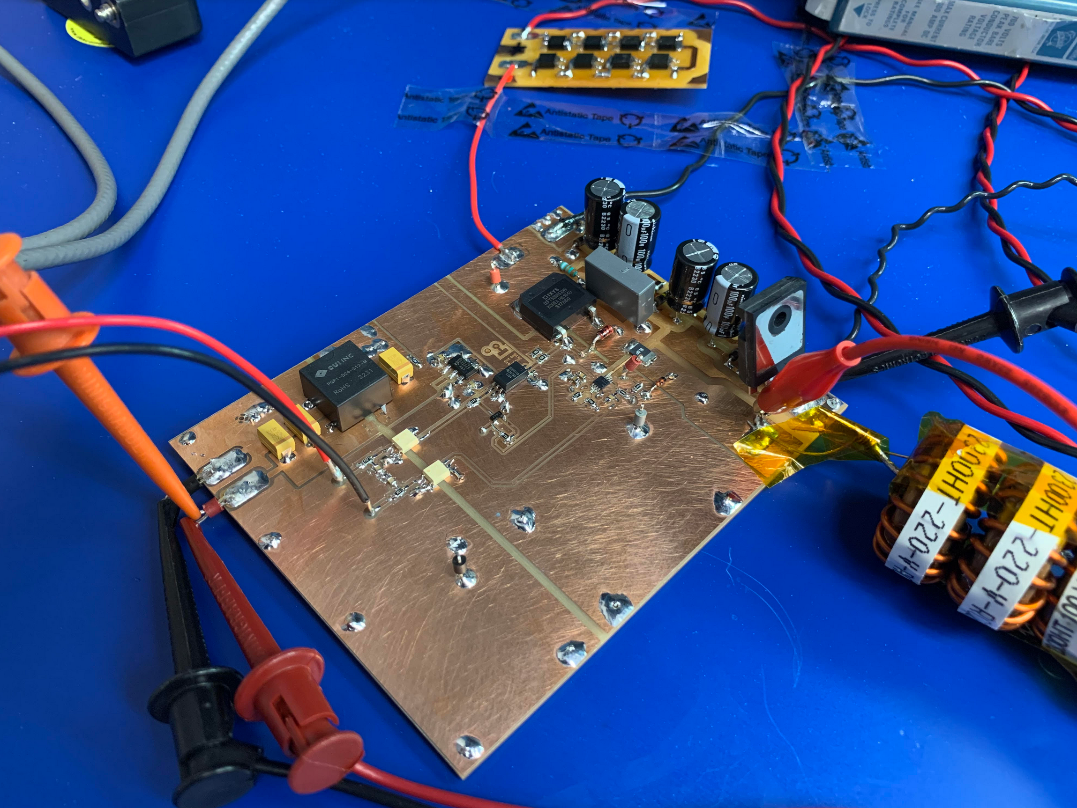
Updated PCB Needed
IPB MOSFET SWITCH
IPB INPUT CAPACITANCE
(20uF)
ISOLATED 12V POWER
IPB OUTPUT INDUCTANCE
(~50uF)
INA310 CURRENT SENSE + FAULT DETECT + FAST RESPONSE PULLDOWN
Original MVP PCB for short protection worked but suffered from induced EMI via drop down wires/standoffs
  High dv/dt and currents in system above 200V caused poor fault detection
  Single 12V HV power supply configuration!
PCB Mill 2-layer board created with entire IPB MOSFET switch and SHORT protection
  No slow overcurrent or upstream logic implemented
    INA310 SHORT detection latching / reset logic was utilized
  Greatly eliminated loop areas – signals were clean and reliable

Slide 9
Conclusion
375V SHORT circuit protection is design and tested
  Took significantly more effort than original understood
  Testing identified system level deficiencies
    These were present prior to short detection inclusion
    Would have been identified later at final testing with capacitive loads
  A new “Test” PCB was needed implementing lessons from the first SHORT protection “MVP” PCB
Up Next
  IPB Updates have started!
    Inclusion of all known prior clearance/issues found
  Request from MBARI
    Do you have detailed MVC output capacitance information/schematics?
    If not – it may be beneficial to plan for adding output capacitance or test for the need

Slide 10
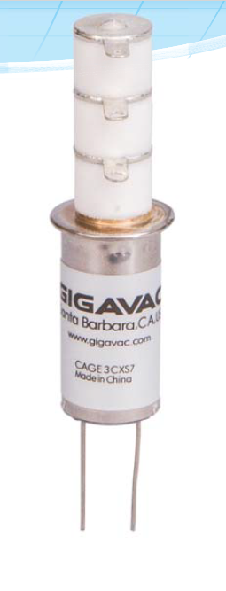
Relay
ABSMAX DC Current
30A for non-switching application
During high current pulse testing (40-90A observed) several relays are observed welded CLOSED

Slide 11
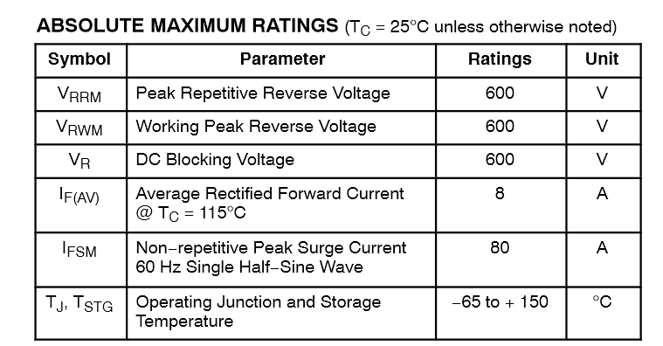
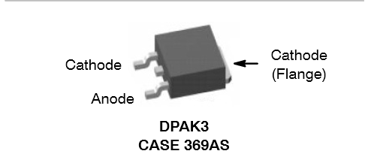
DIODE
FFD08S60S-F085
80A half sine wave 60 Hz
Use this as a rough guide – keep well below 80A

Slide 12
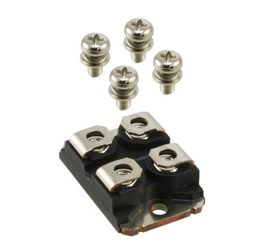
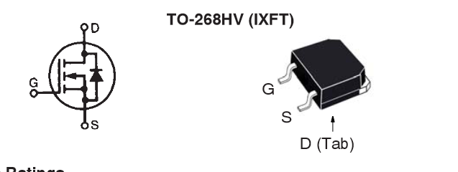
Existing IPB MOSFETS
Existing IPB MOSFETS
New MOSFET?
Same X-Class Family as IXFN66N85X
IXFN66N85X (Littlefuse) ($40/ea)
  SOT-227 Package
  Vds = 850V
  Rds(on) = 65mOhms
    1.04W @ 4A
  Gate Charge = 230nC
  Id(max cont) = 65A
IXFT50N85XHV (Littlefuse) ($18/ea)
  TO-268HV Package (SMT!)
  Vds = 850V
  Rds(on) = 105mOhms
    ~1.68W @ 4A
  Gate Charge = 152nC
  Id(max cont) = 50A
We should seriously consider a NEW MOSFET
  Labor $ to install SOT-227 is > New MOSFETS
  Large, screws = FOD
  Heating is not much of a concern at 4A cont. max…

Slide 13
Extra

