Slide 1
MARS 2 IPB Short Circuit Protection
MBARI Update
Update, Brenton Salmi, June 2024

Slide 2
Overview of Project Goal
Add Short Circuit Protection to IPB
Problem
IPB V1.0 circuitry not fast enough for short circuit protection
Short circuit survivability is a desired operation after discussions with MBARI.
Short Circuit Uniqueness Vs. Overcurrent
Fault current rise times very fast (microseconds)
High energy pulses from system capacitances (~90A at 375V observed!)
Short circuit protection requires detecting, stopping current flow, and dealing with resulting inductive flyback
  This needs to occur while not exceeding any component Safe-Operating-Area (SOA) – Typicallys <<10us
How To Achieve?
Use high-speed analog sensing/comparators
  Detect high currents above a threshold (e.g. 18A) that should never be present, even during in-rush current events.
When detected, the system automatically removes all port current (disables the port) within ~10us
Short circuit protection is integrated into existing channel fault logic
  Latch and indicate as a normal channel fault (Short and overcurrent faults will look the same)
  Building in overcurrent and short circuit identification would be difficult and require additional computer IO lines not currently present

Slide 3


Short Circuit Timing Needs
  di/dt will be roughly 1.7MA/s per IGB inductors
    (may be faster due to L saturation)
  MOSFET off must shutdown within ~10-15us regardless of current regulation to avoid relay damage
    The MOSFET itself can handle MUCH more current <100us than 30A – it’s safe!
  Setting SHORT threshold at 18A
    Above 15A maximum inrush current
    Gives ~7us of buffer before 30A relay welding
  Expected current profile below in a Short Cirucit FAULT condition
    MOSFET transitions thorugh linear region limiting and ramping current down after FAULT is detected
    MOSFET rated for 100’s nano-second switching speeds
No Regulation Fast Shutoff (~5us)
di/dt trajectory
$I_{Max}=$30A
=$I_{Short Circuit Detect}$ 18A
15A Inrush Current Allowed
Short Circuit Detected
Slow Short Circuit Shutdown

Slide 4
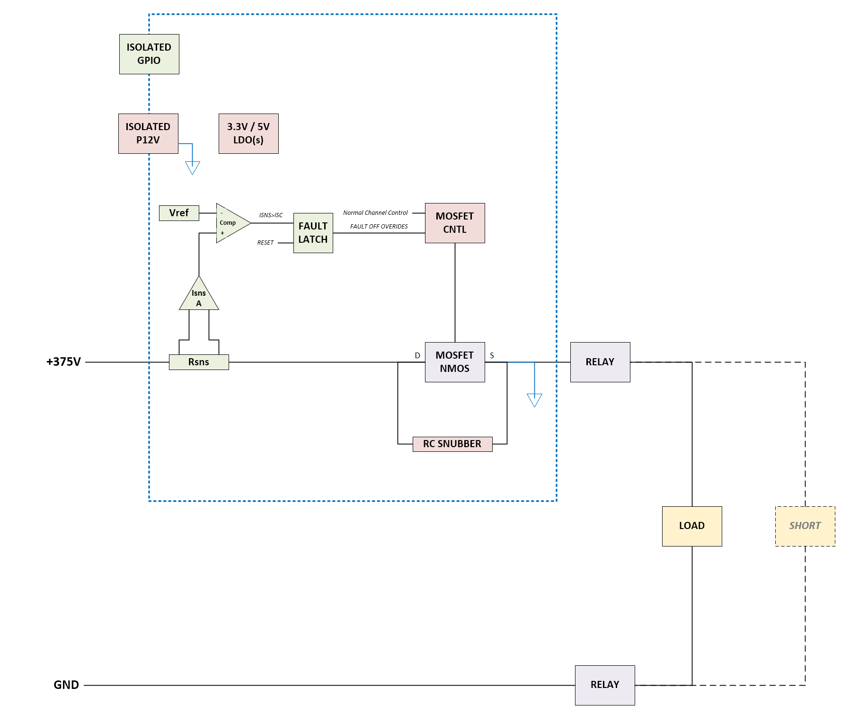
Short Circuit Protection
Minimum Viable (Test) Solution
Goals
Develop short circuit detection
  Accurate threshold
  Fast enough action (us speeds)
Modify Existing MOSFET driver
  Requirement: Turn-off less than ~5us
RC Snubber development
  Tuning for size and Vds
Short Simulation development
  Safely create 375V short circuit in the lab!
Notes
IPB Overcurrent Protection
  This remains in the system but is NOT shown on this slide
  Protects against minor overcurrent issues
    Many load faults may never produce high currents like a short upstream
    E.g. Power limited shorts/faults in load

Slide 5
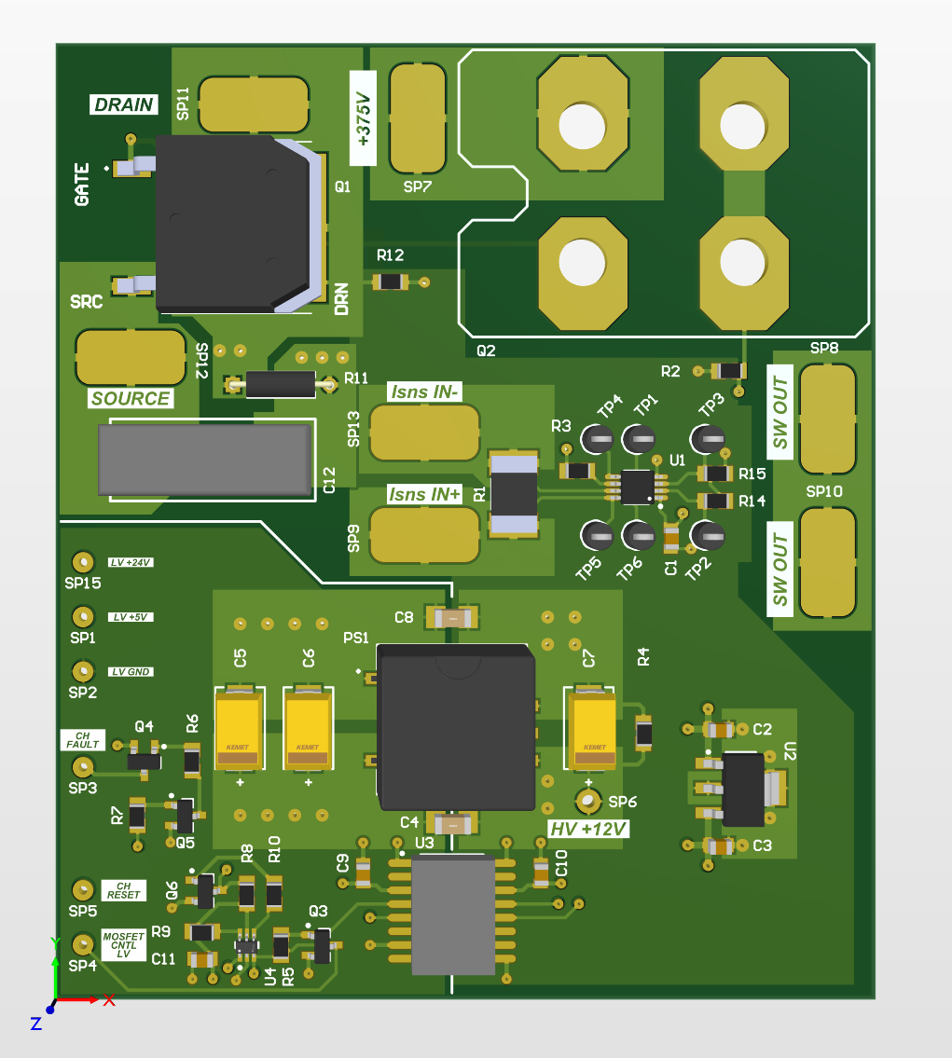
Adapter PCB
+375V
POST
GATE DRIVER
GND POST
ALT MOSFET
OR
SOLDER PADS TO EXISTING FET
Mounts using standoffs to the SOT-227 IPB PCB pads
  Brings out
    +375V
    MOSFET Gate Control
    MOSFET Driver GND
Solder pad configurability
  Supports 2 configurations desired
    Single +12V supply
      Adapter PCB +12V DC/DC DNP’d
    Dual +12V supply
Will be integrated onto IPB 2.0
GATE
DRIVER
POST
LOW VOLTAGE
SOLDER FLYWIRES
SW OUT
LATCHING
CURRENT SENSE
HIGH SPEED
DIGITAL IO
ISOLATOR
(FAULT/RESET)
LV LOGIC INTEGRATION
CIRCUITS

Slide 6
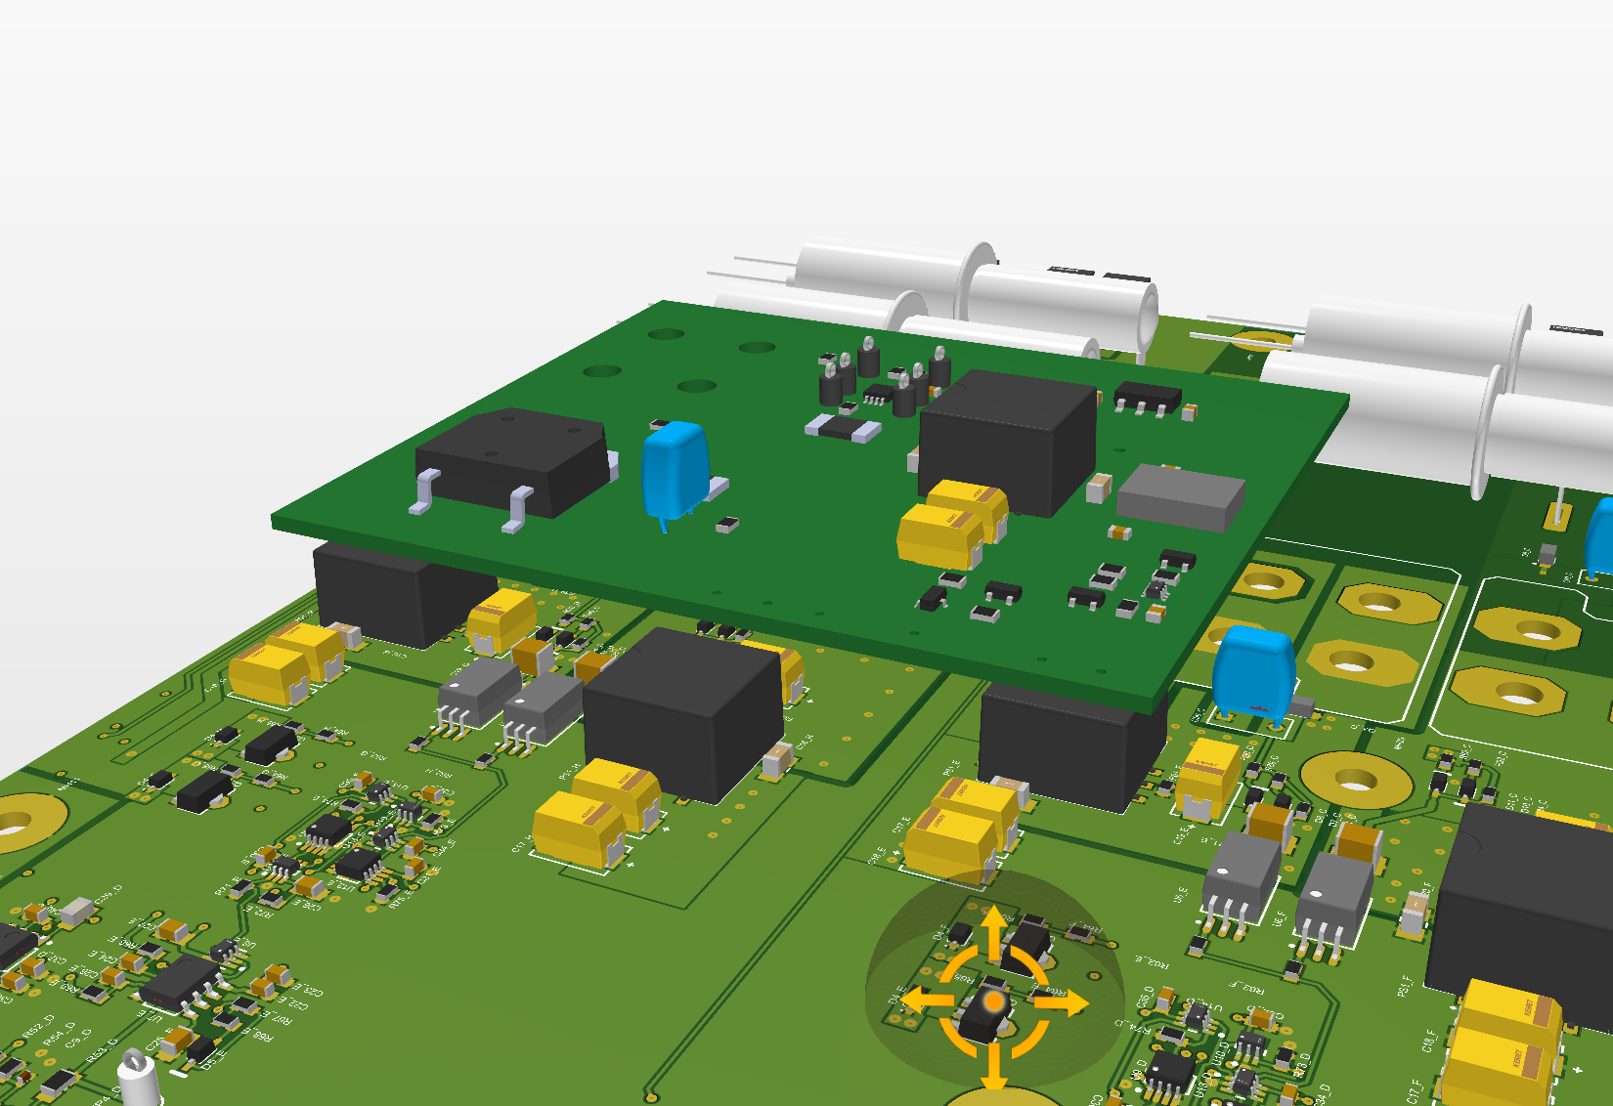
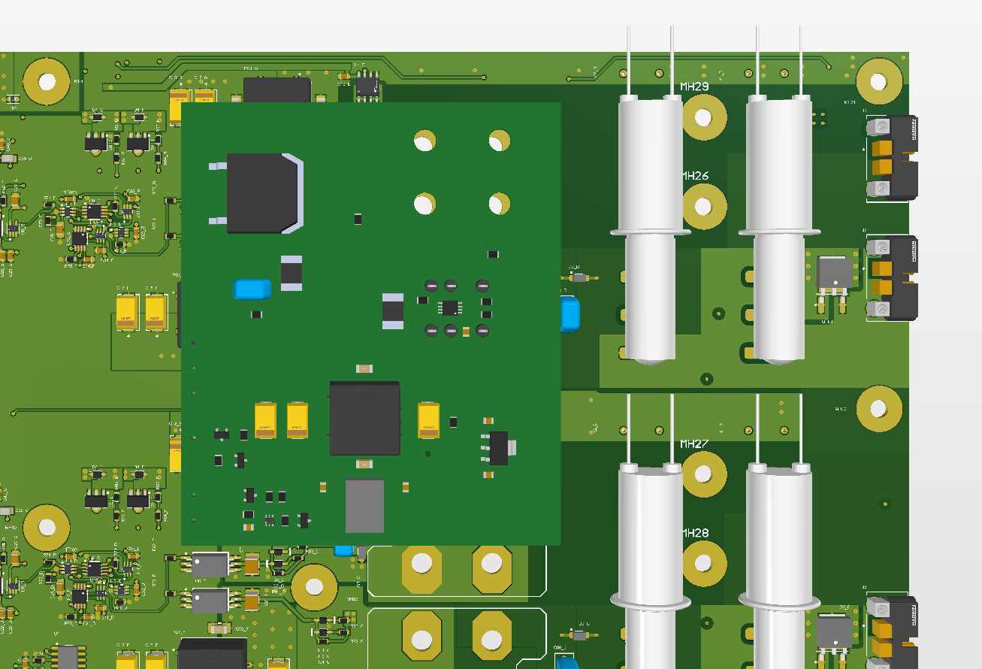
Adapater PCB FIT 3D
Fits over a single channel
Uses 0.5 to 0.75 inch standoffs
A handful of solder flywires to the IPB PCB

