Slide 1
MARS 2 IPB Short Circuit Testing
MVP Test, Brenton Salmi, August 2024
LAST UPDATE = 8/8/2024

Slide 2
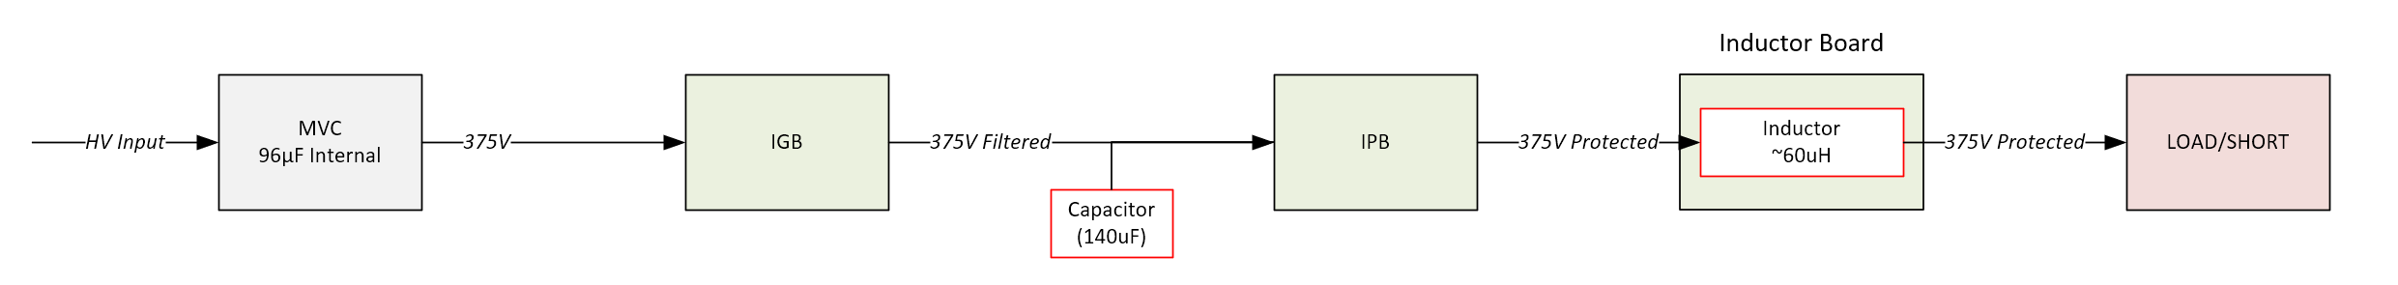
Configuration
IGB
  None
IPB Input Capacitor
  140uF
IPB Output Inductor
  4x 20uH (80uH)
INA310
  Rtop = 6.8K
  Rbot = 3.3K
Snubber
  220 Ohms
  22nF
Rgate
  OFF = 110 Ohms
  ON = 910 Ohms

Slide 3
Output di/dt
4x 20uH = 80uH
V = L*di/dt
  Limits peak current between detection and MOSFET turn-off
  di/dt = (375V)/(80uH) = ~4.69A/us
    1us delay = 22.7A Peak
    2us delay = 27.4 Peak
    3us delay = 32A Peak

Slide 4
375V ON to SHORT
240mA Load to SHORT (Via Contactor)

Slide 5
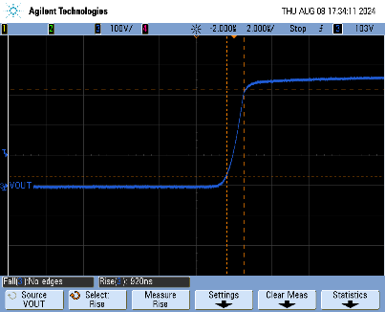
Turn On
Into 240mA Load
920ns rise time
Looks great!

Slide 6
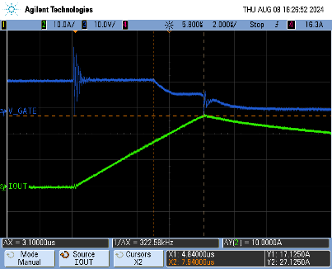
Vgate & Iout
Output Current
  I(max) = 27.1A
  di/dt = 3.2A/us
    L(calc) = 117uH
    Inductor expected to be more inductive at high frequency
    L(SRF) = 13MHz
MOSFET
  Miller plateau visible
  3.1us total reaction time

Slide 7
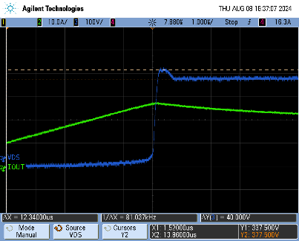
VDS Peak
Approx. 40V inductive flyback across MOSFET
  ~415V peak
NOTE
  375V is applied
  Low voltage shown is due to “GND” floating on high side
    38V loss = 1.4 Ohm LOAD + wiring resistance!
    “SHORT” = 800mOhm resistor

Slide 8
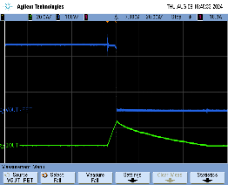
Vout – At FET
Voutput measured at FET (After ISNS, before L’s)
T(fall) = 61ns
  Very clean
  Not as important as detection/react time INA310

Slide 9
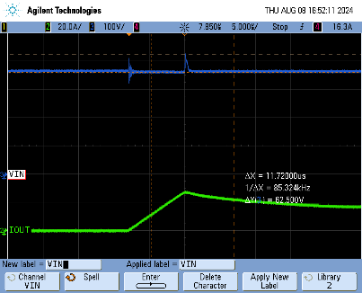
VIN
~63V input voltage spike
  Expected input wiring inductive flyback + VDS Snubber

Slide 10
375V ENABLE Into SHORT

Slide 11
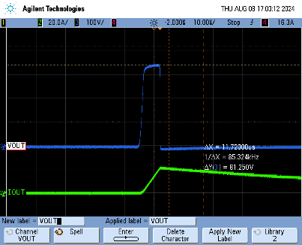
Vgate & Iout
Measured at FET output not inductor output
Expected turn on pulse

Slide 12
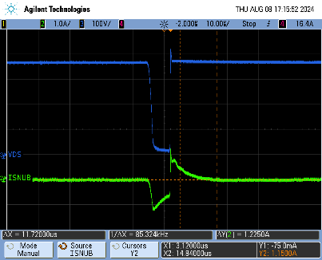
VDS & ISnubber
VDS looks great!
Snubber current
  DIR = Vin > SNUBBER
  -1.22A ON
    Capacitive supplying current
  +1.2A OFF
    Capacitor soaking current (charging)
Calculated Max Snubber Current
  220 Ohm @ 375 = 1.7A

Slide 13
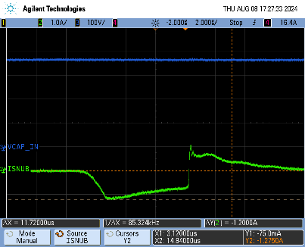
Input Capacitor
No visible voltage droop
  Arguably in practice more than enough input capacitance

Slide 14
Sourcing Final Parts
IPB Input Capacitor
  140uF (FFVE6B0147KJE)
IPB Output Inductor
  4x ED0006-AL
Snubber
  220 Ohms (ASRM12JA220R)
  22nF (R76QI2220SE40K)
Rsns
  SDGF

Slide 15
Extra

Slide 16
INA310 Current Sense
Measuring via a diff probe in 10:1 mode
INA310 output is 100mV/A
  10A = 1V
  20A = 2V
  30A = 3A
Note that EMI can couple in when measuring
  Some noise expected
Threshold set to ~18A
MAY NOT BE NEEDED

Slide 17
Current Sense Probe
(Old) Tektronix AM 503A
  Not well trusted 2024
1A/div mode
Measured 10A via PSU short
  Measured 7.81A
All readings should apply a 0.781 A/A conversion ratio
MAY NOT BE NEEDED

Slide 18
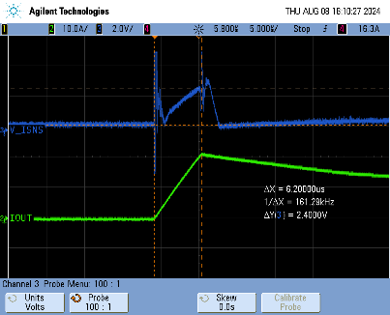
Current (INA310 Measured)
Measurements
  IOUT(probe) = 21.5A
    3.46A/us
  V_ISNS (INA310) = 2.4V (24A)
    3.87A/us
THIS WAS TAKEN WITH RGATE=220OHMS
NOTE: DIFF PROBE MUST BE 100:1 MODE
Probe impedance affects operation (Lowers VISNS)

