Slide 1
MARS 2 IPB Short Circuit Testing
MVP Test, Brenton Salmi, August 2024
LAST UPDATE = 8/8/2024

Slide 2
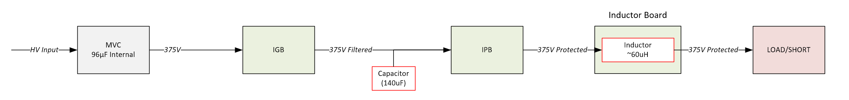
Configuration
IGB
  None
IPB Input Capacitor
  140uF
IPB Output Inductor
  4x 20uH (80uH)
INA310
  Rtop = 6.8K
  Rbot = 3.3K
Snubber
  220 Ohms
  22nF
Rgate
  OFF = 110 Ohms
  ON = 910 Ohms

Slide 3
Current Sense Probe
(Old) Tektronix AM 503A
  Not well trusted 2024
1A/div mode
Measured 10A via PSU short
  Measured 7.81A
All readings should apply a 0.781 A/A conversion ratio

Slide 4
Output di/dt
4x 20uH = 80uH
V = L*di/dt
  Limits peak current between detection and MOSFET turn-off
  di/dt = (375V)/(80uH) = ~4.69A/us
    1us delay = 22.7A Peak
    2us delay = 27.4 Peak
    3us delay = 32A Peak

Slide 5
375V ON to SHORT
240mA Load to SHORT (Via Contactor)

Slide 6
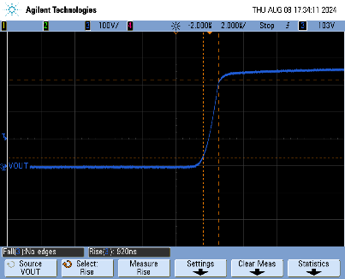
Turn On
Into 240mA Load
920ns rise time
Looks great!

Slide 7
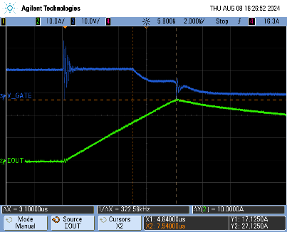
Vgate & Iout
Output Current
  I(max) = 27.1A
  di/dt = 3.2A/us
    L(calc) = 117uH
    Inductor expected to be more inductive at high frequency
    L(SRF) = 13MHz
MOSFET
  Miller plateau visible
  3.1us total reaction time

Slide 8
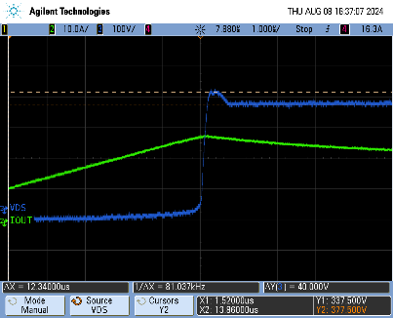
VDS Peak
Approx. 40V inductive flyback across MOSFET
  ~415V peak
NOTE
  375V is applied
  Low voltage shown is due to “GND” floating on high side
    38V loss = 1.4 Ohm LOAD + wiring resistance!
    “SHORT” = 800mOhm resistor

Slide 9
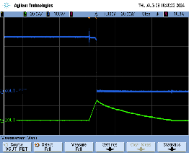
Vout – At FET
Voutput measured at FET (After ISNS, before L’s)
T(fall) = 61ns
  Very clean
  Not as important as detection/react time INA310

Slide 10
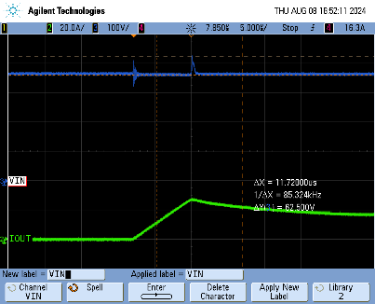
VIN
~63V input voltage spike
  Expected input wiring inductive flyback + VDS Snubber

Slide 11
375V ENABLE Into SHORT

Slide 12
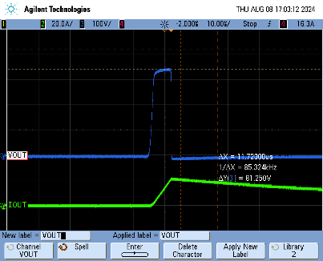
Vgate & Iout
Measured at FET output not inductor output
Expected turn on pulse

Slide 13
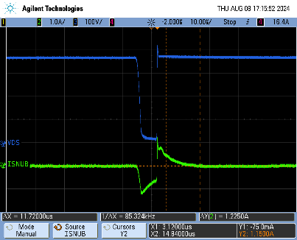
VDS & ISnubber
VDS looks great!
Snubber current
  DIR = Vin > SNUBBER
  -1.22A ON
    Capacitive supplying current
  +1.2A OFF
    Capacitor soaking current (charging)
Calculated Max Snubber Current
  220 Ohm @ 375 = 1.7A

Slide 14
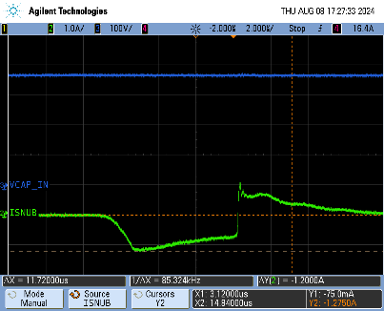
Input Capacitor
No visible voltage droop
  Arguably in practice more than enough input capacitance

Slide 15
Extra

Slide 16
INA310 Current Sense
Measuring via a diff probe in 10:1 mode
INA310 output is 100mV/A
  10A = 1V
  20A = 2V
  30A = 3A
Note that EMI can couple in when measuring
  Some noise expected
Threshold set to ~18A
MAY NOT BE NEEDED

Slide 17
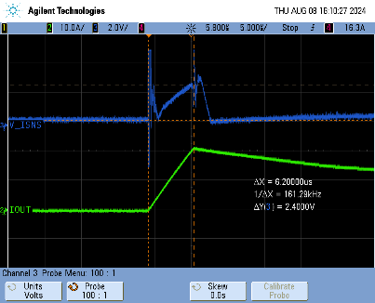
Current (INA310 Measured)
Measurements
  IOUT(probe) = 21.5A
    3.46A/us
  V_ISNS (INA310) = 2.4V (24A)
    3.87A/us
THIS WAS TAKEN WITH RGATE=220OHMS
NOTE: DIFF PROBE MUST BE 100:1 MODE
Probe impedance affects operation (Lowers VISNS)

