Slide 1
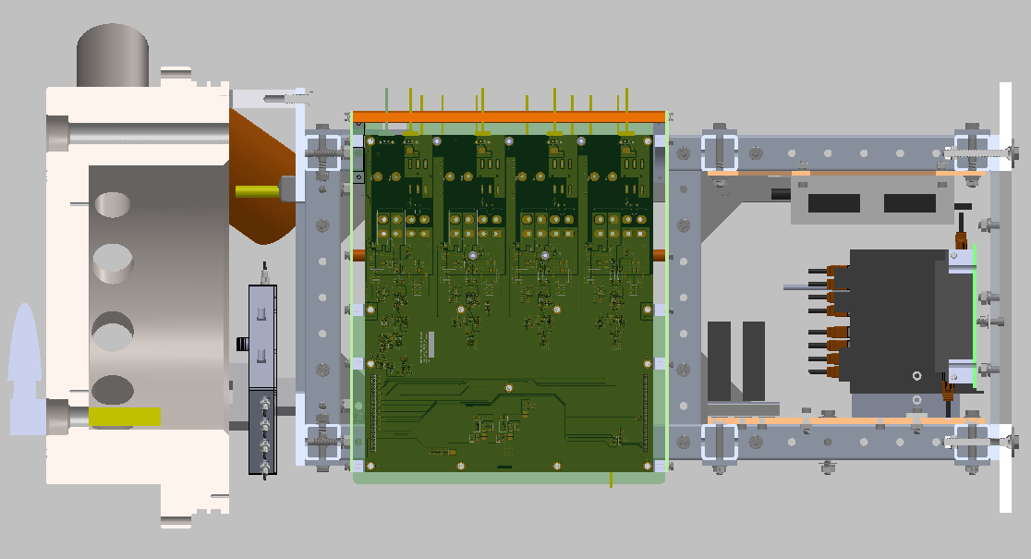
3”
(8 cm)
15” (38 cm)
18” (46 cm)
24” (61 cm)
30” (76 cm)
9” (23 cm)

Slide 2
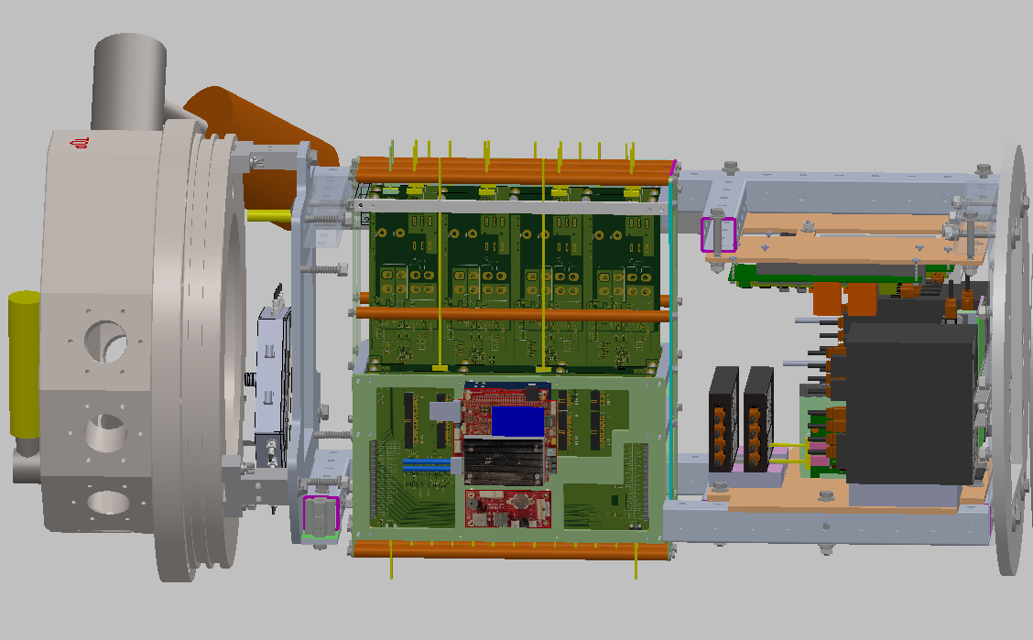

Slide 3
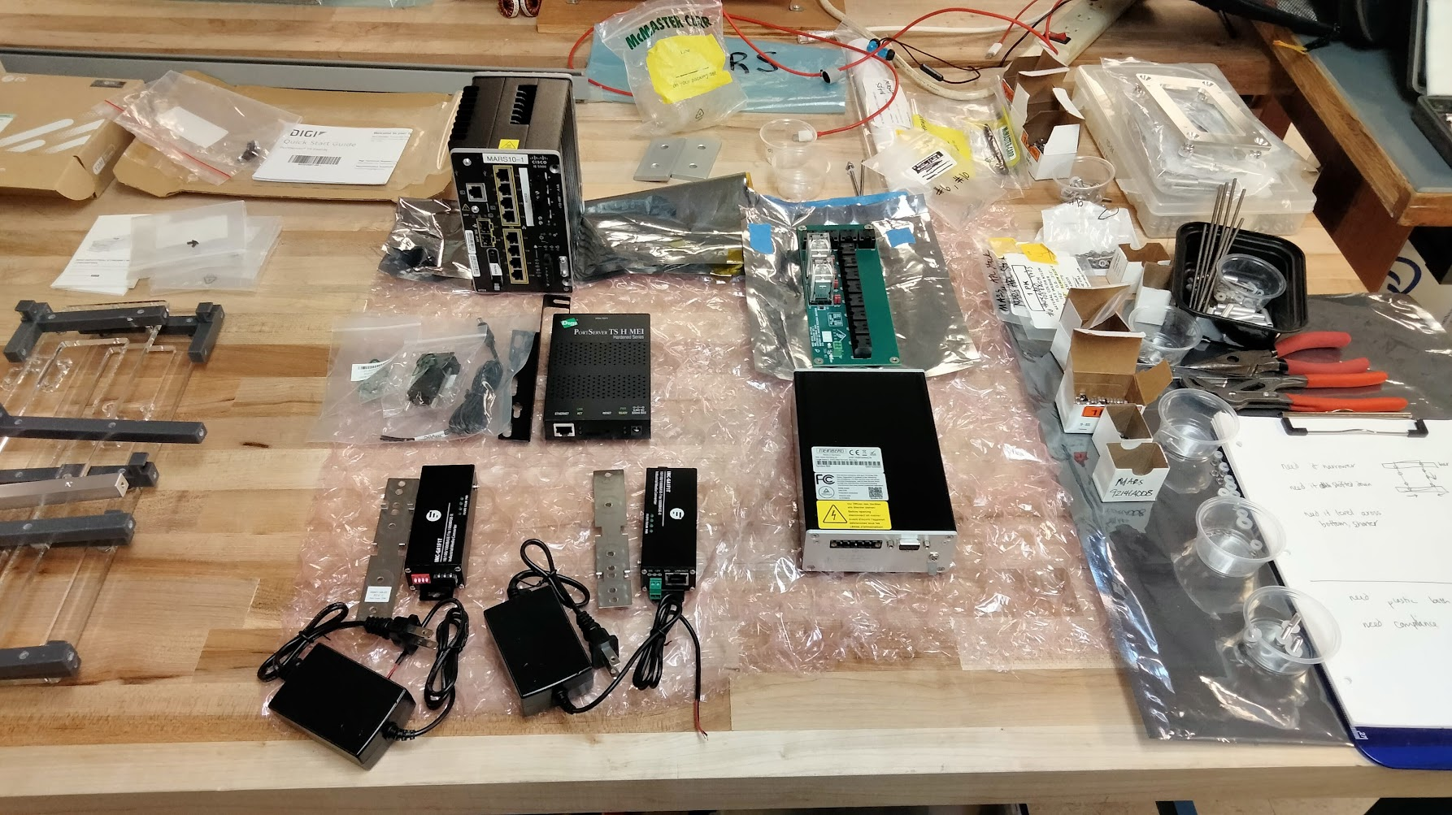
1 of 2 Cisco IE3300
1 of 1 Serial Splitter (custom PCB)
1 of 2 Digi Portserver
1 of 1 Meinberg Syncbox (timing)
2 of 2 Moxa Mini
Not received: custom PCB for time signal distribution

