Slide 1
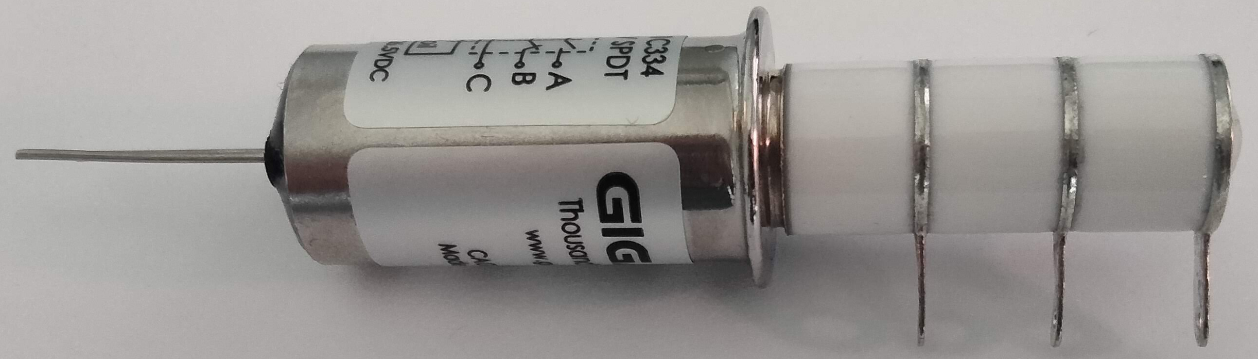
Diam 0.402 in white
0.404-0.405 in silver ring
Diam 0.523 in w/o label
.530 in w/ label

Slide 2
Metal surface at center
White surface
label
Metal surface at end
Metal Ring

Slide 3
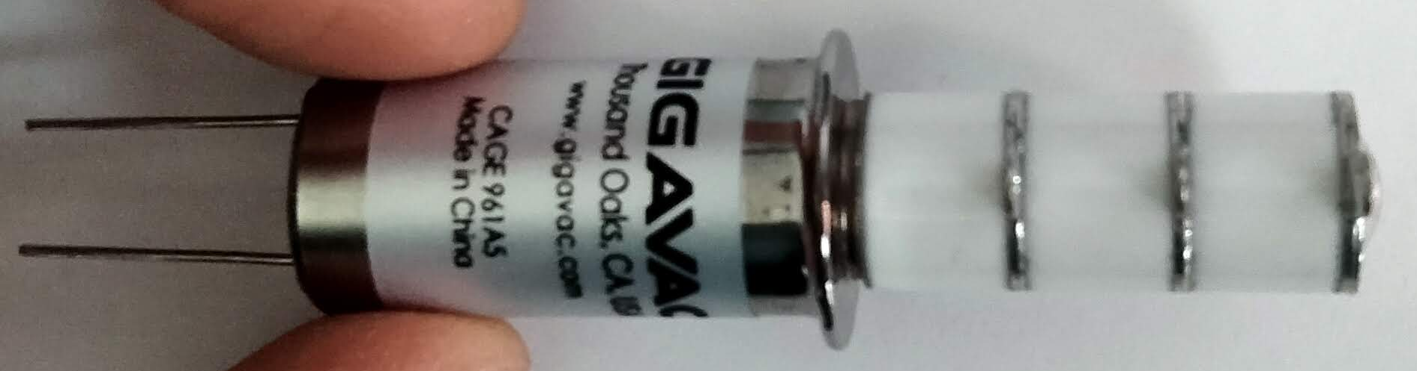

Slide 4
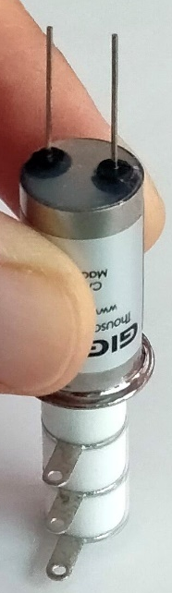

Slide 7
Title
text
text

