Slide 1
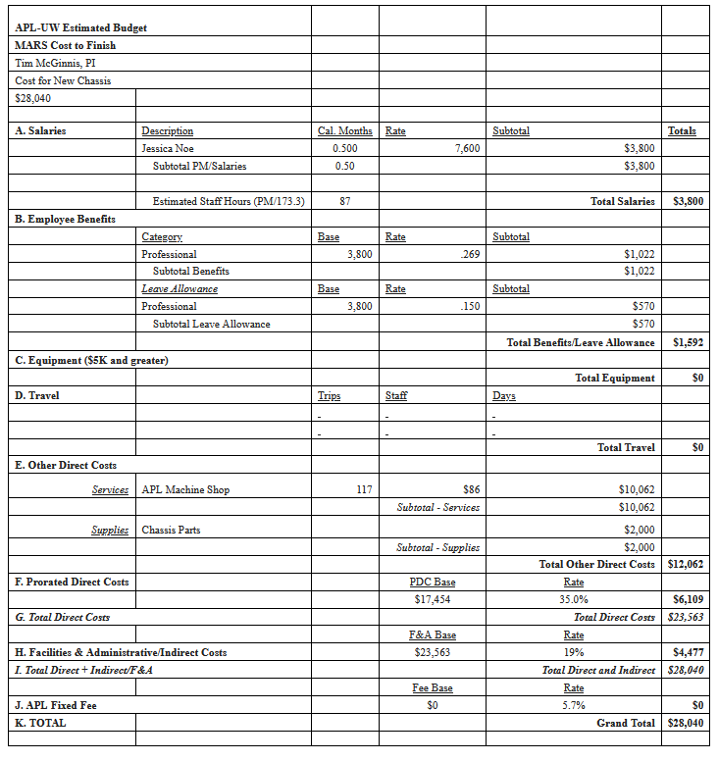
Labor Opt 1: Fabricate/assemble chassis at APL
Design Opt 1: Use mostly custom parts, minimal COTS
A. Salaries = 1 Cal Month total
0.5 Cal Months for design, 0.5 Cal months for fab/assembly
2 weeks to complete design, do design review
1 week to go from models to orders/drawings
1 week to check/assemble/iterate completed parts, shipping
E. Other Direct Costs
APL Machine Shop 96 $86 $8,256
Chassis Parts $2,000

Slide 2
Labor Opt 2: Fabricate mostly at MBARI
Design Opt 1: Use mostly custom parts, minimal COTS
A. Salaries = 0.75 Cal Month total
0.5 Cal Months for design, 0.25 Cal months for fab/assembly
2 weeks to complete design, do design review
1 week to go from models to orders/drawings
1 week to check/assemble/iterate completed parts, shipping
E. Other Direct Costs
(1) APL Machine Shop 32 $86 $2,752
(2) Chassis Parts $2,000
Assumptions:
(1) 96 hours total, APL shop does 1/3 (32 of 96), MBARI does 2/3 (64 of 96)
(2) APL buys material and has it shipped directly to MBARI, so this remains $2,000

Slide 3
Labor Opt 1: Fabricate/assemble chassis at APL
Design Opt 2: Use mostly COTS parts, anodized aluminum
A. Salaries = 1 Cal Month total
0.5 Cal Months for design, 0.5 Cal months for fab/assembly
2 weeks to complete design, do design review
1 week to go from models to orders/drawings
1 week to check/assemble/iterate completed parts, shipping
E. Other Direct Costs
APL Machine Shop 76 $86 $6,536
Chassis Parts $1,500

Slide 4
Labor Opt 2: Fabricate mostly at MBARI
Design Opt 2: Use mostly COTS parts, anodized aluminum
A. Salaries = 0.75 Cal Month total
0.5 Cal Months for design, 0.25 Cal months for fab/assembly
2 weeks to complete design, do design review
1 week to go from models to orders/drawings
1 week to check/assemble/iterate completed parts, shipping
E. Other Direct Costs
(1) APL Machine Shop 25 $86 $2,150
(2) Chassis Parts $1,500
Assumptions:
(1) 76 hours total, APL shop does 1/3 ( 25 of 76), MBARI does 2/3 (51 of 76)
(2) APL buys material and has it shipped directly to MBARI, so this remains $1,500

