Slide 1
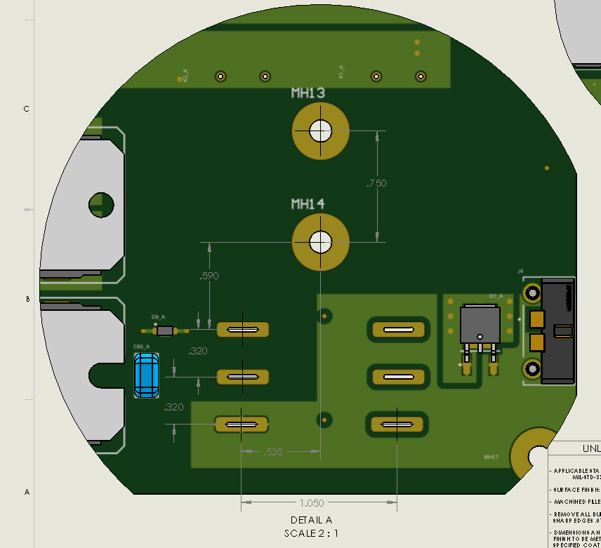

Slide 2
Title
text
text

