Slide 1
Give a man a fish and he eats dinner, Teach a man to fish and he tears up your Cabled Observatory
MARS
Efforts to mitigate the impact of fishing activities on seafloor installations
Craig Dawe

Slide 2
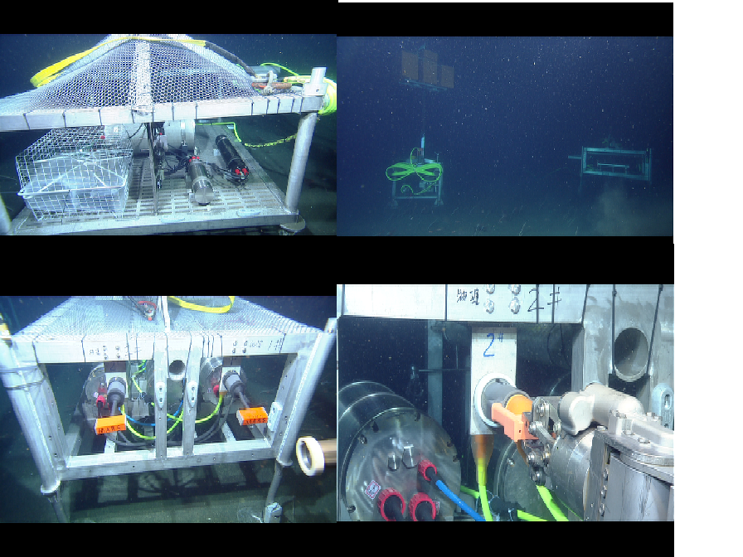
Problem
Bottom trawling causes devastating damage not only to the seafloor but also to anything else in its way
Solution
Trench or plow in extension cables where ever possible especially in known areas of bottom trawling

Slide 3
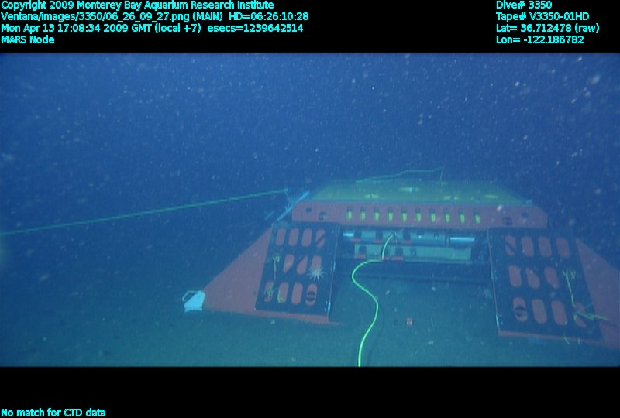
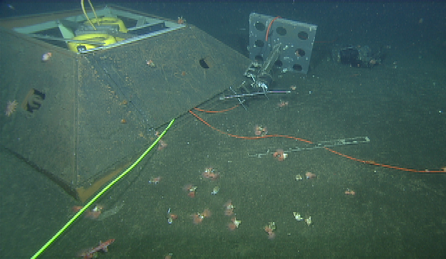
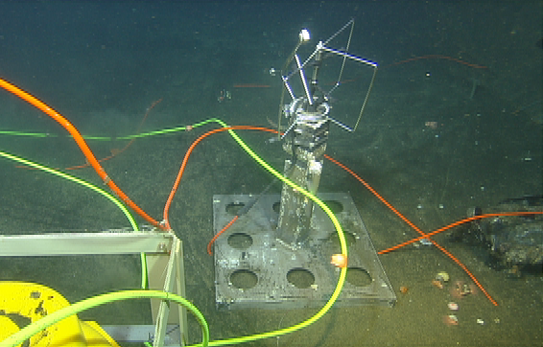
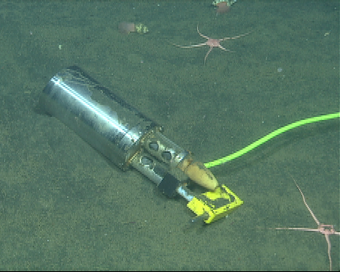
Trawling Video

Slide 4
Initial Efforts
Fisherman Association meetings describing the location and complexity of the MARS system
Established a toll free 800 number available 24/7 for advice or information on the cable and experiment locations and guidance if suspected fouling
Provided both paper and electronic charts free to aid fisherman
After 1st Strike
Spoke directly to the suspected vessel owner.
“He thought it was just a point on the map and stayed 10- 20 yards south of it!”

Slide 5
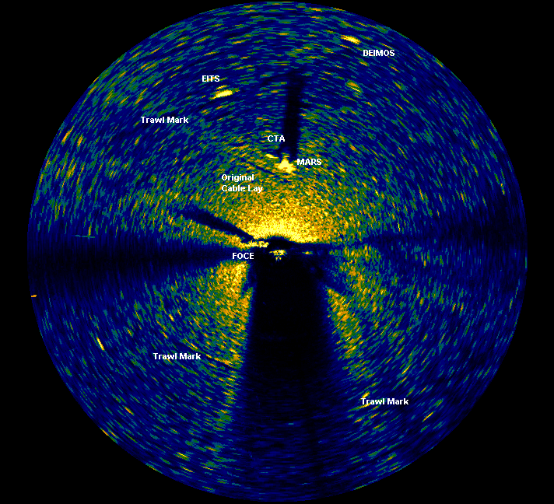

Slide 6
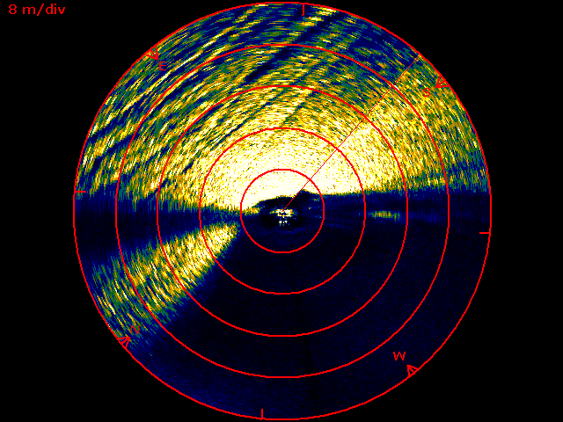

Slide 7
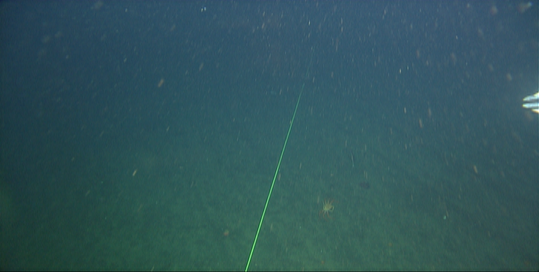
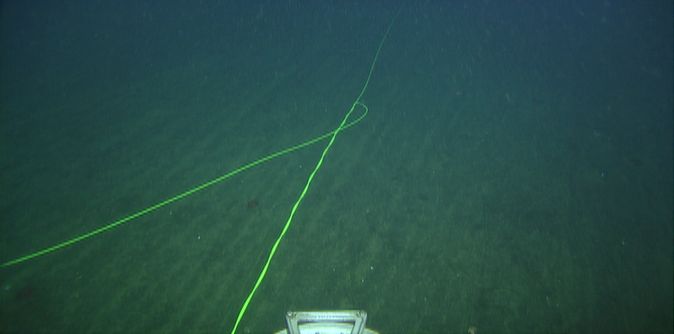
Trawl marks evident in the seafloor
The Initial trawling event drew the cable tight, the second dropped it back to the seafloor in a “wussle”.

Slide 8
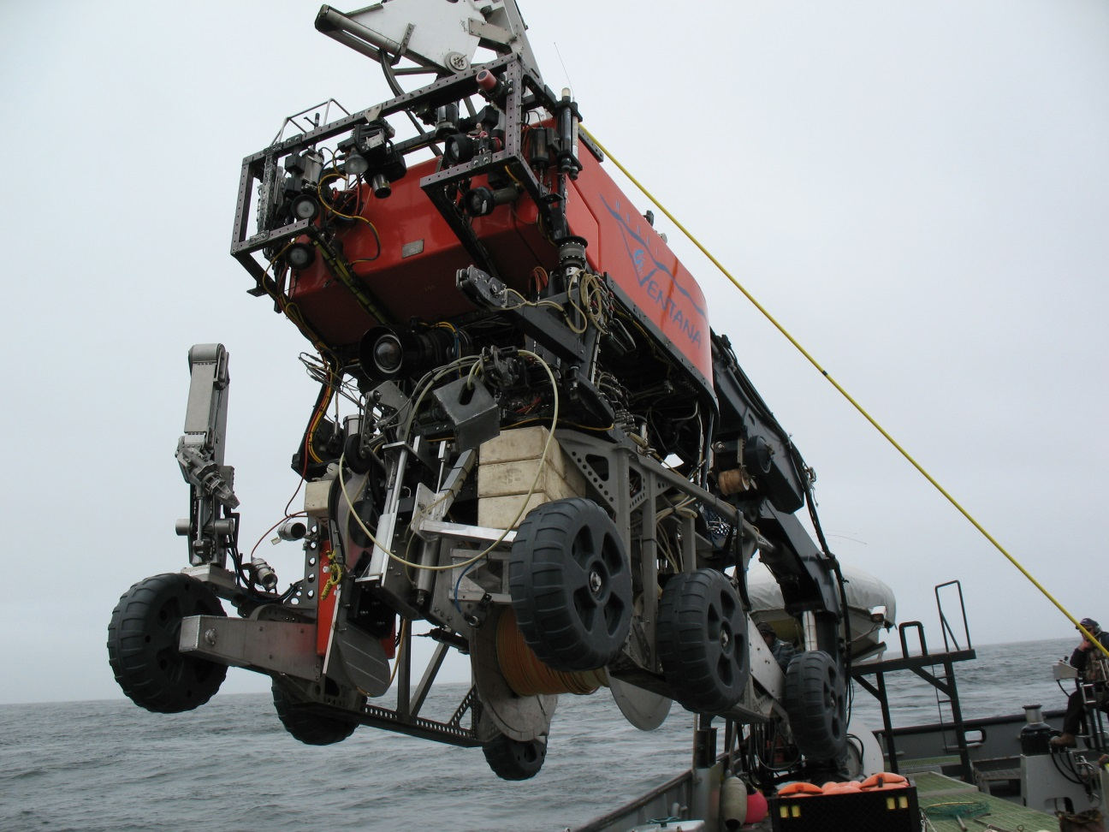
Solution
Bury The cables as they are laid….
C:\Users\dacr\Documents\HOWE_Workshop\MOBBCableLayingJune23_2011.mp4

Slide 9
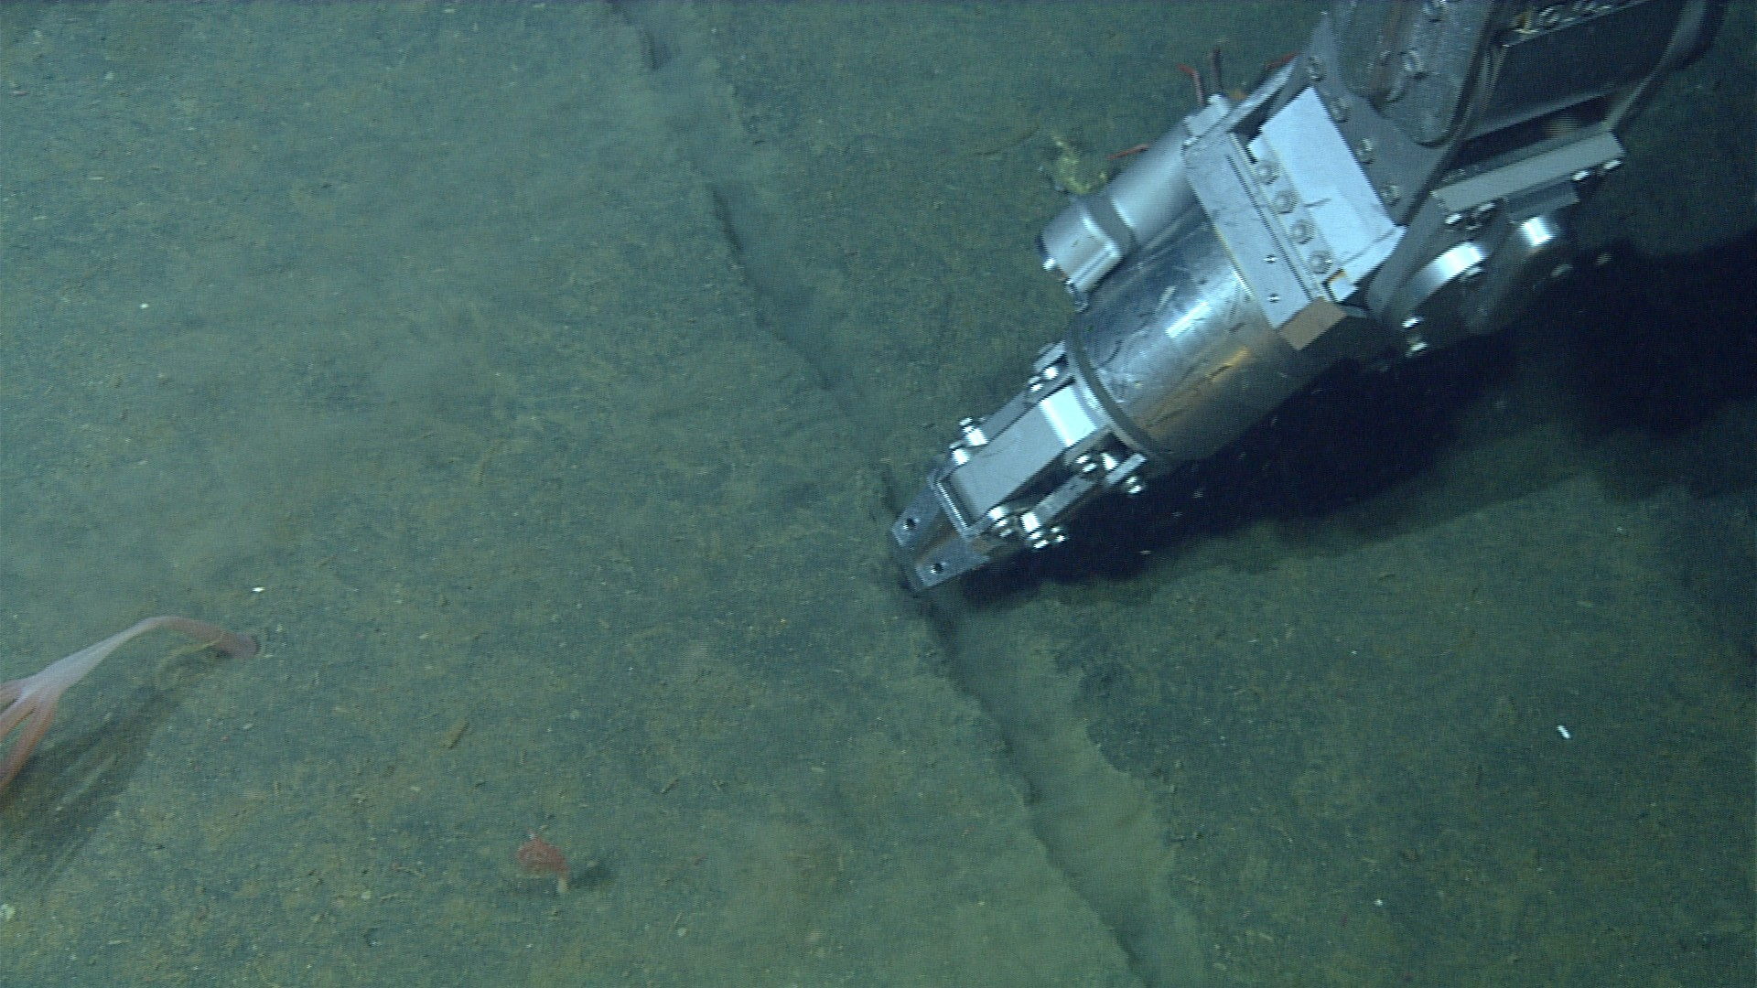
Solution
Bury The cables as they are laid….

Slide 10
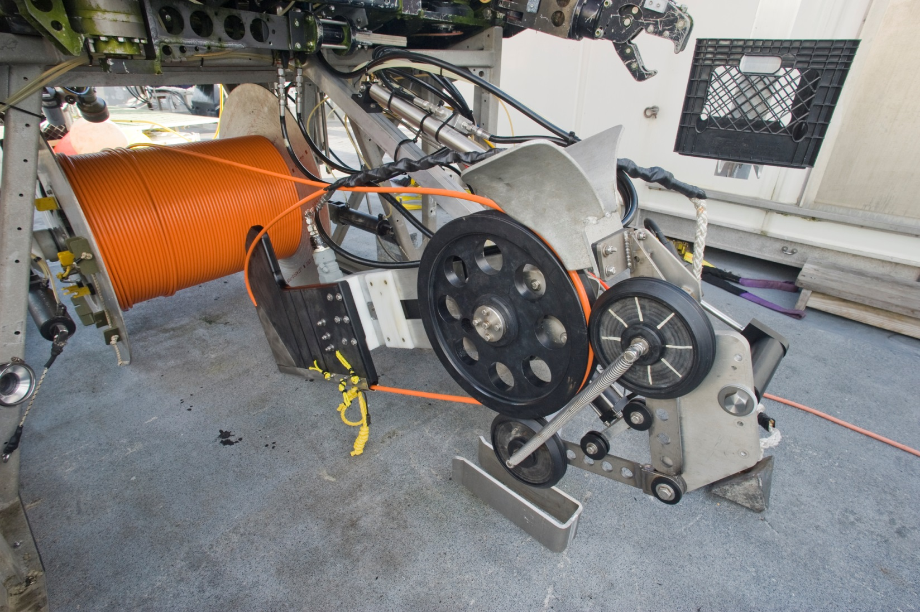
Solution
Bury The cables as they are laid….

Slide 11
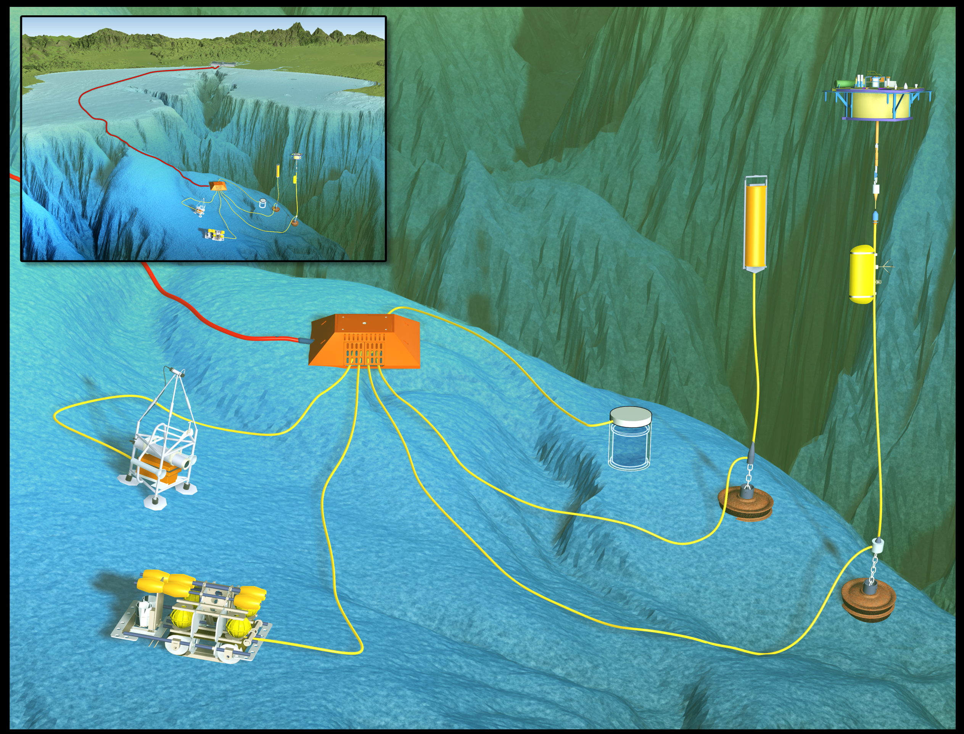
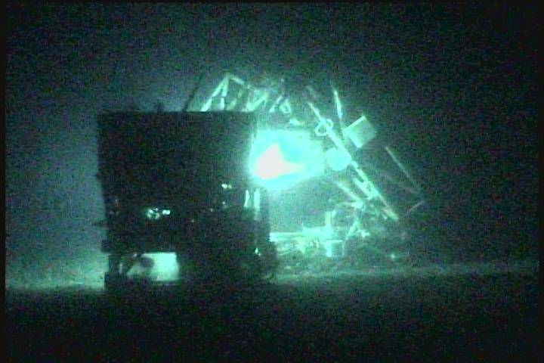
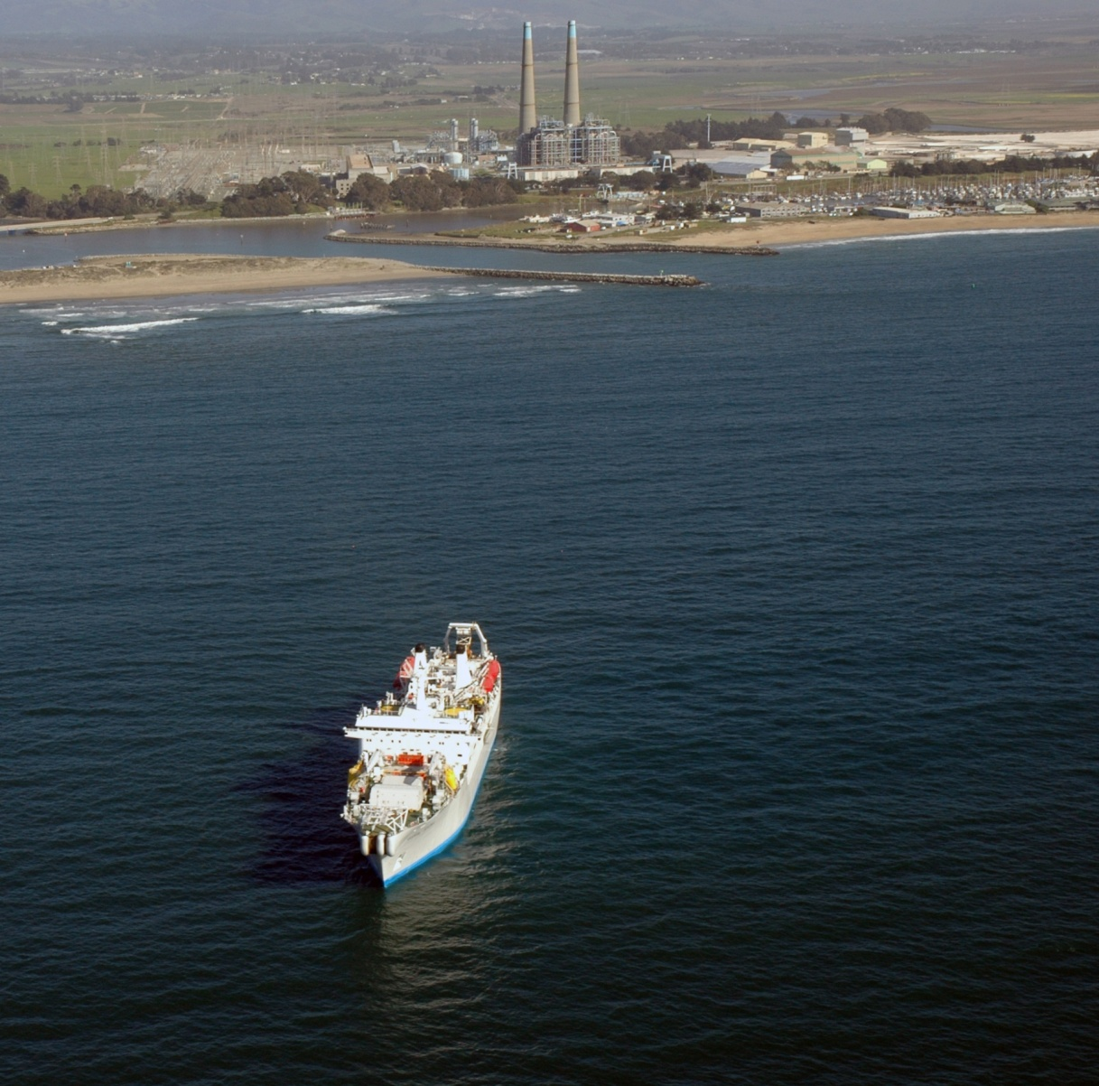
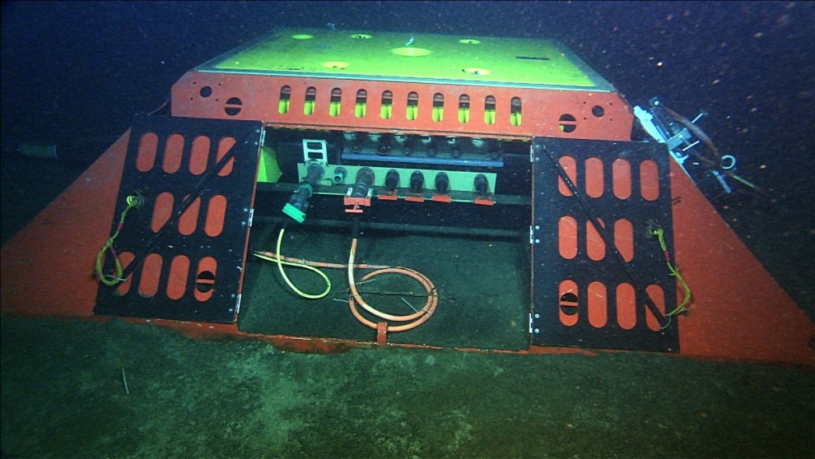
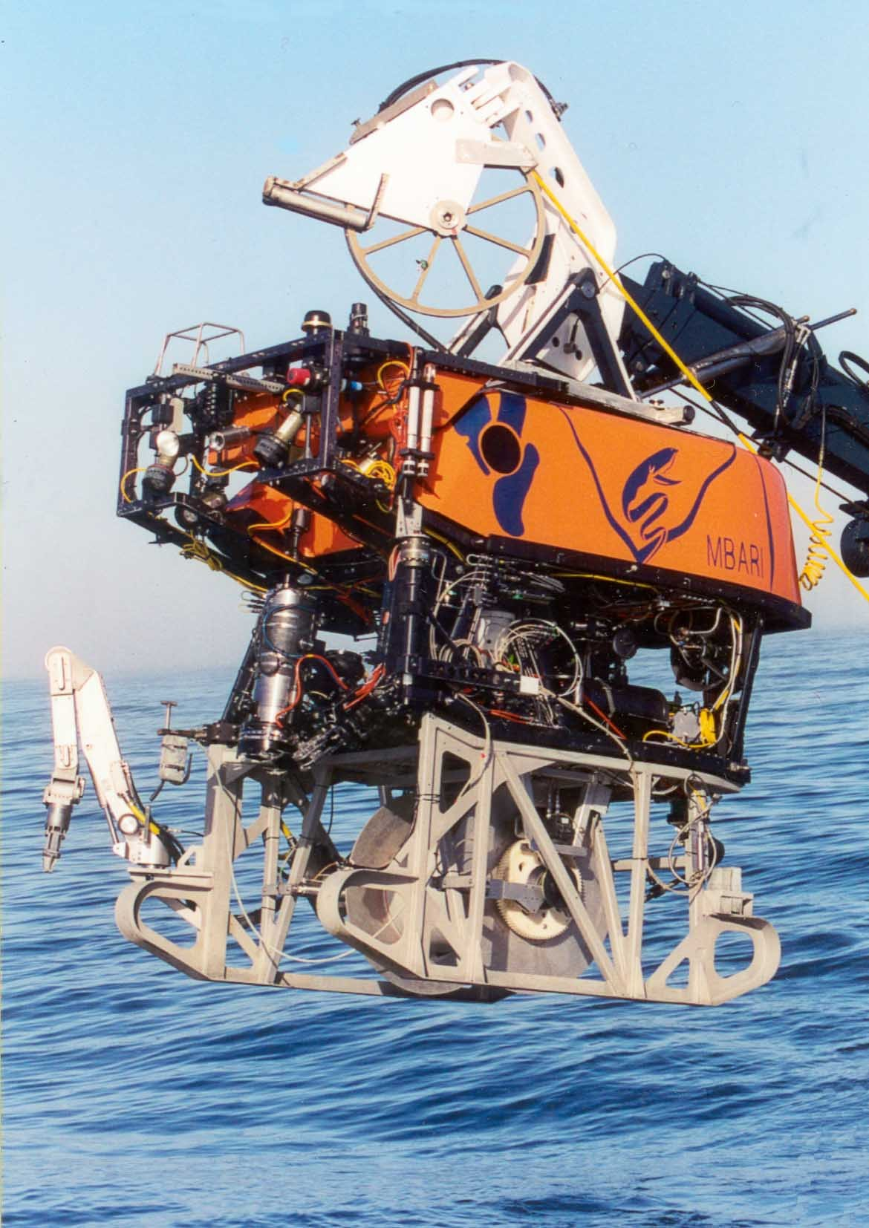
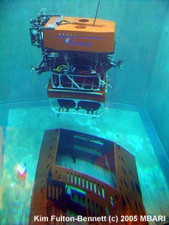
Monterey Accelerated Research System (MARS)
MARS Operations MBARI
2 Gbit/second internet connectivity
6 kW of power for science (Currently)
8 Independent Science Ports each with
  100 Mbit/second TCP/IP Ethernet
  48 and 375 Volts DC
  NTP network time distribution
  Precision GPS synched 1 PPS clock

Slide 12
THE MOTIVATION FOR MARS
Next generation Oceanographic Observing Systems need an accessible system development test bed
  New instruments, techniques and experiments will be required to address global issues
  Developing these systems for use in the ocean is an expensive, difficult, time consuming process
  Oceanographic systems need to be tested in-situ
MARS lowers the cost of entry for researchers worldwide to work on global problems in the world’s Oceans
MARS provides a relatively deep water site (890m) with an easy 2 hour commute from Moss Landing Harbor
MBARI has ships and ROVs operating in the Bay 200+ days per year essentially year round
MARS supports science projects from proposal, through design, test, deployment and data distribution
MARS has no requirement for users to share the data, development can occur in a private space.

