Slide 1
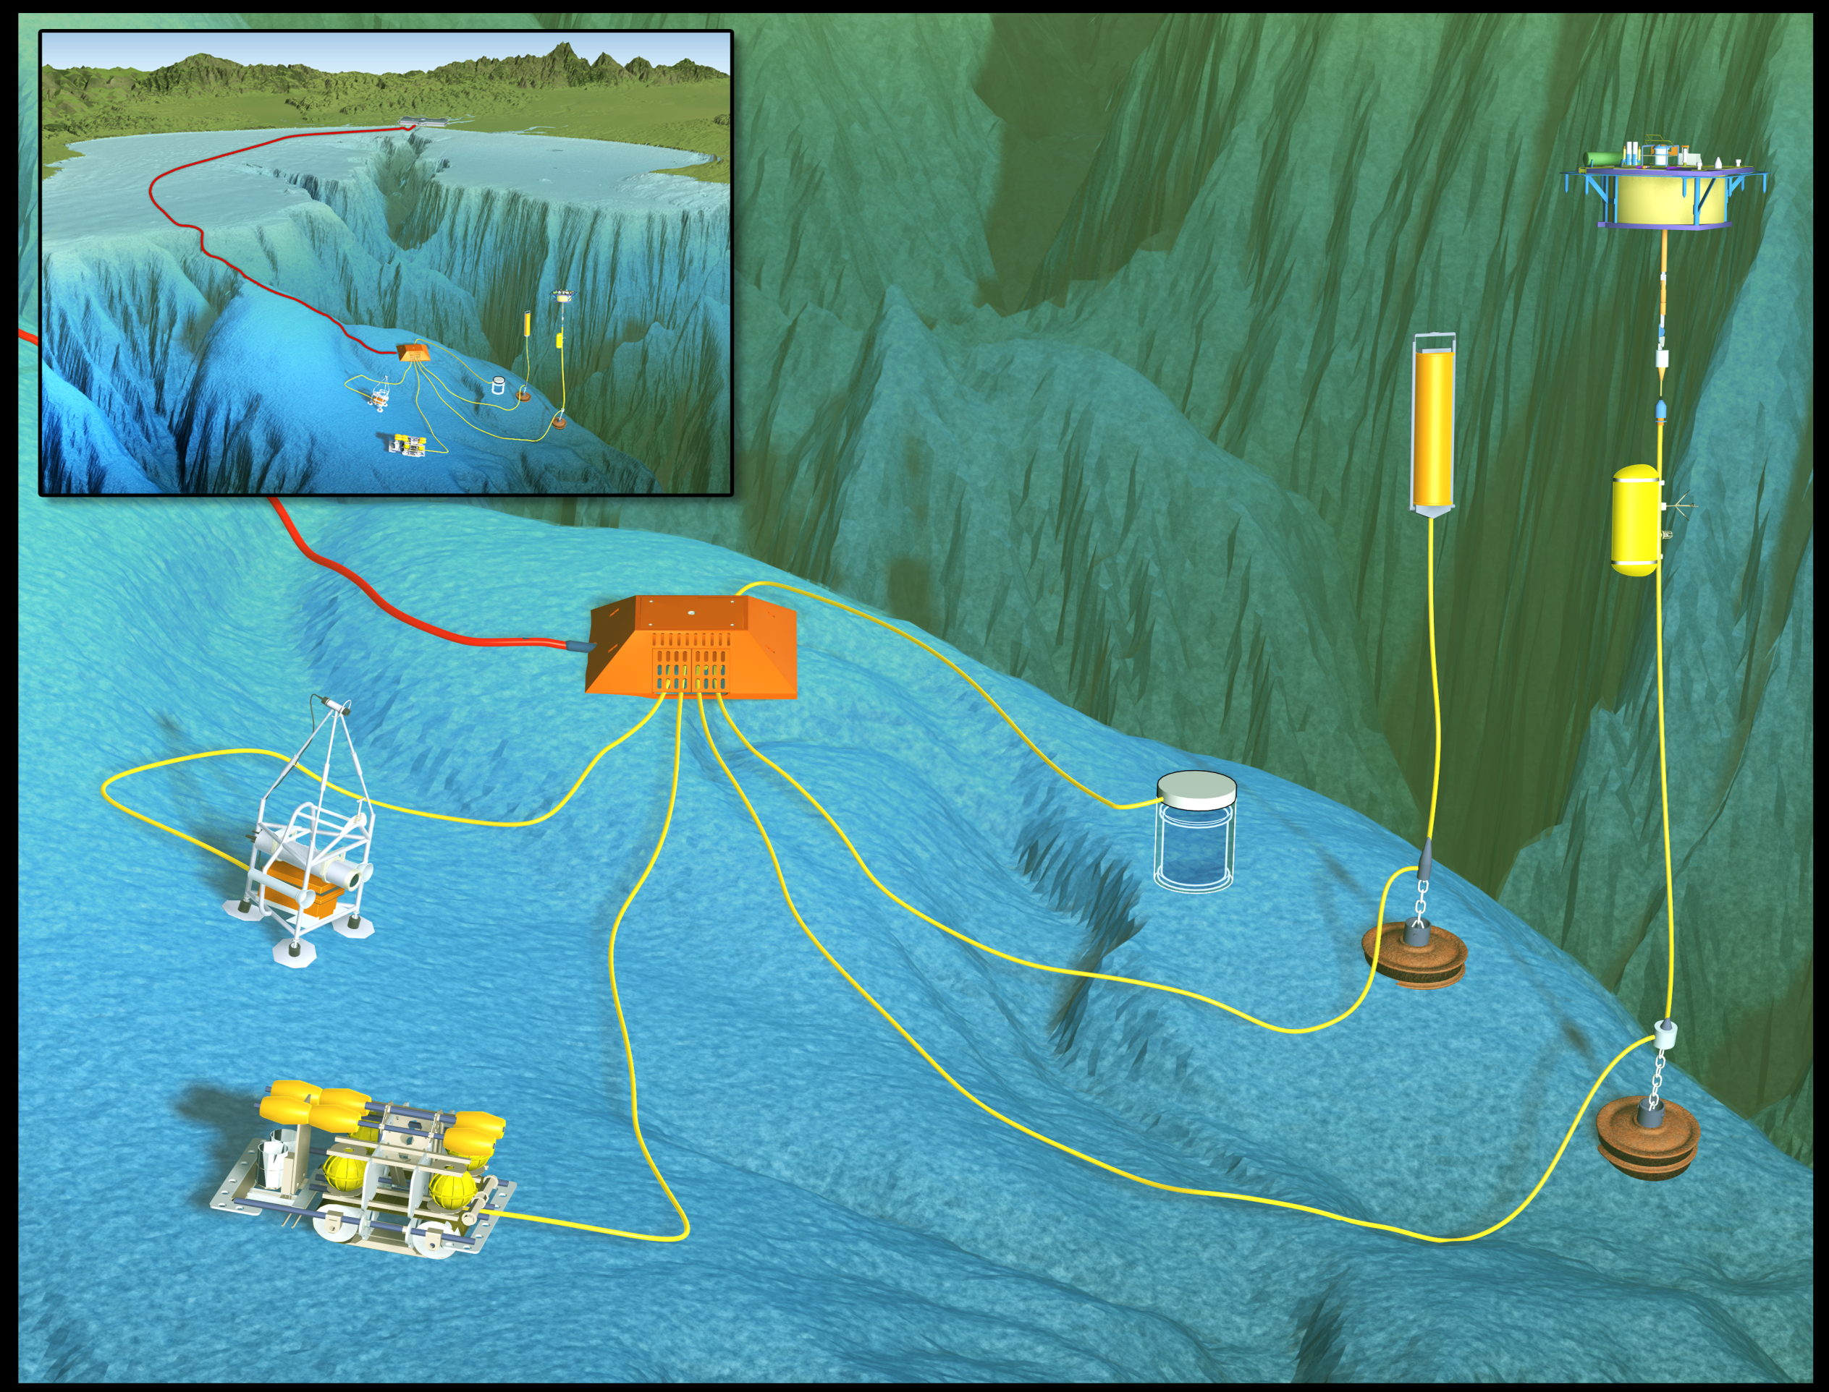
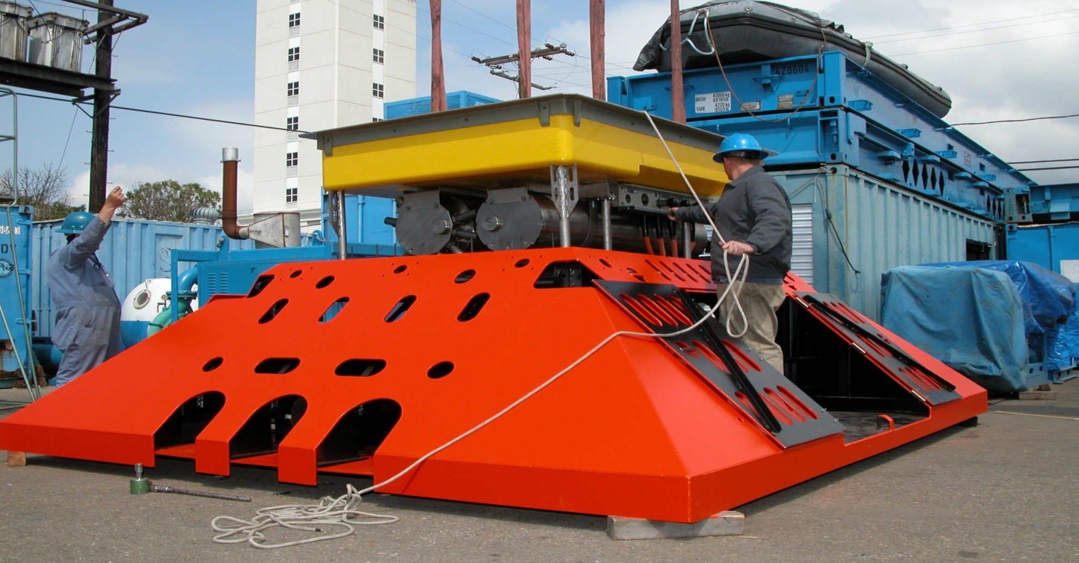
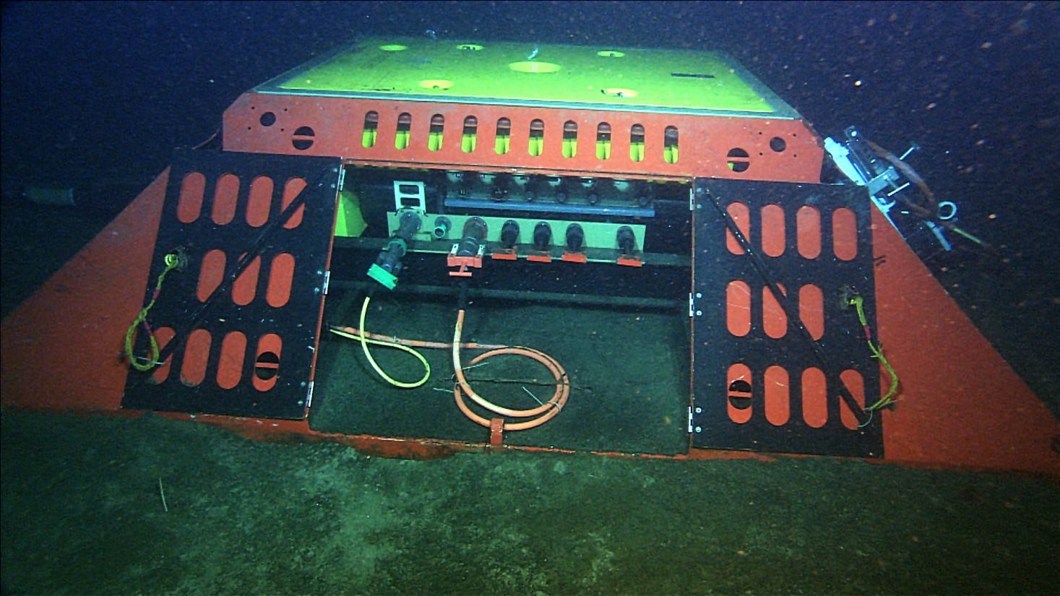
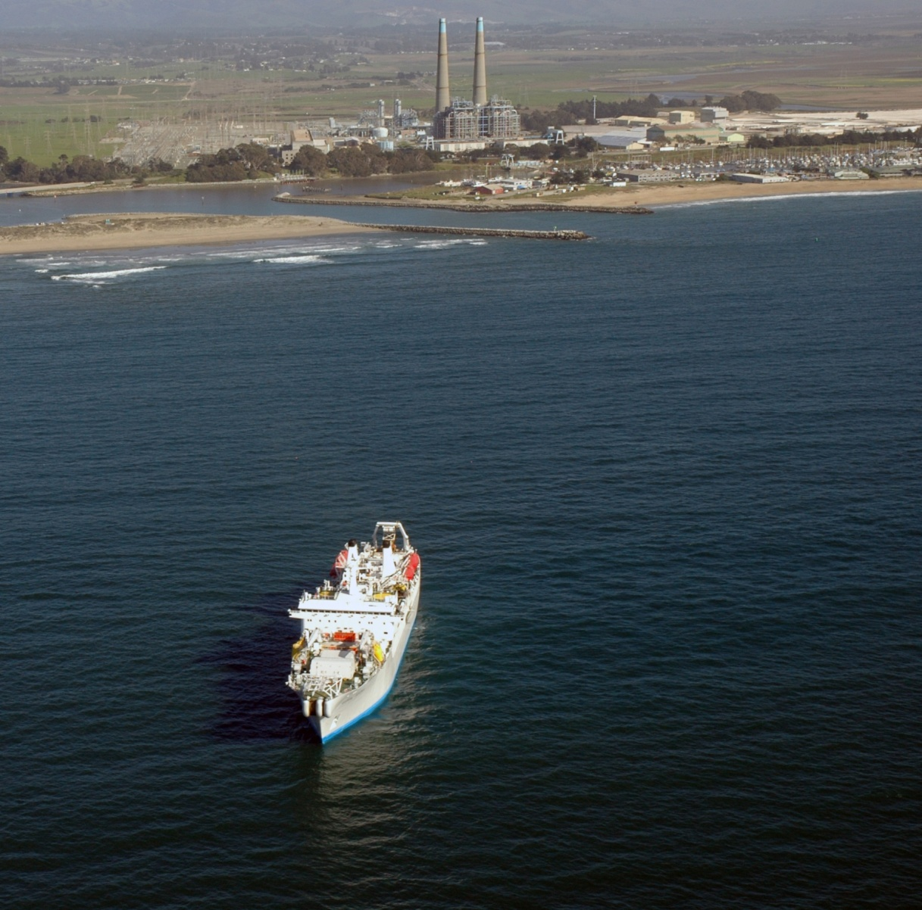
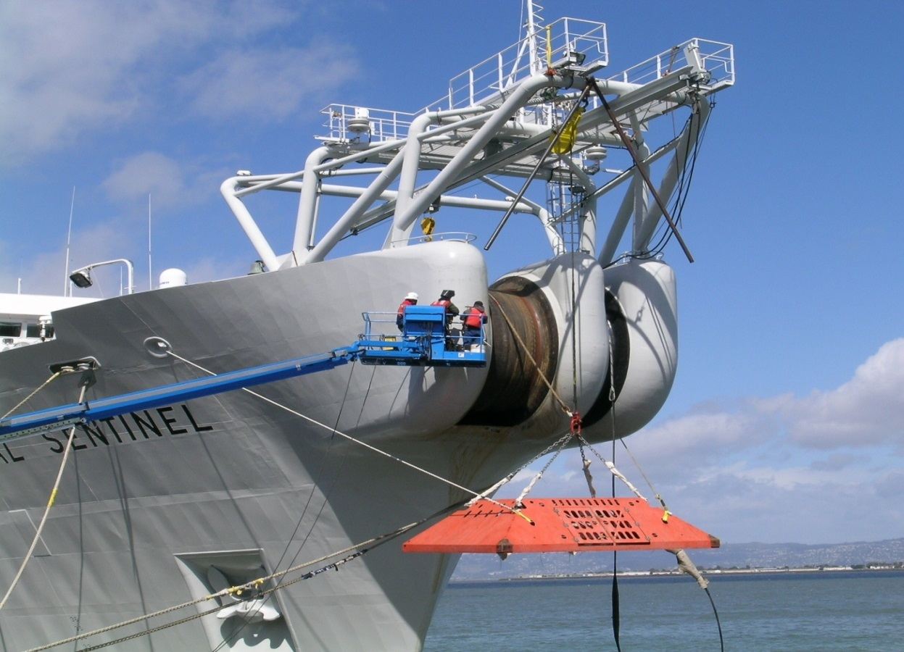
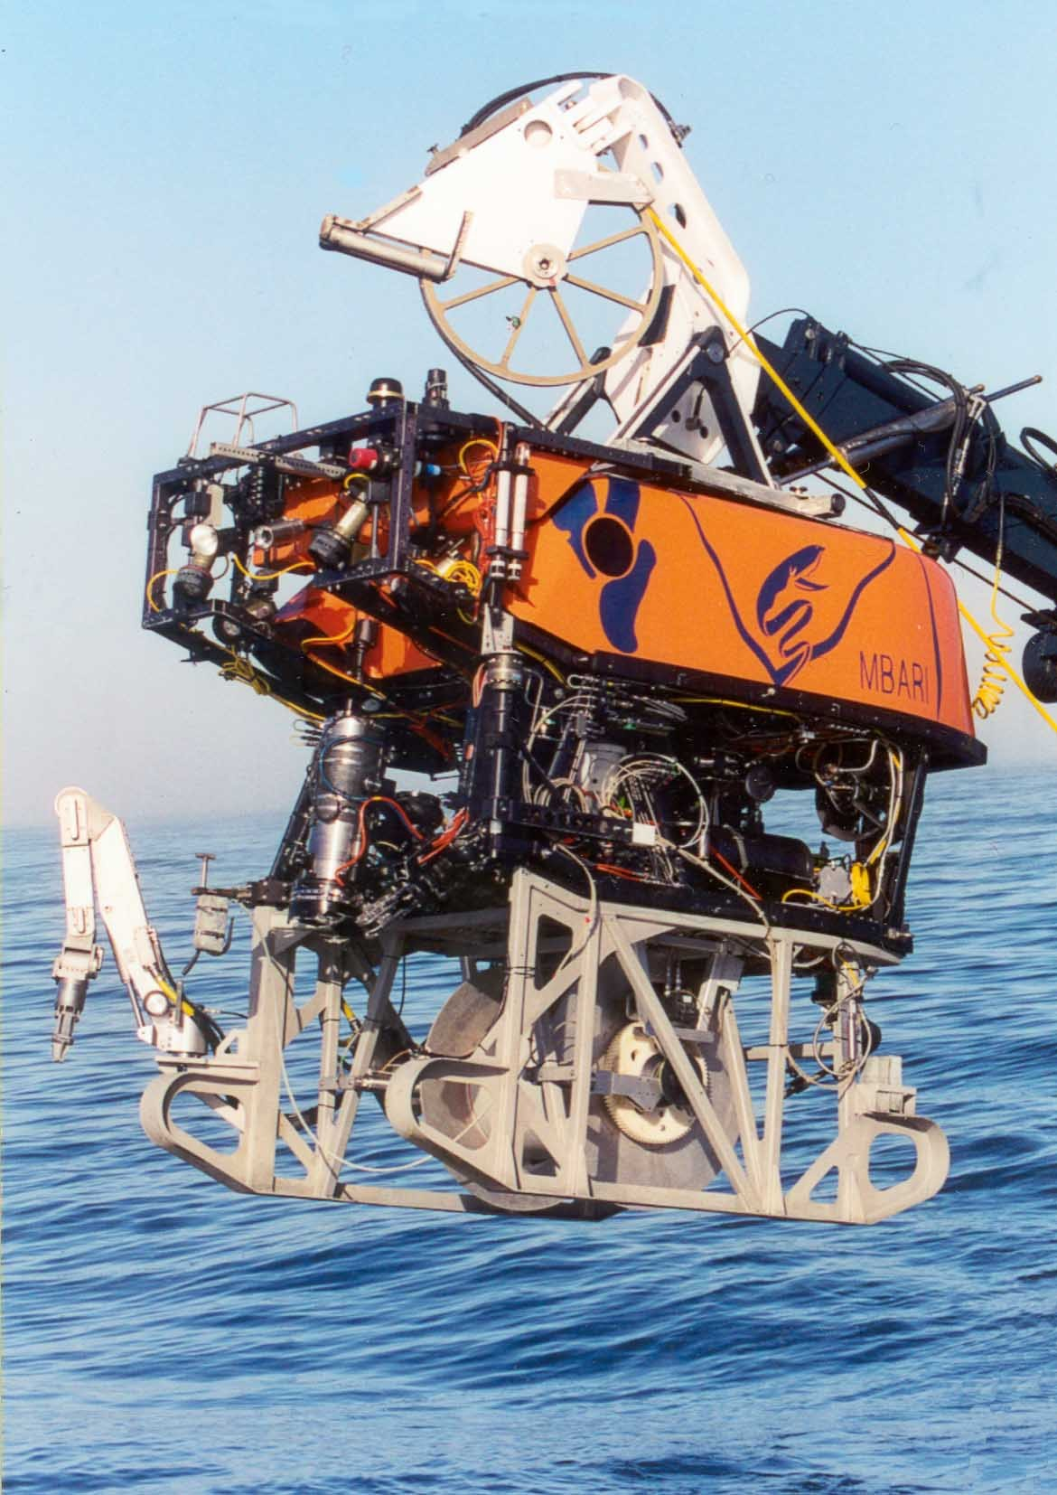
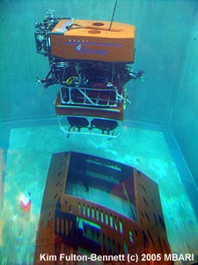
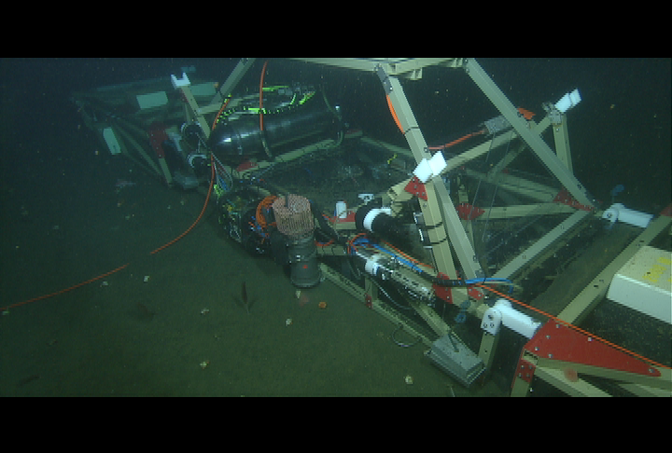
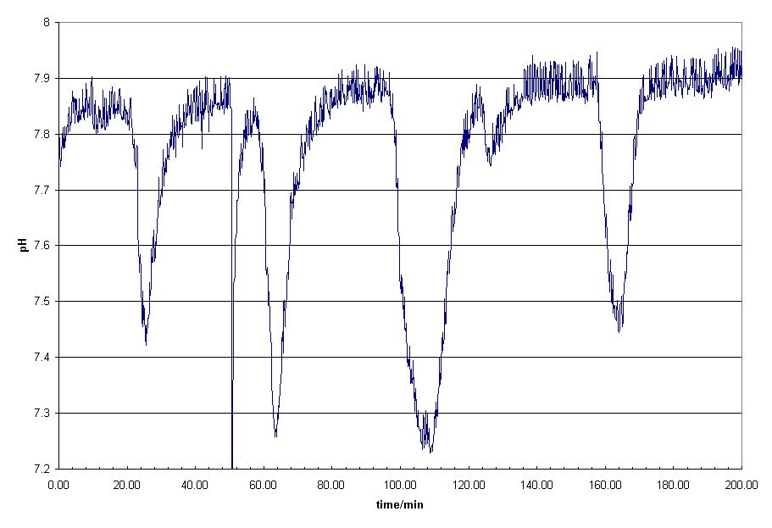
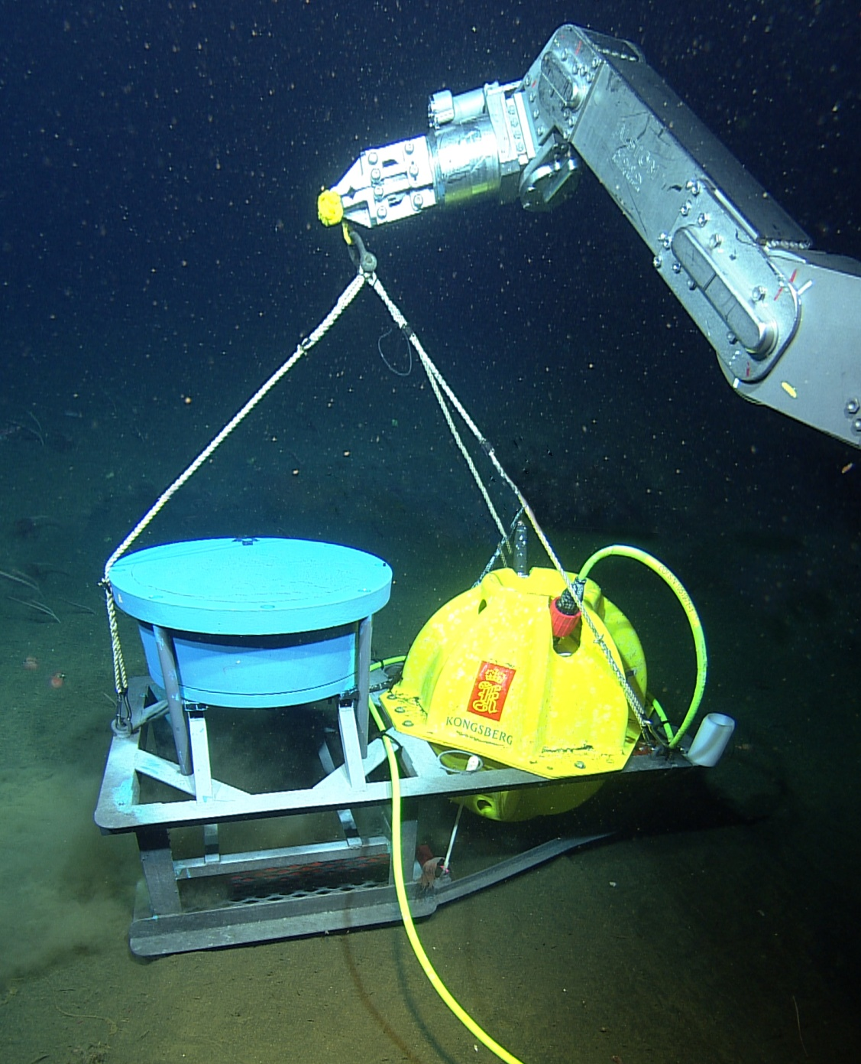
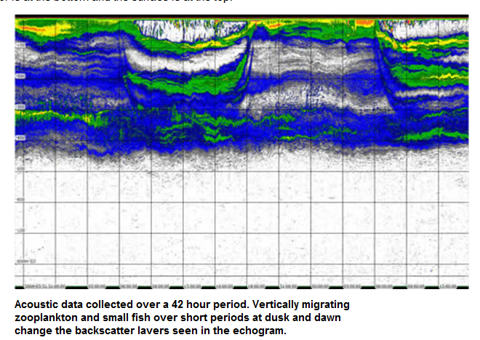
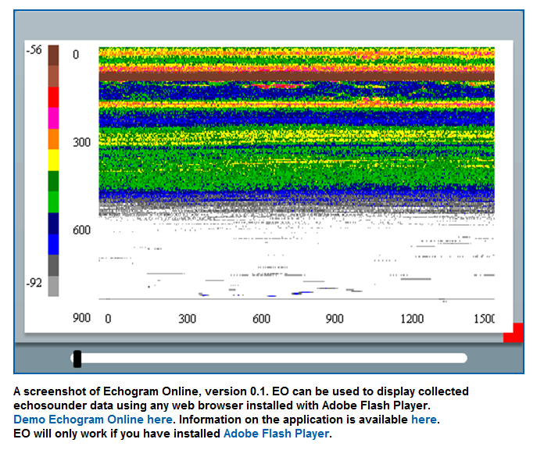
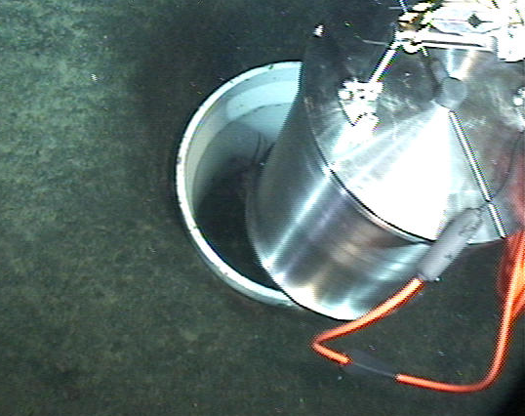
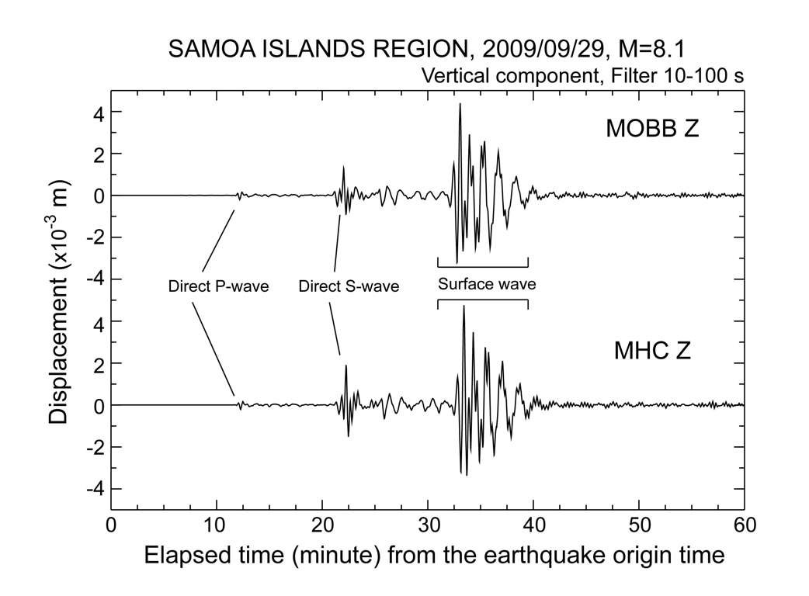
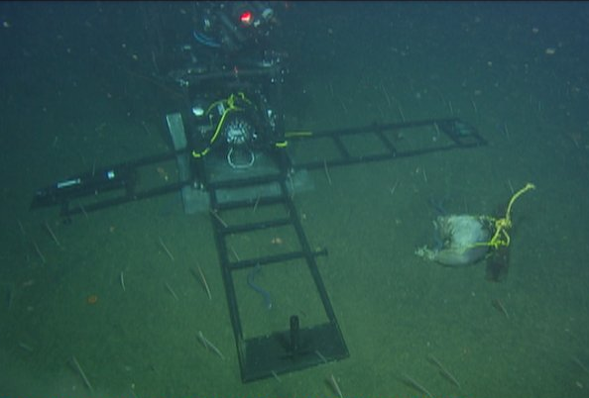
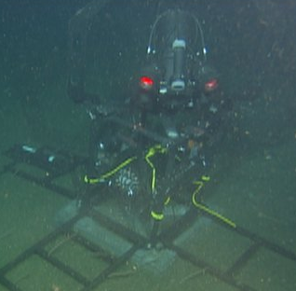
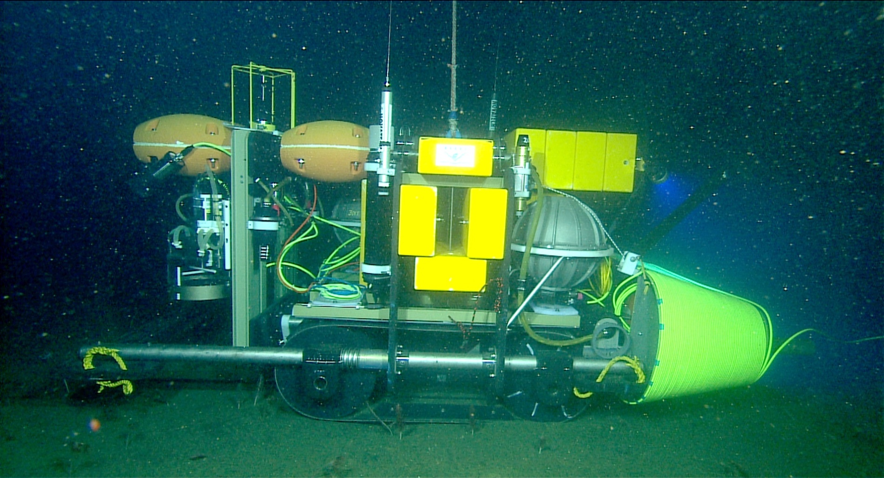
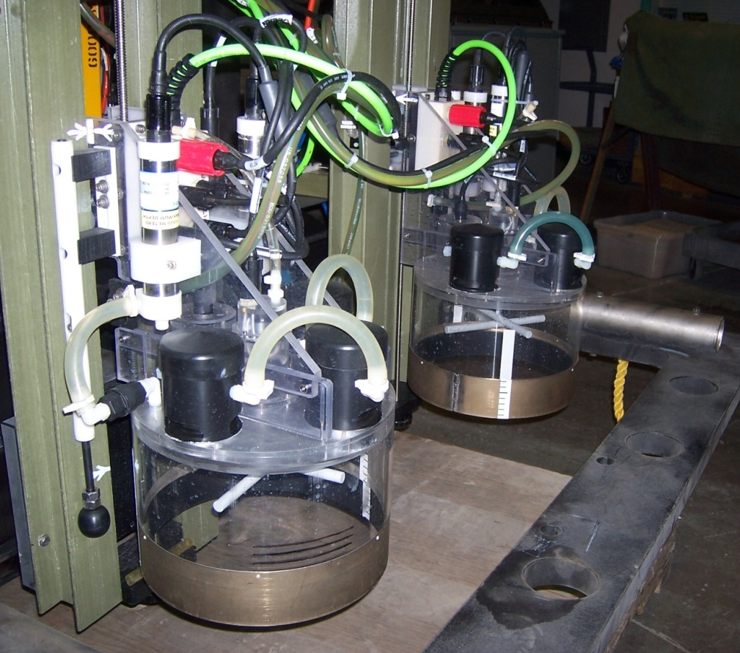
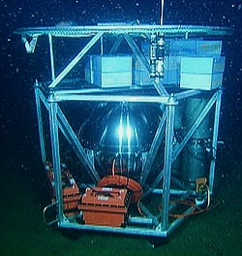
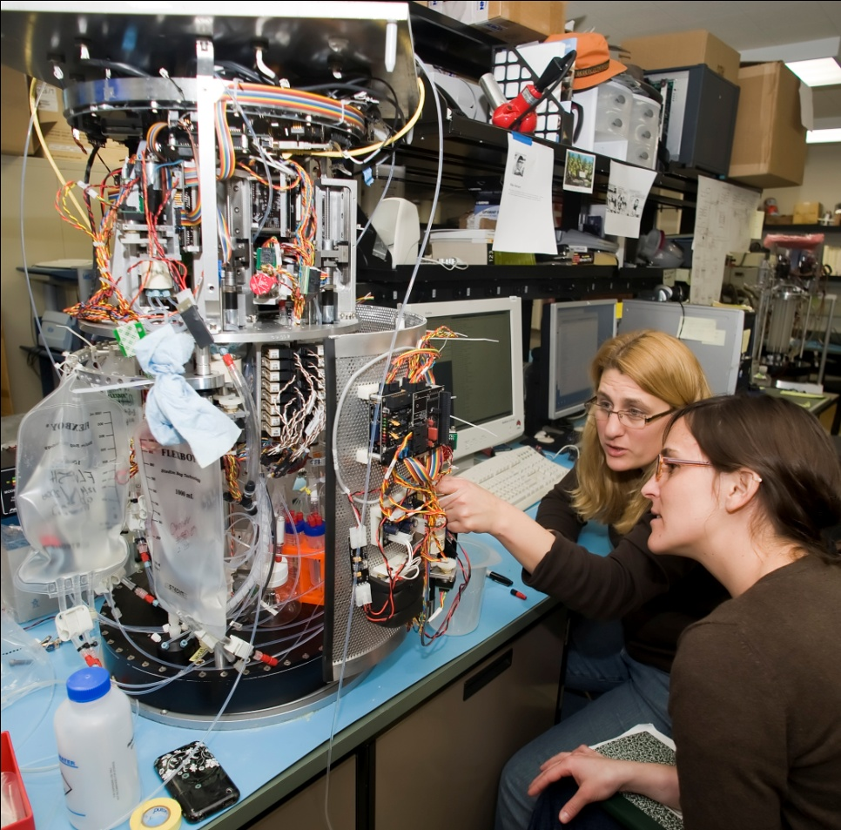
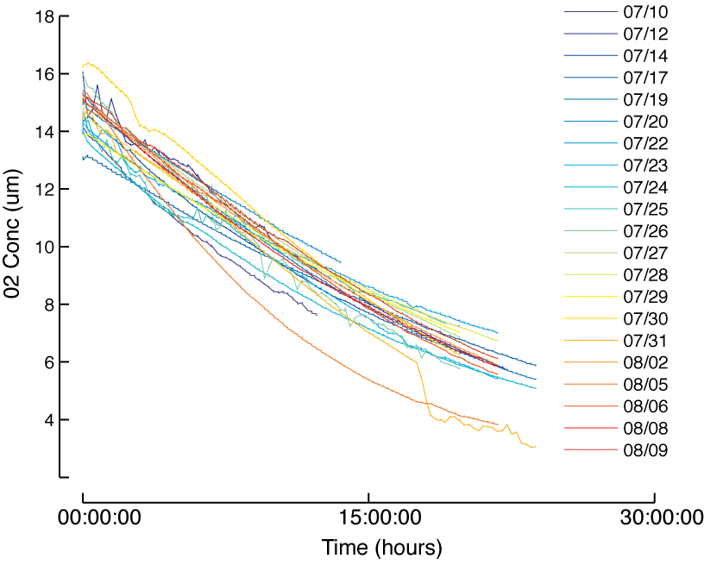
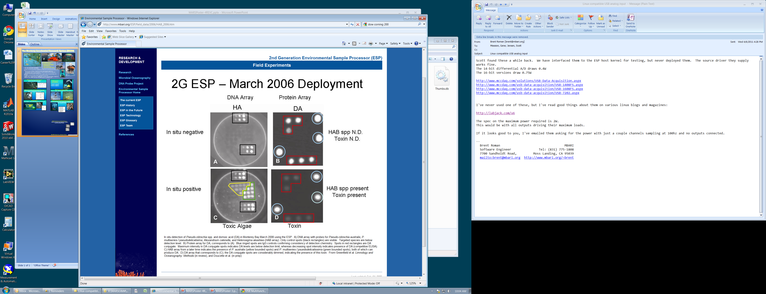
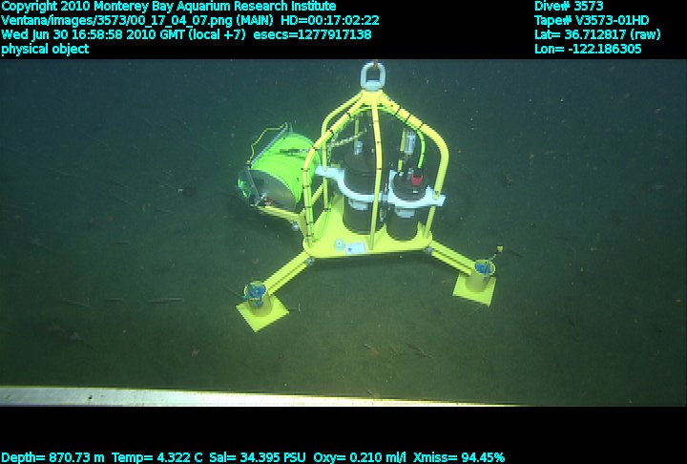
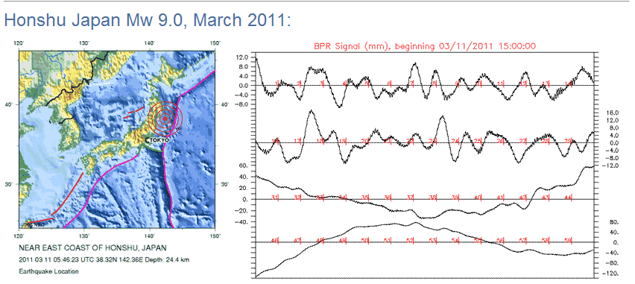

The Monterey Accelerated Research System (MARS)
MARS Operations MBARI
2 Gbit/second internet connectivity
6 kW of power for science
8 Independent Science Ports each with
  100 Mbit/second TCP/IP Ethernet
  48 and 375 Volts DC
  NTP network time distribution
  Precision GPS synched 1 PPS clock
THE MOTIVATION FOR MARS
Next generation Oceanographic Observing Systems need an accessible system development test bed
  New instruments, techniques and experiments will be required to address global issues
  Developing these systems for use in the ocean is an expensive, difficult, time consuming process
  Oceanographic systems need to be tested in-situ
MARS lowers the cost of entry for researchers worldwide to work on global problems in the world’s Oceans
MARS provides a relatively deep water site (890m) with an easy 2 hour commute from Moss Landing Harbor
MBARI has ships and ROVs operating in the Bay 200+ days per year essentially year round
MARS supports science projects from proposal, through design, test, deployment and data distribution
MARS has no requirement for users to share the data, development can occur in a private space.
MARS Science Examples
FOCE: Free-Ocean Carbon Dioxide Enrichment
Assess the future impacts of elevated oceanic CO2 levels (lower pH) on marine ecosystems
DEIMOS: Deep Echo-Integrating Marine Observatory System
Understand the daily vertical migrations of zooplankton, predator-prey interactions (e.g. whale-krill), biological flux
MOBB: Monterey Ocean Bottom Broadband Seismometer
Extend the range of the Northern California Seismic Network to the western side of the San Gregorio Fault Zone
EITS: Eye-in-the-Sea on MARS
Record response to food falls and bioluminescence, observe new species
Benthic Rover
Monitor changes in benthic communities and their O2 consumption
DESP: Deep Environmental Sample Processor
Detection of microbes (harmful algae) and invertebrate larvae using molecular markers
OSU/PMEL Bottom Pressure Recorder Tilt Meter
Real time monitoring of submarine seismic activity
http://www.mbari.org/mars/
Email:marsoandm@mbari.org
MARS has been funded by grants from the National Science Foundation and the David and Lucille Packard Foundation

Slide 2
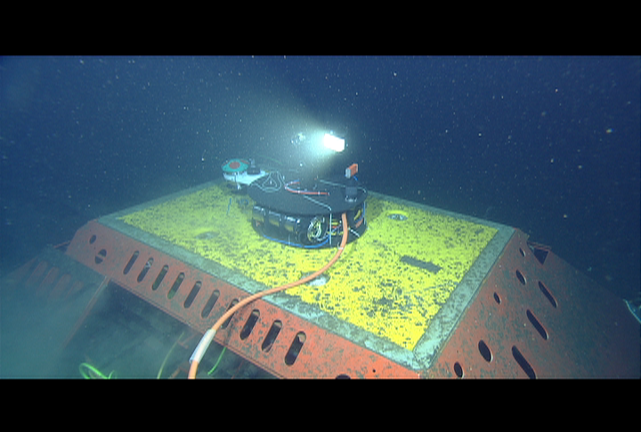
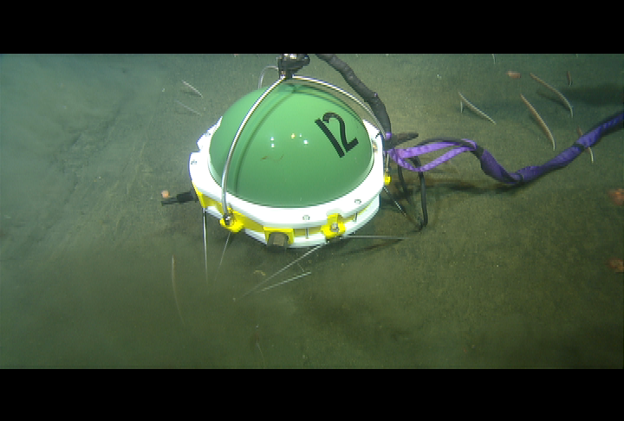
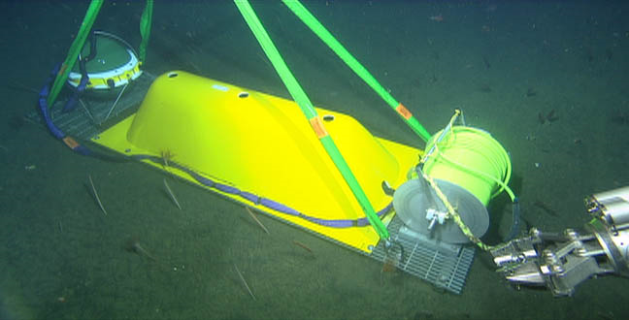
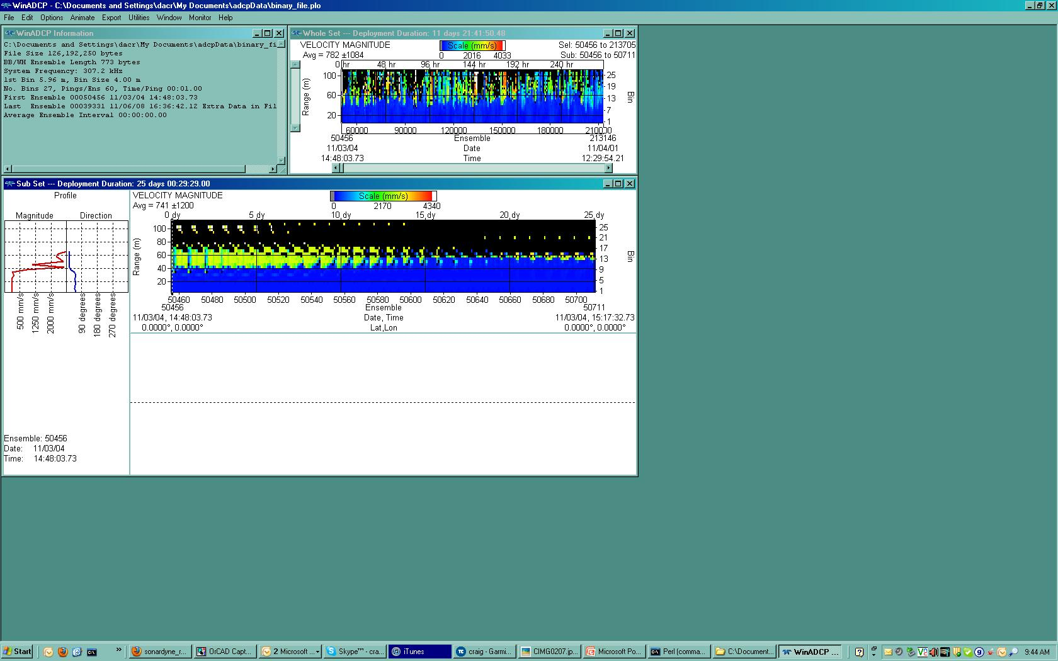
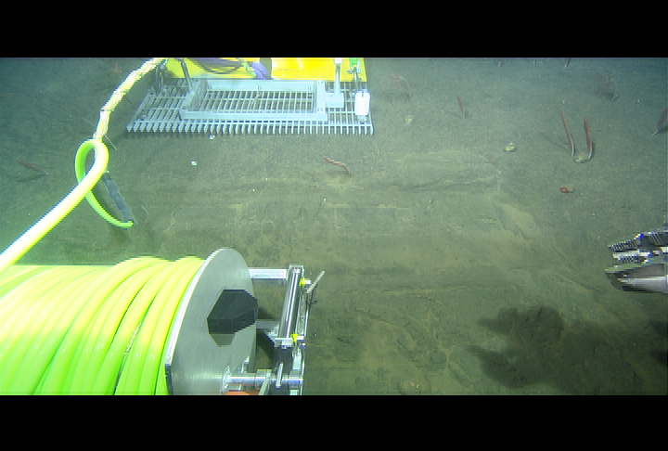
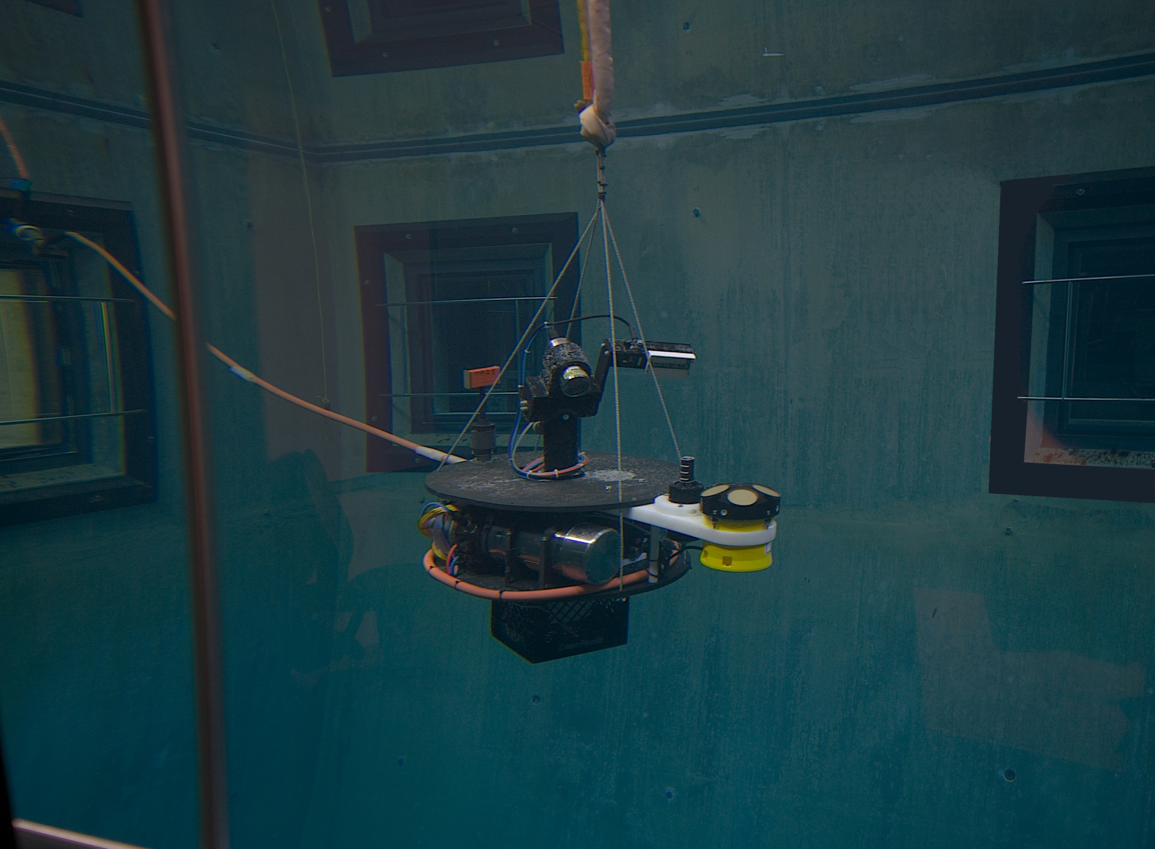
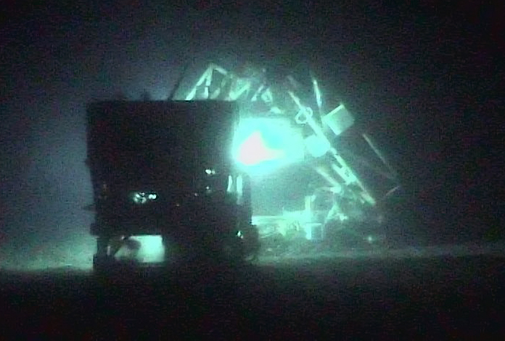
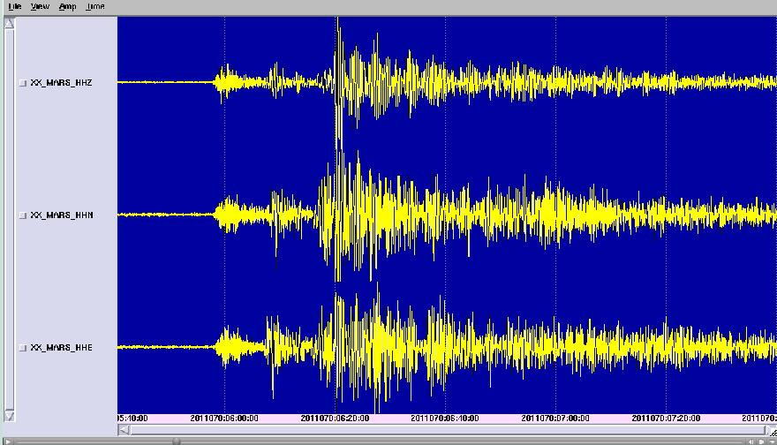
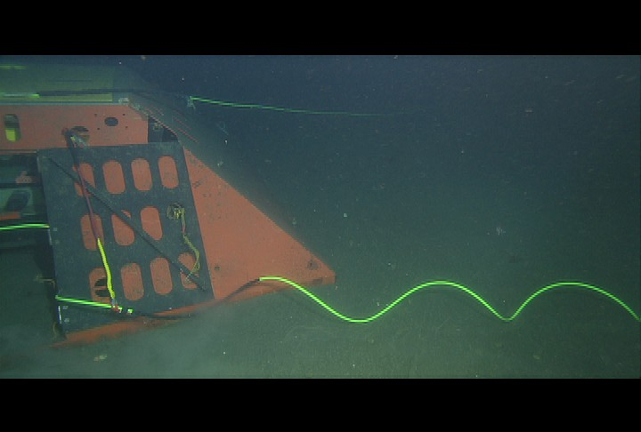
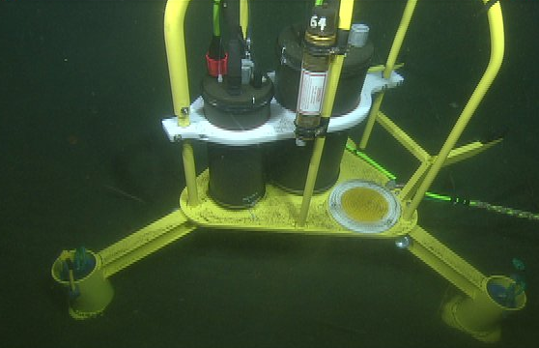
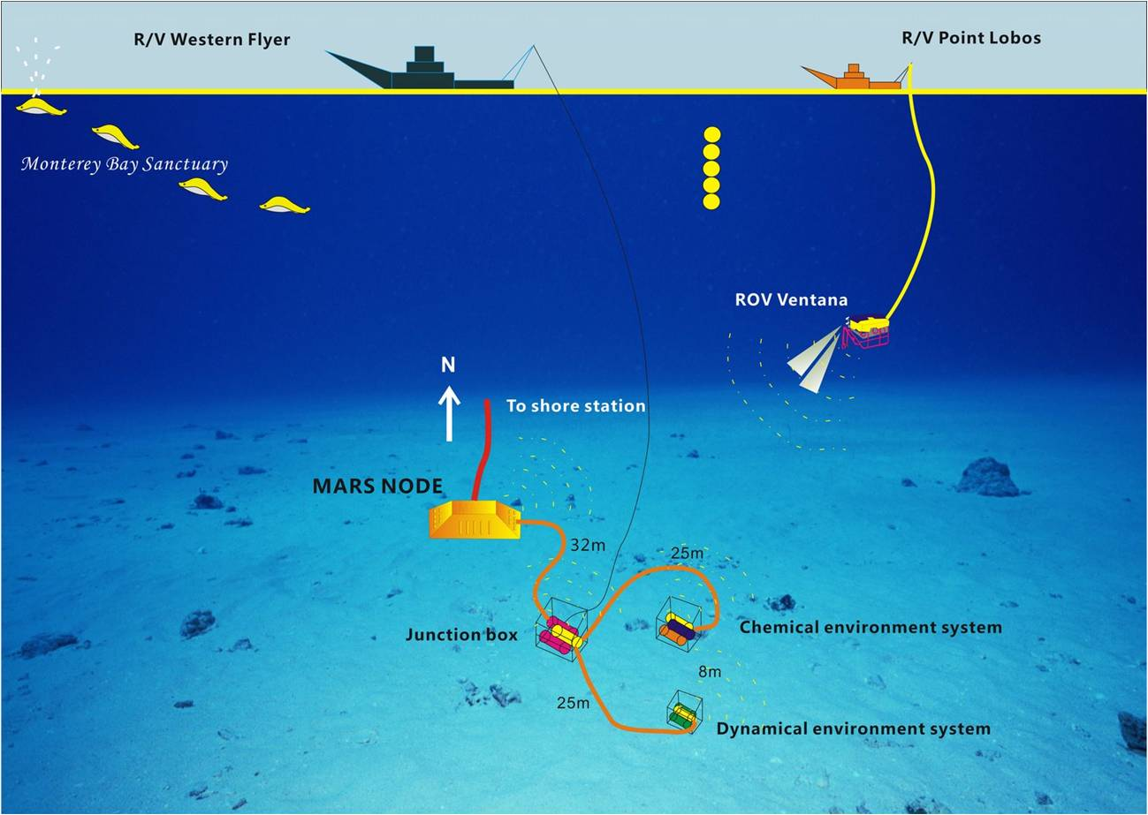
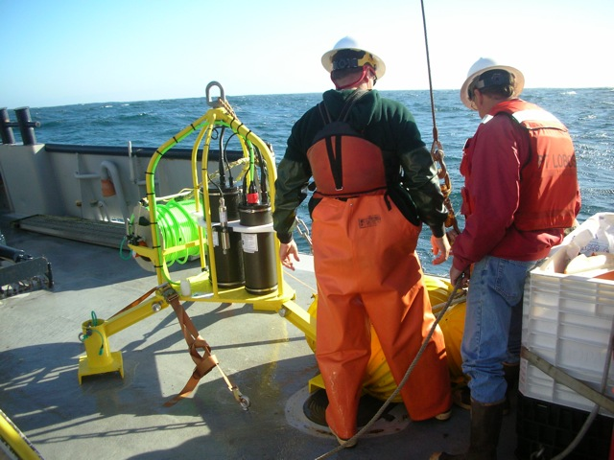
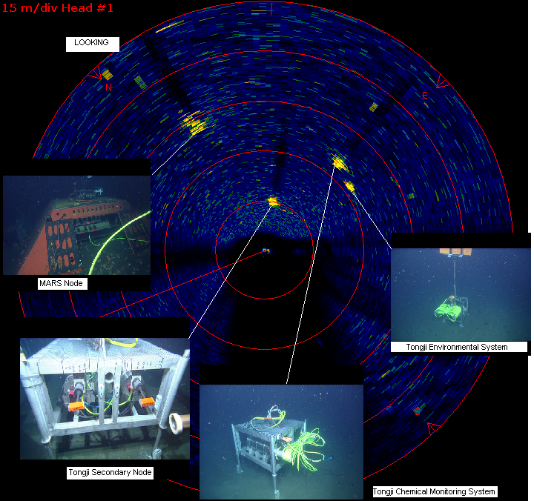
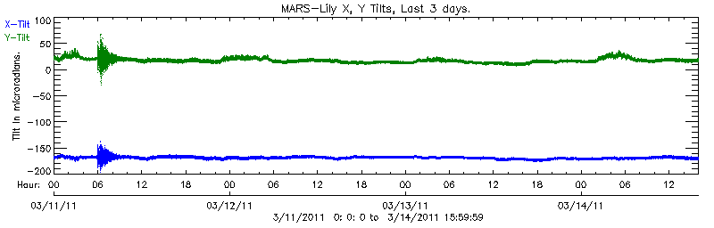
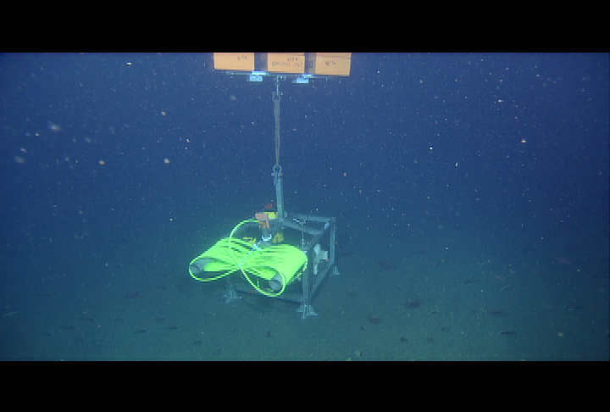
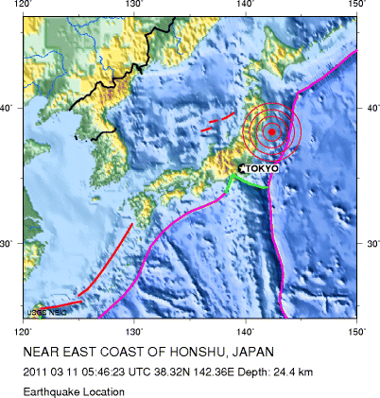
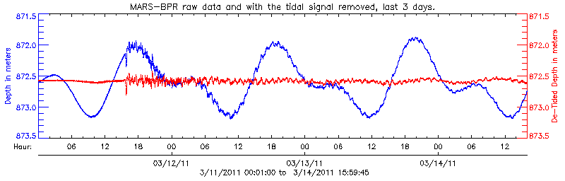
The Monterey Accelerated Research System (MARS)
MARS Operations MBARI
Projects
Photographic Benthic Observing System
PhoBOS
LOOKING Ocean Bottom Seismometer
OBS
PhoBos consists of:
Pan/Tilt/Zoom Color camera
250 watt LED light
Conductivity/Temperature/Depth (CTD) sensor: This device generates information about the physical qualities of the surrounding water. An oxygen sensor will be added to the instrument during the next calibration cycle.
Acoustic Doppler Current Profiler (ADCP): This unit uses acoustics to analyze the motion in the water column above the MARS node by reflecting sound off the particles suspended in the water. Operationally this allows the crews deploying equipment the ability to know where to launch and not hit experiments already in operation.
Expansion Port: An under-water makeable connector similar to those used on MARS is incorporated into PhoBOS to allow for expansion (addition of new instruments or tools) with out recovering the system. This port has limited functionality in it, 100mb Ethernet and 375 vdc only.
Seismometer housing deployed off launch frame
OBS Trawl resistant frame and cable spool
PhoBOS deploy and connected to MARS
The Ocean Bottom Seismometer is a device that monitors motion in the earth’s crust that is generated by earthquakes. The project is operated by the Scripps Institute of Oceanography of the UCSD and is part of the National Science Foundation’s Ocean Observing Initiative (OOI). Scripps is using this instrument to help with the development of the Cyber infrastructure for the OOI. Cyber Infrastructure is the software and tools used to control and manage the network of instruments and all the data that will eventually be deployed and generated as OOI comes online in the near future.
The MARS node is oriented approximately North –South. This allows PhoBOS to be crudely aligned. A magnetic compass in the ADCP is used to calibrate the readings taken by the instrument.
Many tools and techniques are developed to install these types of experiments on the seafloor. Devices called elevators are designed to “gently” lower packages to the seafloor by reducing the in water weight. The same tool is used to recover the package, it is sent to the bottom with an anchor larger than the deployed package. The elevator is connected to the instrument and the anchor released, sending the instrument to the surface of the ocean.
Typical ADCP data for a 3 day period
Typical instantaneous data from the ADCP used to deploy equipment
Deploying the cable to the MARS node
The spool seen above and above to the right is an example of another tool. The spool holds up to 100 meters of cable and the underwater connector, it is deployed with the instrument and allows the ROV an easy way to lay the cable out on the seafloor and then connect to MARS.
PhoBOS under test in tank
Developed as a tool to aid in operations, PhoBOS has become a valuable science tool providing real time information about the physical conditions of the ocean at the MARS site. Future plans include development of web access to the video and data generated for use in educational settings, upgraded camera system to HD quality and improved lighting.
Ventana deploying FOCE from PhoBOS
Data from the OBS showing the Japan 9.0 magnitude earthquake March 11, 2011
Bottom Pressure Recorder /Tiltmeter
BPR
University of Tongji
Ocean Observing System
Peoples Republic of China
With funding from the National Science Foundation (NSF), Oregon State University (OSU) and NOAA/PMEL have developed an instrument designed to monitor submarine volcanoes. It has sensors that can precisely measure vertical movements and tilts of the seafloor, indicators of volcano inflation or deflation that are associated with magmatic intrusions and eruptions. We plan to deploy an array of instruments like the one we are testing at MARS at Axial Seamount, an active submarine volcano that will be part of NSF's Ocean Observatories Initiative in the NE Pacific.
This system is composed of three parts:
Main node or junction box which includes;
  Control electronics
  Data transport equipment
  Video observation system
Chemical environment system
  Anion analyzer to detect the anion composition of seawater (Cl⁻, SO₄²⁻, NO₃⁻, et al)
  AMT pH sensor
  Oxygen Optode
  Chlorophyll Flourometer,
  METS methane sensor
  ISUS nitrate sensor
Dynamic Environment System
  Acoustic Doppler Current Profiler (ADCP)
  Acoustic Doppler Velocimeter (ADV)
  Conductivity Temperature Depth sensor (CTD)
  Turbidity sensor
The OSU BPR/Tilt instrument has 4 sensors: 1) a high-resolution tiltmeter (LILY), 2) a low-resolution tiltmeter, 3) a bottom pressure recorder (BPR), and 4) an experimental high-resolution pressure recorder (Nano-BPR).
The deployment was one of the more complex undertaken by MBARI. It required two ships and an ROV to place all the equipment correctly on the seafloor. On instruction from the Ventana crew the Western flyer maneuvered the heavy systems to exact positions near the MARS main node. Once on the seafloor the equipment was connected to MARS and each other by Ventana. The equipment will remain connected to MARS till late fall. Recovery will be done using two ships. This method is required due to the weight of the equipment. It is too heavy to be moved by the ROV.
In the plots below, one hour of Nano-BPR data are shown in 10-minute segments on the x-axis with a variable scale in mm on the y-axis. Each 10-minute segment of the Nano-BPR data has been crudely "de-tided" by simply subtracting out the average linear trend for that time interval. The black arrows show the origin time of selected earthquakes and are followed within minutes by vertical ground motion at the MARS site, detected by the Nano-BPR. The earthquakes below are from Honshu Japan. The bottom chart shows the tsunami signal arriving delayed from the actual earthquake by the time it took to travel across the Pacific Ocean.
BPR with Cable spool on seafloor
Sonar image from the ROV showing the location of the deployed components of the Tongji Observatory
Environmental Monitoring system prior to connection

