Slide 1
THE MARS Cabled Observatory
Engineering Development & Science Missions
Deep Ocean Cables Observatories
ASPERA Workshop 24-25 May 2012
Gene Massion
Monterey Bay Aquarium Research Institute
Moss Landing, CA USA

Slide 2
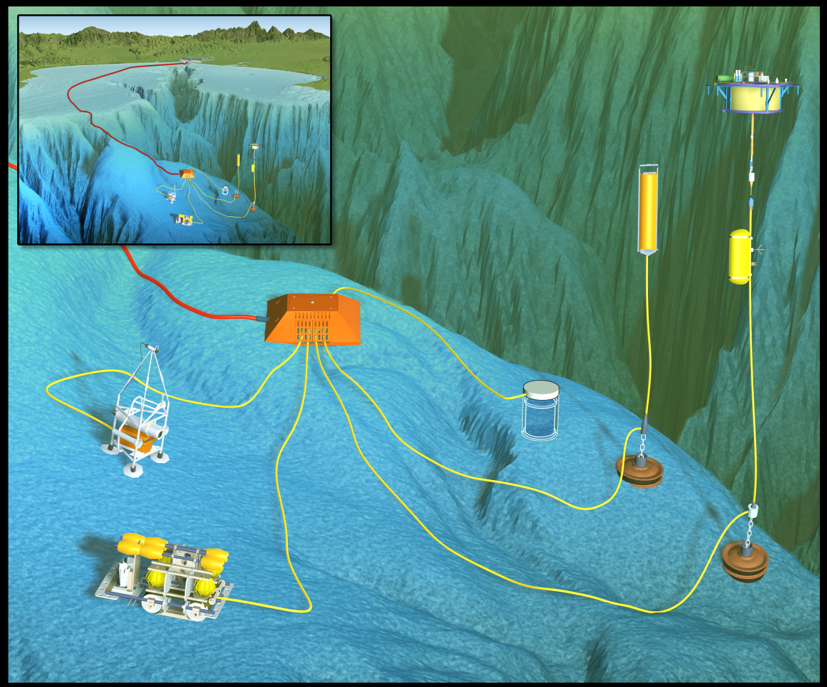
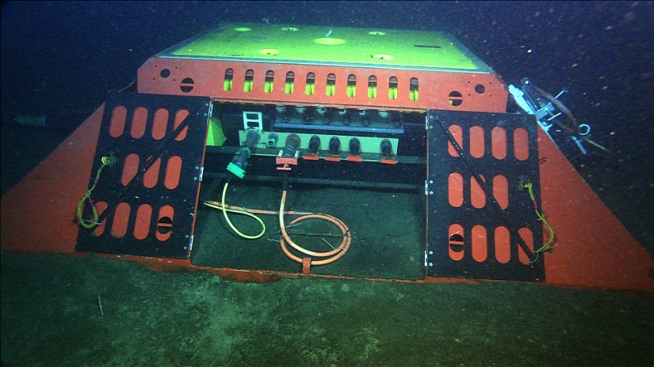
The Monterey Accelerated Research System
Originally conceived as a test bed for instrument development
Opportunity to gain early experience in observatory operations
8X Science ports
100 Mbit/sec Ethernet at each port
6.5 kW of power total for science
Precision time distribution
Deep water - 890 meters
Accessible - 2 hrs from MBARI
Extended geographic coverage with extension cables
Support for a comprehensive workflow process – proposal through development, test, deployment, and operations
In operation since November 2008
Notes:
Introduction slide?

Slide 3
The Motivation for MARS
The US National Science Foundation was funding development of a new generation of high power and high bandwidth observing systems
Entraining and training the science community to use these new systems would benefit from an easy to use test bed
Gaining early experience in all aspects of observatory development and operation would yield a decent return on investment for future observatories
Helping the science community be successful at MARS and other observatories is the ultimate goal

Slide 4
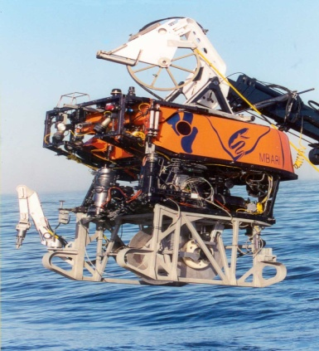
MARS Development Process
Overarching design goal: Entrain new and traditional users and make them successful at power on
We employed a covert System Engineering Process
  We tried never to use the term “System Engineering”
Step 1: Understanding what our users want and what they need
  Developed a spectrum of user scenarios: simple to “blue sky”
  Developed semi-formal user and design requirements
  Continually evaluate the design against the requirements and the user scenarios
The Cable laying (and now plowing) toolsled: An example of what our users want, geographic diversity, driving what we need to provide

Slide 5
MARS User Workflow
Overarching design goal: Entrain new and traditional users and make them successful at power on
Step 2: Understanding how our users work
  Proposal Preparation
    The critical step: No funding, no project
  Design, test, re-design, re-test in their lab
  Stage for pre-deployment testing in the MBARI test tank
  Test, modify as necessary at MBARI
  Stage for deployment, Deploy & Commission
  Operate and Maintain
    recover, redesign, re-deploy as necessary
  Data Management & Distribution
    Explicity not part of MARS scope

Slide 6
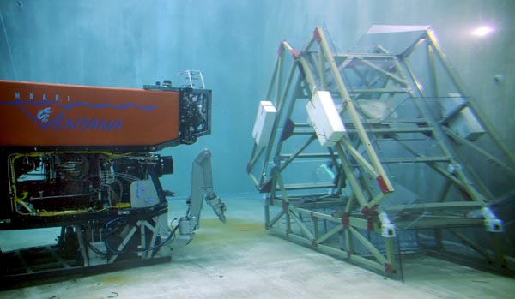
MARS↔Design/Test Cycle
Your deployment team talks to our MARS staff to work out deployment details
  Extension cables need a lot of interaction w/ocean engineers, ROV pilots and ship’s crew
Your network gurus talk to our network
We help make sure you order the right MARS interface cable
We support testing your system in the MBARI test tank using the MARS wet node simulator

Slide 7
MARS SCIENCE MISSIONS

Slide 8
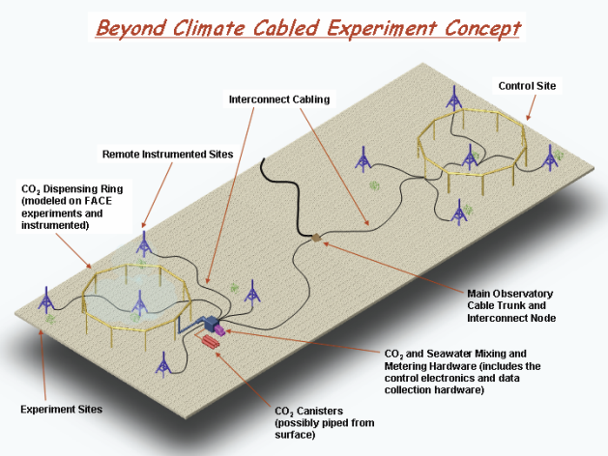

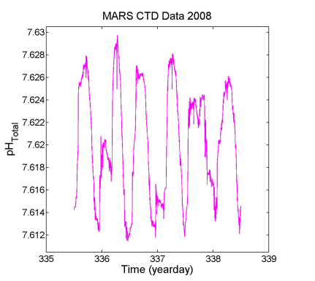
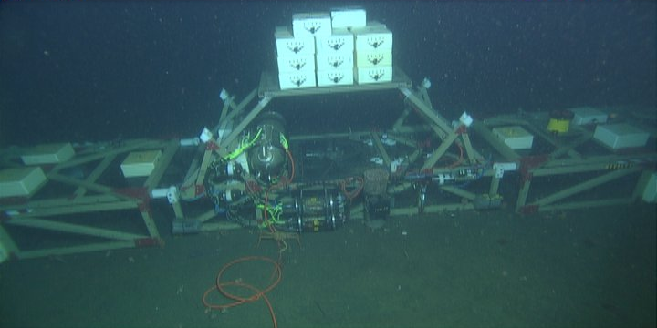
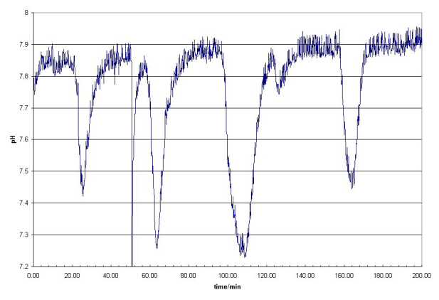
Free Ocean Carbon Enrichment Experiment
A controlled seafloor CO2 enrichment experiment
CO2 has no atmospheric chemistry, enrichment experiments are relatively easy to carry out on shore
In sea water, the slow reaction kinetics of CO2 perturbations require a long reaction path and solving the CO2 kinetic equations in real time

Slide 9
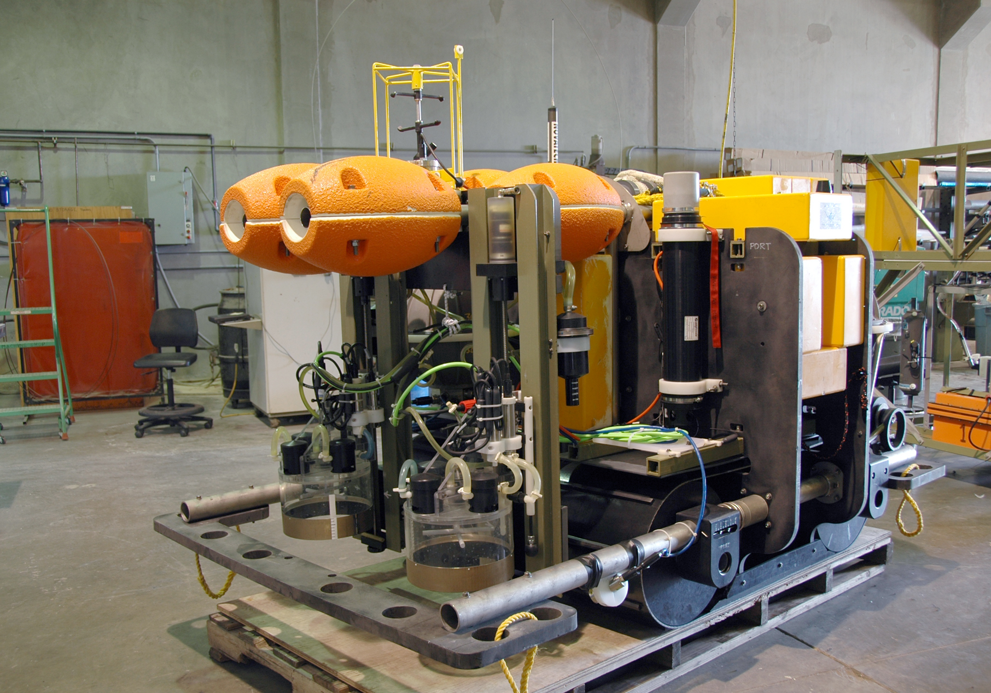
Benthic Rover
Current Meter
Respirometer
Chambers
Tracks
Video Cameras

Slide 10
Benthic Rover
ROVER Science Questions
  Food: What is the quality and quantity of particulate carbon reaching the seafloor?
  Population Response: What responses are elicited in the sediment community by arrival of particulate carbon on the sea floor?
  How do these ecosystem parameters change over time?
ROVER Measurements
  Sediment Community Oxygen Consumption
  Chlorophyll fluorescence of surface sediment

Slide 11
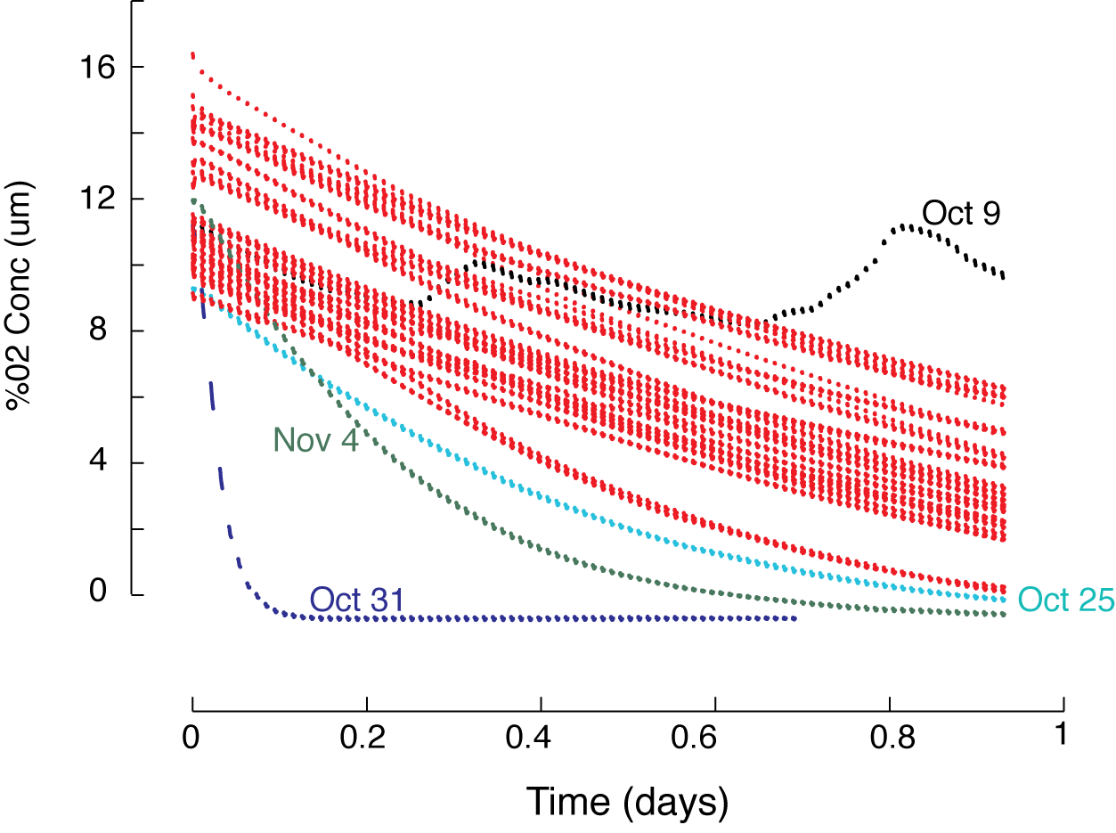
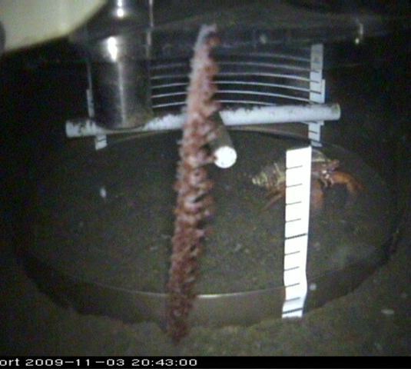
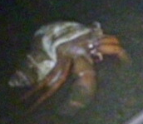
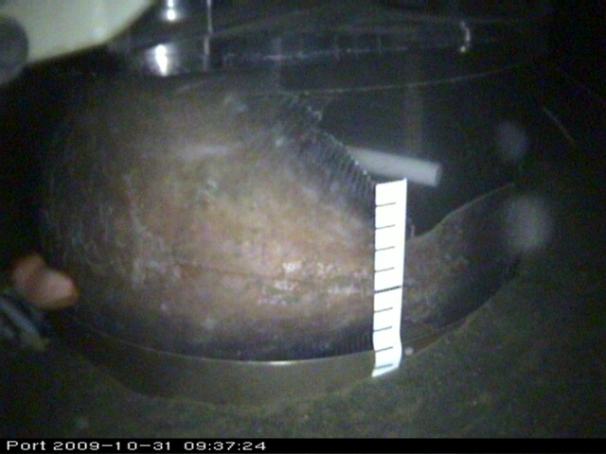
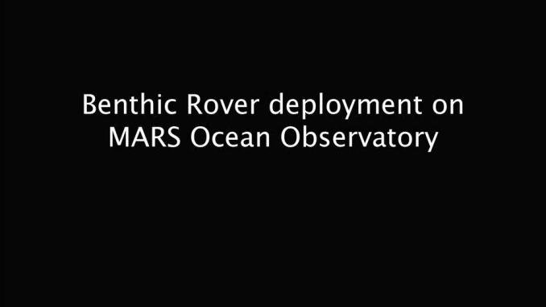
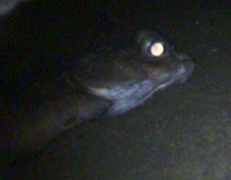
Rover Results
28 One day incubations
November 4, 2009
October 31, 2009

Slide 12
Deep ESP

Slide 13
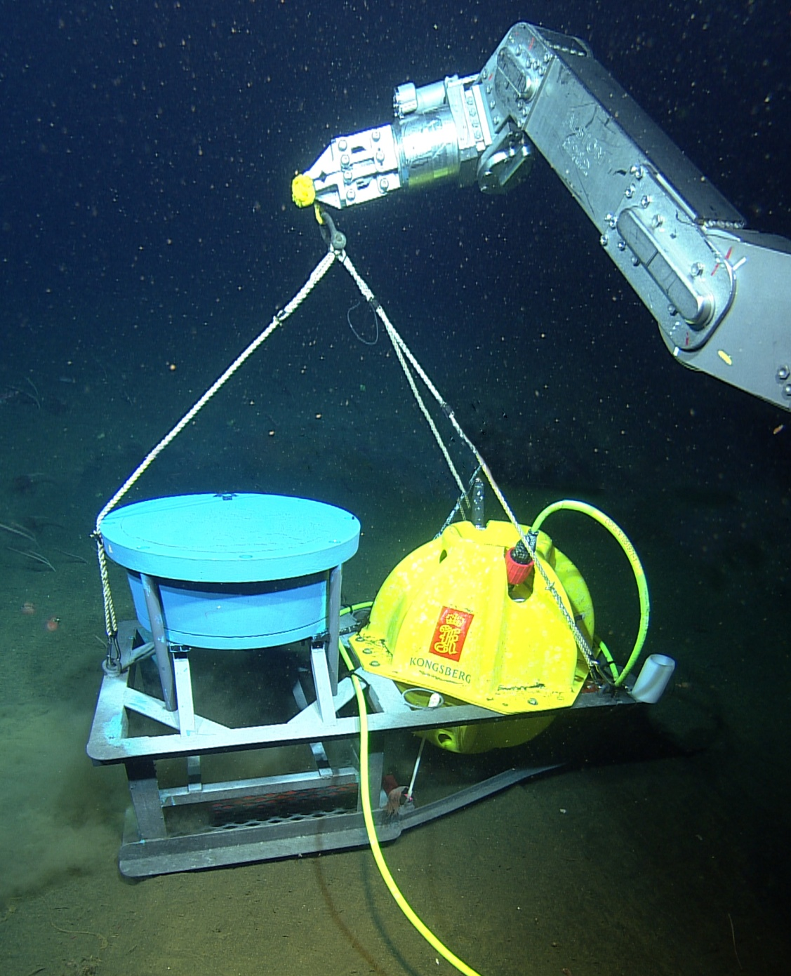
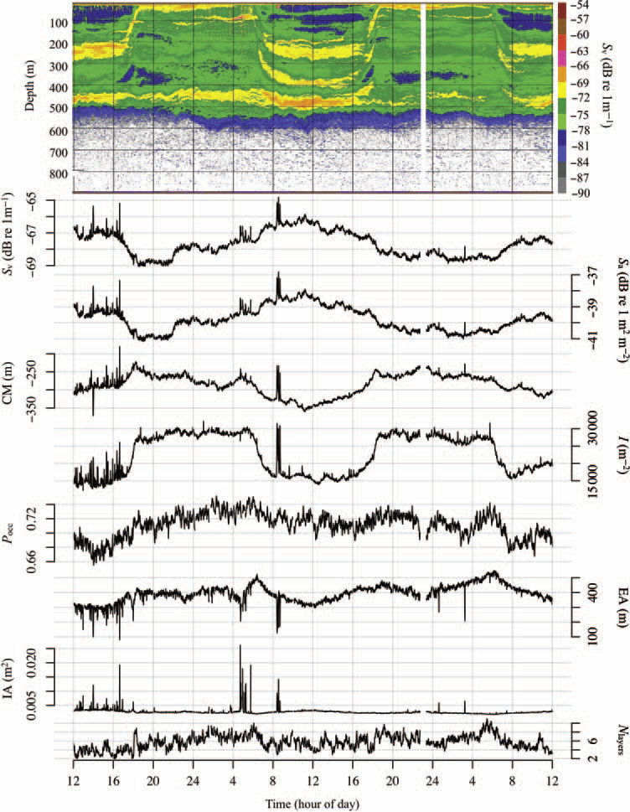
DEIMOS: Deep Echo-Integrating Marine Observatory System
Understand the daily vertical migrations of zooplankton, predator-prey interactions (e.g. whale-krill), biological flux
Echogram for 2–4 March 2009, with the corresponding metrics plotted below. From top to bottom, metrics are mean volume-backscattering strength (Sv), area-backscattering strength (Sa), centre of mass (CM), inertia (I), proportion occupied (Pocc), equivalent area (EA), index of aggregation (IA) and the number of layers (Nlayers).
Courtesy: John Horne, University of Washington
http://www.acoustics.washington.edu/DEIMOS/

Slide 14
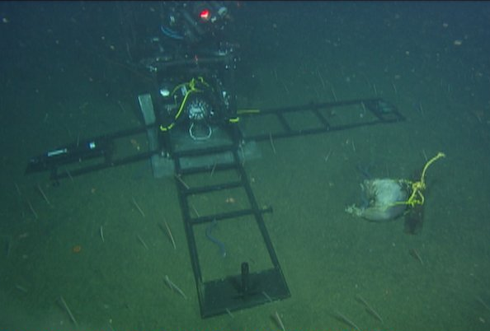
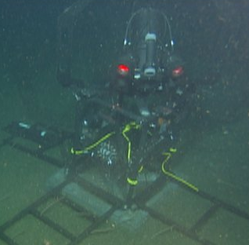
EITS: Eye-in-the-Sea on MARS
Record response to food falls and bioluminescence, observe new species

Slide 15
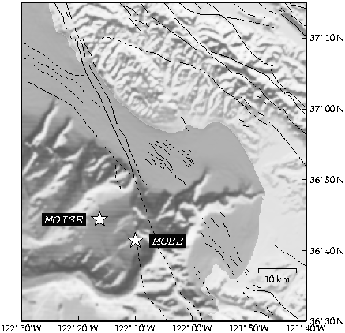
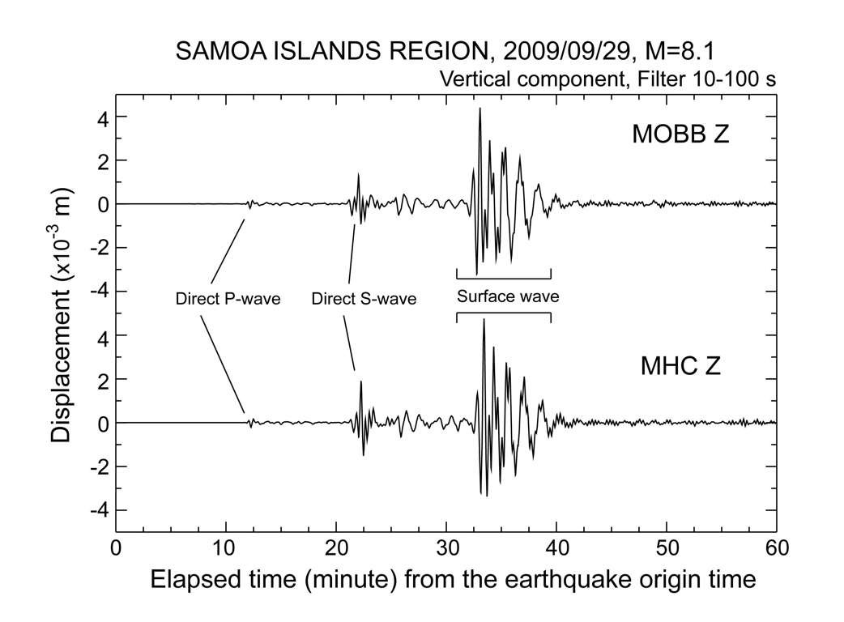
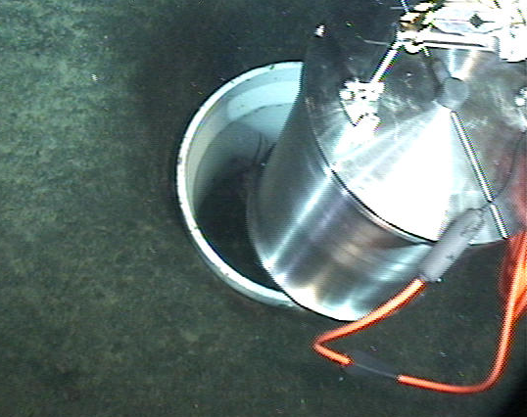
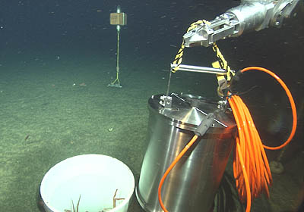
MOBB: Monterey Ocean Bottom Broadband Seismometer
Extend the range of the Northern California Seismic Network to the western side of the San Gregorio Fault Zone
http://seismo.berkeley.edu/bdsn/mobb.overview.html

Slide 16
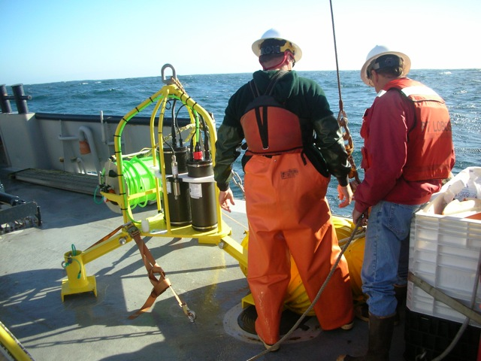
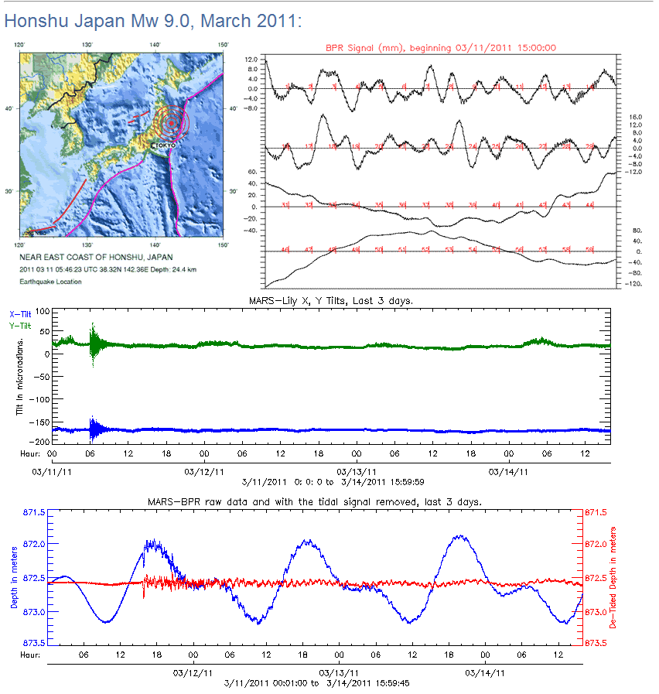
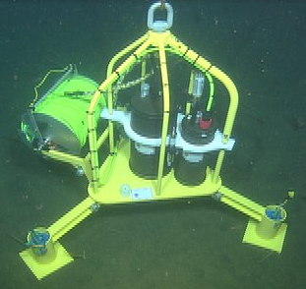
Bottom Pressure Recorder/Tilt Meter
Real time monitoring of submarine seismic activity
Courtesy: Oregon State University
NOAA Pacific Marine Environmental Laboratory
http://www.pmel.noaa.gov/vents/geology/mars/

Slide 17
Other MARS Science Missions

Slide 18
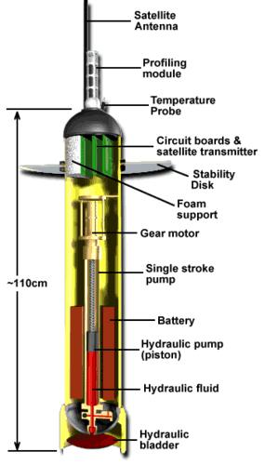
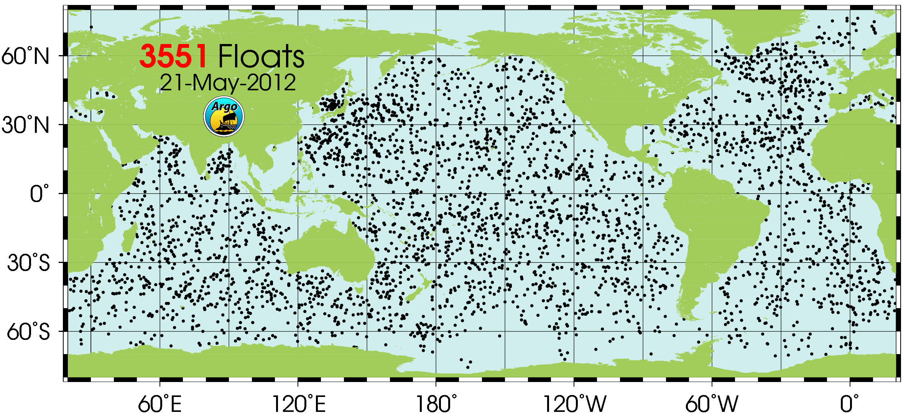
The Other End of the Ocean Observatory Spectrum
The Argo system is one of the few (maybe the only) global, 4D Ocean Observing System
Argo provides a quantitative description of the changing state and patterns of the upper ocean heat content and freshwater storage and transport
3500+ floats, $25K USD per float, maintenance = $0 USD float lifetime: ~4 years, system lifetime: decades
The system is being expanded to include biogeochemical measurements e.g., O2, nitrate, pH and bio-optical sensors

Slide 19
Thanks for listening
MARS is funded by the David and Lucille Packard Foundation and the US National Science Foundation
http://www.mbari.org/mars/
magene@mbari.org

