Slide 1
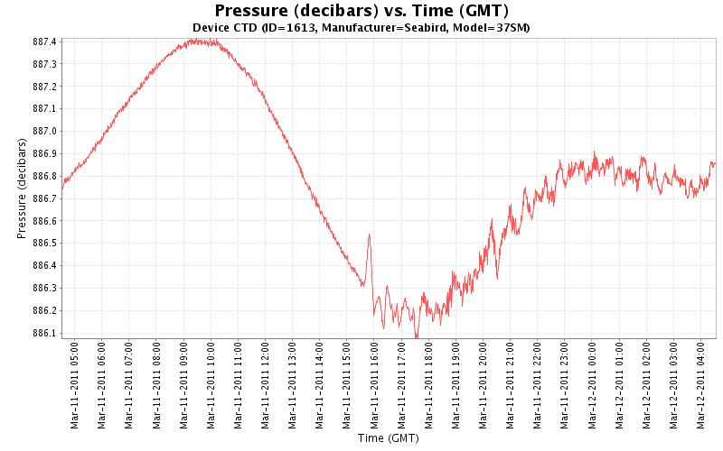
MARS-CTD showing tidal signal for 12 hours after first arrival of tsunami.
The pressure signal from the seiche in Monterey Bay will last a long time.

Slide 2
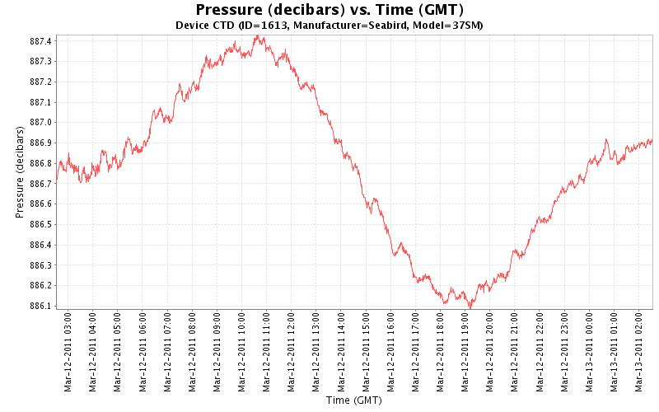
MARS-CTD showing tidal signal 11-34 hours after arrival of tsunami.
Seiche is still going strong the next day.

Slide 3
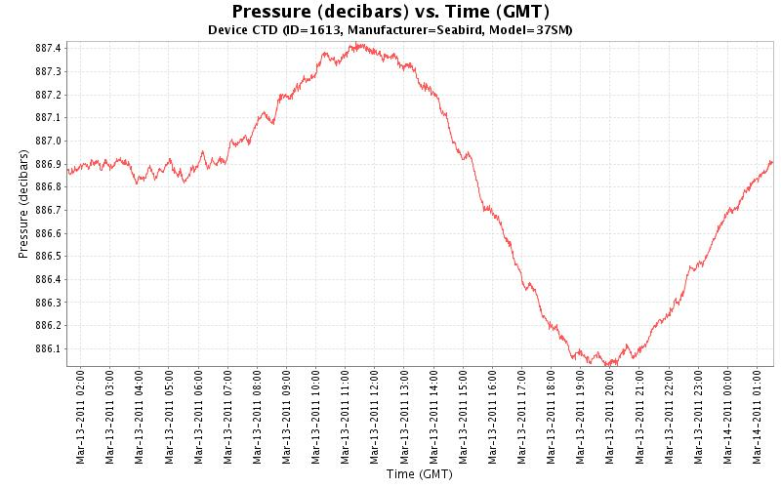
MARS-CTD showing tidal signal 35-58 hours after arrival of tsunami.
Pressure signal from seiche is still easily seen.

Slide 4
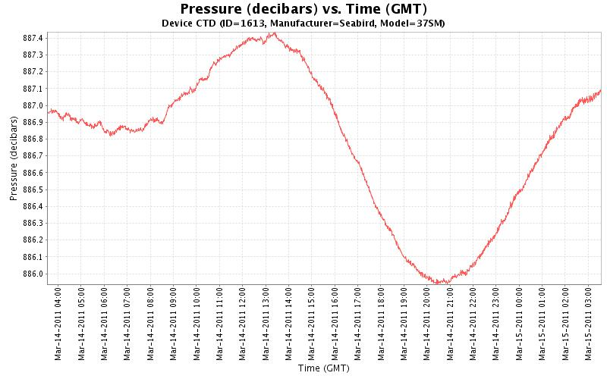
MARS-CTD showing tidal signal 60-84 hours after arrival of tsunami.
Pressure signal from seiche in Monterey Bay is dissipating.

Slide 5
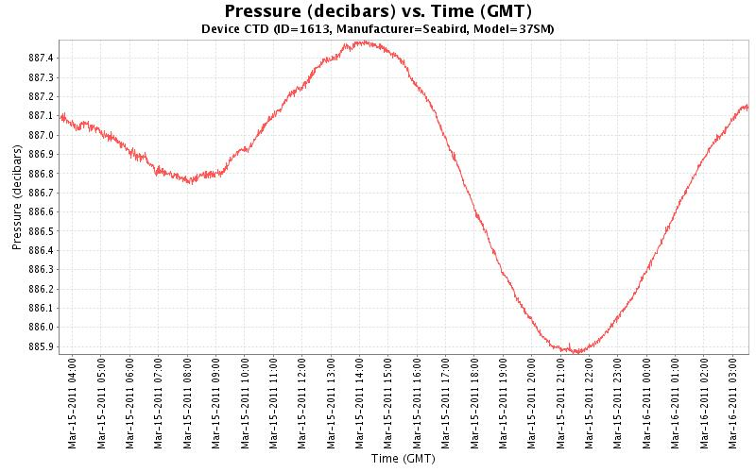
MARS-CTD showing tidal signal 84-108 hours after arrival of tsunami.
Pressure signal from seiche in Monterey Bay is finally gone.

