Slide 1
Academic/Industrial Partnerships for Developing High Reliability Oceanographic Research Systems: Lessons Learned
Gene Massion
MBARI
NSF OceanTech and Lesson Learned Workshop
Monterey Bay Aquarium Research Institute
Moss Landing, California
23-25 September 2016

Slide 2
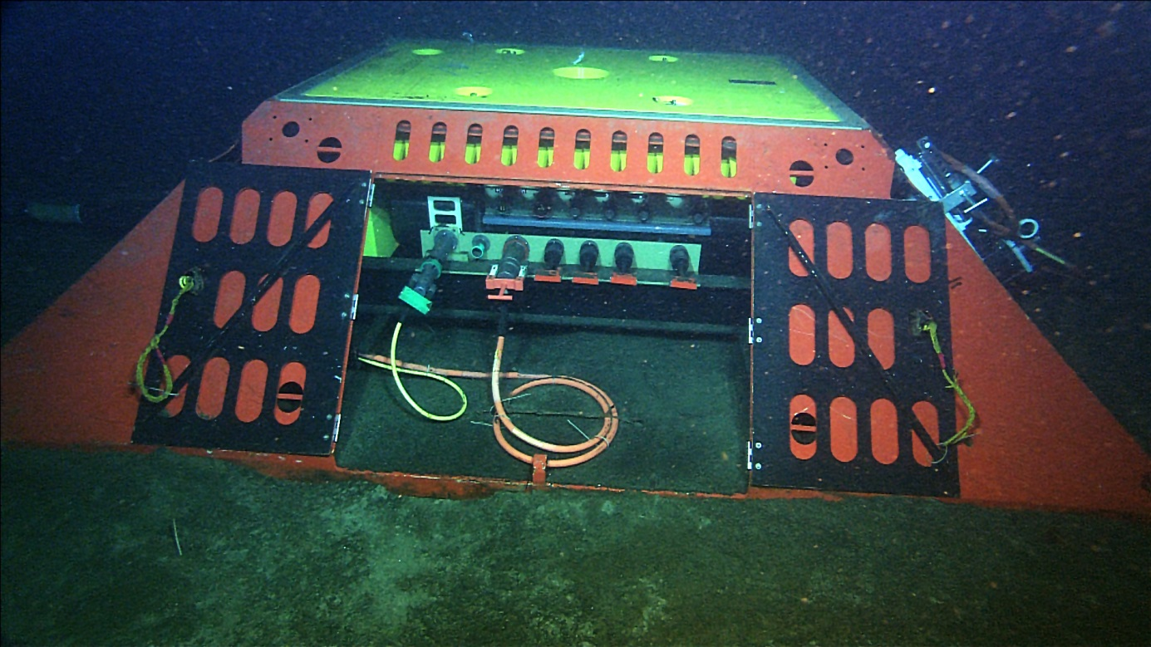
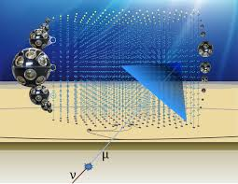
Problem
Academic Institutions developing high reliability Oceanographic research systems need to team with industry to cover all the engineering, installation, operation and maintenance skills needed to design, build, test, deploy and operate a successful system
MARS
The KM3NeT Neutrino Telescope

Slide 3
Description of the Problem
Research labs are really good at developing early prototypes of the instruments and platforms critical to our science mission
However, High Rel (HR) design ( high P(success) over the mission life) requires a range of expertise not generally found in every productive research lab including but not limited to:
  Extensive, effective system engineering including reliability analysis
  Parts, subsystem and vendor qualification
  Material selection based on past HR system experience
  Accelerated life testing and stress screening where appropriate
  Rigorous, documented test, manufacturing and QA/QC processes and staff trained to an appropriate standard
  Effective project management including legal and contract support
  A pervasive team culture and resources appropriate for the design of HR systems
Your 100 M$+ research system is not the place for your really creative, innovative research team to learn and then have to perform these skills
  However, it is a golden opportunity for your staff to upgrade and expand their skills

Slide 4
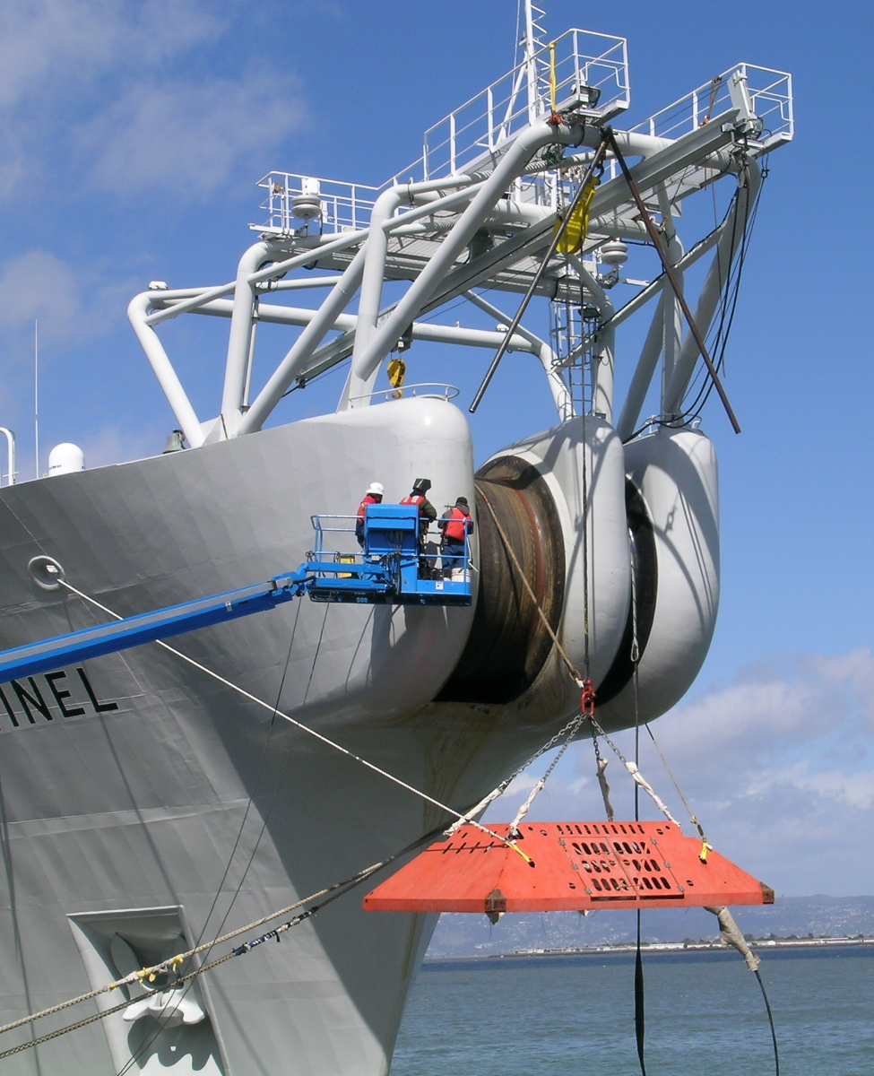
Solution
Build a team with the requisite expertise. It will probably include “for-profit” industrial partners.
  Recognize that for-profit entities need to make a profit
  Realize that even with a profit, there are many tasks that will still be more economical and sometimes only do-able by your for-profit partners
Make sure the right work is being done in the right place, by the right people, at the right time with the involvement of all the right team members
  Manufacturing of high reliability systems needs to be done by a group with a culture of high reliability manufacturing e.g. use of ESD straps needs to be second nature
  The deployment engineer(s) needs to be involved at the right times in the design phase to ensure your gizmo can be put over the side with a high P(success)
This is not an example of proper, prior planning

Slide 5
The MARS Medium Voltage Converter
A Quick Case Study
The most (and maybe only) new engineering challenge on MARS was the MV converter
The original design for the novel DC/DC converter circuit came from a former University Professor working in a research lab at JPL
  Every EE who has looked at this design is somewhere between very and wildly impressed
UW and JPL were funded to develop the first prototype of the MV converter and later funded to develop a deployable MV converter for MARS
Alcatel was eventually contracted to finish the MARS MV converter and subsequently delivered MV converters to NEPTUNE-Canada
LESSON LEARNED: Hardening of the MV converter design by the right partner should have been part of the plan from the beginning

Slide 6
Alcatel’s Process
4 stages of prototype development with several levels at each stage
Each stage had a well defined goal
  Stage 1: Prove the risky parts of the design work
  Stage 2: Build a fully functional but not necessarily deployable system
  Stage 3: Build a fully function deployable system that has most of the design required to meet the reliability and manufacturing requirements
  Stage 4: Build the fully engineered first article ready for production manufacturing
Used existing, proven parts, circuits and subsystems wherever possible
Started parts and vendor qualification for known, new parts early
Started the manufacturing engineering early in the process
The problem was not the new DC/DC circuit. It was all the ancillary control circuitry required to demonstrate a stable, fully functioning, 20 year life MV converter. And then building a deployable version with a reasonable probability of lasting 20 years
Because our time frame forced us to accept an early stage 3 converter (maybe late stage 2) we did not get a full performance, 20 year system. But everyone knew this and we developed an upgrade plan with Alcatel

Slide 7
High Reliability Engineering
Theory 1: The number of systems you’ve successfully fielded that have met a X year mission life requirement is a good indicatory of your P(success) in designing an X+5 year
Theory 2: If you don’t know what a FIT is, your P(success) in designing a HR system is probably low
A system designed for high reliability need to be analyzed to predict expected Failures in Time (1 FIT = 1 failure in 1 billion hours ~ 114,000 years)
  Submarine telecom repeaters are of order 10 FITs
Once the FIT rate for the system and subsystems is known, the probability of surviving the expected mission life can be estimated
  Problematic parts can be replaced and problematic subsystems can be redesigned
  Appropriate redundancy can be added
Single point failures must be identified and addressed
  Putting 2 subsystems in parallel does not necessarily double the system life
This kind of analysis is pretty straight forward but incredibly boring
  Except the serial/parallel topology analysis we did for the proposed 35 node, interconnected early NEPTUNE system was challenging and kind of fun
Building a culture that accepts RE as a fundamental part of the process is hard

Slide 8
Lessons Learned I
Industrial, for-profit companies are (probably) a necessary evil
Contracts have to include explicit, comprehensive technical requirements and spell out the appropriate
  Design reviews
  Status reports
  Performance milestones and demonstrations
  Design analysis reports
  Deployment plans
  Failure reports
  Risk matrices
  Subsystem acceptance tests
  Factory acceptance tests
  System integration tests
  Pre-deployment tests
This is not an easy or quick task
  Ex. Req’t: Everything needs to ship on a truck that can make it across “the bridge”
  Performance goals over and above the minimum requirements are OK

Slide 9
Lessons Learned II
You need staff who can knowledgably assess progress and P(success)
  Make sure you have knowledgeable staff review plans and reports, witness performance demonstrations as well as all acceptance tests
  Knowledge needs to include some familiarity with high reliability design best practices
Stick to the contract
  When the cable ship’s captain asks if it is OK to deviate from the carefully engineered cable slack schedule or lay cable outside the carefully permitted cable route; it’s nice to be able to say “I’d like to give you a break but we have to stick to the contract your company signed”
  Contracts mods happened but they can be incredibly expensive
Trust but verify
  Forgetting one quick, simple test from a 3 day factory acceptance test can (and probably will) sink your perfect prepared plan

Slide 10
One Lesson Probably Worth Learning
We keep reporting the same incredibly expensive ground fault, connector, corrosion, noise and similar mundane problems
Shouldn’t we learn that some “expensive” industrial practices actually pay for themselves?
    Reliability analysis
    Highly Accelerated Lifecycle Testing and Highly Accelerated Stress Screening
      Wouldn’t a community/industry connector test/qualification facility be nice?
    Dedicated Quality Analysis and Quality Control staff
    Dedicated test engineers and testing environments
      X-Rays are cheap and effective insurance for some issues
      Helium leak testing is not so cheap but highly effective insurance
      Most connector vendors have a pressure test chamber
      Design Engineers are different animals than Test Engineers are different than QA, …
    Shore side test systems
    A mature, proven, documented soup to nuts design, procurement, manufacturing, test, deployment process
    Economical, accessible wet test beds: MARS
    Accumulation and distribution of institutional knowledge

Slide 11
One Vision for an Optimal Development System
Criteria of optimality: reducing overall lifecycle cost over many decades for many Oceanographic research systems
Creative, innovative research labs
The community gizmo hardening group
Industrial Partners
1000’s of affordable high reliability instruments, platforms, systems, …
1
1
The missing link
2
2
N
N
Stage 1 or 2-ish Prototype
Stage 3 or 4-ish Prototype

Slide 12
Acknowledgments
MARS was funded with generous support from the David and Lucille Packard Foundation and the US National Science Foundation
The MARS team included MBARI, the University of Washington, the Jet Propulsion Laboratory, the Wood’s Hole Oceanographic Institution along with our industrial partners Alcatel and Maripro
http://www.mbari.org/at-sea/cabled-observatory/
Google: “MARS observatory”

Slide 13
A Few Of Our Other “Failures”
The ODI HV connector failure resulted in a complete recovery of the node and TRF and redesign of the connector
The LV subsystem had to be rebuilt to address workmanship issues
Integration of MARS into other observatory’s instrument development process
A Few Of Our Successes
A modestly rigorous instrument checkout process using the MARS wet node simulator in the MBARI test tank uncovered lots of issues many of which would have been fatal but were easily fixed
The ROV (extension) cable laying toolsled hardware and process
Zero instrument failures on initial power on

Slide 14
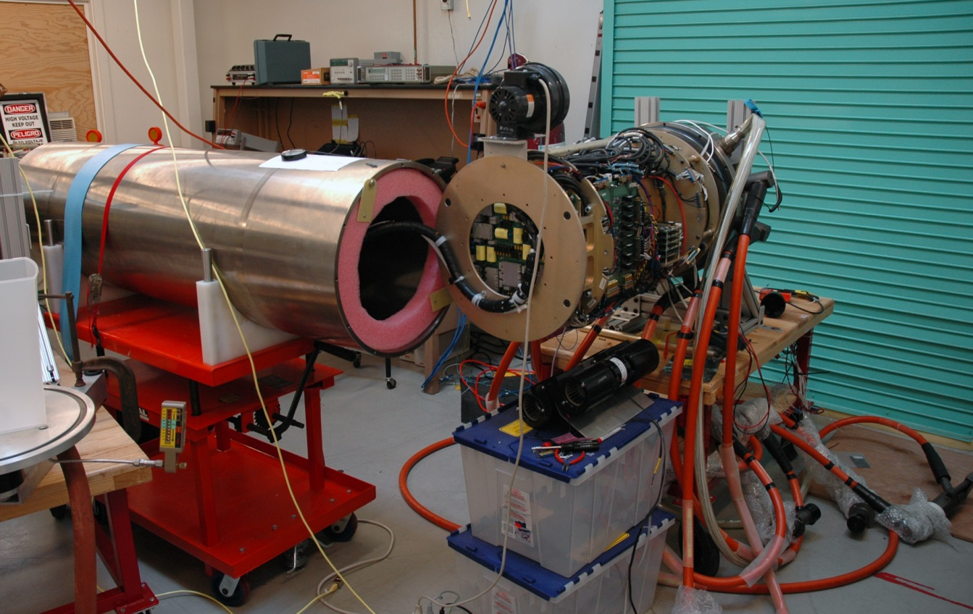
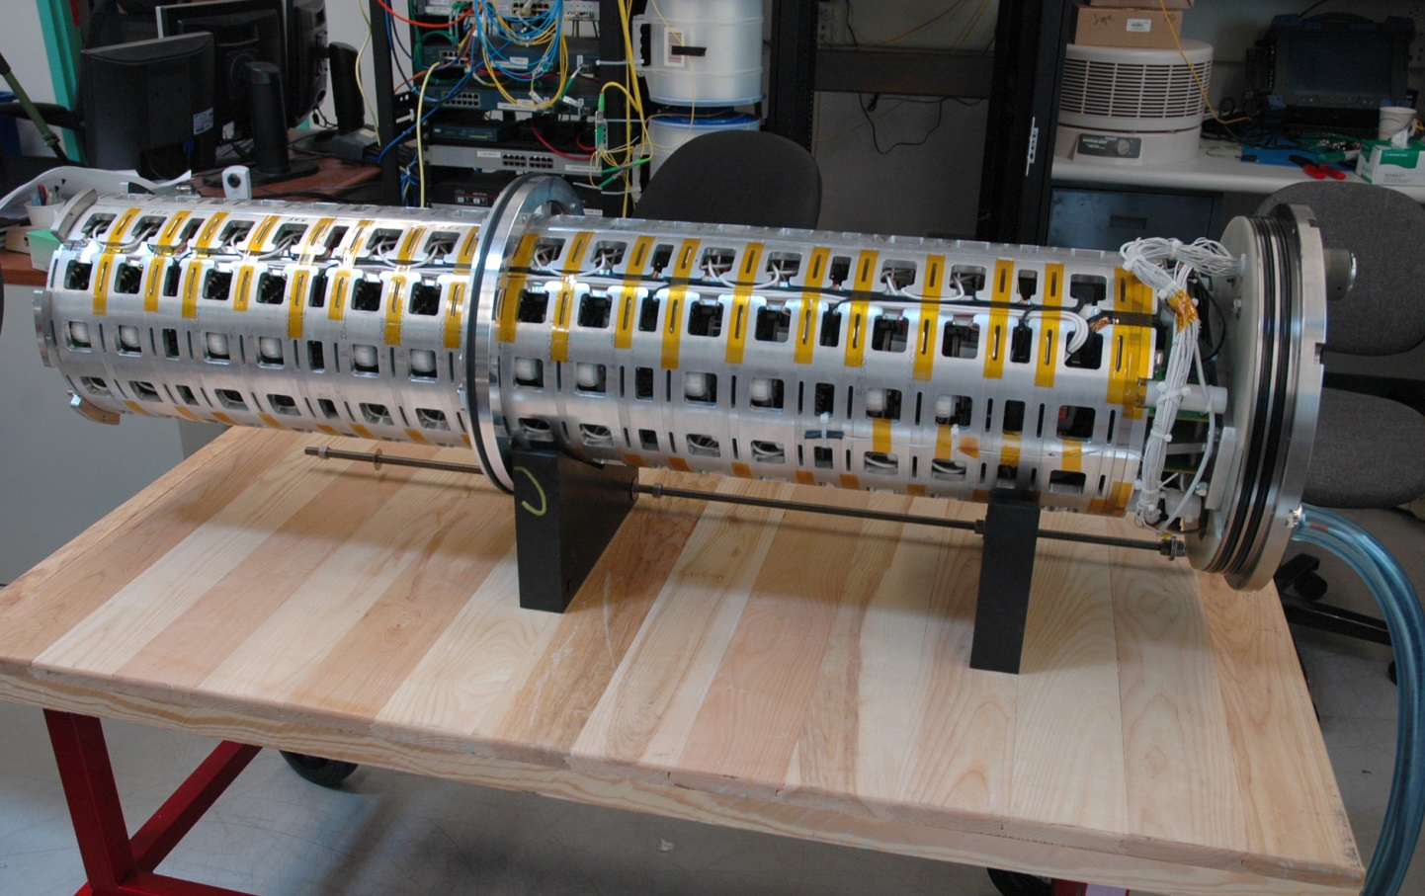
MARS Electronics
MV Converter
Comms and LV Power Distribution

