Slide 1
Wireless Power for MARS
2016
Thom Maughan
Paul McGill
Craig Dawe

Slide 2
Accomplishments for WPDX Medium Power
Implemented the MBARI patent and demonstrated proof of concept to 690m on ROV Ventana 21 June 2016
  100Mbps Ethernet with ethernet IP camera
  150 Watt power transfer demonstrated using LED lights
  Load management with ROV pilot status indicator lights indicating ‘power good’
Plugged and unplugged the Wireless Power and Data transfer connector as the ROV transited down – 4 cycles.
  Issue: Due to high humidity affecting urethane potting compound, we had a potting failure at 690m on the transmit side.

Slide 3
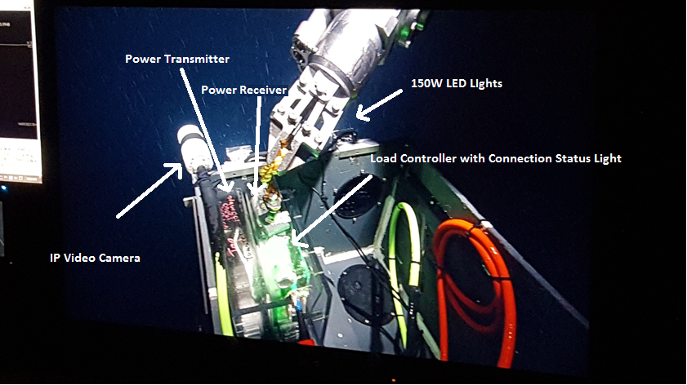
Wireless Power and Data Transfer (WPDX) ROV Test 21 June 2016

Slide 4
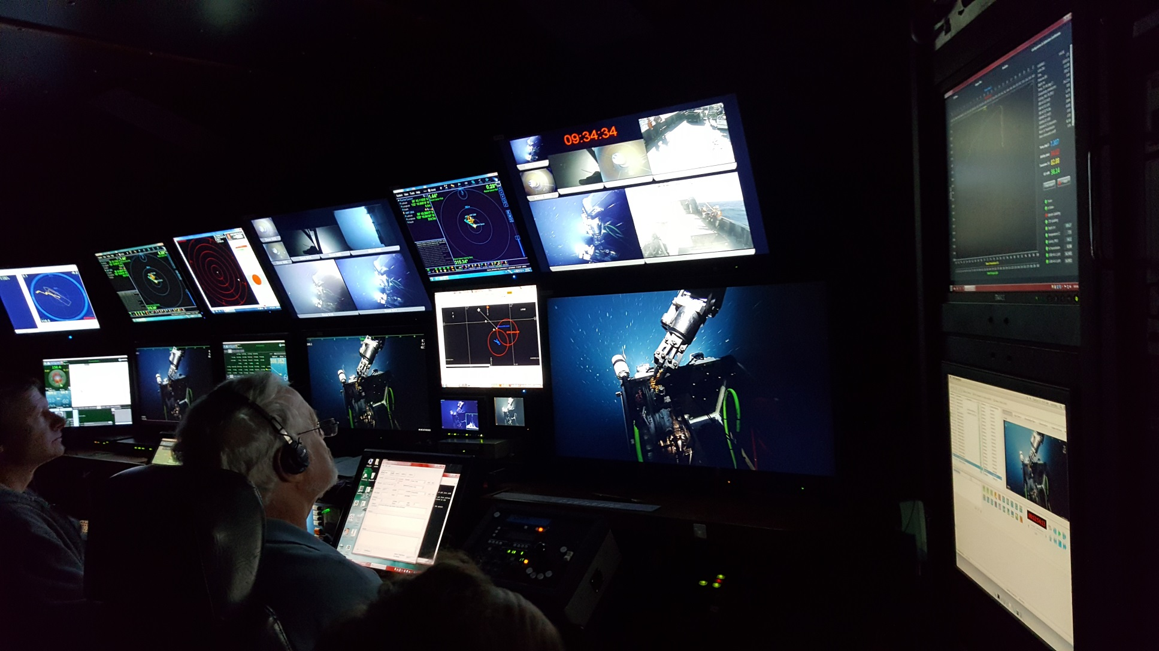
Connect / Disconnect Cycles
During Descent
Steve Etchemendy came out for the demonstration

