Slide 1
MARS Seafloor J-Box Power Electronics Replacement
Concept Design Review
CoDR Meeting: Apr 28, 2021
Document Updated: June 24, 2021
Notes:
Tim ->

Slide 2
Updates Since Apr 28, 2021 CoDR
June 9, 2021
  Removed requirement for 48VDC on Science Connectors – 375VDC only
  With removing the 48VDC from the Science Connectors, there are enough pins (8) for 1000BaseT Gigabit Ethernet – so will use that instead of 100BaseT
  The 1500VDC Medium Voltage Converter will consist of two 1500VDC/4A converters. Each will power 4 Instrument Interface Boards/Science Connectors. Both will be diode ‘OR-ed’ into the Hotel Power Board
  The Hotel Power board loads all appear to be either 5VDC or 24VDC, so those may be the only voltages required
  Hotel Power Board needs to be able to switch 3-4 24VDC loads and monitor the current on the 5VDC and 24VDC busses.
June 17
  Added updated Block/Wiring Diagram
  Made some updates to the board names
  Minor changes to deliverables
  Added J-Box Controller MTBF info
Notes:
Tim ->

Slide 3
Updates Since Apr 28, 2021 CoDR
June 24, 2021
  General edits and updates
  Added pages for MVPS & MVC
  Added page for System Integration Plan
  Removed edits from the previous version
Notes:
Tim ->

Slide 4
MARS Seafloor J-Box
The Monterey Accelerated Research System (MARS) was envisioned as a prototype seafloor J-Box for the NEPTUNE System which later evolved into NSF’s Ocean Observing Initiative Regional Scale Cabled Array (OOI-RCA)
UW/APL was funded by NSF to develop a prototype Power System for NEPTUNE which became the MARS Power System
The MARS J-Box was installed in Monterey Bay a water depth of 900m in 2008 and has been operating since
In 2020, MBARI submitted a proposal to NSF for funding for the refurbishment of the MARS J-Box and has asked UW-APL to provide the replacement low voltage power system
UW-APL plans to leverage the experience gained from the original MARS System and the OOI-RCA Power System, which is currently being used in different configurations in over 25 seafloor J-Boxes
MBARI has funded UW-APL for preliminary design
MBARI expects to find out the status of the NSF proposal in April/May 2021
Notes:
Tim ->

Slide 5
MARS Seafloor J-Box
Notes:
Tim ->

Slide 6
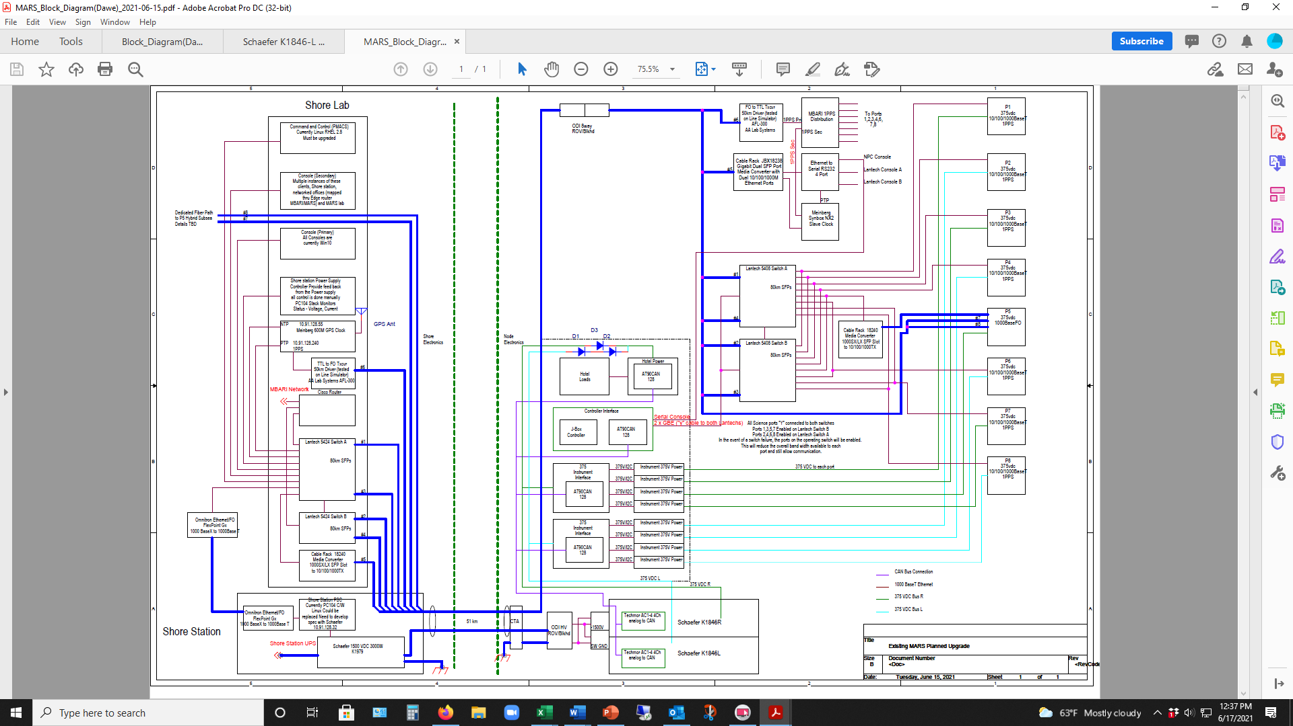
MARS
Schematic
(Preliminary)
MARS2
Schematic
(Preliminary)
Notes:
Tim ->

Slide 7
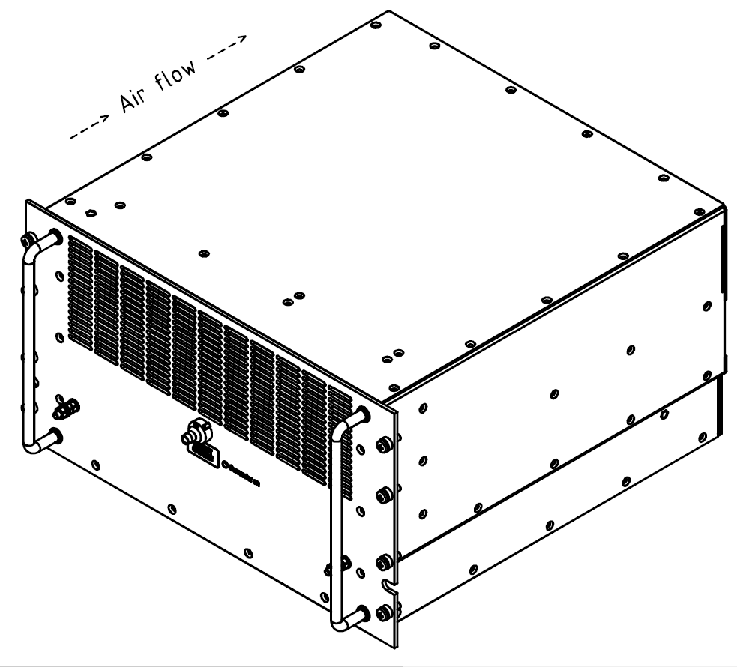
Shore Medium Voltage Power Supply
208VAC Input
1500-1800VDC/4.6A/8000W (max) Output
Controlled and monitored by MBARI Controller
Data provided to PMACS computer over network
Provided by MBARI
Notes:
Tim ->

Slide 8
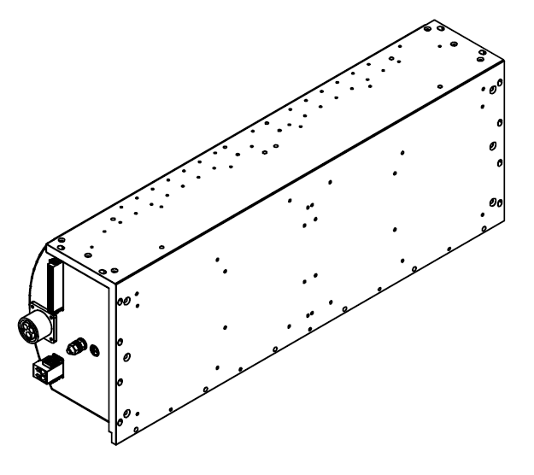
Medium Voltage Converter
1200-1600VDC Input
375VDC/4A/1500W Output
Two separate converters
Each MVC will power 4 Science Connectors
Both converters will be diode OR’ed to power the Hotel Power Board
  Need to confirm voltage stability with load changes and possible oscillation between converters
Input and Output Voltage and Current Monitoring will be done with CAN Enabled controller and transmitted to Node Controller
Provided by MBARI
Notes:
Tim ->

Slide 9
MARS J-Box Power System Block Diagram (Preliminary)
Notes:
Tim ->

Slide 10
Vicor DC-DC Converters
MARS & OOI-RCA low voltage power systems make extensive use of Vicor DC-DC Converters
Vicor converters are high quality, high reliability components with long track record of use at APL
A disadvantage of the Vicor converters is that they have a variable switching frequency that changes with load
Multiple converters can generate conducted and radiated switching noise over a broad, variable frequency range which is difficult to filter effectively
Notes:
Tim ->

Slide 11
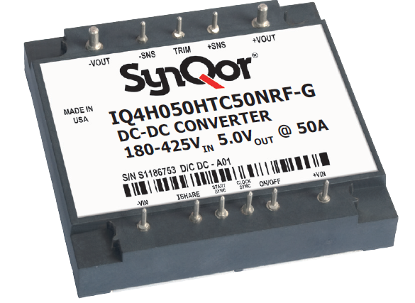
SynQor DC-DC Converters
SynQor makes comparable DC-DC Converters with standard footprints and pin-outs
The SynQor converters operate at a fixed switching frequency which allows easier and more effective filtering of switching noise
Some SynQor converters can also be synchronized to an external clock – potentially allowing the converters to operate at the same frequency and in phase with each other
More research is required, but SynQor DC-DC Converters will be considered for use in the MARS J-Box Power System
Notes:
Tim ->

Slide 12
Hotel Power PCB Board (HPB)
Existing PCB provides 375VDC to 48VDC (300W) conversion for hotel loads and Instrument Ports
Need to modify for 5/24VDC Converters for the MARS Hotel Loads
Critical loads always powered
Lantech switches & Meinberg Sync Box have power switching
Bus current monitoring on 5/24VDC circuits
Features active over-voltage protection
  Input Pass FET shuts off ~420VDC
CAN Enabled Atmel MPU
  CAN Bus Link to Controller Interface Board
Assume ~20 Hotel Loads (Preliminary)
  2 x Ethernet switches (24VDC)
  J-Box Controller (5VDC)
  Mienberg Sync Box N2X (24VDC)
  FO to Ethernet Media Converter (5VDC)
  Ethernet to FO media Converter (5VDC)
Ethernet to Serial Converter (24VDC)
FO to TTL Conv AFL-300-DIG-SM (24VDC)
1PPS Timing Distribution Board (5VDC)
Schaeffer MVC Monitor (24VDC)
LVPS Eletronics (5VDC)
Notes:
Tim ->

Slide 13
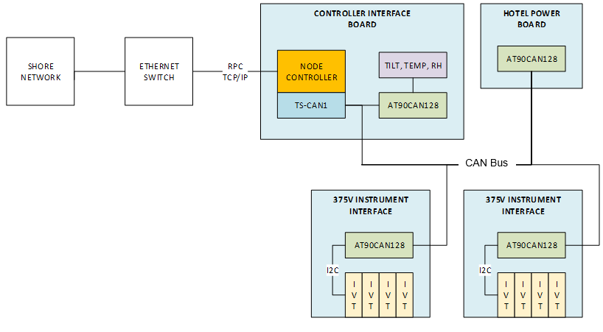
Control Electronics
Controller Interface Board
  PC/104 Node Controller
  CAN Enabled Atmel MPU
  Environmental/Engineering Sensors
  Ground Fault Detection circuit
Hotel Power Board
  Hotel load switching
  Load current monitoring
375V Instrument Interface Board (2)
  4 I²C channels per board for control & monitoring of Remote Instrument 375V Power boards
  CAN Enabled Atmel MPU
Notes:
Tim ->

Slide 14
Controller Interface Board (CIB)
Hosts J-Box Controller
  PC/104 Form Factor, ATOM CPU
Provides Engineering Data
  Temperature, Humidity, Pressure, Tilt
Ground Fault Detection Circuitry
  Single measurement circuit
  Access to all the individual isolated instrument ports (+/-) via high impedance switches as well as the common 375VDC bus
Notes:
Tim ->

Slide 15
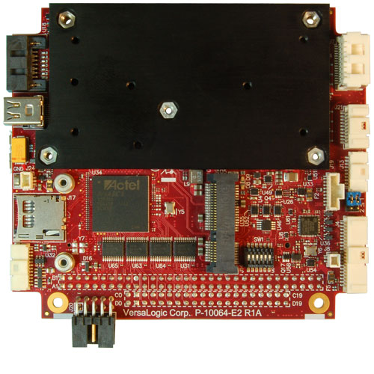
J-Box Controller
Versalogic BayCat VL-EPM-31
  Versalogic Ocelot CPU used in OOI-RCA systems is at end of life and not recommended for new designs
PC/104-Plus Form Factor
Intel Bay Trail Atom E3845 (quad core)
Two 1GbE ports (10/100/1000 autodetect)
8 GB DDR3L SDRAM
I2C, SPI Interfaces
Operating Temp: -40° to +85°C
Shock/Vibration: MIL-STD-202G
Debian Linux Operating System
Notes:
Tim ->

Slide 16
J-Box Controller Reliability
Versalogic BayCat VL-EPM-31ECP
  4 Core CPU 1.91GHz
  Extended Temperature
Analysis Detail
  Environment – Ground, Benign
  Model – MIL-STD-217FN2
  Method – Component Stress
Mean Time Between Failures (Hours) 291,647
Failure Rate (Failures/Million Hours) 3.428798
Versalogic Company Confidential - Not for distribution
Notes:
Tim ->

Slide 17
Instrument Interface Board (IIB)
Provides Power 375VDC/4A/1500W to Science Instruments via remote Instrument Power Board (IPB)
Command and control via CAN Bus to Controller Interface Board (CIB)
4 fully isolated Science Instrument ports per PCB
FETs provide power switching
Load switching control and current monitoring over I2C
In-rush current limiting via FET gate slew
Full isolation via mechanical relays
Fixed current amplitude and time trip levels
  Failover in case of software/DAC level control issue
Software settable current amplitude and time trip levels
FET driver current limiting
Notes:
Tim ->

Slide 18
Instrument Power Board (IPB)
Based on existing OOI-RCA 375V Expansion Board
FETS provides 375VDC @ 4A load switching
Inrush current limiting via FET gate slew
Gigavac mechanical relays provide full galvanic isolation
Controlled and monitored over I2C by 375V Instrument Interface Board (IIB)
Remote mounted on heat sink
Notes:
Tim ->

Slide 19
Printed Circuit Boards (Preliminary)
Hotel Power Board - HPB (1)
  375VDC to 5/12/24/48VDC
  Atmel MPU
Controller Interface Board – CIB (1)
  PC/104 CPU
  Environmental sensors
  Atmel MPU
Instrument Interface Board – IIB (2)
  Atmel MPU
Instrument Power Board – IPB (8)
  I²C control & monitoring
  Gigavac isolation relays
Modify OOI-RCA Hotel Power PCB (48V only) to add other voltages and additional control & monitoring
Modify OOI-RCA design to support new PC/104 CPU, Engineering Sensors and Ground Fault Monitoring
New PCB design based on OOI-RCA 48V Instrument Interface board
Modify OOI-RCA PCB design
Notes:
Tim ->

Slide 20
Environmental / Engineering Sensors
Environmental
  Temperature
    Internal PV air temp
  Humidity
    Internal PV humidity
    Surrogate for leak detection
  Pressure
    Internal PV pressure
  Tilt
    Node Deployment
    Detect External Aggression (ie. trawl or other)
Engineering
  Voltage Monitoring
    375V Instruments
    Hotel Loads
  Current Monitoring
    375V Science Instruments
    Hotel Loads
    Ground Fault
  Temperature Monitoring
    DC-DC Converters
    Load Switching Pass FETs
Notes:
Tim ->

Slide 21
Ground Fault Detection
Circuitry on Controller Interface Board (CIB)
Uses Seawater Ground Reference Electrode for primary GF measurement
Can use Pressure Vessel for secondary GF diagnostics
Can short RSE to PV
Can measure voltage between RSE and PV
Plan to use Sampled GF System vs. Continuous Measurement
  Eliminate continuous measurement circuit induced leakage currents
  Mechanical relays allow for isolation
Measured by ADC and passed over the isolation barrier via I2C isolator IC
Notes:
Tim ->

Slide 22
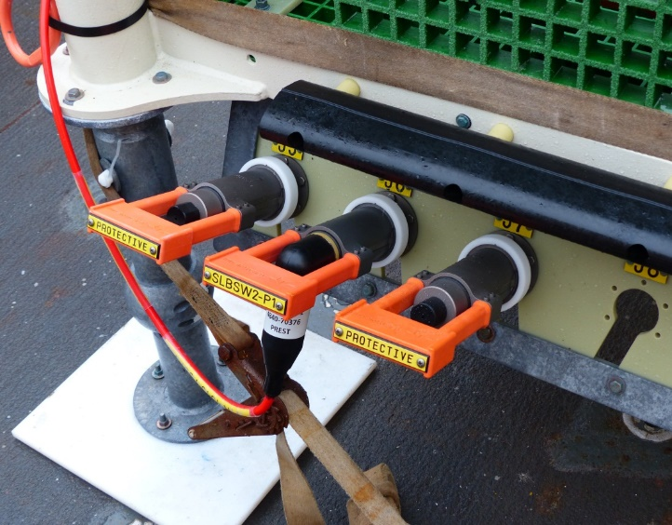
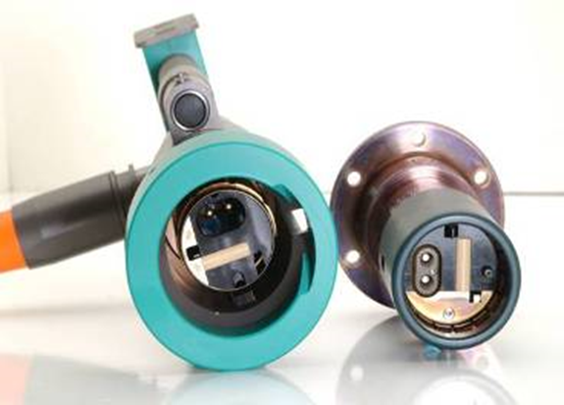
MARS Science Connector Wiring (Prelim)
Ports 1, 2, 3, 4, 6, 7, 8 (Electrical 12-Way)
  Pin 1 BI_DA+
  Pin 2 BI_DA-
  Pin 3 BI_DB+ Gigabit
  Pin 4 BI_DC+ Ethernet
  Pin 5 BI_DC-
  Pin 6 BI_DB-
  Pin 7 BI_DD+
  Pin 8 BI_DD-
  Pin 9 375V (+187VDC, relative to seawater)
  Pin 10 375R (-187VDC, relative to seawater)
  Pin 11 PPS+
  Pin 12 PPS-
Port 5 (Hybrid Electro-Optical)
  Pin 1 375V (+187VDC, relative to seawater)
  Pin 2 375R (-187VDC, relative to seawater)
  Fibers 1-2 Gigabit Ethernet over Fiber
  Fibers 3-4 Reserved (Continuous to Shore)
Notes:
Tim ->

Slide 23
Mechanical
The LVPS will re-use existing MARS titanium housing and endcaps
The LVPS will re-use parts from the existing aluminum internal chassis and will make modifications & additions to the chassis as needed
The replacement electronics will be significantly smaller than the original electronics so there will be more than enough space
One significant modification will be the thermal management of the power switching and conversion electronics by conductive cooling to the titanium housing
Will need to coordinate with MBARI for mounting the comms & networking hardware
Notes:
Tim ->

Slide 24
Power Component Heat Sinking
The OOI-RCA housings use a screw mechanism that pushes aluminum heatsinks with the power electronics against the pressure housing walls
Notes:
Tim ->

Slide 25
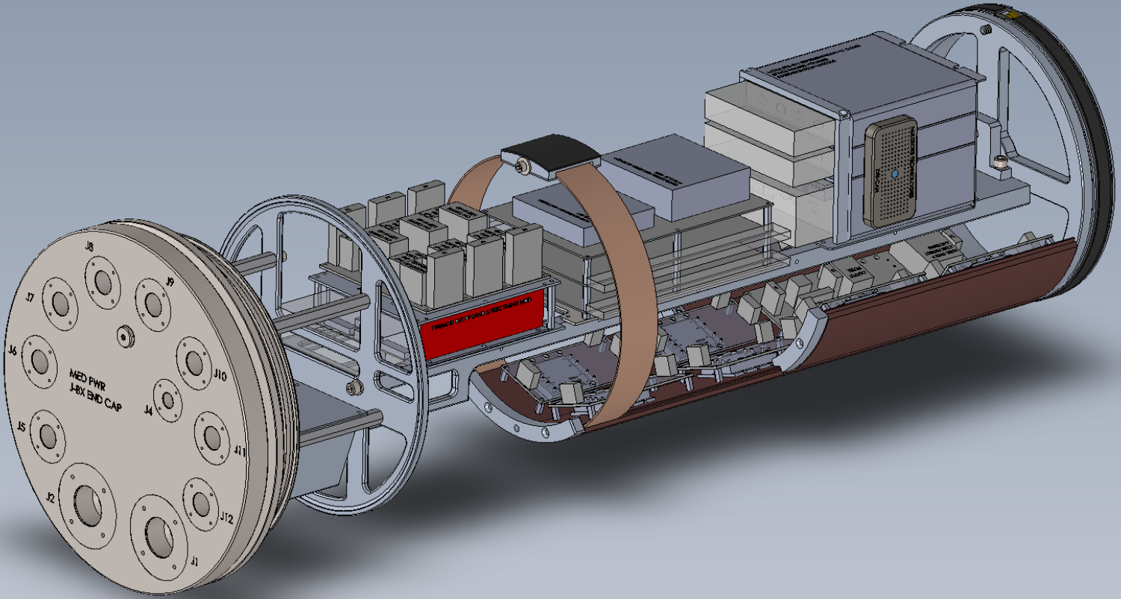
Power Component Heat Sinking
Notes:
Tim ->

Slide 26
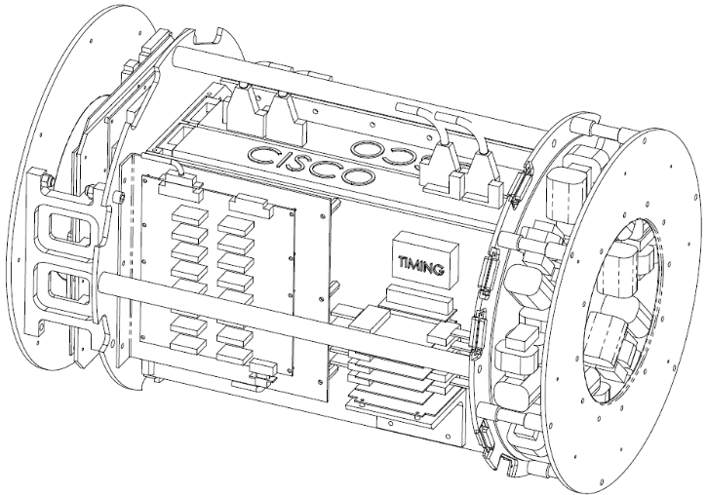
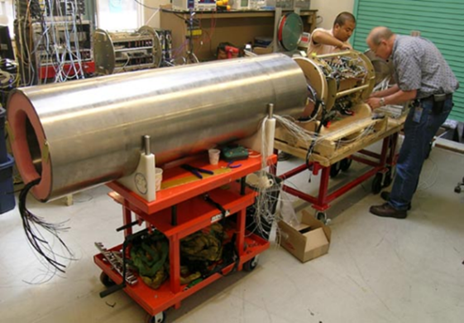
MARS LVS Chassis Logistics
UW/APL plans to modify the existing chassis to mount the MARS2 power system components add the capability of holding the heatsinks against the Pressure Vessel walls
Will need to coordinate with MBARI for mounting the communications & networking hardware
Notes:
Tim ->

Slide 27
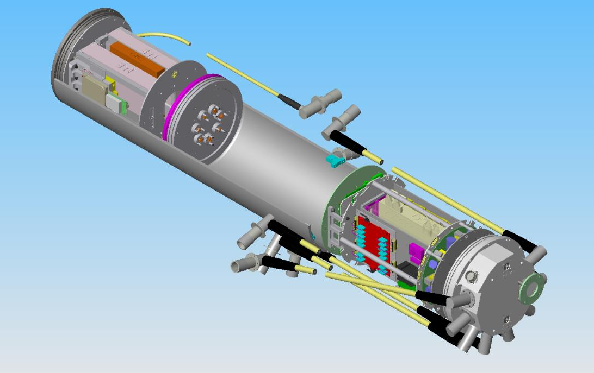
Existing MARS LVS Pressure Housing
Notes:
Tim ->

Slide 28
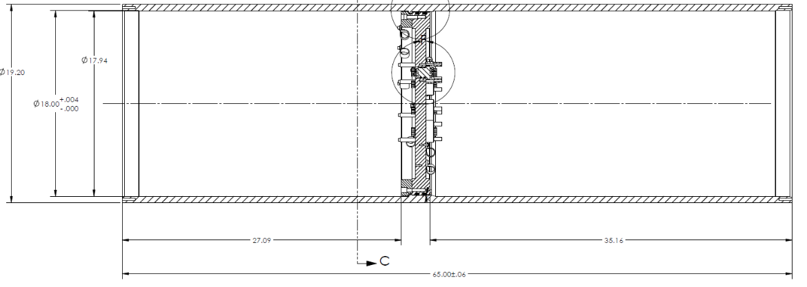
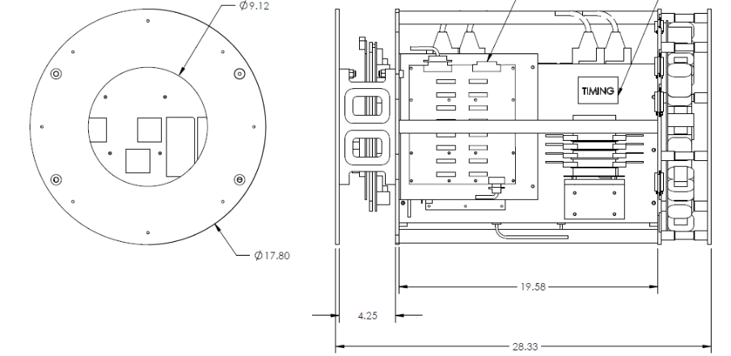
Existing MARS LVS Pressure Housing
Notes:
Tim ->

Slide 29
System Engineering
System Requirements
Interface Specifications
Test Procedures
Notes:
Tim ->

Slide 30
MBARI Deliverables
Shore 1500VDC Medium Voltage Power Supply (MVPS)
MVPS Controller
Shore Data Network & Communications
J-Box Data Network & Communications
J-Box Time Distribution System
J-Box 1500VDC-375VDC Medium Voltage Converter (MVC)
J-Box MVC CAN Bus Controller
J-Box Pressure Housings
J-Box Existing Pressure Housing Internal Chassis for Mounting Power Components for Modification
J-Box Underwater Connectors & Cables
J-Box Seawater Ground Reference Electrode
Notes:
Tim ->

Slide 31
UW/APL Deliverables
Shore Power Monitoring & Control System (PMACS) Computer & Software
J-Box Controller & Software
J-Box Low Voltage Power System Electronics
Low Voltage Power System Electronics Spares - TBD
Modification of Internal Chassis for Mounting LV Power System Components
Integration & Testing of Low Voltage Power System
Support for On-Site System Integration & Testing
Notes:
Tim ->

Slide 32
System Integration Plan
MBARI will send the following components to UW/APL:
  LV Pressure Housing internal chassis
  LV Pressure Housing Endcap with 8 science connectors
  Science Connector mating connector to allow access to conductors
The following components are not critical to completing the system development and testing but may be sent for full system testing:
  Medium Voltage Power Supply, with MBARI controller
  Medium Voltage Converters (2), with MBARI controller
  Components of the Data Network
  Mating cable and
Notes:
Tim ->

Slide 33
Hotel Power (1)
  375VDC to 5/12/24/48VDC
  Atmel MPU
Controller Interface (1)
  PC/104 CPU
  Environmental sensors
  Atmel MPU
48V Instrument Interface (2)
  Atmel MPU
375V Instrument Interface (2)
  Atmel MPU
Instrument 48V Power (8)
  I²C control & monitoring
Instrument 375V Power (8)
  I²C control & monitoring
  Gigavac isolation relays
Modify OOI-RCA Hotel Power PCB (48V only) to add other voltages and additional control & monitoring
Minor modifications to OOI-RCA design to support new PC/104 CPU
Modify OOI-RCA PCB to remove comms components
New PCB design based on 48V Instrument Interface board
Minor modifications to OOI-RCA PCB design
Minor modifications to OOI-RCA PCB design
MARS
Schematic
(Preliminary)
Notes:
Tim ->

Slide 34
MARS Seafloor J-Box
Control System
Concept Design Review
Apr 28, 2021
Notes:
Tim ->

Slide 35
Control System Overview
CAN Bus

Slide 36
Communication Busses/Protocols
RPC (over TCP/IP) - in-band command and control between Node Controller and Shore Computer
  Data: C&C requests, engineering data (V, I, Temp, etc), environment data
  Frequency: ~1 Hz
CAN Bus - interfaces Node Controller Computer with microcontrollers on sub-system boards
  Data: configuration, power control, returned data (instrument port Current, Voltage, Temp)
  Frequency: 15Hz – 2kHz
I²C – attaching engineering & env sensors to the system
  Environmental Data: Temp, pressure, humidity, tilt
  Frequency: 1Hz
  Engineering Data: Voltage, Current, Temperature
  Frequency: 15Hz-2kHz

Slide 37
Node Controller
Versalogic BayCat VL-EPM-31
PC/104-Plus Form Factor
Intel Bay Trail Atom E3845 (quad core)
Operating Temp: -40° to +85°C
Shock/Vibration: MIL-STD-202G
Debian Linux Operating System
  Conservative release cycles focusing on stability vs frequent releases
  Focus on stable packages
  Had least installation and configuration issues (RHEL4, RHEL5, Fedora)

Slide 38

Node Control Code
C++ using Qt Application Framework
  Powerful and convenient API for application development
  “Signals/slots” callback mechanism
  GUI building tools and widgets
Control application threads
  CAN bus thread
  RPC thread
  Main thread
    overall system control
    Engineering GUI updates
Linux SocketCAN API
  Provides a socket-like interface to the CAN hardware

Slide 39
Control Code Functions
Communicates with each board in the system
  Receives data from each board via CAN bus (Eng, Env, Status)
Controls sub-system boards:
  enables/disables instrument/expansion ports
  controls relays/enable pins for power and isolation
  Sets parameters/configurations on AVR
Provides interface (via RPC) to EMS
  Returns data (Eng, Env, Status)
  Executes commands -> controls sub-system boards
Provides GUI for development and diagnostics

Slide 40
Atmel AVR Code
Local management of each sub-system board
Runs “bare metal”, single-threaded app
Timer based interrupt triggers ISR which reads engineering data from instrument port channels: current, voltage, DC-DC converter temperature
Hardware-implemented CAN interface on AVR handles message RX/TX
Main loop:
  Sends CAN frame with engineering data if flagged by ISR
  Checks for incoming CAN frame, calls function to process frame, sends responses
  Reads GPIO pins to check for hardware over-current events
ISR
  Reads A/D converters attached via I2C bus to report engineering data (I,V,T)
  ISR rate can be varied from about 15Hz to 2KHz
  I2C bandwidth < CAN
  However, EMS will only be polling for engineering data ~1Hz

Slide 41
CAN bus hardware on AVR
AVR AT90CAN128 has a full-featured hardware CAN implementation
Running in interrupt-based mode it will receive CAN frames and set a hardware register to flag that new frame(s) are available
  Allows executing main code or ISR without missing frames
Hardware-based acceptance filters
  CAN is broadcast based (all nodes see all messages)
  Acceptance filters set up to ignore non-matching message IDs
  Allows AVR to be given an “address” and acceptance filter will ignore any messages not addressed to it – frees software from having to check if it needs to processes or ignore every single message in the system.
EEPROM in AVR holds its address. The address is used to create the acceptance filter and for the CAN ID for outgoing messages

Slide 42
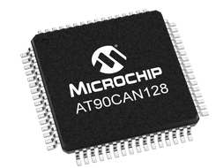
AVR AT90CAN128
8-bit AVR RISC-based microcontroller
128 KB ISP flash memory
4KB EEPROM
4KB SRAM
53 general purpose I/O lines
32 general purpose working registers
CAN controller (V2.0A/V2.0B compliant)
  1Mbits/s Maximum Transfer Rate
Real-time Counter
4 Flexible timer/counters with compare modes and PWM
2 USARTs
Byte oriented two-wire serial interface
8-channel 10-bit A/D converter with optional differential input stage with programmable gain,
Programmable watchdog timer with internal oscillator
SPI serial port
Operating Temperature: -40°C to +85°C

Slide 43
