Slide 1
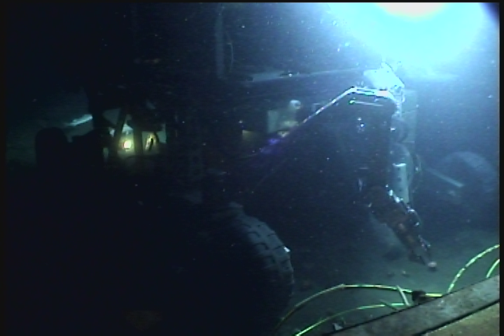
MARS Operation and
Maintenance
III
901727/701127
Node Recovery and Upgrade
Notes:
Ricketts on cable plow at the end of the MOBB deployment

Slide 2
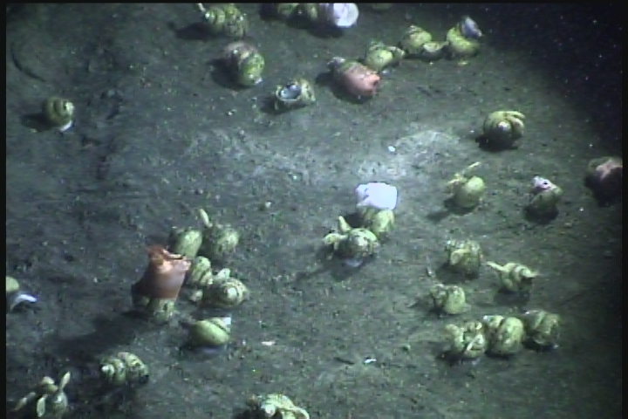
Whats Wrong
Aging Medium Voltage Converter (MVC)
Damaged/Malfunctioning science port connectors
Failure of single 48 VDC channel
Poor timing signals
Obsolete data transport system
Failed engineering sensors in MVC
Notes:
Image from PhoBOS , neptunia snails with piggy backing anemone

Slide 3
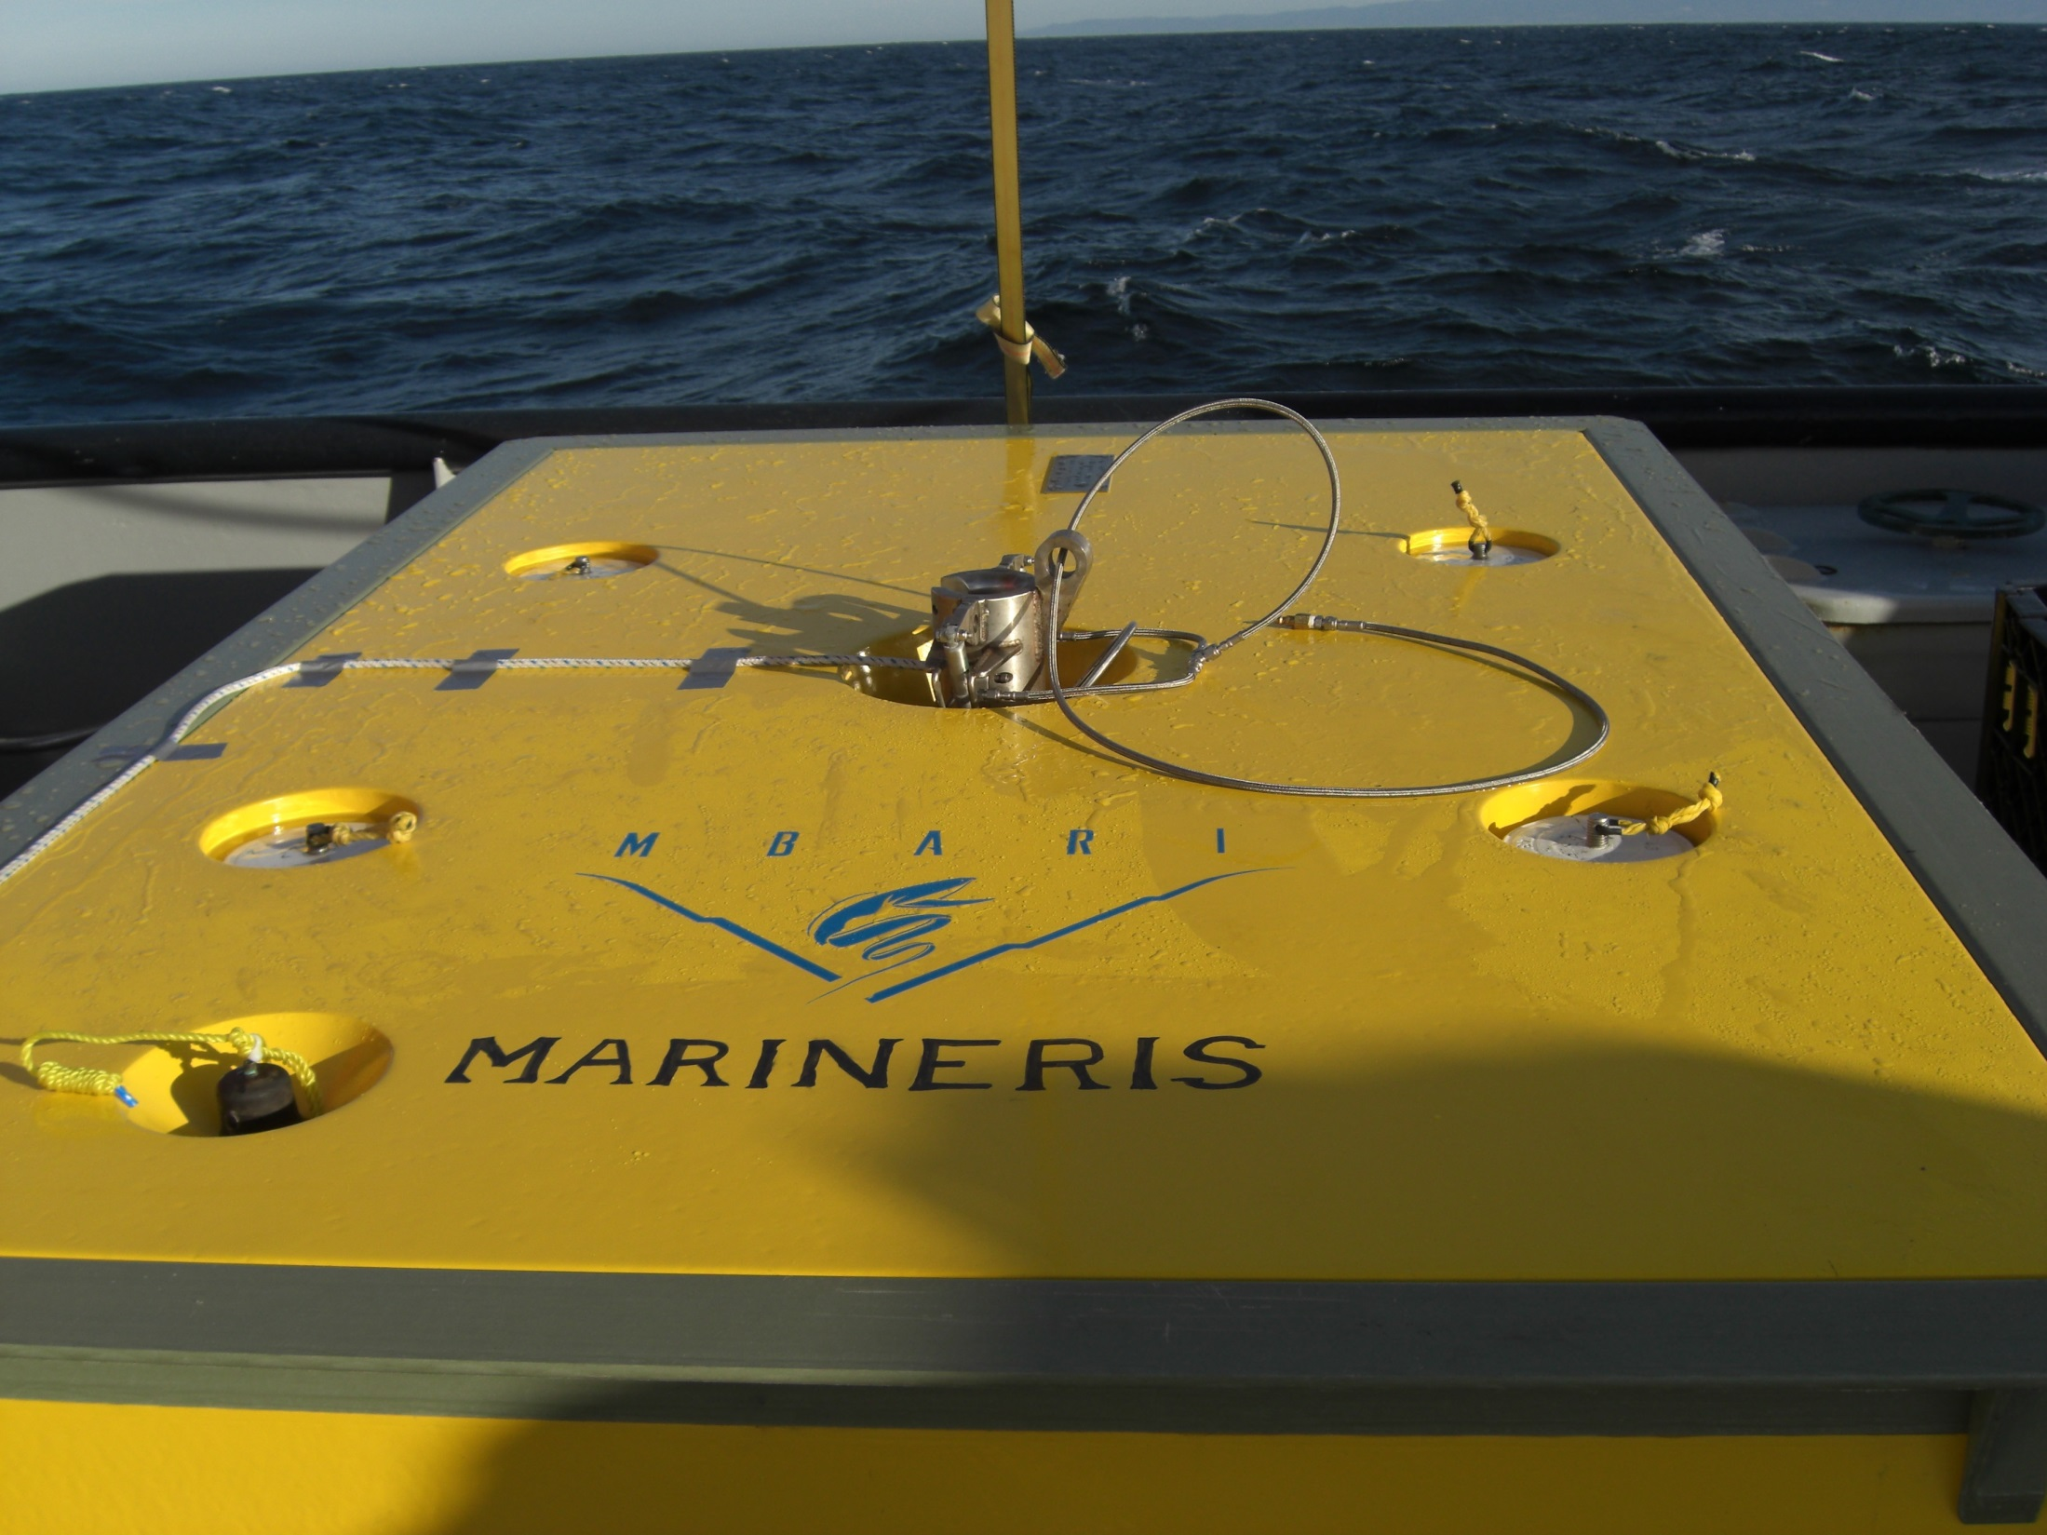
The Plan
Build a “Mini” Node to:
  Maintain current data connectivity
  Test and evaluate new components
Recover the MARS Node (Marineris)
  Replace with Mini node
  Replace MVC with production version
  Replace data transport components
  Repair/refurbish damaged and obsolete components
  Redeploy Marineris
Notes:
Deployment of the MARS node from the Point Lobos

