Slide 1

Development of Chinese Ocean Observatories: from MARS Tests to the South China Sea
Huaiyang Zhou, Xiaotong Peng, Banchun Wu, Feng Lu, et al.
(Tongji Univ.)
Ying Chen, Canjun Yang, Dejun Li, Bo Jin , et al.
(Zhejiang Univ.)
Peiliang Li
(Ocean Univ. of China)
Zhengping Feng
(Shanghai Jiaotong Univ.)
May 16, 2011

Slide 2
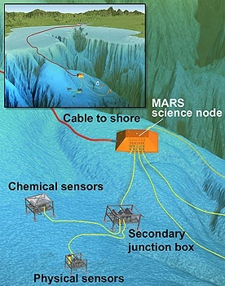
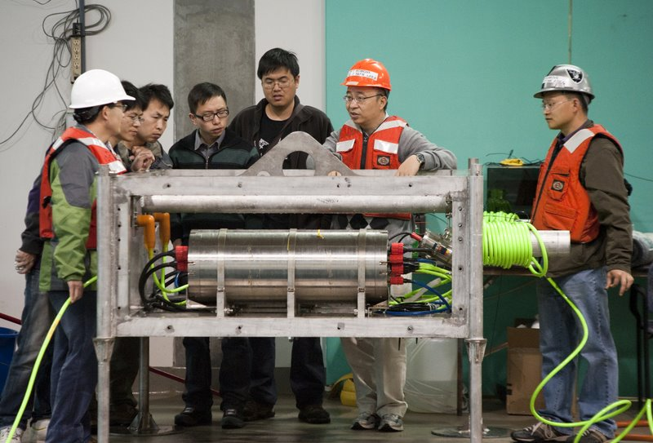
Test on MARS
“On April 21, 2011, four years and 16 days after MBARI and Tongji University signed an agreement to collaborate on ocean science efforts, the Chinese Ocean Observatory on MARS has become a reality” cited from MBARI’s webpage
Image: David Fierstein /Kim Fulton-Bennett © MBARI

Slide 3
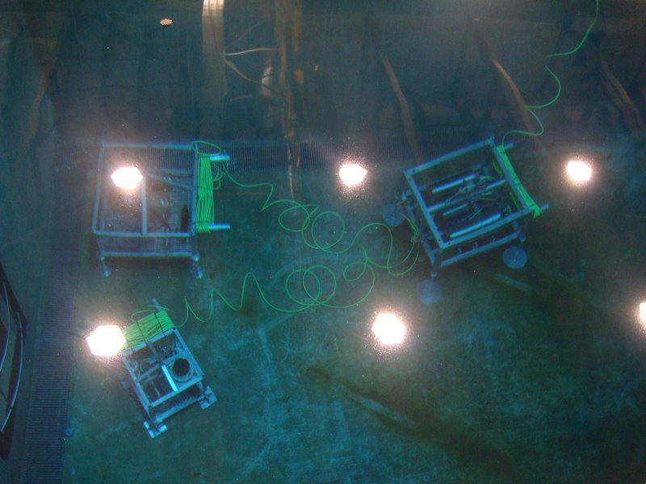
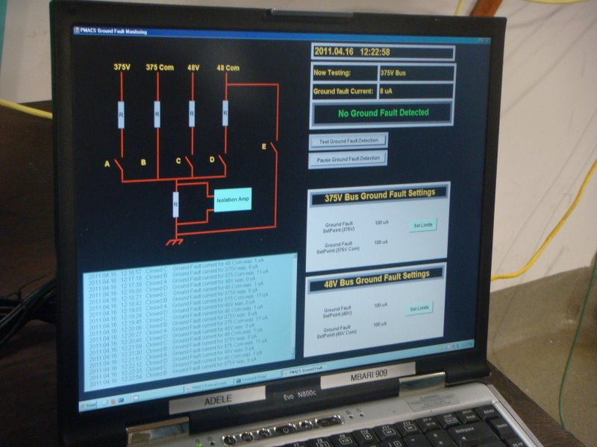
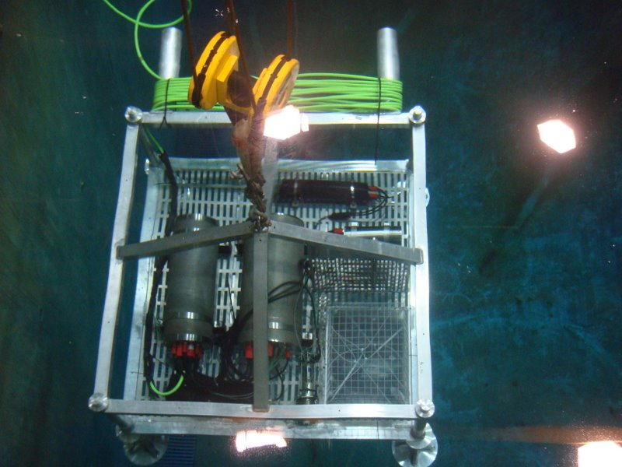
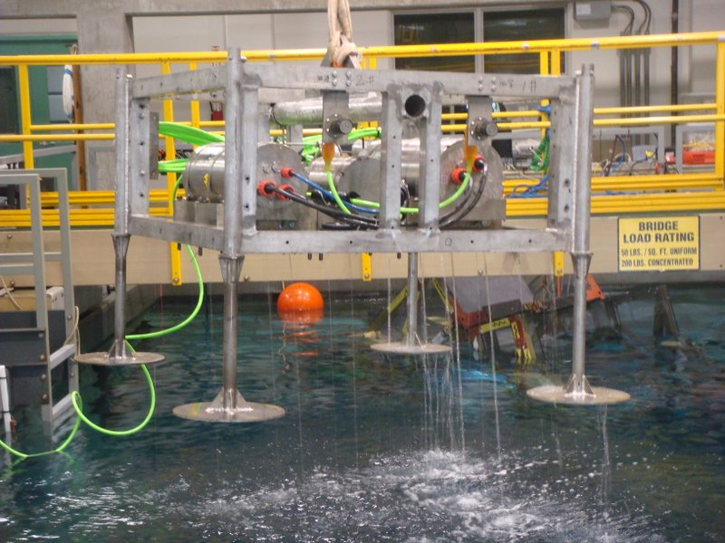
MBARI’s Test Tank

Slide 4
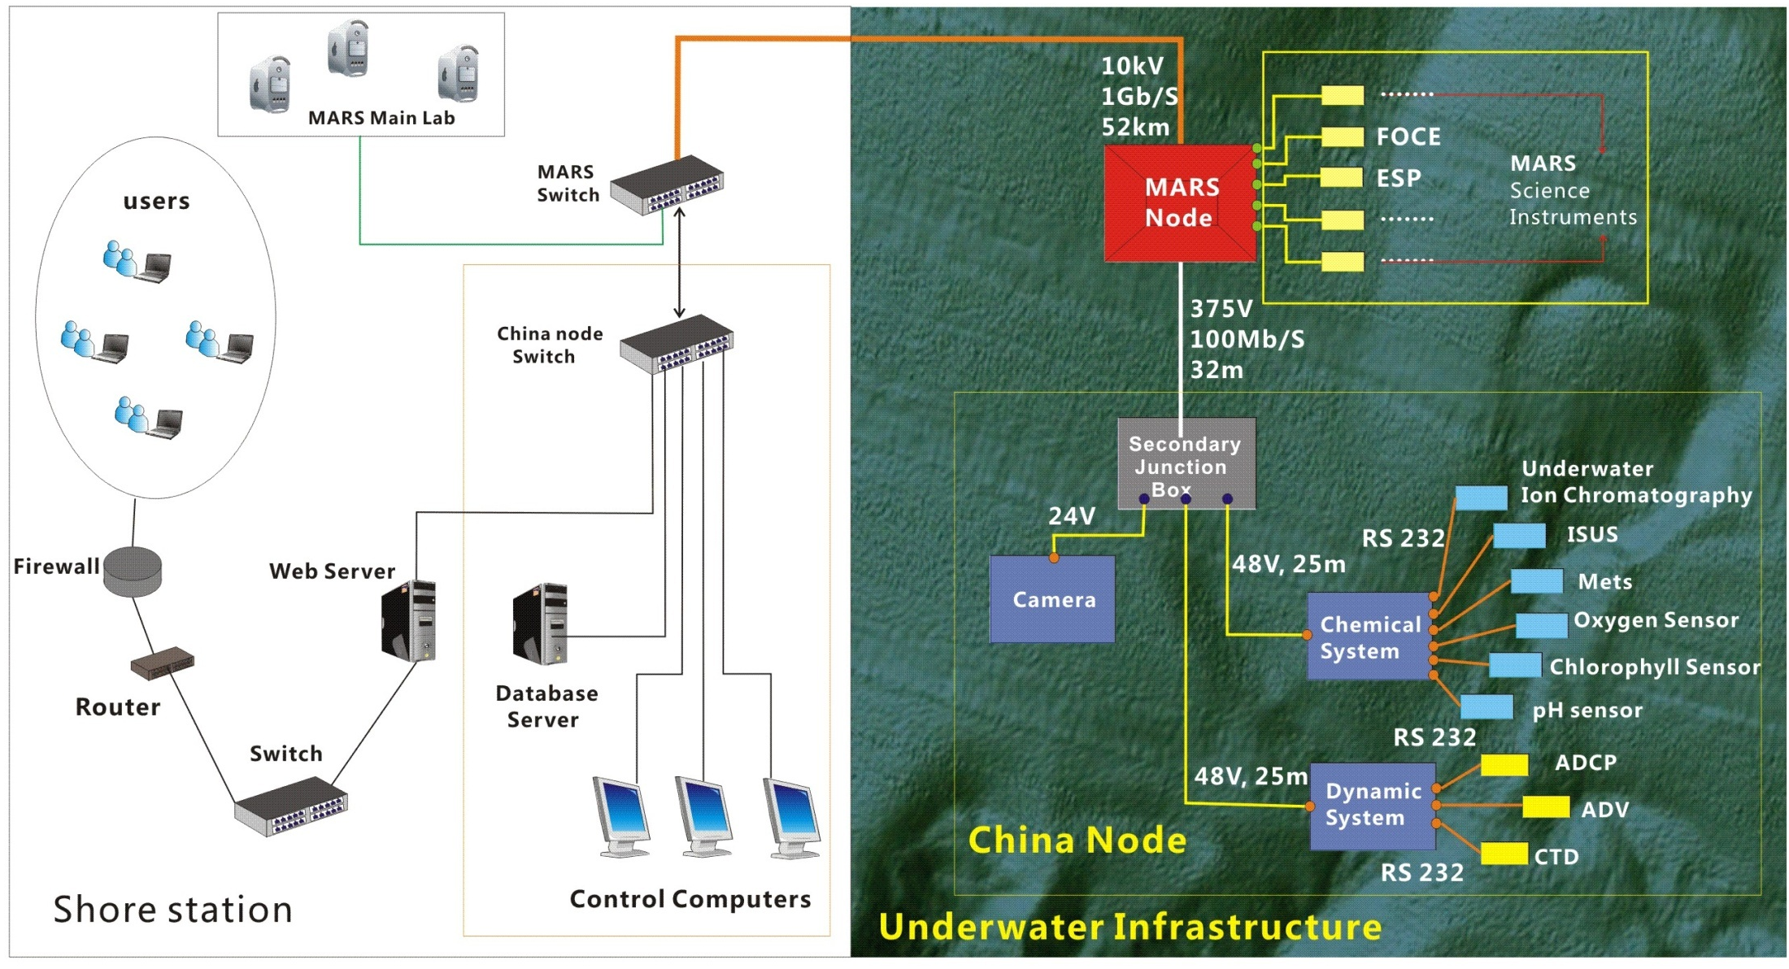
Infrastructure of China Node

Slide 5
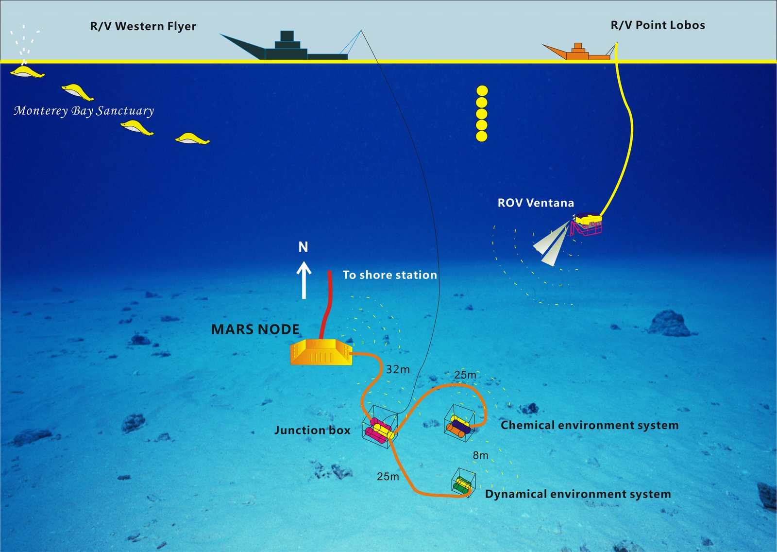
21th, April
Diagram of Deployment of China Node on MARS

Slide 6
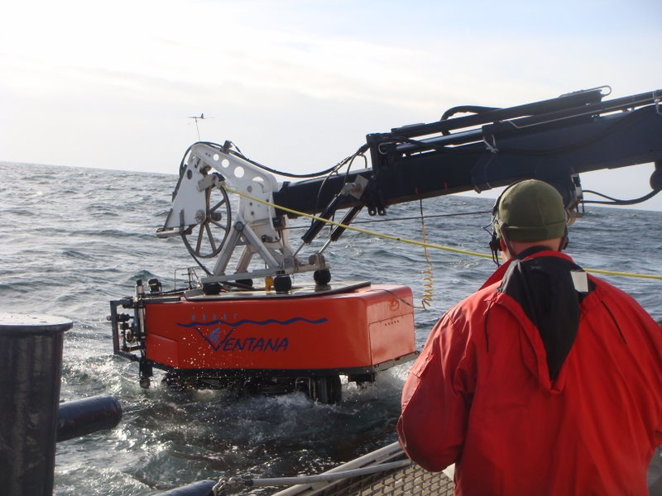
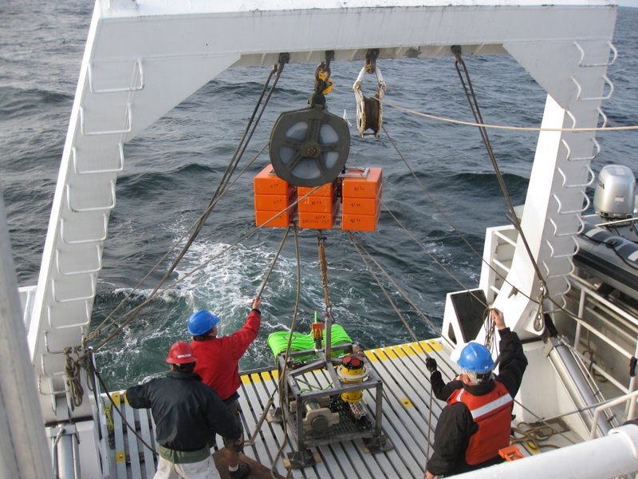
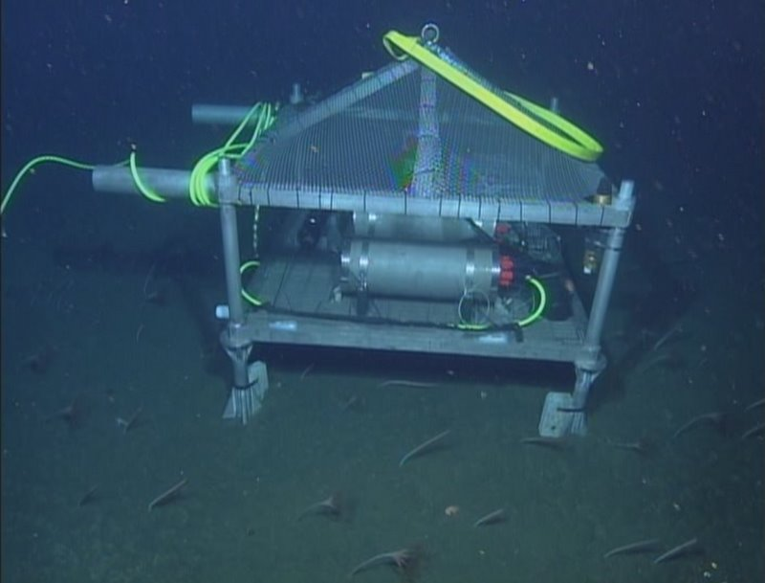
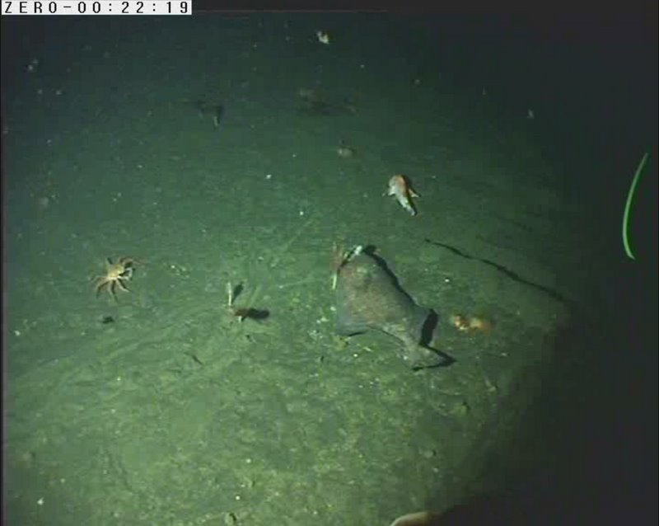
Deployment at Sea

Slide 7
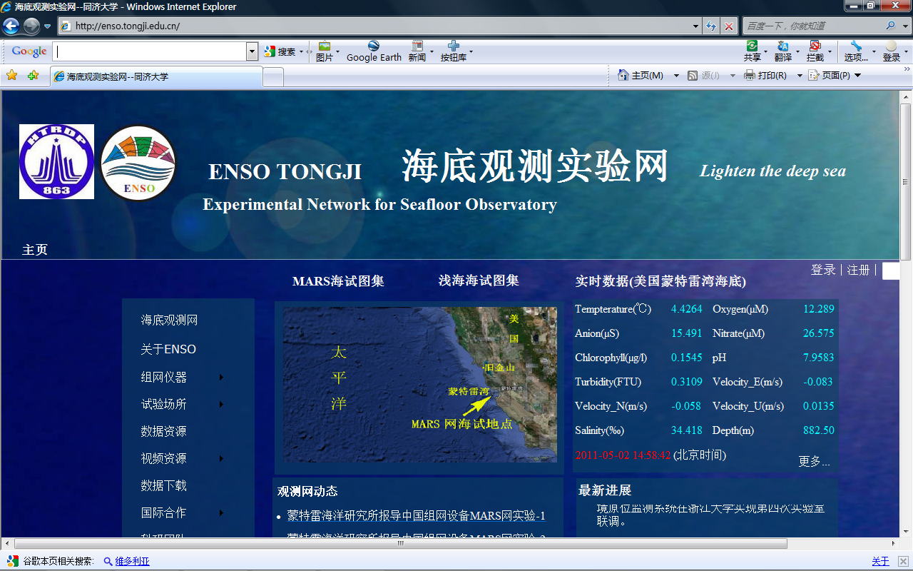
http://enso.tongji.edu.cn/

Slide 8
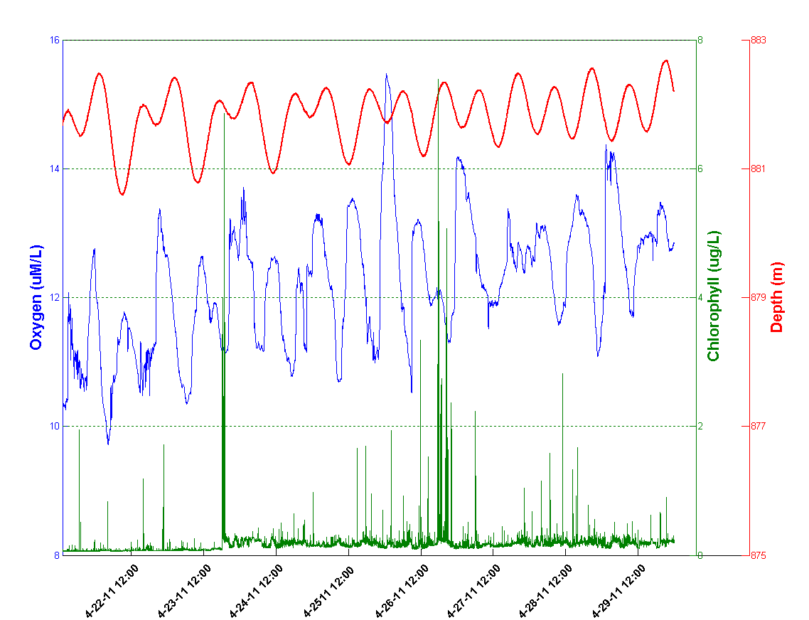
Oxygen, Chlorophyll and Depth Variation During April 22th to April 29th

Slide 9
Original current(Black), Residual current(blue), Tidal current (red)
Ocean University of China

Slide 10
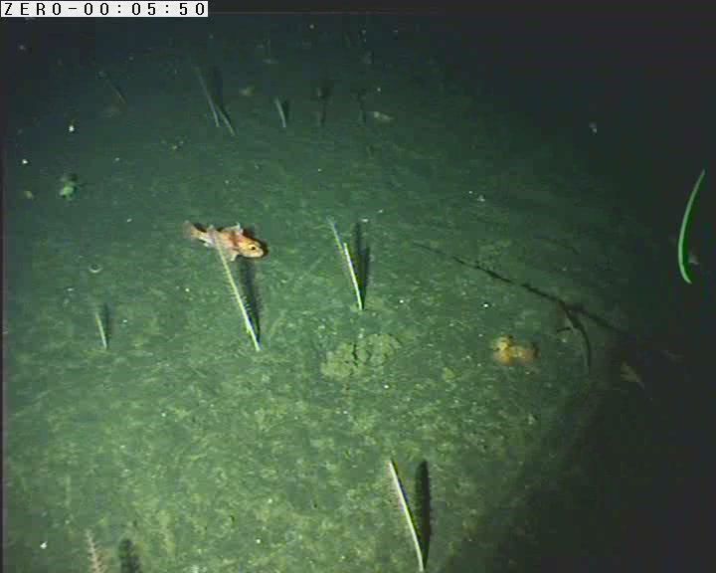
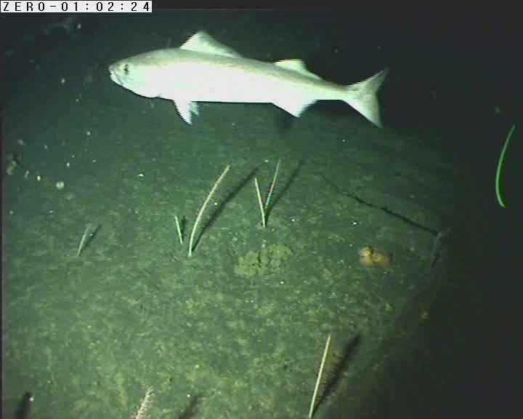
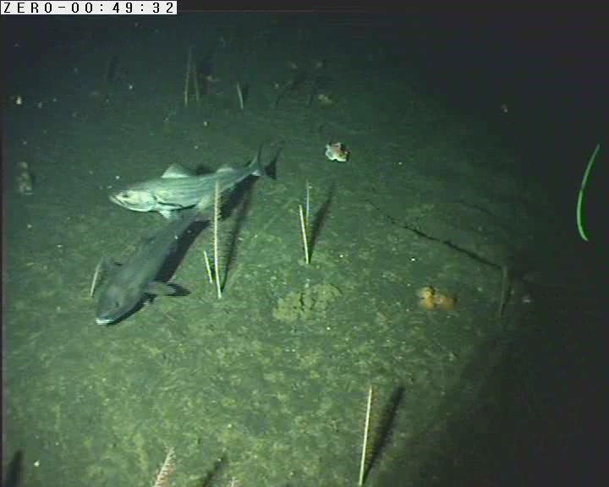
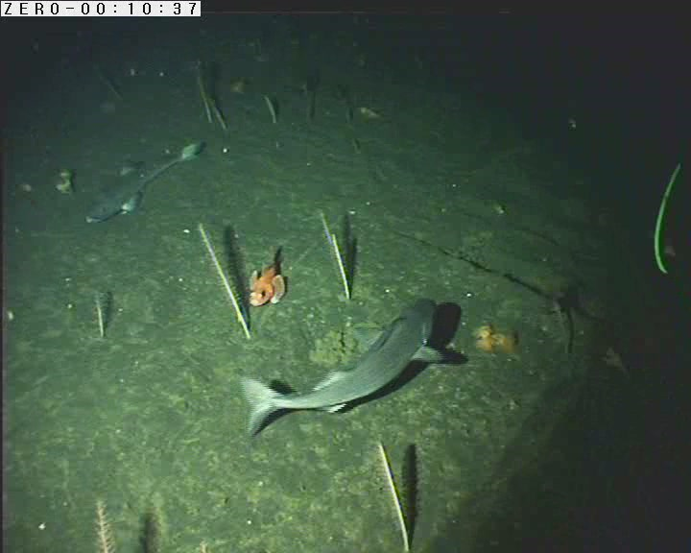
Wonderful Seafloor World in Monterey Bay Taken by China Video Camera

Slide 11

Acknowledgements
We are indebted to
Chris Scholin, Steve Etchemendy, Mike Pinto, Ken Heller, Knute Brekke, Craig Dawe, Gene Massion, Mike Burczynski, D.J. Osborne, Susan Von Thun, Natalie Fairchild, Katie Loweth, Peter Braccio , Kim Fulton-Bennett, Yanwu Zhang, and other folks from MBARI
for your great support and help.

