Slide 1
Monterey Canyon Sediment Transport Acoustic Receiver (McStar)
MBARI Brown Bag Seminar
Gene Massion, Wayne Radochonski, Tom Maughan, Charlie Paull, Bill Ussler
July 19, 2010

Slide 2
A little History
The first Canyon Dynamics project was an ambitious cabled observatory intended to study the dynamics of submarine canyon formation
  The 290m RIN was trashed, the 525m RIN was lost with all instruments
  Scientific results: Evidence of high frequency, highly energetic events was surprising
Next step was a little less ambitious
  Relatively cheap SINs that could be tracked from the surface were deployed
  Scientific results: SIN trajectories were measured for some part of the next 2 years
  Eventually, all SINs lost

Slide 3
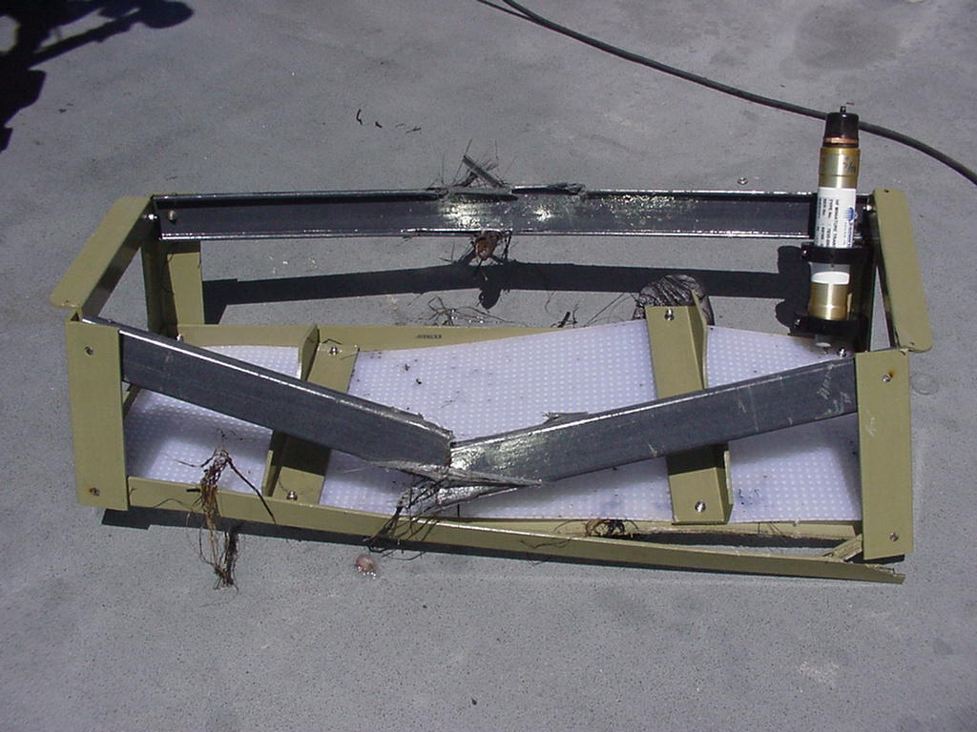
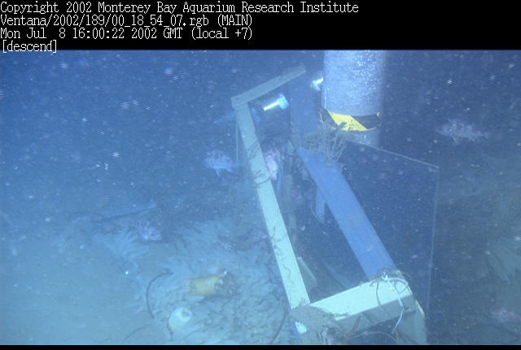
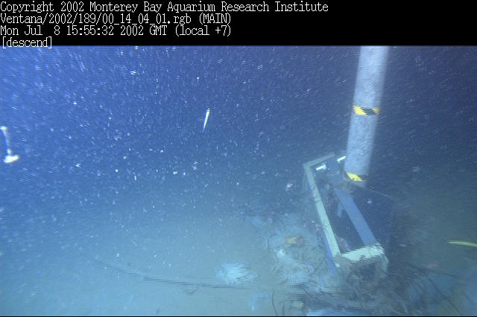
Why McStar?

Slide 4
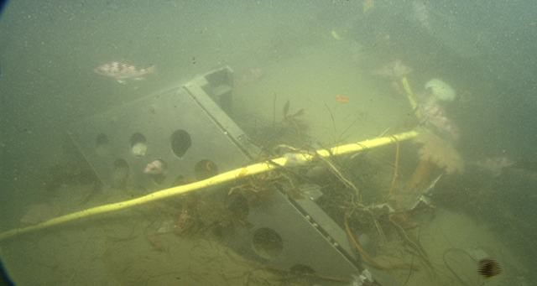
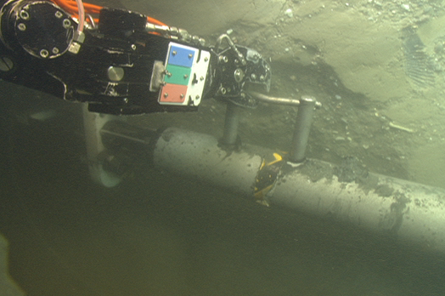
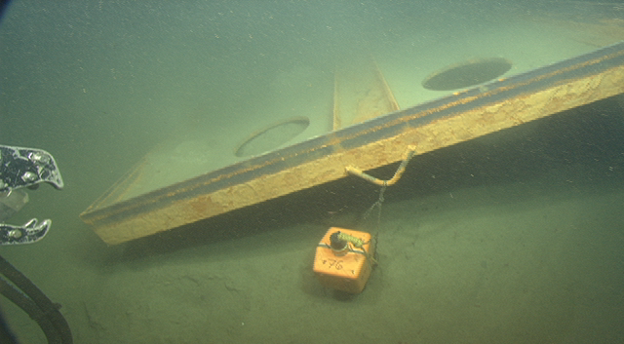
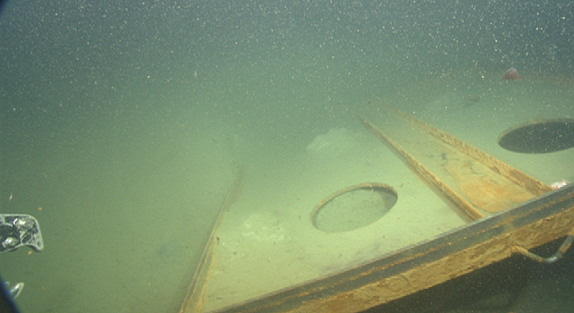
And if that wasn’t enough

Slide 5
What measurements can we make with out getting beat up so badly?
400,000 m^3 of moving sand must make a significant amount of noise
Underwater acoustics provide a remote sensing approach that can provide at least a qualitative understanding of these events
  When does it happen? Is it one major event or a sequence of events? How long do events last? Can we correlate the event with other causal mechanisms?
Need an independent event marker so we know where to look in the acoustic record

Slide 6
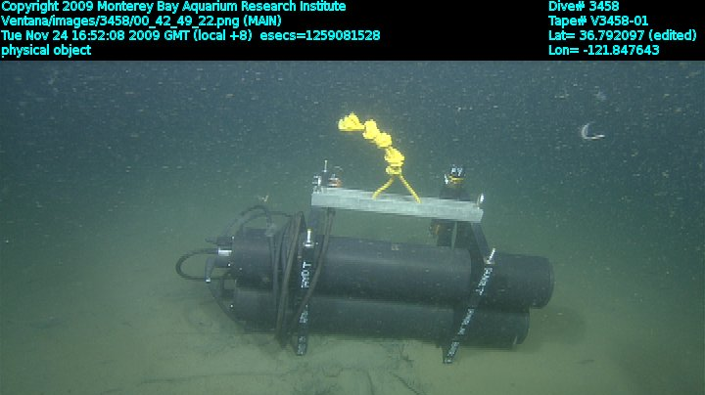
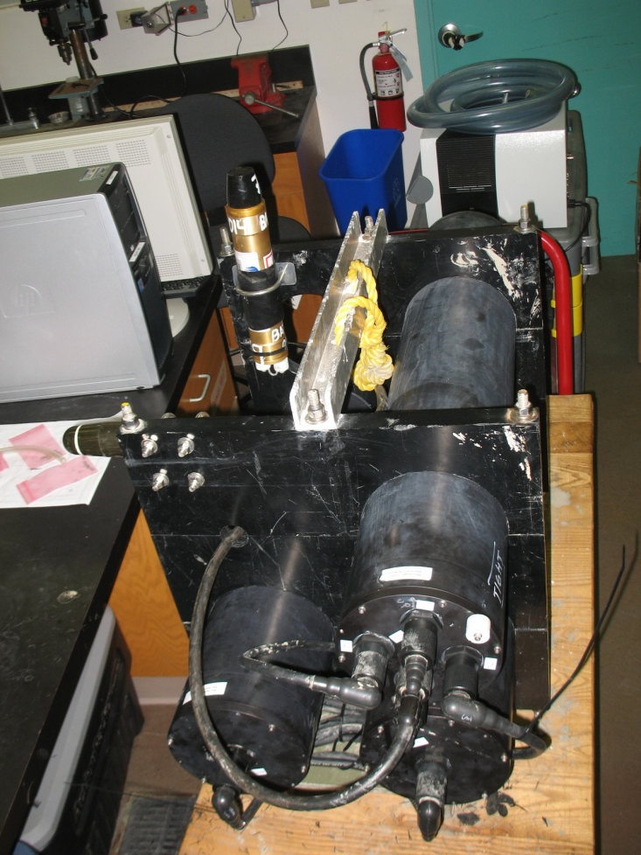
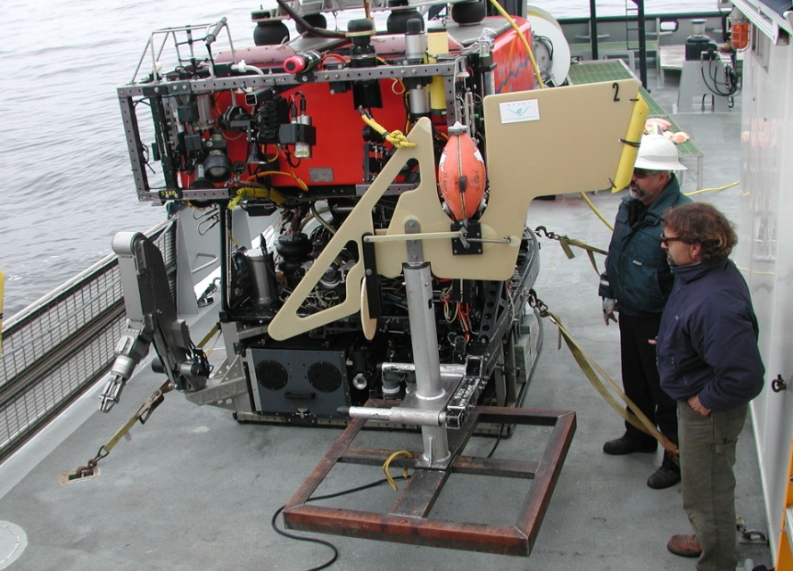
McStar and STED

Slide 7
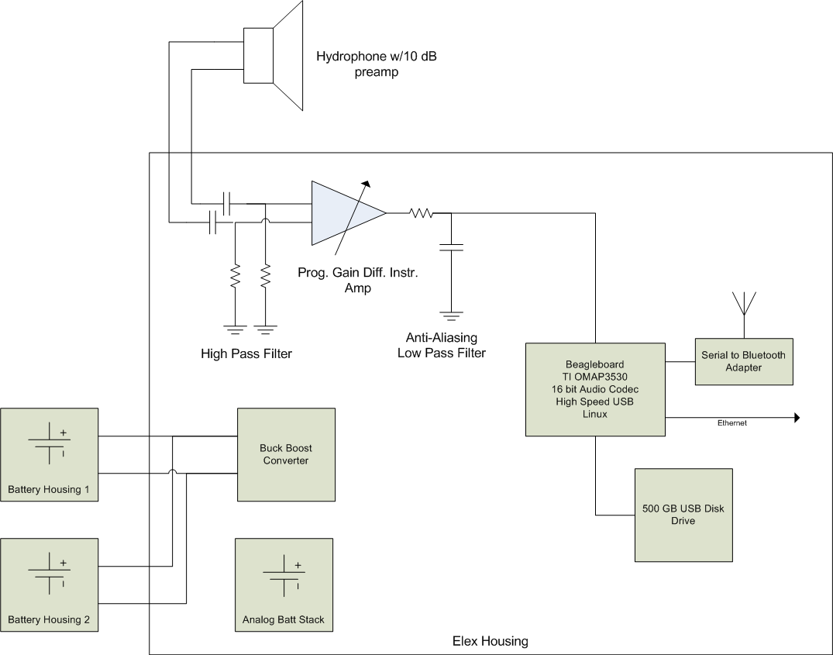
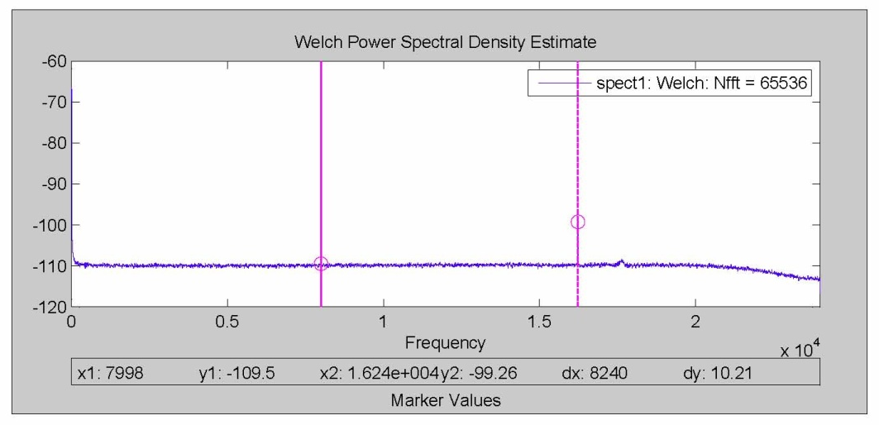
Technical Details
OMAP 3530 processor w/onboard DSP capability
High speed USB (480 Mb/sec)
0.5 TB data storage
48 kHz Stereo 16 bit ADC
3.3 Watt power consumption
2+ month mission duration
Big Question: How much gain?

Slide 8
Data, lots and lots of Data
48000 samples/sec * 2 bytes/sample * 86,400 seconds/day = 8.3 GB of data per day
Current data products include
  RMS vs Time
    Estimate of broadband acoustic power
  Voltage Histogram waterfall plots
    Lets us know when/if we’ve saturated the system
  Power Spectral Density waterfall/spectrograms
    Helps differentiate what is generating the signal
  Automated processing scripts in Matlab

Slide 9
Q4 2009 and Q1 2010 Events
Nov. 29, 2009 McStar & STED deployed
Jan. 5, 2010 Recover McStar
Jan. 12, 2010 STED Trigger & Barry mooring breaks free
Jan. 13, 2010 High turbitidy (low visibility on ROV dive at MOOS mooring)
Jan. 22, 2010 McStar & STED Deployed
Feb. 5, 2010 STED Triggers
Feb. 19, 2010 Recover McStar

Slide 10
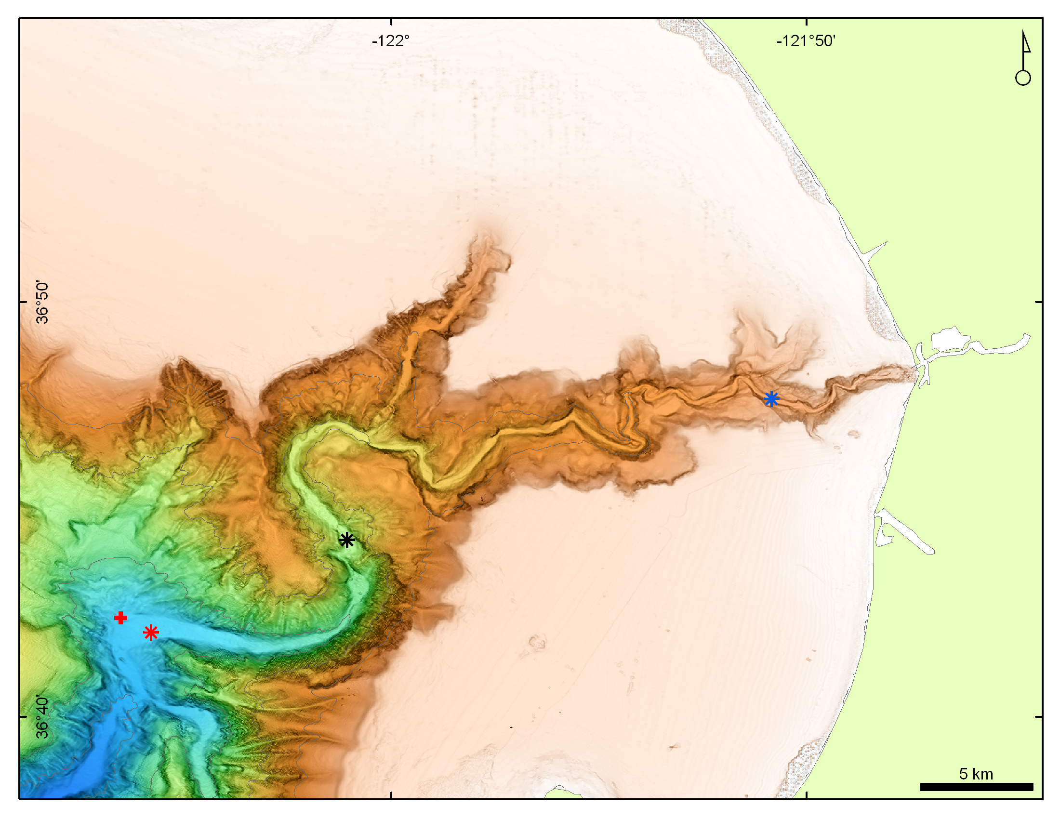
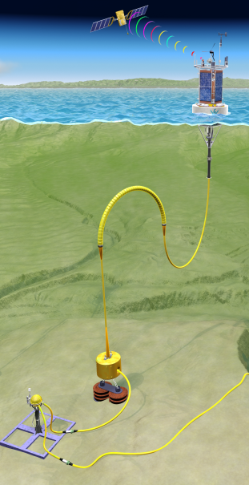
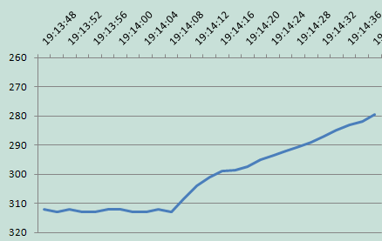
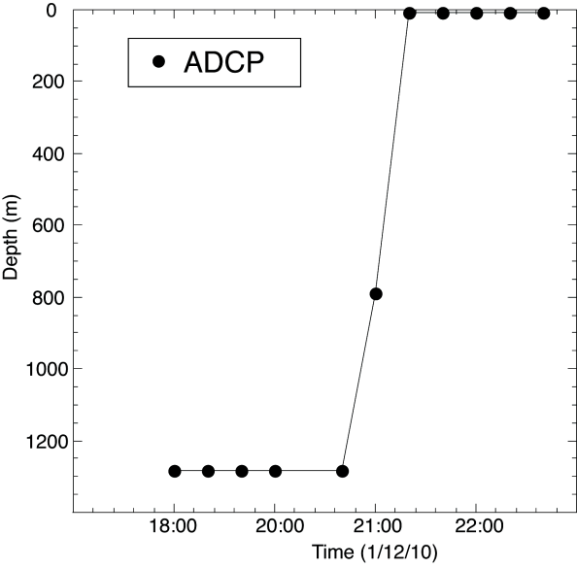
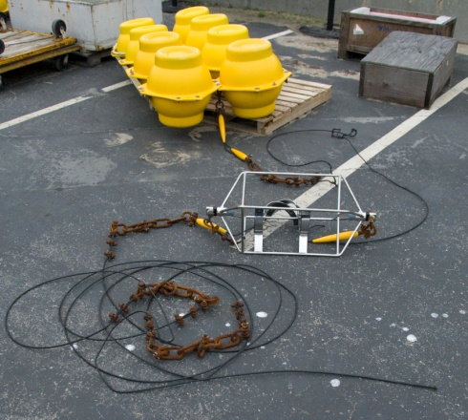
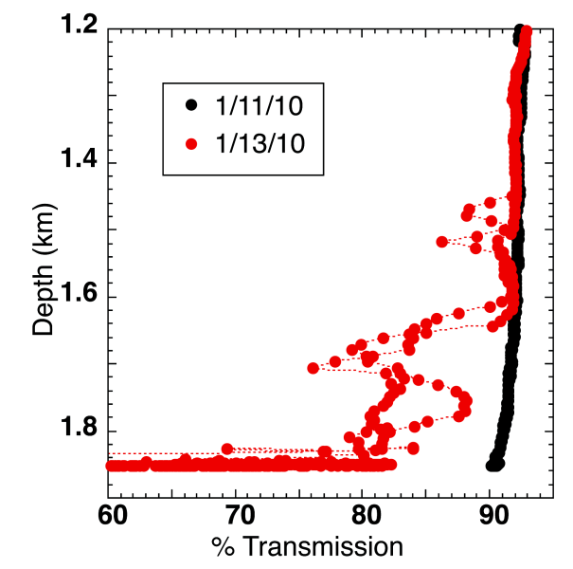
Velocity of the event 4.85 -5.34 m/s
1/12/10 19:14 STED released
MOOS mooring
1/12/10 20:40 Float breaks free
BIN
1/13/10 Visibility is poor

Slide 11
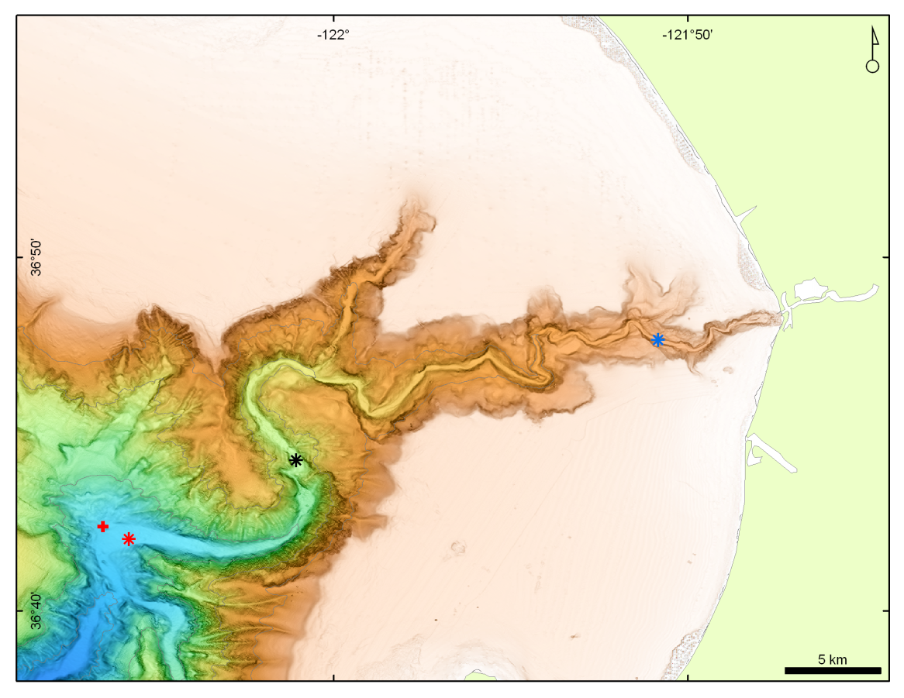
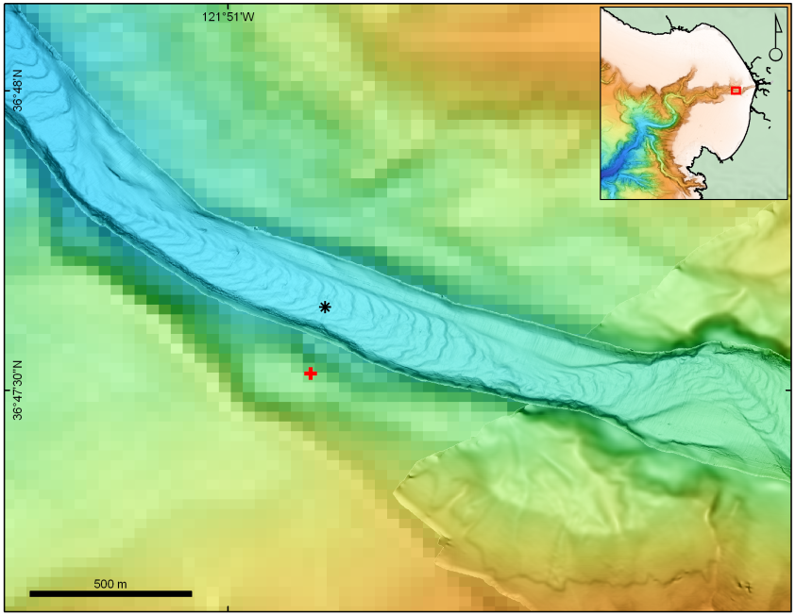
An exception to Murphy’s Law
McStar and STED Deployed: Jan 22, 2010
  McStar: 250m deep; STED: 294m Deep
STED Released: Feb 5, 2010
McStar recovered: Feb 19, 2010
STED
McSTAR

Slide 12
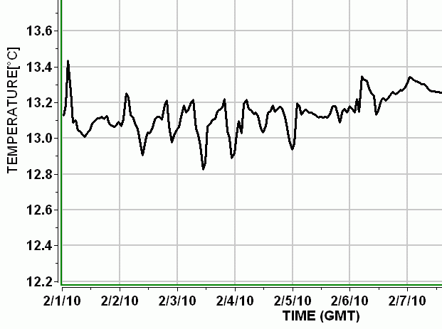

The Event
STED Trigger
STED Trigger
1545 Local

Slide 13
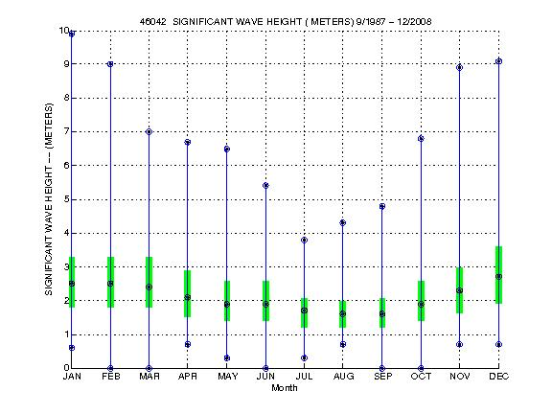
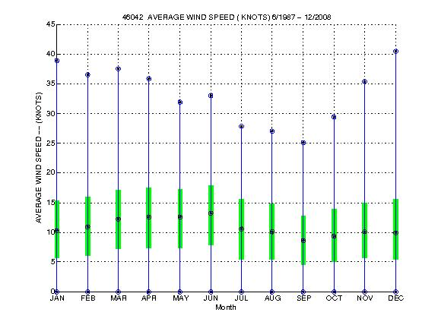
Wind & Wave Data

Slide 14
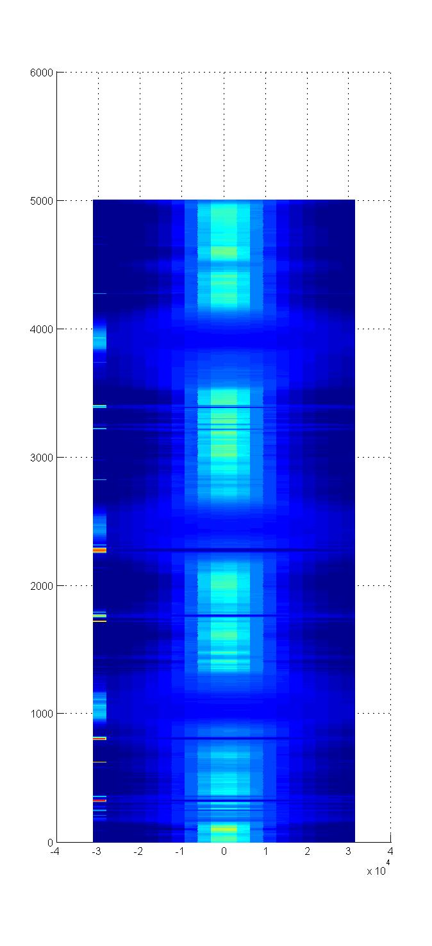
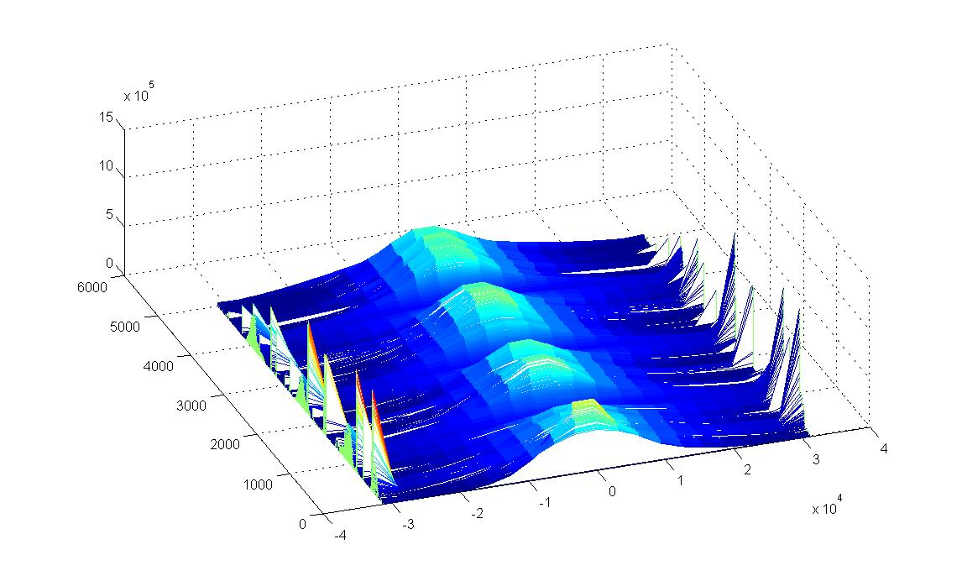
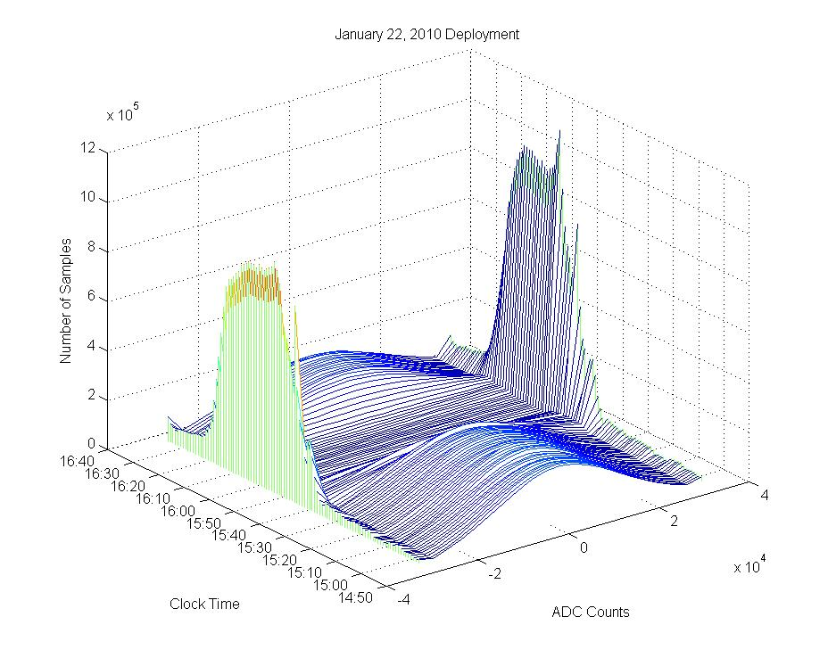
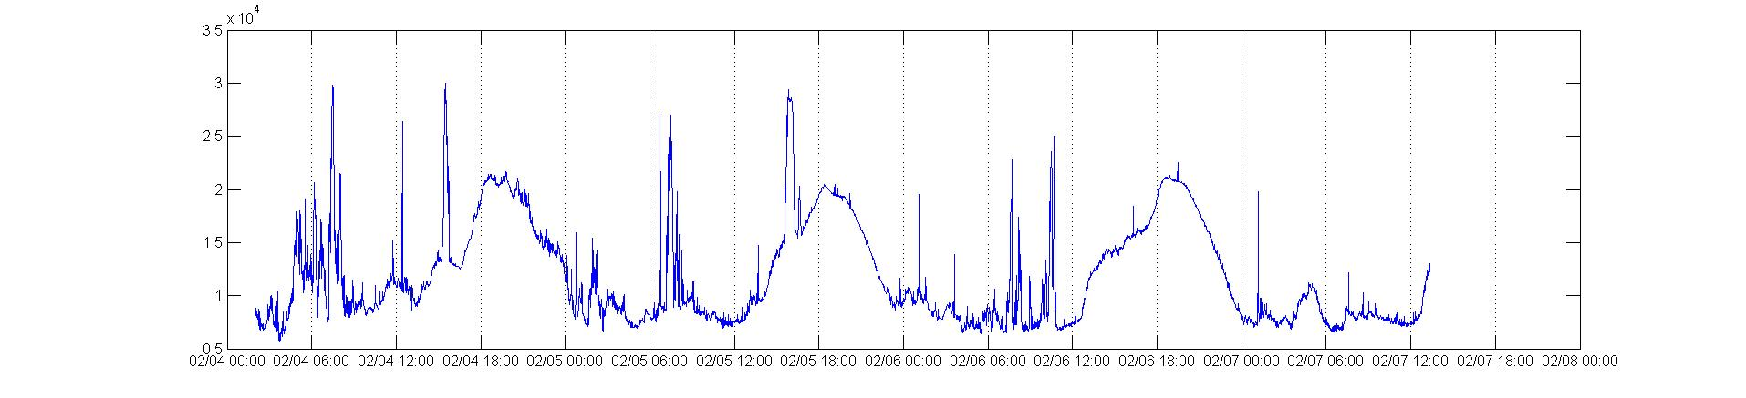
Event signal strength >158 dB re 1 uPa @ 1m
STED Trigger

Slide 15
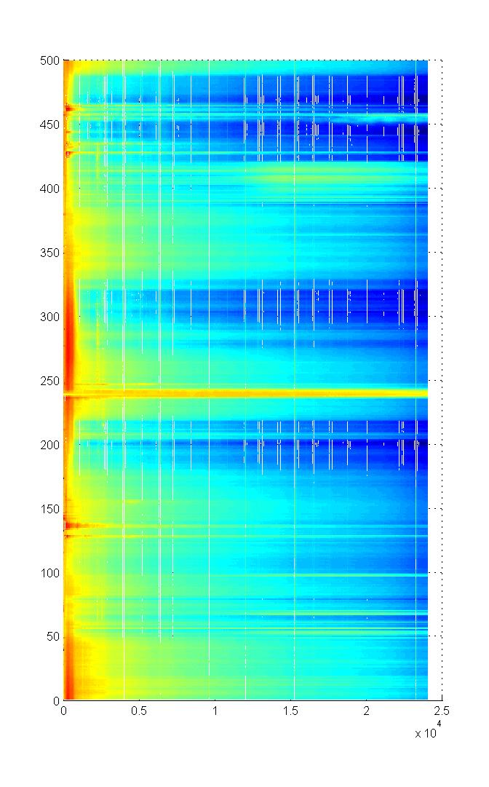
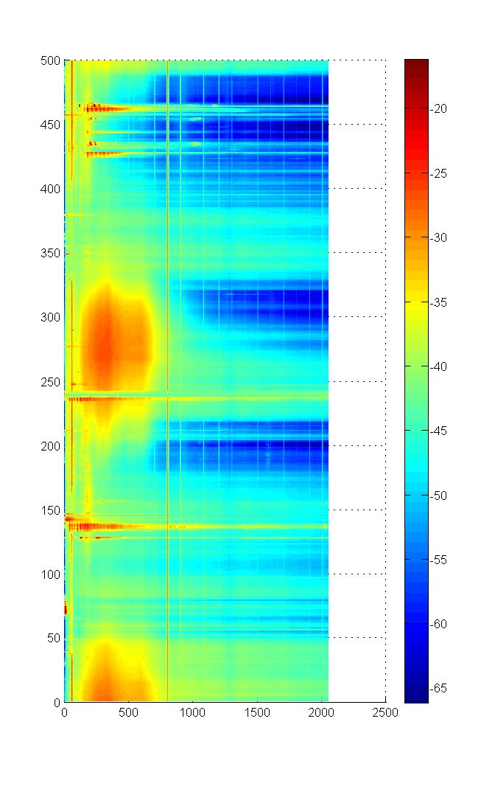
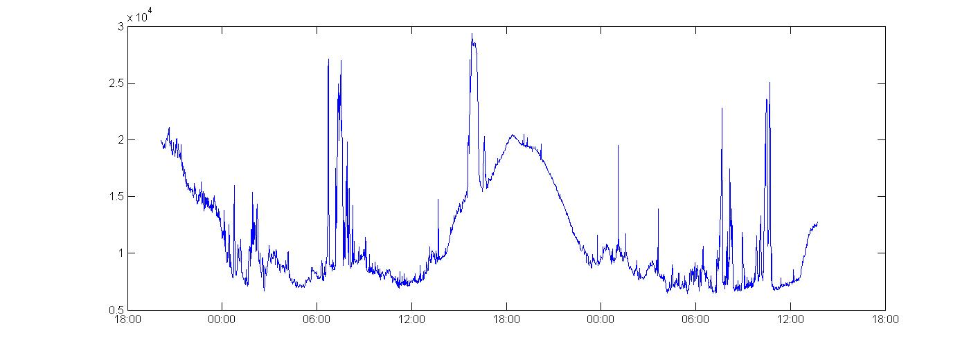

Slide 16
Windows CE: the good, the bad and the ugly
McStar was originally proposed as a National Instrument/Labview Real time system
  A re-evaluation of the COTS market at the start of the project indicated new hardware with strong Windows CE support might be a significantly better choice – lower power, better COTS hardware choices, …
  A contingency project was approved to evaluate the risk of this approach
The Good:
  It is pretty quick and easy to get a CE development environment and OS kernel up and running
  Visual Studio is a great development environment
  Writing a simple SPI driver (non-DMA) was pretty easy in CE 5.0
    No real separation between kernel space and user space
The Bad:
  CE 5.0 has serious memory limitations: max program space of order 32 MB
The Ugly:
  The CE 5.0 32 GB max disk partition size, 8 partitions max limitation isn’t well documented
  CE 6.0 solves the memory and disk issues but breaks the easy driver development process

Slide 17
Engineering Improvements
More dynamic range
  Use both ADC channels (L/R), one with 0 dB gain, one with ~60 dB gain
  Switch to a 24 (or 32) bit ADC or 2X with 0 and 60 dB gain
  Dynamic Programmable Gain Amplification
Less power
  Turn off the hard disk when not actually writing
  Turn down the CPU clock frequency
  Reduce bandwidth
  Event driven recording
More storage
  1 TB USB disks are now available
  Disk array with power switching is do-able
Less noise
  Pretty good as is: Dynamic range is within ~10 dB of 16 bit ADC theor. max.
  Identify existing noise sources
  Slave all clocks to 1 master clock to reduce intermodulation products
  Directional hydrophone array
Less waste
  Rechargeable batteries

Slide 18
New Applications
McStar is currently being used to record bubble streams from a seep in the Santa Monica basin
Event driven recording
  McStar would log data in a N day circular buffer
  The STED could ping when float releases
  Just the data around the “event” would be saved to disk.
Long base line tracking
  Pingers could be buried at various locations and depths in the canyon
  Multiple McSTAR units on one or both sides of the canyon could track the pinger motion
    Some kind of time synch would be required: acoustic?, cabled?, …?

Slide 19
Current Status
The basic McStar system functions with several issues
  500 GB of storage
  ~85 dB of dynamic range
  ~60 days of battery life based on measured power draw and conservative D-cell W-hrs (both analog and digital battery stacks)
  ~60 days of disk storage (16 bits, 48000 samples/sec, 1X 500 GB HD)
  Plenty of unused processing power
2 systems exist – 1 deployment system and 1 test system
The Matlab script works OK
  I used it extensively for the brown bag presentation
  Calculates RMS, histograms and power spectrums
    2D plots, waterfalls and spectrograms
  Extremely large data sets require extra attention

Slide 20
Issues
Need more dynamic range
Frequency “banding” is obvious in deployed data spectrograms but not apparent in bench data
Periodic “click”
Starting the system could be simpler
We may be oversampling by a factor of 10 – 20
  Sample rate strongly drives the mission duration, …

Slide 21
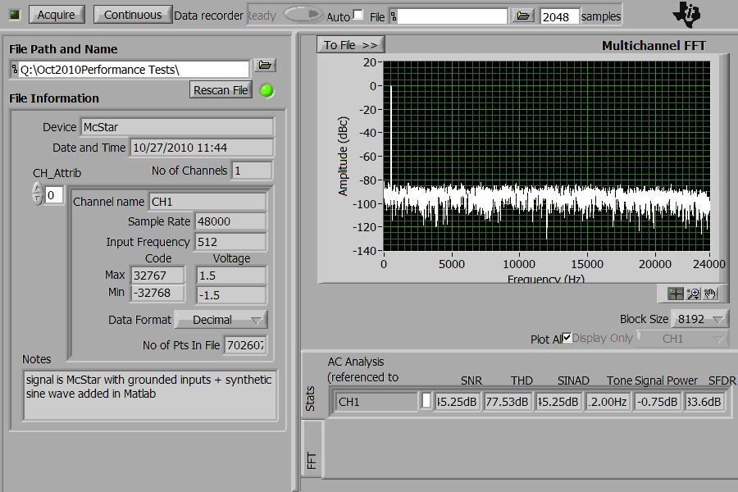
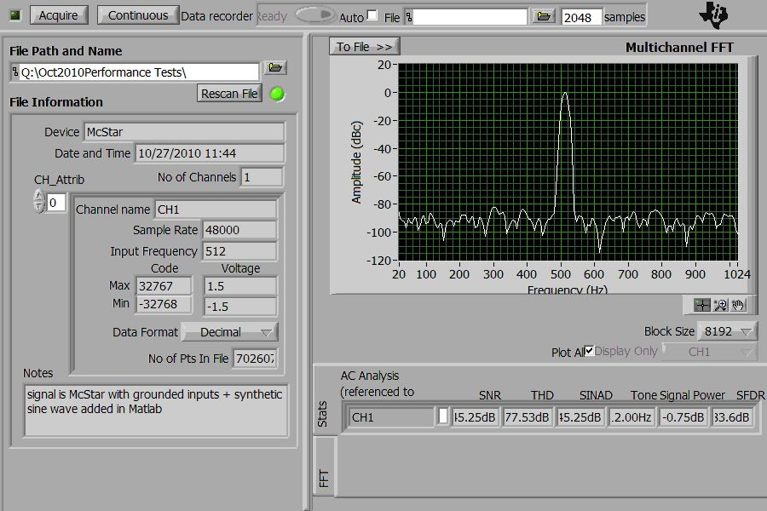
Dynamic range test with no hydrophone and inputs grounded at internal hydrophone connector
Note – no banding

Slide 22
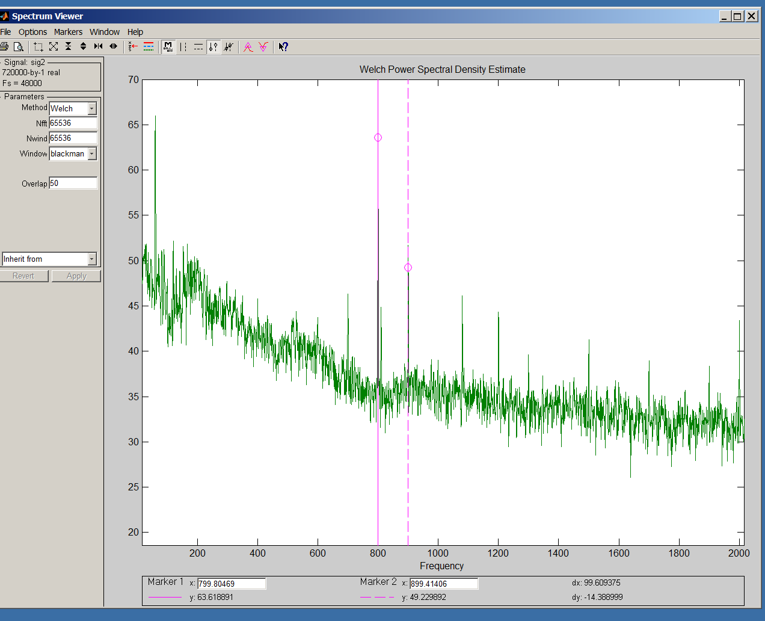
PSD just before event
Note the “banding”

Slide 23
“Must” be done
  Understand where the banding, clicking and 60 Hz line comes from
    Radiated noise on the Hydrophone power supply lines?
    Hydrophone hard mount?
    data burp between files?
    Fix what needs to be fixed
  Better understand the required dynamic range and meet it
  Make the system start with 1 “button”
  Replace current wet connectors
  Make sure the test unit is identical to deployable unit
    e.g., the Instr. Amp. power DB9 is wired differently
  Need to shut down before power dies
Nice to do
  Increase mission duration
  Improve acoustic directionality
  Replace primary alkalines with rechargeable lithiums
  Decrease turnaround time, maybe without opening the elex housing
  Might want to add a ROV readable heartbeat

