Slide 1
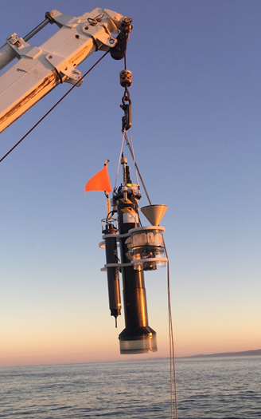
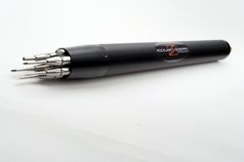
Vertical Mixing Rates from Autonomous Profiling Floats
CPF
902108 Scoping Project (1 year):
To evaluate and determine the feasibility of
integrating microstructure sensors
on MBARI’s Coastal Profiling Float (CPF)
Andrea Fassbender (PI) → Yui Takeshita
Magdalena Carranza (Lead Scientist)
Gene Massion (Ocean Engineer)
Ken Johnson (Scientist)
Yui Takeshita (Scientist) Judah Goldberg (RSI)
Andy Hamilton (Mechanical Engineer) Peter Franks (SIO-UCSD)
Yanwu Zhang (Research Engineer) Rob Pinkel (SIO-UCSD)
Tom O’Reilly (Software Engineer) James Girton (APL-UW)
Outcome
MicroRider
(RSI)
concomitant
vertical profile data of BGC
properties
+ dissipation rates of turbulent kinetic energy, ε (z)
+
=
MBARI Team
Potential External Collaborators

Slide 2
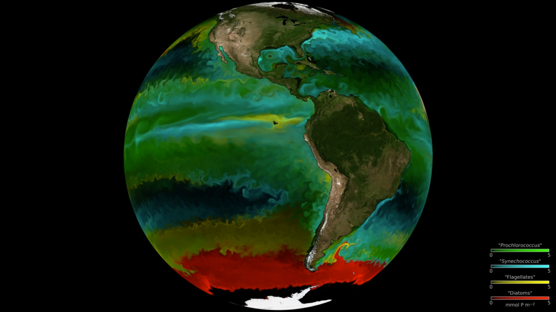
Why should we care about mixing rates?
The ocean’s inherently turbulent nature
Turbulence in the surface mixed layer:
- major forcing for vertical exchange in the surface layer
- deepens the mixed layer → dilution of properties
Particularly important for biology
and biogeochemistry:
- distribution of light and nutrients → phytoplankton growth
- prey-predator encounter rates → grazing rates
- aggregation rates → carbon export
Thus, turbulence shapes plankton distributions
high-resolution
ocean and ecosystem model Darwin Project (MIT-gcm)
https://youtu.be/wAsNzQ2RDqM

Slide 3
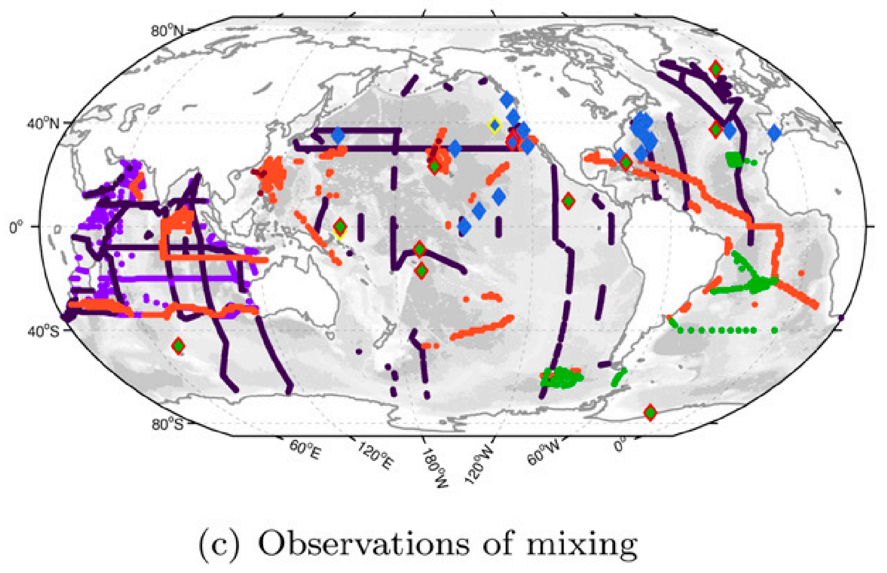
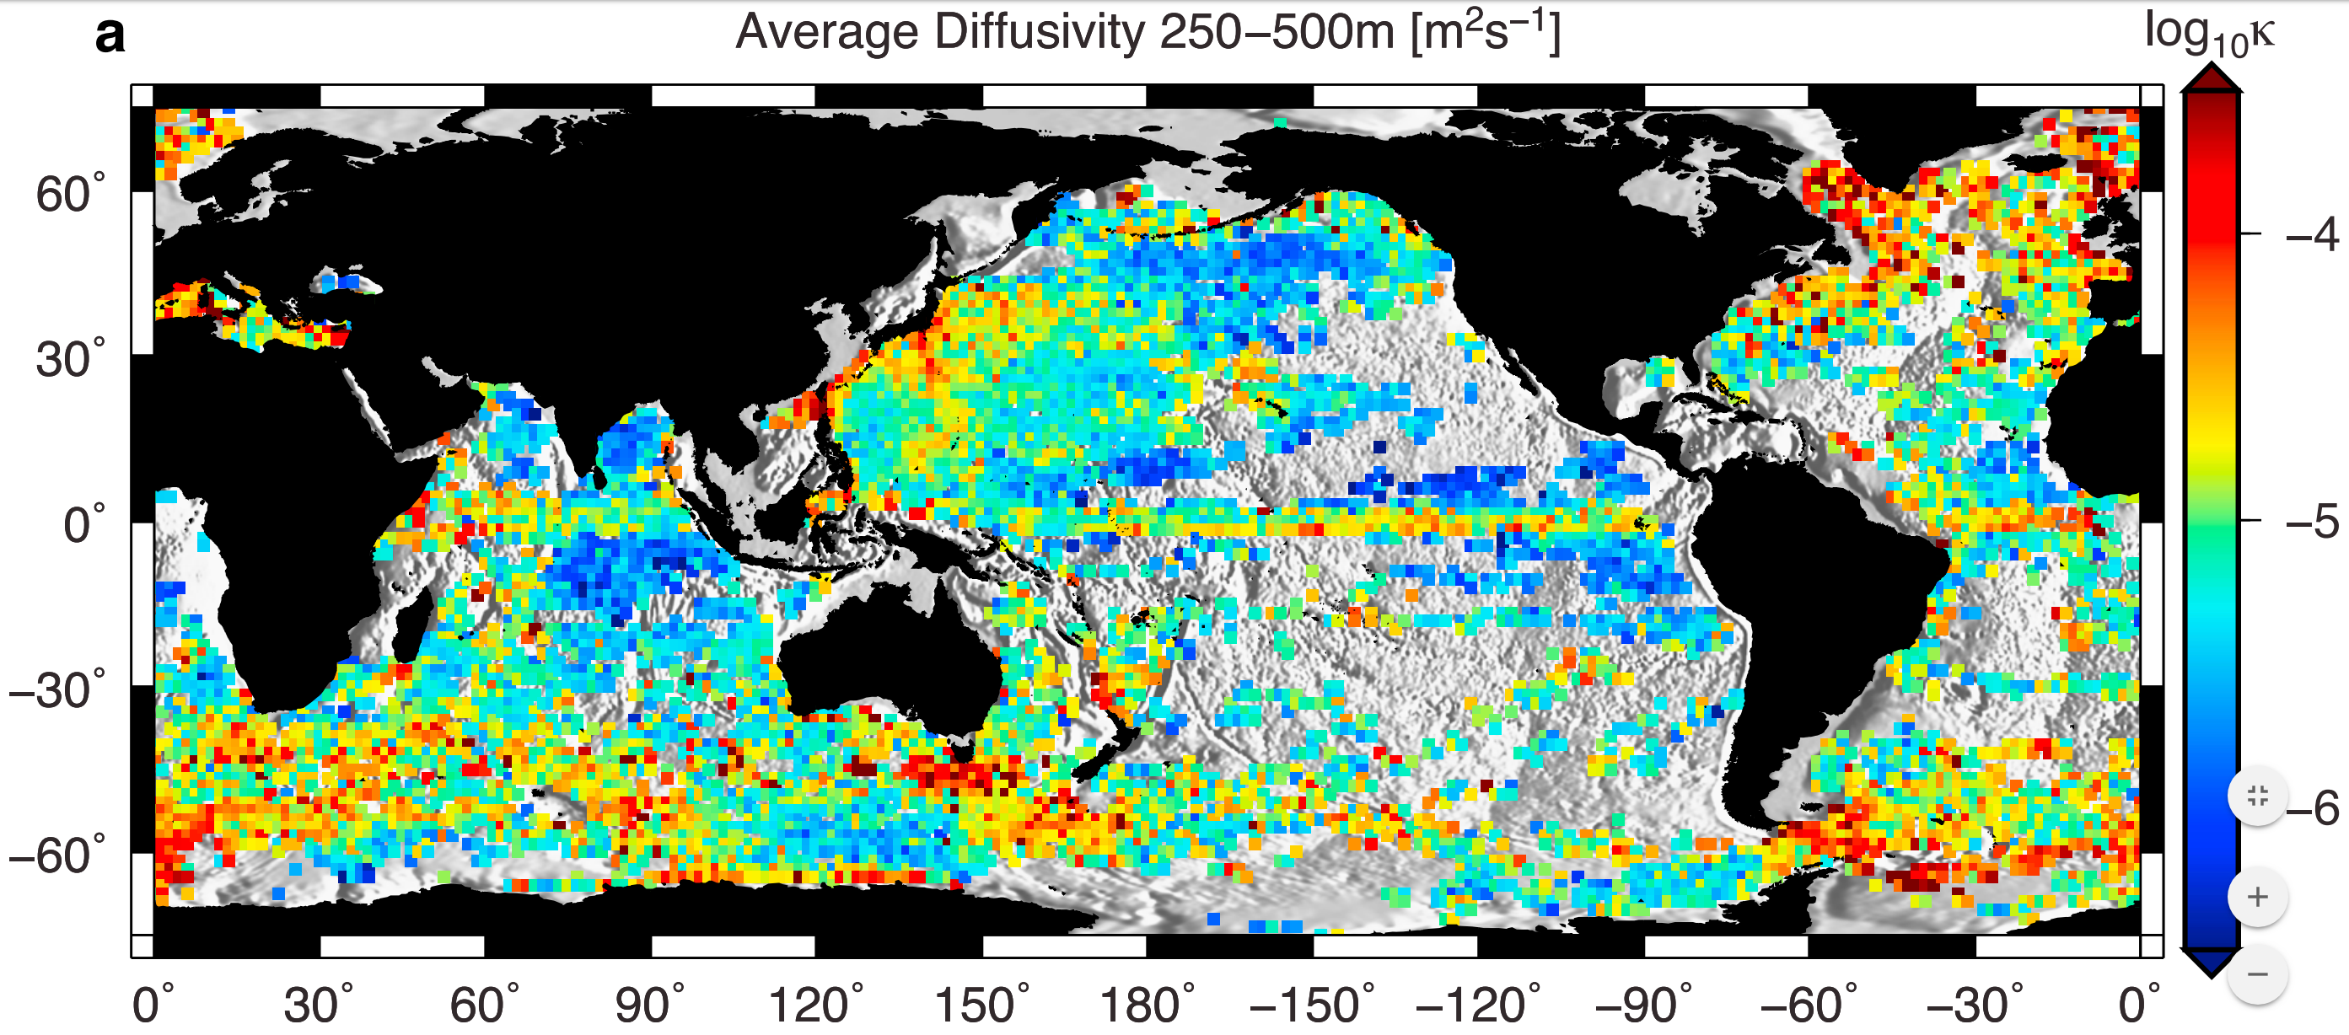
The Fundamental Problem
    - From microstructure measurements (, )
    on Vertical Microstructure Profiler, VMP
    - From acoustic measurements (, )
    → very expensive, and thus sparse
    Argo float data (fine-scale parameterizations):
Mixing rates in the top surface layer
or coastal oceans are hard !!!
from physical grounds
    Whalen et al. 2012, Waterhouse et al. 2014
Notes:
The most (statistically) reliable and direct estimates of diffussivities
come from microstructure sensors (typically mounted on free-falling profilers) that can measure either velocity or temperature fluctuations on scales of 1cm or less (i.e. the dissipation range of turbulence scales)
From dissipation rates (epsilon) one can get estimates of diffusivities (Osborn 1980)…
These microstructure shear probes are very expensive (~100K for a standard VMP), the probes themselves are extremely fragile..
Globally, the green dots in the map represent how many of these measurements exist (up to 2014)
Indirect estimates (e.g. from acoustic sensors) are possible
But also require shiptime
Other alternative methods
(e.g. fine-scale parameterization (from Argo float data)
Have allowed to map diffusivitities on much larger spatial scales
But these estimates require certain assumptions that break in low stratification conditions, like the surface mixed layer!
Thus, mixing estimates in the top surface layer.. Or the coastal ocean are hard!
One is thus left.. with “conventional” and expensive observations from ships, at targetted sites
%%%%%%%%%%%%%%%
Shear can also be measured by shipborne ADCPs (acoustic measurements)
strain-based inferences of diffusivity from Argo floats (Whalen et al, 2012)

Slide 4
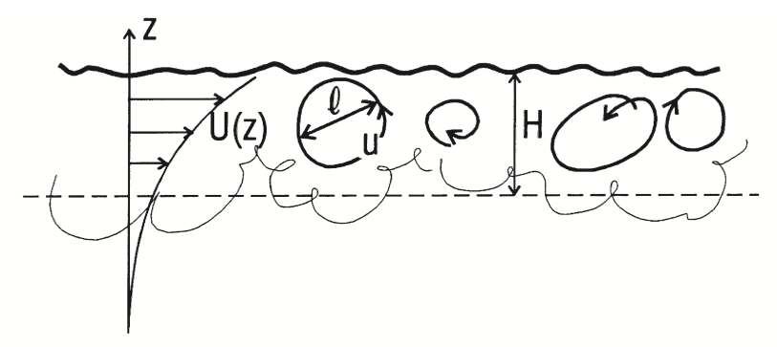
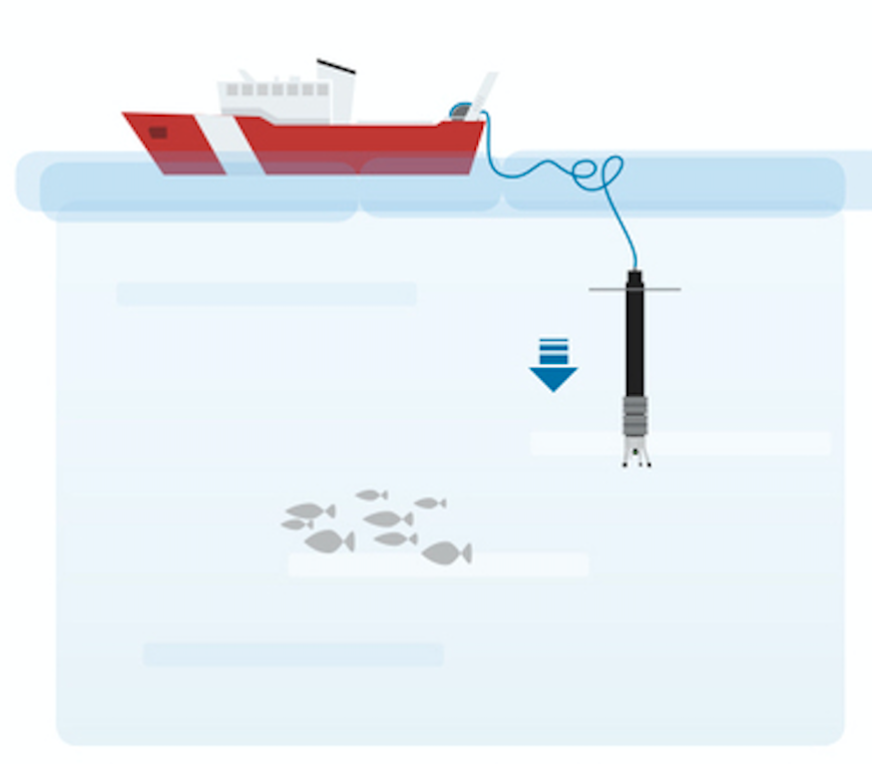
How do we quantify and measure vertical mixing rates?
Reynolds’ Decomposition (mean + turbulent flow):
Turbulent fluxes of properties:
- Turbulent eddy diffusivity, K_{z} (variable in time and space)
times a vertical gradient dP/dz (in analogy to viscous diffusion)
Microstructure shear sensors (cm-scale)
on Vertical Microstructure Profilers (VMPs)
Invoking “theory”:
Osborn (1980)
dissipation rate
(from microstructure obs)
mixing coefficient
stratification
    Breaks in low stratification conditions (N~0),
    like the surface mixed layer!
Notes:
The most immediate use of a vertical mixing rate is the quatification of turbulent fluxes
That are often parameterized (in analogy to viscous diffusion):
As a TURBULENT eddy diffusivity (in principle, variable in space and time)
times a vertical gradient
So the presence of a gradient (i.e. variations of the concentration in the water column, for instance) precludes a turbulent flux
The resolution of the dissipation profile depends on the profiling speed * length of data used to calculate. For a given length (typically 8s), the higher the W the smaller the resolution:
At 0.7 m/s (VMP)… epsilon ~ 3m
At 0.3 m/s (glider)… epsilon ~ 0.4m/s
Microstructure range of velocity fluctuations:
2-100 cpm in the surface mixing layer
In the coastal ocean, dissipation rates can be 1000 times larger.. Which means 10-600 cpm
i.e. the higher the turbulence level.. the smaller the scales one needs to resolve (higher wavenumbers)
Nearly all oceanic estimates of the rate of dissipation are made using some form of spectral
integration to derive the variance of shear.
The necessity of using Taylor's Frozen Field Hypothesis places a lower limit on the profiling speed
of an instrument.. (the time it takes to profile needs to be small compared to the timescales over which turbulence billows evolve)
for profiing speeds larger than 0.1m/s the turbulence is essentialy Frozen.
We measure in the dissipation range (as opposed to the larger scale eddies), because it requires a much shorter period to average over in order to get a statistically reliable estimate of epsilon
(otherwise one would need to average over 100s of eddies..)
The dissipation scale is almost always shorter
than 0.01m and a few hundred dissipating eddies are sampled in only 1m of profiling, or within
1 to 10 s, depending on the speed of profiler. That is the good news.
The bad news is that measurements in the dissipation range make far greater demands on the
characteristics of the sensors:
-
The speed of profiling cannot be chosen arbitrarily. The upper limit is set by the frequency
response of the probes.
VMPs equipped with microstructure velocity probes (shear probes), high-resolution
temperature sensors (thermistors), and high-accuracy CTD sensors
%%%%%%%%%%%%%%%%%%%%%%%%
\frac{\partial \overline{w' p'}}{\partial z} \sim \frac{\partial}{\partial z} (K_z \frac{\partial P}{\partial z})
K_z = \frac{\Gamma}{\overline{N}^2} \epsilon \quad [m^2 s^{-1}]

Slide 5
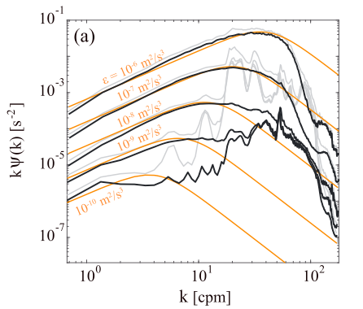
How do we quantify and measure mixing rates?
Reynolds’ Decomposition (mean + turbulent flow):
→ turbulent fluxes of properties:
- Turbulent eddy diffusivity, K_{z}
(parameterization, in analogy to viscous diffusion)
cm-scale u,v shear spectra
(obs + theoretical
For different epsilon regimes
Invoking “theory”:
Osborn (1980)
dissipation rate
(from microstructure obs)
mixing coefficient
stratification
    Breaks in low stratification conditions (N~0),
    like the surface mixed layer!
    Fisher et al. (2008)
Notes:
%% Difficulties of measuring directly turbulent fluxes (eddy covariances):
The need of a very stable platform (difficult in the ocean).. Any shi/ vehicle will be inherently subject to motion that will contaminate the velocity fluctutations signa;
Most velocity instruments ttend to have high noise signal (compare dto the ocean ssignals away from boundaries)
statistically reliable measurements takes a long time to sample
internal wave motions can be larger and difficult to separate from the turbulence signal
If one could hold sensors stable at a given location.. It would require measuring over long periods of time (~15 min) to get a statistically reliable estimate of a fluctuation (due to internal wave contamination), i.e. to sample ~ 100’s of eddies.
%% Parameterization, in analogy to viscous diffusion
Diffusivity times a gradiet of the property
% Invoking some theory..
Kz is directly proportional to the dissipation rates of TKE
(the stronger the stratification, the lower Kz.. i.e. in the deep ocean)
In the mixed layer.. N2, goes to zero.. And Kz → the eq blows up.
the model is not appropiate to estimate Kz low stratification conditions
With a focus primarily in the deep ocean.. Microstructure measure dissipation rates, which require to resolve the smaller scales of turbulence
Into the DISSIPATION RANGE,
the duration of the measurement to get a statistically reliable estimate of a turbulent flux is considerably smaller
The dissipation scale is almost always < 0.01 m = 1cm
Thus a few hundred (dissipative eddies) are sampled by profiling through 1 m of water column (or within 1-10s, depending on the speed of the profiler)
CONS:
BUT it implies greater demands on the characteristics of the sensors.. They need to measure cm-scale fluctuations!
AND be fast enough
MOREVOER, turbulence signals are spectrally red.. ~ k,f ^(-5/3)
So the sensor in the dissipative range, has to have much lower noise (than the ones used in the energy-containing scales)
% The smallest eddy size, Kolmogorov scale, ~1 cm will have a u_rms ~3 x 10 ^-5 m/s.
No acoustic sensor could possible measure that tha level of signal
%%%
\frac{\partial \overline{w' p'}}{\partial z} \sim \frac{\partial}{\partial z} (K_z \frac{\partial P}{\partial z})
K_z = \frac{\Gamma}{\overline{N}^2} \epsilon \quad [m^2 s^{-1}]

Slide 6
Scalability Assessment: Can we infer mixing rates in the upper-ocean from “coarse” resolution BGC float data?
Exploit the observation that biogeochemical tracer’s distributions show vertical gradients within the mixed layer (i.e. homogenized in density) to infer vertical eddy diffusivities in the surface layer
Phytoplankton production and nutrient demands → vertical diffusivities, Kz(z)
    (Eppley et al. 1979, King and Devol 1979, Lewis et al. 1986)
Photo-adaptation principles/theory in a turbulent layer → bulk mixed-layer diffusivity Kz
    (Lewis et al. 1984a, 1984b, Cullen and Lewis 1984, Falkowski 1983)
From vertical velocity variance (Large-eddy scales) → estimate dissipation rates → Kz(z)
(Gargett, et al. 1994, Rudnick et al. 2013; Beaird et al. 2012)
Tools and Approach
Notes:
In terms of the research outcomes that could leverage these datasets and products developed..
I envision a two-way interaction between the physics and biology or biogeochemistry…
In which indeed we make use of Kz from microstructure data to learn how mixing impacts on biology
But also, can we infer mixing from BGC signals?

Slide 7
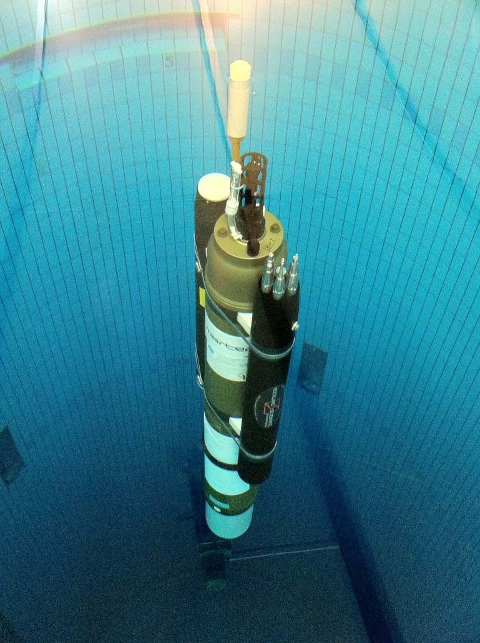
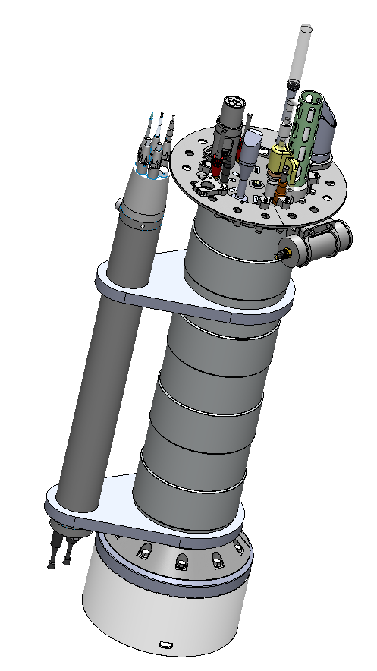
New Technology: Microstructure Sensors on Autonomous Platforms
1. Microstructure sensor’s Solutions from Rockland Scientific International (RSI):
      MicroRider Package (RSI):
          2 shear probes, 2 fast-response thermistors (FP07s, or χ-pods)
          2 vibrational sensors and inclinometer
          self-powered, self-logging → minimal engineering effort
          still expensive, but can be leased for a month (~13K)
      2. MBARI’s own Coastal Profiling Float (CPF)
      full control on profiling speeds
      higher payload capacity, full BGC sensor suite:
      CTD, nitrate, bio-optics (FLBB),
      radiometer (4 channel OR), pH and oxygen
Notes:
Here is when New technology and innovation comes in…
Microstructure sensors development is matured enough that..
and Microstructure sensor packages (from Rockland Scientific), specifically designed to be mounted on autonomous platforms are available
\item Chi-pods. These are fast-response thermistors that measure temperature microstructure, $\theta_z = \frac{\partial \theta}{\partial z}$, which allows to estimate dissipation rates of thermal variance, $\chi$.
\item Vertical Microstructure Profilers (VMPs, e.g. the VMP-250 from Rockland Scientific \url{https://rocklandscientific.com/products/profilers/vmp-250/}) measure micro-scale velocity shear, $u_z = \frac{\partial u}{\partial z}$.
\item Microstructure Package (MicroRider) can be mounted in different platforms, including floats (\url{https://rocklandscientific.com/products/modular-systems/microrider/}). Check this site for a list of MicroRider publications: \url{https://rocklandscientific.com/support/knowledge-base/publications/microrider-2/}
EM-APEX floats with microstructure
The slow profiling speed of EM-APEX floats enables them to capture the higher wavenumber regime of microscale temperature variation
Turbulence measurements derived from FP-07 sensors on autonomous
profiling floats are of comparable quality to those on conventional free-fall microstructure
profilers.
Microstructure sensors, measure cm-scale
Fine-scale, 1m-scale

Slide 8
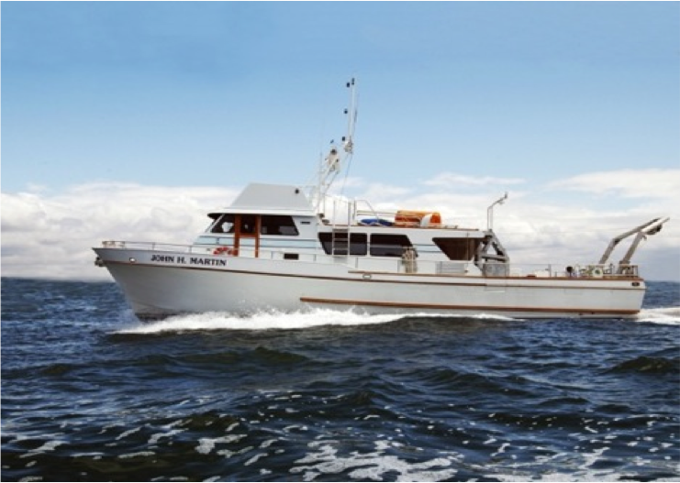
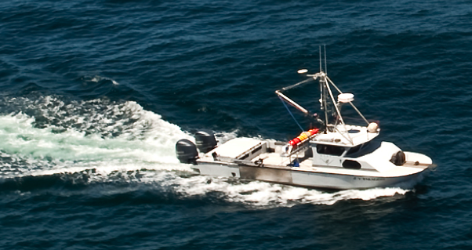
Strategy – Test Deployments
Integrate a MicroRider (full microstructure sensor package)
on the CPF to evaluate:
  - float’s behavior
  - quality turbulence signal
  (noise removal from additional sensors)
  Perform stability tests of CPF-MicroRider in the tank
  CPF float deployments and instrument recovery
  (from R/V Paragon or R/V John Martin)
2) Evaluate the feasibility of full integration
- Power & data telemetry integration
- OEM Float Kit (in development by RSI for float manufacturers),
would require significant engineering efforts
Notes:
We will aim to
%%%%%%%
Email from Judah on the OEM Float Kit:
The OEM Float Kit, on the other hand, would require engineering of a fully integrated solution - including:
- custom top cap with spacing adequate for 2x microstructure probe holders
- Microstructure sensors need to be positioned far enough away from other sensors / antenna / strobes / etc. to be the undisturbed flow on the ascent.
- Mounting and shielding of up to 3 boards within the float
- Power & data telemetry integration
- There are no high-accuracy vibration or tilt sensors
- Only up to 2-analog microstructure signals can be accommodated (ie - either 1x each shear & temp, or 2x of either)
The OEM Float Kit is currently designed and priced for sales only to float manufacturers, so that the integration support required for each float design would be leveraged across volume sales of each float design. If MBARI has plans to eventually transfer the CPF technology to a commercial manufacturer, this would be a worthwhile endeavor. However, for a single float project, I do not believe it would be worth the integration effort.

Slide 9
Scalability Assessment: Can we infer mixing rates in the upper-ocean from “coarse” resolution BGC float data?
Exploit the observation that biogeochemical tracer’s distributions show vertical gradients within the mixed layer (i.e. homogenized in density) to infer vertical eddy diffusivities in the surface layer
Phytoplankton production and nutrient demands → vertical diffusivities, Kz(z)
    (Eppley et al. 1979, King and Devol 1979, Lewis et al. 1986)
Photo-adaptation principles/theory in a turbulent layer → bulk mixed-layer diffusivity Kz
    (Lewis et al. 1984a, 1984b, Cullen and Lewis 1984, Falkowski 1983)
From vertical velocity variance → estimate dissipation rates → Kz(z)
(Rudnick et al. 2013; Beaird et al. 2012)
Tools and Approach

Slide 10
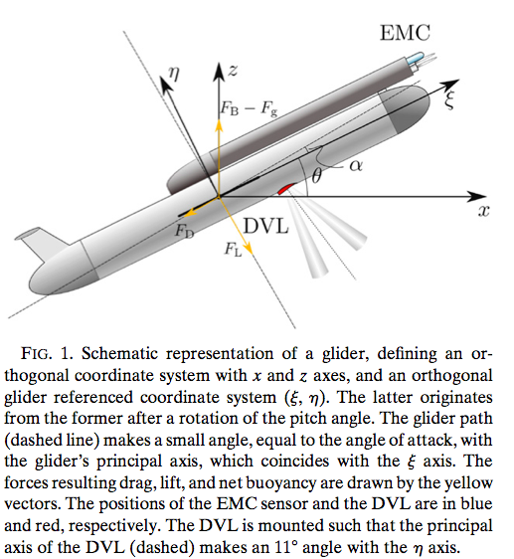
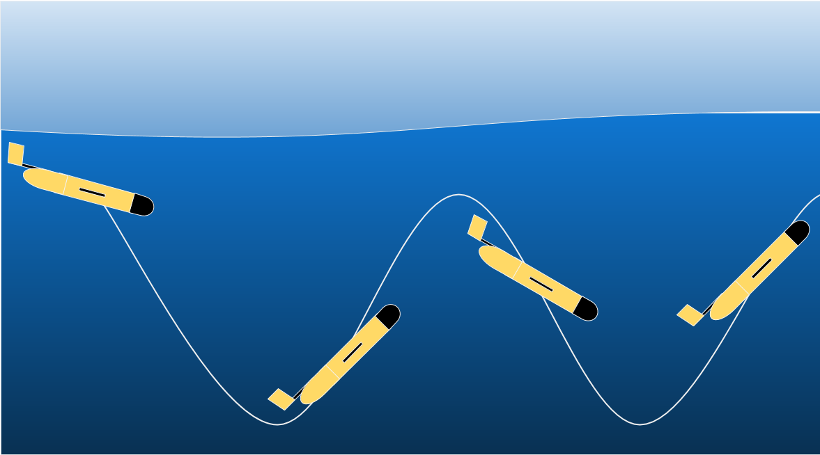
Vertical velocities from glider’s CTD data and steady flight model
Merckelbach et al. (2010) for a Slocum glider
Frajka-Williams (2011) for a Seaglider
Rudnick et al. (2013) for a Spray glider
Basic assumption:
water vertical velocity
vertical velocity that the glider would have if going
through still water
Low freq ~ flight
High freq ~ water motion
Notes:
A dive profile for Spray through still water would follow a smooth path down to the desired depth and back up to the surface.
Instead, the pressure sensor indicates that path is not smooth..
The vertical velocity, calculated by the first difference of depth, is characterized by
the glider’s flight at low frequency and
by internal waves at high frequency.
Thus, one way of getting at w from glider’s is to model what that path would look like through still water.. By means of a
w = w_{ctd} - w_{steady}
%% On Floats, AUVs/Gliders %%%%%%%%%
From https://www.geomar.de/en/research/fb1/fb1-po/observing-systems/floats-glider-auv/
“Floats, Gliders and AUVs differ fundamentally in their propulsion systems.
While floats are carried by ocean currents without any external control, AUVs and Gliders can independently move through the oceans. AUVs are driven by a conventional propeller and are characterized by their high speed and good controllability. Gliders however, have no propellers and can only move at relatively slow speed through the oceans (about half the speed of a pedestrian). Gliders share their ingenious propulsion system with floats. A high pressure pump can move oil from the interior of the pressure housing of the devices into a bubble outside of the housing and back. Thereby float and glider are able to change their density and similar to a submarine they move up and down in the water column.
While the float uses this vertical movement only to gain measurements over the entire depth range, gliders convert the vertical into an additional forward movement similar to the principle of a paper airplane.
All three new observation platforms share batteries as their energy supplier.
Their range is therefore limited. Because of their different propulsion systems differing andcomplementary measurement strategies are employed. On a single battery charge AUVs can for example travelfor one day along a pre-programmed up to 200 km long track. Gliders move, however, much slower and more economical in terms of their battery usage. Their deployments can last up to several months and the distance they cover can be well above 2000 km. Floats on the other hand are the energy saving champion.
They travel the oceans for up to 5 years. During this time they are carried along with the ocean currents and can therefore, depending on these highly variable flows, travel thousands or just a few dozen kilometers.”

Slide 11


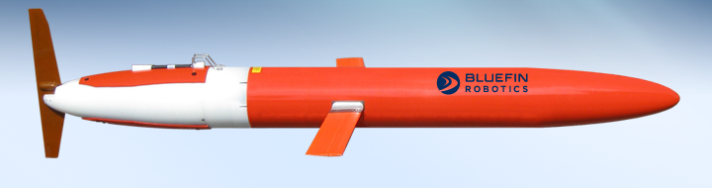

Vertical velocities from a Spray Glider
1) from a steady flight model along the glider’s path
+ additional filtering (to remove effects from model imperfections):
detrending (quadratic polyfit) + low-pass filtering (cutoff 100s)
Buoyancy ~ Drag
Solve for q: glider’s velocity (along its path)
2) detrending (quadratic polyfit) + low-pass filtering (cutoff 100s) + high-pass filtering (cutoff 5400s)
φ
    Rudnick et al. (2013), w from Spray Glider

Slide 12
Vertical velocities from a Spray Glider
RMSE for w ~ 0.005 m/s
    Rudnick et al. (2013), w from Spray Glider
Notes:
Gliders buoyancy control:
At the beginning of the dive, while on the surface, the glider’s external bladder is completely emptied to decrease buoyancy
Vacuumed out (no hydraulic pump current)
Vacumm valve closes at 50 m on descent..
The glider free falls on the way down..
2) Once it reaches the target depth, A hydraulic pump then fills the external bladder enough to achieve a desired upward buoyancy
3) As the glider rises, the pump runs three to four times per dive to maintain vertical velocity above 0.1 m
Spikes in velocity from ctd
%% On Floats, AUVs/Gliders %%%%%%%%%
From https://www.geomar.de/en/research/fb1/fb1-po/observing-systems/floats-glider-auv/
“Floats, Gliders and AUVs differ fundamentally in their propulsion systems.
While floats are carried by ocean currents without any external control, AUVs and Gliders can independently move through the oceans. AUVs are driven by a conventional propeller and are characterized by their high speed and good controllability. Gliders however, have no propellers and can only move at relatively slow speed through the oceans (about half the speed of a pedestrian). Gliders share their ingenious propulsion system with floats. A high pressure pump can move oil from the interior of the pressure housing of the devices into a bubble outside of the housing and back. Thereby float and glider are able to change their density and similar to a submarine they move up and down in the water column.
While the float uses this vertical movement only to gain measurements over the entire depth range, gliders convert the vertical into an additional forward movement similar to the principle of a paper airplane.
All three new observation platforms share batteries as their energy supplier.
Their range is therefore limited. Because of their different propulsion systems differing andcomplementary measurement strategies are employed. On a single battery charge AUVs can for example travelfor one day along a pre-programmed up to 200 km long track. Gliders move, however, much slower and more economical in terms of their battery usage. Their deployments can last up to several months and the distance they cover can be well above 2000 km. Floats on the other hand are the energy saving champion.
They travel the oceans for up to 5 years. During this time they are carried along with the ocean currents and can therefore, depending on these highly variable flows, travel thousands or just a few dozen kilometers.”

Slide 13
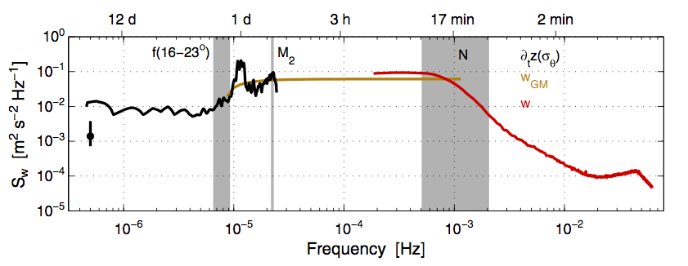
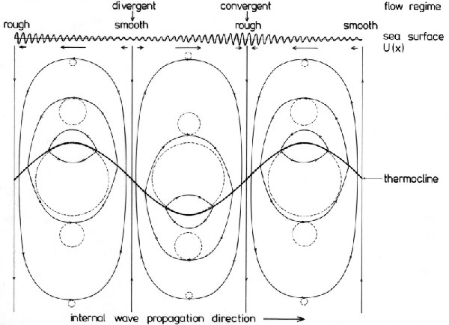
Internal Wave induced vertical motion
    Luzon Strait
Orbital velocities
Monterey Bay: T ~ 20 h – 15-50 min
Non linear waves: Solitons, internal bores
BREAKING internal waves → turbulent fluxes
Inertial
T ~ h
Buoyancy
T ~ min
Notes:
Associated with internal waves are orbital motions of the water particles as depicted in Fig. 1 (the dashed circular lines). The radius of the circular motion of the water particles is largest at the pycnocline (or thermocline) depth and decreases downwards as well as upwards from this depth.

Slide 14

Dissipation rate estimates from w
Large Eddy Method (LEM):
velocity scale of the largest (energy-containing) eddies
time it takes to overturn once
their length scale
For stratified flow,
(Ozmidov Scale)
calibration coefficient (determined from MR casts)
buoyancy frequency/stratification
    Following Beaird et al. 2012; Greene et al., 2015; Gargett (1994,1999)
Notes:
- based on a simple scaling of the turbulent kinetic energy (TKE) equation (Taylor 1935).
- Hypothesis: that a steady turbulent energy cascade exists, which allows measurements of the relatively large energy-containing scales to be used to infer the energy loss at viscous scales (Moum 1996).
“Energy is introduced to the turbulent flow by instabilities in the large-scale mean. In a steady state, this energy must be passed to smaller and smaller scales until it can be dissipated by viscosity.
the Kolmogoroff scale, the dissipation scale for ocean turbulence can be on the order of millimeters… way smaller than the scales measured by CTD on a glider
Assuming no leakage of energy (by, for example, nondissipative linear internal waves), the cascade of TKE may be described by the energy of the largest eddies in the turbulent flow and their overturning time scale (Tennekes and Lumley 1972).
Physical interpretation of Eq: the kinetic energy (q’)2 of a turbulent eddy is dissipated in the time it takes to overturn once, tau
Eq holds in a variety of oceanic regimes, including regions of low average dissipation containing sporadic energetic events (Peters et al. 1995)
For stratified flow, a modification may be obtained by using the Ozmidov length LOz 5 «1/2N23/2 for l in Eq. (5).
% From large eddy scales one can also derive (by dimensional analysis), and estimate of diffusivity:
K \sim q^{\prime} l , [\frac{m^2}{s}]
From Gargett (1997), referencing the book “First Course in Turbulence” by Tennekes and Lumley (1972), Section 1.5, Or equation 1.4.9
NOTE from TL1972:
It should be noted that this is a dimensional estimate, which cannot predict the numerical values of coefficients that may be needed. Expressions like these, with experimentally determined coefficients, are used frequently in practical applications.
K~u*l arises from dimensional analysis of heat diffusion eq.
The Ozmidov length is a measure of the maximum vertical overturn displacement that may occur for a given turbulent energy level and stratification (Thorpe 2005).
ADVANTAGE: IMPLICIT DEPENDENCE on the length scale// through the scale over which vertical velocities fluctuate
Presence of N could be problematic in the mixed layer
Ann Gargett (1999).. Applied this method to ADCP data.:
Why Vertical kinetic energy?
Equipartition of energy between waves and turbulence (unlike horizonta kinet energy that is anisotropic)
ADCP measures w through the water column
3) Large vertical velocities is a necessary, if not sufficient, condition for the existence of turbulence.
NOTE: Inhomogeneity in the turbulent structures, requires determination of length scale locally
Upper bound for l (largest possible eddies).. Gives a lower bound for epsilon
However, this is likely a relatively small contribution to error in e compared with error in q’, which enters the Eq as the cube.
%%%%%%%%%%%
e =c_{\epsilon} N (q^{\prime})^2
l \sim L_{Oz} = N^{1/2} \epsilon^{3/2}

Slide 15
Dissipation rate estimates from glider’s CTD data
Large Eddy Method (LEM):
velocity scale of the largest eddies
time it takes to overturn once
their length scale
For stratified flow,
(Ozmidov Scale)
calibration coefficient
buoyancy frequency
    Following Beaird et al. 2012
Notes:
- Based on a simple scaling of the turbulent kinetic energy (TKE) equation (Taylor 1935).
- Hypothesis: that a steady turbulent energy cascade exists, which allows measurements of the relatively large energy-containing scales to be used to infer the energy loss at viscous scales (Moum 1996).
“Energy is introduced to the turbulent flow by instabilities in the large-scale mean. In a steady state, this energy must be passed to smaller and smaller scales until it can be dissipated by viscosity.
the Kolmogorof scale, the dissipation scale for ocean turbulence can be on the order of millimeters… way smaller than the scales measured by CTD on a glider
Assuming no leakage of energy (by, for example, nondissipative linear internal waves), the cascade of TKE may be described by the energy of the largest eddies in the turbulent flow and their overturning time scale (Tennekes and Lumley 1972).
Physical interpretation of Eq: the kinetic energy (q’)2 of a turbulent eddy is dissipated in the time it takes to overturn once, tau
Eq holds in a variety of oceanic regimes, including regions of low average dissipation containing sporadic energetic events (Peters et al. 1995)
For stratified flow, a modification may be obtained by using the Ozmidov length LOz 5 «1/2N23/2 for l in Eq. (5).
The Ozmidov length is a measure of the maximum vertical overturn displacement that may occur for a given turbulent energy level and stratification (Thorpe 2005).
ADVANTAGE: implicitly depend on the length scale// through the scale over wich vertical velocities fluctuate
Presence of N could be problematic in the mixed layer
Ann Gargett (1999).. Applied this method to ADCP data.:
Why Vertical kinetic energy?
Equipartition of energy between waves and turbulence (unlike horizonta kinet energy that is anisotropic)
ADCP measures w through the water column
3) Large vertical velocities is a necessary, if not sufficient, condition for the existence of turbulence.
%%%%%%%%%%%
e =c_{\epsilon} N (q^{\prime})^2
l \sim L_{Oz} = N^{1/2} \epsilon^{3/2}

Slide 16
Dissipation rate estimates from vertical velocity variance: Glider Survey in MB
Large Eddy Method (LEM):
velocity scale of the largest eddies
time it takes to overturn once
their length scale
For stratified flow,
(Ozmidov Scale)
calibration coefficient
buoyancy frequency
    Following Beaird et al. 2012

Slide 17
Basic requirements for microstructure turbulence measurements
Sensor placement (unperturbed flow, extremely fragile sensors)
Platform moving smoothly, at profiling speeds ~ 0.2 - 1 m/s
(Taylor’s “frozen” turbulence hypothesis + freq response of the probe, f = V * k)
- Quiet platform: minimal mechanical vibrations & electronic noise
in the dissipation range
- Angle of attack: +/- 10 deg
    RSI VMP-250 Workshop Course Notes
Notes:
Typically made from a free falling profiler (e.g. effort to obtain this time of measurements form autonomous platforms)
upper and lower bounds for profiler speed to capture the full range of dissipation scales (k ~ 1-100 cpm, though dependent on epsilon)
Turbulent eddies evolve slowly over time.. One can consider the flow characteristics to be “frozen” as the profiler passes through them
i.e. the measurement time interval from bottom to surface needs to be SHORT compared to the turbulent eddy time scales
Taylor Frozen Field Hypothesis:
Measurements made in the temporal domain,
But turbulence is typically described by their spatial scales
Conversion from FREQUENCY Spectra to a WAVENUMBER Spectra, which requires multiplying by the profiling speed
Requirements for profiling:
Probes must be smaller 1 cm, to resolve wavenumbers as large as 100 cpm
Platform must profile smoothly
The UPPER limit of the profiling speed is set by the freq response of the probe
f= U* k (any
\frac{\partial \overline{w' p'}}{\partial z} \sim \frac{\partial}{\partial z} (K_z \frac{\partial P}{\partial z})
K_z = \frac{\Gamma}{\overline{N}^2} \epsilon \quad [m^2 s^{-1}]

Slide 18

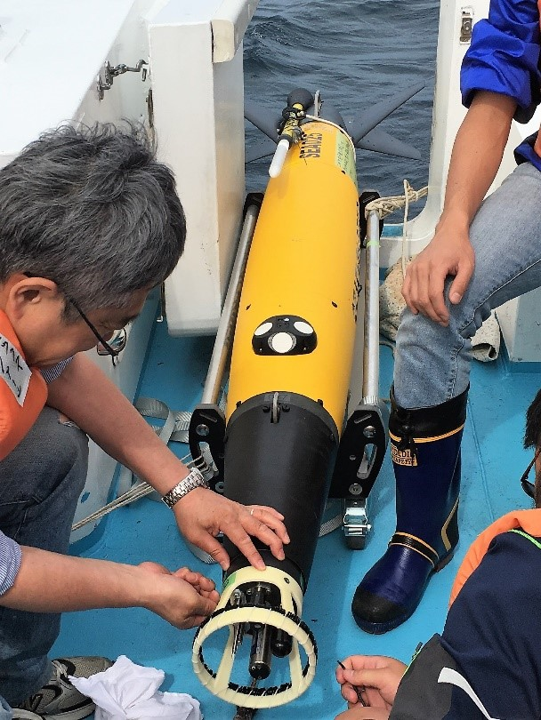
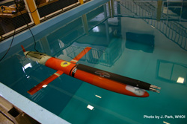
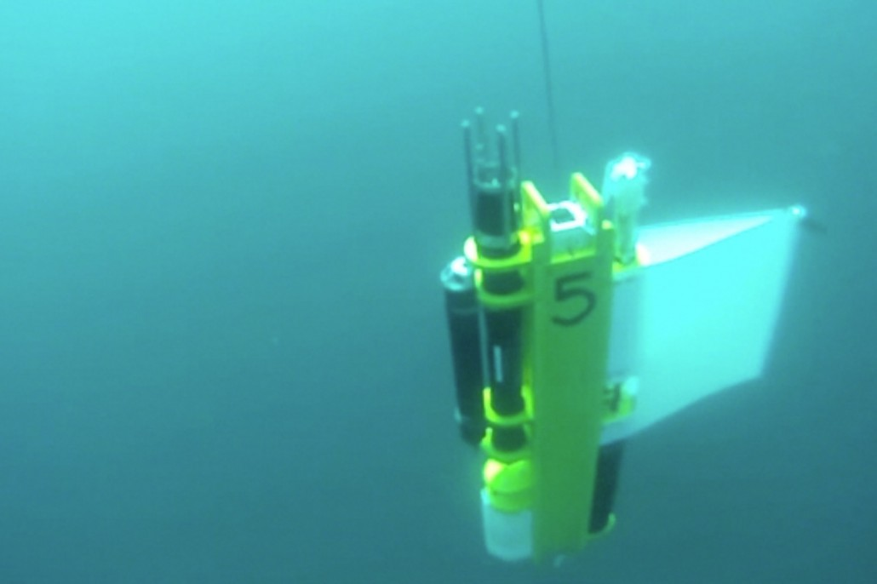
MicroRider-1000-WW Specifications
SeaExplorer Glider
Dimensions: ~ 1m (w/probes)
Weight: 5.5 kg in air, ~0 kg in water
Power: 9-18 DVC supply,
Consumption ~ 1 W sampling, 10^⁻⁵ sleep
Sampling rates:
Shear probes, 512 Hz
CTD, 64 Hz
Mode of Operation
(continuous vs cyclic sampling)
Data Storage ~ 64 GB
Outputs ~ 8192 bytes/s
APEX-float
Spray Glider
WireWalker
Notes:
Self contained Package:
Record data internally (up to 64 GB)
Standard configuration:
2 shear probes, 1 fast-response thermistor (FP)7, extremely fragile.. Glass-type material).
2 vibrational sensors (high- accuracy accelerometers, for noise removal)
1 tilt sensors (angle of attack)
It can be powered by any 12 VDC supply, and can be turn on and off REMOTELY?
data collection controlled by a simple ON-OFF signal. Thus. Ideal for AUVs, glider’s etc
Want to sample only on the UPCASTs, will require clock synchronization
PROTECTIVE CAGE?

Slide 19
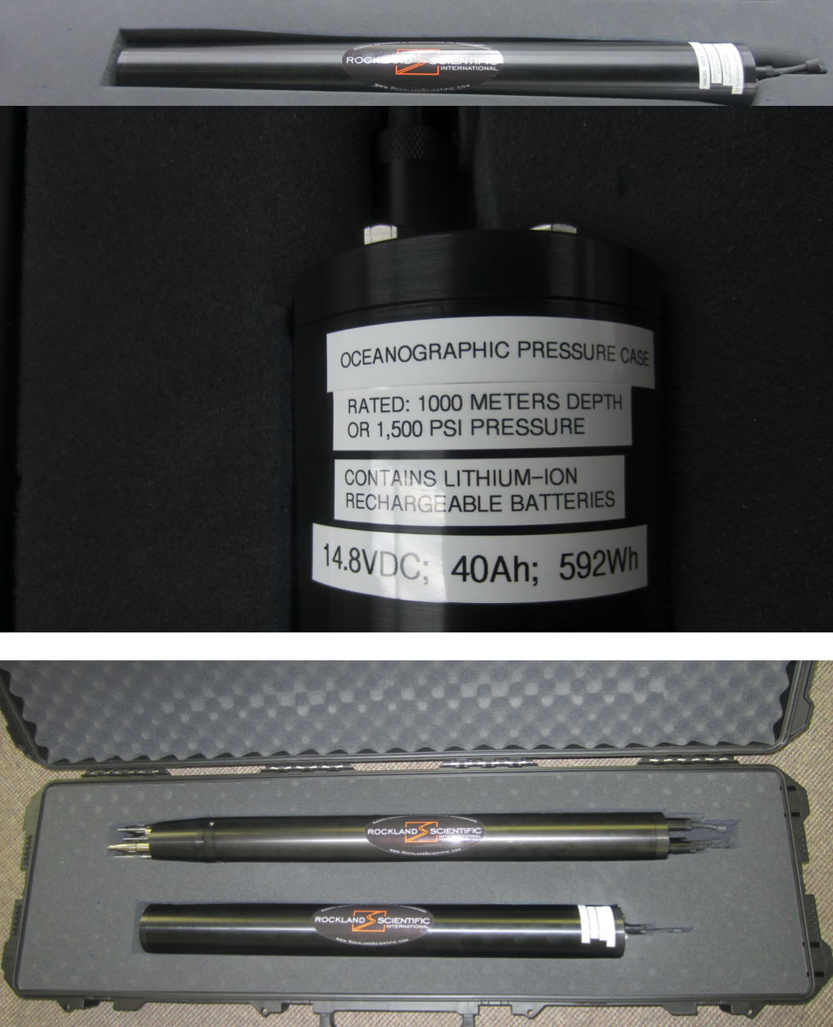
High-energy Battery Pack
Length: ~ 1 m (w/probes)
Weight: ~ 0 kg in water
14.8 VDC (Li-Ion), rechargeable
~ 48 hours of continuous sampling
(# of upcast profiles to ~ 200m depth?)
APEX-float
Spray Glider
WireWalker
Notes:
We are purchasing the battery Pack

Slide 20
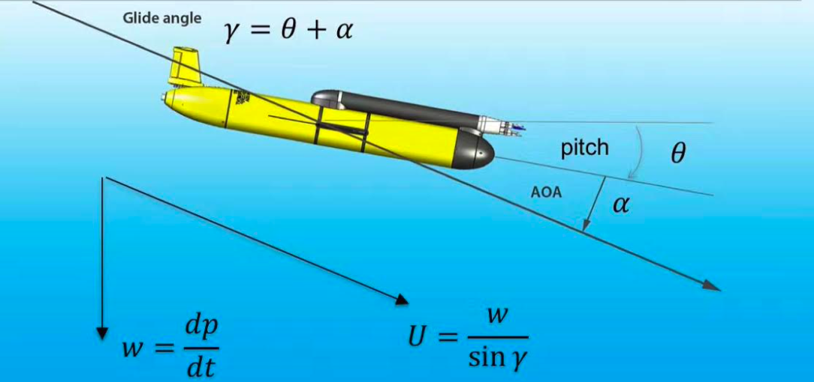
CPF Spray Gliders
Minimize pitch/roll and buoyancy adjustments
Angle of attack : ~+/3 deg
Test deployments:
Minimize potential sources of vibrations & electronic noise
Stability can be compromised
Removal of coherent noise
(RSI Technical Note ­028)
w_p ~ 0.4 m/s
Dynamic model
CTD + full set of
BGC sensors
(ISUS, bio-optics, transmisometer)
External battery power
Target depth/
sampling?
Mission length?
Drift vs anchored mode
w_p ~ 0.2 m/s (suboptimal)
Dynamic model/filtering
CTD + fluorescence +
Oxygen, but no ISUS
Spray powered?
Targeted sampling,
deep MLD
Longer Science Mission
Schematic, courtesy of RSI Technical Note-022
Notes:
CPF:
Turbulence sensor needs to be higher up.. Pass throught the antenna (?) to measure “unperturbed flow”
“anchoring” mode vs parked at depth (float would drift with currents):
I presume the float stands in the bottom, but chances that it could get tilted by strong bottom currents?
Sensors are EXTREMELY FRAGILE..
SAFER to park it at depth..
State of development of the Inertial Measurement Unit (Current Meter).. Are we going to be able to keep the float within x km of an offshore region?
Or drifting could be a problem for recovery?

Slide 21
Discussion
Platform (Plan A: CPF, Plan B: BOG-CPF, Plan C/Z!?: Spray glider, LRAUVs?)
(profiling speeds, sensors on board, range/recovery, targeted sampling, mission length)
Deployment Strategy
(eng lab/at-sea test deployments vs science missions)
get as many ε(z) profiles as possible, capturing the diurnal cycle
Deployment Sites
upper water column (target depth ~200m), ideally deep mixed layers
Timeline
Phytoplankton blooming season, spring/fall (not too stratified or strong upwelling)
Notes:
COF: no “anchoring” mode is desirable

Slide 22
Pre-MR arrival Tasks
CPF readiness, buoyancy control adjustments? Output for w_water?
Sensor placement
Design brackets (MR and battery pack)
Protective cage?
Cables, connectors
Tools
Battery Power: # of profiles to 200m in cyclic mode, how long to fully recharge?
Data Telemetry? (Evaluate/Discuss before May Proposal deadline)
Go through the MicroRider-1000-WW Manual
Instrument Communication protocols
Familiarize with processing software: ODAS MATLAB Library and Zissou Essentials (Windows only)
Data visualization and post-processing (VMP-250 Workshop Materials)
Identification of mechanical noise & removal
Notes:
There will still be sufficient work just to make sure mechanical noise is reduced and/or accounted for in post-processing, the vehicle(s) provide enough of a consistent angle of attack and speed - in order to obtain quality turbulence estimates
CPF: “drift” vs “anchoring” mode
Anchoring mode pros cons:

Slide 23
Tank Tests
Bench Tests
Instrument communication
- RSI checklist
ideally,
2 weeks max
Float’s stability
Optimal profiling speed
Consistent angle of attack
Vibrations & electronic noise
Clock’s syncing for cyclic sampling
At-sea engineering tests
Deploy nearby, within the canyon axis for 2 days
(recover to ensure data acquisition, data quality)
Recharge battery overnight, redeploy the next day for 2 days

Slide 24
Science Missions ( 2 weeks)
Gather as many ε(z) profiles as possible, 1-2 week deployments
(MR battery-power dependent)
- As many BGC sensors as possible (optics, radiometer, isus would be a plus)
Target depth ~200 m
Capture the diurnal cycle (~ 1 profile every 1-2h)
Phytoplankton blooming season, spring/fall when mixed layers can be deep (storms)
High and low turbulence environments (e.g. Canyon axis and @ or past M1)
CPF: “drift” vs “anchoring” mode?
Notes:
CPF: “drift” vs “anchoring” mode
Anchoring mode pros cons:

Slide 25
Timeline
MR Lease for ONE month
Upwelling
Shadow
(low ε)?
Canyon
Mouth
(high ε)
April
May
June
July
Aug
Sep
Oct
Nov
Dec
Spring CANON cruise
Original Target Date
(CPF)
Fall CANON cruise
/atlas.shore.mbari.org/ProjectLibrary/Mixing Rates – 902108
/Rockland_VMP-250 : Workshop Materials
Notes:
Original Target Day was set for June….

Slide 26
Tasks TO DO to meet June deadline
CPF Buoyancy control adjustments?
Canyon
Axis
Feb
Mar
April
May
June
…
Oct
Nov
Dec
MARS?
brackets?
protective cage?
weather-dependent
for R/V Paragon
Target for Deployments
(CPF)
/atlas.shore.mbari.org/ProjectLibrary/Mixing Rates – 902108
/Rockland_VMP-250 : Workshop Materials

