Slide 2
Everything You Ever Wanted To Know About Functional Global Variables
Nancy Hollenback
Field Architect

Slide 3
Agenda
What is a functional global variable (FGV)?
Does the FGV prevent race conditions?
Is the FGV better than the global variable?
Which use cases are a good fit for FGVs
Is there a better way? (DVRs)
Notes:
The goal of this session is to promote the responsible use of functional global variables (FGVs). The newer user may be unaware of FGVs and the role that they play in LabVIEW development. Some developers over use FGVs and should consider another technique for global data storage.

Slide 4

Why Do We Need Functional Global Variables?
  A large application usually has many processes executing concurrently
  Processes need to share data or send and receive messages.
User interface
IO Engine
Alarm Engine
Control Model
Data Logger

Slide 5
Inter Process Communication
Typically straightforward use cases with limited implementation options
  Store Data
  Stream Data
  Send Message
Many more variations, permutations, and design considerations

Slide 6
Store Data
  Data is stored and made “globally” accessible
  Storage mechanism holds only the current value
  Other code modules access the data as needed
  The potential for race conditions must be considered
UI Process 1
Headless
Process 1
Headless
Process N
Use Cases
Configuration data Slowly changing data Non-critical messages
“Global Data”
Notes:
By comparison, consider typical messaging mechanisms such as queues. These types of data communication implementations invoke some type of action. When an element is enqueued, the dequeue will immediately run, receiving the message with a command to process. In the classic producer/consumer design pattern, the producer loop will cause an action to occur in the consumer loop.
In contrast, global data storage is simply a memory location that stores data. Any process that needs the data must fetch the data. As such some type of polling would be required for regular retrieval of the data.

Slide 7
Functional Global Variables – Benefits
  Provide global access to data while also providing a framework to avoid potential race conditions.
  Encapsulate data so that debugging and maintenance is easier
  Facilitate the creation of reusable modules which simplifies writing and maintenance of code
  Program becomes more readable.

Slide 8
Functional Global Variable - Review
The general form of a functional global variable includes an uninitialized shift register (1) with a single iteration For or While Loop
Notes:
This is information straight out of Core 1.
You can use uninitialized shift registers in For Loops or While Loops to hold data as long as the VI never goes out of memory
Place a loop within a subVI and use the shift registers to store data that can be read from or written to, similar to a global variable
This method is referred to as a functional global variable
The advantage to this method over a global variable is that you can control access to the data in the shift register

Slide 9
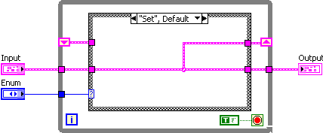
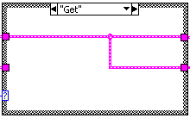
Functional Global Variables
  A functional global variable usually has an action input parameter that specifies which task the VI performs
  The VI uses an uninitialized shift register in a While Loop to hold the result of the operation
Notes:
This is information straight out of core 1

Slide 10

Best Practices for Documentation
The action/method control should be a type defined enum.
Make “get” the default action/method.
Consider making the action/method required.
Include this in the label.
Wire to the top connector
Notes:
The developer of the FGV or action engine wants to avoid the situation in which the someone uses the FGV, forgets to wire the method and then accidentally changes the state of the FGV. Making the “get” method the default prevents this. Additionally, making the method/action a required terminal will force the user to specifically wire to the input as well.

Slide 11
Functional Global Variables – History
(LV2 Style Global, Action Engine, VIGlobals, USRs, Components)
  Global data storage mechanism prior to the introduction of the global variable in LabVIEW 3
  Foundational programming technique that has been in extensive use in the LabVIEW community
Note: The behavior of an uninitialized shift register was not defined in LabVIEW 1.0
Notes:
Functional Global Variables – History
The functional global variable has a fascinating history. Prior to the release of LabVIEW 2, the value of the initialized shift register had not been defined. This was during the time period in which LabVIEW was black and white and required the developer to disconnect all of the terminals to move an icon. With the release of LabVIEW 2, the LabVIEW development team wisely determined that the uninitialized shift register would retain its previous value. The alternative would have been that it revert back to the default value of the data type.
Subsequently, with the release of LabVIEW 2, this technique became the methodology for storing global data in LabVIEW. The native global variable was not introduced until LabVIEW 3. But even with the introduction of the native global variable, the functional global variable remained a popular programming technique for global data storage.

Slide 12
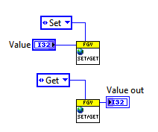
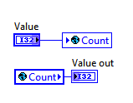
Replacing Global Variables with FGVs
This is a common initial use case.
Notes:
The overly simplified message that reaches to LabVIEW community is “don’t use globals, use functional globals to prevent race conditions.” However, as we shall see, it’s not just the functional global encapsulation that prevents the race conditions. So let’s evaluate what this simple set & get functional global provides us.

Slide 13
Demo
Main – Using a Global
Notes:
This is a initial demo that includes a global variable for storing data.
Run Main – Using a Global.vi in the Simple Get-Set FGV virtual folder.
Show the block diagram.

Slide 14
Demo
Main – Using a Simple Set-Get FGV
Notes:
The global variable has now be replaced with an FGV.
Run Main – Using a Simple Set-Get FGV.vi in the Simple Get-Set FGV virtual folder.
Show the block diagram.

Slide 15

Do FGVs Eliminate Race Conditions?
What if the FGV includes only set and get methods?
VI-1.vi
Modify
Data
VI-2.vi
Modify
Data
What happens when 2 VIs call the get and both modify the data before either has called the set?

Slide 16
Demo
Race Condition with a Set-Get Functional Global Variable
Notes:
Run Race Conditions >> Main – Race Conditions with Set-Get FGV
Open the block diagram. Note that Total Iterations should equal Current Value FGV after running the program. However, each time the program runs Current Value FGV is equal to half of the Total Iterations. Since the LabVIEW execution system processes both loops concurrently, or rather time slices between the two, and since the “critical section” of code is not protected, both loops are modifying the count at the same time. As such half of the counts are missed.
This example exaggerates the problem with the inclusion of the 100 msec delay. Typically these types of race conditions are not so obvious. It might be something that occurs occasionally. As such it can be very difficult to spot.

Slide 17
Use FGVs to Protect Critical Sections of Code
Identify a critical section of code, such as the modification of a counter value or a timer value.
Identify the actions that modify the data (increment, decrement)
Encapsulate the entire get/modify/set steps in the FGV
This is commonly called an Action Engine. It is a special type of FGV.

Slide 18
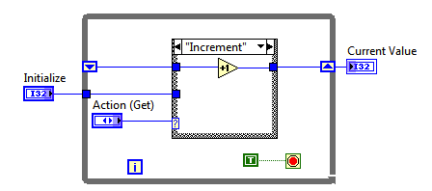
FGV – Action Engine Protects Critical Sections of Code
FGV Counter.vi
Get
Modify
Set
This action engine wraps the “get/modify/set” around the critical section of code.

Slide 19
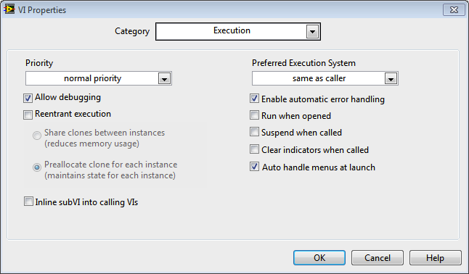
Sidebar: Execution Properties – Non Reentrant Execution
  VIs are non reentrant by default
  The LabVIEW execution system will not run multiple calls to the same SubVI simultaneously

Slide 20

Sidebar: Reentrant vs. Non-Reentrant
Non reentrancy is required for FGVs
Reentrancy allows one subVI to be called simultaneously from different places.
  To allow a subVI to be called in parallel
  To allow a subVI instance to maintain its own state
State (or the data that resides in the uninitialized shift register) is maintained between all instances of the FGV
Data Space
Data Space
Data Space
Notes:
This is information that is taught in the LabVIEW Performance course.
Reentrant VIs have two different uses. For performance, it is important to understand that a VI must be marked as reentrant so that you can call it from two spots simultaneously.
Functional global variables must be non-reentrant to maintain state between calls. If two calls are made to a non-reentrant VI simultaneously, one call must wait until the other call is complete. This may slow execution.
If you have a subVI that performs an operation, such as searching a data structure is passed to the subVI from the calling VI, but it is called in multiple places, this subVI is a good candidate for being reentrant because it does not need to maintain information from other calls.
Deciding if a VI should be reentrant or not requires you to decide if optimizing for memory usage or optimizing for execution speed is more important. Having multiple instances in memory improves execution speed but increases memory usage. VIs must be reentrant in order to call themselves recursively.

Slide 21

Non Reentrant VIs Block Other Calls
These two VIs are non reentrant by default
They cannot run simultaneously
One will run until completion and block the other from running until completed.

Slide 22

Shared Clones vs. Preallocate clones
  20 unique Instances of a reentrant VI
  During execution, max of 3 instances called simultaneously
  Preallocate – 20 Clones
  Shared Clones – 3 Clones
Time
Notes:
This slide is from the performance course. It is hidden as it does not directly address the topic of the presentation. It is included in the presentation materials as it is
The Preallocate clones reentrancy option allocates a clone for every instance of a reentrant subVI in your application. This means that if a reentrant VI has 20 instances in your code,
20 clones are allocated at the start of execution.
Shared clones, added as a reentrancy option in LabVIEW 8.5, allocates a pool of clones for use during execution. At any given time during execution, you may only simultaneously call two instances of your reentrant subVI. This option allows only two clones to be allocated and reused by different instances when needed. If, at some time during the execution, you require three clones, a third clone is allocated at run time. This option induces jitter, so is not recommended if jitter is a concern. Also, this option cannot be used if each instance needs to maintain its own state. This will, however, reduce the overall memory usage if only a few clones are needed at any given time.

Slide 23
Action Engines Protect Critical Sections!
VI-1.vi
VI-1.vi
Modify
Data
VI-2.vi
VI-2.vi
Modify
Data
The FGV will block other instance from running until it has completed execution. Therefore, encapsulating the entire action prevents the potential race condition.

Slide 24
Demo
Avoid Race Conditions!!! Fully encapsulate the get/modify/set.
Action Engine FGV
Notes:
Run Race Conditions >> Main Race Conditions Avoided with Action Engine.vi
Note that in this instance, the FGV returns the correct information. Each instance of the action engine blocks the other until the critical section of code executes.
Note also that this Action Engine includes an unnecessary delay so that the example is comparable to the Set-Get FGV.

Slide 25
Globals vs FGVs
Globals are significantly faster.
FGVs allow for extra code to check for valid data.
Notes:
Remember that a global variable is actually a special kind of VI. The diagram is removed and the global values are placed on the front panel.
The benchmark indicates that the Global is about 7x faster than the FGV for a simple increment in a loop that runs 1,000,000 times. The benchmark code is in the benchmark folder.

Slide 26
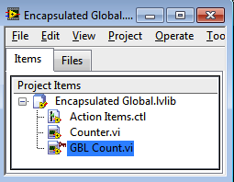
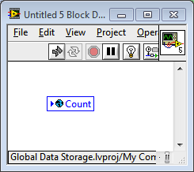

Encapsulated Global
Create a global variable
Add it to a project library and set access scope to private
Private VIs cannot be used outside the .lvlib
Notes:
Note the broken

Slide 27
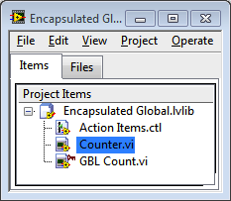

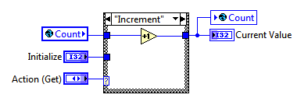
Encapsulated Global
Create the VI in the lvlib, that will act on the privately scoped global variable.
Notes:
This is an idea was recommended on the forums by a very knowledgeable LabVIEW developer. It has not yet been widely adopted at this time.

Slide 28
Demo
Consider locking and password protecting the .lvlib
Encapsulated Global
Notes:
Run Encapsulated Global >> Main – Using an Encapsulated Global.vi
Open the block diagram.
Open the Counter.vi
Explore the similarities with the previous solution
Show that code breaks if the global is called from a VI that is not a member of the .lvlib
Remind everyone that locking the .lvlib will not only prevent edits, but also make the global and any other private data hidden in the project.

Slide 29
Reusable components with FGVs
Recall that FGVs encapsulate the data and functionality and as such are a good design pattern for building reusable components
Consider using a FGV as a look-up table.
Name | Password
John | 66ford90
Mary | spring2012
Array of names has corresponding array of values or datasets
Notes:
Reusable components:

Slide 30


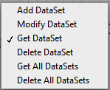

Name Value Look Up Table
Define the data type of the value that is associated with the name.
Modify the method to include all actions to perform related to adding, getting, and deleting items from the list.
Add code to ensure whether data is valid

Slide 31
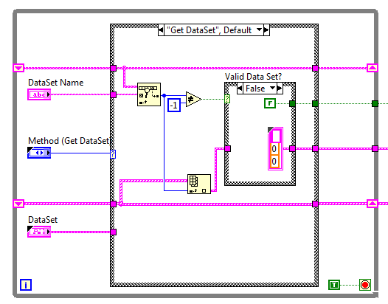
FGV – Resource Storage
Design pattern for a key-value look up table.
Array of names has a one-to-one correspondence to the array of data sets
Does not protect against race conditions
Allows for the qualification of valid data

Slide 32
demo
FGV Password Storage

Slide 33
Resource Storage FGVs
Build drop-in reusable components.
Provide protection and validation of data.
Susceptible to race conditions.
Can be used to store:
  References (User Events, DVRs, etc)
  Information about devices
  Paths for data storage
  Operator information
  Anything that requires a name-value lookup
Notes:
Note that with reference storage, you may want to remove the modify from the list of methods as a reference would never be modified.

Slide 34
Demo
Creating Your Own Resource FGV
Notes:
Create new from the *.vit.
The two type defs (data and the methods) are saved as *.ctt, so you will be required to save those unique type defs that correspond to the new FGV.
Once complete, edit the data set as needed and you are done!

Slide 35

What if You Need Multiple Counters…
  Reentrant functional global?
  Array manipulation of the functional global data?
  Perhaps there is a better way…
?

Slide 36
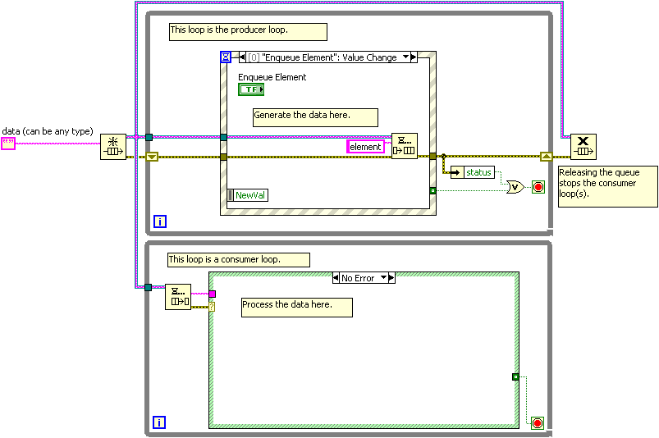
Review of Queues and References
Reference is a pointer to the data
The wire contains the reference, not the data.
Forking the wire creates a copy of the reference, not a copy of the data
Access data through methods (VIs)
Developer controls the creation and destruction of the data
Notes:
You already conducted a thorough evaluation of the Producer/Consumer (Events) design pattern, but you are now going to see how this pattern plays a very foundational role in the primary templates that your team will use.

Slide 37
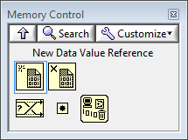
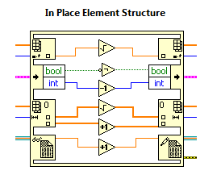
What is the Data Value Reference (DVR)?
This is a simple way to wrap a reference around any type of data.
Create & Destroy
Modify

Slide 38
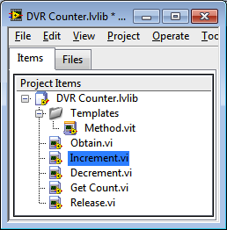

Data Value Reference (DVR) Library
Create a constructor and destructor.
Create a template for the methods.
Create a method for each case that will modify the data.

Slide 39
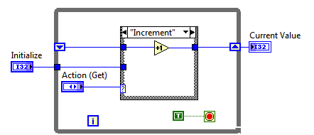

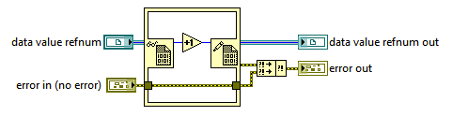
Creating a DVR from an FGV
If you already have an FGV, you can easily transform it into the more flexible DVR library.
Create the constructor and destructor.
Create a method (VI) for each case that was in the FGV.

Slide 40

Data Value Reference (DVR) - Library
Reference acts as a pointer to the data
Create unlimited instances
Easily expand the library

Slide 41
Demo
Using a DVR Library
Notes:
Run DVR >> Main – Using a DVR.vi
Show the block diagram.

Slide 42
DVR Library Design Issues
Easily add new methods (VIs) to the library as needed.
Create a library that has a similar look and feel to native APIs (Queues, Notifiers, Semaphores)
Identify the owner of the library who will update and maintain the library.
Anyone with Core 1 & Core 2 understanding can use the DVR library.

Slide 43
demo
Add a Method to the DVR Library
Notes:
From the template, create a new method to reset the counter.
Then add this method to the demonstration.

Slide 44
Summary Slide
Add content

Slide 45
What Else Do I need to Know?
Typically straightforward use cases with limited implementation options
  Store Data
  Stream Data
  Send Message
Many more variations, permutations, and design considerations
Notes:
We’ve only explored the myriad ways to store data in a LabVIEW application. We may need to stream data or send messages.

Slide 46
Various Inter-process Communication Methods
 | Same target Same application instance | Same target, different application instances OR Different targets on network
Storing -Current Value | Single-process shared variables Local and global variables FGV, SEQ, DVR CVT Notifiers (Get Notifier) | Network-published shared variables (single-element) CCC
Sending Message | Queues (N:1) User events (N:N) Notifiers (1:N) User Events | TCP, UDP Network Streams (1:1) AMC (N:1) STM (1:1)
Streaming | Queues | Network Streams TCP
Notes:
Various Inter-process Communication Methods
This table lists various inter-process communication methods organized by scope and transfer type. This list is not comprehensive, but it is beneficial to know about all of the listed methods.
Various Inter-process Communication Methods:
Single-process shared variables
Local variables
Global variables
Network-published shared variables (single-element)
Network-published shared variables (multiple-element)
Functional global variables (FGV)
Single Element Queues (SEQ)
Data Value Reference (DVR)
Current Value Table (CVT)
Client CVT Communication (CCC)

Slide 47
Foundational APIs for Storing & Messaging
Queues
Lossless (option)
User Events
1:1,N:1,1:N,N:N
Notifiers
1:1, 1:N
DVRs
FGVs
Pointer to Data
1:1, N:1
Full API
Full API
Lossy
Secure
Flexible
Named
Named
Buffered
1:1,1:N,N:1,N;N
Full API (DVR)
Notes:
We’ve covered this one key component. There is still a lot that we need to learn to write scalable applications.

Slide 48
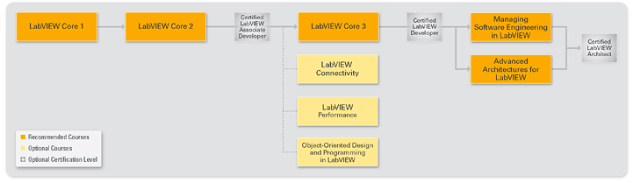
Where to Go Next…
What are your next training options?
Notes:
This presentation included material from Core 1, Core 3, Performance, and Advanced Architectures courses.

