Slide 2
Introduction to LabVIEW
Object-Oriented Programming

Slide 3
Presentation Expectations…
Note: This is an Introductory Presentation
We assume no prior knowledge of OOP
We assume LabVIEW skill at or above CLAD
All demos will be simple to stress concepts
For advanced LVOOP content, see:
Presentation: Designing Scalable LabVIEW Applications with Object-Oriented Programming
ni.com/largeapps

Slide 4
Today’s Agenda
What is Object-Oriented Programming (OOP)?
Object-Oriented Programming 101
Object-Oriented Programming using LabVIEW
How to Get Started Tomorrow

Slide 5
An Introduction to OOP
Note: the following concepts are not specific to LabVIEW

Slide 6

“Anyone even peripherally involved with computers agrees that object-oriented programming (OOP) is the wave of the future. Maybe 1 in 50 of them has actually tried to use OOP – which has a lot to do with its popularity.”
– Steve Steinberg, Wired
Notes:
Quote Attribution:
Steve Steinberg, "Hype List", Wired, Vol. 1, No. 1, Mar/Apr 1993
Photo Credit:
http://www.enterprisecioforum.com/en/blogs/christian/should-big-data-reside-cloud

Slide 7
Why learn OOP?
By attending this session, you’ve taken the first step to developing code that…
…is written with greater EASE
…performs with more STABILITY
…simplifies MAINTAINANCE
GREAT! …but how?

Slide 8
What is OOP?
A different approach to programming (of many)
An attempt to make programming better model the way we think about the real world
A programming option in languages including:
  VB.NET, C#, C++, Java, Python, G
  …and many more

Slide 9
OOP History
Dates back to the early 1960s
First used by MIT’s artificial intelligence group
  Primarily programmed using LISP
Becomes a dominant methodology in mid 1990s
…and most importantly,
Born from a need to increase the manageability and organization of complex software

Slide 10
Why is code manageability a concern?
Software and hardware gain greater complexity
Development team size has increased
Development timelines have decreased
Number of LabVIEW VIs per Application
Number of Developers per Project
Source:
2010 Survey on ni.com/largeapps

Slide 11

Even more concerning:
As many procedural programs
grow, they can become fragile
because they naturally
endanger
data.
Notes:
Simple, non-OOP programs may be one "long" list of statements (or commands). More complex programs will often group smaller sections of these statements into functions or subroutines each of which might perform a particular task. With designs of this sort, it is common for some of the program's data to be 'global', i.e. accessible from any part of the program. As programs grow in size, allowing any function to modify any piece of data means that bugs can have wide-reaching effects.
Photo Credit:
Chris-Håvard Berge
http://www.flickr.com/photos/37318693@N04/4332120849/

Slide 12
Comparing Programming Approaches
Procedural (Task-Oriented)
Object-Oriented
Focuses on process
Step-by-step instructions
Modularized by routines that compartmentalize actions
Dissociates data and behavior
Focuses on data
Series of interacting entities
Modularized by components with distinct responsibilities
Unites data structure with its manipulators

Slide 13
Two Views, One Problem
Procedural (Task-Based) Design Problem Statement
We need to test each widget as it comes off of the production line to ensure appropriate functionality. If any widget fails the test, we should email the result report to management.
Where does the responsibility fall?

Slide 14
Two Views, One Problem
Object-Oriented Design Problem Statement
The production line should produce widgets. Each widget should execute a functionality test and log any problems. The report should be emailed to management if any failures are encountered.
Where does the responsibility fall?

Slide 15
Pseudocode: Widget Testing
Procedural (Task-Oriented)
Object-Oriented
…
DIM Status, Report
DO
  CALL ProduceWidget(1)
  Status = TestWidget(Report)
  IF Status = 0 THEN
  CALL Email(Report)
  ELSE
  Nothing
  END IF
LOOP UNTIL (Stop = TRUE)
…
Widget = NEW Widget()
DO
  SET Widget = Line.ProduceWidget(1)
  CALL Widget.Test(Report)
  IF Widget.GetTestStatus() = 0 THEN
  CALL Report.SendEmail()
  ELSE
  Nothing
  END IF
LOOP UNTIL (Stop = TRUE)

Slide 16

Object-Oriented Design Requires…
…that you Change your Perspective.
Notes:
Photo Credit:
http://www.rusava.me/

Slide 17
Object-Oriented Programming 101
Note: the following concepts are not specific to LabVIEW

Slide 18

OOP is a lot like
There are only a few simple concepts to learn, but putting them together and making it look pretty is a pain in the
golf…
grass.
Notes:
When it comes to the basics, object-oriented programming is a lot like golf. There are a few simple concepts you have to learn that, individually, aren’t really all that complicated. However, putting those concepts together and making something effective out of it is a challenge in and of itself. We’ll be going through the fundamental OOP concepts now – remember that they aren’t that difficult, but they hold a lot of power.
Photo Credit:
http://www.freegreatpicture.com/golf/golf-1405

Slide 19
Concept #1: Properties and Methods
Properties are the characteristics (data) of an object.
Methods are the actions that an object can perform.
Properties of a Human:
  Height
  Weight
  Hair color
  Eye color
  IQ
  …etc.
Methods of a Human:
  Run
  Jump
  Swim
  Eat
  Sleep
  …etc.
1

Slide 20
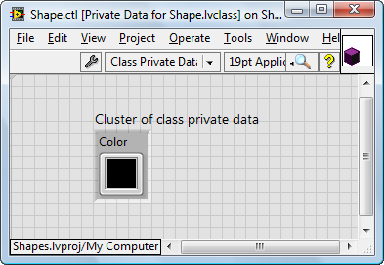
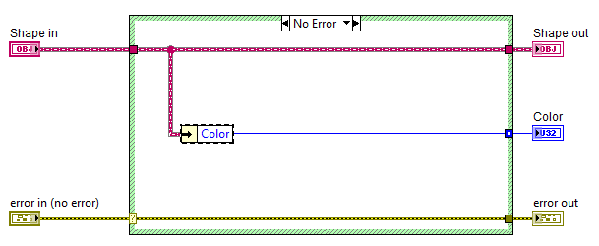
LabVIEW Properties and Methods
LabVIEW Properties (data) are simply one big cluster of common data types
  Data members are accessed via Bundle/Unbundle
LabVIEW Class Methods are just VIs
The “Class Private Data” of a Shape class
The Color property might be read using this GetColor() method VI.

Slide 21
Pop Quiz #1
What are some example properties of a DMM?
What are some example methods of a DMM?
1

Slide 22
Concept #2: Classes and Objects
Classes
Objects
A definition
A template describing attributes (properties) and actions (methods)
The “blueprint” of an object
The “tangible” existence of a class
Models the real world
Referred to as the “instantiation” of
a class
2
1

Slide 23
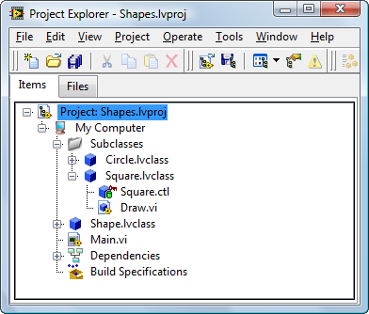
Creating a LabVIEW Class
LabVIEW Classes are managed in a Project
Circle Class
Square Class
Class Private Data
Draw() Method

Slide 24
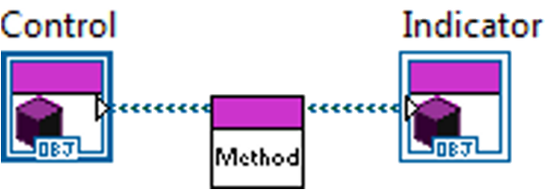
What Is an “Object” in LabVIEW?
…the block diagram use of a class definition
  Data on the wire (copies when the wire forks)
  Uses a customizable wire appearance
  Includes functions to help use internal data
The data type of an object is its class
Notes:
Remember that when you’re passing around an object, you’re also implicitly passing around a way to use the data that it contains.

Slide 25
Creating a LabVIEW Class
Creating a Class with Data and Methods
DEMO

Slide 26

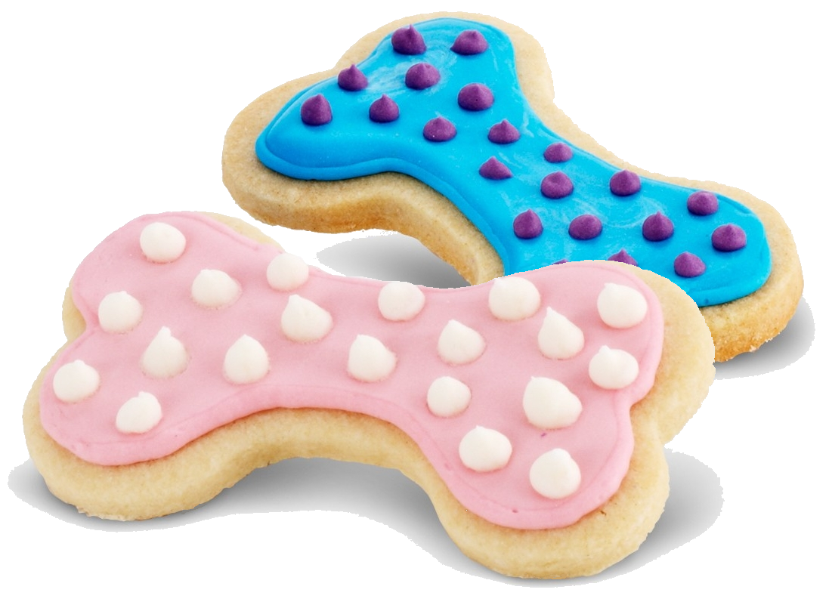
Pop Quiz #2: Class or Object?
Class
2
Objects
1
Notes:
Photo Credit:
http://www.birthdayexpress.com/Dog-Bone-Cookie-Cutter/51508/PartyItemDetail.aspx

Slide 27
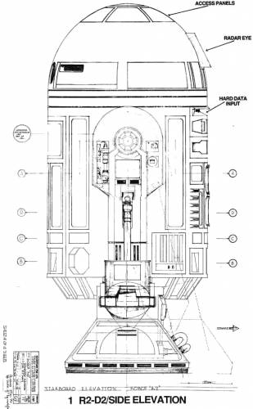
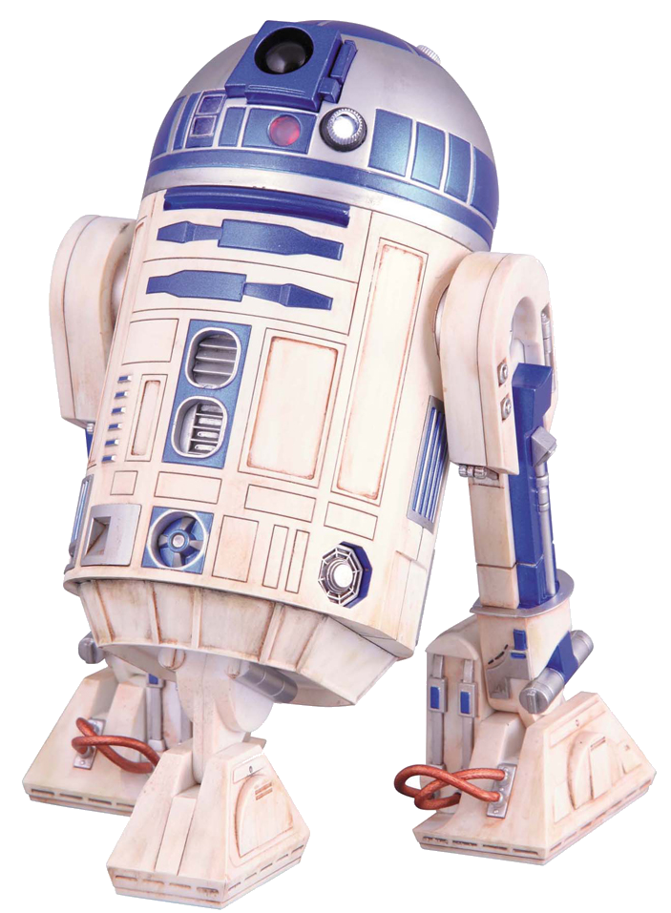
Pop Quiz #2: Class or Object?
Object
2
1
Class
Notes:
Photo Credit:
http://www.the-blueprints.com/
http://www.blister.jp/images-item-big/page-14695.jpg

Slide 28

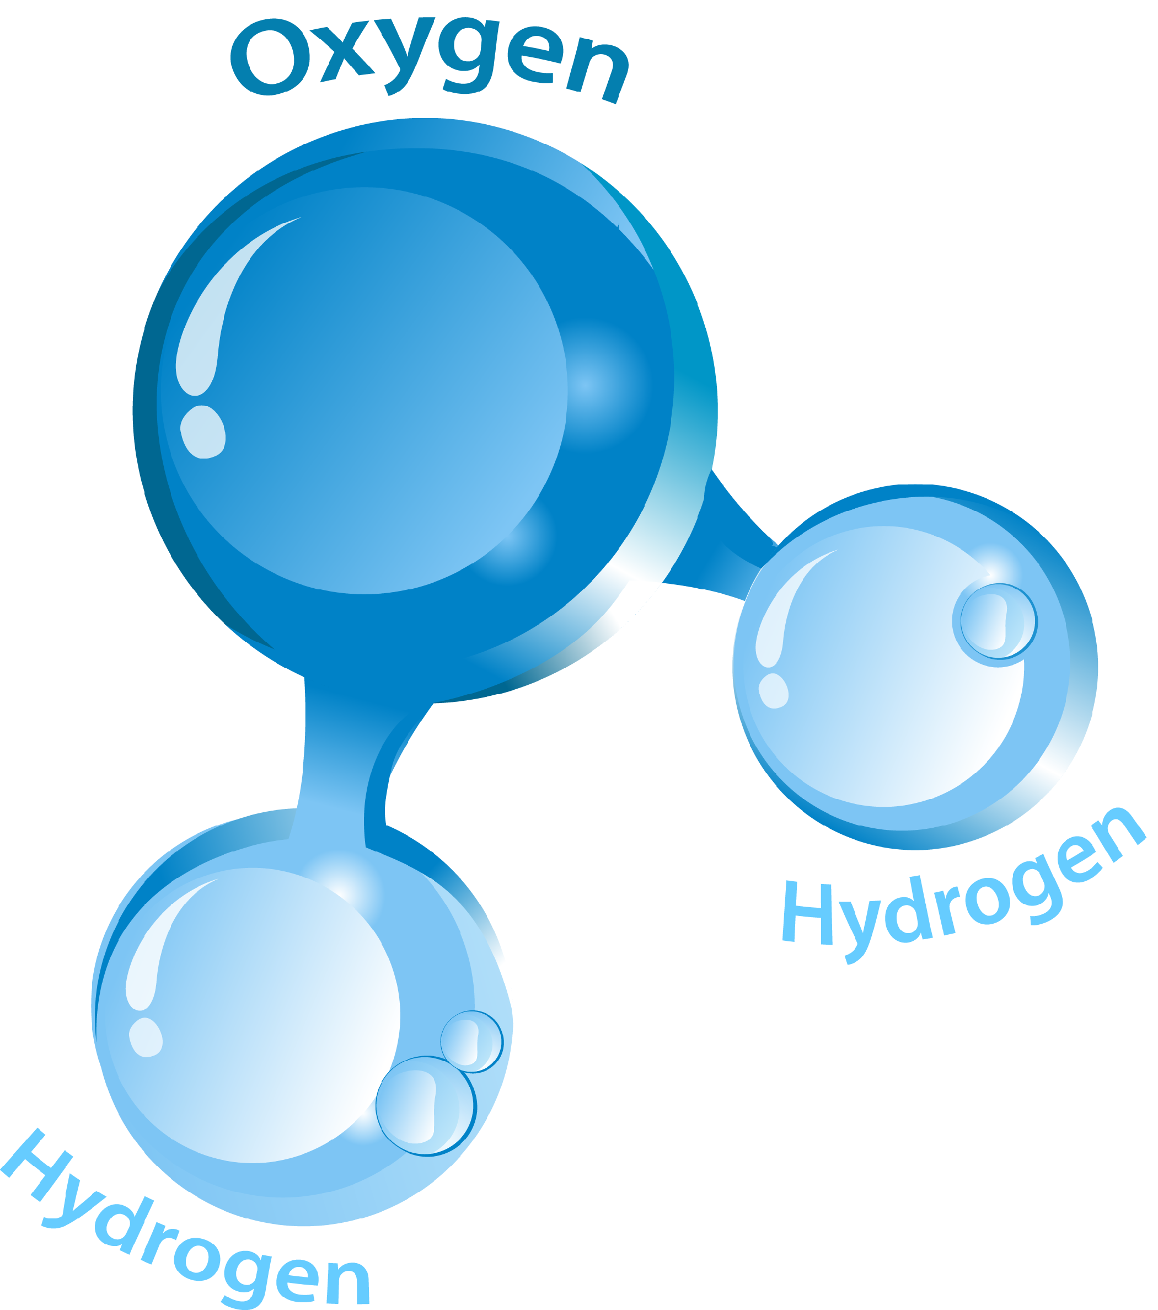
Pop Quiz #2: Class or Object?
Object
2
1
Class
Notes:
Photo Credit:
http://www.merchantcircle.com/
http://www.ck12.org/ck12/images?id=341266

Slide 29
Concept #3: Encapsulation
Traditionally, there exists no formal connection between code and data
Example: ANSI C Code
  Units of code are called “functions”
  Units of data are called “structures”
  Functions can operate on different
  types of structures
  More than one function can operate
  on the same structure
3
2
1
Notes:
In a traditional task-based application, data and functions have no implicit connection. This adds danger when applications grow in complexity because data could be modified by functions throughout the application (for example, through the use of global variables), introducing a scalability, maintainability, and modifiability nightmare.

Slide 30
Concept #3: Encapsulation
Data
Object
Data
3
2
Methods
(for interacting with that data)
1
Methods
(for interacting with that data)
Notes:
An “object” is the idea that you should combine data and the methods that let you interact with that data and combine them into one inseparable entity. Whenever you pass objects around in a program, you’re always passing around data and methods together.

Slide 31
Concept #3: Encapsulation
By consolidating data and methods into an object, access to that object’s data is restricted like a black box.
Object
Data
3
2
Methods
(for interacting with that data)
Outside World
(e.g. Main VI)
1
Notes:
Encapsulation of data and methods into an object entity yields a powerful programming benefit: an object’s data can only be modified using its defined methods. This means that the outside world doesn’t have to know how an object works – it simply interfaces with the object via its exposed accessor methods. This also means that if for some reason a data format changes over time, the outside world doesn’t need to accommodate that change – only the accessor methods do. Lastly, debugging becomes easier because whenever data is set incorrectly, you no longer have to hunt all over an application to find the spot where the data is being improperly modified – you have a single choke point.

Slide 32
Concept #3: Encapsulation
Allows the object to store
data most conveniently and translate it for the outside world to consume
Object
Data
3
2
Methods
(for interacting with that data)
Outside World
(e.g. Main VI)
1
Notes:
Encapsulation of data and methods into an object entity yields a powerful programming benefit: an object’s data can only be modified using its defined methods. This means that the outside world doesn’t have to know how an object works – it simply interfaces with the object via its exposed accessor methods. This also means that if for some reason a data format changes over time, the outside world doesn’t need to accommodate that change – only the accessor methods do. Lastly, debugging becomes easier because whenever data is set incorrectly, you no longer have to hunt all over an application to find the spot where the data is being improperly modified – you have a single choke point.

Slide 33
Encapsulation Benefits Example
Imagine I work as part of a development team
Data Comes In
Data is Manipulated
Data Flows Out
My Part

Slide 34
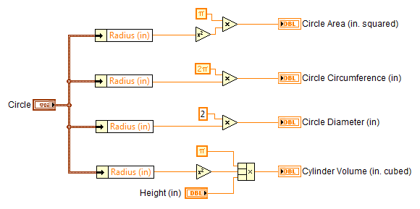
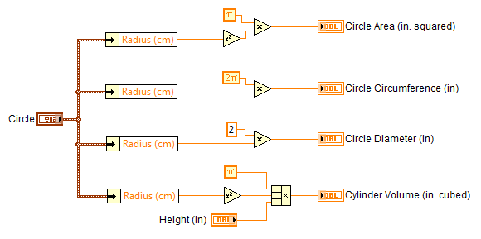
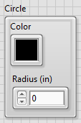
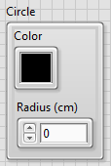
Encapsulation Benefits Example
Circle Data In »
My Awesome IP »
Results Out »

Slide 35
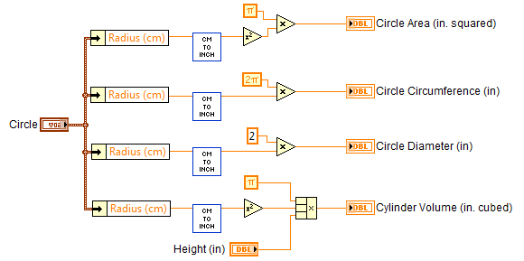
Encapsulation Benefits Example
Circle Data In »
My Awesome IP »
Results Out »

Slide 36
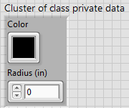
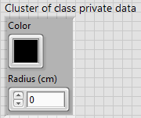
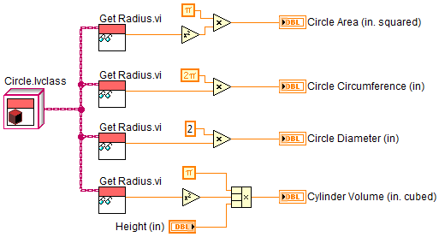
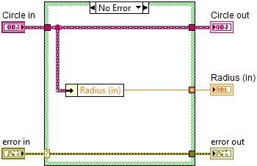
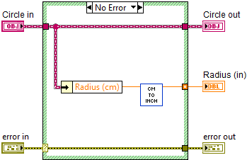
Encapsulation Benefits Example
Circle Data In »
My Awesome IP »
Results Out »

Slide 37
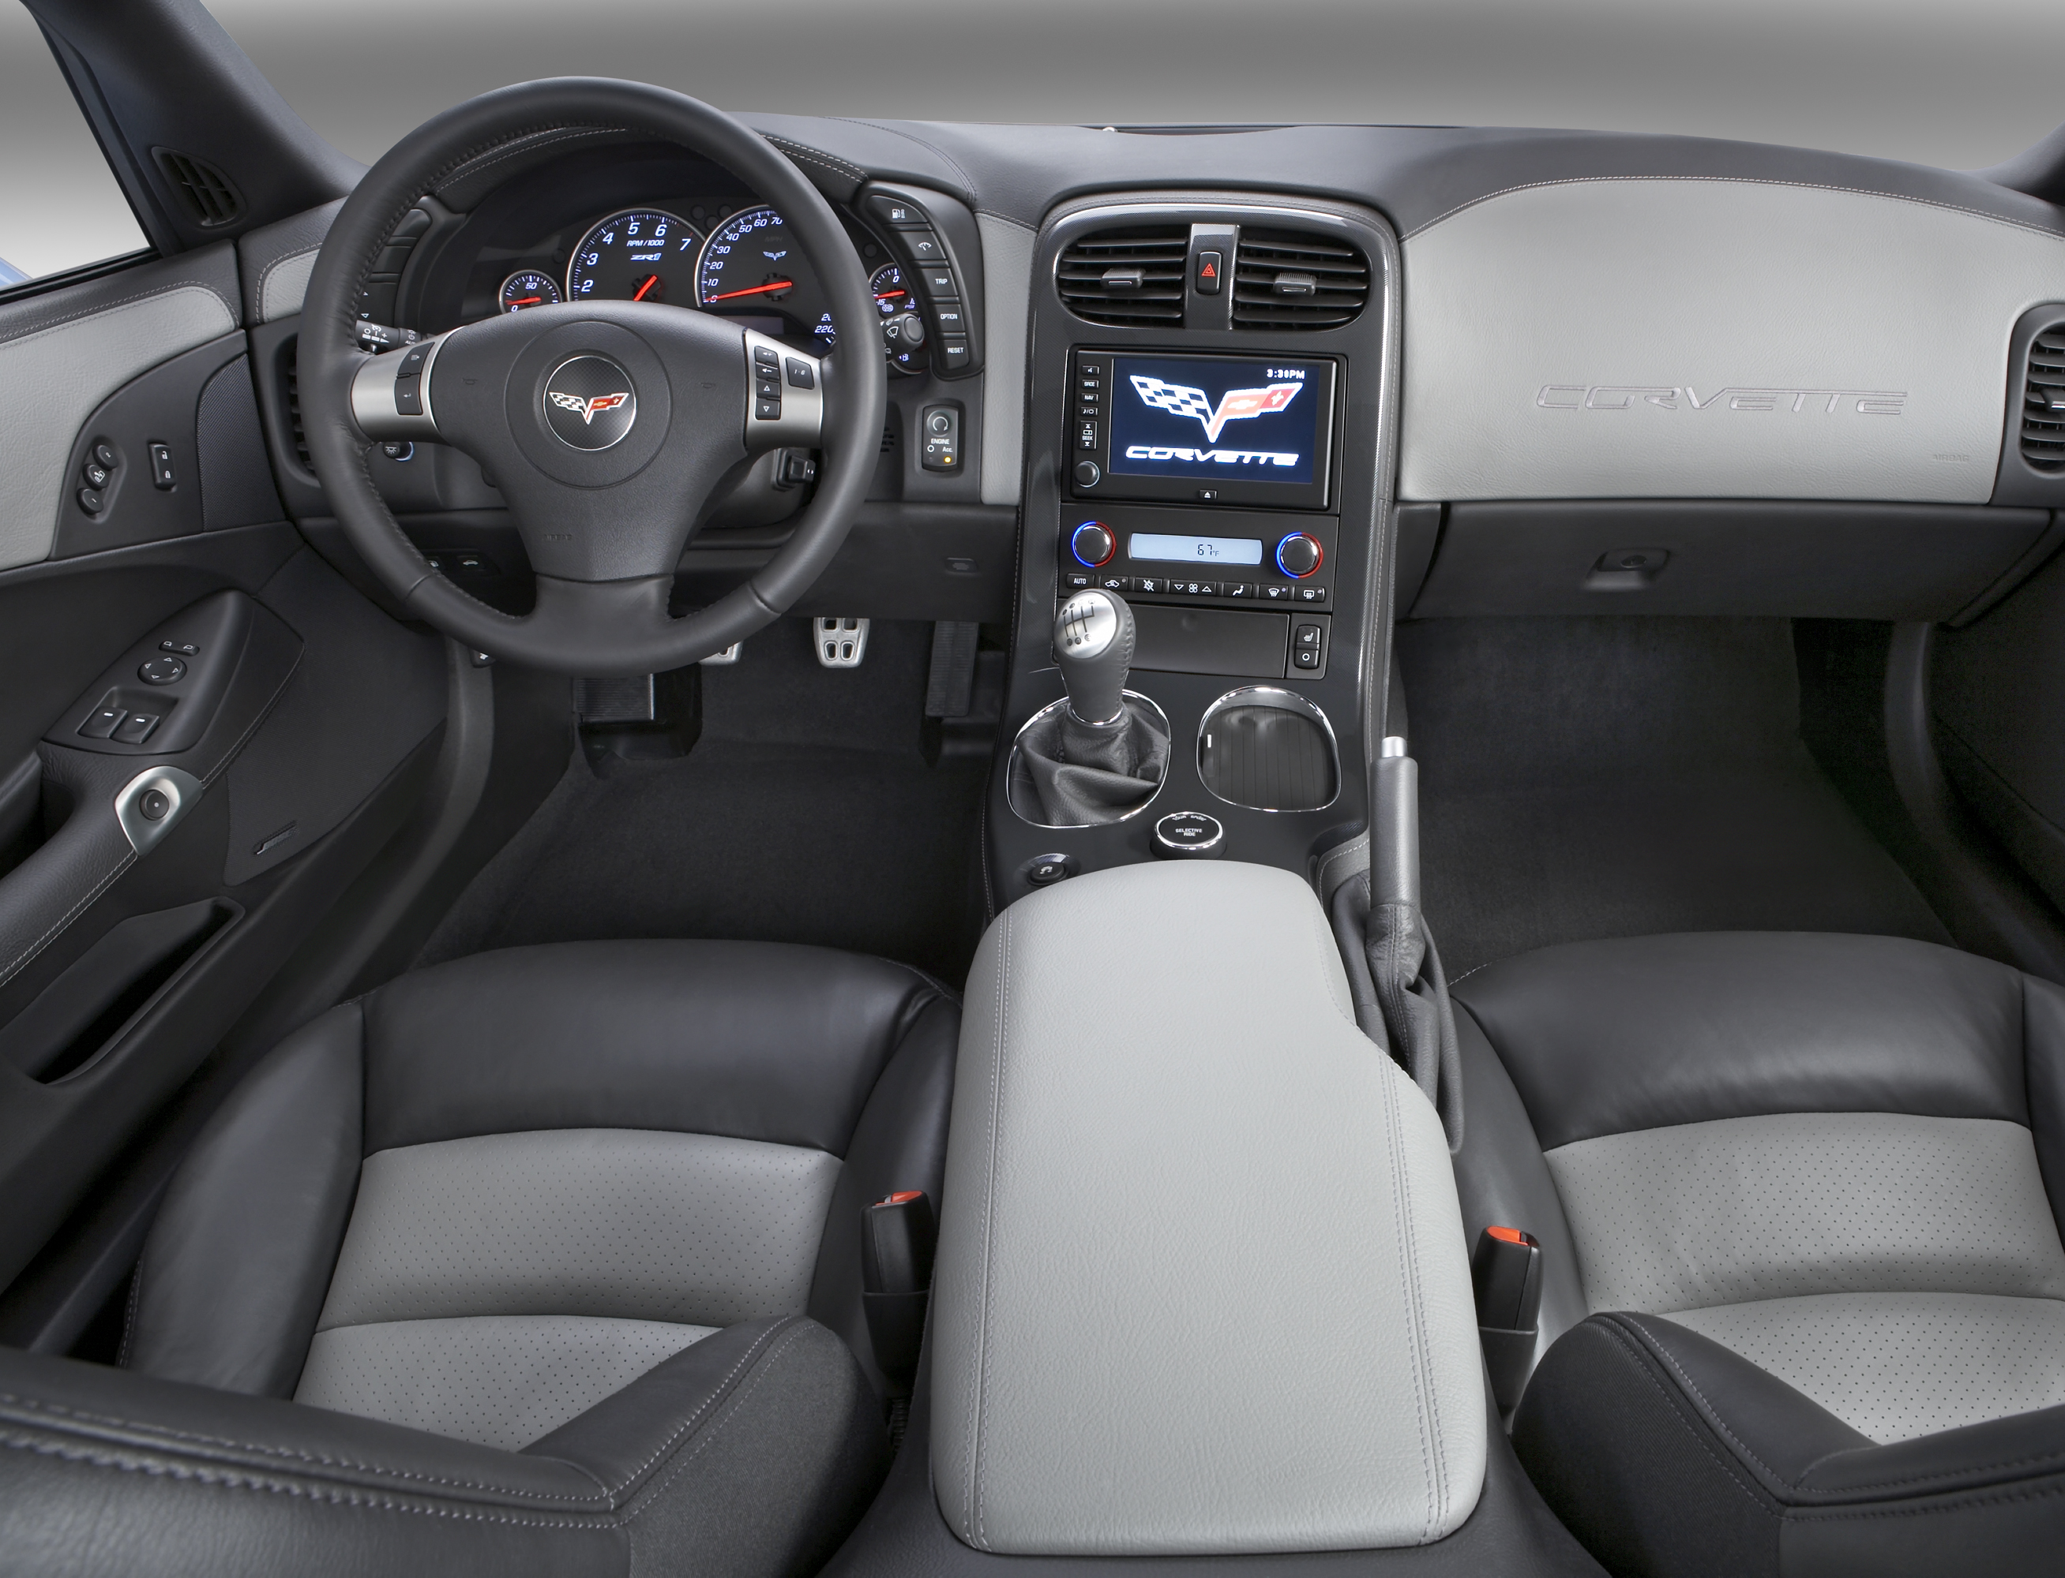
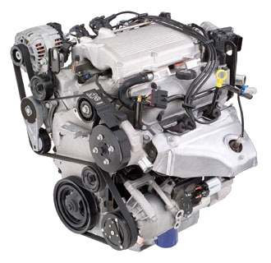
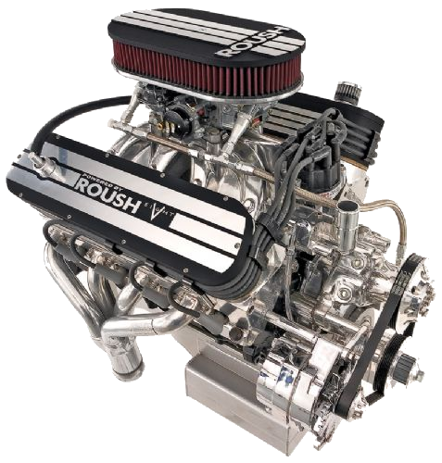
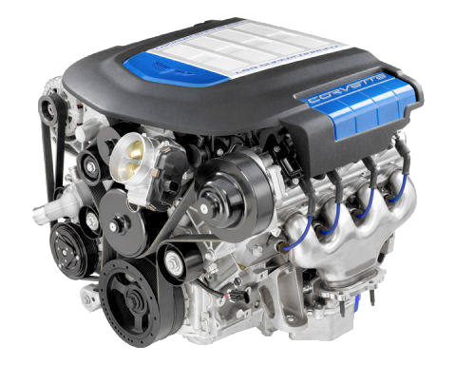
Pop Quiz #3: Encapsulation
Explain the benefit of encapsulation as it pertains to driving different types of vehicles.
Hint:
3
2
1
Notes:
Each different automobile contains a different type of engine, and as automobiles evolve, engine technologies follow suit. However, the interface to an automobile’s engine – the steering wheel, pedals, and shifter – has remained largely unchanged for decades. In fact, as drivers, we don’t even have to care how a car’s engine works – we simply interface with it through the use of the steering wheel, pedals, and shifter. In this case, the automobile (the object) would encapsulate the engine (the data) and the cabin (methods). Any given driver (the outside world) never interfaces directly with the engine (the data); they must use the cabin (methods) to do so. A change to the engine may mandate a change to the way the steering wheel, pedals, and shifter interface with the engine, but never directly changes the interface to the outside world.
Photo Credit:
http://www.familycar.com
http://www.usedcars.pokal.jp/
http://cars-engine.blogspot.com/
http://www.zorly.com/images_corvette/ZR1_wallpapers/

Slide 38
Concept #3: Encapsulated Code…
…is written with greater EASE
  Each component using data can use the most convenient form of that data
…performs with more STABILITY
  Less code must change if data format changes
…simplifies MAINTAINANCE
  Less code must change to introduce new
  features and fix bugs
3
2
1

Slide 39
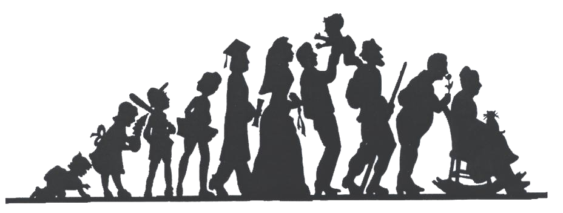
Concept #4: Inheritance
Classes are organized hierarchically
You can use classes as the starting point for more specific classes
Like a family tree, ancestors pass traits to
their descendants
4
3
2
1
Notes:
Photo Credit:
http://www.familycourtservices.org/

Slide 40
Concept #4: Inheritance
2D Shape
Polygon
Quadrilateral
Pentagon
Circle
Hexagon
Rectangle
Kite
Rhombus
Draw ()
GetColor ()
4
3
Draw ()
GetColor ()
2
Draw ()
GetColor ()
CountSides ()
Draw ()
GetColor ()
1
Draw ()
GetColor ()
CountSides ()
Draw ()
GetColor ()

Slide 41
Concept #4: Inheritance
Inheritance depth is unlimited
Children already know how to do everything their parents can do
Child classes can override their parent’s implementation
  Example: CountSides() may be coded
  differently for a Triangle versus a Rectangle
4
3
2
1

Slide 42
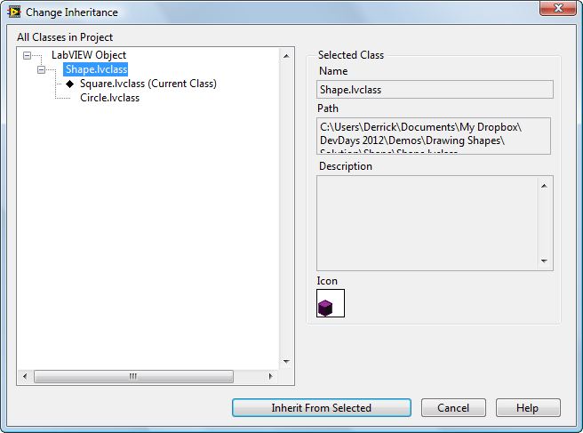
LabVIEW Class Inheritance
Dictate Class Inheritance by selecting
Right-Click » Properties » Inheritance

Slide 43
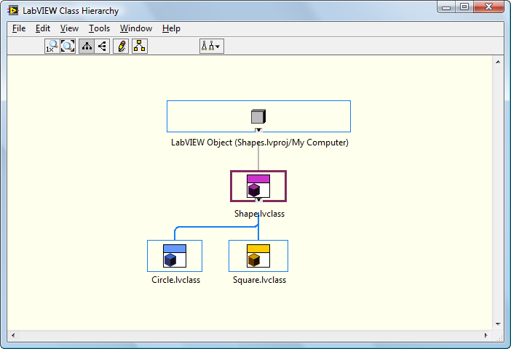
LabVIEW Class Inheritance
The Class Hierarchy Window is your friend!
2D Shape
+ Draw()
Polygon:
+ Draw()
Quadrilateral
+ Draw()
Pentagon
+ Draw()
Circle
+ Draw()
Hexagon
+ Draw()
Rectangle
+ Draw()
Kite
+ Draw()
Rhombus
+ Draw()
To access, right-click and select Show Class Hierarchy

Slide 44
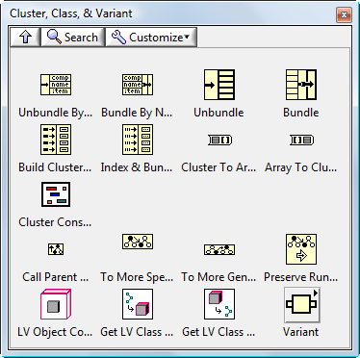
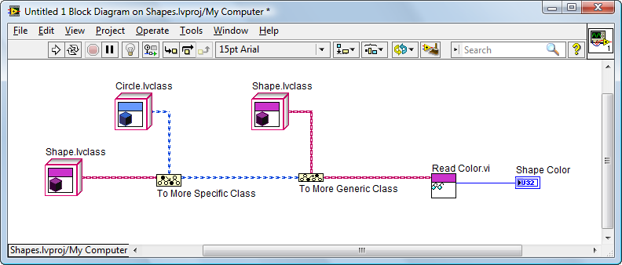
Casting Class References
LabVIEW Classes can be cast up or down their class inheritance hierarchy without loss of data.
Objects can travel on their own wire, or their parent’s.

Slide 45
Pop Quiz #4: Inheritance
Mammal
- eyeColor
+ getEyeColor()
If MyDog is an object of the Canine class,
which of the following makes no sense?
Calling MyDog’s getEyeColor() method
Calling MyDog’s cleanFur() method
Calling MyDog’s markTerritory() method
4
3
Canine
- favoriteFood
+ markTerritory()
Feline
- remainingLives
+ cleanFur()
2
1

Slide 46
Concept #4: “Inherited” Code…
…is written with greater EASE
  When created, child classes are automatically already partially written (code reuse)
…performs with more STABILITY
  Child classes can be built on the proven foundations of their parents
…simplifies MAINTAINANCE
  You can reduce duplicated code by
  providing common methods in parent
  classes
4
3
2
1

Slide 47

Concept #5: Dynamic Dispatching
5
Objects built from classes within a parent-child ancestral chain can determine which version of a method to call on-the-fly
Can be thought of as a type
of dynamic polymorphism
A parent class can define an entry point
– like a contract – that children fulfill
4
3
2
1
Notes:
Up until now we’ve been using an idea of static dispatching, which is the concept that a parent class defines a given method that all of its child classes inherit. That’s okay as long as the parent implements (and therefore passes on) all of the details and information to provide a given set of functionality.
In some cases, all of this information is not available. In that situation, we can use a beneficial OOP technique called dynamic dispatching, in which a parent class defines an entry point which is then forwarded to its specific child class. The child class then “overrides” the entry point defined by the parent.
In this case, a parent can define a sort of contract with the outside world that it has no idea how to fulfill. The children, then, can fulfill the contract in whatever way makes sense to them.

Slide 48
What makes a Dynamic Dispatch VI?
The following five things must be true:
  The VI must be inside a class
  The VI must be part of an inheritance hierarchy
  Overriding VIs must have the same name
  Overriding VIs must use identical connector panes
  Connector Pane must have Dynamic Dispatch terminals
As usual, LabVIEW includes productivity enhancements that make this job much easier

Slide 49
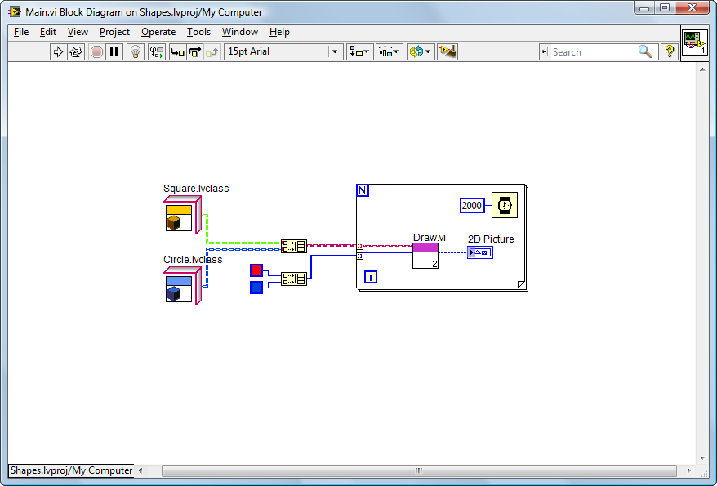
Inheritance and
Dynamic Dispatching
Unlocking the Power behind OOP
DEMO

Slide 50
Pop Quiz #5: Dynamic Dispatching
5
What might each class implement for its Draw() method?
4
2D Shape
+ Draw()
Polygon:
+ Draw()
Quadrilateral
+ Draw()
Pentagon
+ Draw()
Circle
+ Draw()
Hexagon
+ Draw()
Rectangle
+ Draw()
Kite
+ Draw()
Rhombus
+ Draw()
?
3
?
2
1
?

Slide 51
Concept #5: Dynamically Dispatched Code…
5
…is written with greater EASE
  Code can be written against the promises made by
  a parent without having to care about the details
  of a particular child as long as the parent’s
  interface is supported
…simplifies MAINTAINANCE
  New features can be introduced by making up
  a new child class that follows all the
  promises made by a parent
4
3
2
1

Slide 52
Taking it up a notch
Examining a slightly more complex example using LabVIEW

Slide 53

Introducing:
Starbuzz Coffee is the fastest growing food cart in Austin
Starbuzz has asked us
to design their
point-of-sale system
We must design the system with
scalability in mind
STARBUZZ
COFFEE
DEMO

Slide 54
Use LabVIEW OOP Tomorrow
How to ease into implementing OOP

Slide 55

Taking the OOPlunge
Reframe your thinking
Look for the Clustersaurus
Look for the case structures
“Convert TypeDefs to Classes”
LabVIEW Example Finder
Start with basic OO Design Patterns:
https://decibel.ni.com/content/docs/DOC-2875
Notes:
Photo Credit:
http://www.livefortheoutdoors.com/

Slide 56

Software is not written...
it is
rewritten.
Notes:
Photo Credit:
http://art.newcity.com/

Slide 57
Key OOP Takeaways
Code written using object-oriented
programming techniques:
…is written with greater EASE
…performs with more STABILITY
…simplifies MAINTAINANCE

