Slide 1
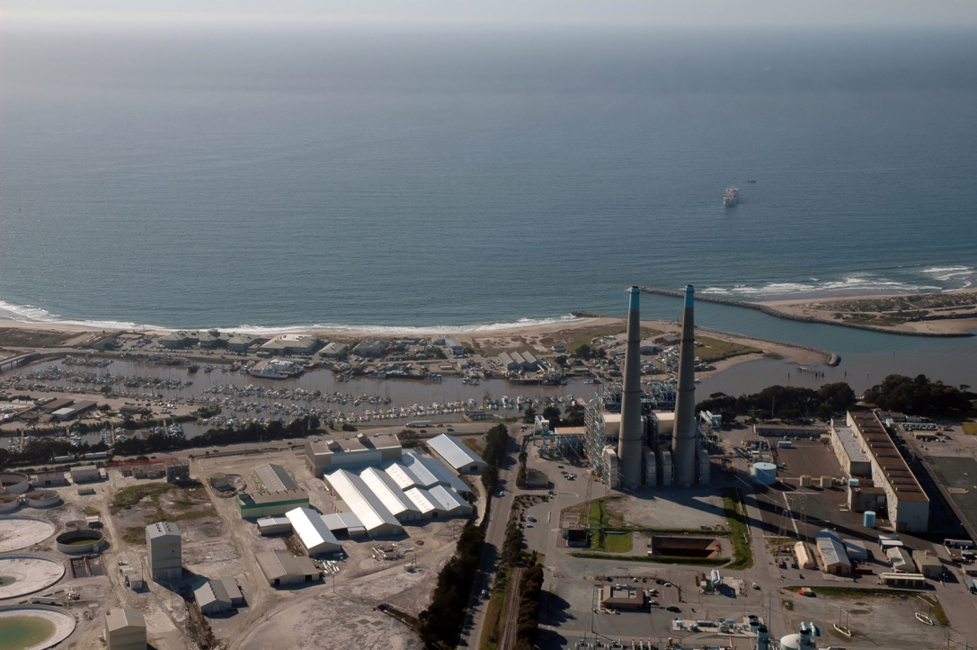
Project Management at MBARI
Day 2 – Budgets and other jetsam
Jim Birch
March 14, 2019

Slide 2
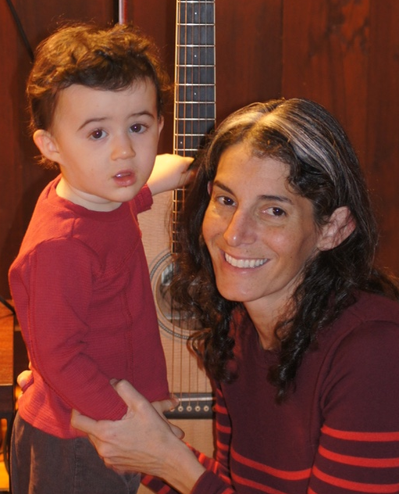
Last Meeting
Reporting (Annual, Bullets, EC, Updates)
Permits (see Mandy/Doug)
Working with DMO (pre-cruise, post-cruise reports)

Slide 3
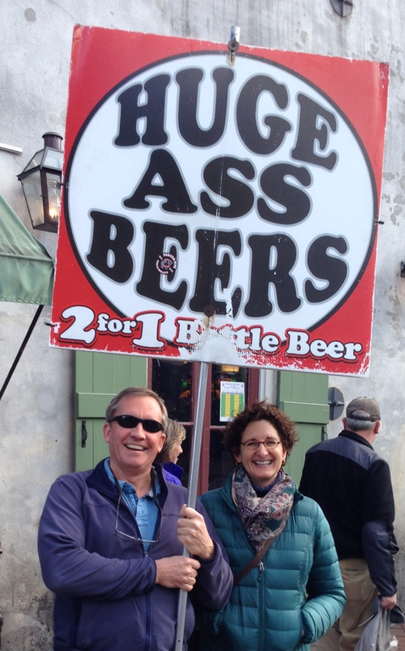
Last Meeting
Proposals (Internal vs. External)
What is a DQ and details for filling one out

Slide 4
Let’s talk RESOURCES
A well-run project always has a BUDGET
Hours – to get people (translates into $$)
Dollars – to purchase goods/services

Slide 5
Budgets
How many hours can someone work?
One Year = 2080 workable hours = 173.3hrs/month
BUT
-80 hrs for Holidays and -80 hrs for Vacation (avg)
= 160 hrs/month

Slide 6
Budgets
Start with External Projects
Benefits—Health, Dental, Retirement etc.
Capital Equipment is any single item
> $5000
Indirect = Overhead
  Pays for lights, water, heat…
Notes:
Cost share. Look at cost share policy.
PI and their techs can cost-share, but all engineers and eng. Tech must be paid for, unless they are PI. Must be called out in DQ.
Policy is here: https://mww.mbari.org/Accounting/Grants/policies/cost-share-policy.html

Slide 7
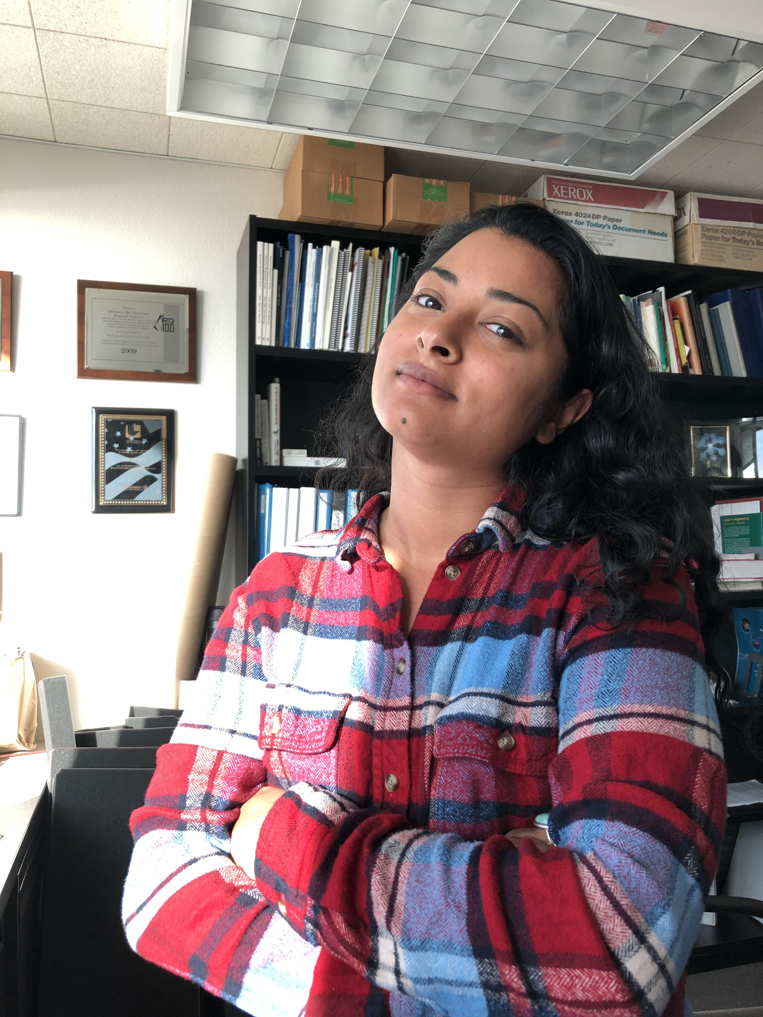
Budgets
When setting up a budget for external grant
  Talk to Danielle Haddock!

Slide 8
Budgets
For both Internal OR External Grants:
1. Contact Judy Nelson --- who is allowed to charge hours to grant project
2. Contact Chris DiSalvo --- who is allowed to purchase ‘stuff’ on grant

Slide 9
Budgets – an aside
What is ‘Cost Share’?
MBARI promises to provide funds (i.e., salary) to have
certain people work on the external grant
PI’s can cost-share up to 2 months / grant
No cost sharing allowed for Engineering or DMO.
Any cost-sharing MUST be called out in the DQ.
Policy is here: https://mww.mbari.org/Accounting/Grants/policies/cost-share-policy.html
Notes:
PI and their techs can cost-share, but all engineers and eng. Tech must be paid for, unless they are PI. Must be called out in DQ.
Policy is here: https://mww.mbari.org/Accounting/Grants/policies/cost-share-policy.html

Slide 10
Budgets – an aside
What is ‘Cost Share’?
Some funding agencies do not allow cost-sharing.
Check with Danielle!
MBARI promises to provide funds (i.e., salary) to have
certain people work on the external grant
PI’s can cost-share up to 2 months / grant
No cost sharing allowed for Engineering or DMO.
Any cost-sharing MUST be called out in the DQ.
Policy is here: https://mww.mbari.org/Accounting/Grants/policies/cost-share-policy.html
Notes:
PI and their techs can cost-share, but all engineers and eng. Tech must be paid for, unless they are PI. Must be called out in DQ.
Policy is here: https://mww.mbari.org/Accounting/Grants/policies/cost-share-policy.html

Slide 11
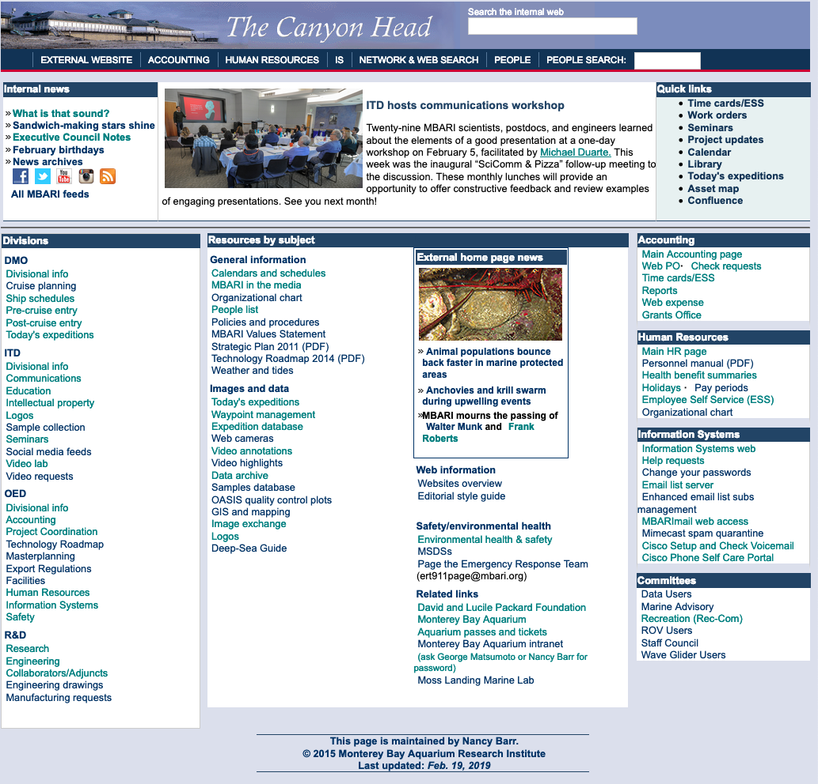
$$ Budgets
Once you get the grant, then what?

Slide 12
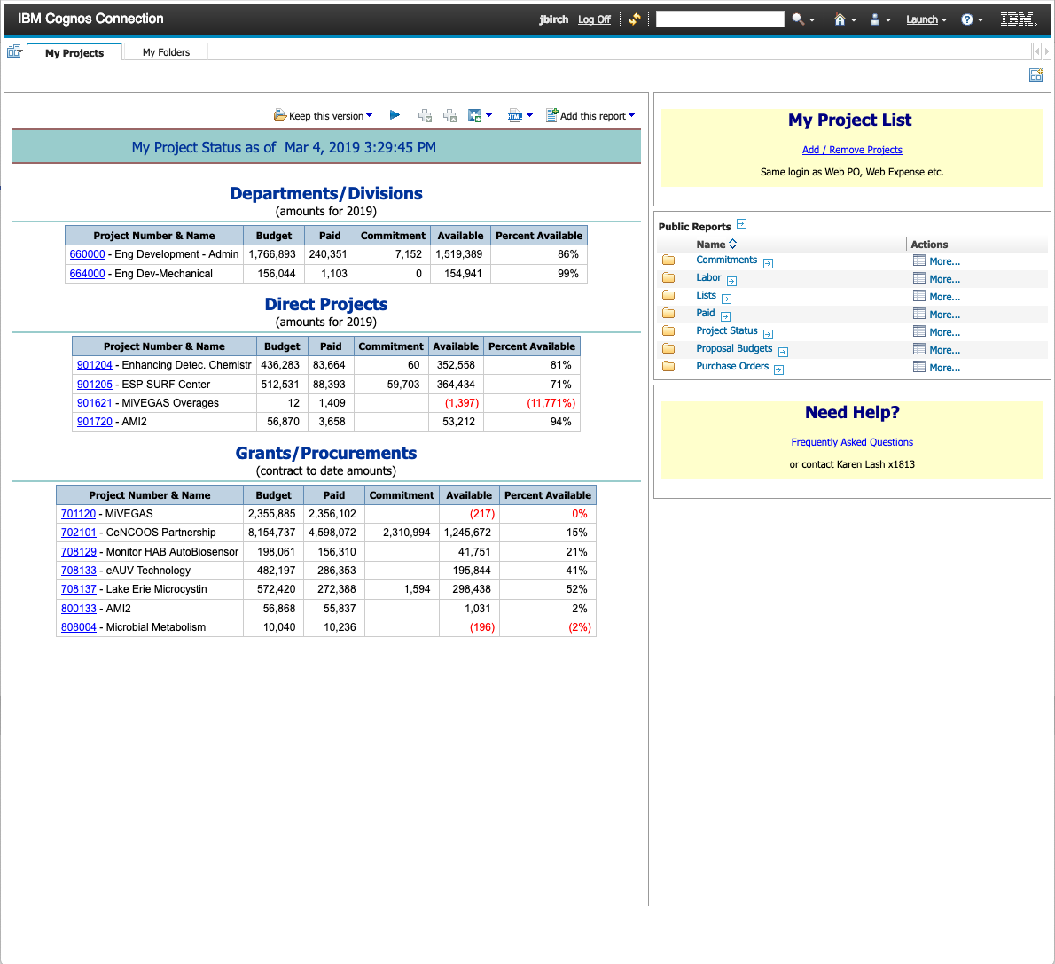
$$ Budgets
Set up Cognos to show you what you are interested in
1xxxxx – OED/Acct/Safety….
2xxxxx -- Indirect Science
3xxxxx -- DMO
5xxxxx -- ITD
6xxxxx – Indirect Engineering
70xxxx -- Federal Grant
77xxxx -- Procurement
80xxxx -- Non-Fed Grant
90xxxx – Internal MBARI
‘Drilling Down’
901621.98
category
sequence
year started
Sub-project

Slide 13
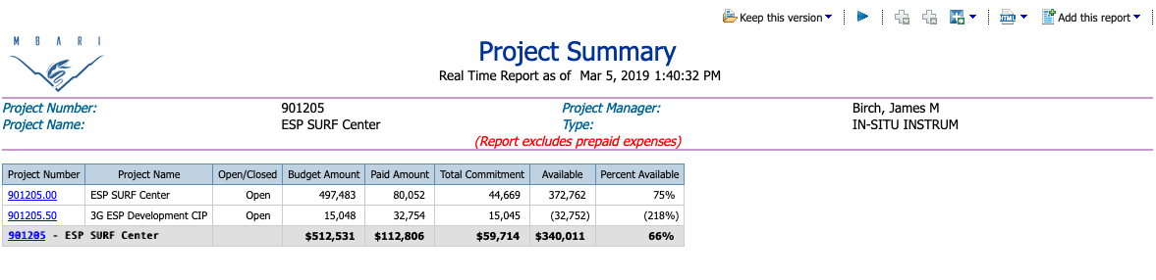
$$ Budgets
‘Drilling Down further’

Slide 14
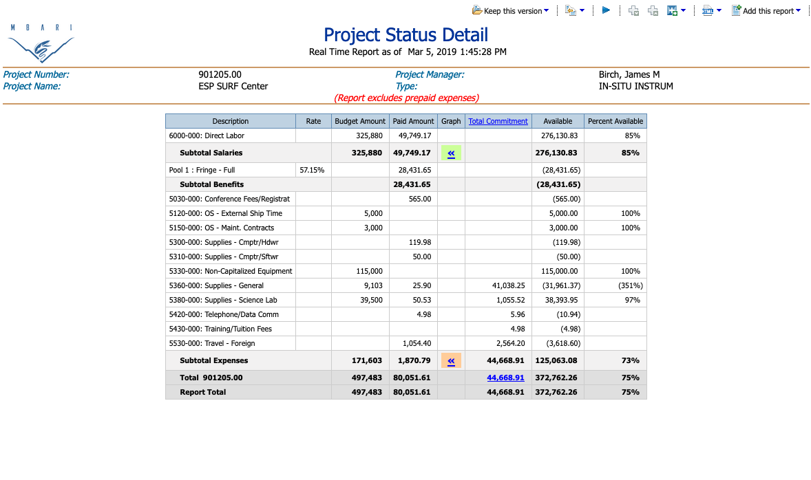
$$ Budgets
Where is all your money going??

Slide 15
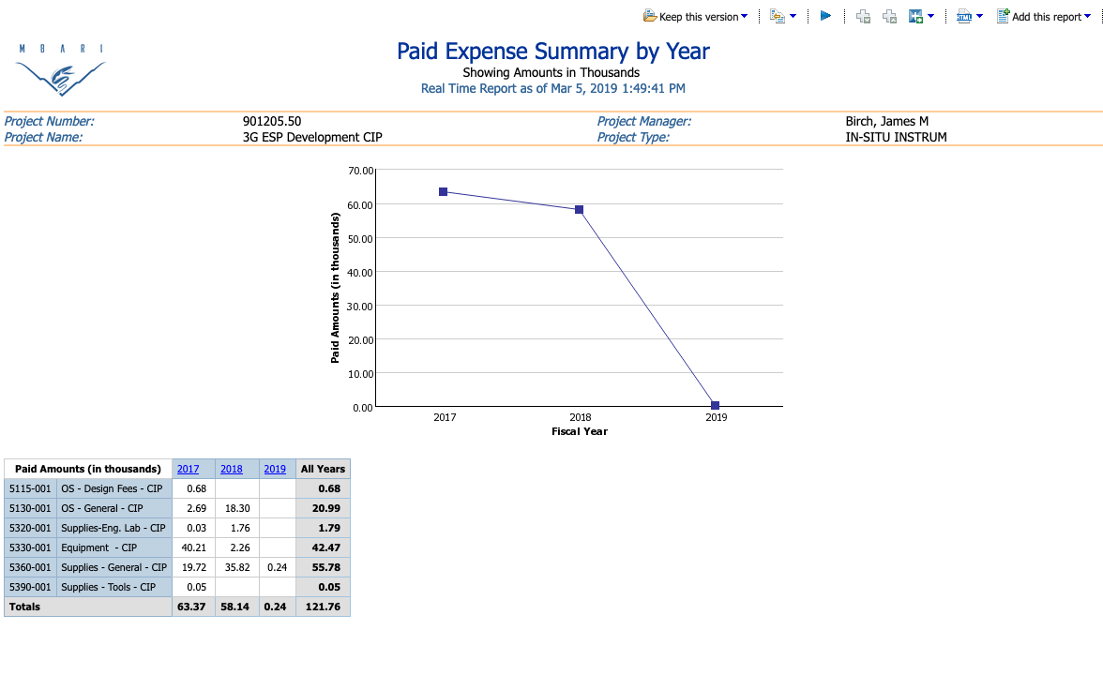
$$ Budgets
Where did money go last year??

Slide 16
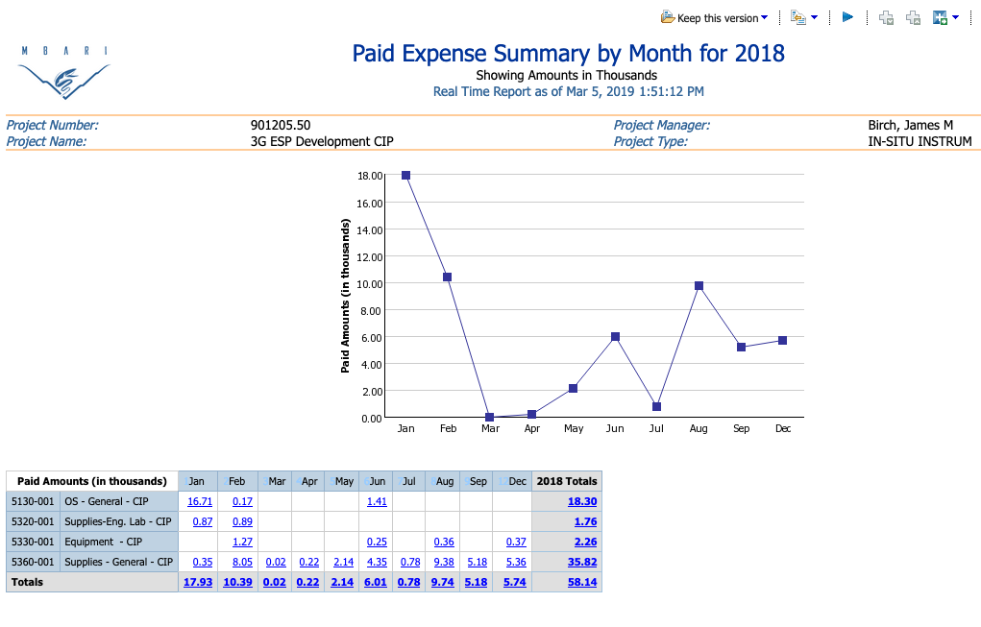
$$ Budgets
What was spent in Feb????

Slide 17
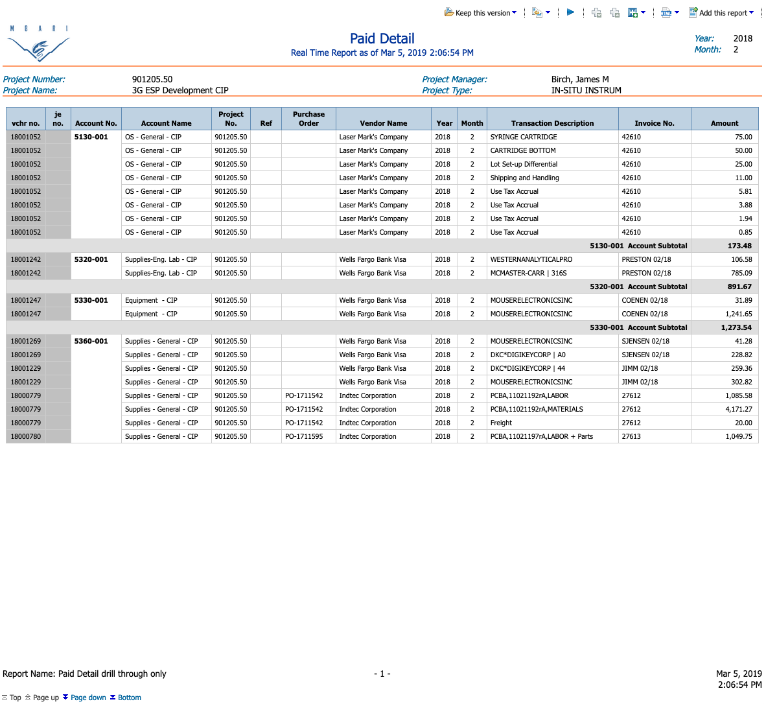
$$ Budgets
Don’t forget…
Better get on Scott about this charge!

Slide 18
Labor Budgets
How to keep track of your PEOPLE

Slide 19
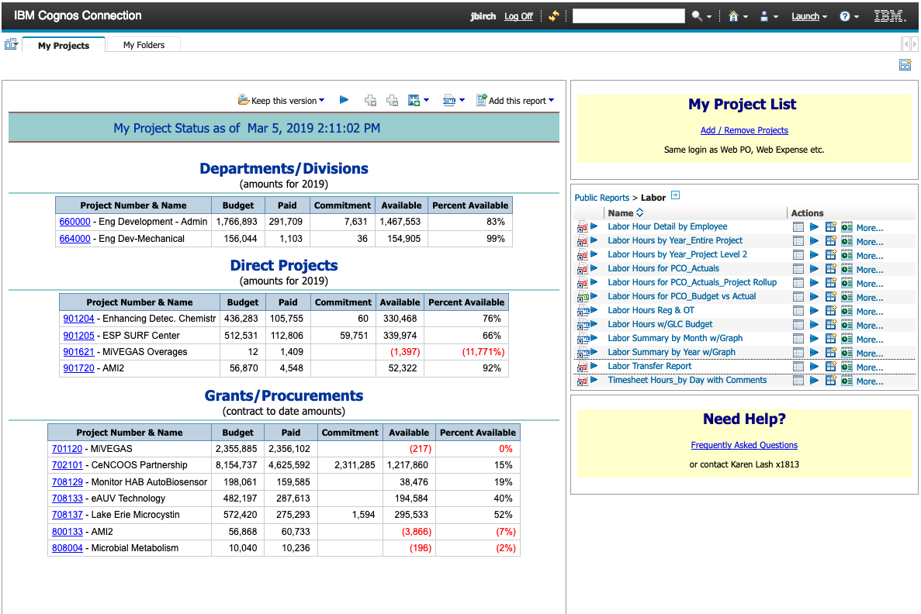
Labor Budgets
How to keep track of your PEOPLE

Slide 20
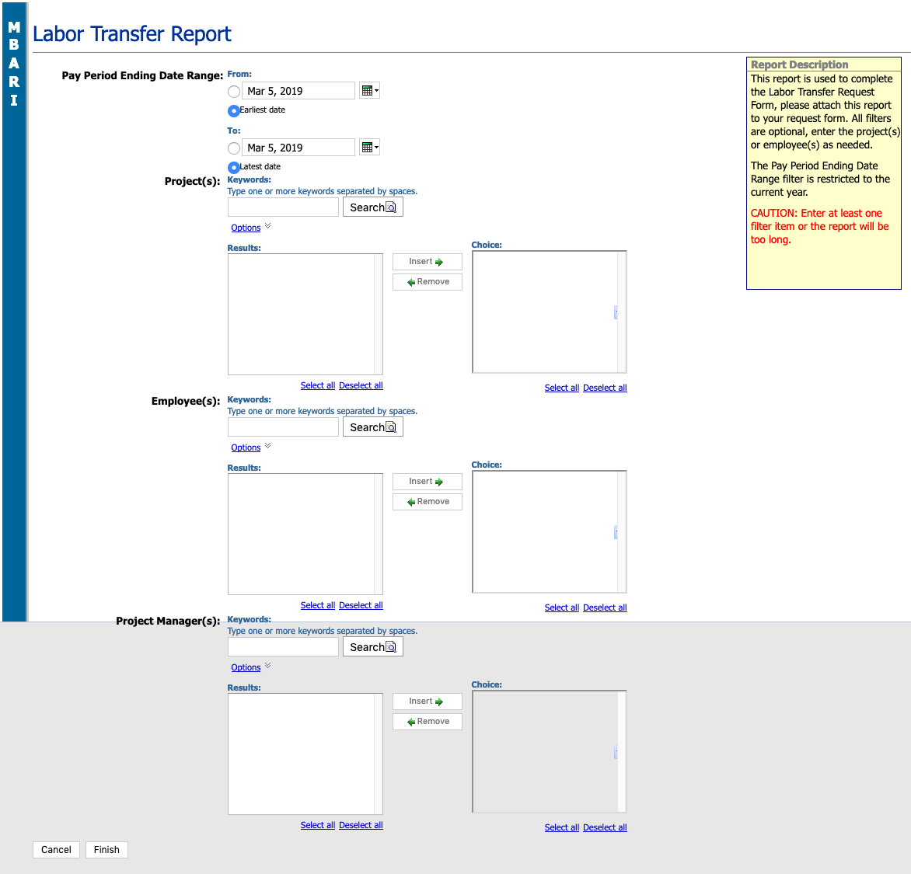
Labor Budgets
You can search by date range
--THEN EITHER--
Project Number
Employee name
Project Manager
Click here for a PDF result

Slide 21
Labor Budgets
Results for project 708129 since Jan 1, 2019

Slide 22
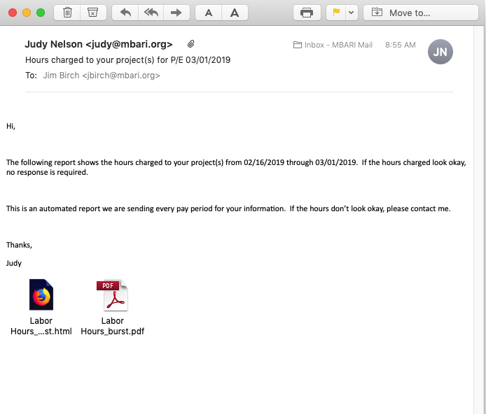
Labor Budgets—one Final thing
Judy sends this out every 2 weeks

Slide 23
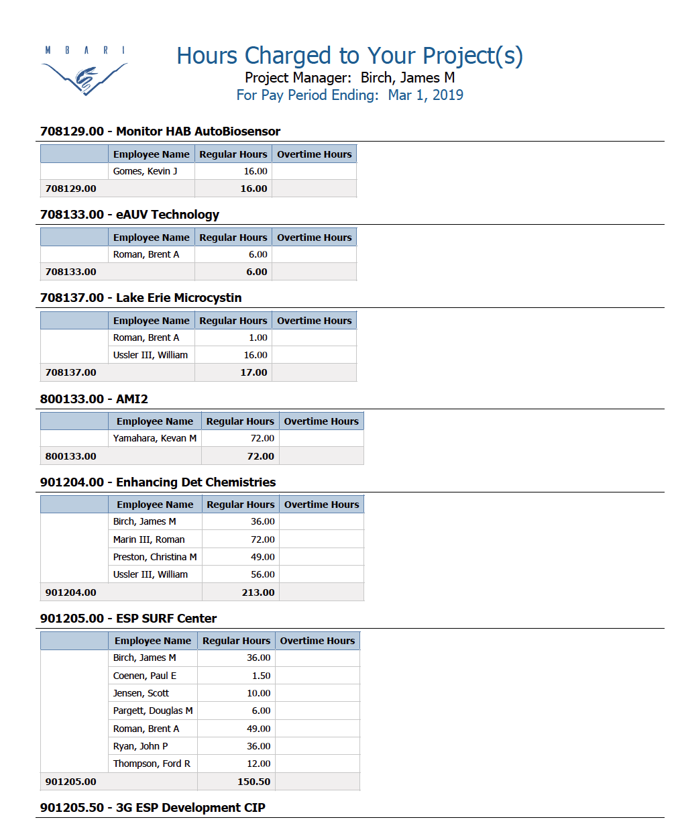
Labor Budgets—one Final thing
Please CHECK IT!!

Slide 24
Projections
Each Year at proposal time, Management asks for an 18-month projection
  What external funds will be slushing around MBARI?
2019
2020
Jun
Jan
Jun
Dec
When proposals due in June, M-Team wants to know:
What have you spent (i.e., brought to MBARI) up to June 2019
What do you project to spend (i.e., still bring into MBARI) in remainder of 2019
What do you project to spend (i.e., bring to MBARI)in 2020

Slide 25
Project Projections—an example
2015
2016
Here’s the scene:
    It’s June 2015, and we need to write 2016 proposals
Jun
Jan
Jun
Dec
What have we ACTUALLY contributed up to June 2015?
(prediction for year was $1.408M)

Slide 26
Project Projections—an example
2015
2016
Here’s the scene:
    It’s June 2015, and we need to write 2016 proposals
Jun
Jan
Jun
Dec
What do we PROJECT for all of 2015?
( prediction for year was $1.408M)

Slide 27
Project Projections—an example
2015
2016
Here’s the scene:
    It’s June 2015, and we need to write 2016 proposals
Jun
Jan
Jun
Dec
What do we PROJECT for 2016?

Slide 28
Budgets
Help is close by…..
  Talk to Danielle Haddock!

Slide 29
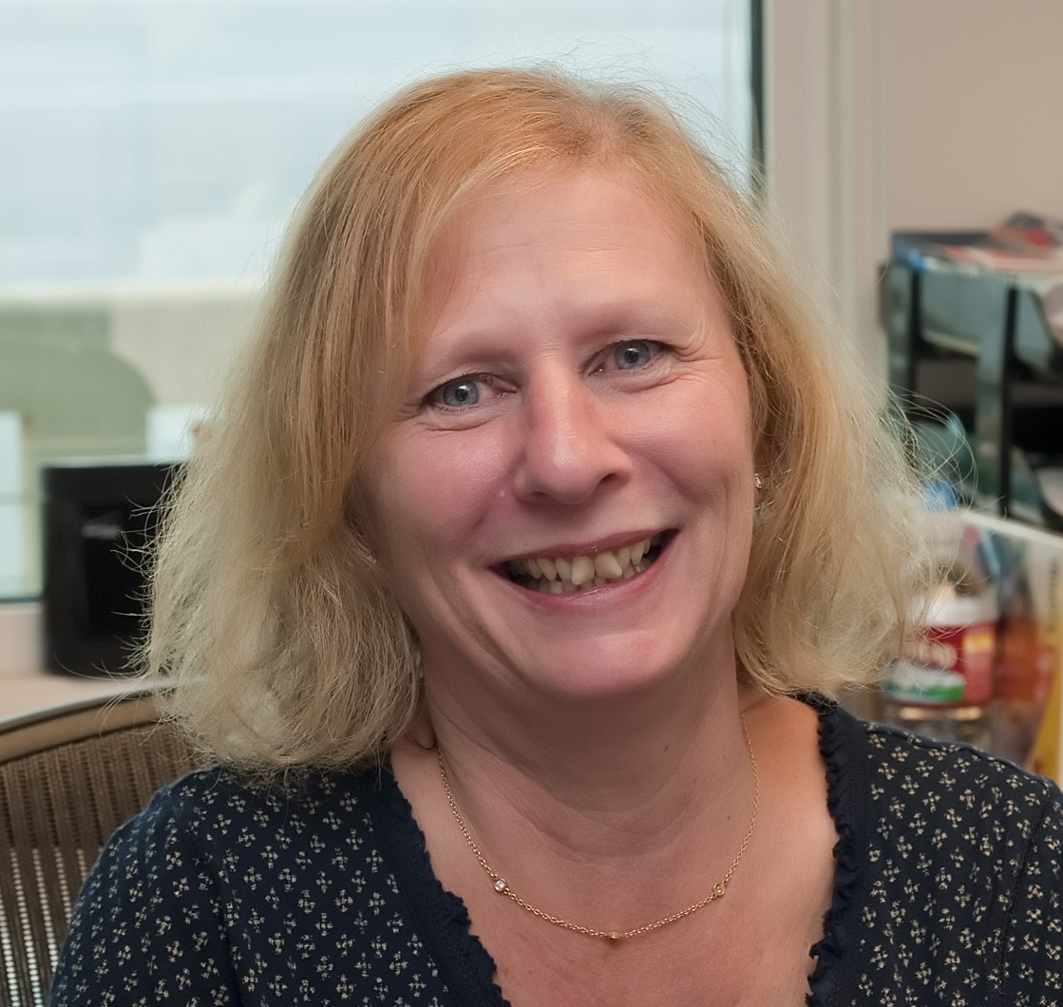
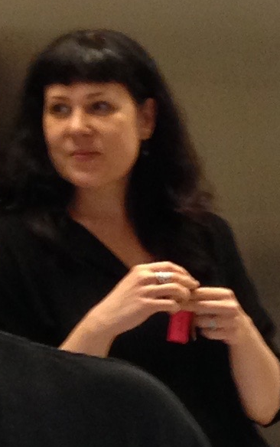
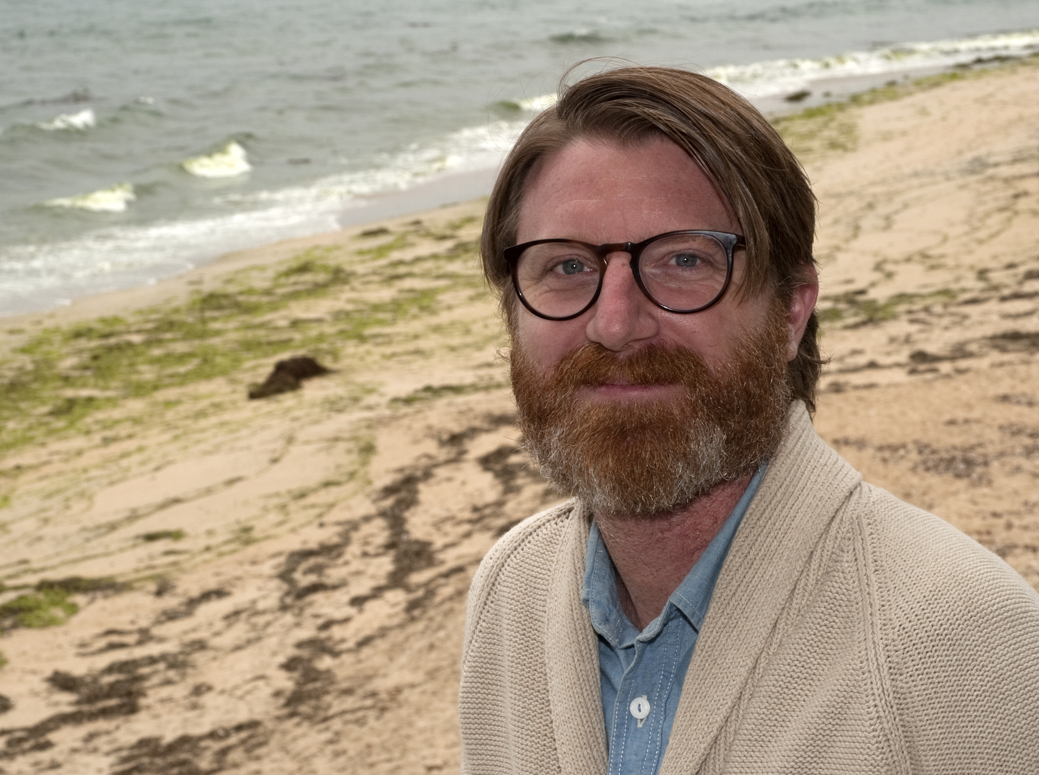
Misc. -- the CMD squad
We have trifecta of help at our disposal
Cindy
Dana
Mariah

Slide 30
Misc. -- the CMD squad
We have trifecta of help at our disposal
Especially in 3 broad areas:
  Helping with Travel
  Project Budget Entry
  Minor Purchasing

Slide 31
CMD Help #1 --Travel
BEFORE you go on a trip, have them start a TRAVEL REQUEST
CMD can do the following for you:
  Reservations for plane, car rental, hotel
  Register you for meetings
  Take care of membership dues (AGU, ASLO, etc.)
AFTER a trip, bring them receipts and they will handle EVERYTHING.

Slide 32
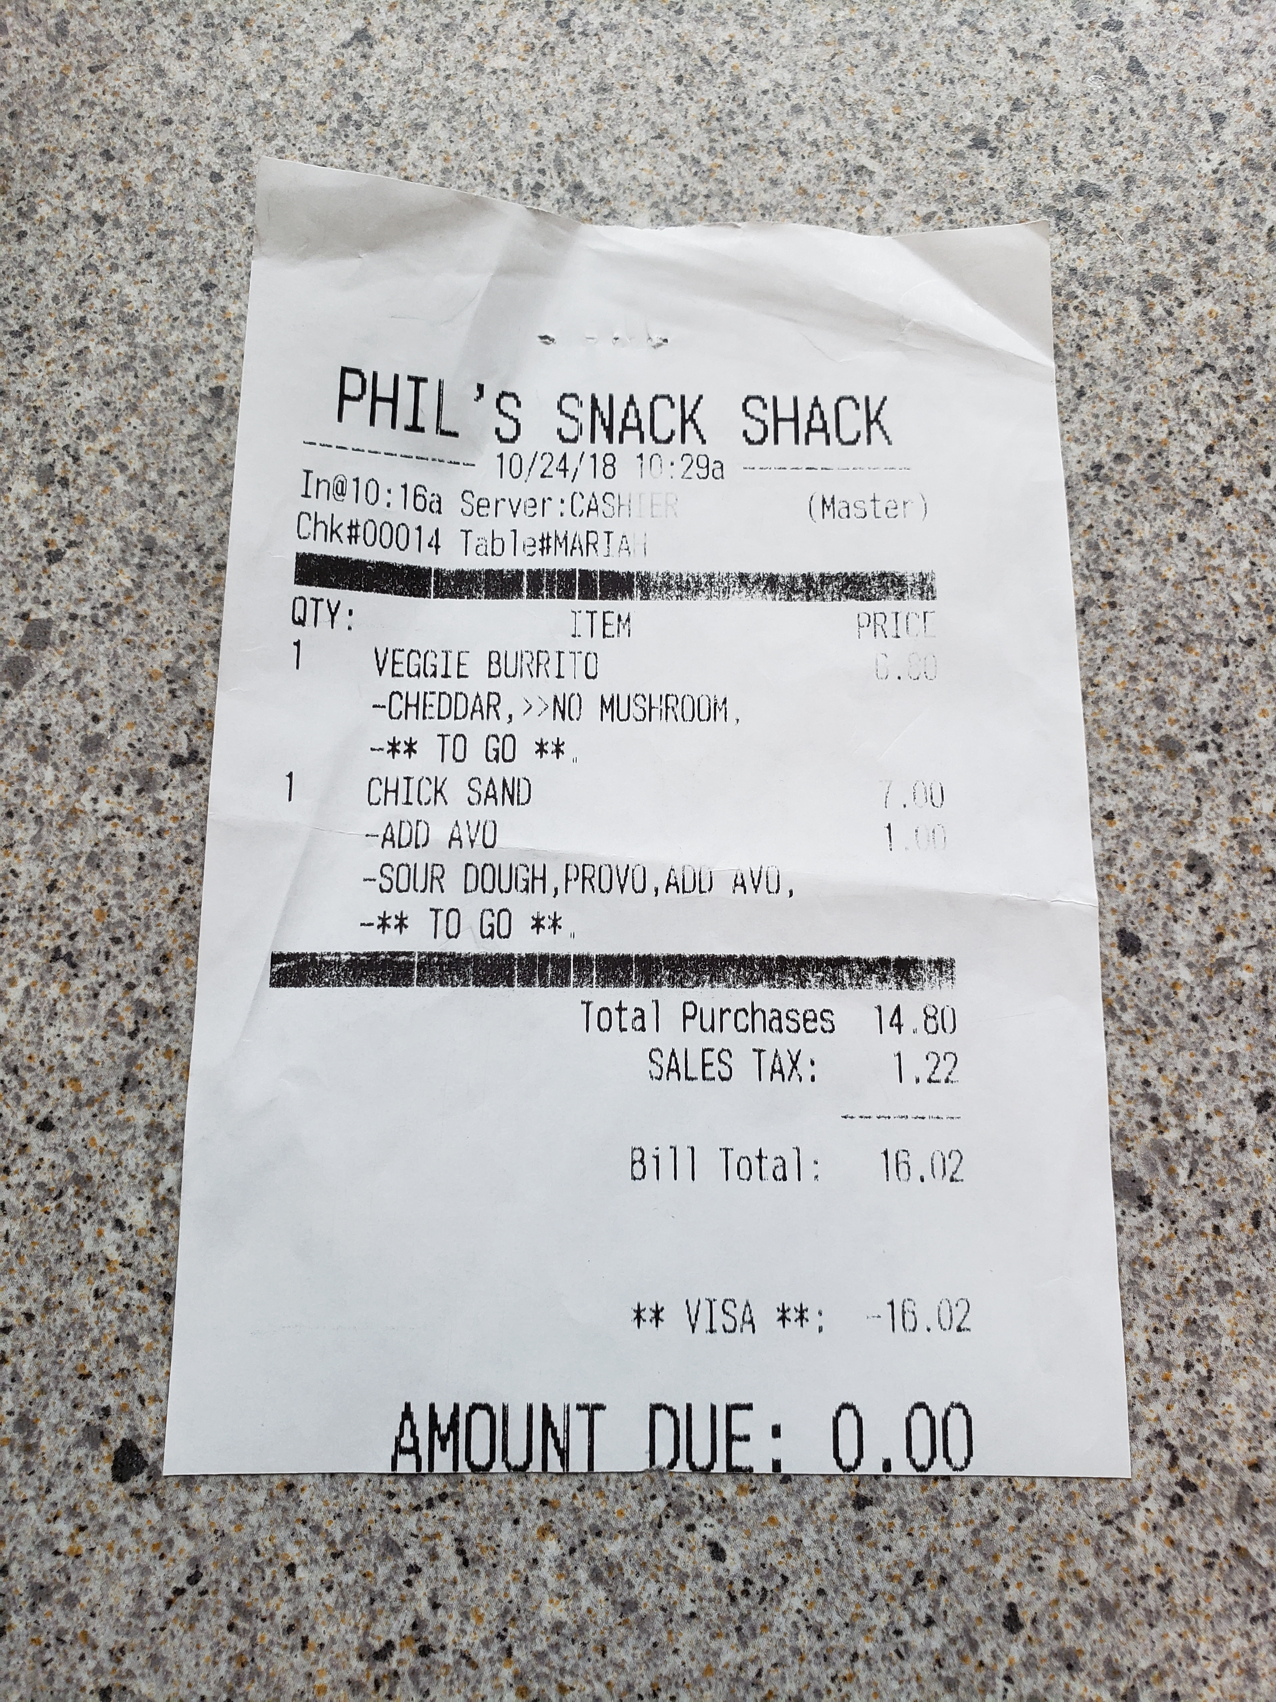
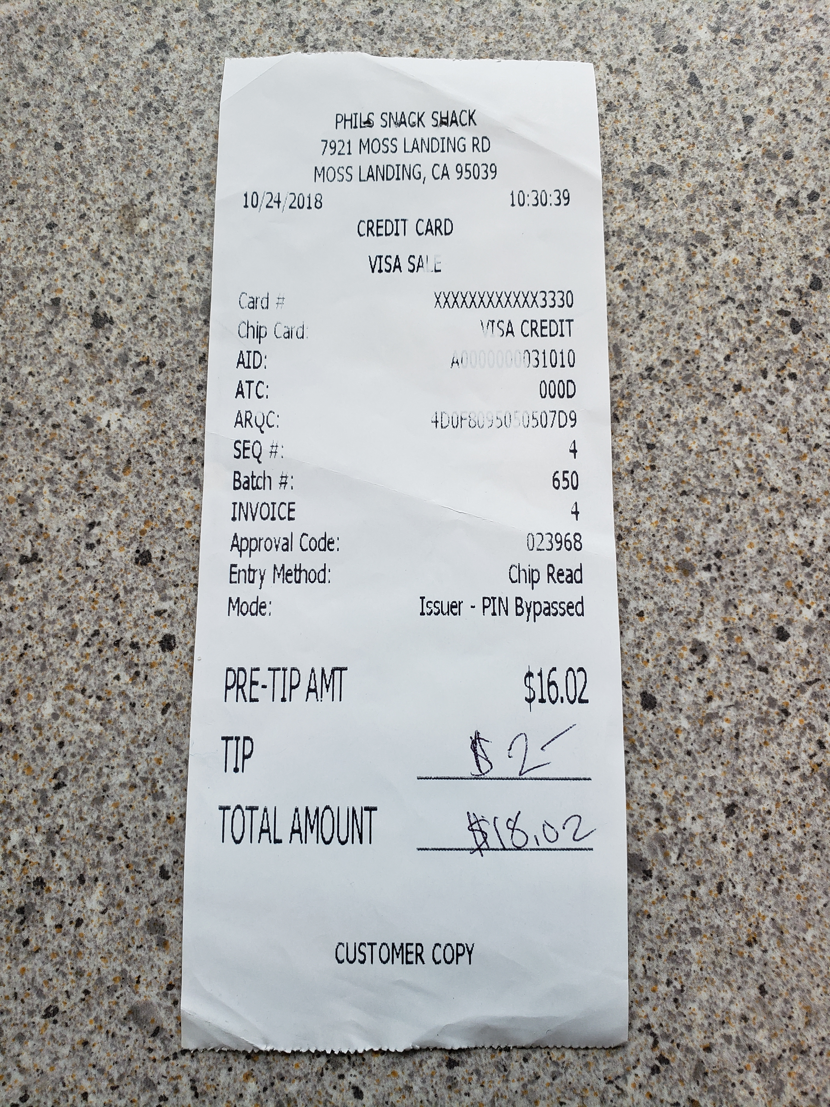
CMD Help #1 --Travel
Remember, receipts need to be ITEMIZED !
Vendor’s name
Date
What did you buy and its cost
BAD:
Good:
(except you shoulda
gotten mushrooms)

Slide 33
CMD Help #2
-Budget Entry

Slide 34
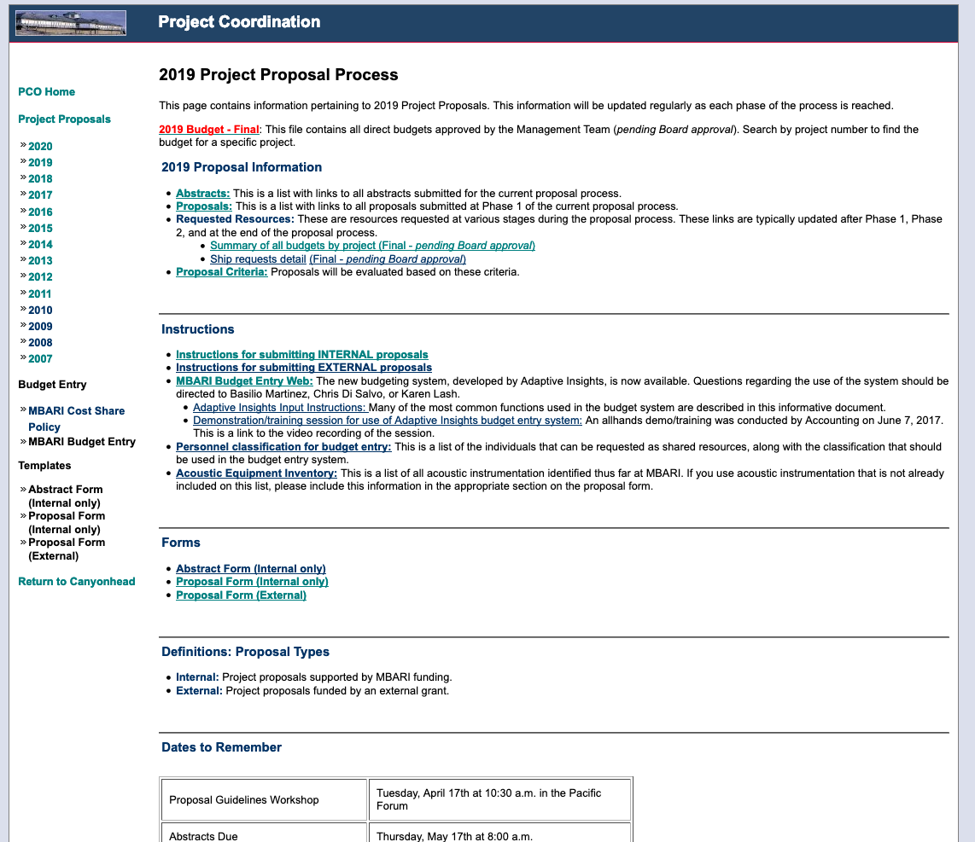
CMD Help #2
-Budget Entry
Every Summer
Notes:
Abstract or no Abstract?
External proposal form?

Slide 35
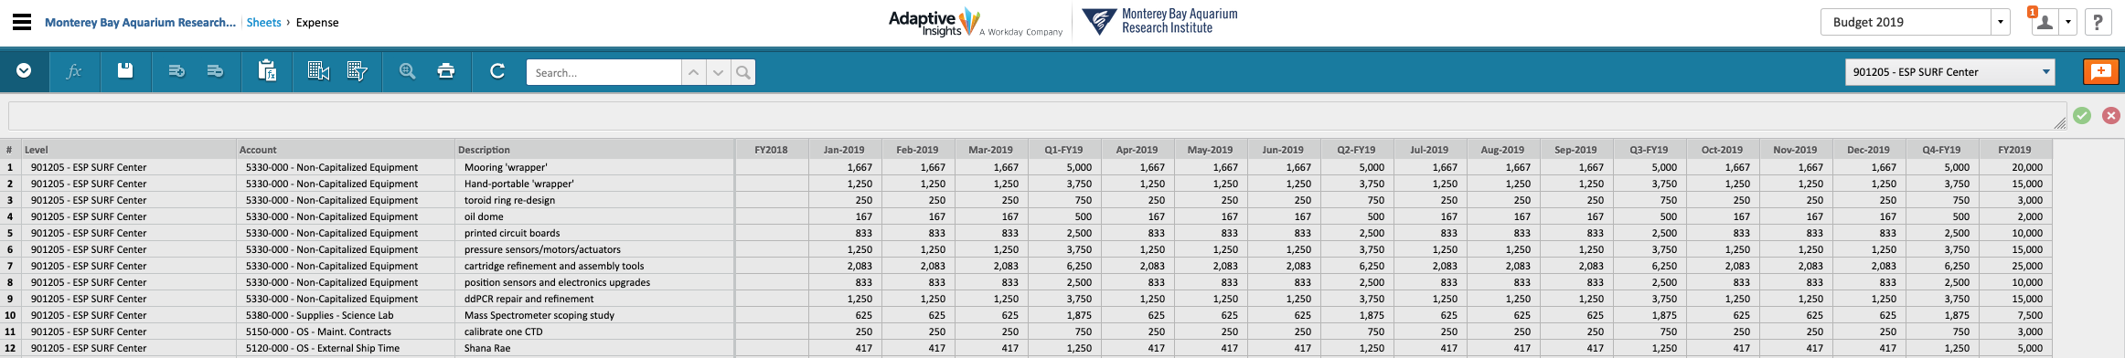
CMD Help #2
-Budget Entry
We are using ADAPTIVE, and CMD are pro’s at using it….

Slide 36


Meetings – ugh.
Daily Check-in
Weekly Tactical
Monthly/ad hoc strategic
Quarterly Review
One thing is INVIOLATE:
---ALWAYS HAVE AN AGENDA---
Notes:
How to run efficient meetings
You may hear people say that there of too many meetings, but what they are really saying is that there are too many inefficient meetings. There is a big difference
keep the meetings focused and efficient, meetings are expensive
make sure you have an agenda and are well prepared
circulate material to be discussed before the meeting
know when to stop a discussion especially if discussion starts about how to design the system.
Guideline: If less than 50% of the persons present don’t need to hear the discussion, bring the discussion to a close
summarize each main agenda item before moving onto the next item.
ensure that side discussions do not go on at the same time
distribute a meeting summary (Actions)(Decisions)(Statements)

Slide 37
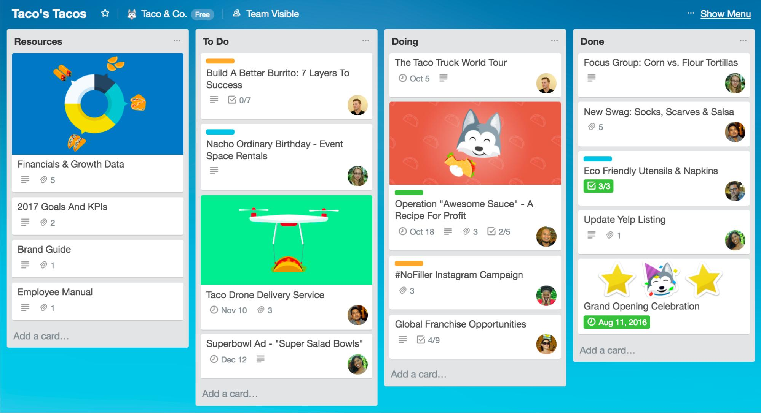

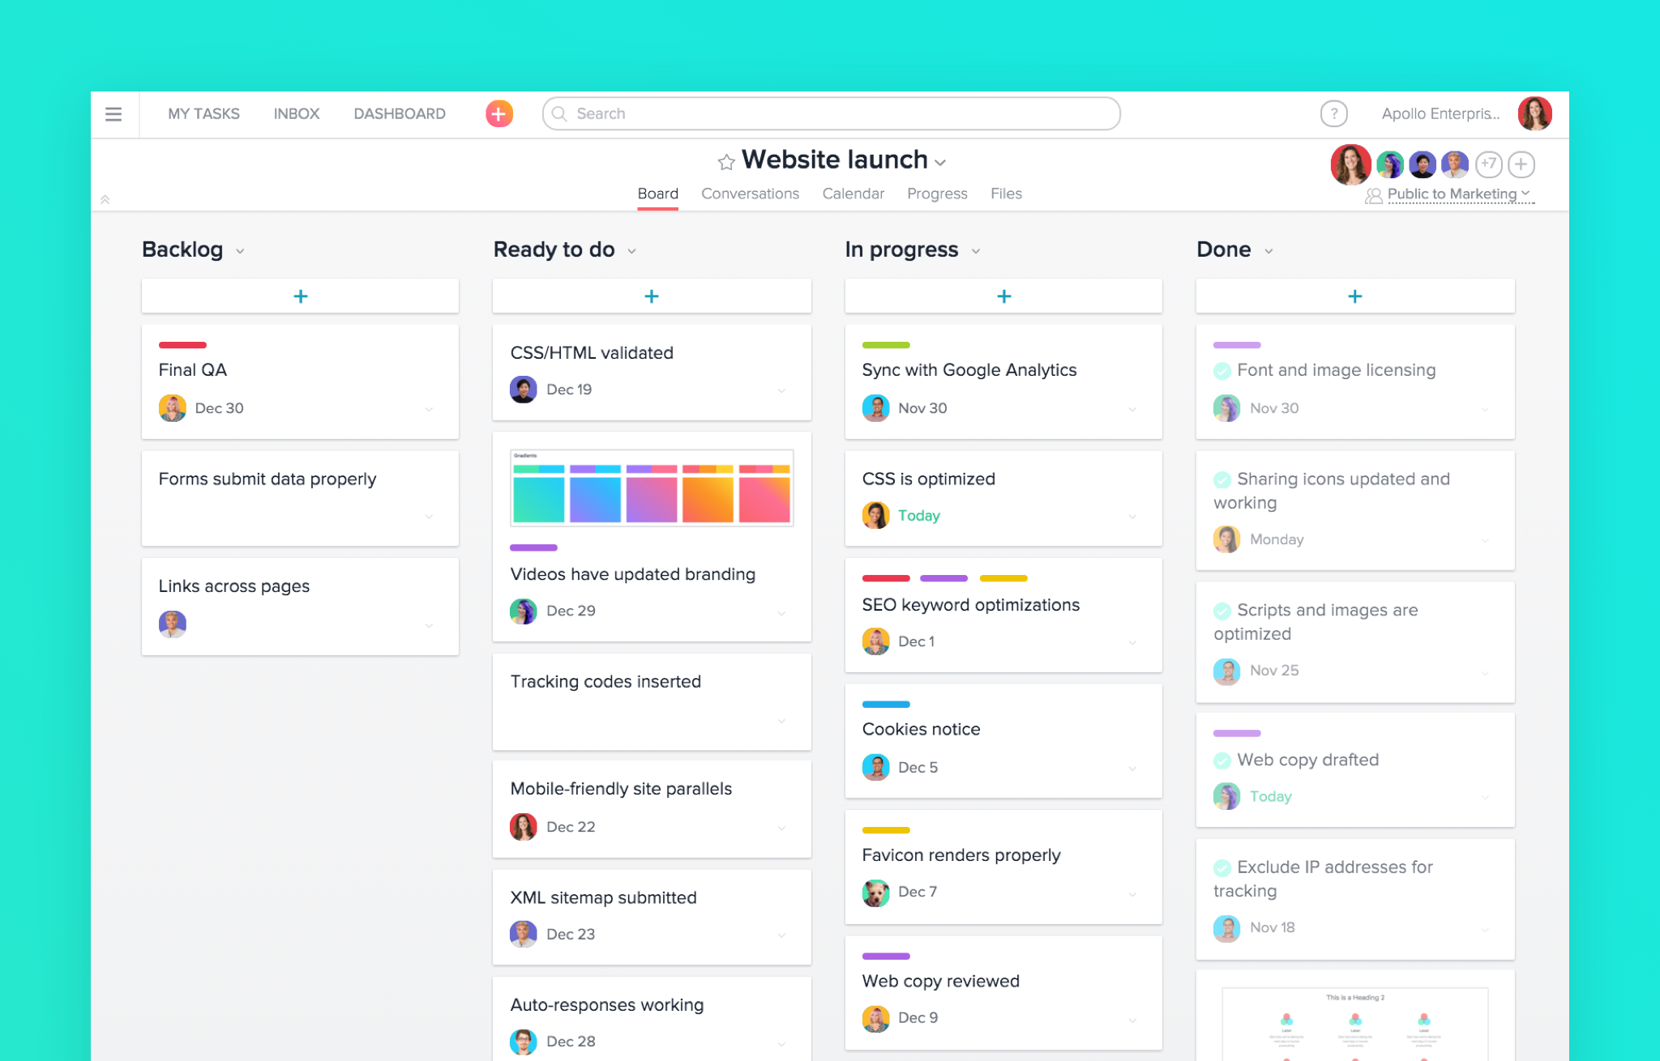

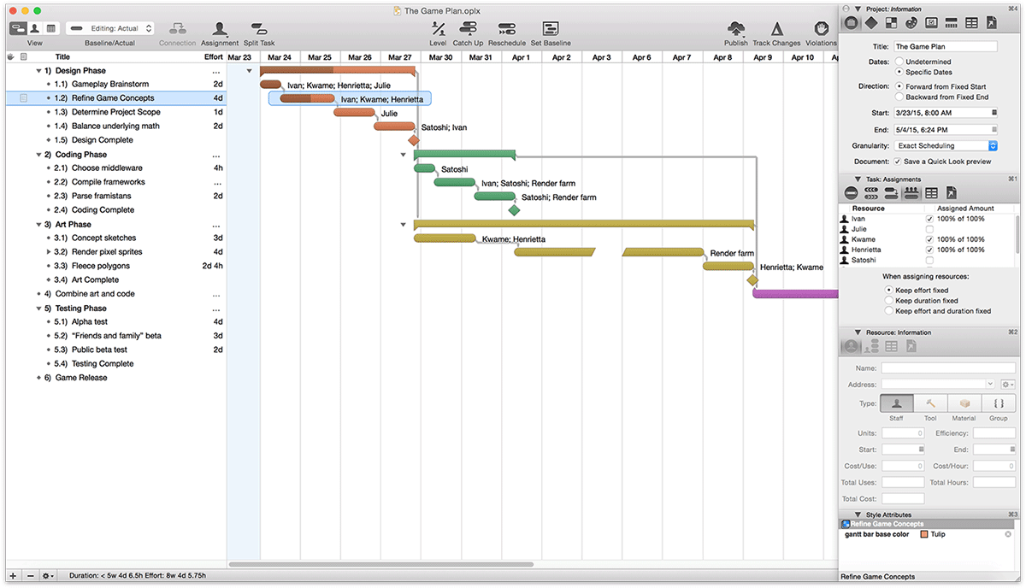


Other Project Management Resources
Merlin
MS-Project
Notes:
Merlin (OS) and MS-Project are full-blown project management powerhouses
Trello is a ‘listing’ software, allowing you to make lists / brainstorm and see it all at once
Asana revolves more around tasks, and teams can see task progress

Slide 38
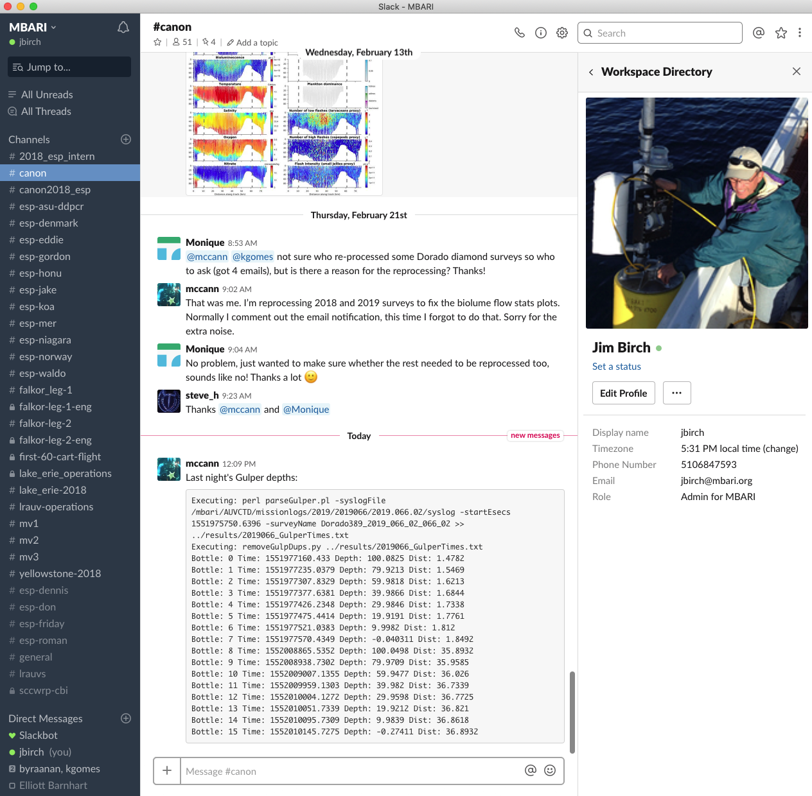

Other Project Management Resources
Slack
(See Kevin Gomes)

Slide 39
The Final Word
As PM, it’s your responsibility to keep an eye on hours and $$
Information for internal or external grant procedures are on Canyon Head
TALK to people!!! There is much help out there…

Slide 41
Project Projections
Proposal due dates complicate budgeting from EXTERNAL grants
2019
2020
Jun
Jan
Jun
Dec
Aug
Jul
These projections get tricky when you land a grant
and this is the ‘grant year’

Slide 42
Project Projections—an example
Here’s the scene:
    It’s June 2015, and we need to write 2016 proposals
What did we PREDICT we’d contribute to MBARI in 2015?

