Slide 1
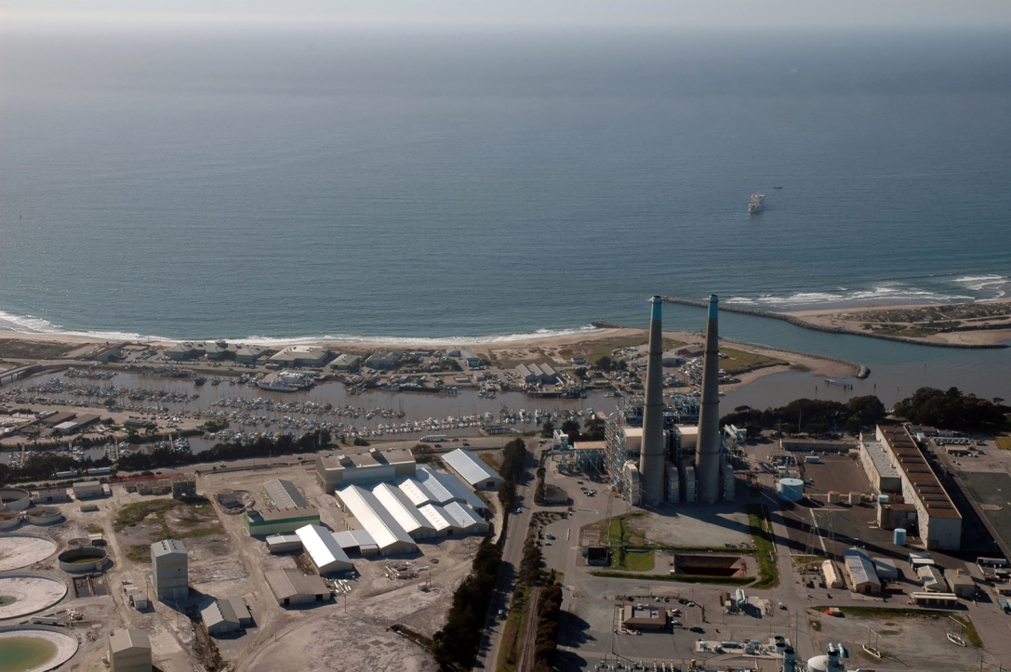
Project Management at MBARI
Alana Sherman
Jim Birch
March 7, 2019

Slide 2
Proposals
MBARI projects (i.e., INTERNAL)
Grant-Funded projects (i.e., EXTERNAL)

Slide 3
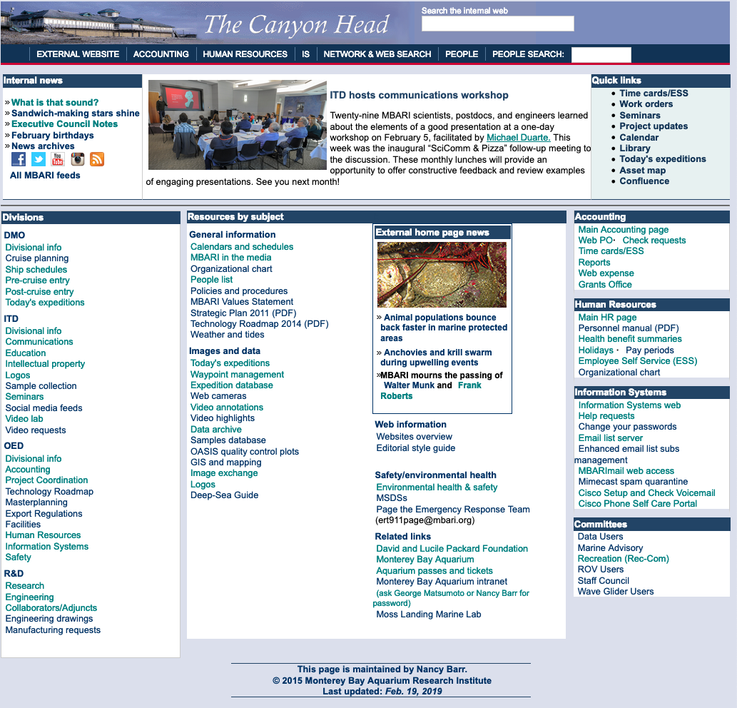
Proposals
Internal

Slide 4
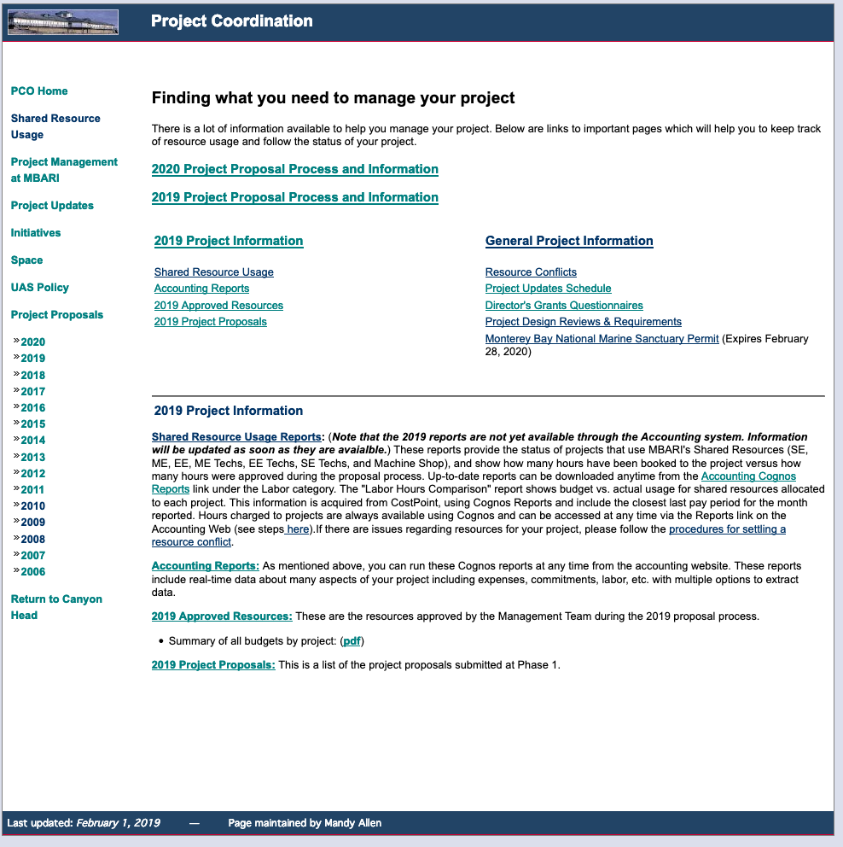
Proposals
Internal

Slide 5
Proposals
Internal
May 2, 2019
2020 Proposal Planning Workshop
Mandy Allen
(Here in Forum)

Slide 6





Proposals
What about External Grants?

Slide 7
Proposals
What about External Grants?
  Usually come about from:
    RFI – Request for Information
    RFP – Request for Proposals
    BAA – Broad Agency Announcement
    FFOA – Federal Funding Opportunity Announcement
…….Regardless of call, they come in 2 flavors:

Slide 8
External Proposals
Two Broad Categories:
  Grants/Collaborative Agreements
  Contracts/Procurements
Grants = ‘BEST EFFORT”
Contract = deliver property or service

Slide 9
External Proposals
Grants = ‘BEST EFFORT”
Contract = deliver property or service
Two Broad Categories:
  Grants/Collaborative Agreements
  Contracts/Procurements

Slide 10
External Proposals—What ARE we?
Grants = ‘BEST EFFORT”
$$$$
$$$$
Everyone
else
$$$
UCSC
$$
$
$
UCSC
MBARI
CSUMB
MBARI
CSUMB
$
$
MBARI is a Collaborator
MBARI is a Sub-Recipient

Slide 11
Proposals
External

Slide 12
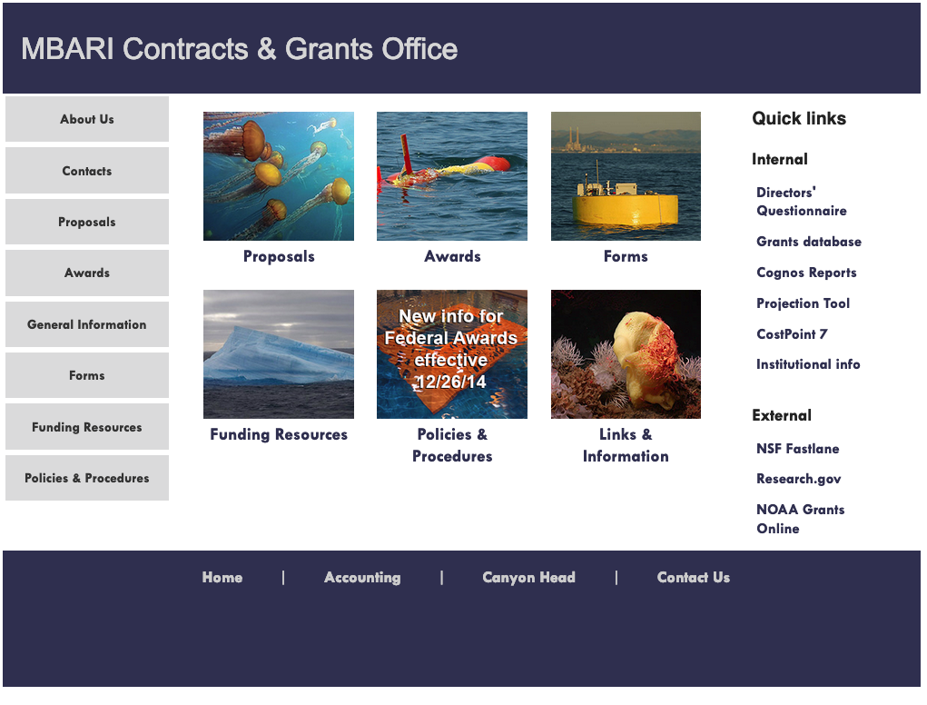
Proposals
External

Slide 13

Proposals
What is MOST IMPORTANT?
  Talk to Danielle Haddock!!
  Fill out a DQ.
Directors’ Questionnaire --Absolute Requirement to get MBARI’s OK to pursue external funds.
--Must be in before grant is submitted.

Slide 14
Proposals
External

Slide 15
Proposals
External

Slide 16
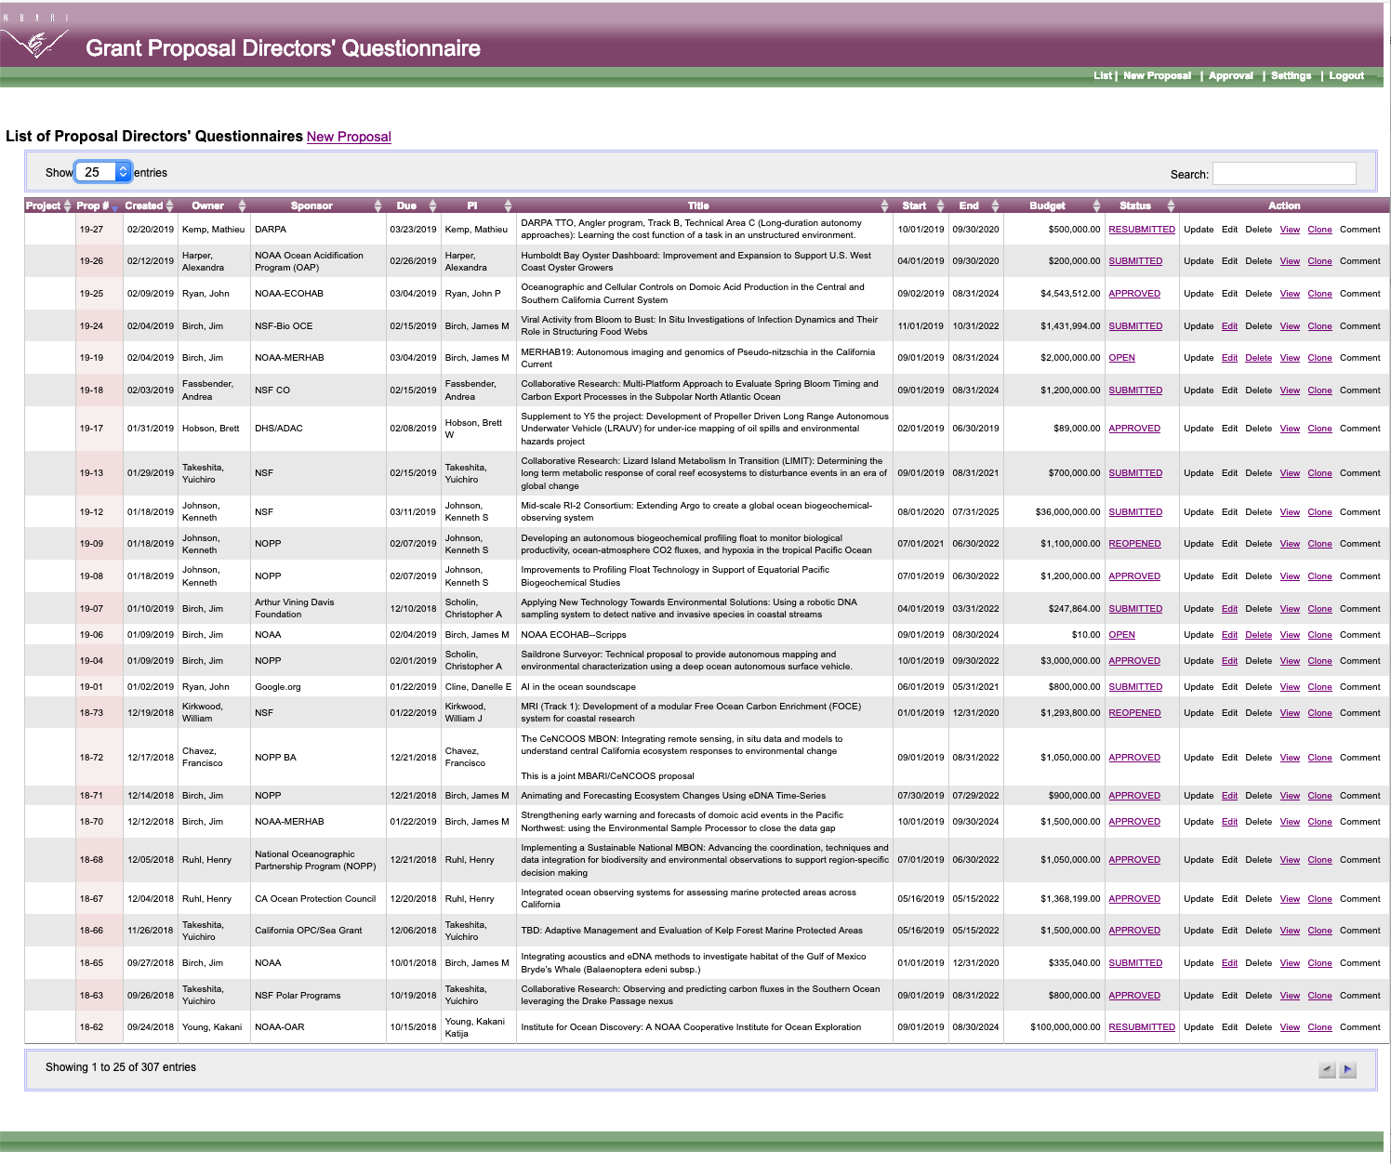
Proposals
External
  Directors’ Questionnaire

Slide 17
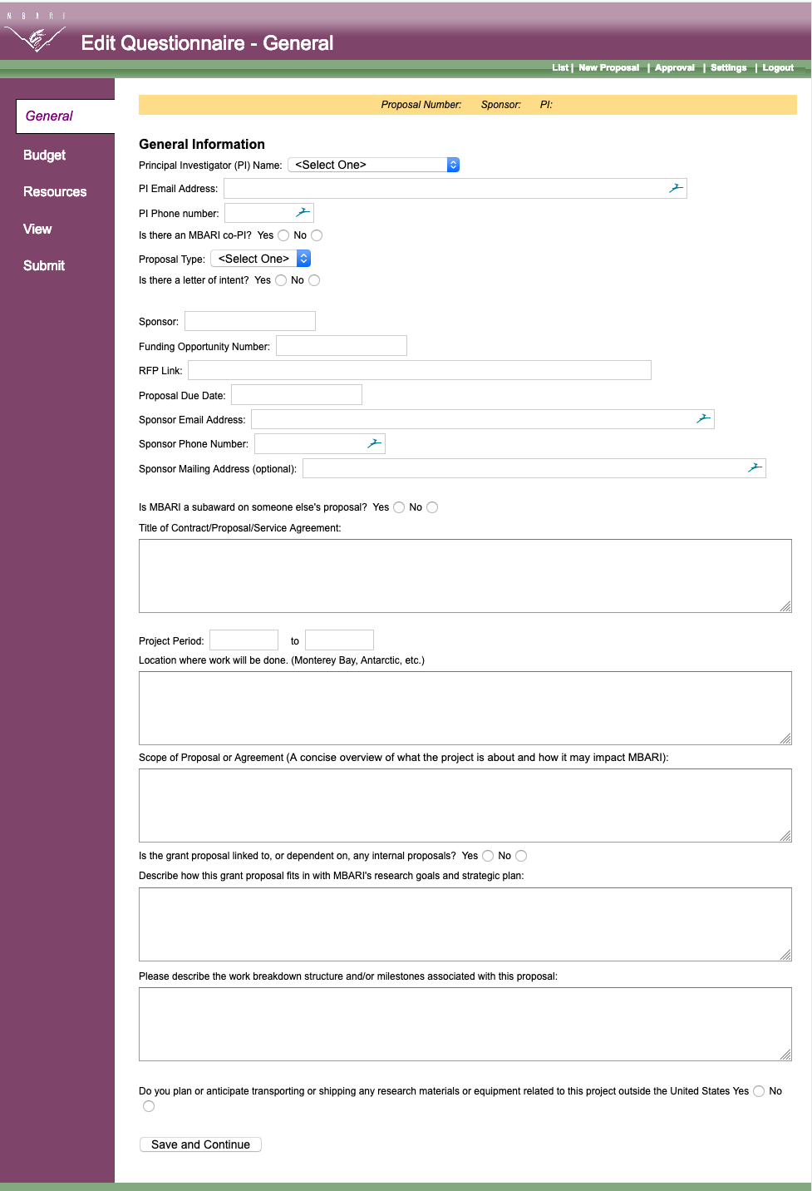
Proposals
Need 3 pages of Info
This is page 1:

Slide 18
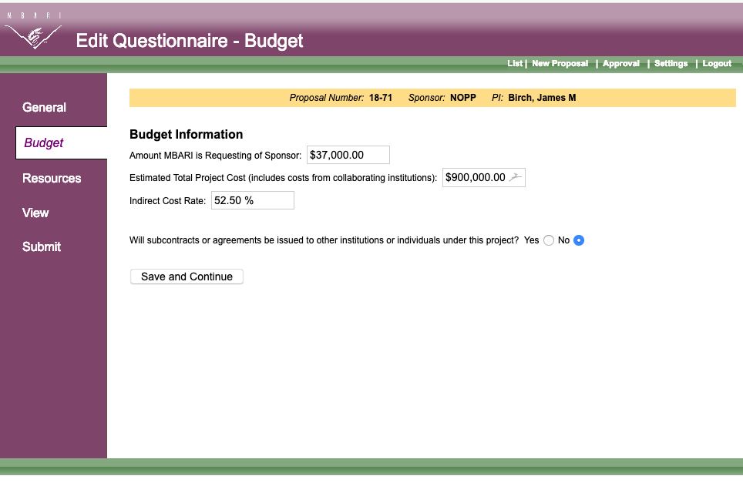
Proposals
Need 3 pages of Info
This is page 2:

Slide 19
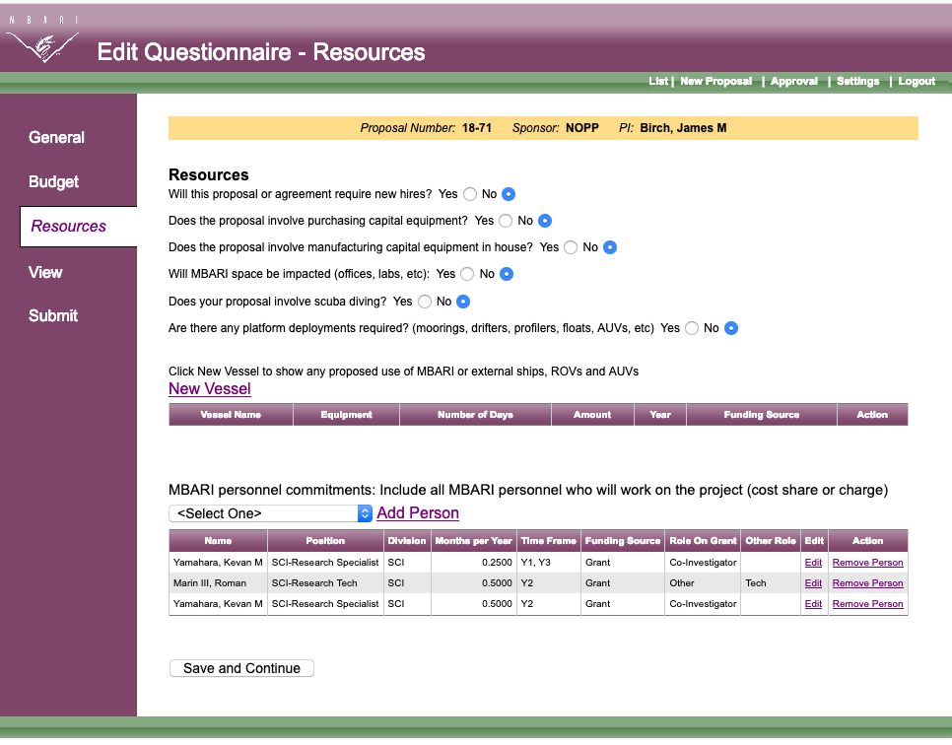
Proposals
Need 3 pages of Info
This is page 3:

Slide 20
Proposals
When working with other Institutions who will lead project, this is what you need for the DQ:

