Slide 1
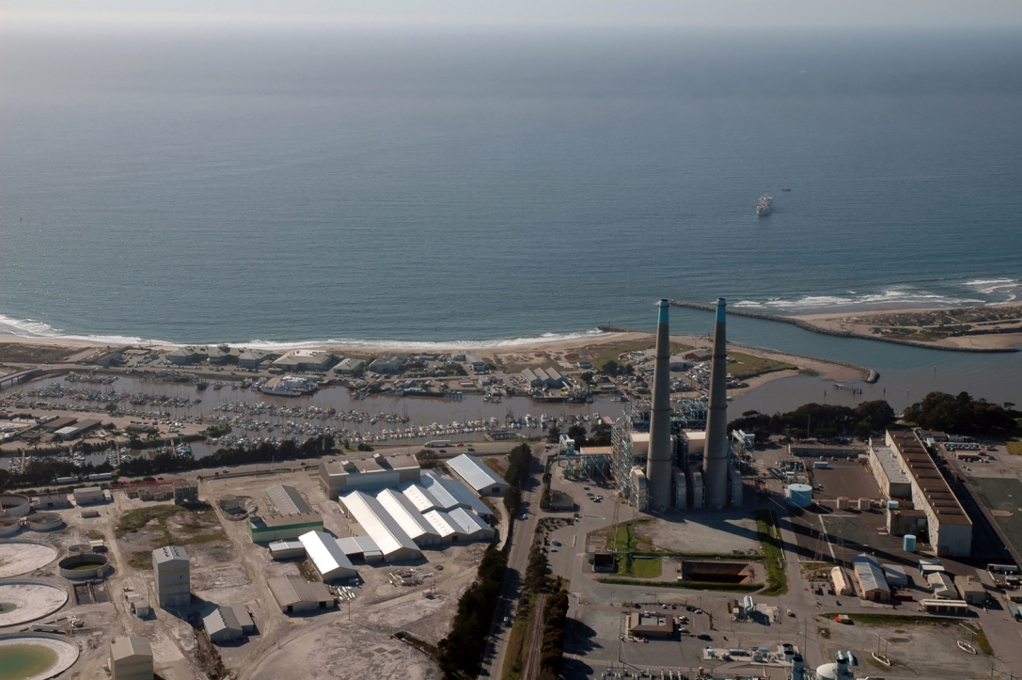
Project Management at MBARI
Alana Sherman
Jim Birch
March 7, 2019

Slide 2
Proposals
MBARI projects (i.e., INTERNAL)
Grant-Funded projects (i.e., EXTERNAL)

Slide 3
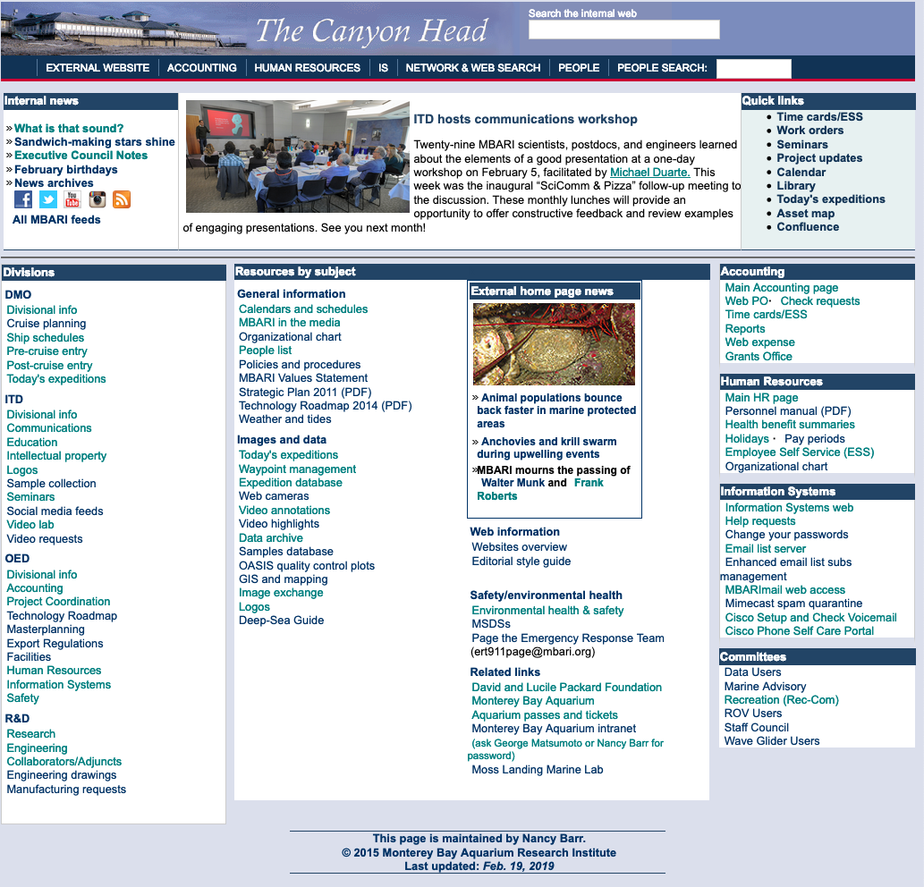
Proposals
Internal

Slide 4
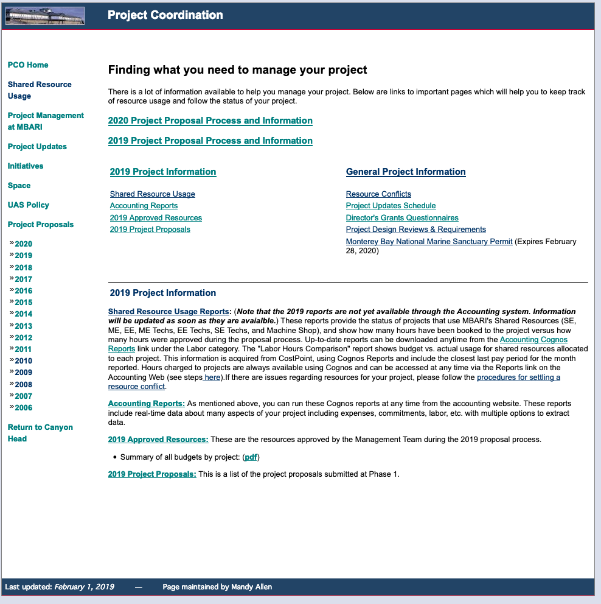
Proposals
Internal
OR
  Let’s look at last year’s instructions

Slide 5
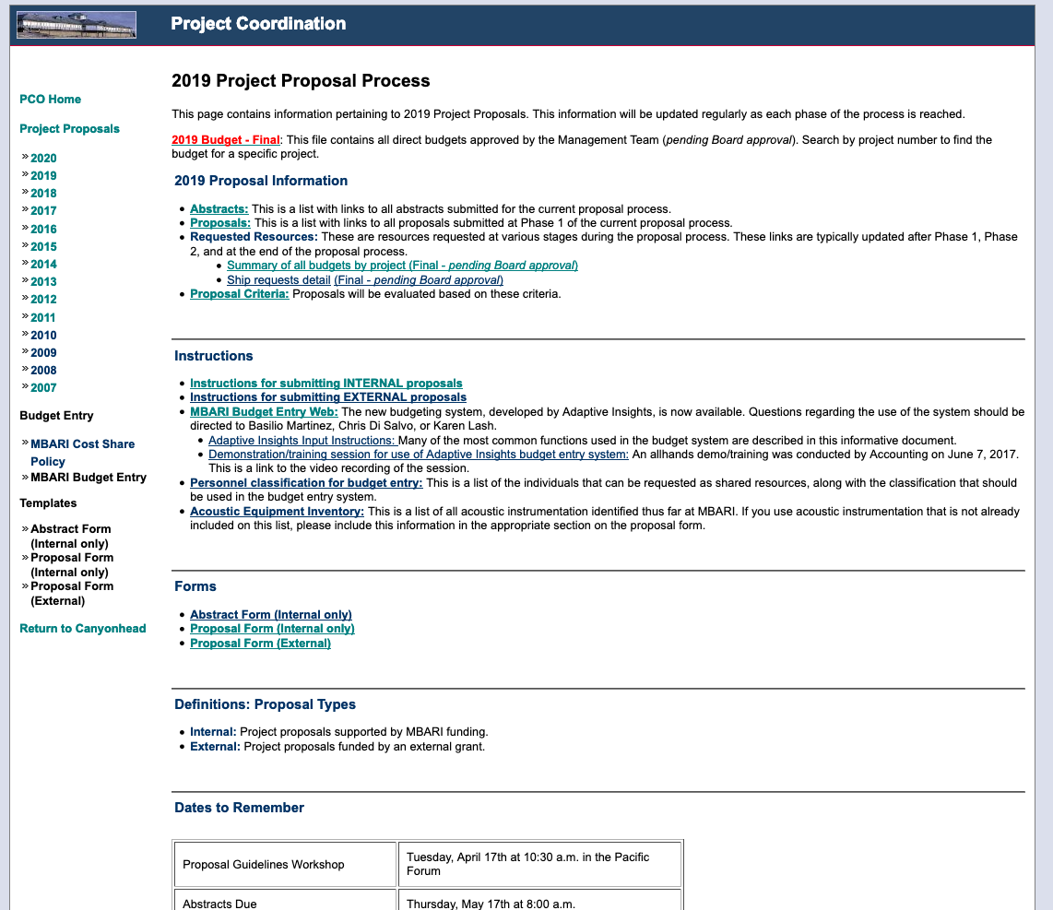
Proposals
Internal
This is from 2019
Notes:
Abstract or no Abstract?
External proposal form?

Slide 6
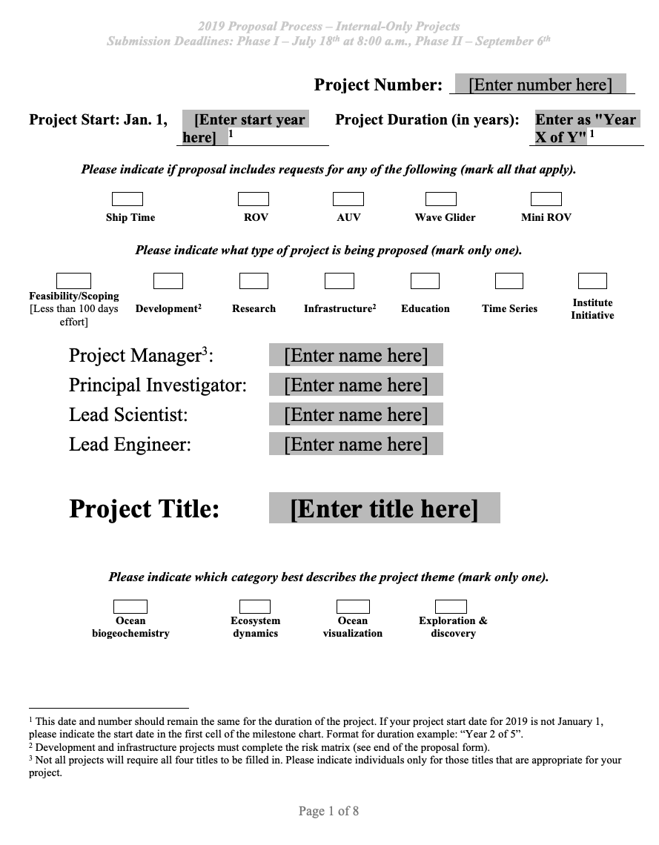
Proposals
Internal
  Start date NEVER CHANGES
  Projects can be 1-5 years long
Know the difference between
  Feasibility
  Development
  Research
  Infrastructure
Talk to people and have them read it!!
(don’t assign someone to these positions without talking to them first)
Notes:
Watch for cut-and-paste errors.
Don’t assume hours are available
Don’t put someone on whom you haven’t talked to---DON”T put PI on you haven’t talked to
Labor spreadsheet. The timing should be consistent with what you enter into your budget entry. We may be getting rid of this
Come to M-Team proposal writing workshop May 2!!

Slide 7
Proposals
Internal

Slide 8
Proposals
Internal
  Get a 174 page .PDF of all Projects at MBARI

Slide 9
Proposals
Internal
May 2, 2019
2020 Proposal Planning Workshop
M-Team
(Here in Forum)
Notes:
Can get a sense of what Chris/M-Team are looking for (or not looking for) during the next year, at this meeting.

Slide 10
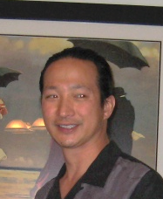
Proposals
Working with people OUTSIDE MBARI
  Collaborator’s Agreement
  Independent Contractor’s Agreement
  Material Transfer Agreement
  Non-Disclosure Agreement
  License agreement
See: Doug Au
Notes:
Collaborators agreement: non-MBARI employee comes onto campus must have this. It defines IP rights. Do NOT send code without this in place!
ICA: This is the contract to hire an outside person to do work for us. Especially needed for Federal Grants if paying over $10K to the person.
MTA: this is the ‘loan’ document, that codifies what we are transferring, the term of the transfer, and when it’ll come back
NDA: usually provided by commercial company to protect their IP
License Agreement: defines the relationship when another entity uses MBARI-developed technology.

Slide 11





Proposals
What about External Grants?

Slide 12
Proposals
What about External Grants?
  Usually come about from:
    RFI – Request for Information
    RFP – Request for Proposals
    BAA – Broad Agency Announcement
    FFOA – Federal Funding Opportunity Announcement
…….Regardless of call, they come in 2 flavors:

Slide 13
External Proposals
Grants/Collaborative Agreements
Grants = ‘BEST EFFORT”
Research.gov (FastLane.nsf.gov)
Contracts/Procurements
Contract = deliver property or service
Everyone
else
Grants.gov
Notes:
Fastlane began in 1995 for NSF
Grants.gov began in 2002
But majority of scientists still use Fastlane…

Slide 14
External Proposals—What ARE we?
Grants = ‘BEST EFFORT”
$$$$
$$$$
Everyone
else
$$$
UCSC
$$
$
$
UCSC
MBARI
CSUMB
MBARI
CSUMB
$
$
MBARI is a Collaborator
MBARI is a Sub-Recipient
Notes:
Add slides for projection (from SURF Center)
Also, what if grants doesnt’ get funded? Let M-team know!
Also grant front pages.

Slide 15
Proposals
External

Slide 16
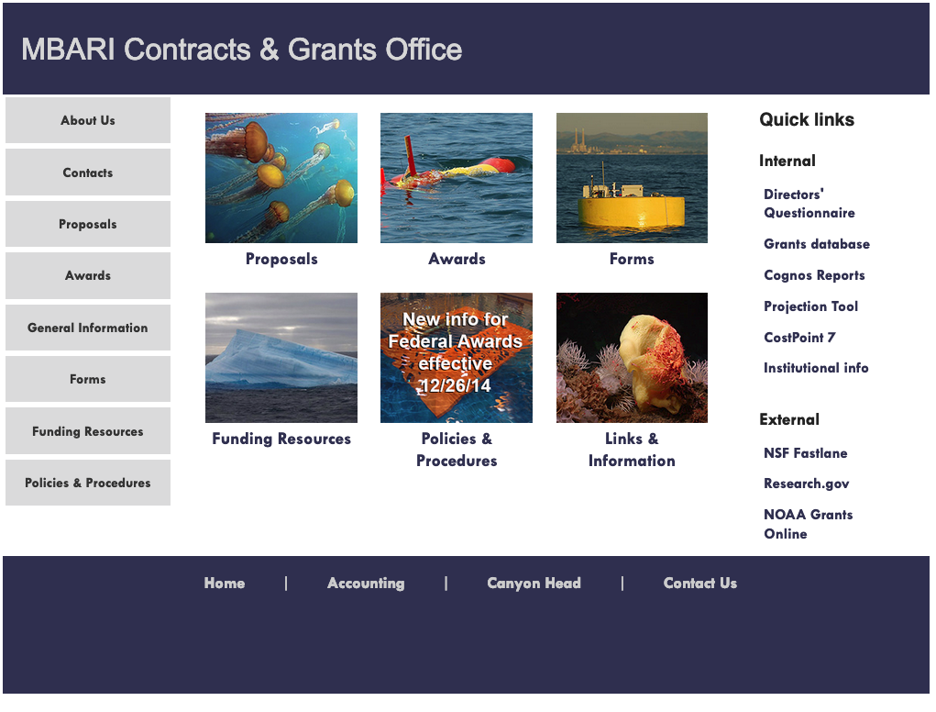
Proposals
External
ALL information is here

Slide 17
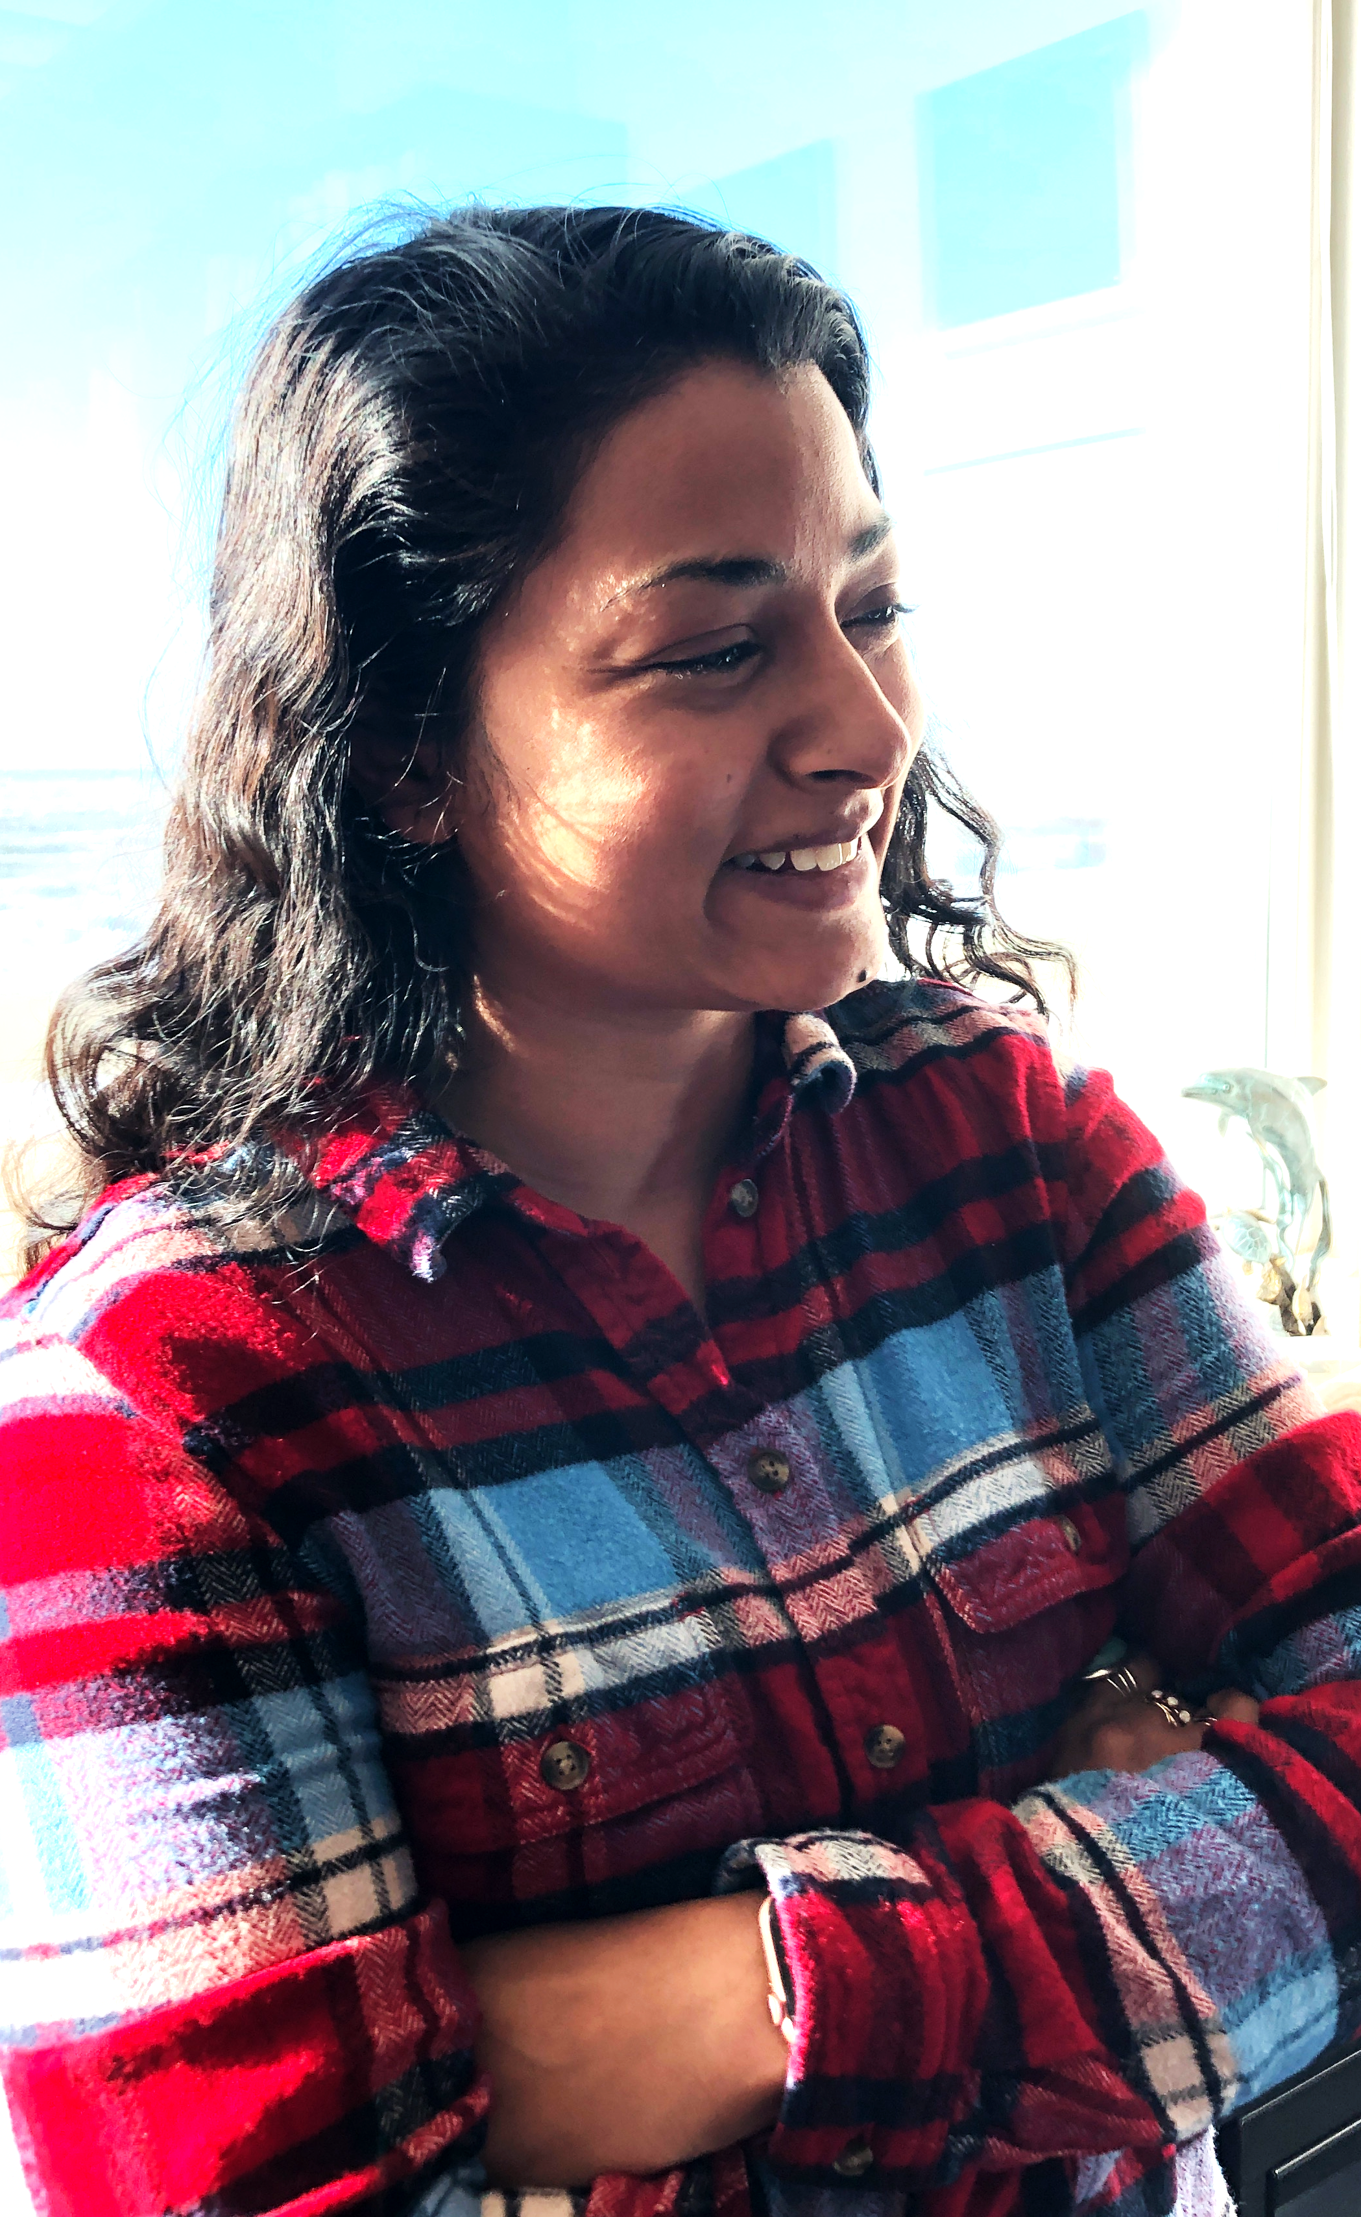
Proposals
What is MOST IMPORTANT?
  Talk to Danielle Haddock!!
  Fill out a DQ.
Directors’ Questionnaire --Absolute Requirement to get MBARI’s OK to pursue external funds.
--Must be APPROVED before FULL grant is submitted. (not nec. for Letter of Intent)
Notes:
Important to talk to Supervisor of who you want and if you need more space BEFORE you start the DQ
Is it appropriate, do we have enough time in people yrs, any major space impacts?

Slide 18
Proposals
External

Slide 19
Proposals
External

Slide 20
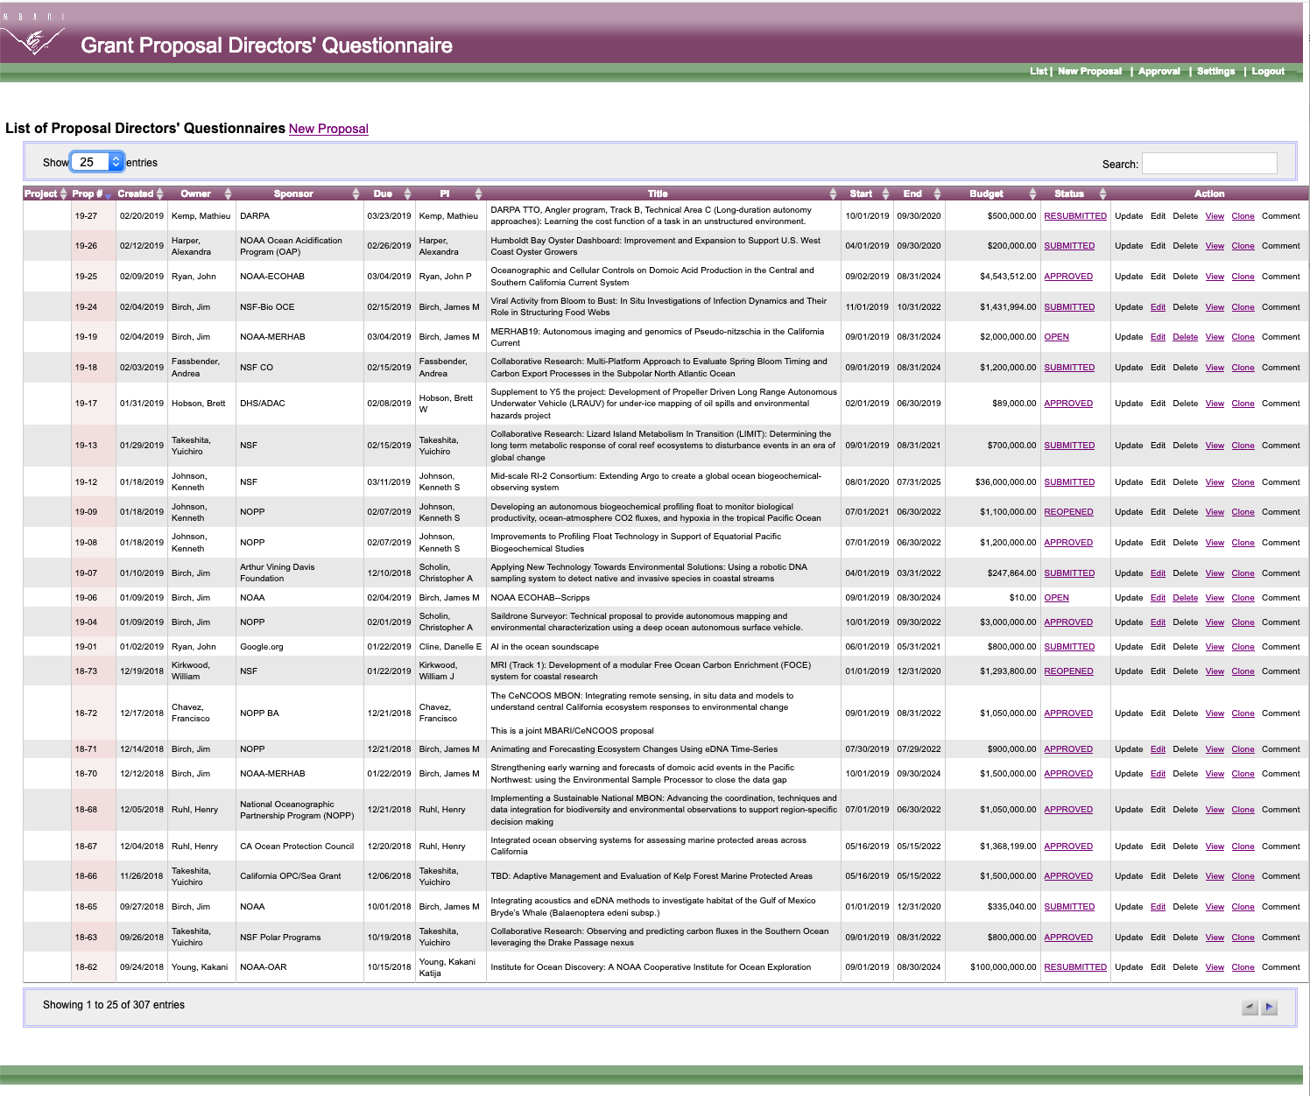
Proposals
External
  Directors’ Questionnaire

Slide 21
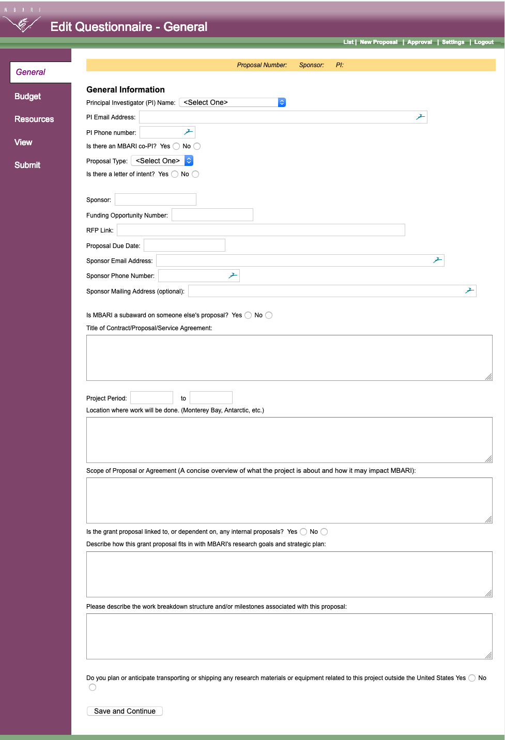
Proposals
Need 3 pages of Info
This is page 1:

Slide 22
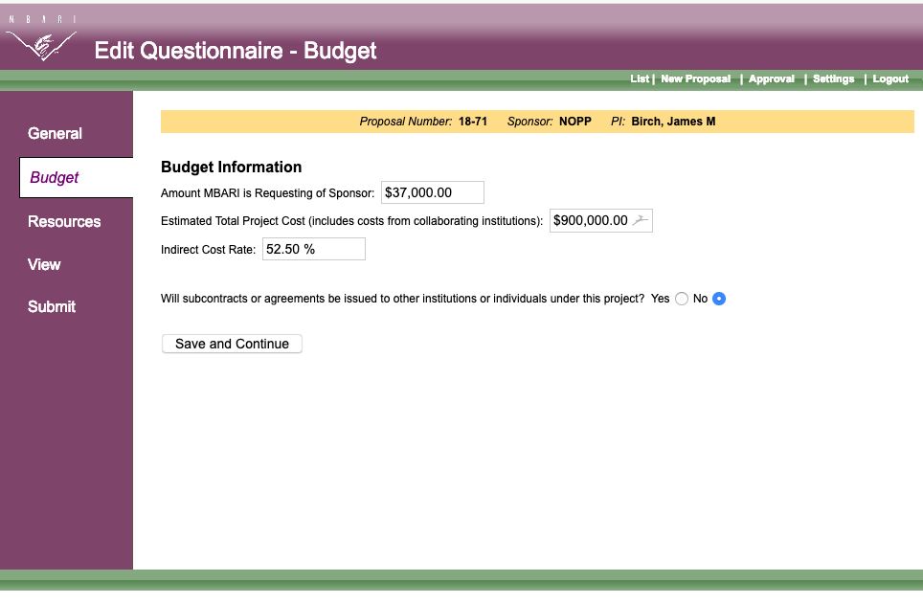
Proposals
Need 3 pages of Info
This is page 2:

Slide 23
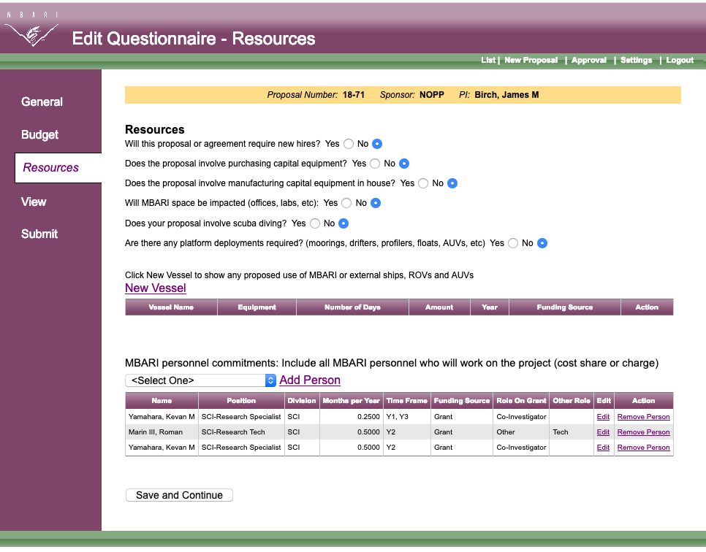
Proposals
Need 3 pages of Info
This is page 3:

Slide 24
Proposals
When working with other Institutions who will lead project, this is what you need from them for the DQ:
Sponsor (NSF, NOAA, etc.)
Funding Opportunity # (BAA #N00014-18-S-B007)
RFP Link (https://www.onr.navy.mil........)
Proposal Due Date
Sponsor’s email and phone
Title
Project Period
TOTAL budget number
MBARI budget number

Slide 25
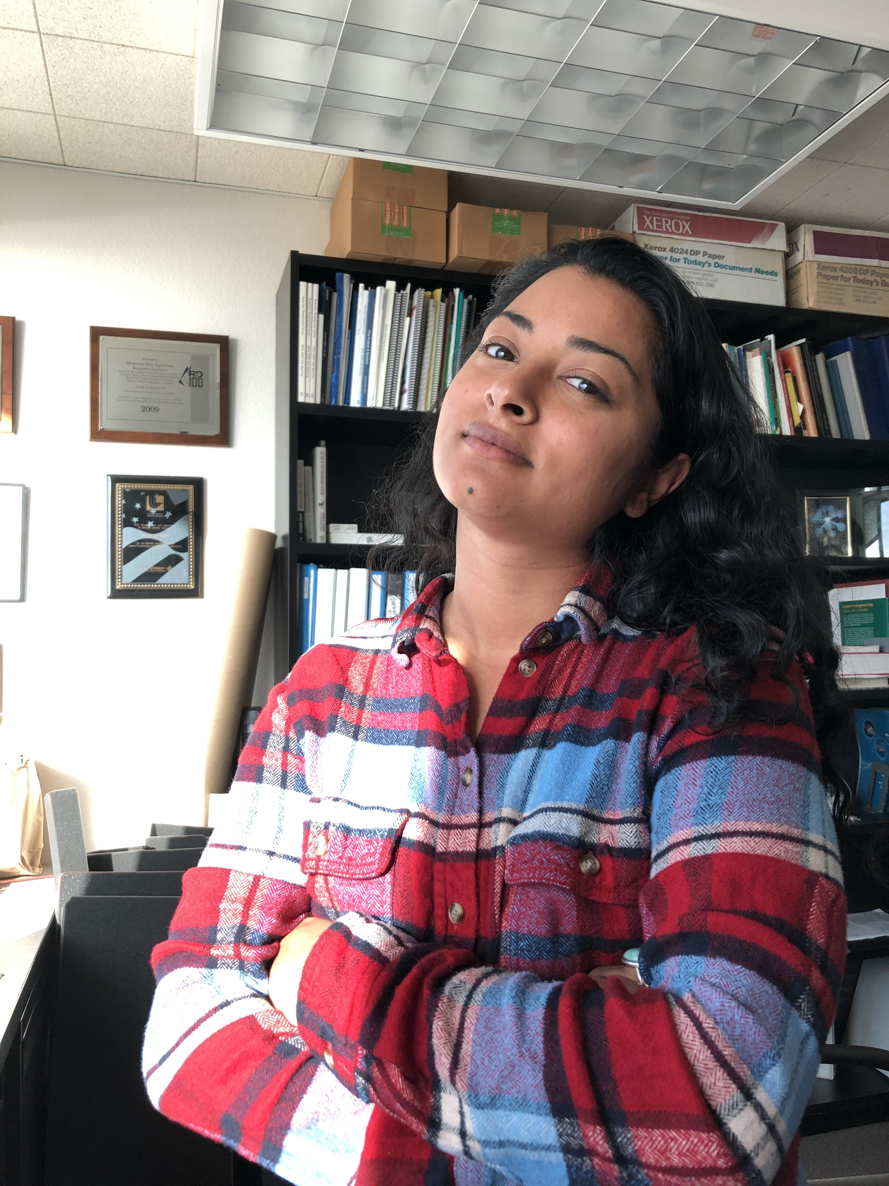
Proposals
What is MOST IMPORTANT?
  Talk to Danielle Haddock!

Slide 26
Budgets
How many hours can someone work?
One Year = 2080 workable hours = 173.3hrs/month
BUT
-80 hrs for Holidays and -80 hrs for Vacation (avg)
= 160 hrs/month

Slide 27
Budgets
Start with External Projects
Benefits—Health, Dental, Retirement etc.
Capital Equipment is any single item
> $5000
Indirect = Overhead
  Pays for lights, water, heat…
Notes:
Cost share. Look at cost share policy.
PI and their techs can cost-share, but all engineers and eng. Tech must be paid for, unless they are PI. Must be called out in DQ.
Policy is here: https://mww.mbari.org/Accounting/Grants/policies/cost-share-policy.html

Slide 28
Budgets
What is ‘Cost Share’?
MBARI promises to provide funds (i.e., salary) to have
certain people work on the external grant
PI’s can cost-share up to 2 months / grant
No cost sharing allowed for Engineering or DMO.
Policy is here: https://mww.mbari.org/Accounting/Grants/policies/cost-share-policy.html
Notes:
PI and their techs can cost-share, but all engineers and eng. Tech must be paid for, unless they are PI. Must be called out in DQ.
Policy is here: https://mww.mbari.org/Accounting/Grants/policies/cost-share-policy.html

Slide 29
Budgets
What is ‘Cost Share’?
MBARI promises to provide funds (i.e., salary) to have
certain people work on the external grant
Some funding agencies do not allow cost-sharing.
Check with Danielle!
PI’s can cost-share up to 2 months / grant
No cost sharing allowed for Engineering or DMO.
Policy is here: https://mww.mbari.org/Accounting/Grants/policies/cost-share-policy.html
Notes:
PI and their techs can cost-share, but all engineers and eng. Tech must be paid for, unless they are PI. Must be called out in DQ.
Policy is here: https://mww.mbari.org/Accounting/Grants/policies/cost-share-policy.html

