Slide 1
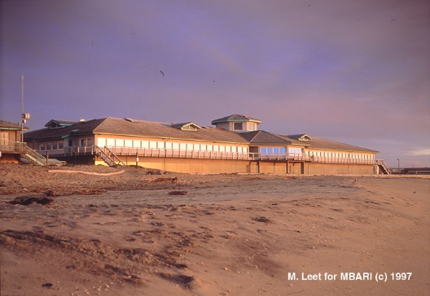
Project Management at MBARI Workshop
DAY 1

Slide 2
Day One
Six phases of a project
Enthusiasm
Disillusionment
Panic
Search for the Guilty
Persecution of the Innocent
Distinction for the Uninvolved
PM Responsibilities
Proposals
Day Two
Accounting
Management Tools
Group Meetings

Slide 3
Supporting Materials and Slide Docs
\\atlas\ProjectLibrary\Project Management Workshop 2019

Slide 4
Project Manager Responsibilities
Everything
Everything else
Annual Report
Board Bullets
EC Notes
Project Updates
Proposal Writing (Budget Entry)
…and managing the project

Slide 5
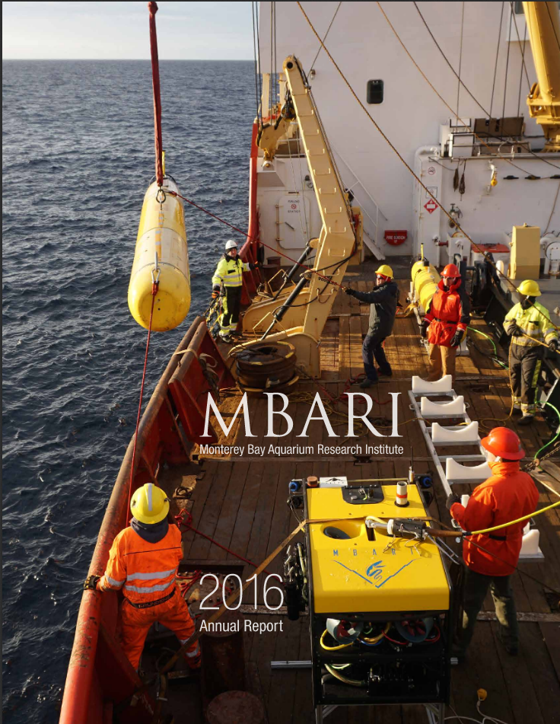

Project Manager Responsibilities
Annual Report
Notes:
Annual Report
Annual Report Instructions, from Chris Scholin’s email:
“This is the important part:
The PMs/PIs whose work we plan to highlight will be contacted directly in the next few days.
We ask that all staff members submit information about any publications, mentorships, honors, etc. that relate to your MBARI 2018 work year. These accomplishments will be posted on our website. Please use the attached form to submit this information.
In order for us to pull this volume together in a timely fashion, all information must be submitted to Nancy Barr by XXX”
2. Check instructions each year as they change, due date is usually in January.
2. Annual Report Notes
1. Due annually, must be submitted to Nancy Barr in January
2. Pubs, invited lectures, awards from everyone in the group related to that project
3. No more little paragraph
4. BUT you may be contacted for a longer write up to be highlighted in the Annual Report

Slide 6
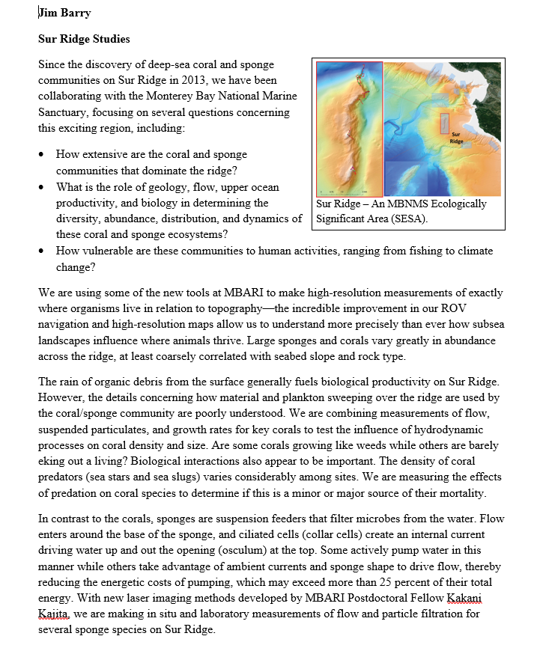
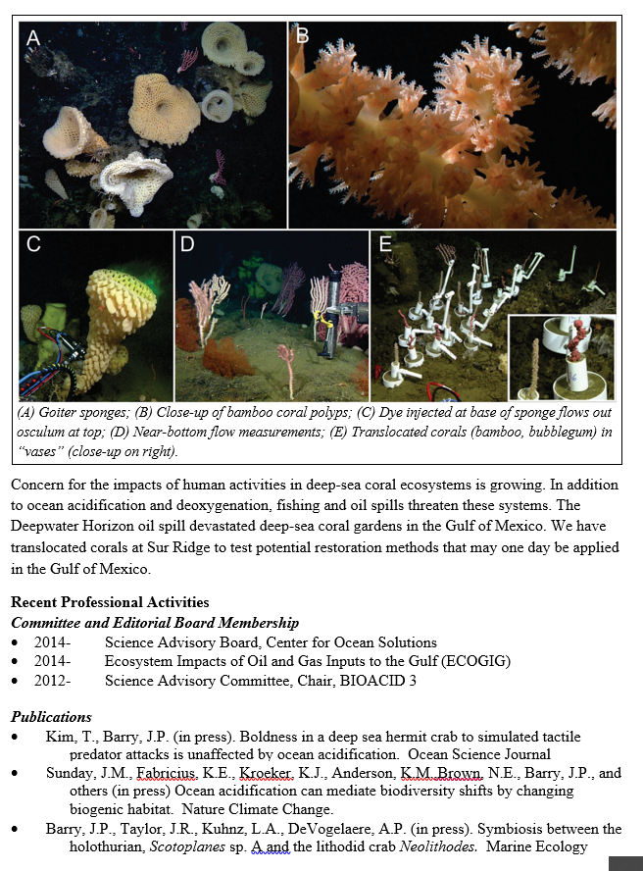
Project Manager Responsibilities
Board Bullets
Notes:
Board Bullets
Similar BUT not the same as the Annual Report
Due three times a year (Feb, May, October)
Necessary if there is some significant accomplishment/milestone to report
Project managers need to write up a 1-2 page summary, including images, that addresses the big questions and the progress made in the development/research.
See Jim Barry’s example as a reference
AS an individual you are responsible to report mentorships, conferences, pubs, invited lectures, awards, etc

Slide 7
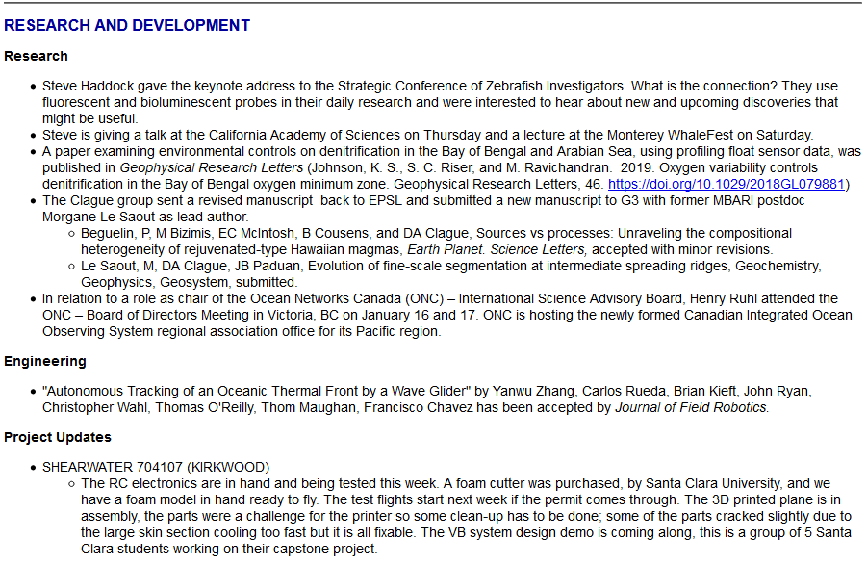
Project Manager Responsibilities
EC Notes
Notes:
EC Notes
Send email when important project milestones reached:
Significant deployments
Design reviews
Publications or conference presentations
WEEKLY event
Proposal Writing
Attend the proposal workshop to see what is new and important
Submit abstract for new project
Consult M-team if project is renewing about if abstract/presentation necessary
Submit proposal on time and make sure you have done budget entry
https://mww.mbari.org/resources/2020_Proposal_Process/instructions_home_2020.html

Slide 8
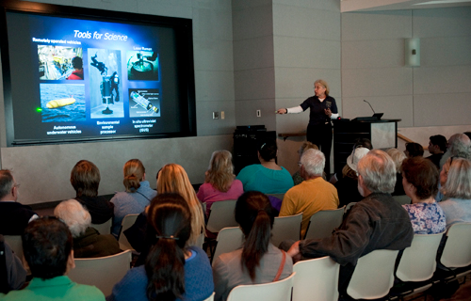
Project Manager Responsibilities
Project Updates
Notes:
Project updates
45 minute presentation
Good to do every couple of years
Why?
So people are aware of what you have done
Disseminate novel technology/methods/solutions to your colleagues
Yes it is a lot of work but often the slides for these will be reused many times over
Other stuff:
Web presence of project
Communications related to project: within team, within MBARI, outside MBARI

Slide 9
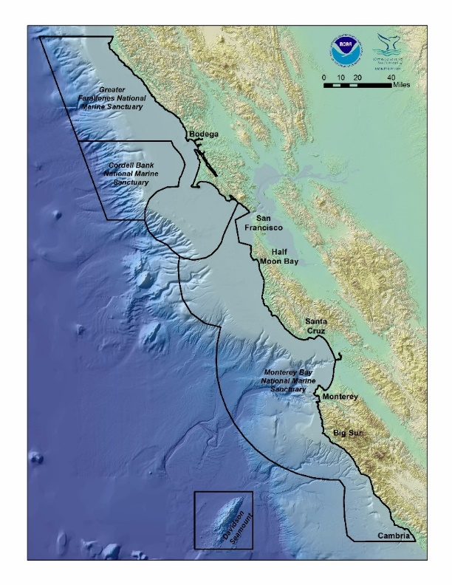
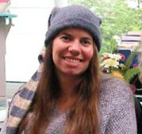
Permits: MB Sanctuary (Federal/NOAA)
Are you doing an activity that requires a sanctuary permit?
Some MBNMS (Sanctuary) Permit Triggers
  Benthic sampling
  Instrument and mooring deployments
  Discharges (including chemicals, AUVs, drifters, etc.)
  Cables
  Work at Davidson Seamount
Is it covered under our Annual Permit?
Annual Permit requires all groups covered to submit:
  Spreadsheet
  Project Summary
Notes:
Are you doing work that requires a permit from the sanctuary?
Benthic sampling
Instrument and mooring deployments
Discharges (including chemicals, AUVs, drifters, etc.)
Cables
Work at Davidson Seamount
Sanctuary also wants to know about any work in any SESA, but does not want to discourage research in these areas.
Ask Mandy if you are not sure.
If so, is your work covered under our general permit?
https://mww.mbari.org/pco/permits/mbnms-2015-002_feb2015.pdf
Ask Mandy if you are not sure.
If it needs a permit but is not covered under our general permit, Mandy needs to know. Most critical case!!!
There is an annual report provided to the sanctuary every February, requests from Mandy will be sent out in January. Materials you will need to provide Mandy
Project summary: a narrative of what you did last year and what you plan to do the following year.
Spreadsheet: all the activities you did the prior year under the permit
These are mandatory.
Mandy is the single point contact with the sanctuary. If you feel compelled to contact the sanctuary, please discuss with Mandy first.

Slide 10
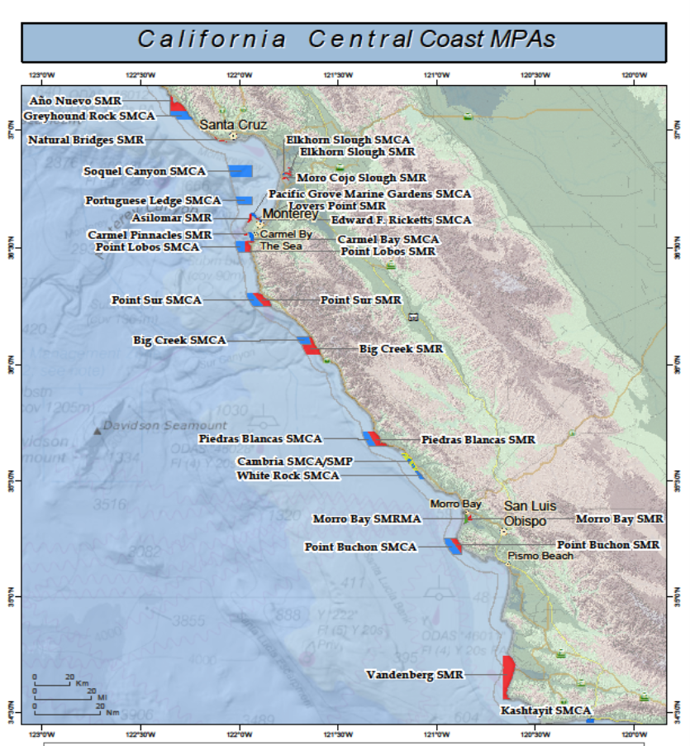
Permits: Collecting permits – CA
This is CA department of fish and wildlife
Are you collecting ANYTHING in an MPA?
Even if you are just collecting your thoughts in an MPA you probably need a permit.
Separate but related if you are doing active acoustics talk to Mandy
Notes:
Do I need a collecting permit?
If you are collecting biological samples anywhere that will transit CA waters you need a permit.
If you are working in an MPA a permit is required for additional activities.
Includes rocks
Includes water
Includes plankton net tows
Data not included
From Mandy’s email:
“California Dept. of Fish & Wildlife (CDFW) Scientific Collecting Permit (SCP)
Required for any collections of biota anywhere offshore California (even in Federal waters and beyond)
Required for any work in a Marine Protected Area (MPA) (https://nrm.dfg.ca.gov/FileHandler.ashx?DocumentID=105424&inline)
Additional requirements for collections beyond offshore California
Permit structure: "Entity" permits or individual permits
Coordinate permit applications with Mandy.
Mariah can help with submitting applications and payment. “
2. Additional points:
This is required even if your collection is outside of California waters BUT you are transiting through state waters (i.e. coming back to Moss Landing)
If you fall into this category go see Mandy or Mariah.

Slide 11
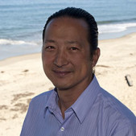
Permits: Export Control (ITAR, EAR)
Reminder that exports of hardware or software/tech data may require a license.
Exports include giving access or sharing information regarding hardware or software/tech data with foreign nationals by any mechanism (conversation, email, hard copy, etc.) and any location (visitors to MBARI, when traveling in other countries, etc.)

Slide 12
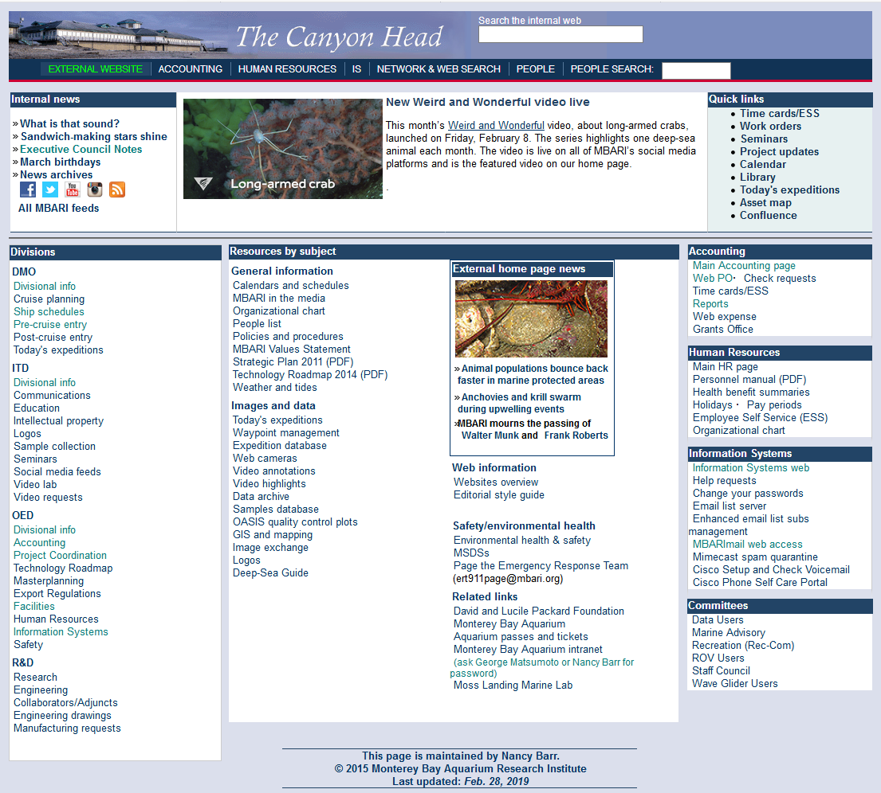
Working with DMO- Ship Schedules
Request ship days (both how many and when as part of the proposal process)
First revision of schedule released in late Fall
This is the best time to change dates so ignore this email at your own peril
Find your dates using the Ship schedule link

Slide 13
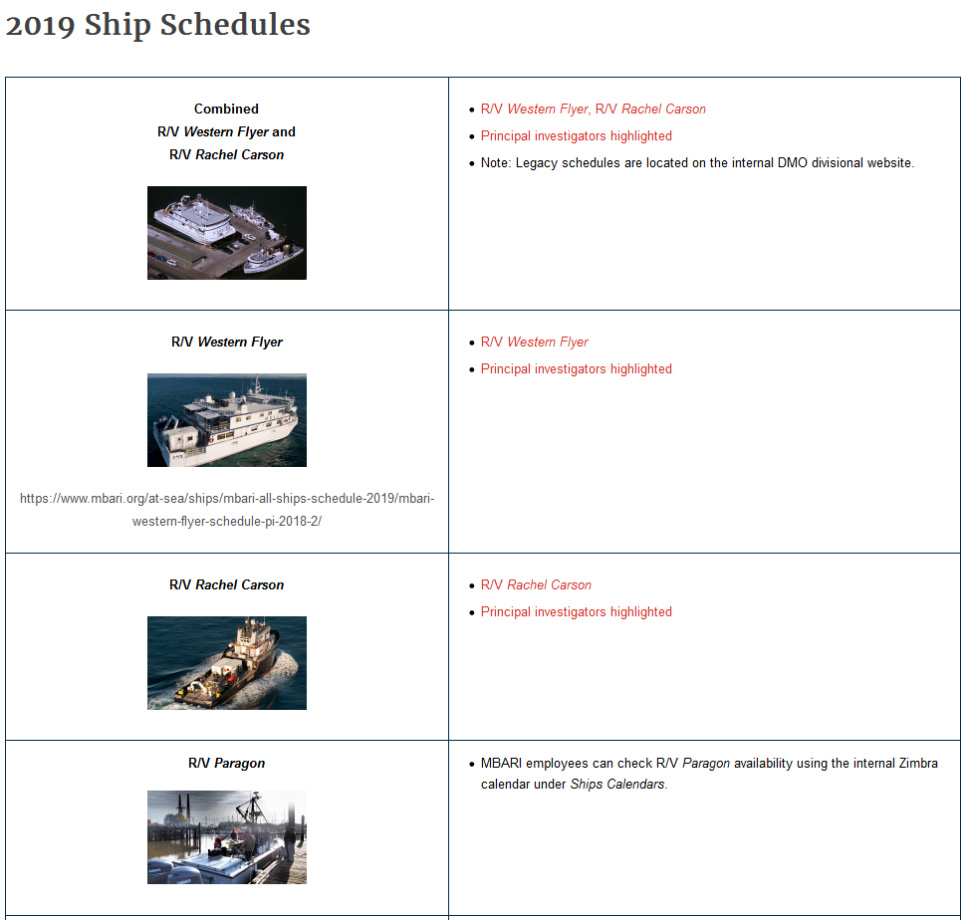
Working with DMO – Ship Schedule

Slide 14
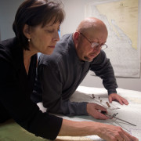
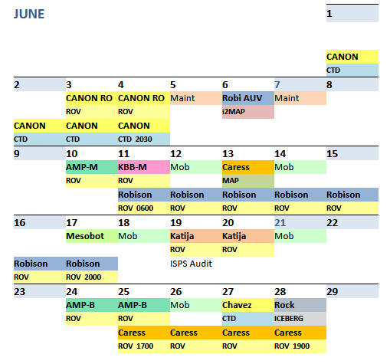
Working with DMO – Ship Schedules
Flyer and Carson schedule on DMO website
Talk to Teresa Cardoza and Chris Grech
Notes:
Western Flyer/ Rachel Carson
When are my ship days? Do I have any control over this?
Request days in proposal
Initial schedule sent out for input late fall/early winter
Schedules can be found: https://www.mbari.org/at-sea/ships/mbari-all-ships-schedule-2019/ and on CanyonHead
Communicate change requests to Chris Grech, Teresa Cardoza
I need to change my ship days
Communicate change requests to Chris/Teresa
VERY hard to change Flyer days
Don’t assume maintenance days or days in port are available. Availability depends on a number of factors including crew schedules
There are a number of contingency days factor in each year but as the year progresses the get used up
Paragon
When are my ship days?
Request in proposal
Schedule as you go, more fluid not done months in advance
Calendar available through internal MBARI Zimbra Ships Calendars
I need to change my ship days
Communicate change requests to Teresa or Jared F.
You need to have a captain, read Paragon cruise planning site for list of qualified captains.
External Ships
In Moss Landing- make sure you have $$$$ to cover these dates, non-MBARI ship costs come directly out of your expense budget
MLML ships, John Martin and Sheila B (https://www.mlml.calstate.edu/marineops/)
Shana Rae (http://www.shanarae.com/shanarae.html)
Why would I use one of these boats?
Deployment capability
External collaborators

Slide 15

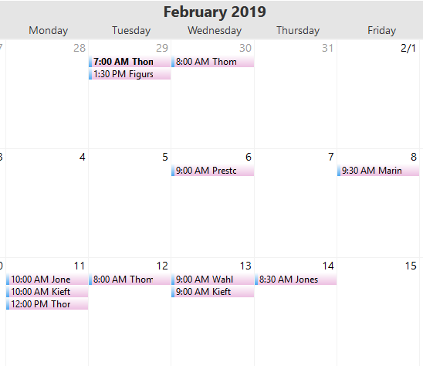
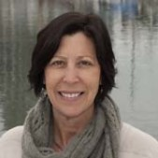
Working with DMO – Ship Schedules
Paragon Calendar on Zimbra
Jared Figurski
Teresa Cardoza
Notes:
Western Flyer/ Rachel Carson
When are my ship days? Do I have any control over this?
Request days in proposal
Initial schedule sent out for input late fall/early winter
Schedules can be found: https://www.mbari.org/at-sea/ships/mbari-all-ships-schedule-2019/ and on CanyonHead
Communicate change requests to Chris Grech, Teresa Cardoza
I need to change my ship days
Communicate change requests to Chris/Teresa
VERY hard to change Flyer days
Don’t assume maintenance days or days in port are available. Availability depends on a number of factors including crew schedules
There are a number of contingency days factor in each year but as the year progresses the get used up
Paragon
When are my ship days?
Request in proposal
Schedule as you go, more fluid not done months in advance
Calendar available through internal MBARI Zimbra Ships Calendars
I need to change my ship days
Communicate change requests to Teresa or Jared F.
You need to have a captain, read Paragon cruise planning site for list of qualified captains.
External Ships
In Moss Landing- make sure you have $$$$ to cover these dates, non-MBARI ship costs come directly out of your expense budget
MLML ships, John Martin and Sheila B (https://www.mlml.calstate.edu/marineops/)
Shana Rae (http://www.shanarae.com/shanarae.html)
Why would I use one of these boats?
Deployment capability
External collaborators

Slide 16
Working with DMO
– Pre-cruise
Notes:
From the Canyon Head, in the left column under “DMO” you can access links to:
Precruise entry
Postcruise entry
Ship schedules
Also available externally under At Sea\Ships

Slide 17
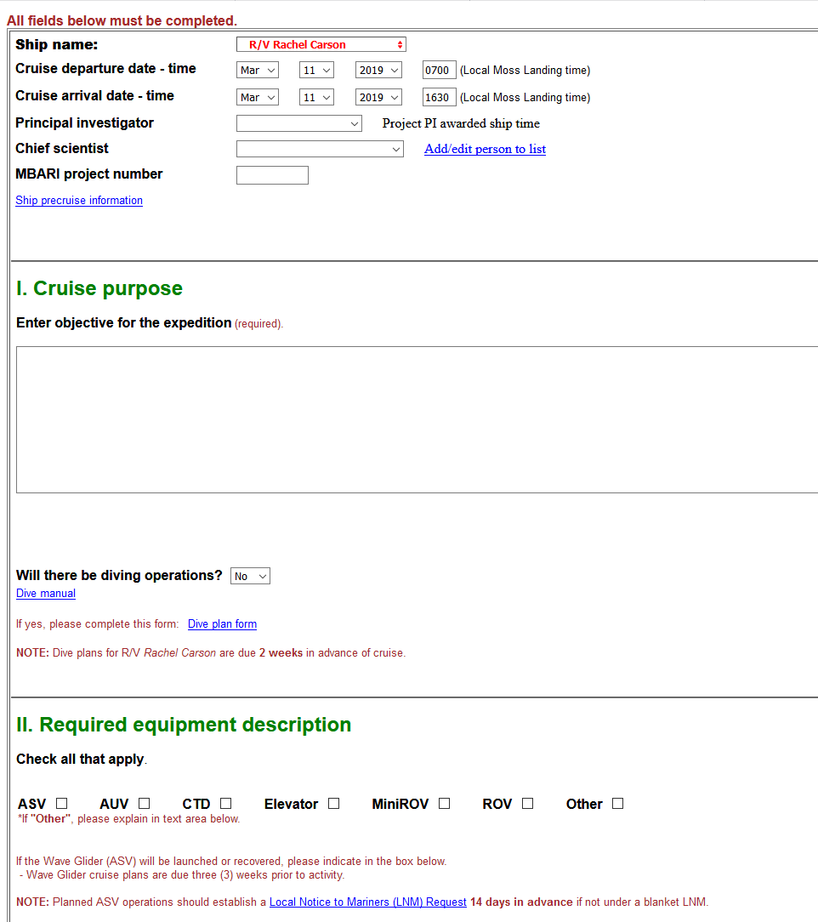
Working with DMO
– Pre-cruise
Key points:
Submit pre-cruise 2 weeks before your ship day for the Carson and 3 weeks before a Flyer cruise.
Remember ship crew and ROV pilots have no idea what you are planning to do unless you tell them!!
Pre-cruise is necessary but NOT sufficient for complex MOBs and operations. Talking to ship crew and pilots is essential.
If you change your plans after the precruise is submitted talk to Teresa.
Notes:
Filling out your precruise should help you pin down the following things:
What are you trying to do on your ship day?
Where are you going?
Whose paying (Project Number)
What equipment do you need:
ROV?
What toolsled?
What sampling equipment?
What are you putting on the ROV? How will it interface:
Electrically
Mechanically
Comms
How do you plan to use the ROV during the dives
AUV?
Which one?
Have you planned the mission with the AUV team?
MiniROV (control van?), CTD, Other
Do you need a special winch?
Does your work involve haz mat? Itar? Isotopes?
Whose coming? Any foreign nationals?
Does MBARI (Mandy) have permits in place for your activities?
Have you checked the start/end time/tides?
Do you have/need extended ops?
For Flyer, who has a TWIC card?
Do you need seawater, cold room, dark room, are you scuba diving?
Use the wonderful CRUISE PLANNING link for far more info:
https://www.mbari.org/at-sea/cruise-planning/

Slide 18
Working with DMO - MOB
Do you need a MOB day? Do you need a deMOB day? Do you have one scheduled?
Engage the pilots and ship crew well before the morning of your MOB day, don’t expect to “figure it out” on your MOB day
Even though it is “your” MOB day, you may not have the whole day to do just your work, MOB’ing can be delayed by sled changes, crew availability, etc.
Very important to make crew and pilots aware of any large equipment/vehicles that needs to be craned on the ship.
If your cruise plan is late, please let DMO know you are working on it.
Notes:
Do you need a MOB day? Do you need a deMOB day? Do you have one scheduled?
Engage the pilots and ship crew well before the morning of your MOB day, don’t expect to “figure it out” on your MOB day
Even though it is “your” MOB day, you may not have the whole day to do just your work, MOB’ing can be delayed by sled changes, crew availability, etc.
Very important to make crew and pilots aware of any large equipment/vehicles that require a crane.

Slide 19
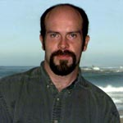

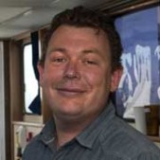
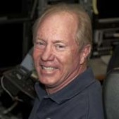
Working with DMO - MOB
Aaron Gregg, Carson Captain
DJ and Mike B,
Ventana Pilots
Crew/Pilots like:
  Advanced warning
  Knowing what the plan is
  Having a schedule and sticking to it
  If there is a problem, let them know and allow them to be involved in the solution
Andrew McKee, Flyer Captain
Knute Brekke,
Ricketts Chief Pilot

Slide 20
DMO- Post Cruise

Slide 21
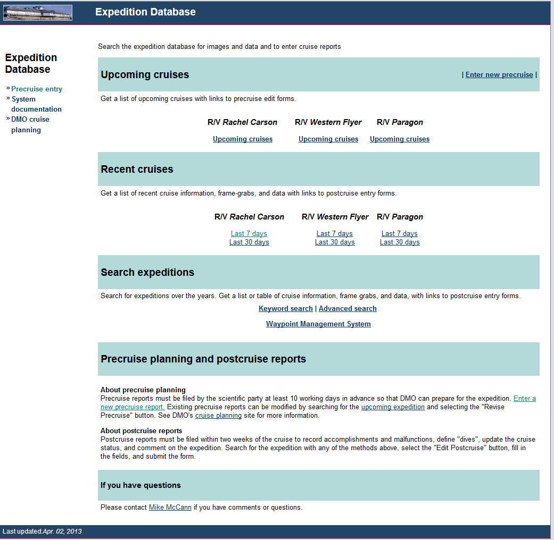
DMO- Post Cruise
If it has been more than 30 days you will need to do an “Advanced search” to find your days.
Notes:
It is part of good MBARI citizenship to file a post cruise report.
Post cruise reports keep the expedition database current and consistent, thereby making it a more useful resource for all at MBARI.
Dive start and end times are manually entered by video lab staff.
Once these are entered there are a number of data products that become automatically linked and organized.
Data products include frame grabs, video annotations, samples database, 3D replay.
Visual bars will display to indicate if VARS images or cool pix images are available, and if pilot's log and CTD data line up correctly

Slide 22
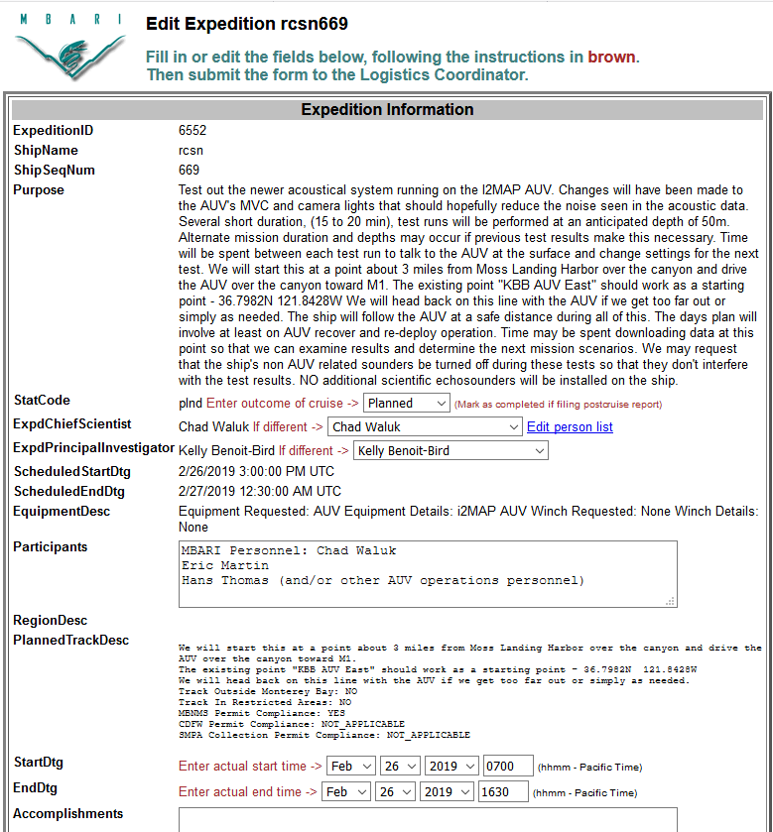
DMO- Post cruise
Please fill out your postcruise within 10 working days after returning to shore.
Change all brown text
Post cruise reports keep the expedition database current and consistent, thereby making it a more useful resource for all at MBARI.

Slide 23
Contact lists
See supporting materials for current contacts that project managers may need to know in Accounting, ITD, IS, DMO…
Notes:
Accounting Contacts

