Slide 1
Project Management - Misc
Need more….?
Version Control Resources
Design reviews
Managing time expectations
Notes:
Accounting Contacts

Slide 2

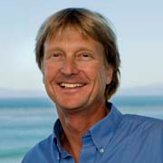

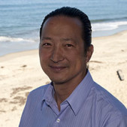

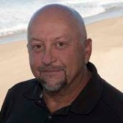
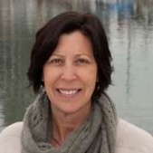

Project Manager Responsibilities
I Need More…(or changes to my…)
=
=
=
Ship schedule
Advanced DMO Issues
Notes:
Overseeing expense and labor budgets
What to do if you need more $$$$
Talk to the project PI
Talk to Chris and/or send message to Mteam
What to do if you need more labor:
Talk to Doug Au
What to do if you need more ship time
Good luck with that
What to do if you are not going to make significant milestones:
Make Mteam aware of this, as well as why the delay. Sometimes this is done in the following years proposal

Slide 3
Need Space?
If you are in need of project lab space talk to Doug
  Should be called out in the proposal
If you are in need of office space talk to your division director
  If office space for a externally funded hire it should be called out in the DQ
If you need space in the High bay talk to Johnny
If you need space in the Tin shed talk to your division director
If you need new space in Castroville talk to Doug

Slide 4


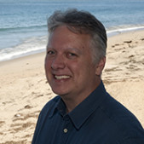

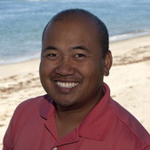
Version Control (and Back Up) at MBARI
Software Solutions Used at MBARI:
  SVN
  Git Hub
  Mercurial – Git Hub-like
  Bit Bucket (Hosting site of Git Hub, Mercurial,..), MBARI has it’s own group – talk to Brian Schlining
  Be aware of issues with sharing code externally
  Ask if you are unsure
Mechanical Drawings:
  Solidworks vault available
  Mike Parker administrator
Electrical Drawings:
  There is a vault for Orcad, may be implemented in the next year
  Most people use the Project Library for back up
Brian Schlining
Kevin Gomes
Kent Headley
Mike Parker
Jose Rosal

Slide 5
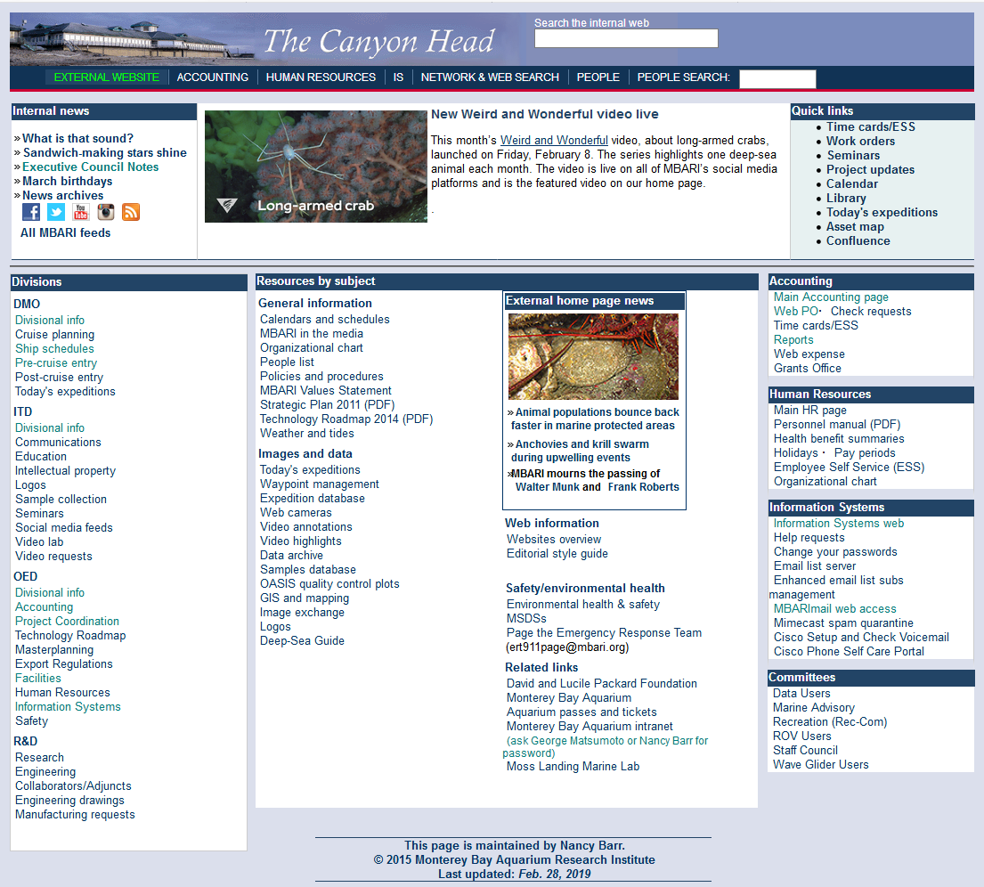
Drawing Number System
Create unique drawing numbers

Slide 6
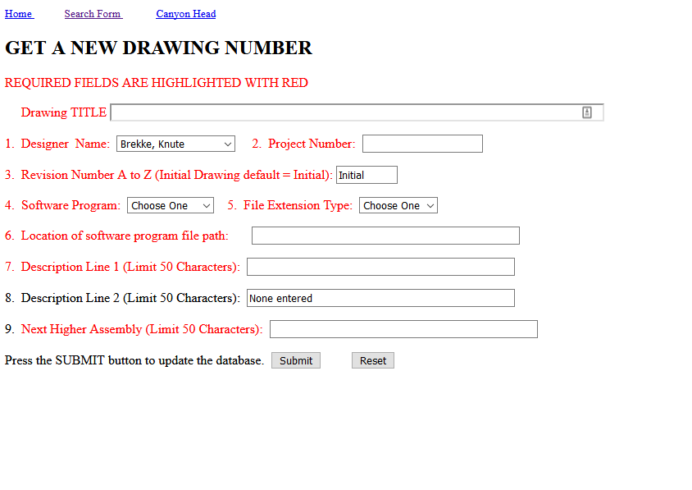
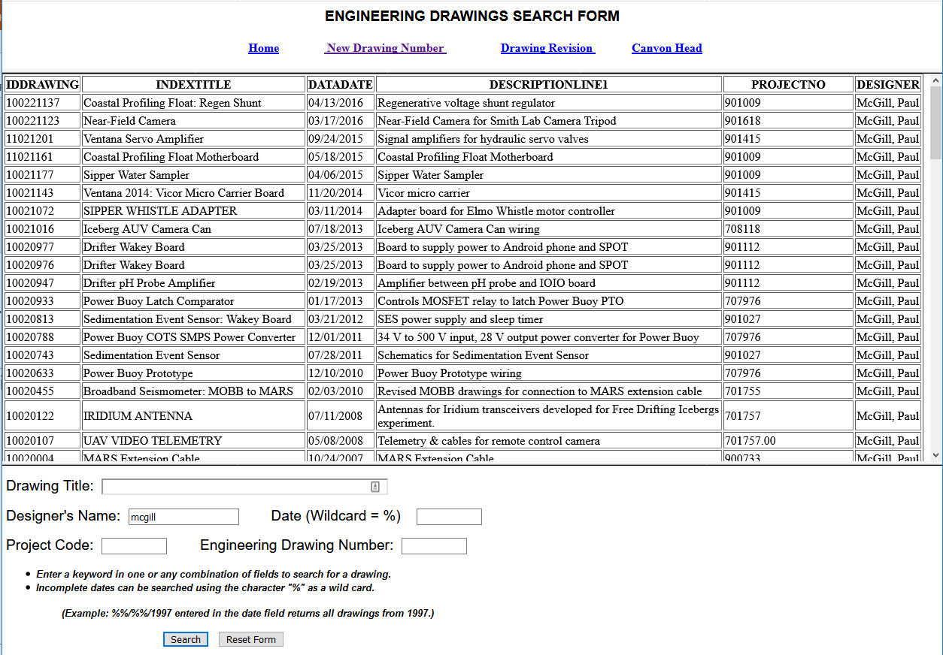
Drawing Number System
Assign drawing number
Searchable database

Slide 7
Design Reviews
For developments and complex deployments design reviews are a important part of the engineering process (and good insurance)
There are many types of reviews:
  Concept design review
  Preliminary design review
  Critical design review
  Requirement review
  Readiness review
Which reviews are necessary is entirely project dependent

Slide 8
Design Reviews
Choosing the right people to attend the review is very important
Consult with Doug or engineering group leads when in doubt
Be clear within your project team and to fellow reviewers about what the scope of the review is
Keith Raybould’s documents are still a great resource:
https://mww.mbari.org/pco/project_management_at_mbari.html

Slide 9
Managing Time Expectations
Setting realistic deadlines
  Factor in long lead efforts or items
  Use previous developments as a metric
  Communicate delays clearly to all interested parties
  “Managing Up”
Estimating engineering time
  A great challenge for all
  Use past developments to help estimate (Labor hours on Reports)
  Again, this is hard to get right but if you see you got it way wrong talk to Management sooner than later

Slide 10
Advice from Keith
Set documentation standards from the beginning
Make sure you include time for project management in the resources requested in the proposal. It does take time to do properly and it very easy to overlook when estimating resources
Apply the right level of project management for your particular project

Slide 11
Advice from Keith
Make sure the scope of the project is really clear
Address high risk items as early as possible in the project
Keep a regular eye on resources
Plan transition once development is completed

Slide 12
Project Management Resources
\\atlas\ProjectLibrary\Project Management Workshop 2019\Supporting Materials
https://mww.mbari.org/pco/project_management_at_mbari.html
Come ask for advice/help when needed: Doug, Jim, and Alana

