Slide 1
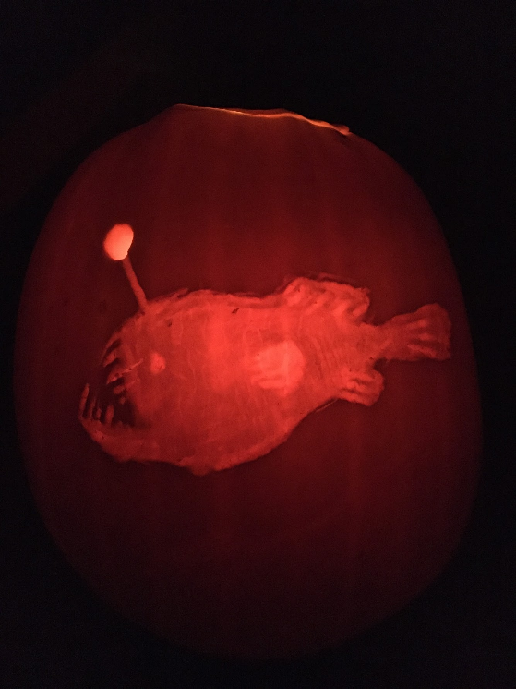
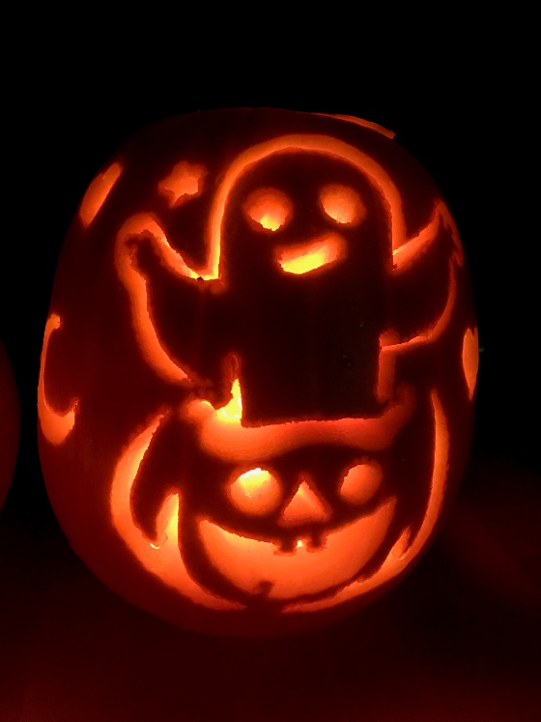
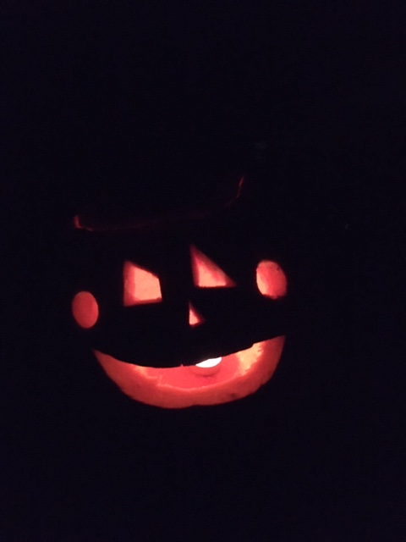
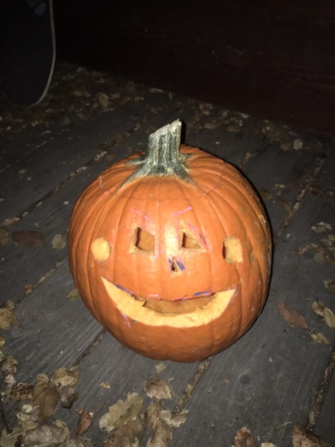
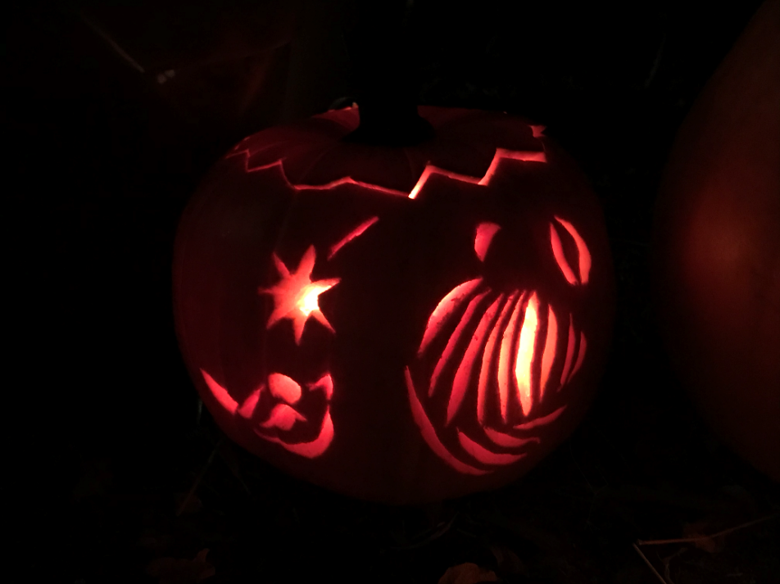
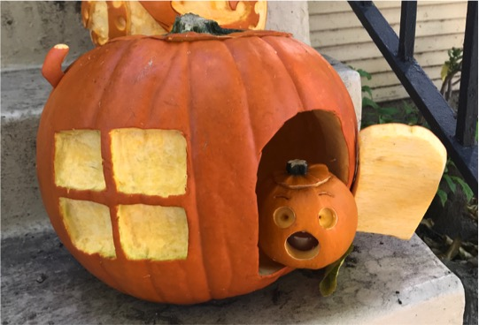
Entry #3
Entry #1
Entry #2
Entry #3
MBARI 2020 PUMPKIN CARVING CONTEST
Entry #4
Entry #5
For a original pictures: \\atlas\ProjectLibrary\Rec Com\Pumpkin Contest\PUMPKIN ENTRIES

Slide 2
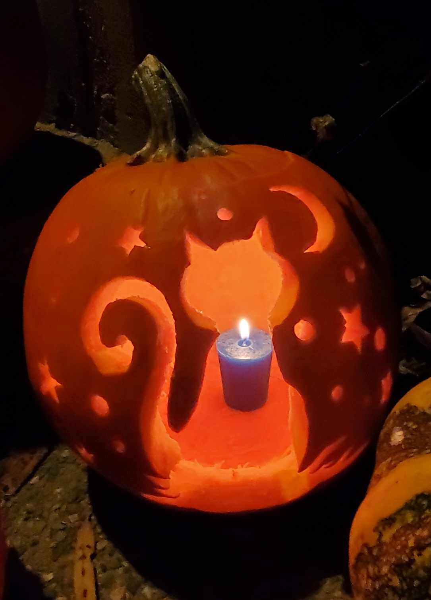
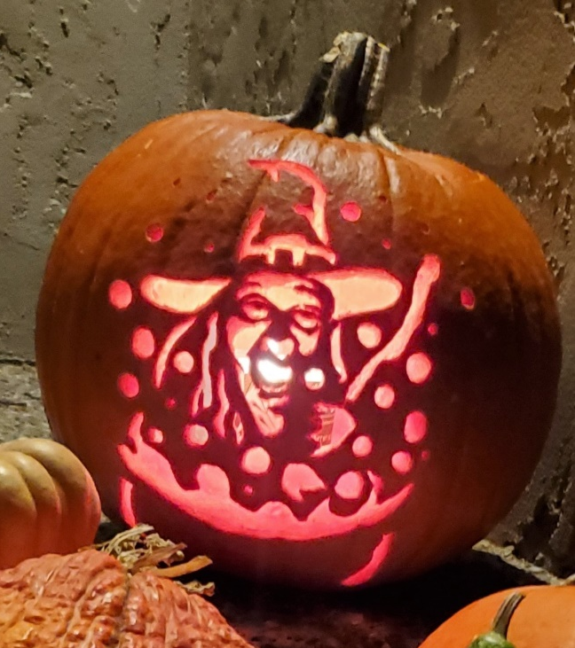
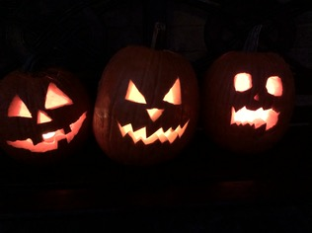
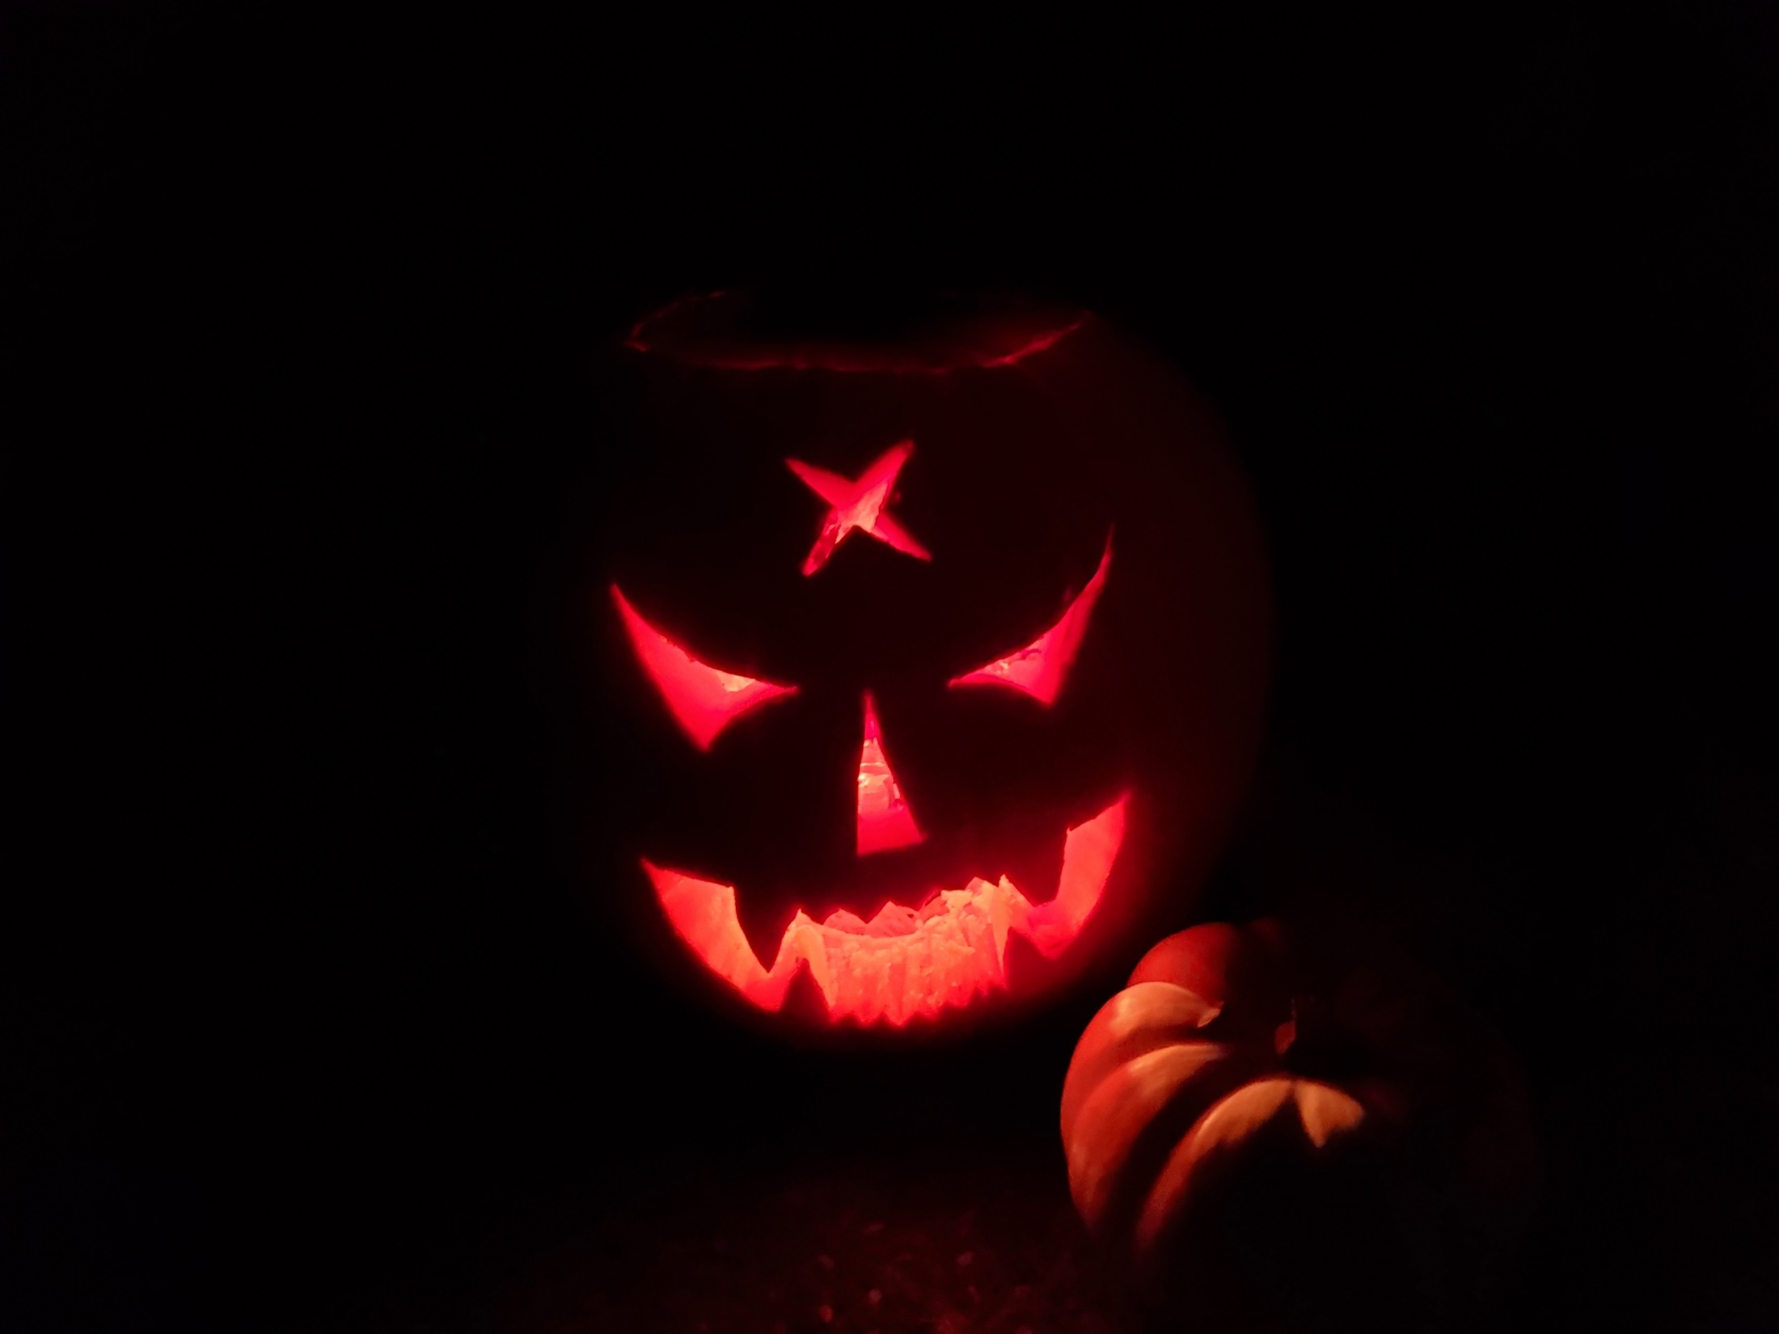
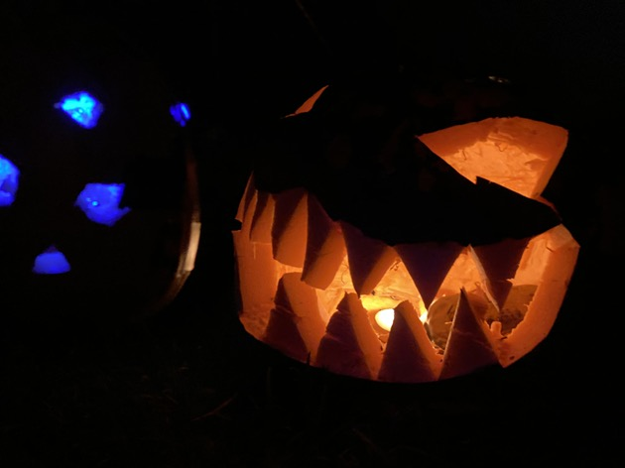
Entry #6
Entry #7
Entry #8
MBARI 2020 PUMPKIN CARVING CONTEST
Entry #9
Entry #10

