Slide 1

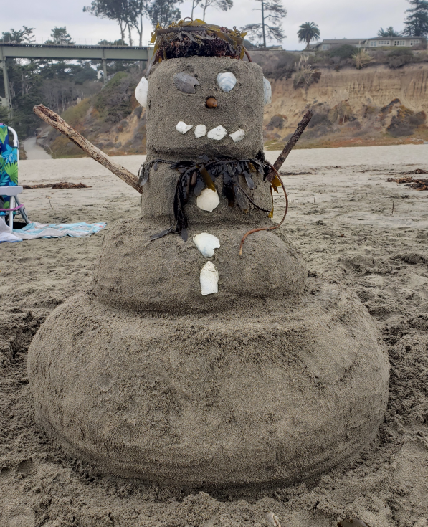
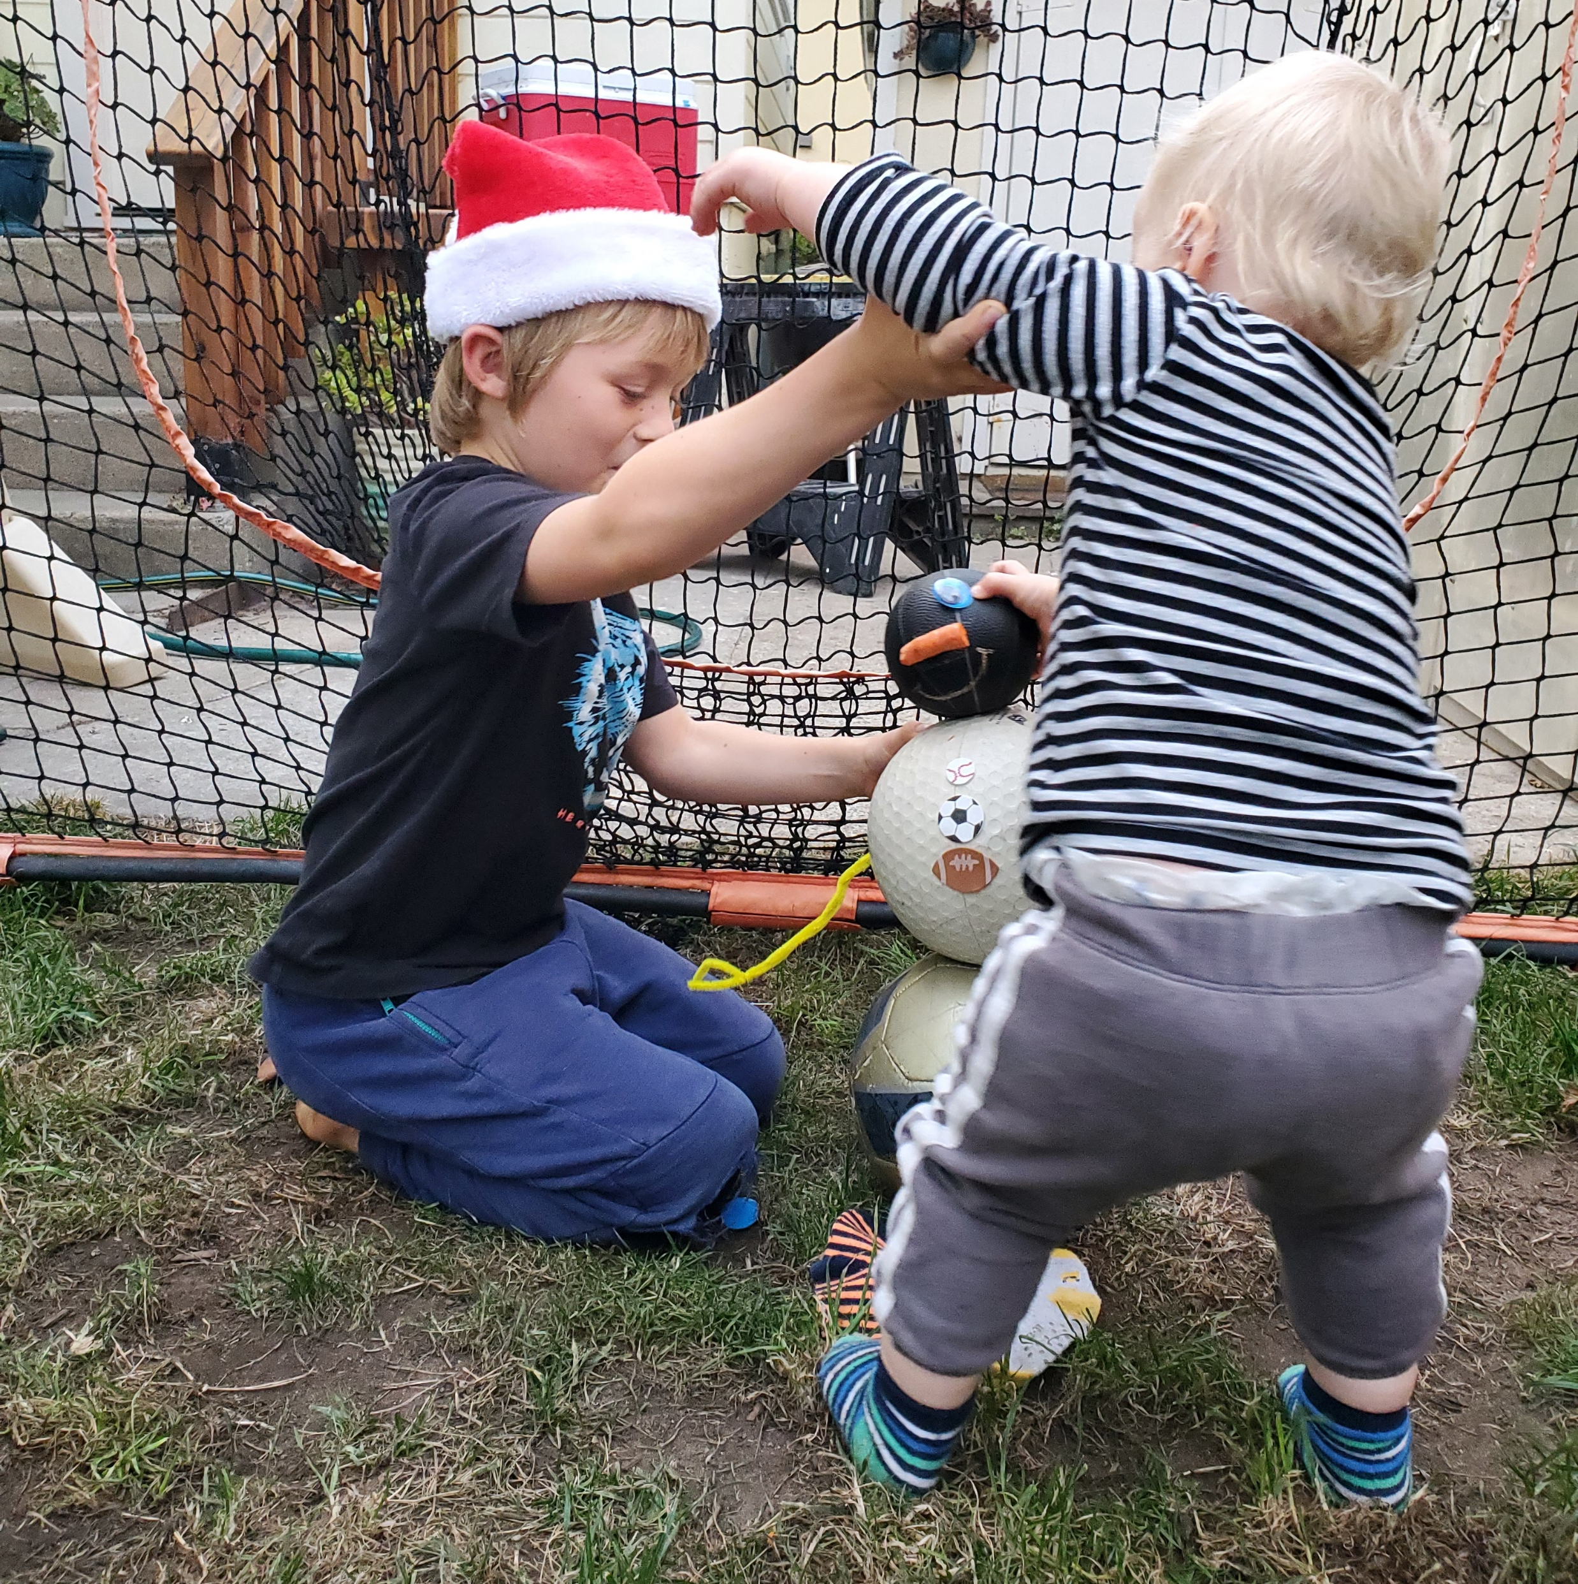
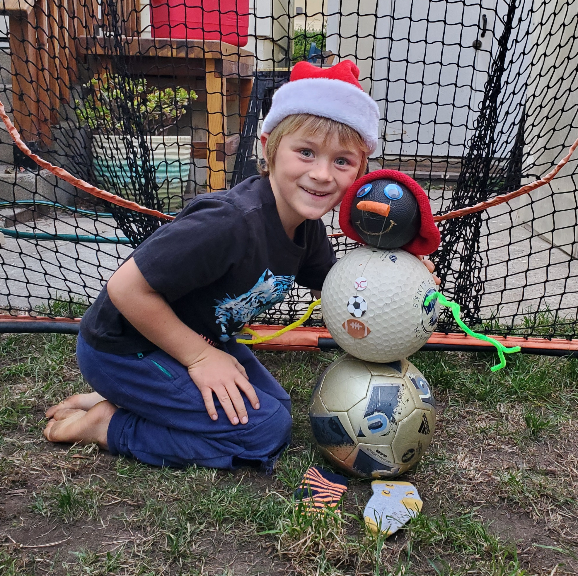
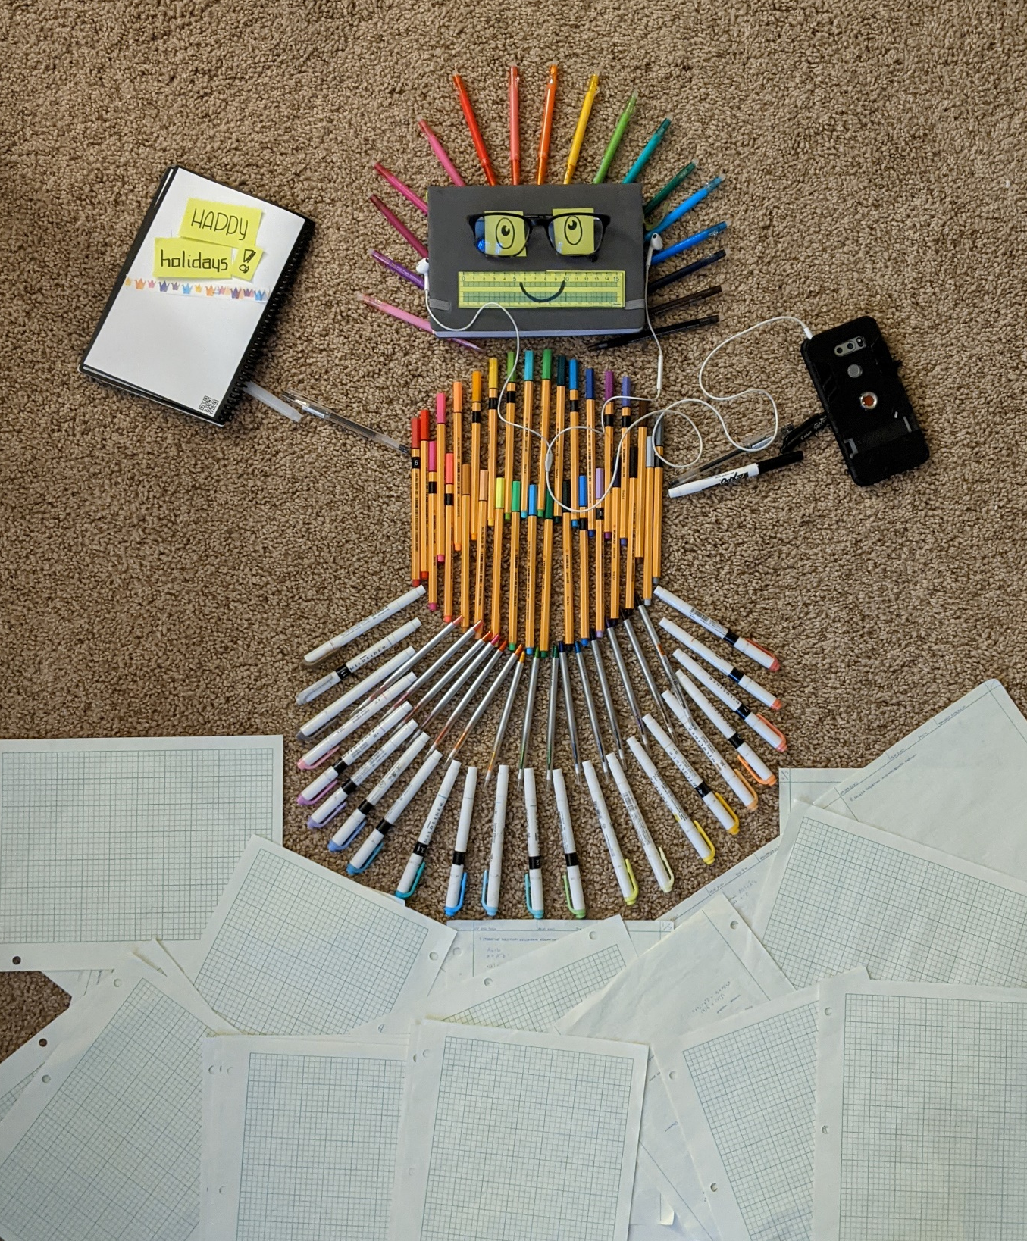
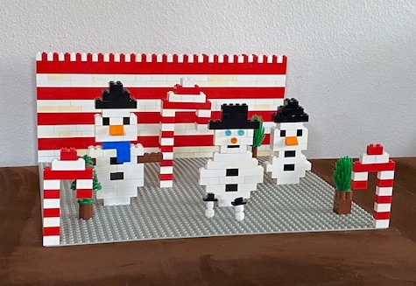
Entry #2- Ballman
SANDY CLAUS CONTEST
Make a “snow-person” from your surroundings
Entry #1- Sandman
Entry #3- Pen-Person
Entry #4- Snow People

Slide 2
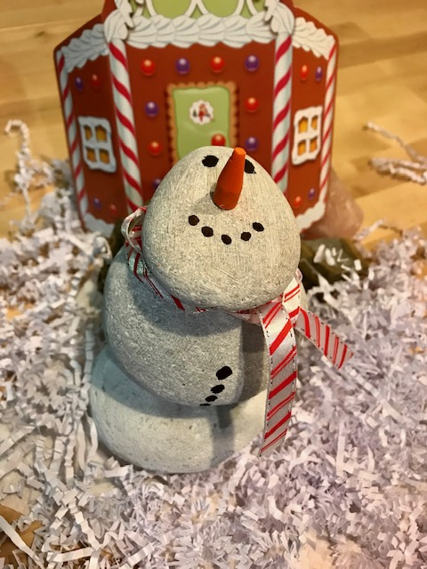
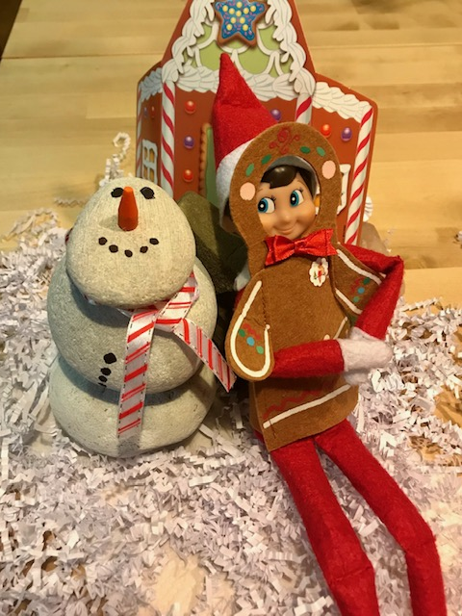
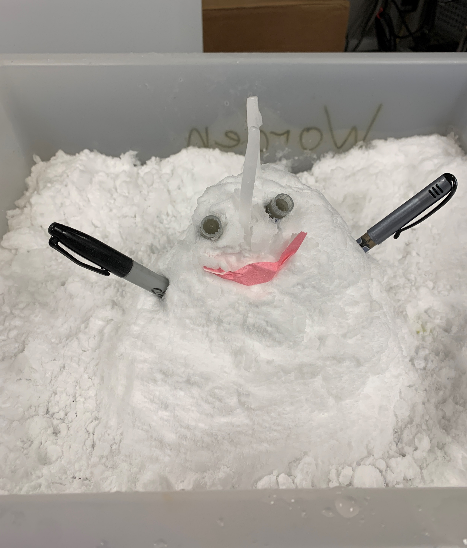
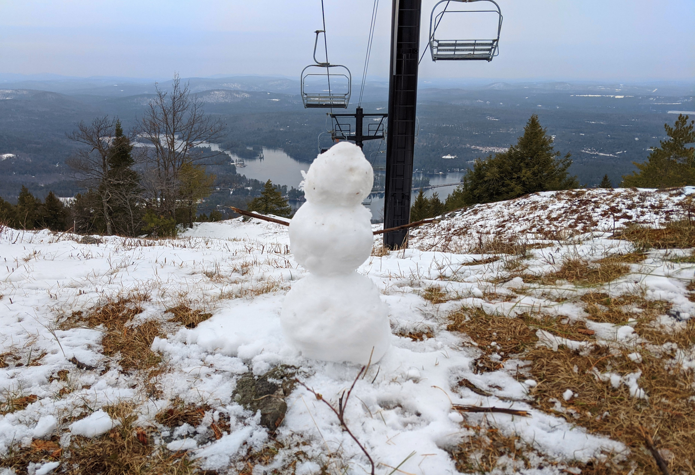
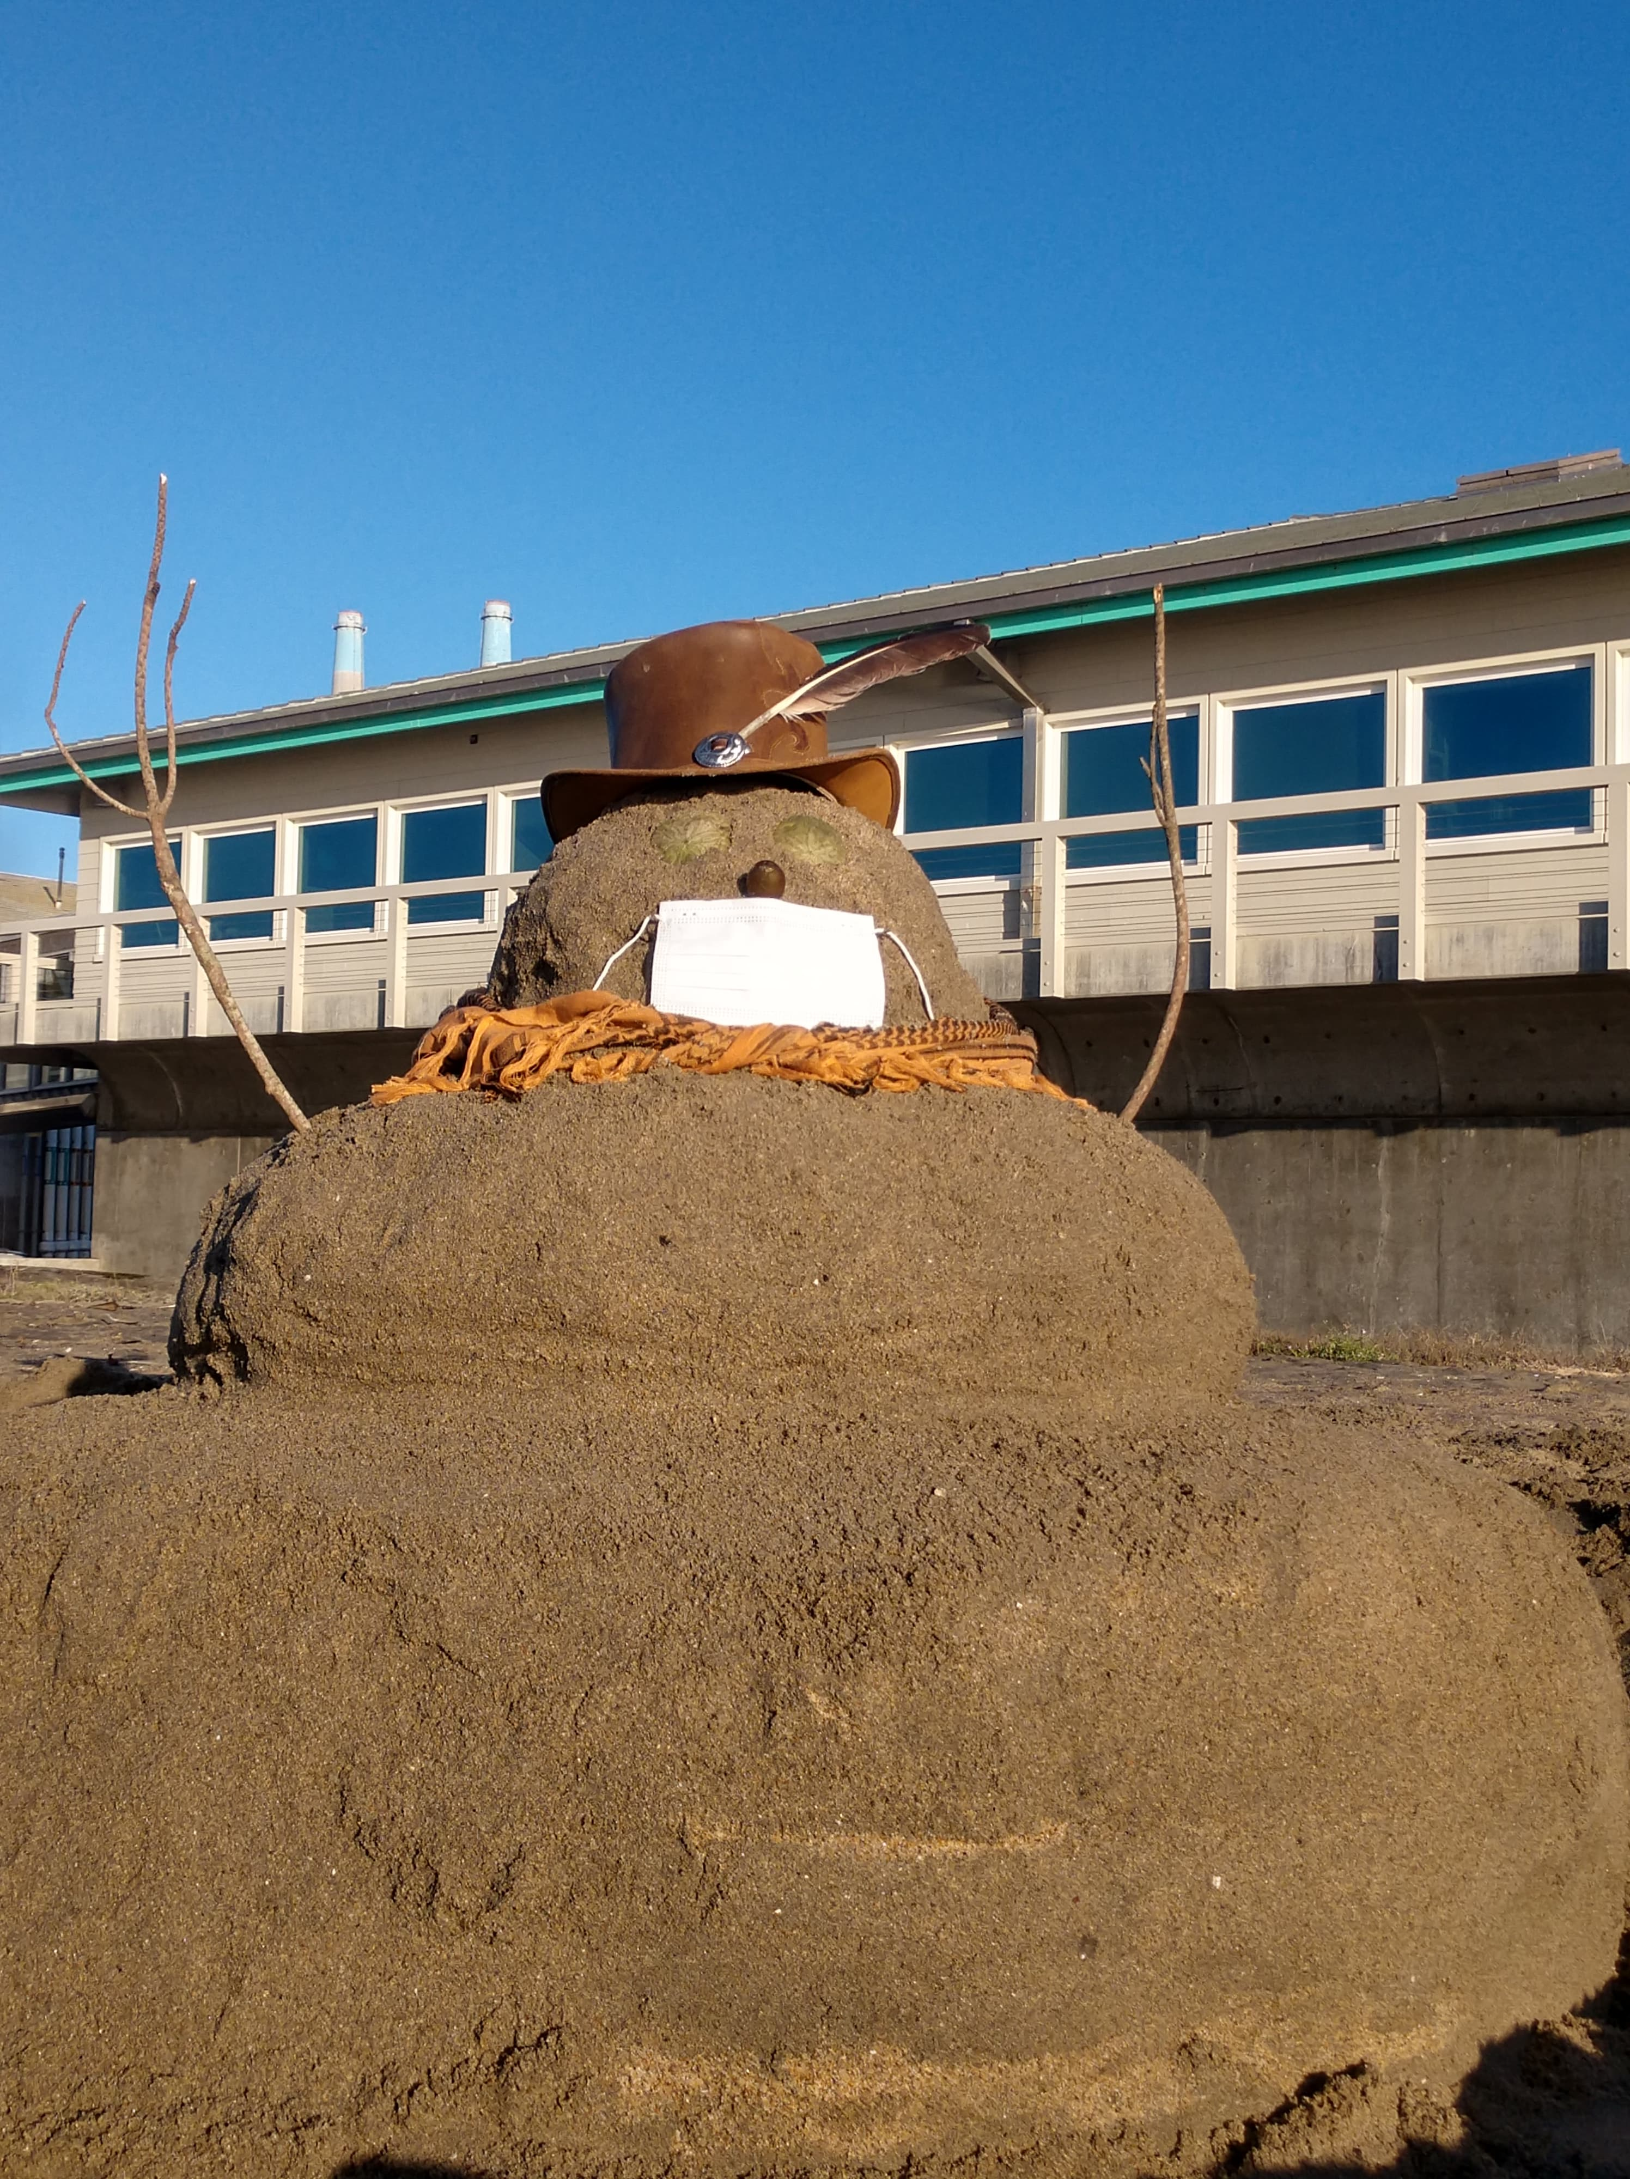
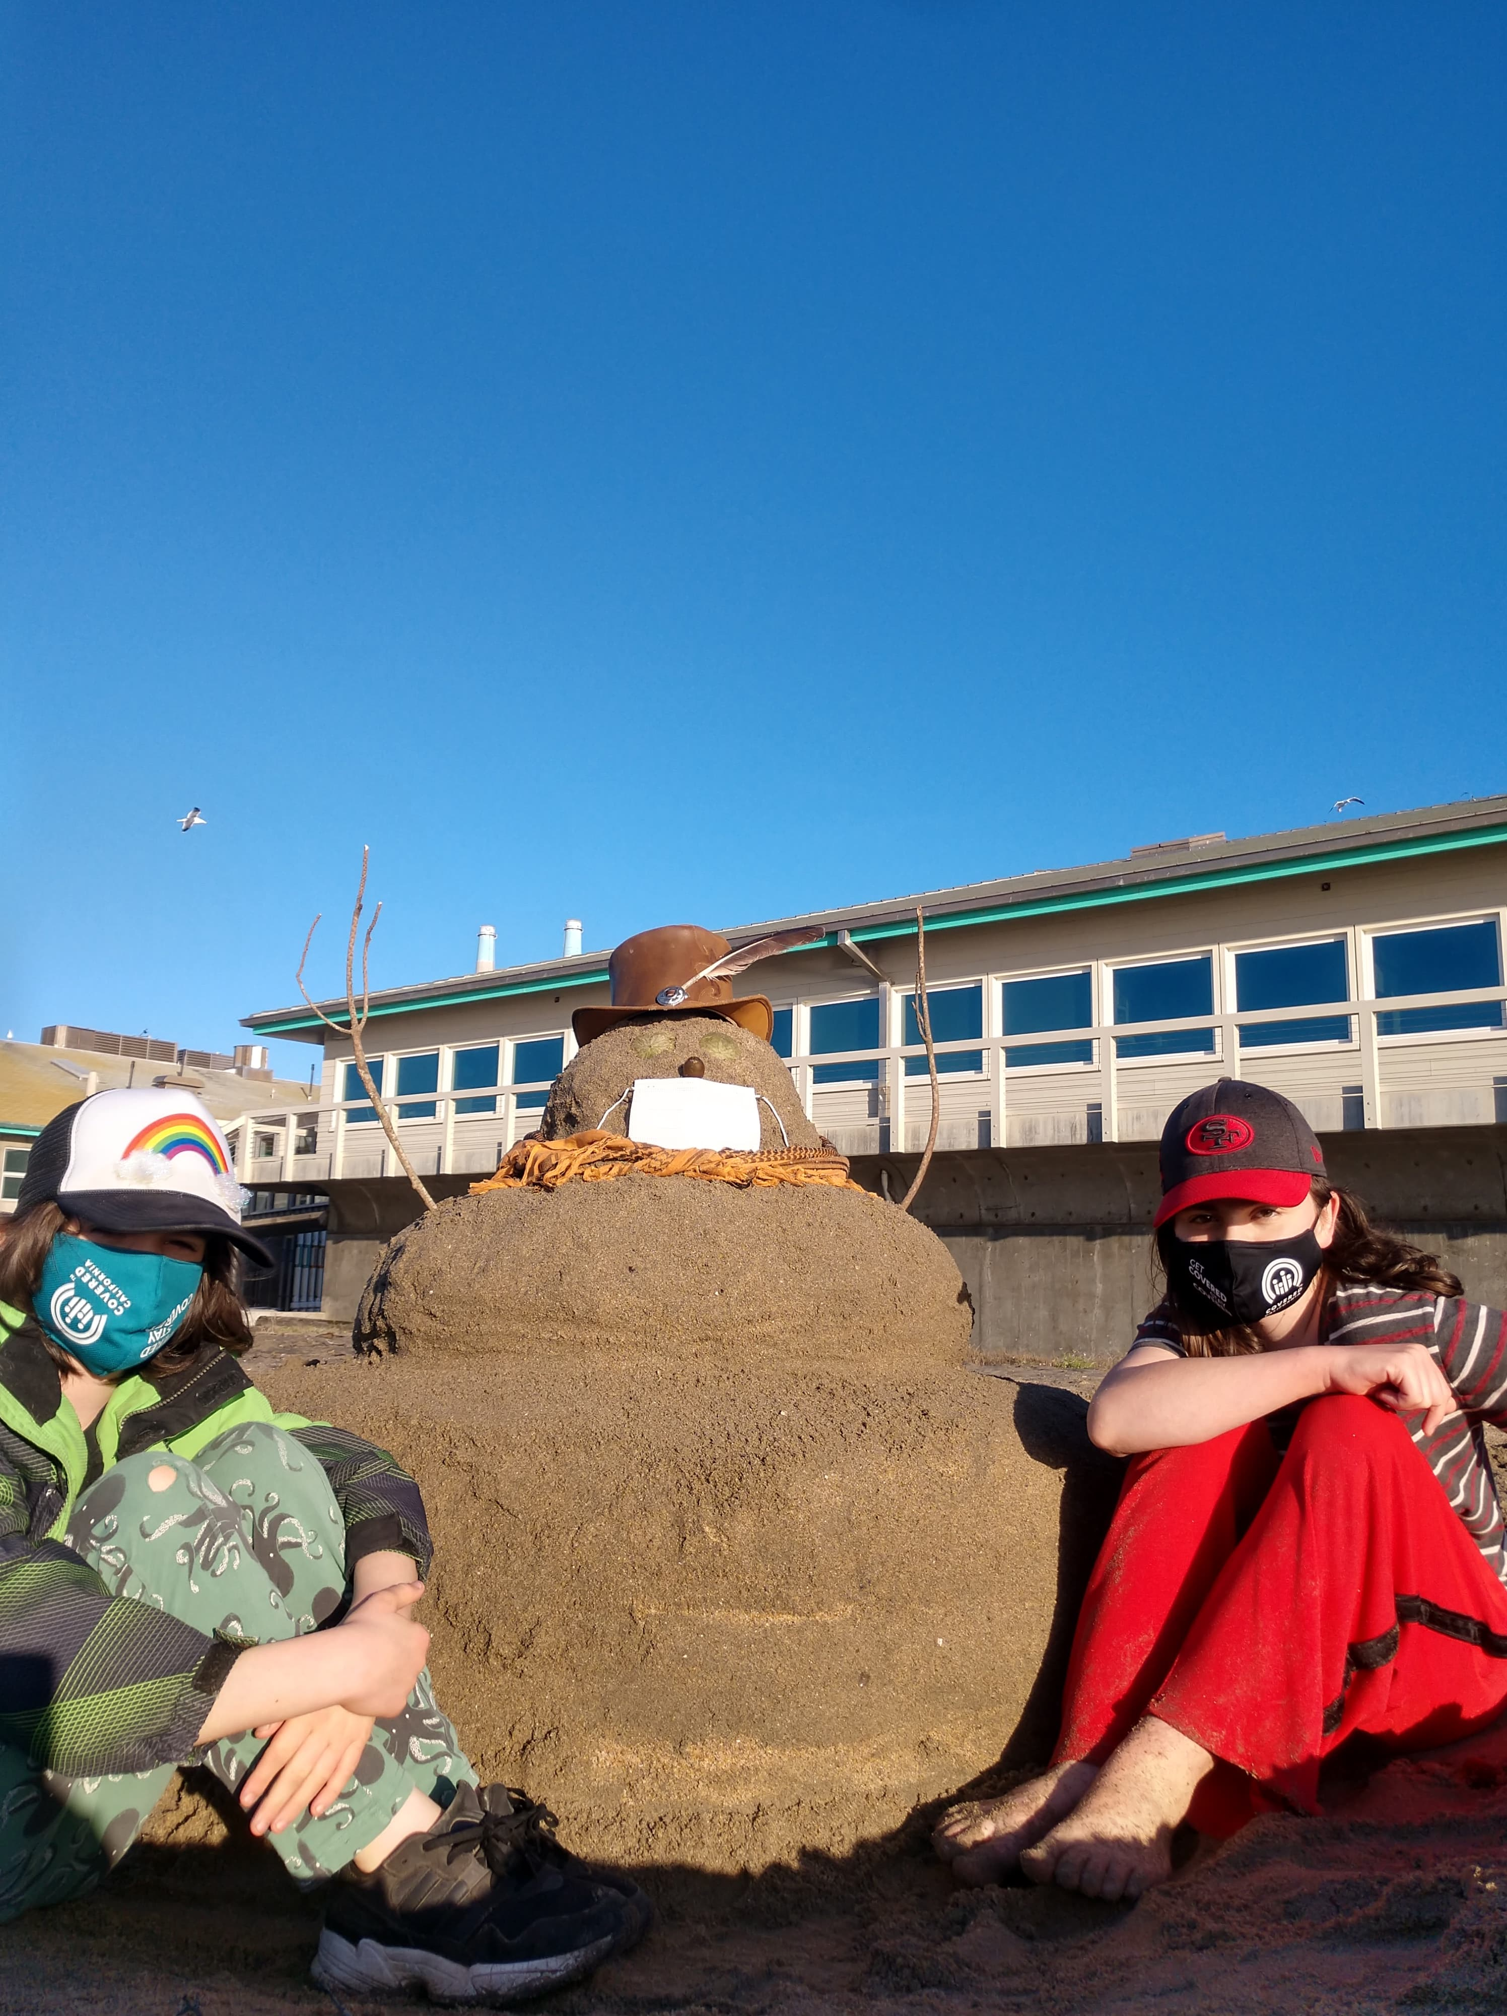
SANDY CLAUS CONTEST
Make a “snow-person” from your surroundings
Entry #6- Snowman
Entry #5- Rockman
Entry #8- Plump Sandy Snow Person
Entry #7- Pleasant Mountain Snowman

